Slide 1
Catapult SystemC Matchlib Training July 2020
Stuart Swan
HLS IP/Platform Architect
July 2020
Source: Notes are in Tahoma, regular, 8 point, italic, flush left, vertically aligned from the bottom of text box.

Slide 2
Basic SystemC and Matchlib Training
Stuart Swan
HLS IP/Platform Architect
July 2020
Source: Notes are in Tahoma, regular, 8 point, italic, flush left, vertically aligned from the bottom of text box.

Slide 3
Why use SystemC + Matchlib for HLS?
SystemC provides HDL semantics on top of C++ language
time, module structure, hierarchy, channels, HW semantics, resets, signals
SC enables time based behaviors to be cleanly modeled and verified prior to synthesis (as compared to pure C++ HLS)
SC integrates nicely with HDL simulators
Matchlib enables models to be “throughput accurate” pre-HLS
Matchlib provides commonly used components ready for HLS

Slide 4
How does Catapult SC synthesis differ from C++ synthesis ?
Primary difference is in input language
Once code is read in by Catapult, 90% of flow and usage is same.

Slide 5
Important to understand how HLS sees your SystemC model:
Set of processes communicating only thru signals (sc_signal<>)
For synthesis purposes, hierarchy is irrelevant (it is preserved in the RTL however)
HLS synthesis occurs on each process one at a time, in complete isolation
No analysis/optimizations across processes
Huge designs can be synthesized thru HLS, as long as each process is not too large
Each combinational process (SC_METHOD) becomes combinational logic in RTL
Each sequential process becomes exactly one FSM + Datapath in RTL

Slide 6
How HLS sees your SC model (continued)
Primary optimizations done by HLS are in construction of the FSM and Datapath (e.g. resource sharing).
Unlike RTL synthesis, HLS is (usually) allowed to add clock cycles (latency) into design to improve QOR
e.g. often loops are pipelined to maintain thruput while latency is added by HLS
Properly constructed models and proper usage of HLS should show no functional differences (aside from latency differences) pre and post HLS.
For SC HLS, reset behaviors and IO protocols are present in pre-HLS model and synthesized into RTL together with rest of model

Slide 7
Catapult supports two SystemC Coding Styles
“RTL in SystemC” coding style
“Matchlib SystemC” coding style
Each has advantages/disadvantages
The two coding styles can be mixed in same design, even in same block or process

Slide 8
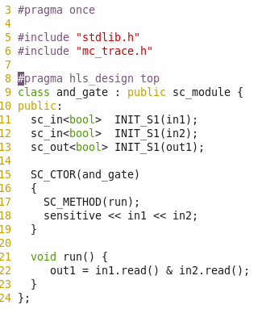
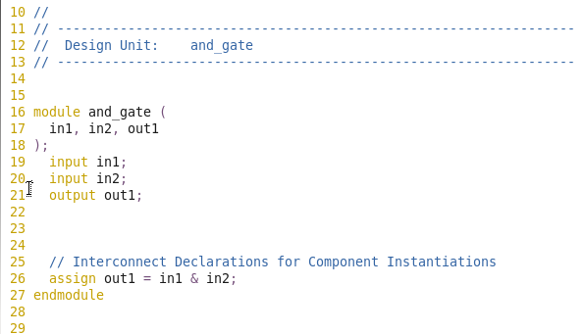
“RTL in SystemC”: example 01: SC Combinational Process
HLS Input
HLS Output

Slide 9
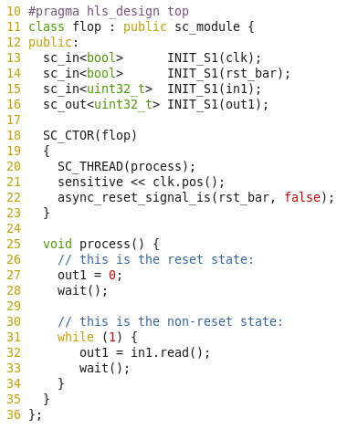
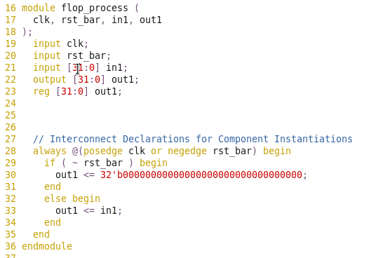
“RTL in SystemC”: example 02: SC Sequential Process
HLS Input
HLS Output

Slide 10
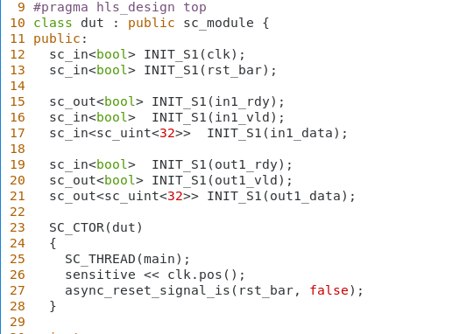
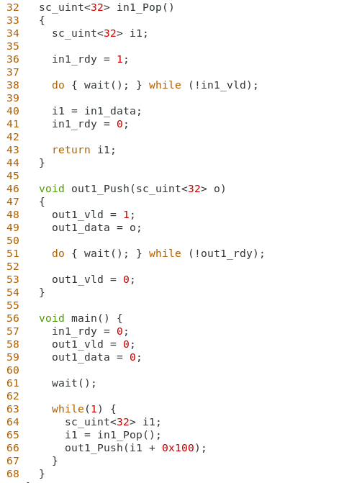
“RTL in SystemC”: example 04: SC signal level protocols
Question: What’s the throughput?

Slide 11
“RTL in SystemC” Rules
Code up to first wait() in process models the reset state.
Every sc_out should be assigned reset value here.
Clock and reset use sc_in<bool>
All data IO uses sc_in<>, sc_out<>
Every loop has a wait() statement (unless fully unrolled)
Catapult will add an implicit wait() statement if needed.
Some of the added value over real RTL:
Catapult loop pipelining still works
Any AC + SC datatypes can be used (ac_fixed, ac_float, etc).
Any AC functions can be used (e.g. AC Math)
Module hierarchy and IO in RTL will be the same as in SystemC

Slide 12
“RTL in SystemC” Rules (continued)
By default,
Signal reads occur at preceding wait statement in SC source
Signal writes take effect at next wait statement in SC source
Catapult is free to insert scheduler states between SC wait statements
Use IO_MODE=fixed if you don’t want Catapult to add any states
Use #pragma hls_direct_input if you don’t want Catapult to insert pipeline registers for signal reads
E.g. useful for CSRs which are held stable after block reset (better QOR)
Keep in mind that SC TB and DUT are modeling HW, not SW
e.g. shared variable between 2 processes in TB or DUT may cause races
Use sc_signal, Matchlib Connections, sc_fifo, tlm_fifo, etc., to avoid races.

Slide 13
“RTL in SystemC” Advantages/Disadvantages
Advantages:
Useful if RTL pin level protocols are “fixed”
Useful for integrating with existing Verilog/VHDL RTL designs
Useful for data_valid protocol (i.e. no backpressure) (see example 15*)
common in time-domain signal processing
May be a better fit for “RTL-centric” customers
Disadvantages:
Low level of abstraction
Larger models
No fast TLM simulation mode
Less automation for SV UVM verification
Less automation for debug (e.g. no rand stall and transaction logging)

Slide 14
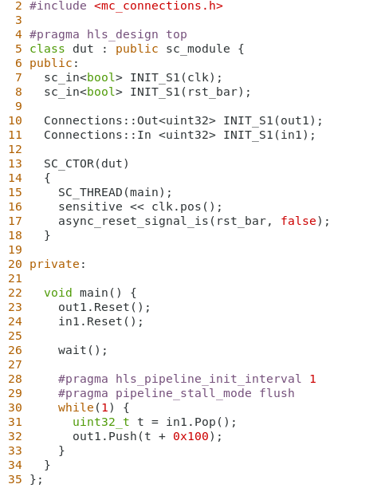
“Matchlib Coding Style”: example 05: Pop/Push

Slide 15
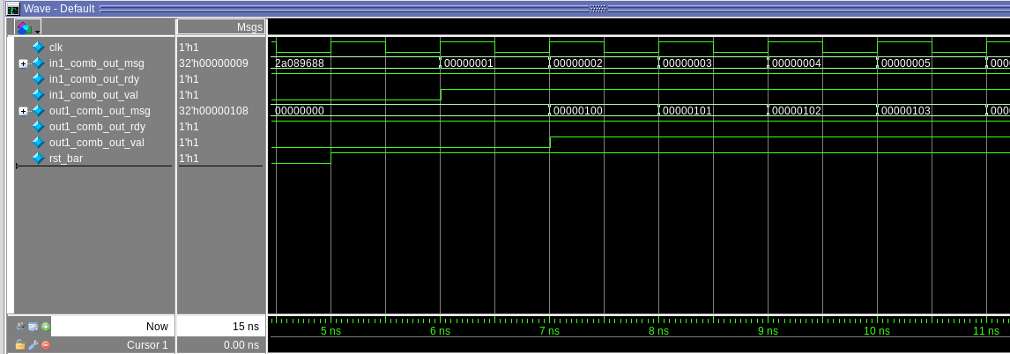
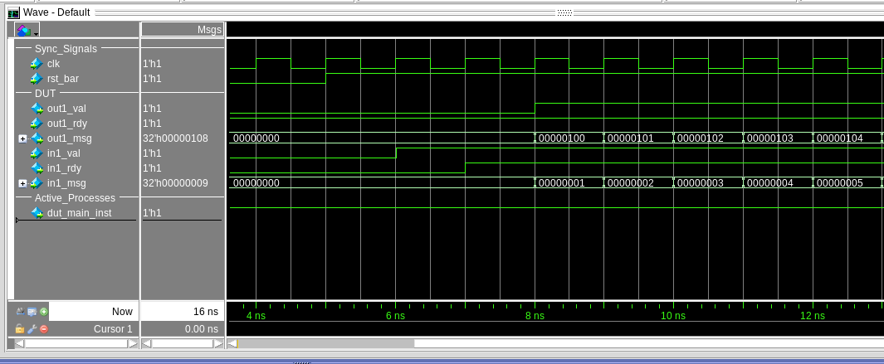
05 Waveforms
Pre-HLS
Question:
What’s the throughput?
Post-HLS

Slide 16
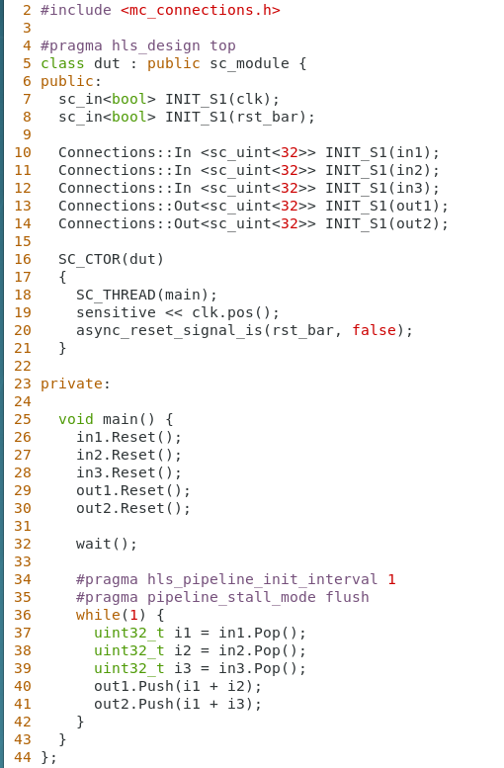
“Matchlib Coding Style”: example 06: Throughput Accurate

Slide 17
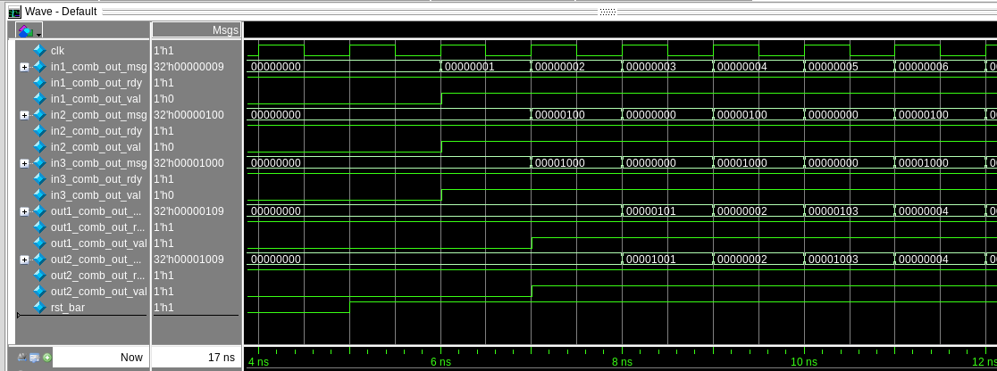
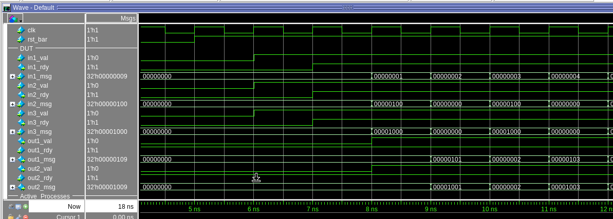
06 Waveforms
Pre-HLS
Question:
What’s the throughput?
Post-HLS

Slide 18
“Matchlib SystemC” Coding Style Rules
Code up to first wait() in process models the reset state.
Reset() methods on all ports should be called (both In and Out ports).
Clock and reset use sc_in<bool>
All data IO uses In<>, Out<>, or other Matchlib transaction ports
Only use of wait() is for:
Reset state
Loops with all non-blocking Push/Pop and no blocking Push/Pop
Use default Catapult scheduling modes only
Only use coding style documented in Mentor Matchlib examples

Slide 19
“Matchlib SystemC” Coding Style Rules (continued)
Only use sc_in, sc_out, sc_signal when:
You need to mix “RTL in SystemC” coding style with Matchlib blocks/processes (try to keep these cases isolated).
You want to model CSRs which are held stable after block reset
Enables efficient way to distribute CSR data to multiple blocks without synchronization overhead.
Usually also want to use #pragma hls_direct_input for these CSR signal inputs

Slide 20
Matchlib: When do you need to use Non-blocking IO?
Arbitration requires Peek or PopNB to all arbitrated inputs.
Time-based splitting and merging of transaction streams requires PushNB and PopNB (respectively)
There are cases where a process will need ALL non-blocking IO (all PopNB and PushNB), but it should be pretty rare.
In this case the process should be kept as small / simple as possible, ideally communicating with other processes that follow the guidelines above.
With all non-blocking IO, you will likely be modeling at very close to RTL level, and most likely HLS will just be translating SC RTL into Verilog RTL.

Slide 21
Matchlib: Always prefer to use blocking IO over nonblocking IO.
Your models will be simpler and more likely to have a good process structure.
100% blocking IO is called KPN (Kahn Process Networks)
KPN is deterministic
easier to verify.
Non-blocking IO is sometimes needed, but introduces timing dependent behavior, and can make verification more difficult in some cases if the timing dependent behavior is externally visible.

Slide 22
Matchlib: Methods for user-defined transactions (07*)
struct engine_t
{
static const int plugs = 4;
sc_uint<16> engine;
spark_plug_t spark_plugs[plugs];
static const unsigned int width = 16 + (spark_plug_t::width * plugs);
template <unsigned int Size> void Marshall(Marshaller<Size> &m) {
m &engine;
for (int i=0; i<plugs; i++)
m &spark_plugs[i];
}
inline friend void sc_trace(sc_trace_file *tf, const engine_t& v, const std::string& NAME ) {
sc_trace(tf,v.engine, NAME + ".engine");
for (int i=0; i<plugs; i++)
sc_trace(tf,v.spark_plugs[i], NAME + ".spark_plug" + std::to_string(i));
}
inline friend std::ostream& operator<<(ostream& os, const engine_t& rhs)
{
os << rhs.engine << " ";
for (int i=0; i<plugs; i++)
os << rhs.spark_plugs[i] << " ";
return os;
}
};
User’s struct/transaction
Declare HW bitwidth
Pack/Unpack to bits
SystemC standard tracing (see LRM)
Stream to text, used for transaction logging

Slide 23
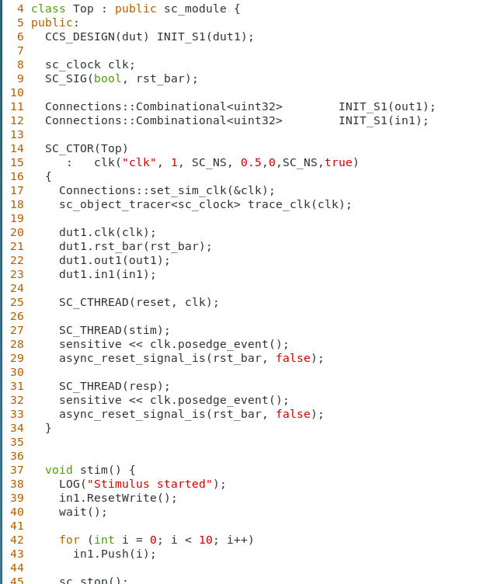
Matchlib “gotchas”
Multiple clocks and multiple resets are not currently supported.
Keep your code clean by using convenience macros for naming ports, signals, and module instances (uses -std=c++11)
Always call set_sim_clk exactly once to identify your clock to Matchlib
(may get bad pre-HLS sim results if you forget currently)
All processes in both DUT and TB must use exact same clock and reset signals.
TB processes must be sensitive to reset.
Always use wait(), wait(int), never wait(sc_time) in both TB and DUT.
Matchlib TB and DUTs are “cycle models”.
All transaction IO methods must be called exactly on clock edges.
(may get bad pre-HLS sim results if you forget currently)

Slide 24
“Matchlib Coding Style” Advantages/Disadvantages
Advantages:
“Throughput accurate” modeling in pre-HLS simulations for complex models
Higher level of abstraction than “RTL in SystemC”
Models are smaller
Fast TLM simulation mode available
Automation available for SV UVM verification flow
Automation available for debug (rand stall injection, transaction logging)
Growing Matchlib IP models available (AXI4, NOC, reorder buffers, etc)
Verification flow for Matchlib enables pre-HLS model to be “stress tested”
Disadvantages:
Learning curve may be longer than “RTL in SystemC” flow
C++ compiler error messages can sometimes be difficult to decipher (use an IDE)
Signal level protocols not as flexible as “RTL in SystemC”, however you can mix in “RTL in SystemC” where needed

Slide 25
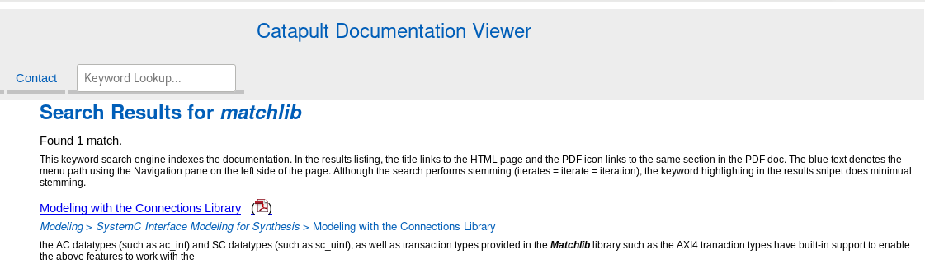
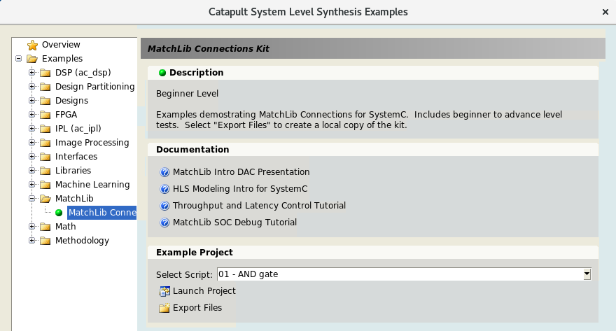
Catapult SystemC / Matchlib Collateral
General SystemC HLS and Matchlib Tutorials available here:
$MGC_HOME/shared/examples/matchlib/toolkit
Also see below:

Slide 26
How do I model “X” in Matchlib?
How do I model a Fifo in Matchlib?
10*, 11*
How do I model a sync (aka "barrier")
12*
How do I model a dual port RAM shared between two processes?
12*

Slide 27
Does Mentor support everything in Matchlib?
No. Mentor supports all constructs documented in Catapult documentation.
Mentor supports all constructs used in examples included in Catapult.
Everything else in Matchlib is currently “open source” code that is not directly supported by Mentor
Over time, Mentor is likely to directly support a larger subset of Matchlib

Slide 28
Timing Accuracy of Matchlib Models vs Catapult RTL
Currently:
Intent is to be nearly throughput accurate for pipelined II=1 processes
A bit of special handling needed for II != 1 (insert extra wait statements)
Intent is NOT to be cycle accurate
Latency and buffer storage capacity backannotation is not yet actively supported by Mentor

Slide 29
Matchlib QOR
As of Catapult 10.6, expectation is that QOR of Matchlib designs is in general equivalent to Catapult C++ flow.

Slide 30
General Guidelines for Coding for Good QOR in SC
Simulate and debug your pre-HLS model before you synthesize (!)
Verify performance and functionality in your pre-HLS model
In SystemC HLS, you should always have:
At least a rough idea of what your HW implementation will be (e.g. pipeline characteristics)
An exact idea of what your module pin level interfaces are
Refine your architecture in your pre-HLS model
Usually this is by far the most effective way to improve QOR
If functionality can easily be split into smaller processes, it is usually better to do so
Control FSMs generated by Catapult will be smaller
Smaller processes may be able to run in parallel

Slide 31
Can I use “feature X” with Catapult SystemC Flow?
AC Datatypes – Yes
AC Math – Yes
AC DSP – Functions only, no hierarchy or instantiated AC channels
AC channel – No
“Interface synthesis” – Generally, No
“Interface synthesis for C arrays in single process” - Yes
Ccores – Yes
Blackboxes – Yes
Catapult Directives – Generally, Yes

Slide 32
AXI4 Introduction and Matchlib AXI4 Models
Stuart Swan
HLS IP/Platform Architect
July 2020
Source: Notes are in Tahoma, regular, 8 point, italic, flush left, vertically aligned from the bottom of text box.

Slide 33
Why should I learn about AXI4?
Very common on-chip bus interface
Representative of modern bus protocols, even representative “network on chip” bus protocols
Enables Catapult users to build bus based HW accelerators
Enables Catapult users to build bus fabrics in HLS
The Matchlib AXI4 models are high quality and in use in by Catapult users
AXI4 models and examples show how to mix control and dataflow while keeping good QOR

Slide 34
AXI4 is a Message Passing Protocol
Message Passing is very common, goes by many names:
Kahn Process Networks (KPN)
“Latency Insensitive”
Matchlib Connections is also a message passing framework
So is ac_channel
Message passing is good because:
Deterministic
Scalable
Latency insensitive
Can add pipeline registers (e.g. for long paths across chips)
Catapult is really good at pipelining message passing models

Slide 35
AXI4 Protocol
AXI4 is a “point-to-point” protocol between a Master Port and a Slave Port
Master initiates reads or writes
Slave responds
Routers, Arbiters, multi-layer bus fabrics etc can be built using AXI4 Master/Slave Ports
Matchlib contains a number of these components
The read interfaces are completely separate from the write interfaces
Possible (and common) to have blocks that only have read interface but not write interface (or vice-versa)
All addresses in AXI4 are byte addresses

Slide 36
AXI4 Read Channels
AR is “Address Read” Payload
Specifies address, burst length, beat width, etc.
R is “Read” Payload
Returns read data from Slave Port
Each read item is called a “beat”
Protocol is:
Master sends AR item that specifies # of beats
Slave always returns specified # of beats
Even if there is an error! (e.g. if address is invalid)
Read beats are returned in order
AXI4 Read
Master Port
AR Item
AXI4 Read
Slave Port
R Item
R Item
R Item

Slide 37
AXI4 Write Channels
AW is “Address Write” Payload
Specifies address, burst length, beat width etc.
W is “Write” Payload
Contains write data to send to Slave Port
Includes write strobes (aka “byte enables”)
Each write item is called a “beat”
B is “Write response” Payload (tells if the write succeeded)
Protocol is:
Master sends AW item that specifies # of write beats
Master sends exactly # of W items specified, in order
Even if there is an error! (e.g. if address is invalid)
Slave port returns exactly one B item per AW item.
AXI4 Write
Master Port
AW Item
AXI4 Write
Slave Port
W Item
W Item
W Item
B Item

Slide 38
The Plot Thickens…
AXI4 allows a maximum of 256 beats per AW or AR burst
AXI4 forbids a AR or AW burst from spanning a 4K address boundary
The last beat of every W and R item in a burst must have its “last bit” set.
These restrictions keep the size of counters and adders within bus fabric components (e.g. routers, arbiters) and slaves small and fast
Also, the 4k boundary restriction simplifies routers, assuming all slaves are located on 4k boundaries within address map.
In practice, these restrictions improve area and do not reduce thruput
However, if these AXI4 aspects are visible in user’s HLS models, the HLS models become complex and error-prone.
So, the Matchlib AXI4 components are designed to (mostly) hide these details from user’s HLS models.
Big value-add over RTL models that use AXI4.

Slide 39
Matchlib Automatic Burst Segmentation
The Matchlib Automatic Burst Segmenters provide:
Automatic burst segmentation so that AXI bursts be specified as having up to 2^32 beats
Automatic segmentation at 4k address boundaries
Automatic setting of the “last bit” in W items
There are separate AXI4_W_SEGMENT() and AXI4_R_SEGMENT() modules
These are instantiated in blocks with AXI4 master interfaces
The effect is that the AXI4 protocol viewed within this block is extended as noted above
Usage of these segmenters is invisible to slaves and bus fabric components
This is because in all simulation modes, the AXI4 protocol is strictly followed on all module interfaces

Slide 40
Encoding of AXI4 Beat Lengths
AXI4 specifies beat lengths in AR and AW payloads
Uses an 8 bit unsigned integer
But, we allow lengths from 1 -> 256
So, the AXI4 encoding is:
“0” means “1” beat
“1” means “2” beats
“0xff” means “256” beats
This encoding is visible in user models (to hide it would cost QOR).
When Matchlib AXI4 Burst segmenter is used, encoding remains the same:
“0” means “1” beat
“0x1000” means “0x1001” beats
Reasons: consistency, and QOR

Slide 41
Don’t forget…
“0” encoding always means “1” beat
Every Push(aw) must correspond to exactly one b.Pop()
If you are using burst segmentation, don’t “reach around” it and try to access the native AXI4 master ports
Exception: r items are read from native AXI4 master read port even when read segmenter is used.
Number of beats is same regardless of success or failure:
masters must supply number of write beats they specify in aw, slaves must consume them
masters must read number of read beats they specified in ar, slaves must produce them

Slide 42
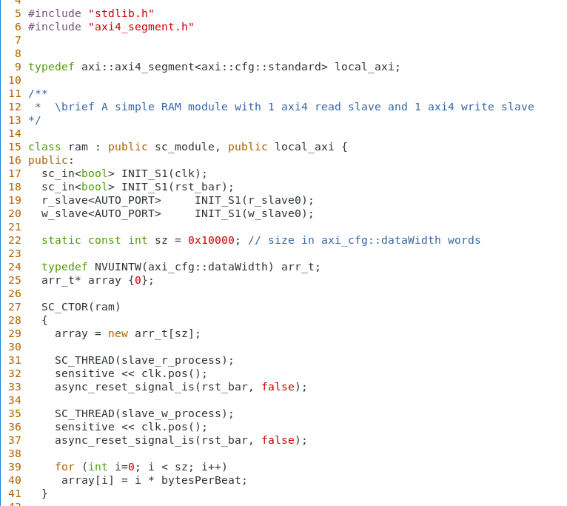
$MGC_HOME/shared/examples/matchlib/toolkit/include/ram.h
Default AXI4 configuration is
64 bit data width
Ram has 1 read slave port and 1 write slave
Ram stores 64k words (64 bits each)
Read and Write slaves are fully independent and each get their own thread

Slide 43
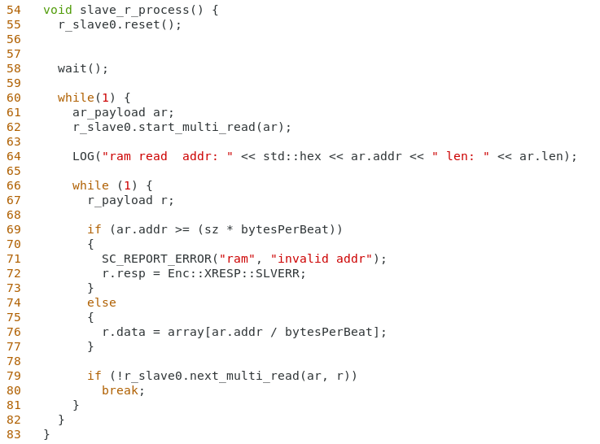
$MGC_HOME/shared/examples/matchlib/toolkit/include/ram.h(cont)
Need to call reset() methods for signals this process drives
start_multi_read() is a convenience method implemented in the AXI4 read slave port.
Start waiting for any length burst read (“multi”).
Result is returned in “ar”
If address is invalid we still need to return an “r” item, but mark it with an error code
Map byte address to word address and read data
Send read item back to master, continue if more data to read, else break out of loop if done
Automatically sets “last bit” on r item when needed
ar.addr will be updated to next read address if we continue
AXI4 Read
Master Port
AR Item
AXI4 Read
Slave Port
R Item
R Item
R Item

Slide 44
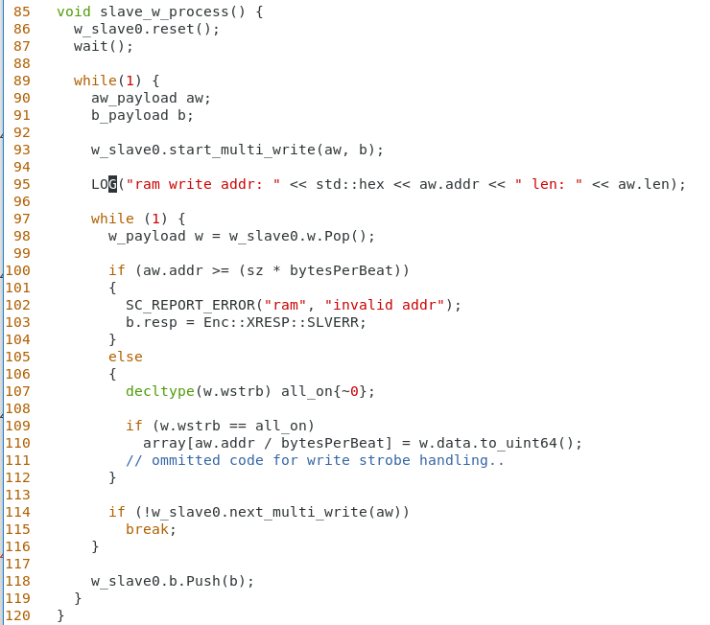
$MGC_HOME/shared/examples/matchlib/toolkit/include/ram.h(cont)
Call reset for signals this process drives
Start waiting for any length burst write
Result is returned in aw
B is initialized to “success”
Pop a w item
On invalid address set write response to an error
Write the data into the ram array
If more, update aw.addr and continue, else finish
Push write response
AXI4 Write
Master Port
AW Item
AXI4 Write
Slave Port
W Item
W Item
W Item
B Item

Slide 45
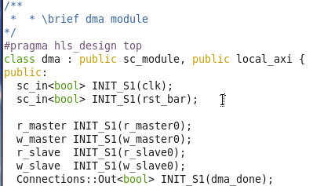
Simple Example: AXI4 DMA using MatchLib
clk
CPU Stimulus
clk
DMA
clk
RAM
rst
rst
rst
w_master0
w_slave0
w_master0
w_slave0
Control Regs
r_master0
r_slave0
r_master0
r_slave0
dma_done
dma_done
= top level of design

Slide 46
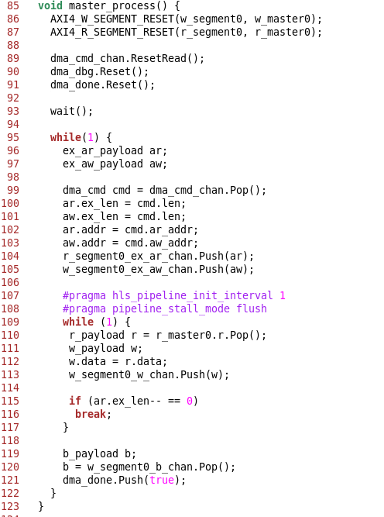
The DMA performs a memory copy using AXI4 bursts
The only clock/wait is for reset state
Entire AXI4 DMA C++ is 170 lines
RTL after HLS is 6000 lines
This IO is in parallel
Main compute loop gets pipelined in HLS
This IO is in parallel

Slide 47
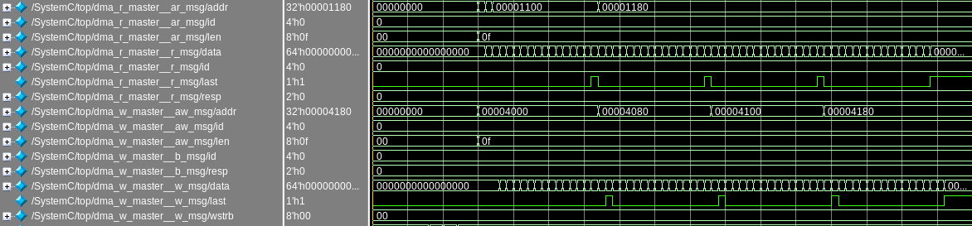
AXI4 DMA Waveforms Before HLS (SystemC simulation)
Automatic AXI4 last bit generation
Automatic AXI4 burst address segmentation
Read and write burst streams are concurrent.
R/W bus utilization is 100%
(1 read and 1 write beat per clock cycle)
Makefile sets segmentation
size to 16 rather than 256 so
easier to see in waveforms

Slide 48
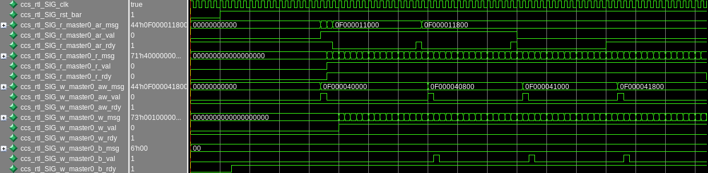
AXI4 DMA Waveforms After Catapult HLS (Verilog Sim)
RTL waveforms are almost the same as SystemC waveforms:
- Throughput is same
- Bus utilization is the same
- HLS may have added pipeline stages (under user control)
- HLS may have increased latency (under user control)

Slide 49
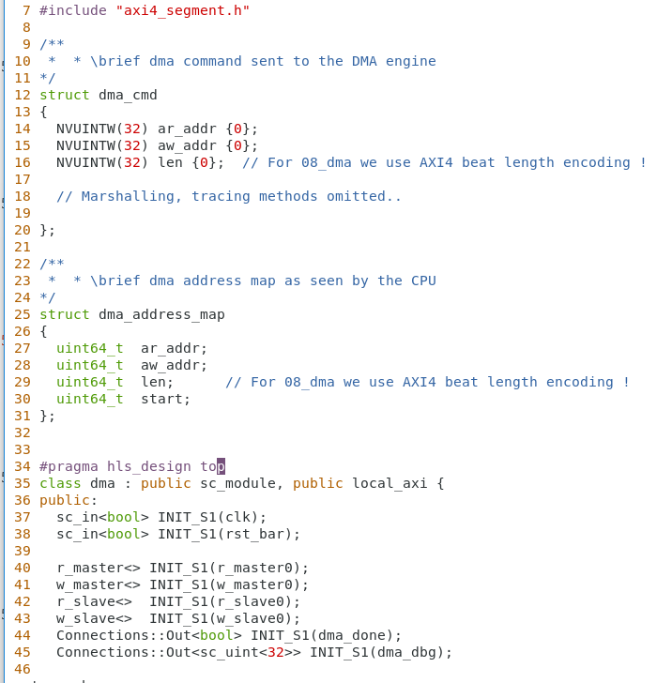
$MGC_HOME/shared/examples/matchlib/toolkit/include/dma.h
DMA command sent from slave to master process
DMA address map as seen by CPU
AXI4 read and write master ports
AXI4 read and write slave ports
DMA done interrupt

Slide 50
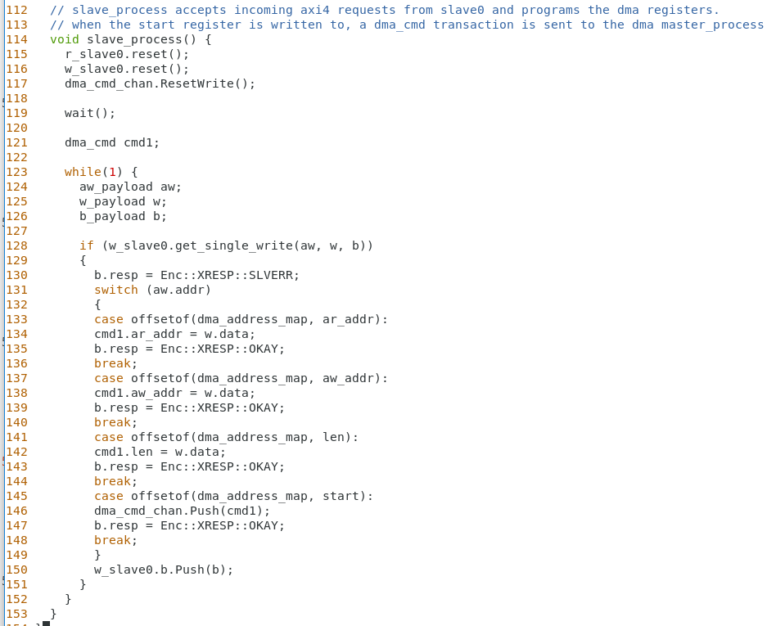
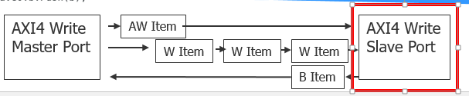
$MGC_HOME/shared/examples/matchlib/toolkit/include/dma.h(cont)
Reset signals that slave process drives
Get an AXI4 write where there must be only a single beat. If there is more than one beat, single_write() will automatically deal with the AXI4 protocol error requirements
Decode the CSR write and update status fields
When start register is written issue new DMA command
Every aw.Pop needs a b.Push

Slide 51
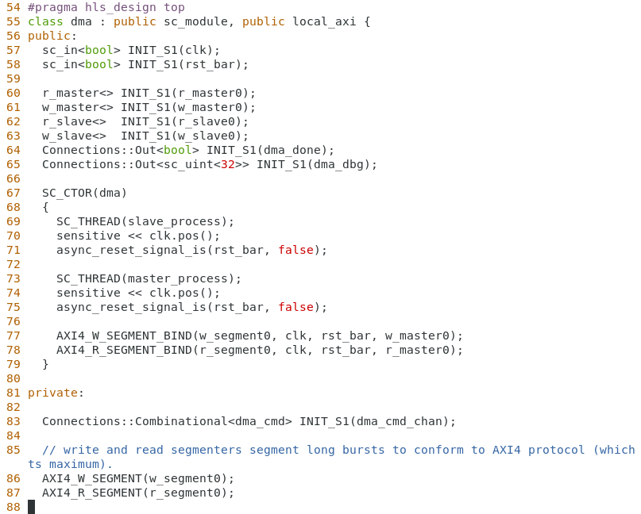
$MGC_HOME/shared/examples/matchlib/toolkit/include/dma.h(cont)
Bind W and R segmenters to native AXI4 master ports
Instantiate DMA command channel
Between slave and master processes
Instantiate W and R Segmenters

Slide 52
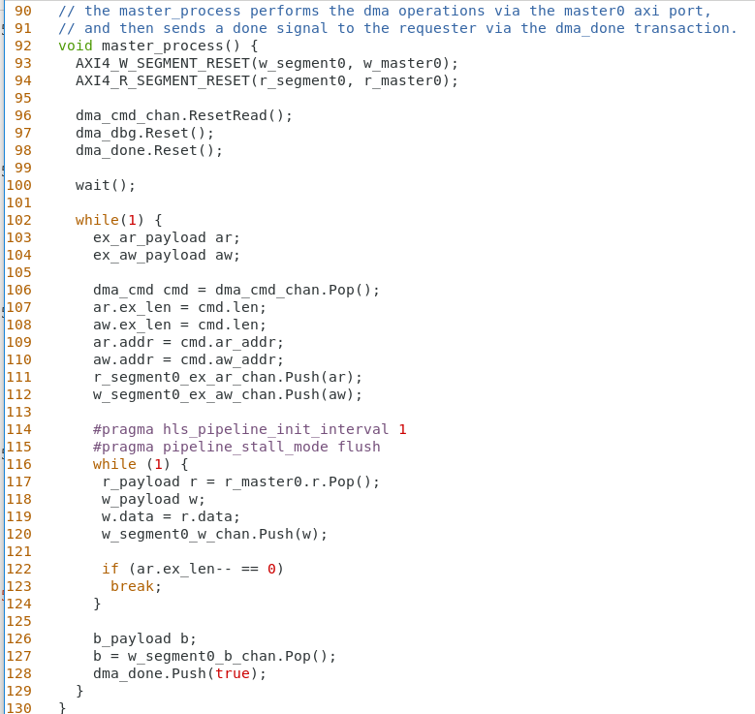
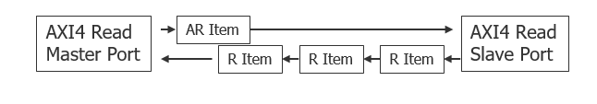
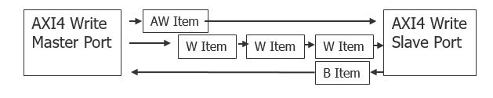
$MGC_HOME/shared/examples/matchlib/toolkit/include/dma.h(cont)
Reset all signals this process drives
Extended AR and AW payloads work with segmenters and allow > 256 beats
Pop a new DMA command from slave process
Copy length, and AW and AR addresses
Push out AW and AR addresses to RAM
Insure full thruput of R and W channels
Copy R data to W data and push out
If ex_len is currently 0 we are done
Consume write response and send interrupt to CPU

Slide 53
Miscellaneous AXI4 Stuff
Write strobes / “aka byte enables”
W item has one bit per byte in data payload indicating whether a particular byte is to be written.
Allows for precise control of which bytes are written, even if data width of beats is large
Default constructor for W item sets wstrb bits to all 1 so default behavior is to write all bytes
Works fine with write segmenter too.
“AXI4 Narrow transfers”
This is when the actual data width read or written is less than the bus data width
Supported in native AXI4 master and slave interfaces
There are complex AXI4 rules about data alignment for narrow transfers!
Not supported in R and W segmenters

Slide 54
Scatter Gather DMA
Stuart Swan
HLS IP/Platform Architect
June 2020
Source: Notes are in Tahoma, regular, 8 point, italic, flush left, vertically aligned from the bottom of text box.

Slide 55
Scatter Gather DMA Introduction
DMA modules are common in SOCs to offload data movement tasks from other blocks
The Scatter Gather DMA is a simple but representative example of common SOC blocks that use bus fabrics and which are not only datapath blocks but also include control
Also represents typical DV aspects for SOC blocks
The DMA fully uses the AXI4 features explained previously such as automatic burst segmentation
The scatter gather DMA adds features to the simple DMA block presented previously
Same top level interfaces as simple DMA
Same RAM block

Slide 56
Scatter Gather DMA block diagram
clk
CPU Stimulus
clk
DMA
clk
RAM
rst
rst
rst
w_master0
w_slave0
w_master0
w_slave0
Control Regs
r_master0
r_slave0
r_master0
r_slave0
dma_done
dma_done
= top level of design

Slide 57
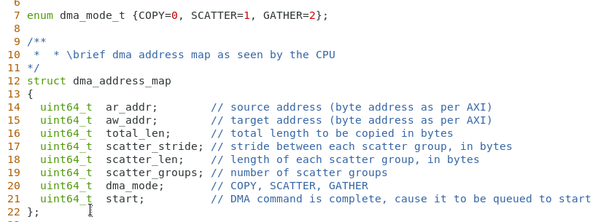
Scatter Gather Slave Address Map
Note: In previous DMA (example 08*), total_len
was in beats, but now it is a byte length

Slide 58
Scatter Operation
Source data
Target data
Ar_addr
Aw_addr
Scatter_len
Scatter_stride
Total_len
Scatter_groups
All addresses are byte addresses
All lengths are byte lengths
total_len = scatter_groups * scatter_len

Slide 59
Gather Operation
Target data
Source data
Aw_addr
Ar_addr
Scatter_len
Scatter_stride
Total_len
Scatter_groups
All addresses are byte addresses
All lengths are byte lengths
total_len = scatter_groups * scatter_len

Slide 60
Copy Operation
Source data
Target data
Ar_addr
Aw_addr
Total_len
Total_len
All addresses are byte addresses
All lengths are byte lengths
For copy operation, scatter_len, scatter_stride, scatter_groups are ignored

Slide 61
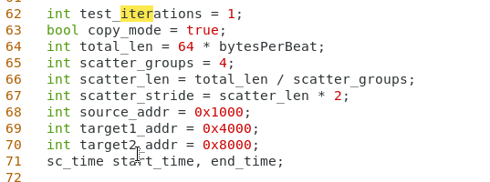
SC Testbench
If true, each iteration is a copy then a copy, else it is a scatter then a gather
Target address for first operation, source address for second operation

Slide 62
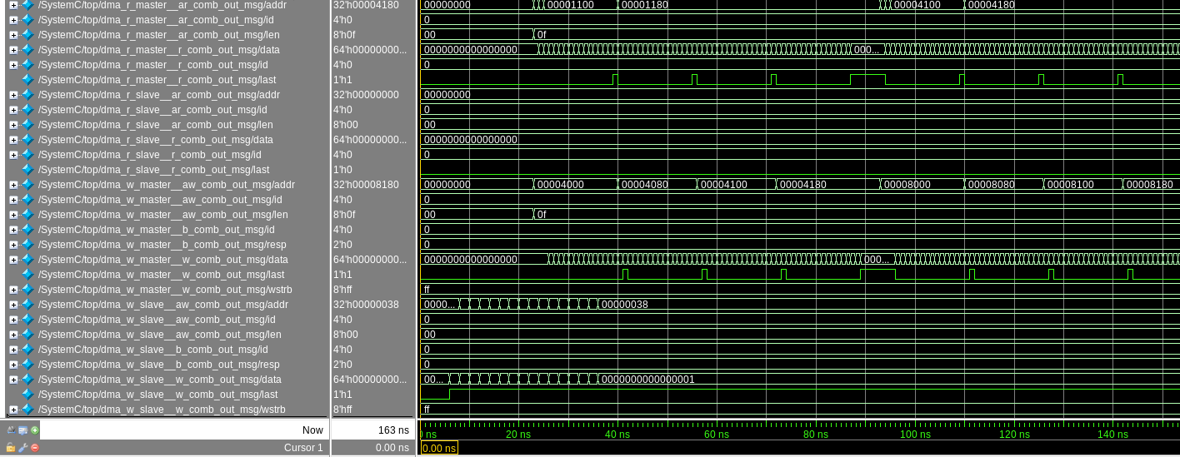
Copy_mode = true, test_iterations = 1
1st copy operation read data
2nd copy operation read data
Burst segmentation
Last bit generation
1st copy operation write data
2nd copy operation write data
TB programs dma_slave for 2 operations
Note: SystemC Waveforms, (not RTL)
Makefile sets segmentation size to 16 rather than 256 so easier to see in waveforms

Slide 63
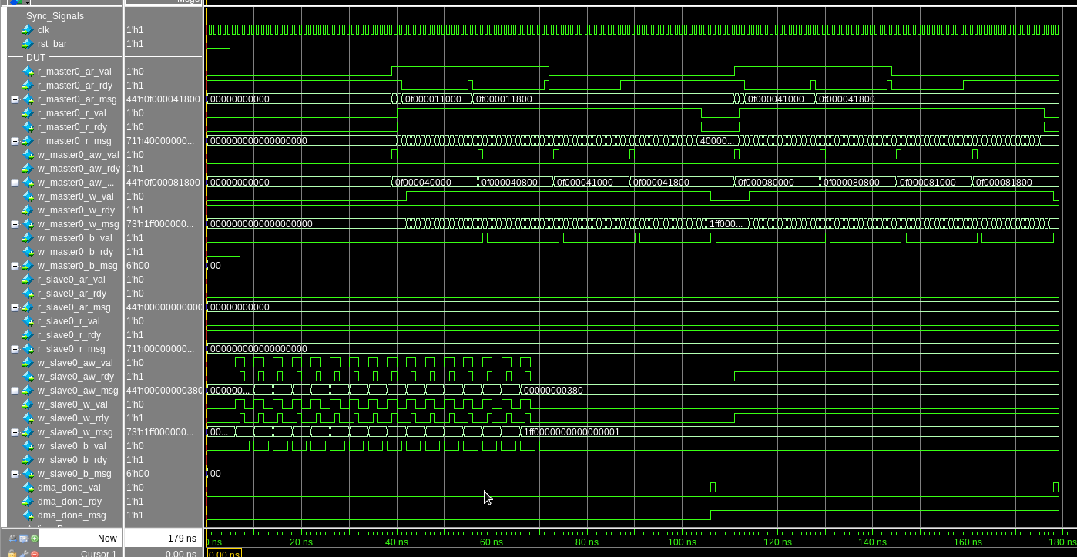
Same scenario, but in RTL

Slide 64
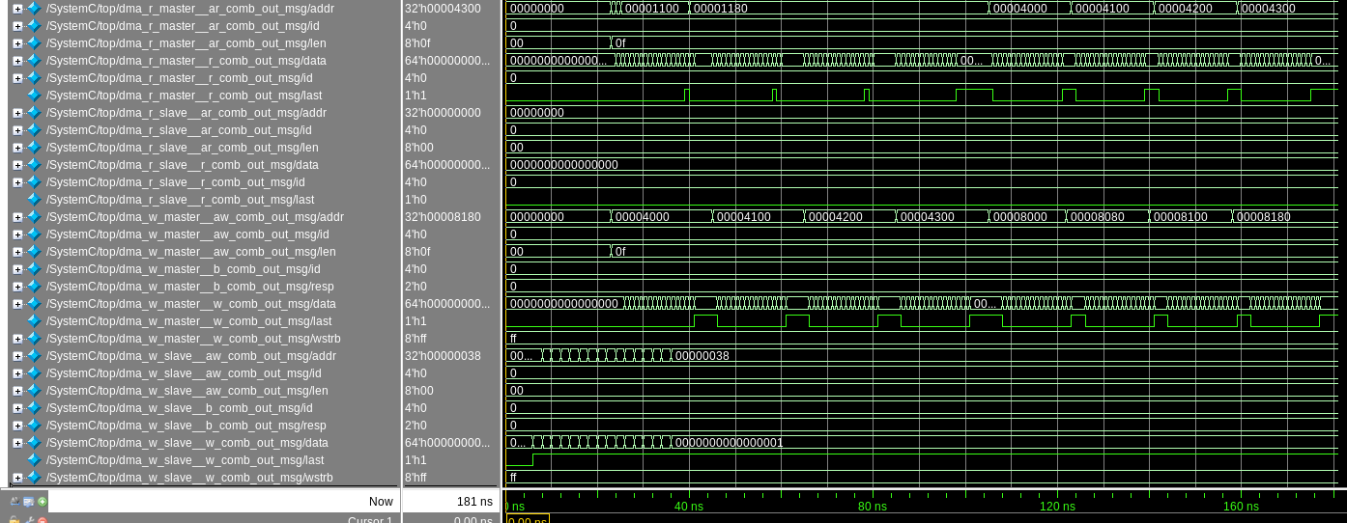
Copy_mode = false, test_iterations = 1
Read addresses are gathered
Read addresses are scattered
Write addresses are scattered
Write addresses are gathered
Note: SystemC Waveforms, (not RTL)

Slide 65
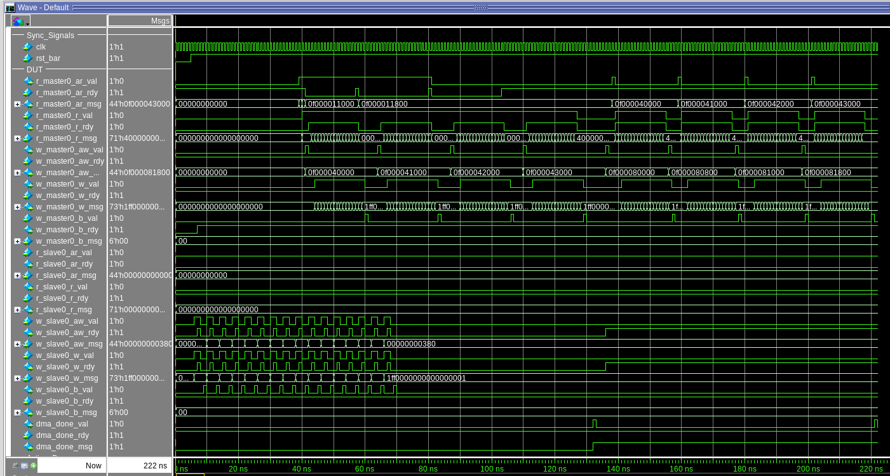
Same scenario, but in RTL

Slide 66
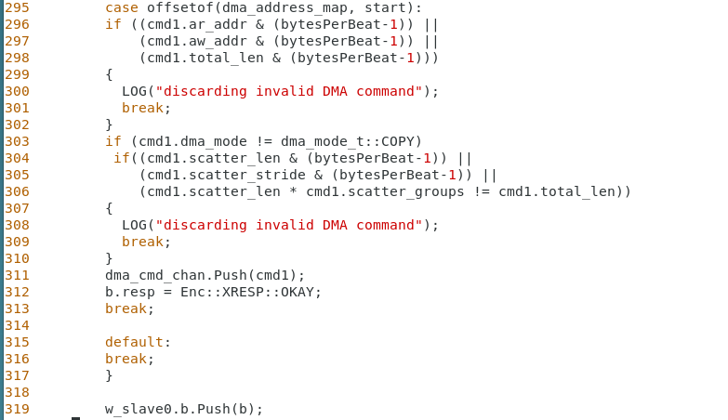
Keeping things simple..
To simplify both the DUT and the TB, the DUT enforces that all addresses and lengths are aligned to bus datawidth boundaries
When TB writes to “start” CSR, checks are enforced and a AXI4 error response if returned if there any errors.
When TB writes to “start” CSR
Make sure addresses and lengths are aligned
Do additional checks if not in COPY mode
Send AXI4 error code to TB if any checks fail

Slide 67
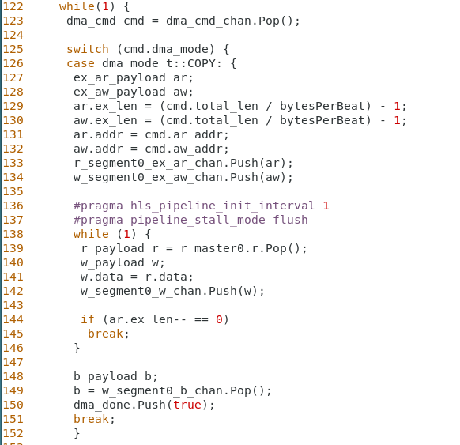
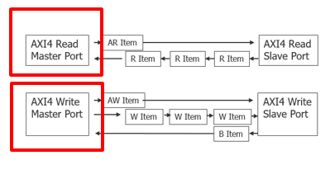
COPY implementation in DMA
Pop next DMA command
Convert byte length to beat length (AXI4 beat length encoding)
Push out AR and AW bursts
Copy data from R to W
We are done when length is currently 0 (AXI4 beat encoding)
Pop write response from b channel

Slide 68
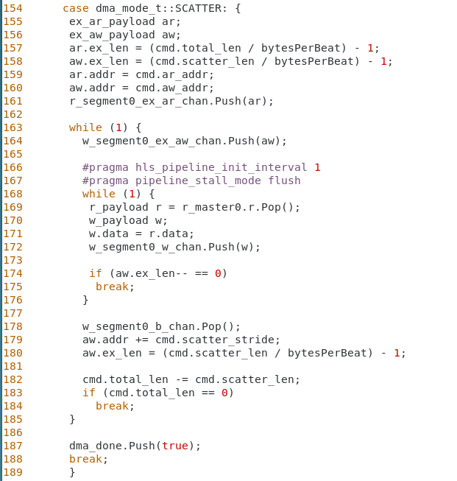
SCATTER implementation in DMA
Convert byte length to beat length (AXI4 beat length encoding)
aw.ex_len is computed based on scatter_len, not total_len
Start the AR burst, but not the AW yet
Start the AW burst for current region in the scatter groups
Copy data from R to W
We are done when length is currently 0 (AXI4 beat encoding)
Need to do b.Pop for every Push(aw)
Increment aw.addr for next scatter group region
We are done when the remaining total_len is zero

Slide 69
Homework #1 - GATHER implementation in DMA
Steps:
Edit testbench.cpp and change copy_mode to be false
Edit scatter_gather.h and write the code for GATHER
This is strictly confined to the GATHER branch of the case statement.
If you are stuck for more than 15 minutes, ask for help.
Compile and run your SC code and make sure the TB self-check passes
View SC and RTL waveforms – see README file in same dir.

Slide 70
Homework #2 – Optimize the beat rate
For copy_mode = false and test_iterations = 10, make small modifications to model and synthesis directives to optimize throughput (as reported in log output as "beat rate").
Measure in both SC sim and RTL sim.
Remember your best results and approach to report to group.

Slide 71
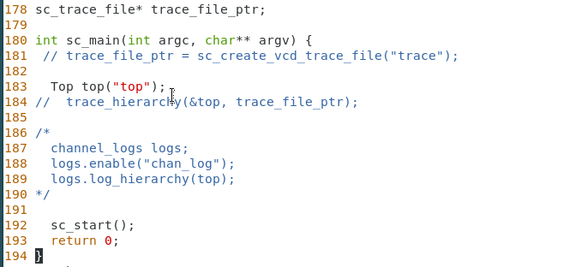
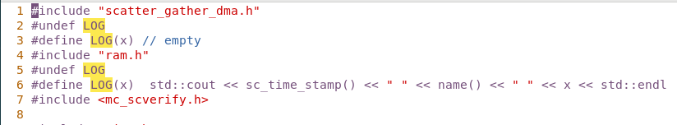
Homework #3 – Compare SC and RTL sim performance #1
Edit Makefile and add –O3 to CFLAGS
Edit testbench.cpp:
Set copy_mode = false and test_iterations = 1000
Disable SC tracing and transaction logging as shown below
Disable LOG messages in ram.h by modifying code in testbench.h as below
Measure simulation CPU time in SC and RTL simulation as reported in log output

Slide 72
Homework #4 – Compare SC and RTL sim performance #2
Perform same sim performance comparison as previous slide, but use Catapult Matchlib example 20_DCT_sysc
Use the same approaches as previous slide
Note that DCT test runs long enough that a single iteration is adequate
Try to explain any performance differences from previous test

Slide 73
Homework #5 – Matchlib SOC Verification and Debug Tutorial
Read and follow the steps in the document:
$MGC_HOME/shared/examples/matchlib/toolkit/doc/matchlib_soc_debug_tutorial.pdf

Slide 74
Matchlib Homework Wrap-Up and Miscellaneous Topics
Stuart Swan
HLS IP/Platform Architect
July 2020
Source: Notes are in Tahoma, regular, 8 point, italic, flush left, vertically aligned from the bottom of text box.

Slide 75
Homework Wrap Up and Q&A
Discuss Homework assignments 1-5
Q&A

Slide 76
Verilog Wrapper Generation
Since Matchlib models are “protocol-accurate” and support pin level interfaces, it is easy to generate Verilog RTL wrappers for them.
This makes it easy to embed Matchlib and “RTL in SystemC” models in SV UVM testbenches
Or even in “regular old Verilog” testbenches
Wrapped SC model has identical Verilog pins as actual RTL
So same testbench can be used for SC model as well as RTL just by swapping the DUT model.

Slide 77
Verilog Wrapper Generation for Scatter Gather DMA
Do the following in scatter_gather dir:
This generates two files:
scatter_gather_dma_wrap.cpp : this wraps Matchlib ports to sc_in/sc_out and exports it to Verilog
scatter_gather_dma_wrap.v : this is the Verilog module interface declaration. It is not actually used in the mixed language simulation, it is only for documentation.
chmod +x ../bin/wrapper*py
../bin/wrapper_gen.py --clock_name clk --clock_period 1 sim_sc top.dma1

Slide 78
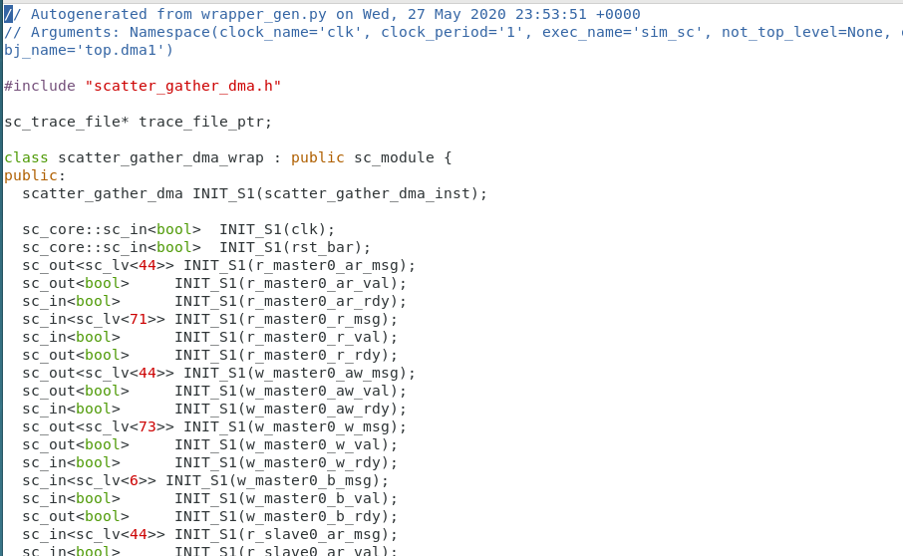
Verilog Wrapper Generation for Scatter Gather DMA

Slide 79
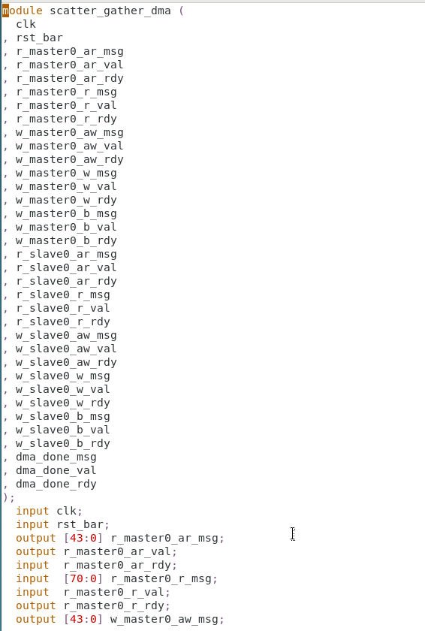
Verilog Wrapper Generation for Scatter Gather DMA

Slide 80
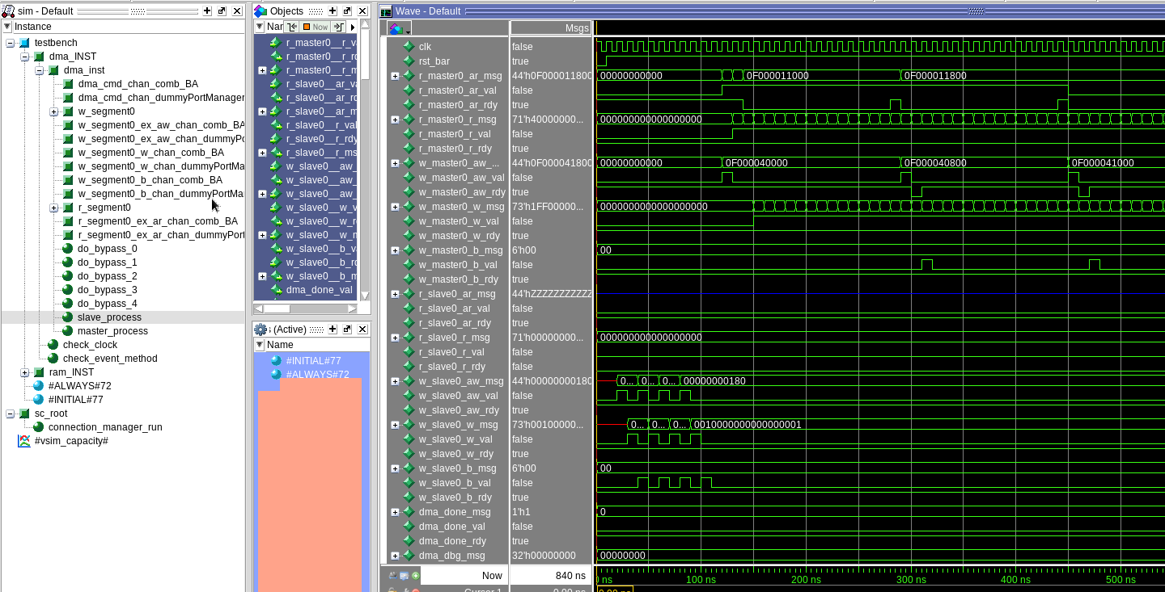
Simulating SC Matchlib DMA with a Verilog Testbench
A simple Verilog TB for similar DMA is shown in Catapult Matchlib example 45*:

Slide 81
Shared Memories in SystemC Designs – Approach #1
Definition: A shared memory is an array in HLS that is preserved thru HLS that is accessed by more than one thread.
Approach #1: “Make the shared memory go away”
Use only preserved arrays which are accessed by a single thread
Use architectural directives in Catapult to allocate ports for those rams, etc.
Use Matchlib components such as Scratchpad, ArbitratedScratchpad, etc., to route requests from other threads to those arrays.
If throughput is top concern, and a few extra cycles of latency is OK, this is a very robust and flexible approach.
Pre-HLS sim will be throughput accurate under assumption that mem rd wr access to arrays within threads are not the bottleneck

Slide 82
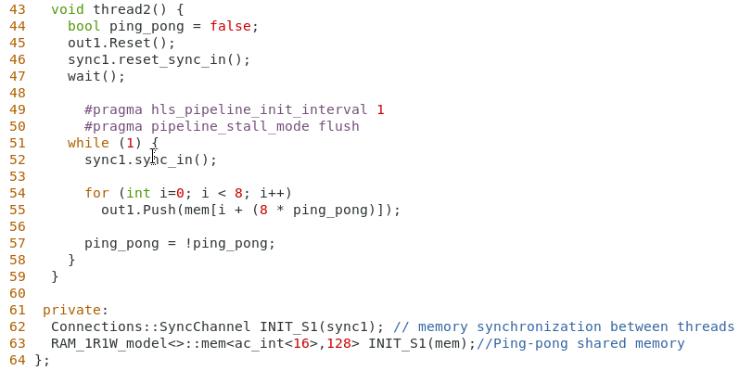
Shared Memories in SystemC Designs – Approach #2
Approach #2: Use memory model from Catapult Memory Generator
This is demonstrated in 12_ping_pong_mem
Each thread accessing memory needs a dedicated RAM port
There needs to be some synchronization scheme to avoid data races between threads
12_ping_pong_mem uses Connections::SyncChannel
Catapult memory generator SC models currently need “wait(0.3, SC_NS)” statements deleted from them so they work properly in Matchlib sims
Catapult memory generator SC models currently do not participate in Matchlib “thruput accurate” simulation mechanism, so sim will not be thruput accurate if thread has > 1 mem accesses per clock
Memory read operation
Memory instance

Slide 83
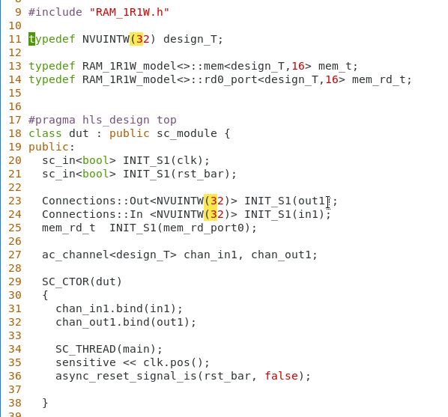
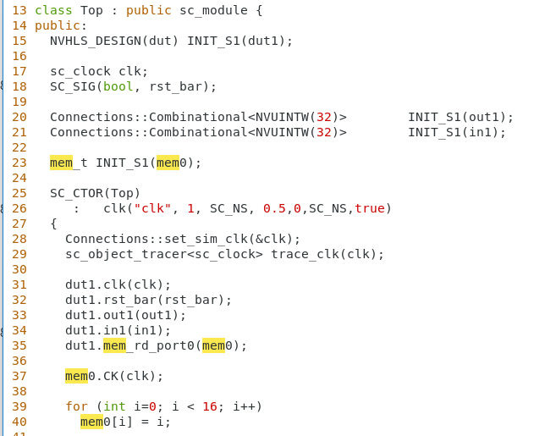
Shared Memories in SystemC Designs – Approach #2 (cont.)
Example 12_ping_pong_mem shows shared memory shared by threads in same module.
In this case, you do not need to explicitly code the mem read and write ports
You can also have memory ports on modules, so that memories can be external and/or shared between multiple modules.
In this case, you do need to explicitly code the mem read and write ports on module interfaces
Memory types
Memory read port
Bind memory read port to memory instance

Slide 84
Shared Memories in SystemC Designs – Approach #3
Approach #3: Use ac_shared<>
This approach is currently not supported and not recommended for SC designs.

Slide 85
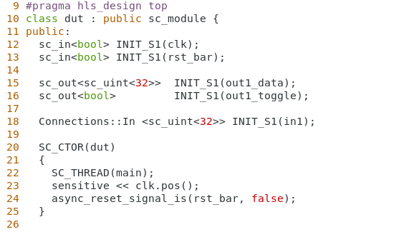
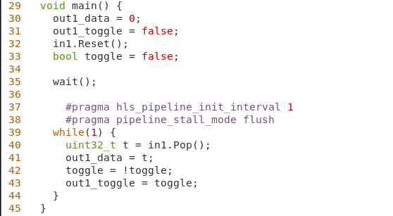
Toggle Protocol Converter – Matchlib Example 13*
Toggle Protocol Converter is a simple (and useful) example of “RTL in SystemC” mixed with Matchlib style
Toggle protocol indicates that a message has been sent when the toggle signal changes
Reliable message delivery as long as consumer process “can keep up”
Producer and Consumer can be running at different clock rates
Data output
Toggle output
Input uses Matchlib rdy/vld protocol
Toggle output when we output new data

Slide 86
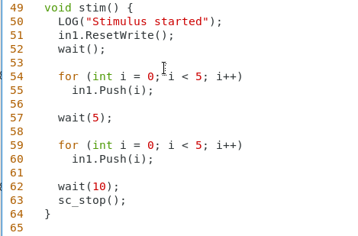

Toggle Protocol Converter – Matchlib Example 13*
Stimulus uses Matchlib rdy/vld protocol
Input is rdy/vld protocol
Output is toggle protocol

Slide 87
Data Valid Protocol – Matchlib Example 15*
Data Valid protocol is similar to rdy/vld protocol, except rdy signals are removed because either:
consumers are assumed to “always be ready” to receive messages
if consumers are not ready and messages are dropped, it is OK.
Note: In this case, if latency of design changes from SC model to RTL, then sim results may change due to this timing sensitivity
Assumption is that if vld=true for two consecutive clock cycles, then two messages were sent.
Data valid protocol is modeled using sc_in/sc_out (ie. “RTL in SystemC” style)
This protocol is common in time domain signal processing, where each block is clocked at a particular sampling frequency and consumes one sample per clock. The valid bit indicates if the particular sample is valid.
When a chain of filter blocks come out of reset, the first sample at the beginning of the chain will be valid, and input samples further down the chain will not be valid until the first valid sample propagates thru the chain.
rdy/vld protocol is not suitable for such designs.

Slide 88
Real World Design Example – 5G Receiver
Matchlib Push/Pop work over here due to discrete
transactions and framing signals – backpressure is useful
You cannot apply backpressure to the antenna!
SC clock frequency dynamically changes for certain blocks for different
bandwidth modes
Data Valid Protocol
IQ samples which are
Ac_complex<ac_fixed>>
AXI4 and Matchlib Push/Pop
Frames, Tones, Resource Units
AXI4 and Matchlib Push/Pop Packets
Analog
Radio
ADC
Time Domain
Receiver
FFT
Freq Domain
Receiver
Error
Correction
Automatic
Gain Control
AXI4 and
Interrupt lines (sc_signal)
Data Valid Protocol
CPU
Control
Approach to architectural analysis and refinement to production HLS code is presented in “car factory” tutorial in Catapult Matchlib doc directory

