Slide 1
Behaviour-Driven Development (BDD) em Python
Hugo Lopes Tavares

Slide 2
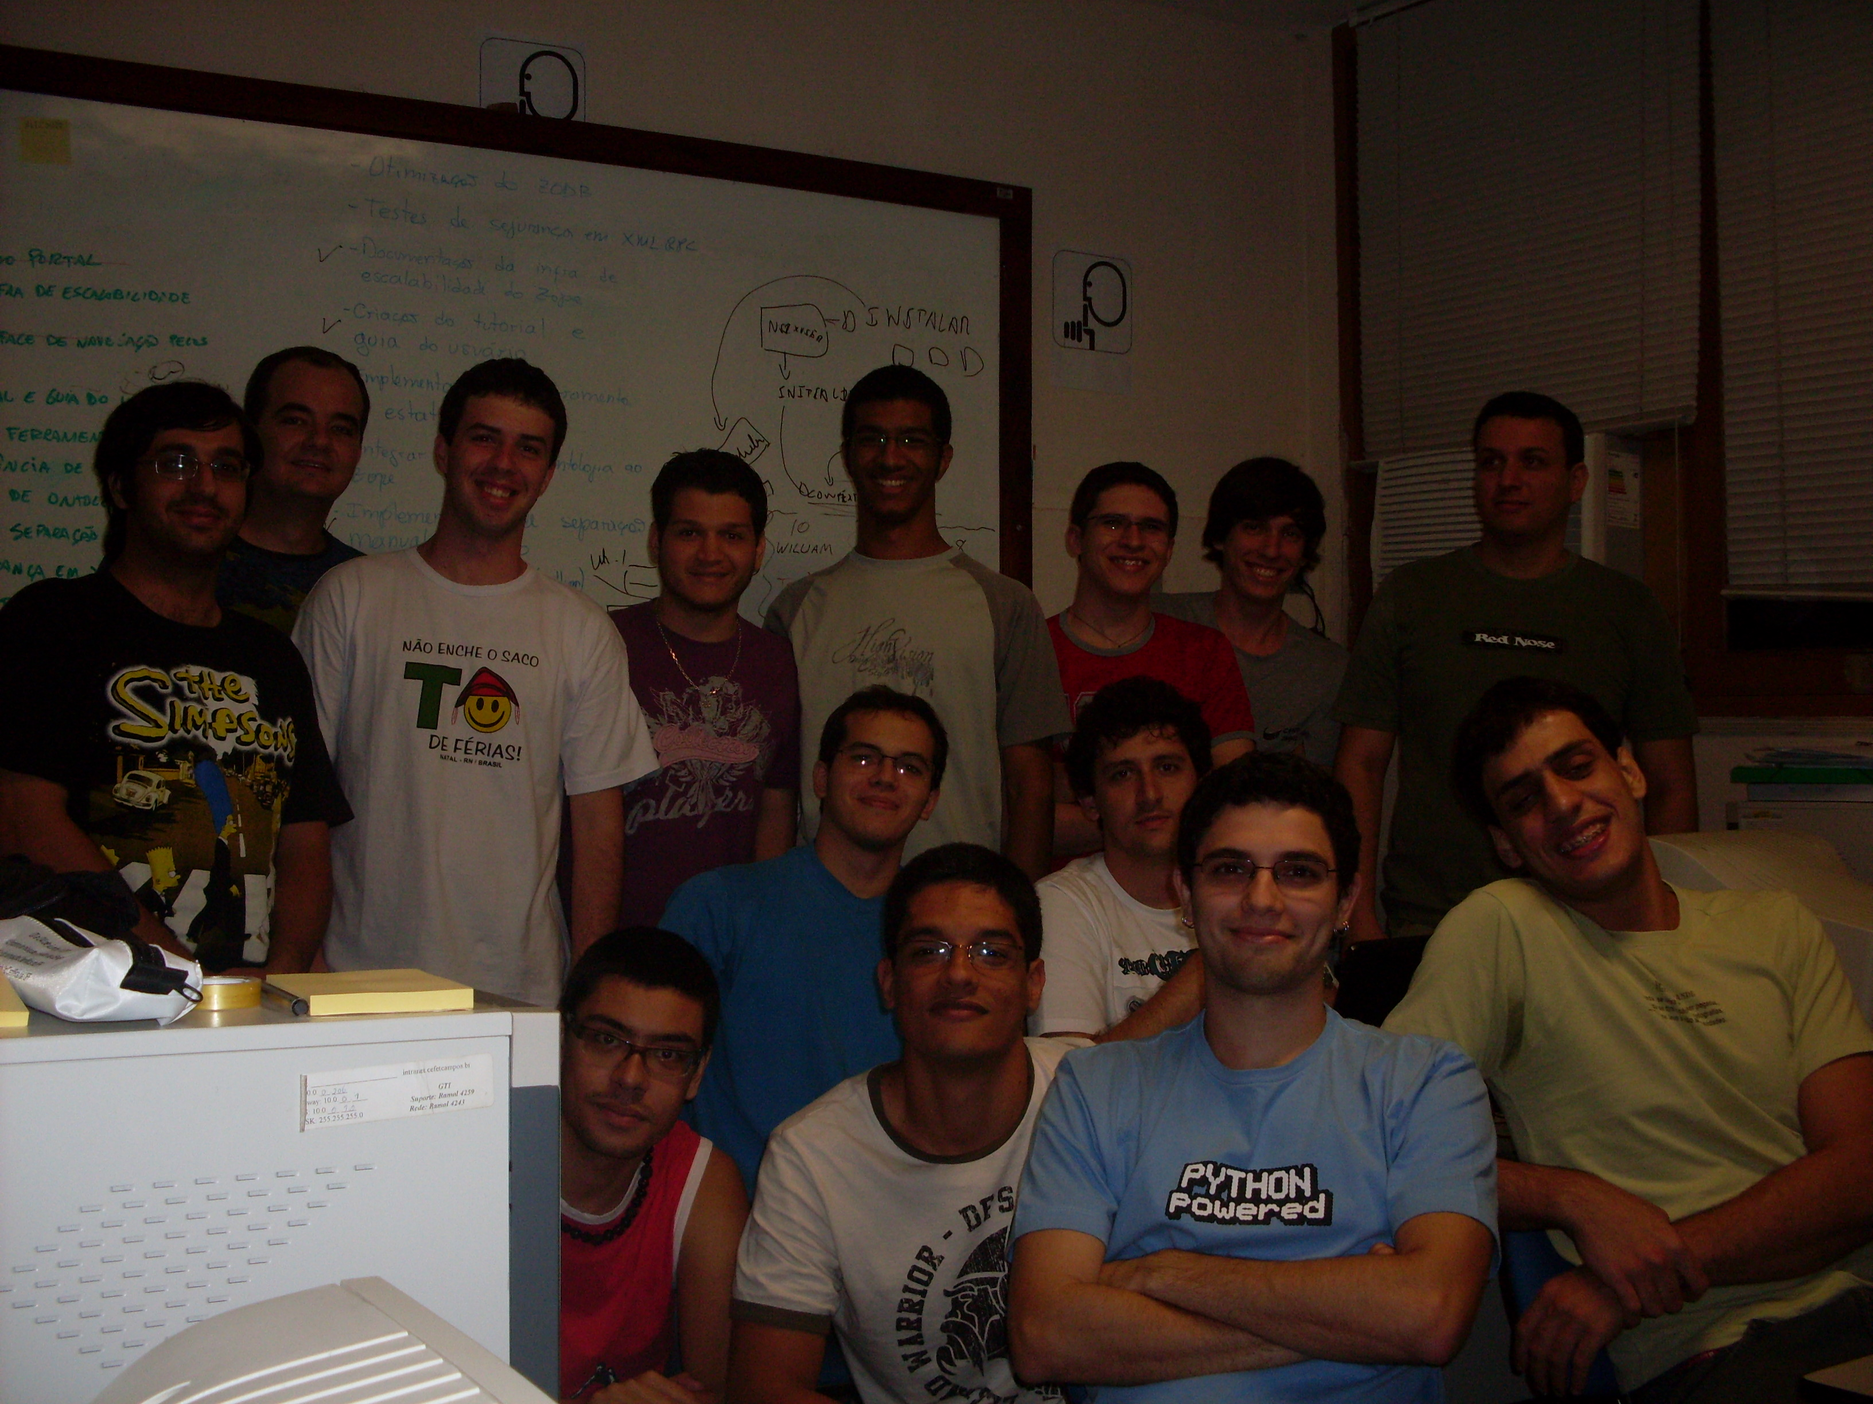

Slide 3
Parte 1: Conceitos

Slide 5
TestDox
Public class FooTest extends TestCase {
public void testIsASingleton() {}
public void testAReallyLongNameIsAGoodThing() {}
}
Foo
- is a singleton
- a really long name is a good thing
Notes:
Mostrar um exemplo e falar sobre a ideia do should

Slide 8
“Getting the words right”

Slide 9
Palavra mágica:
should

Slide 10
public class CustomerLookupTest {
@Test
public void shouldFindCustomerById() { }
@Test
public void shouldFailForDuplicatedCustomers() { }
}
CustomerLookup
- should find customer by id
- should fail for duplicated customers

Slide 11
Ubiquitous Language
para análise de software

Slide 12
Histórias
e
Cenários

Slide 13
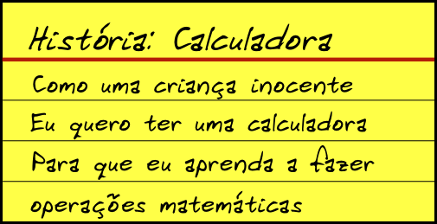

Slide 14
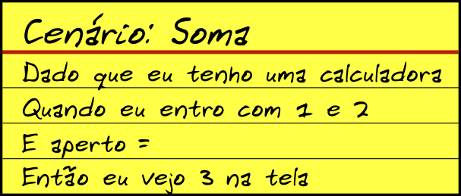

Slide 15
“It's all behaviour”

Slide 16
histórias e cenários → aplicação
exemplos → código

Slide 17
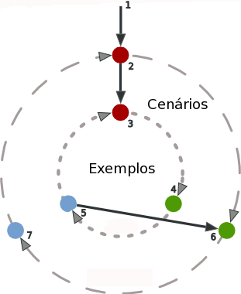
Outside-In Development

Slide 18
O que precisamos sempre manter em mente?

Slide 19

Specification,
not Verification

Slide 20
todo comportamento precisa de exemplos

Slide 22
Benefícios

Slide 23
foco

Slide 25
documentação correta em sincronia com o código

Slide 27
Cenários:
testes de aceitação e de regressão

Slide 28
Exemplos:
testes unitários
e
documentação

Slide 29
YAGNI

Slide 30
Mock Objects

Slide 31
Como fazer BDD no dia-a-dia?

Slide 32
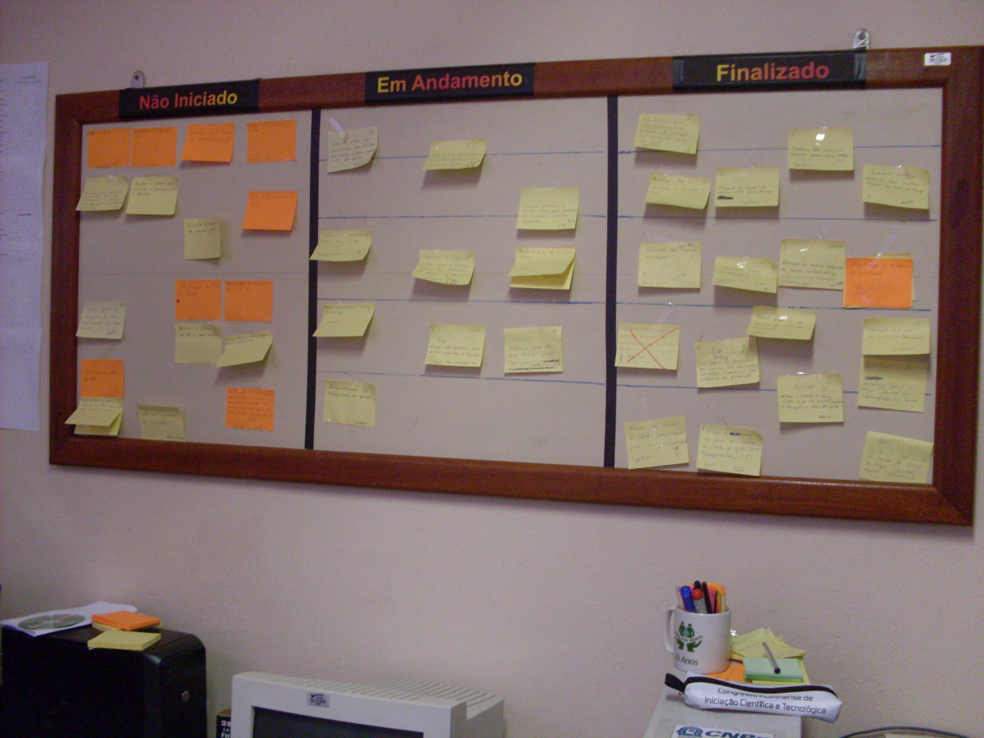

Slide 33
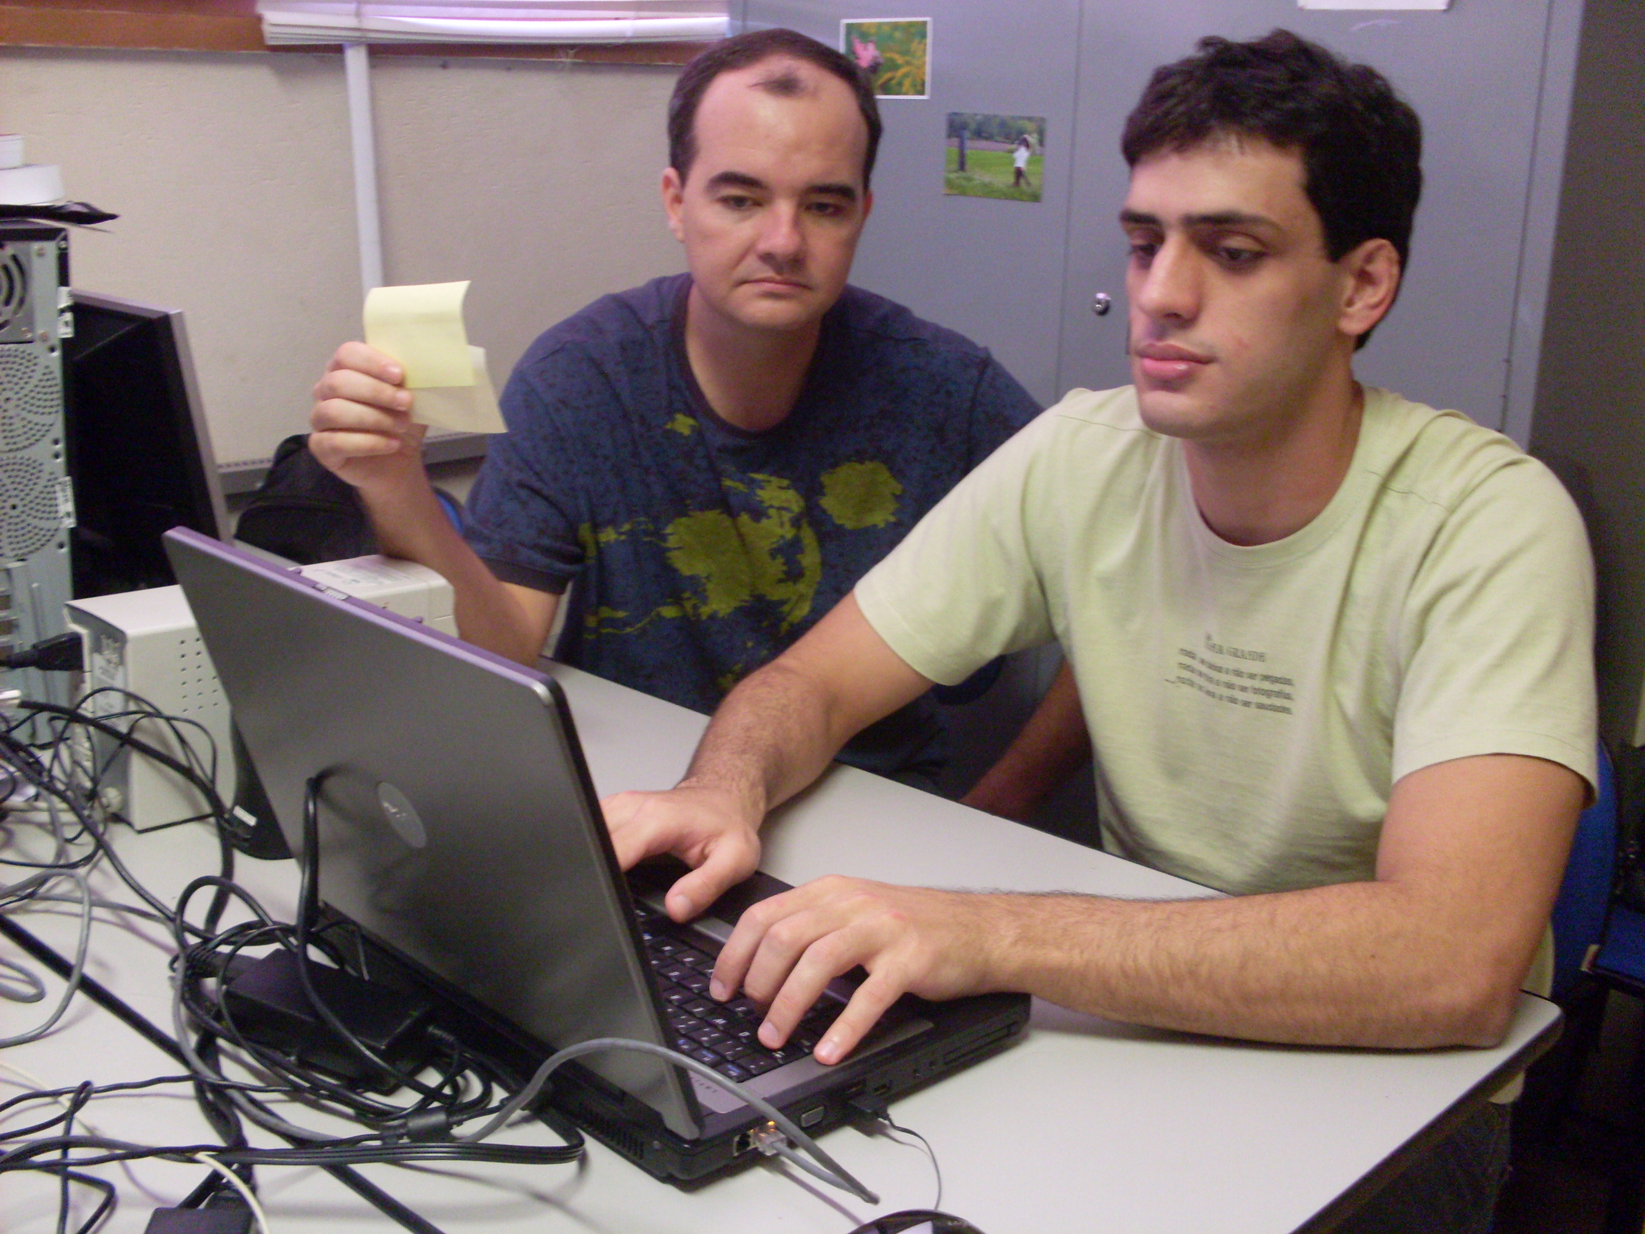

Slide 34
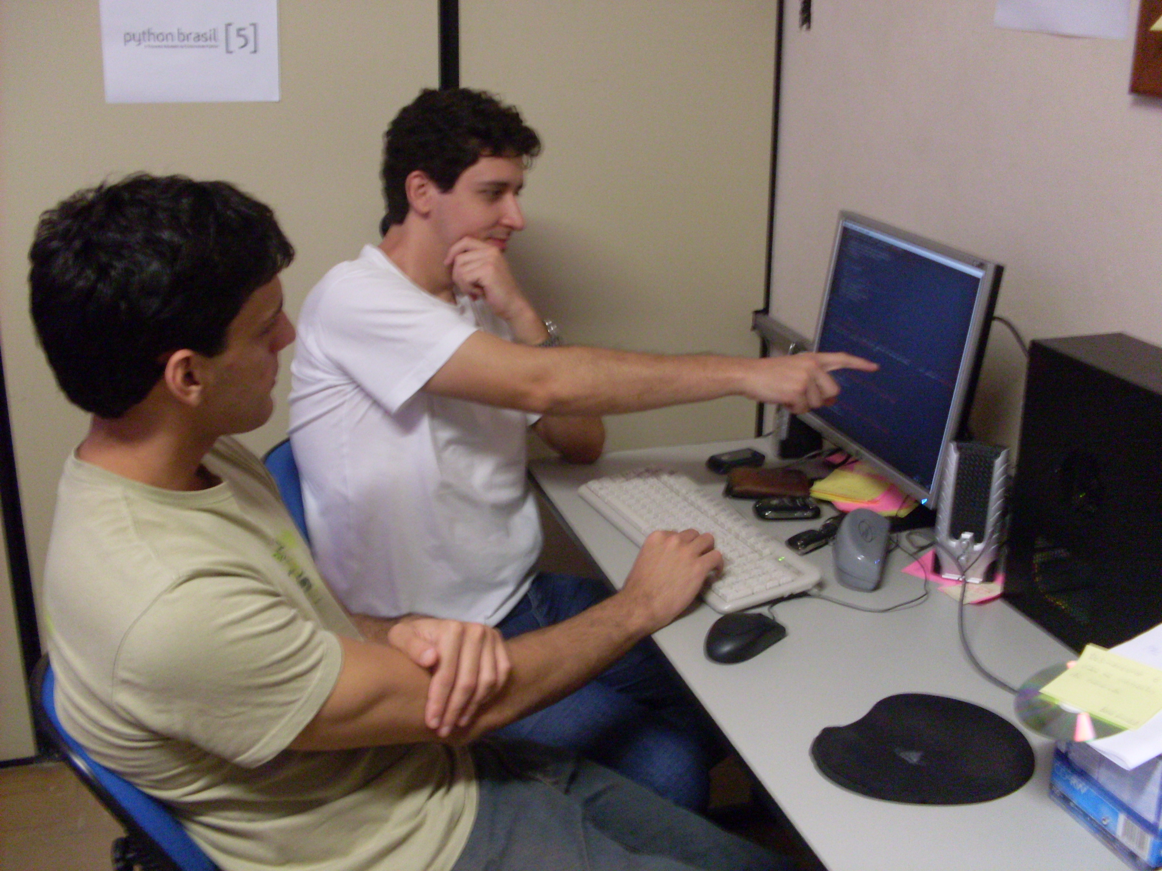

Slide 35
Todas as práticas em BDD são novas?

Slide 37
Beer-Driven Development

Slide 38
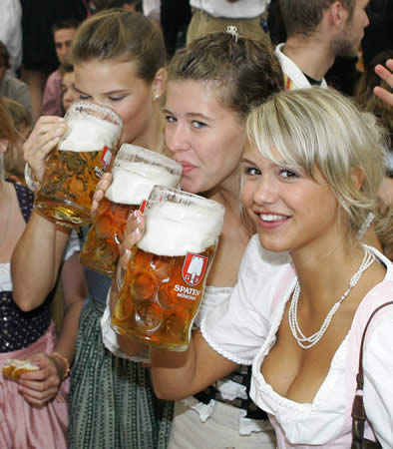

Slide 41
Parte 2:
Ferramentas em Python

Slide 42
Mock Frameworks

Slide 43
Mockito
from mockito import Mock, when, verify
class MaquinaDeSaque(object):
@staticmethod
def transferir(valor, conta1, conta2):
if conta2.pegar_saldo() >= valor:
conta2.sacar(valor)
conta1.depositar(valor)
conta2 = Mock()
conta1 = Mock()
when(conta2).pegar_saldo().thenReturn(200)
MaquinaDeSaque.transferir(100, conta1, conta2)
verify(conta1).depositar(100)
verify(conta2).sacar(100)

Slide 44
Ludíbrio
from __future__ import with_statement
from ludibrio import Mock
class MaquinaDeSaque(object):
@staticmethod
def transferir(valor, conta1, conta2):
if conta2.pegar_saldo() >= valor:
conta2.sacar(valor)
conta1.depositar(valor)
with Mock() as conta1:
conta1.depositar(100)
with Mock() as conta2:
conta2.pegar_saldo() << 200
conta2.sacar(100)
MaquinaDeSaque.transferir(100, conta1, conta2)

Slide 45
http://bitbucket.org/szczepiq/mockito-python
http://github.com/nsigustavo/ludibrio

Slide 46
Should-DSL

Slide 47
2 |should_be.greater_than| 1
'hugo' |should_not_be.equal_to| 'Hugo'
5 |should_be.less_than| 10
['python', 'C'] |should_have| 'python'
'C' |should_be.into| ['python', 'C']
assert 2 > 1
assert 'hugo' == 'Hugo'
assert 5 < 10
assert 'C' in '[python', 'C']

Slide 48
>>> from should_dsl import matcher, should_be
>>> @matcher
... def abs_of():
... return lambda x, y: x == abs(y),\
... '%s is%s the abs of %s'
...
>>> 1 |should_be.abs_of| -1
True

Slide 49
>>> from math import sqrt
>>> deve_ser = should_be
>>> @matcher
... def a_raiz_quadrada_de():
... return lambda x,y: x == sqrt(y),\
... "%s %se' a raiz quadrada de %s"
...
>>> 2 |deve_ser.a_raiz_quadrada_de| 4
True

Slide 50
http://github.com/hugobr/should-dsl

Slide 51
Example Frameworks

Slide 53
PySpec
behaviour_spec.py:
import stack # import production code
from pyspec import * # import pyspec framework
class Behavior_Stack(object):
@context
def new_stack(self):
self.stack = stack.Stack()
@spec
def should_be_empty(self):
About(self.stack).should_be_empty()
if __name__ == "__main__":
run_test()

Slide 54
stack.py:
class Stack(object):
def __len__(self):
return 0
$ python behavior_stack.py
new stack
should be empty ... OK
------------------------------------
Ran 1 spec in 0.048s
OK

Slide 55
Behaviour
class verifyUserSpecification(behaviour.Behaviour):
def setUp(self):
self.user = User("Mark Dancer")
def verifyInitialUserNameIsNameInConstructor(self):
self.shouldBeEqual(self.user.name, "Mark Dancer")
def verifyInitialUserHasNoLanguages(self):
self.shouldBeEmpty(self.user.languages)

Slide 56
Yeti
# coding: spec
from should_dsl import should_be
class Bowling:
score = 0
def hit(self, v):
self.score += v
describe Bowling:
def before_each:
self._bowling = Bowling()
it "should score 0 for gutter game":
self._bowling.hit(0)
self._bowling.score |should_be.equal_to| 0
it "should score 1 for just one hit":
self._bowling.hit(1)
self._bowling.score |should_be.equal_to| 1

Slide 57
http://www.codeplex.com/pyspec
http://pypi.python.org/pypi/Behaviour
http://github.com/fmeyer/yeti

Slide 58
Story/Feature Frameworks

Slide 59
Pyccuracy
As a Google User
I want to search Google
So that I can test Pyccuracy
Scenario 1 - Searching for Hello World
Given
I go to "http://www.google.com"
When
I fill "q" textbox with "Hello World"
And I click "btnG" button
And I wait for 2 seconds
Then
I see "Hello World - Pesquisa Google" title

Slide 60
Pyhistorian
from should_dsl import *
from pyhistorian import *
class Calculator(object):
def sum(self, n1, n2):
return n1+n2
class SpecifyingMyNewCalculator(Story):
"""As a lazy mathematician
I want to use a calculator
So that I don't waste my time thinking"""
colored = True
template_color = 'yellow'
scenarios = ['SumScenario'] # optional

Slide 61
Pyhistorian
class SumScenario(Scenario):
@Given('I have a calculator')
def set_my_calculator(self):
self.calculator = Calculator()
@When('I enter with 1 + 1')
def sum_one_to_one(self):
self.result = self.calculator.sum(1, 1)
@Then('I have $value as result', 2)
def get_result(self, value):
self.result |should_be| value
if __name__ == '__main__':
SpecifyingMyNewCalculator.run()

Slide 62
PyCukes
Story: Bowling Game
As a bowling player
I want to play bowling online
So that I can play with everyone in the world
Scenario 1: Gutter Game
Given I am playing a bowling game
When I hit no balls
Then I have 0 points

Slide 63
PyCukes
from pycukes import *
class BowlingGame(object):
score = 1
def hit(self, balls):
pass
@Given('I am playing a bowling game')
def start_game(context):
context._bowling_game = BowlingGame()
@When('I hit no balls')
def hit_no_balls(context):
context._bowling_game.hit(0)
@Then('I have 0 points')
def i_have_zero_points(context):
assert context._bowling_game.score == 0

Slide 64
Freshen
Feature: Division
In order to avoid silly mistakes
Cashiers must be able to calculate a fraction
Scenario: Regular numbers
Given I have entered 3 into the calculator
And I have entered 2 into the calculator
When I press divide
Then the result should be 1.5 on the screen

Slide 65
Freshen
Feature: Addition
In order to avoid silly mistakes
As a math idiot
I want to be told the sum of two numbers
Scenario Outline: Add two numbers
Given I have entered <input_1> into the calculator
And I have entered <input_2> into the calculator
When I press <button>
Then the result should be <output> on the screen
Examples:
| input_1 | input_2 | button | output |
| 20 | 30 | add | 50 |
| 2 | 5 | add | 7 |
| 0 | 40 | add | 40 |

Slide 66
Freshen
from freshen import *
from freshen.checks import *
import calculator
@Before
def before(sc):
scc.calc = calculator.Calculator()
scc.result = None
@Given("I have entered (\d+) into the calculator")
def enter(num):
scc.calc.push(int(num))
@When("I press (\w+)")
def press(button):
op = getattr(scc.calc, button)
scc.result = op()
@Then("the result should be (.*) on the screen")
def check_result(value):
assert_equal(str(scc.result), value)

Slide 67
http://github.com/heynemann/pyccuracy
http://github.com/hugobr/pyhistorian
http://github.com/hugobr/pycukes
http://github.com/rlisagor/freshen

Slide 68
Referências
http://dannorth.net/introducing-bdd
http://blog.daveastels.com/files/BDD_Intro.pdf
http://behaviour-driven.org/
http://pt.wikipedia.org/wiki/Behaviour_Driven_Development
http://en.wikipedia.org/wiki/Behaviour_Driven_Development
http://agiledox.sourceforge.net/
http://cukes.info
http://rspec.info

Slide 69
Obrigado!
hltbra@gmail.com
@hltbra
http://hugolt.wordpress.com

