Slide 1
Case Tracker
Retire the Excel workbook — one live board for the whole case lifecycle
https://hltsai9.github.io/threenine/
Deployable for your team · PostgreSQL-backed · multi-operator · live Case Center sync

Slide 2
Today: one shared Excel workbook
It works — until it doesn't.
Free-form cells → inconsistent values and broken formulas.
No action queue → you rely on memory and ad-hoc filters for "what's next".
No visibility → "where is this case stuck? who's slow?" is guesswork.
Handover is verbal or a side document → nothing enforced or auditable.
The cost: cases stall between teams, SLAs slip unnoticed, and context is lost at every shift change.
Case Tracker · https://hltsai9.github.io/threenine/
1

Slide 3
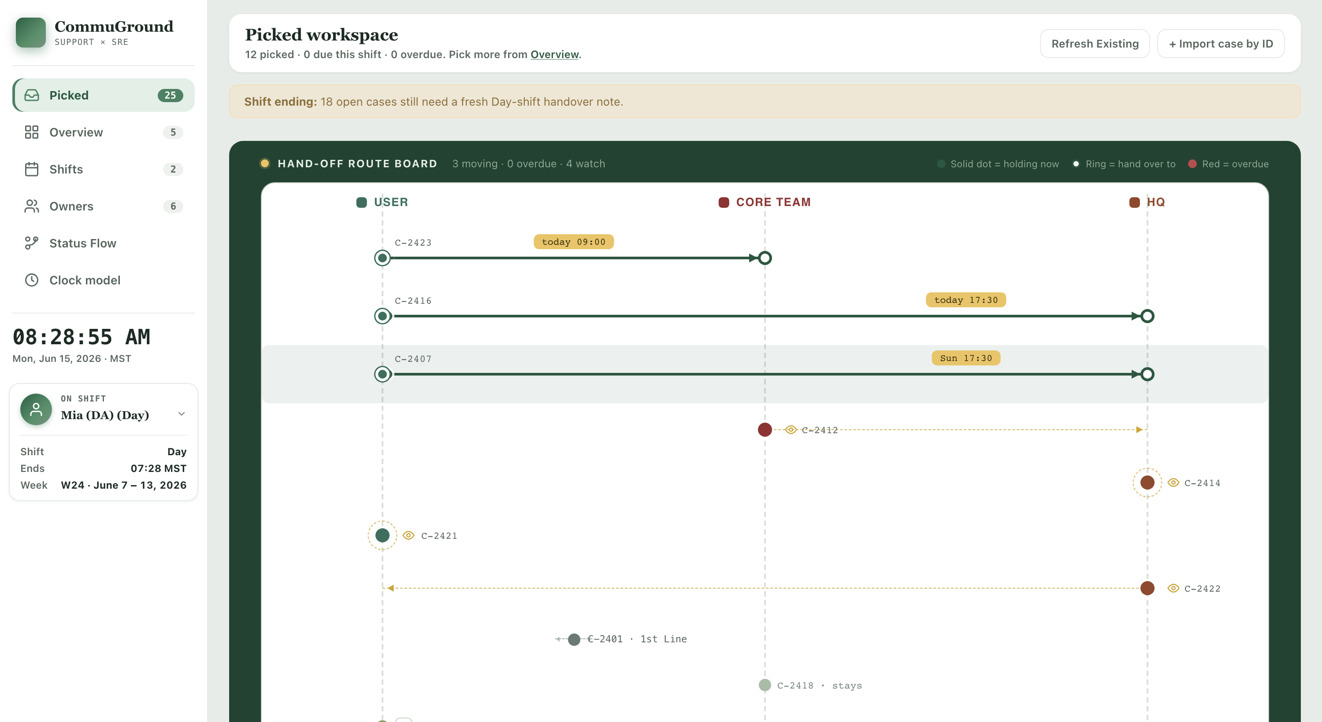
One board, live — the workbook, replaced
Your Picked workspace + the Hand-off Route Board — where every case is, live from Case Center.
Case Tracker · https://hltsai9.github.io/threenine/
2

Slide 4
The Hand-off Route Board
See where every case actually is — and where it still needs to go.
One strip across User → Core Team → HQ. The dot sits where Case Center says the case is now.
A dashed "watch" ring = parked there, keeping an eye; a moving arrow = it should move (your intent).
Scheduled hand-offs (weekend / retry / escalate) carry a deadline; the board never hides the real location.
At a glance: who holds each case, and exactly where first line still has an action.
current — Case Center
User
Core Team
intent — Track Status
HQ
Case Tracker · https://hltsai9.github.io/threenine/
3

Slide 5
Two assignees per case
Where it IS (Case Center) vs where you WANT it (your Track Status).
Case Center assignee = where the case is now — this places the dot.
Track Status = where first line wants it next, with a suggested time.
When the two differ, the board animates an arrow — your cue to act.
Do the work in Case Center; the board catches up on the next sync.
Current — Case Center Site IT + processType → Core / 1st Line · HQ dept → HQ · returned → User
Desired — Track Status Escalate to HQ · Need to contact user · Weekend case · Sanity check — each with a suggested action time
Case Tracker · https://hltsai9.github.io/threenine/
4

Slide 6
Live from your on-prem Case Center
Real cases, refreshed every time you load the board.
Pulls live cases from Case Center on every refresh.
Runs locally — your API key and cookie never leave your laptop.
Your queue, handover notes and reminders are kept across refreshes.
Case Center owns the status; your handling layer stays yours.
Your laptop (browser)
🔒 key + cookie stay here
Local server (Python)
Case Center (on-prem)
Case Tracker · https://hltsai9.github.io/threenine/
5

Slide 7
The next action is on the card
Surfaced by status and idle time — the agent never hunts.
A
Assign to Core Team New case with no owner yet.
C
Chase — no response Owner idle past the threshold (Core 4h / HQ 8h).
E
Escalate to HQ Core Team can't resolve — hand to the product team.
V
Verify reported fix Sanity-check, then close.
Plus reminders/bells and a one-click handover note — nothing falls through the cracks.
Case Tracker · https://hltsai9.github.io/threenine/
6

Slide 8
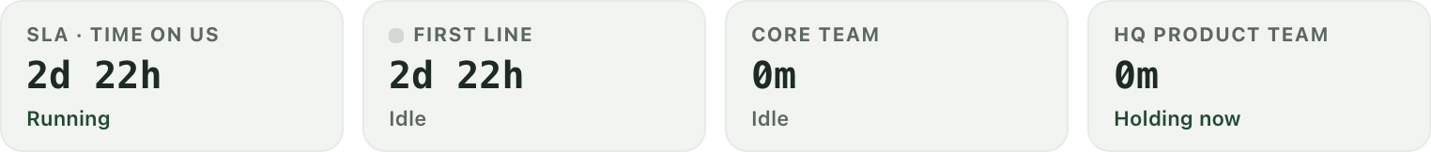
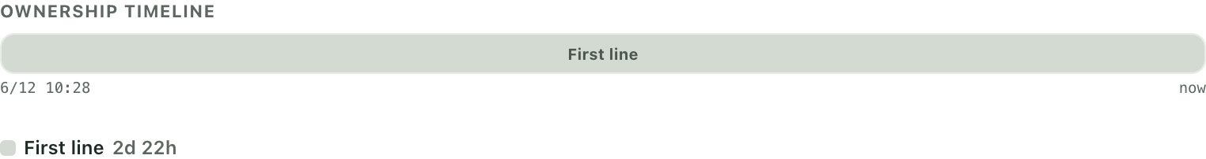
Two clocks — and a timeline of who held it
SLA clock = time on us (pauses when returned to the requester).
Core Team vs HQ time, tracked separately.
Ownership timeline shows exactly when a case sat with whom.
Answers "who's consuming the time?" at a glance.
Separated Core Team / HQ clocks
Ownership timeline
Case Tracker · https://hltsai9.github.io/threenine/
7

Slide 9
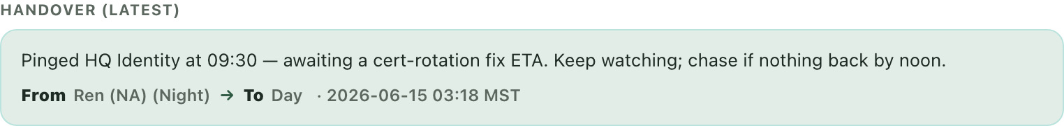
Handover, on the board
No separate screen, no lost context.
One structured note per case, labelled Day → Night.
Write it straight from the card (⚠ Note) or the reading panel.
A banner flags open cases that still need a fresh note before cutover.
Yellow = stale for the current shift and needs a rewrite.
Case Tracker · https://hltsai9.github.io/threenine/
8

Slide 10
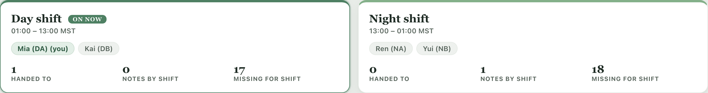
Shift coverage at a glance
Day / Night rosters, handover stats, and a "view as" perspective switch.
See who is on, what was handed over, and what still needs a note.
Switch the active operator to see exactly what they see.
Case Tracker · https://hltsai9.github.io/threenine/
9

Slide 11
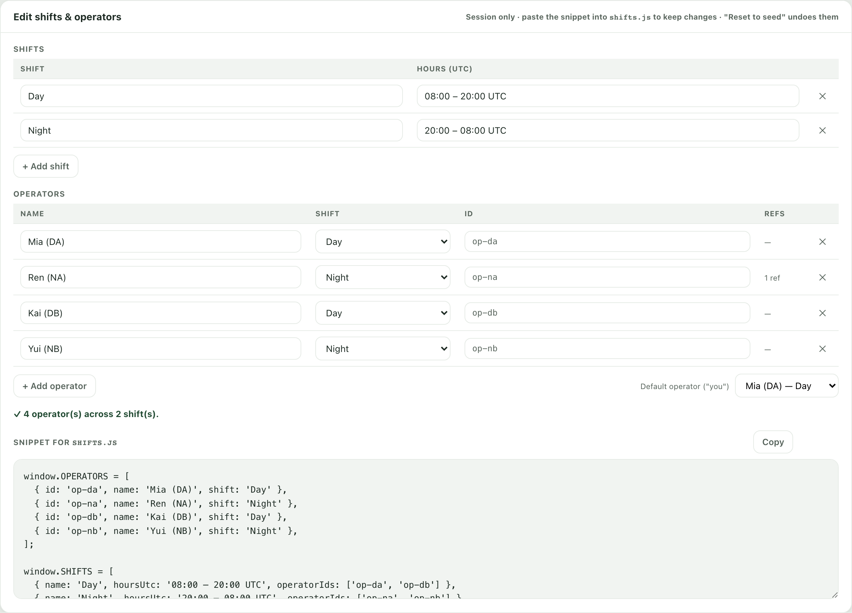
Manage your own roster
Add and edit operators right in the app.
Add/edit shifts and operators; IDs auto-suggest from names.
Foolproof delete: reassign an operator's records or block — never orphan data.
Can't delete the last operator; the default operator moves automatically.
Generates the shifts.js snippet to make changes permanent.
Case Tracker · https://hltsai9.github.io/threenine/
10

Slide 12
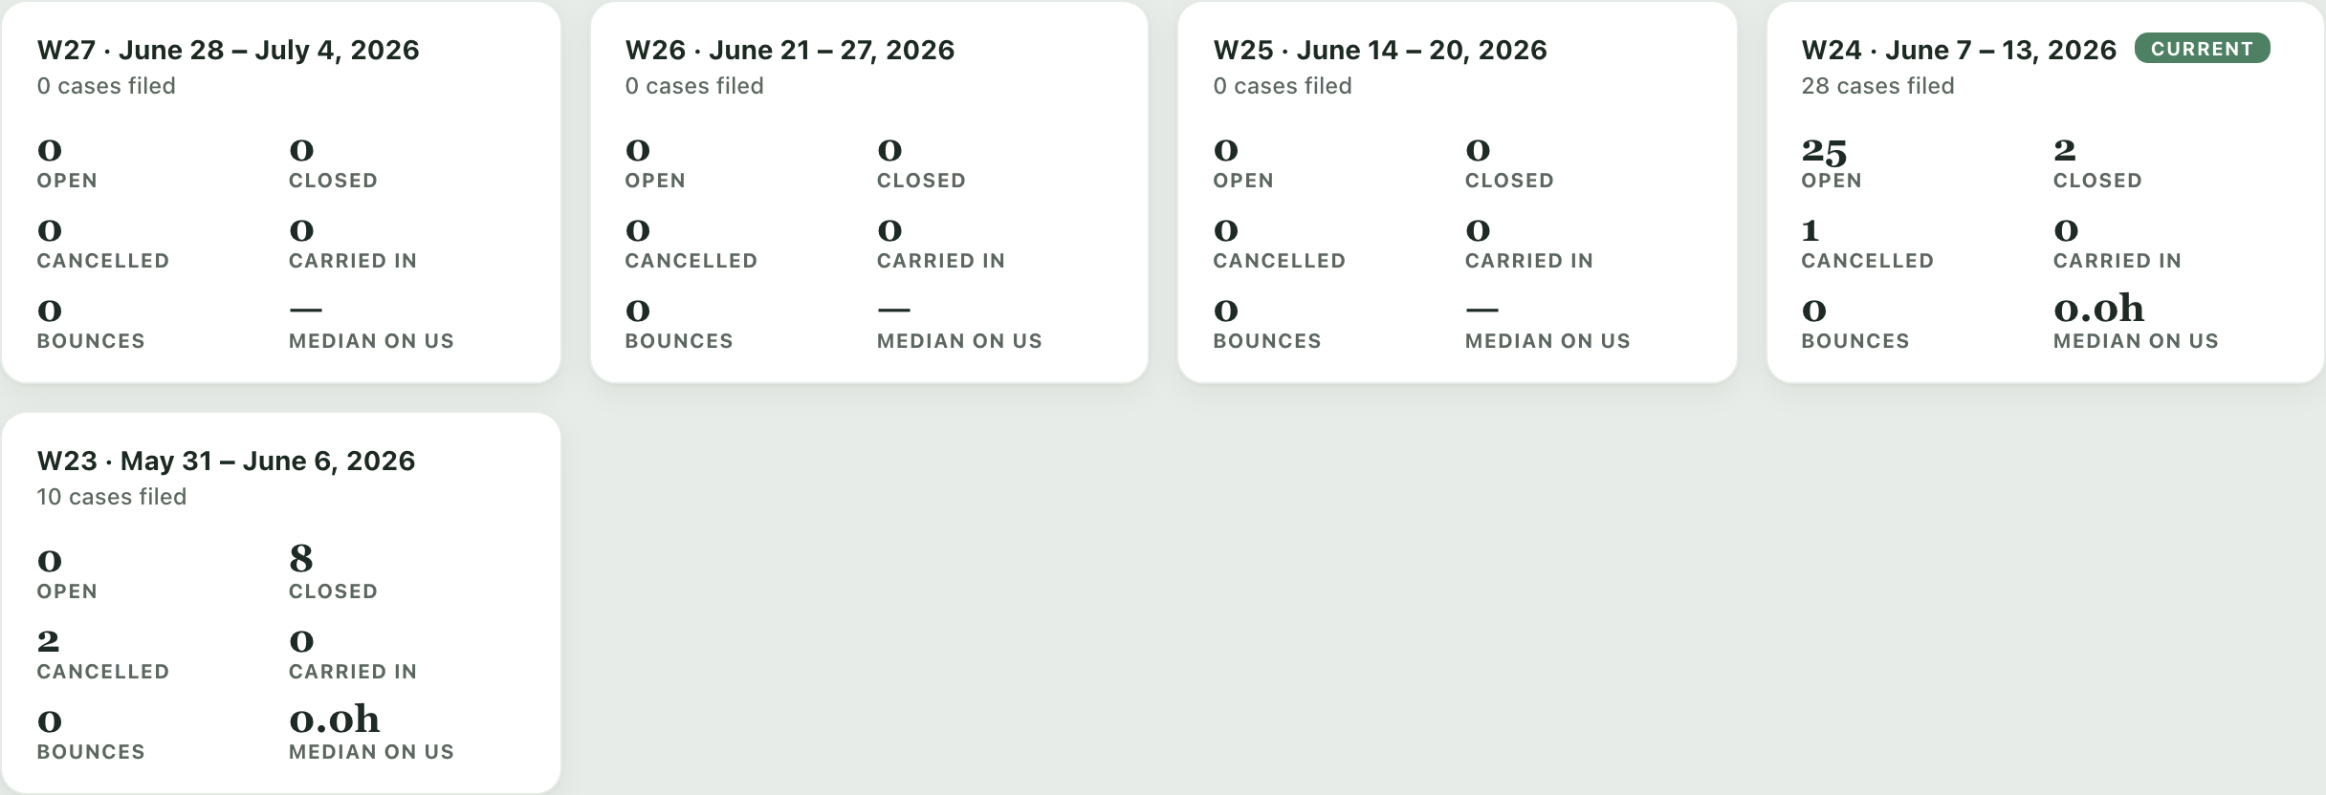
Reporting the workbook can't
Every week, automatically.
Per-week totals: opened, closed, cancelled, carried-in, bounces.
Median time-on-us — track whether you're getting faster.
Case Tracker · https://hltsai9.github.io/threenine/
11

Slide 13
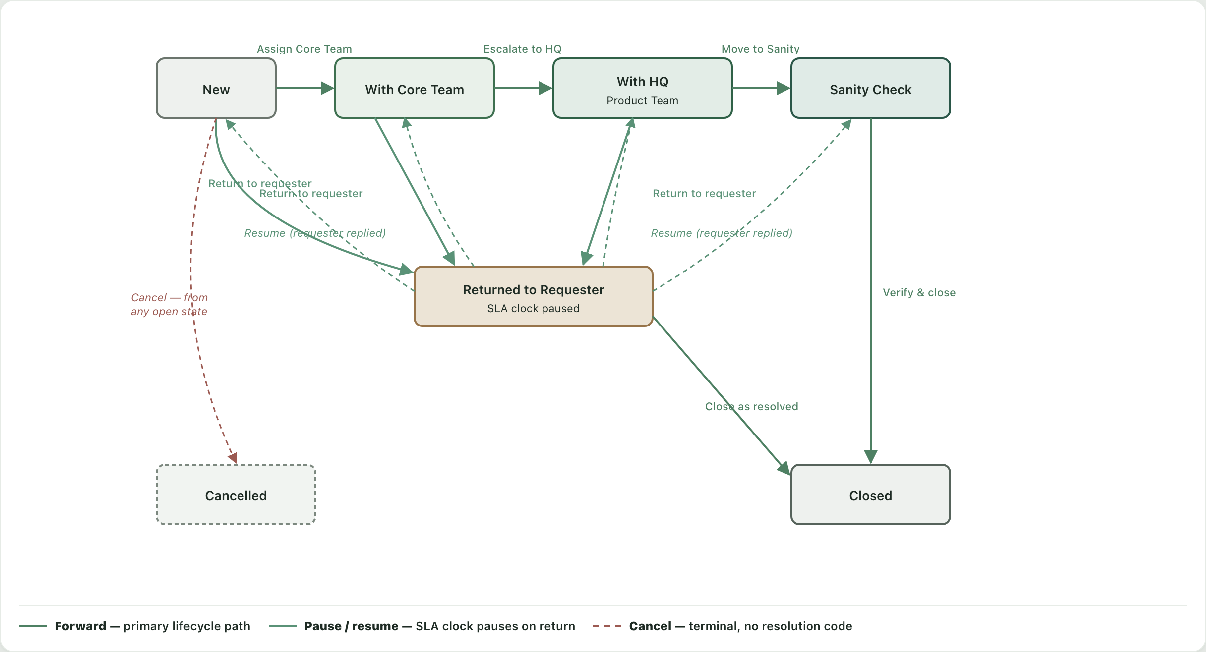
A clear, enforced lifecycle
New → Core Team → HQ → Sanity Check → Closed, with pause/return and escalation paths.
Case Tracker · https://hltsai9.github.io/threenine/
12

Slide 14
Why switch
Excel workbook
Case Tracker
Free-form cells
Remember what's next
No SLA / owner-time visibility
Verbal, unenforced handover
Manual, no reporting
Structured, validated data
A queue that tells you what's next
SLA + separated Core/HQ time + timeline
Enforced, auditable shift handover
Weekly dashboards · live Case Center sync
Shared across operators · PostgreSQL-backed · deployable (Render or your own server)
Case Tracker · https://hltsai9.github.io/threenine/
13

Slide 15
Deploy it for your team
From single-laptop demo to a shared, always-on board.
PostgreSQL-backed: every operator signs in and sees the same live board, from any device.
Secured: a token login gate in front of the API — case data is never left wide open.
Periodic Case Center sync: a scheduled job pulls new cases into the DB automatically (systemd timer / cron).
Host it your way: your own Ubuntu server, or a managed platform like Render.
Case Center
Ingest (timer)
PostgreSQL
API + SPA
Operators
Step-by-step self-host runbook: docs/SELF-HOST-UBUNTU.md
Case Tracker · https://hltsai9.github.io/threenine/
14

Slide 16
What it runs on
A Python web service + PostgreSQL. Node is build-time only — never needed to run the site.
🌐
Front end — the web app Plain HTML / CSS / vanilla JavaScript. No framework, no Node in the browser; just static files.
🐍
Back end — web server + API Python · FastAPI · uvicorn. Serves the app and the /api endpoints from one origin.
🐘
Database PostgreSQL — one shared, live board for every operator and device.
⏱️
Data sync A scheduled Python job pulls from Case Center on a timer (systemd / cron).
🔒 Optional: nginx + HTTPS in front. 🧰 Node.js is build-time only (bundler · tests · this deck) — the running site needs only Python + PostgreSQL.
Case Tracker · https://hltsai9.github.io/threenine/
15

Slide 17
See it. Deploy it.
https://hltsai9.github.io/threenine/
Try the live demo — open the link and take the built-in guided tour.
Deploy for your team — Postgres + token login + periodic Case Center sync, on Render or your own Ubuntu server.
Step-by-step runbook: docs/SELF-HOST-UBUNTU.md. Feedback welcome — it's a working tool, not a mockup.

