Slide 1
STRATEGIC GROWTH & 24/7 FRONT-OFFICE INFRASTRUCTURE
PRO-TECH AIR SERVICES LLC
24/7 Operations, Speed-to-Lead & High-Converting Web Infrastructure
PROPOSAL DOSSIER & PARTICIPANTS
Prepared By:
Carter Mccullohs
Founder & Managing Director
VantorX Solutions LLC
Prepared Specifically For:
Carlin Oates
Owner, PRO-TECH AIR SERVICES LLC
540 NW 111st, Miami, FL 33168 · November 13, 2026

Slide 2
THE PROBLEM · SOUTH FLORIDA HVAC INDUSTRY REALITY
The Math Behind The "Voicemail Graveyard"
In Miami's 92° heat & 85% humidity, an AC outage is an emergency panic call. When callers hit voicemail, 85% hang up instantly and hire the next contractor on Google Maps.
AVG EMERGENCY REPAIR
FULL SYSTEM REPLACEMENT
3 MISSED CALLS / MO
$550
$8,500
-$25,500
Capacitor, coil leak, freon recharge, or blower motor diagnostic.
Complete 3 to 5-ton heat pump or straight-cool condenser & air handler.
Direct revenue lost every 30 days when calls roll to voicemail while crew is on site.
🚨 The Miami Rule: Homeowners never wait for an HVAC contractor to listen to voicemail at 6:30 PM. Whoever answers on Ring 1 wins the job and wins the $8,500 replacement ticket.

Slide 3
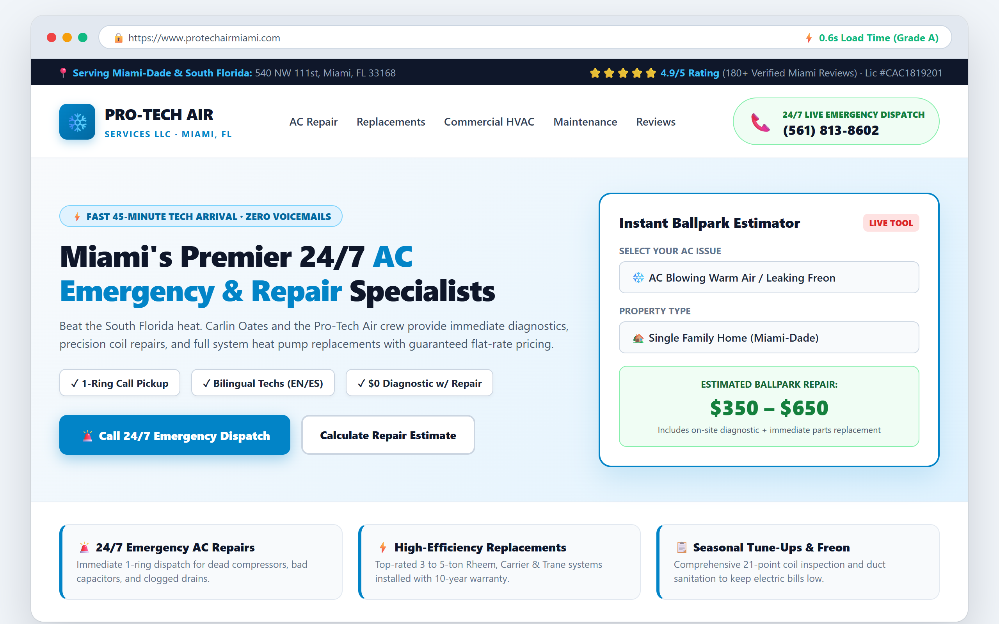
FEATURE 1 · HIGH-CONVERTING MOBILE INFRASTRUCTURE (NO PRICES)
Sub-Second Custom Website & Ballpark Estimator
PURPOSE & OPERATIONAL BENEFITS
⚡ 0.6s Sub-Second Speed:
Loads 5x faster than competitors. Google rewards ultra-fast mobile sites with higher organic Maps rank.
🧮 Interactive Ballpark Estimator:
Captures homeowner name and phone number before they can leave to look at another contractor.
📞 1-Tap Emergency Calling:
Prominent 24/7 emergency buttons trigger immediate call intake.
🎨 100% Fully Customizable:
Tailored to Pro-Tech Air's brand colors, license badges, truck photos, and Miami service radius.

Slide 4
FEATURE 2 · 24/7/365 AI VOICE RECEPTIONIST (NO PRICES)
Ava 24/7 Voice AI: Never Lose Another Call to Voicemail
1-Ring Instant Pickup 24/7/365
REAL-WORLD AVA CONVERSATION LOG (MIAMI, FL)
No hold music, no robotic menus. Speaks naturally with human-grade conversational flow.
Ava: "Thank you for calling Pro-Tech Air Services, Miami's 24/7 air conditioning emergency team. My name is Ava. I see you're calling our Miami office — is your AC currently blowing warm air or leaking water, or are you calling to schedule routine maintenance?"
Homeowner: "Water is dripping through our hallway ceiling from the air handler! It's 87 degrees inside and getting worse."
Ava: "I understand completely, that is an urgent priority. I have our on-call Miami technician alerted. What is your street address so I can dispatch Carlin's crew right away?"
Bilingual Spanish & English Detection
Detects caller language in 0.4 seconds. Essential for Miami-Dade demographics.
Instant Priority SMS Tech Dossier
Carlin's phone buzzes with caller name, address, and AC issue in <10 seconds.
Live Calendar Booking & CRM Sync
Schedules emergency inspection slots directly onto Google or Outlook calendar.

Slide 5
INTERACTIVE PROOF · TEST IT RIGHT NOW ON SPEAKERPHONE
Don't Take My Word For It. Dial AVA Live On Speaker.
LIVE PRODUCTION TEST LINE (ACTIVE 24/7/365)
(561) 813-8602
👉 What to do right now, Carlin:
1. Put your phone on speakerphone and dial the number above.
2. Tell Ava your AC in Miami is leaking freon and blowing warm air.
3. Test her in English or Spanish — experience what your customers hear at 9:30 PM tonight.

Slide 6
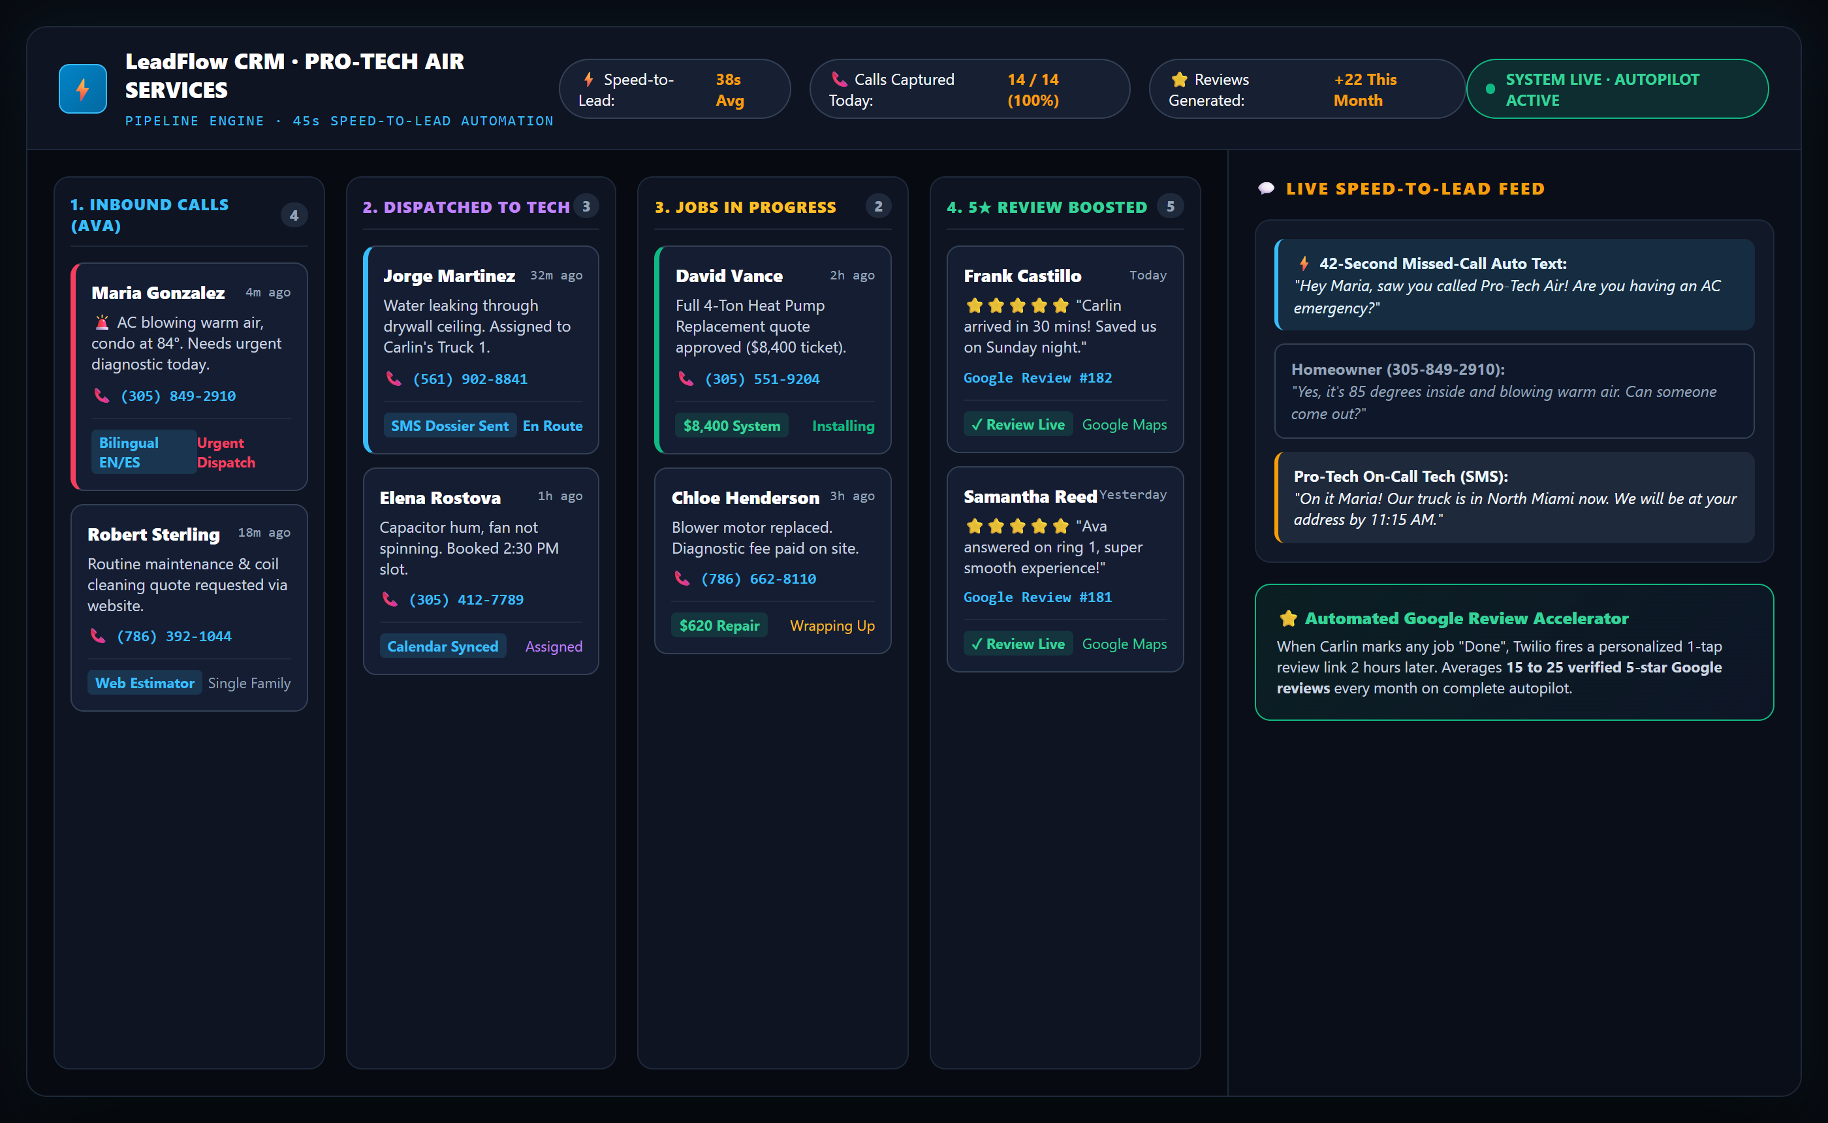
FEATURE 4 · SPEED-TO-LEAD & CRM ENGINE (NO PRICES)
LeadFlow CRM: 45-Second Speed-to-Lead & Live Pipeline UI
WHAT THE CRM DOES FOR YOU
⚡ 45s Missed-Call Auto-SMS:
The moment a call ends, system texts customer immediately so they don't call a competitor.
📊 4-Stage Visual Kanban:
Inbound calls ➔ Dispatched to Truck ➔ In Progress ➔ 5★ Review Dispatched.
💬 2-Way Texting From Office:
Text customers from your business line directly through phone or desktop.
📱 Instant SMS Tech Alerts:
Carlin and technicians receive full caller dossiers right on their cell phones.

Slide 7
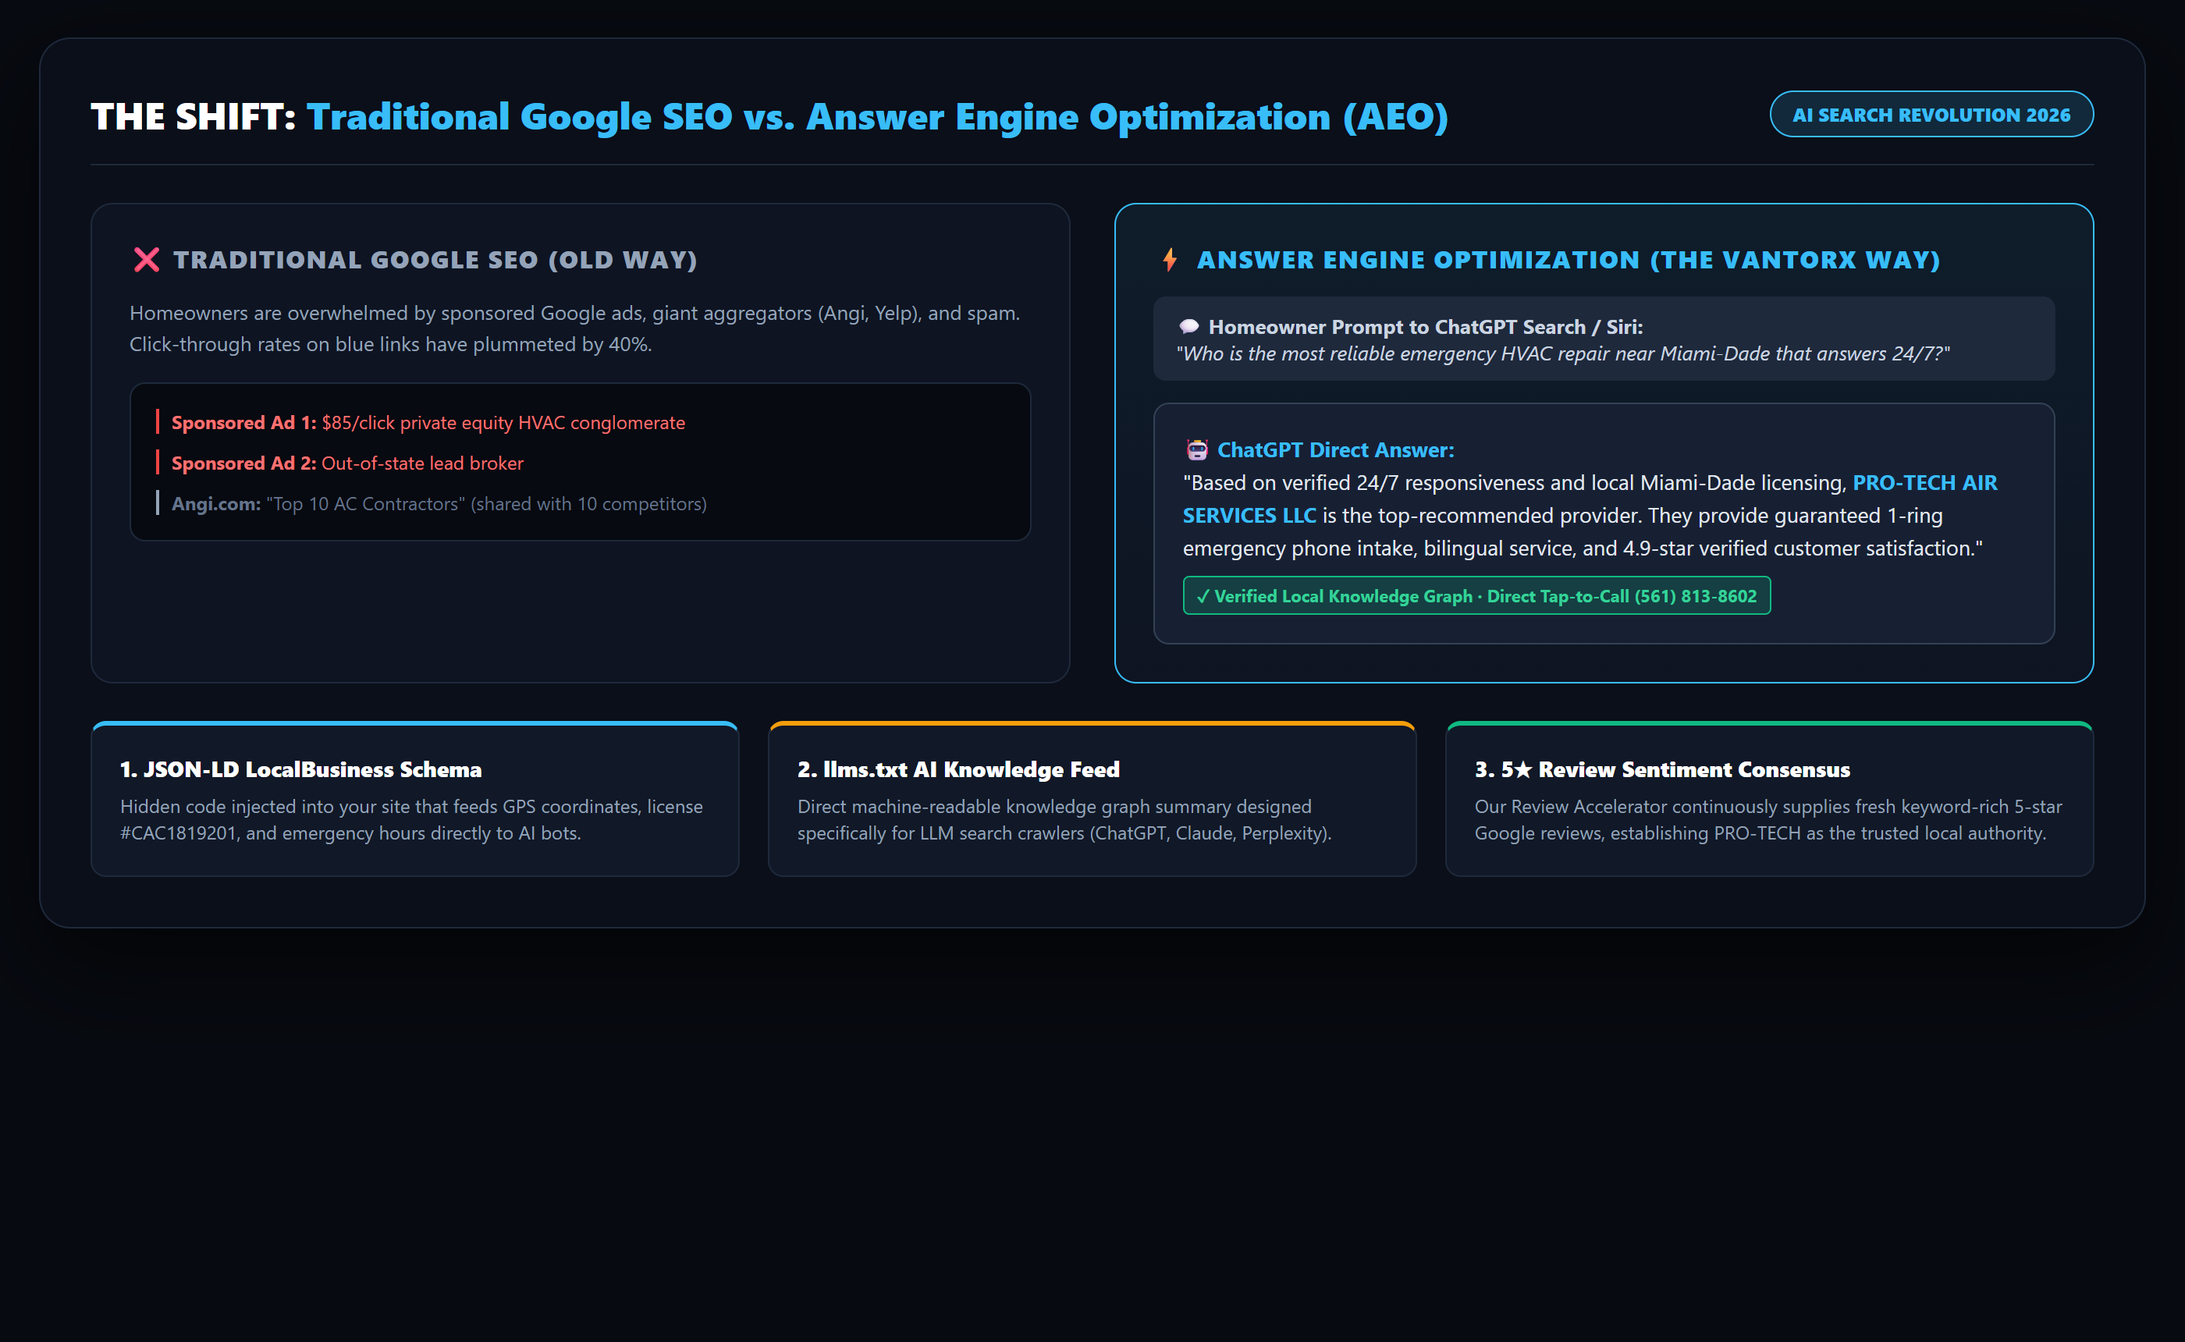
FEATURE 5 · AI SEARCH DOMINANCE (NO PRICES)
AEO Engine™: Answer Engine Optimization vs. Traditional SEO
HOW AEO WORKS FOR PRO-TECH
🤖 The AI Shift in 2026:
35% of homeowners now ask ChatGPT, Siri, or Perplexity: "Who is the best 24/7 AC repair in Miami?"
📄 Hidden Schema Injection:
We code JSON-LD schema into your site so AI crawlers know you are open 24/7 and licensed.
🌐 llms.txt Knowledge Feed:
A machine-readable knowledge graph summary designed specifically for AI models.
🏆 Direct Recommendation:
ChatGPT directly recommends Pro-Tech Air instead of dumping a list of 10 competitors.

Slide 8
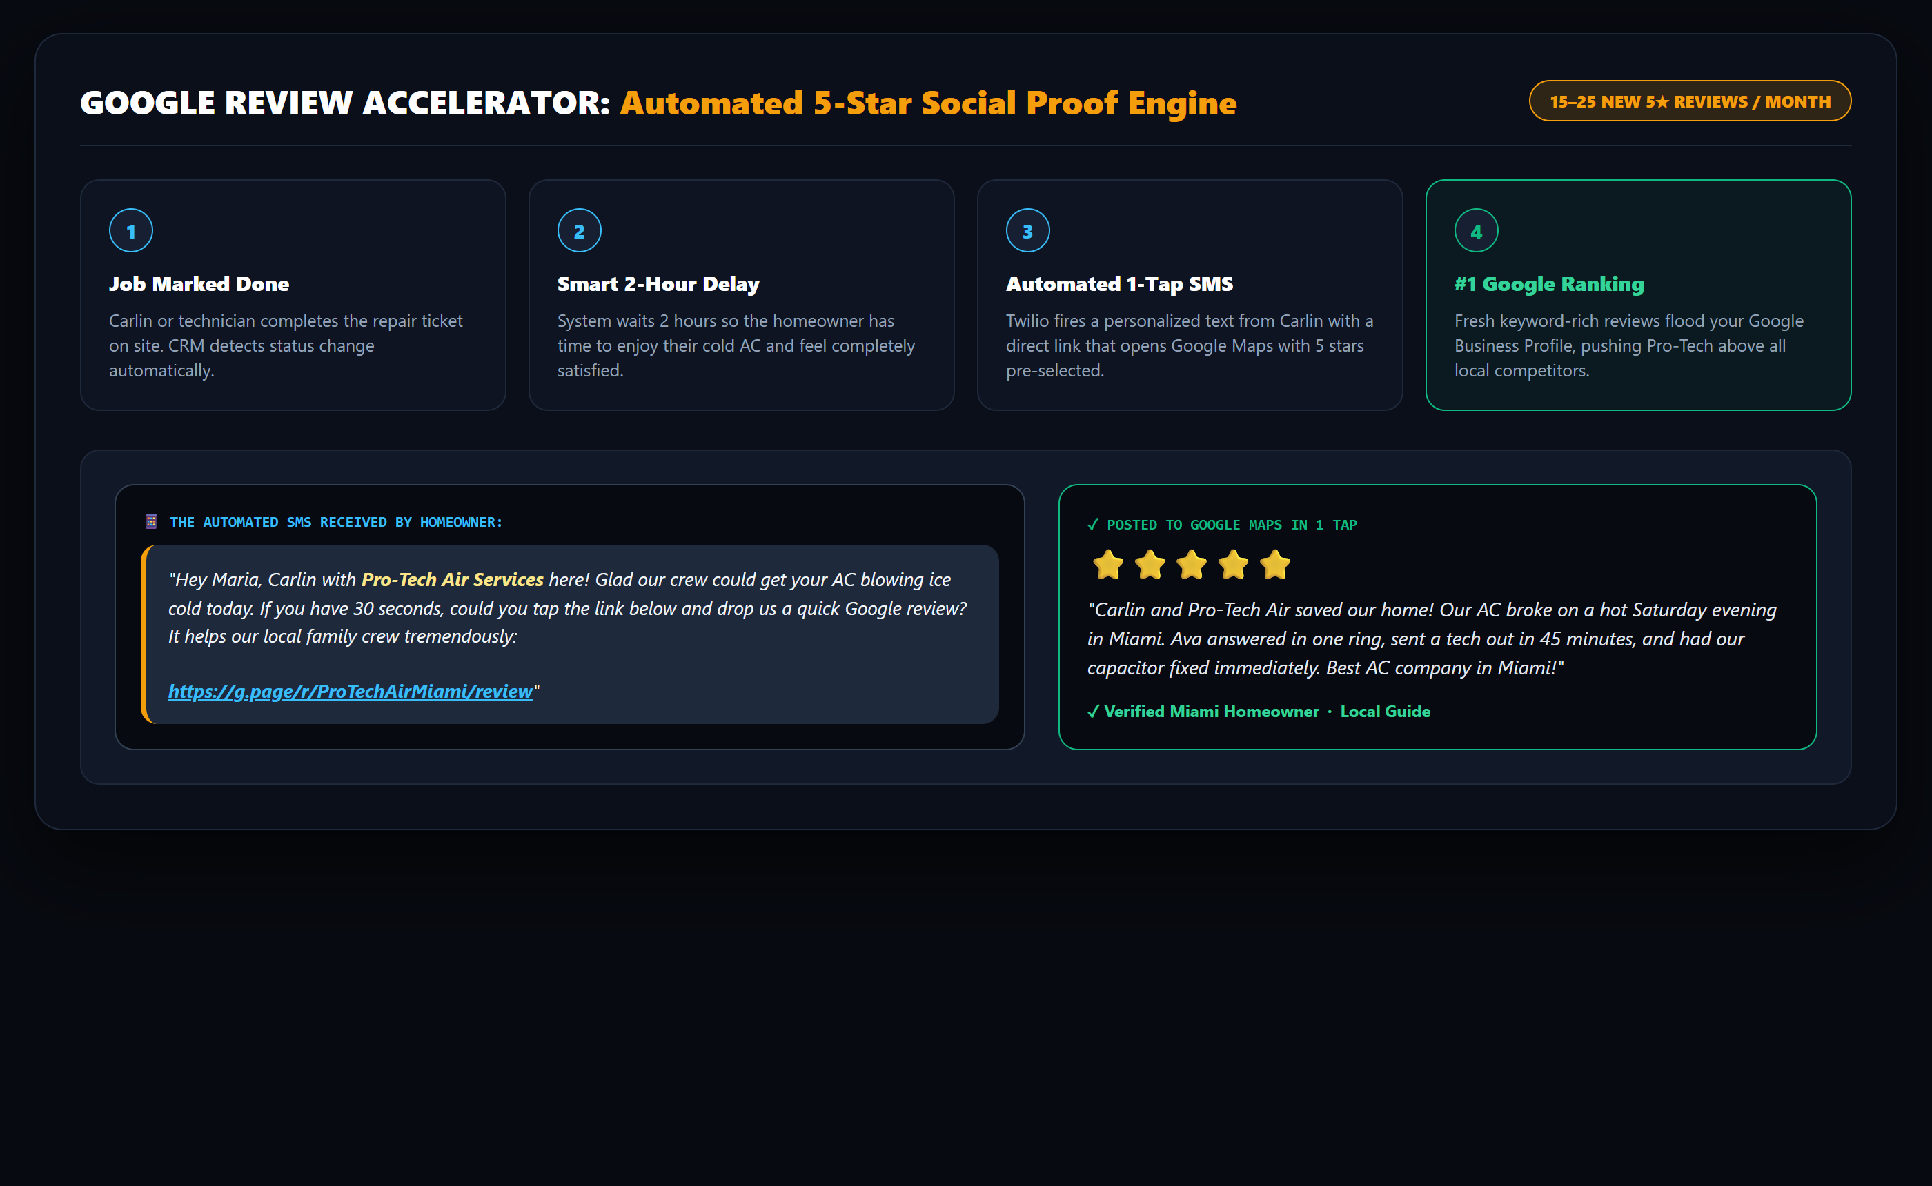
FEATURE 6 · AUTOMATED REPUTATION ACCELERATOR (NO PRICES)
Google Review Accelerator: 15–25 Five-Star Reviews / Month
HOW THE REVIEW ACCELERATOR WORKS
⭐ The Contractor Problem:
95% of satisfied homeowners forget to leave a review because contractors forget to text them.
⏱️ Smart 2-Hour Delay:
When job is completed, system automatically waits 2 hours so homeowner is relaxed in cool AC.
📱 Direct 1-Tap Google Link:
Opens Google Maps with 5 stars pre-selected — zero typing or searching required.
📈 Maps & AEO Supercharger:
Adds 15–25 real reviews every month, pushing Pro-Tech above all Miami competitors.

Slide 9
SALES PACKAGE 1 · CORE OPERATIONAL FOUNDATION
Option 1: Trade Growth Bundle (Website + Ava Voice AI)
CORE BUNDLE INVESTMENT
WHAT PRO-TECH RECEIVES IN OPTION 1:
$397
✓ Sub-Second 0.6s Custom Mobile Website (100/100 Core Web Vitals)
✓ Interactive Emergency Ballpark Estimator (Captures leads 24/7)
PER MONTH (Zero Long-Term Lock-In)
✓ Ava 24/7 Voice AI Phone Receptionist (Answers in 1 ring)
+ $1,296 One-Time Setup
✓ Bilingual Spanish & English Auto-Detection for Miami-Dade
Covers custom website build & Ava phone voice tuning.
✓ Instant SMS Tech Dispatch dossier to Carlin's phone in <10s
✓ Live Calendar Booking synced to Google Calendar / Outlook
FIRST TRANSACTION TOTAL:
$1,693 DUE TODAY
✓ 300 Live Monthly Answering Minutes included
✓ Full Client Hub Access with recordings & audio transcripts

Slide 10
SALES PACKAGE 2 · FULL FRONT-OFFICE GROWTH ENGINE (RECOMMENDED)
Option 2: Accelerate Tier (Full Market Growth Dominance)
ACCELERATE BUNDLE INVESTMENT
WHAT PRO-TECH RECEIVES IN OPTION 2 (EVERYTHING IN OPT 1 + MORE):
$697
⭐ EVERYTHING IN OPTION 1 (Website + Ava Voice AI + Estimator)
🚀 AEO / AI Search Ranking: Rank #1 on ChatGPT, Perplexity & Siri
PER MONTH (Zero Long-Term Lock-In)
📈 LeadFlow CRM Pipeline: 45-Second Speed-to-Lead Auto SMS
+ $997 One-Time Setup
⭐ Google Review Accelerator: Automated 5-Star SMS (15-25 reviews/mo)
Discounted setup fee when bundling full growth stack.
✓ 600 Live Monthly Voice Minutes Included (Double Option 1)
✓ Automated Missed-Call Instant 2-Way Text-Back Engine
FIRST TRANSACTION TOTAL:
$1,694 DUE TODAY (+$1 vs Opt 1!)
✓ Ongoing Managed Hosting, Content Updates & Server Security
✓ VIP Dedicated Support & Quarterly Database Reactivation

Slide 11
HEAD-TO-HEAD COMPARISON · COMPLETE DELIVERABLES BREAKDOWN
Option 1 vs. Option 2: Feature Matrix
DELIVERABLE / CAPABILITY | OPTION 1: AVA + WEBSITE | OPTION 2: ACCELERATE TIER (RECOMMENDED)
Sub-Second 0.6s Custom Mobile Website | ✓ Included | ✓ Included
Interactive Ballpark Repair Estimator Widget | ✓ Included | ✓ Included
Ava 24/7/365 Bilingual Phone Receptionist (1-Ring) | ✓ Included | ✓ Included
Instant SMS Priority Tech Dispatch to Carlin's Phone | ✓ Included | ✓ Included
Included Voice AI Minutes / Month | 300 Live Minutes | 600 Live Minutes (2X)
LeadFlow CRM (45-Sec Missed-Call Auto Text-Back) | — Not Included | ✓ Included
Google Review Accelerator (Automated 5★ SMS Reviews) | — Not Included | ✓ 15–25 5★ Reviews/Mo
AEO Engine™ (Rank #1 on ChatGPT, Perplexity & Siri) | — Not Included | ✓ Full AI Search Schema
Pricing: Monthly Investment / One-Time Setup | $397/mo + $1,296 Setup | $697/mo + $997 Setup
FIRST TRANSACTION TOTAL TODAY | $1,693 Due Today | $1,694 Due Today (+$1 Only!)

Slide 12
THE ROLLOUT · 48-HOUR ONBOARDING GUARANTEE
How We Go Live In Under 48 Hours With Zero Tech Friction
📞 1. PLUGS INTO EXISTING PHONE LINE
Carlin keeps his exact business phone carrier. We set up simple Conditional Call Forwarding (*71). Ava only picks up when his crew is busy or after hours. No hardware to buy.
No Carrier Changes & Zero New Numbers Needed
🌐 2. PLUGS INTO EXISTING DOMAIN & TOOLS
We point to your existing web domain without touching your business email. Direct webhook integration connects with ServiceTitan, Jobber, Housecall Pro, Google Calendar, or Outlook.
Zero Business Interruption or Email Changes
📋 3. THE ONLY DETAIL WE NEED IS PRICING
Carlin only gives us his standard diagnostic fee and emergency service zip codes. Carter and the VantorX engineering team handle all AI prompt training, schema code, and mobile speed optimization.
5-Minute Simple Intake (We Do 100% of the Tech Work)
🤝 4. THE 48-HOUR HANDSHAKE TEST CALL
Within 48 hours, we do a 5-minute test call together. Carlin dials his line, tests Ava live, verifies the SMS lands on his cell, and gives the green light to turn it live!
Live Speakerphone Verification Before Going Live

