Slide 1
Exploring Issues in Set Based Partitioning from Last-level Cache
Group Member 1:
Hanumat Lal Vishwakarma
2021CSM1019
Group Member 2:
Rahul Verma
2021CSM1004

Slide 2
Introduction to Partitioning
Need of partitioning
-for multi-core systems
-without partitioning(no benefit of principle of locality, security issues)
Two type of partitioning
-Way-based partitioning(Traditional)
-Set-based partitioning(New era/transition)

Slide 3
Problem in dynamic Way-partitioning
Security(*our motivation)
-CCA attack is possible
Scalibility(*our motivation)
-for LLC with 4096sets+16ways,max 16 partition is possible(1 way to each partition).
Various other issues
Now, explore set-based partitioning(static & dynamic both) and challenges

Slide 4
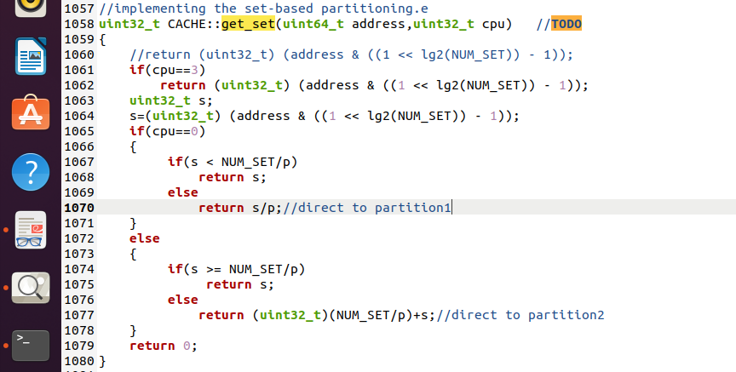
Implementation of static set-based partitioning

Slide 5
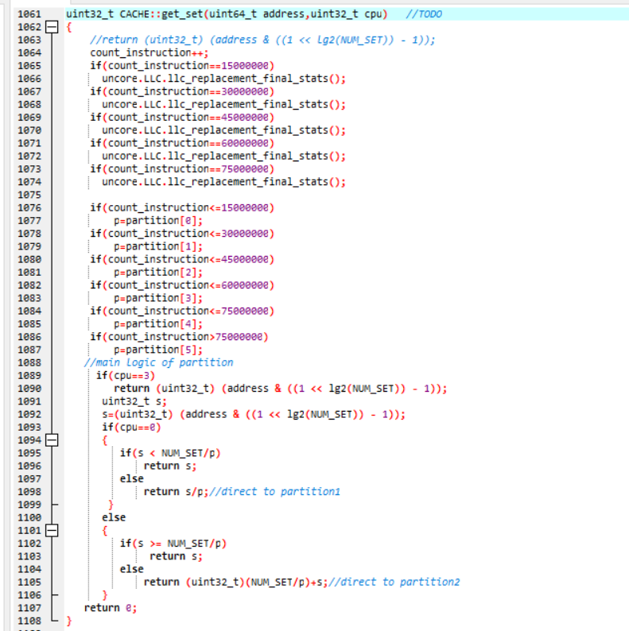
Implementation of Dynamic set based partitioning

Slide 6
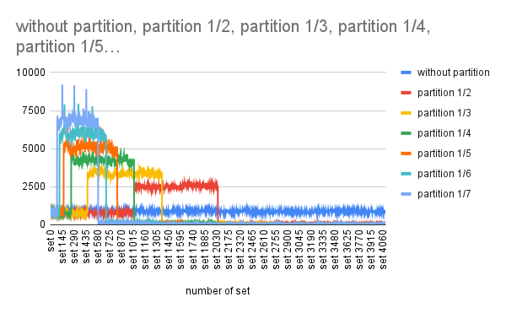

Slide 7
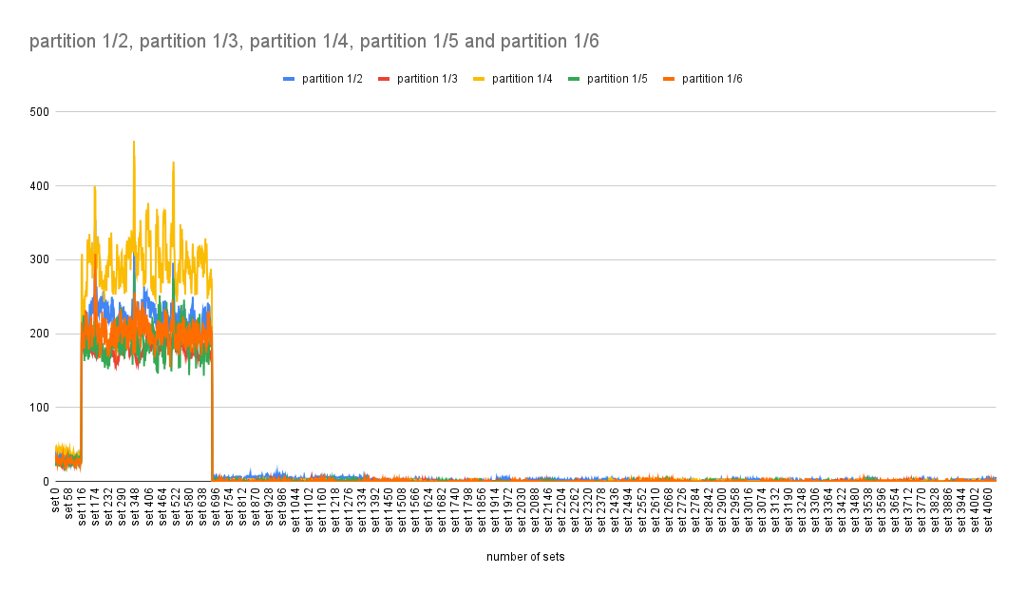

Slide 8
Different Issues observed in Set-based partitioning.
Load imbalances
-forcely divert the mapping to appropriate partition.
2. Write-back issue on changing partition dynamically.
-latency overhead on every change in partition.
3. Invalid blocks in each partition
-some utility based set-partitioning needed

Slide 9
Conclusion
Partition is needed in multi-core system.
More such issues in set-partitioning need to address.
These are the challenges which need to care of while implementing while implementing set based partitioning.
Set-partitioning provide security and scalability.
Load balancing need to be care of while implementing set-partitioning.

