Slide 1
UNIT-4 LIQUID PROPULSION SYSTEMS

Slide 2
CONTENTS
Classifications- Booster stage and upper stage rockets.
Hardware components and it’s functions.
Thrust chamber and its cooling
Injectors and its types
Propellant feed systems-Turbo pumps.
Cryogenic propulsion system
Special features of cryogenic systems.
Numerical problems.

Slide 3
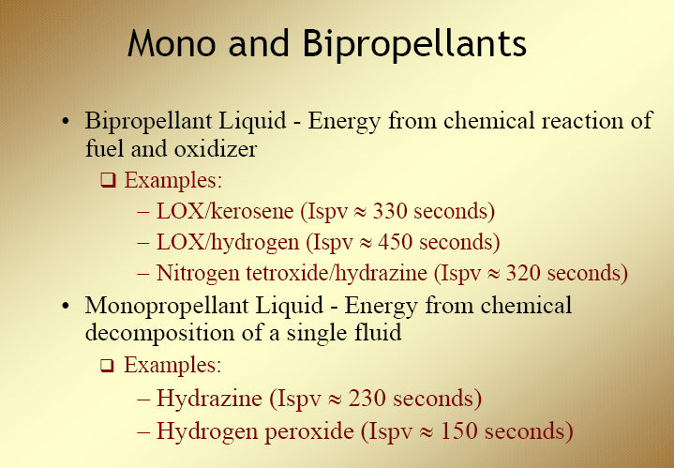

Slide 4
BOOSTER STAGE & UPPER STAGE SYSTEM
Booster stage
A booster rocket is the first stage of a multistage launch vehicle
Boosters are traditionally necessary to launch spacecraft into low Earth orbit, and are certainly necessary for a space vehicle to go beyond Earth orbit.
Upper stage rockets
An upper stage is designed to operate at high altitude, with little or no atmospheric pressure. This allows the use of lower pressure combustion chambers and engine nozzles with optimal expansion ratios.
The upper stages are usually tasked with completing orbital injection and accelerating payloads into higher energy orbits

Slide 5
BOOSTER STAGE & UPPER STAGE SYSTEM
General Categorization:
a) Booster stage system
b) Upper stage system
a)Booster Stage System
-Large volumes
-Pump-fed system
-Self supporting walls reinforced by skin stringers
-Independent designer
b)Upper Stage System
-Smaller volumes
-Pressure-fed system
-Waffle / Iso grid walls
-Most likely engine designer

Slide 6
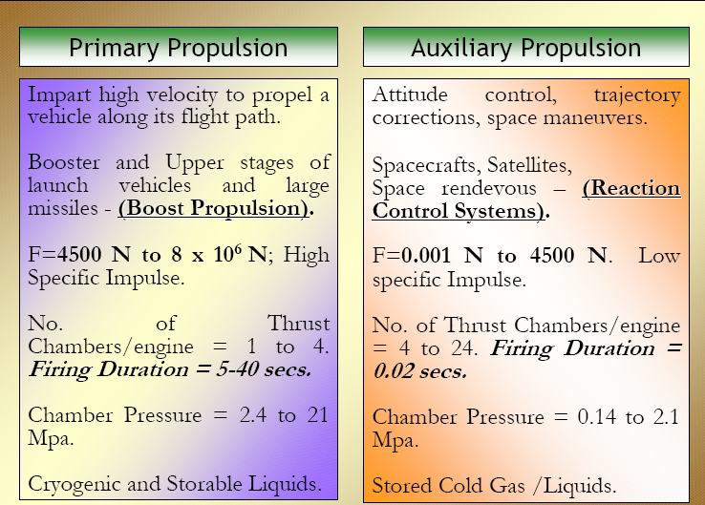

Slide 7
The Liquid Propellant Rocket
PARAMETER | CHARACTERISTIC VALUE RANGE
Specific Impulse [m/s] | 2500-3800
Burn Rate [mm/s] | N.A
Chamber Pressure [MPa] | 2-10
Combustion Efficiency [-] | 0.95-0.98
Thrust to Weight Ratio | Low
Throttle | Easy
Stop and Restart | Easy
Lifetime | Very Long (> 10 years)

Slide 8
Liquid Rocket Motor Components
Liquid Propulsion system consists of
Tanks
suitable plumbing or piping
Feed mechanism
Injector
Power source
Thrust chambers
Structure
Control devices

Slide 9
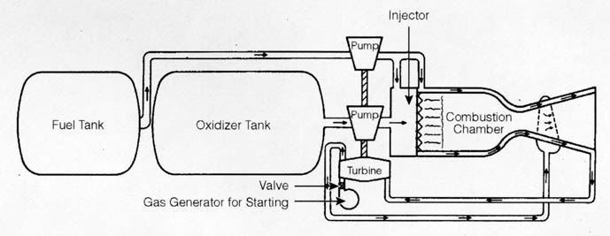
Liquid Propulsion System

Slide 10


Slide 11
Hardware components and its functions
Tanks→ one or more to store the propellants
suitable plumbing or piping→ to transfer the liquids
Feed mechanism→ to force the propellants from the tanks into the thrust chamber(s)
Power source→ to furnish the energy for the feed mechanism
Thrust chambers → one or more to burn propellant
Structure→ to transmit the thrust force and
Control devices→ to initiate and regulate the propellant flow and the thrust
In some applications an engine may also include a thrust vector control system.

Slide 12
Advantages and Disadvantages
Advantages
Disadvantages
They provide a relatively higher thrust than solid propellants
Thrust can be controlled.
Engine can be stopped or ignited at any time.
Used for short and medium range applications
Low signature plume
Liquid propellants are difficult to handle
It requires separate storage tanks.
They demand a complex engine with pumps and turbo-pump for combustion
Costly system
Complexity
Reduced reliability
High fuelling time

Slide 13
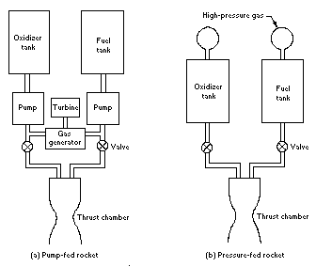
Pump Fed And Pressure Fed System

Slide 14
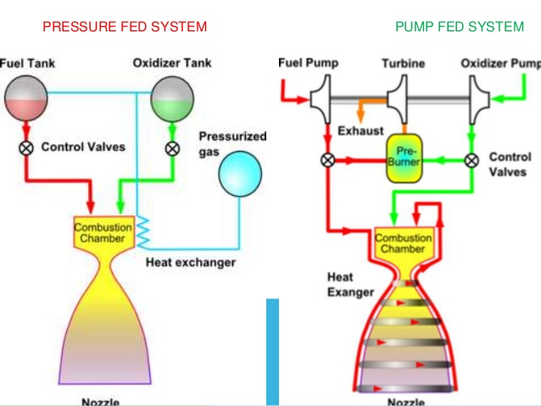
PRESSURE & PUMP FED SYSTEM

Slide 15
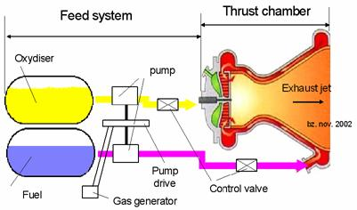
PUMP FED SYSTEM

Slide 16
Pump fed system
Used in high thrust engines requiring high propellant flow rate
Larger pressurant flow rate & larger tank volume make tank weight highly non-optimal
Tank pressures are kept at low pressure levels just sufficient enough to meet the requirements of pumps (0.4-0.5 MPa)
Classified into either open or closed system depending on the way the power is supplied to turbine and how the energy of the working fluid is dumped from turbine exhaust.

Slide 17
Open Cycle & Closed Cycle
Open cycle:
Turbine exhaust is directly discharged in a separate nozzle or into main thrust chamber nozzle at some point near exit where pressure levels are compatible.
Closed cycle:
Partially burnt turbine gas is introduced into main thrust chamber for complete burning. Very effective due to maximum energy conversion of propellants and therefore a complex system.

Slide 18
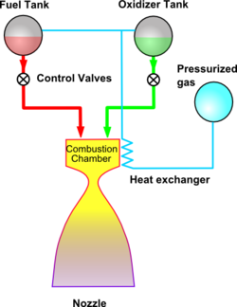
PRESSURE FED SYSTEM

Slide 19
Pressure –fed system
Pressurant gas is used- Inert Gas
Tank pressure higher than engine chamber pressure
Flow rate governed by feed line resistance
For higher engine thrusts above 220 kN, not effective
Stored gas system
High pressure storage gas bottles are used
Pressure & flow rate are regulated for a specified tank pressure
Helium gas is the most common gas

Slide 20

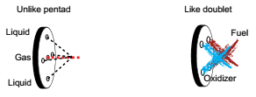

Slide 21
Functions Of Injector
The injector has to fulfil three functions:
it should ensure that the fuel and oxidiser enter the chamber in a fine spray, so that evaporation is fast;
it should enable rapid mixing of the fuel and oxidiser, in the liquid or gaseous phase and
it should deliver the propellants to the chamber at high pressure, with a high flow rate.

