Slide 1
ADVANCED PROPULSION SYSTEMS

Slide 2
Classification
Advanced Propulsion System
Electrical
Solar
Electro-thermal
Electro-static
Electro-magnetic
Nuclear

Slide 3
Electric Propulsion System
The basic operating principle behind the operation of an electric propulsion system is the
creation,
acceleration, and
expulsion of charged particles,
using primarily electricity to accomplish said functions.
Electric thrusters have significant advantages-extremely high specific impulse ranges.
A contrasting drawback with the electric propulsion system is extremely low thrust ranges generated.

Slide 4
Electric Propulsion
Features:
High exhaust speed (i.e. high specific impulse), much greater than in conventional (chemical) rockets
Much less propellant consumption (much higher efficiency in the fuel utilization)
Continuous propulsion: apply a smaller thrust for a longer time
Mission flexibility (Interplanetary travel, defense)
Endurance (commercial satellites)

Slide 5
TYPES OF ELECTRIC PROPULSION
Electrothermal
Propellant is electrically heated through wall (resistojet) or by electrical arc discharge (arcjet)
Electrostatic
Charged particles (ions) accelerated by electrostatic forces (Ion, Hall Effect thrusters)
Electromagnetic
Electrically conducting fluid accelerated by electromagnetic and pressure forces (Magnetoplasma dynamic Thruster ,pulsed plasma thrusters (MPD, PPT))

Slide 6
ELECTRO-THERMAL PROPULSION
Electrical power is used to add energy to exhaust products

Slide 7
Electromagnetic and electrostatic systems propel charged ions through the use of electric and magnetic fields, while electro-thermal systems heat the propellant, and rely upon thermal dynamics to propel the system
In typical operation, a propellant is electrically heated, which increases the pressure and expands the gas, forcing the energized mass out of the nozzle and providing thrust to the spacecraft

Slide 8
ARCJET
Arcjet
High voltage arc at nozzle throat adds thermal energy to exhaust
Various gaseous or vaporized propellants can be used.

Slide 9
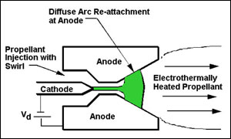
ARCJET

Slide 10
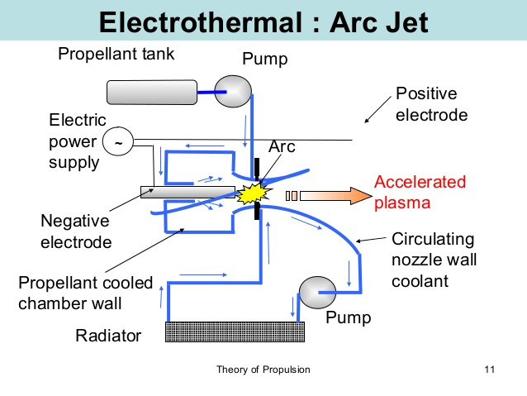

Slide 11
RESISTO JET
Resistojet
Catalytic decomposition of hydrazine is augmented with high power electric heater
800 – 5,000 W

Slide 12
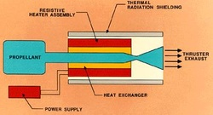
RESISTOJET

Slide 13
ELECTRO-STATIC PROPULSION
The production of ions for acceleration is achieved by
conventional electron bombardment method
electron cyclotron resonance method, which electrically charges atoms from an onboard fuel supply
This fuel supply is an inert gas, often xenon or krypton, which is injected into the ionization chamber then expelled for propulsion
Electrostatic thrusters provide relatively large Isp values, ranging from 1,000 to approximately 10,000 sec, and also have relatively high efficiencies ranging between 55% - 98%
Electrostatic thrusters produce minimal thrust relative to alternative propulsion methods

Slide 14
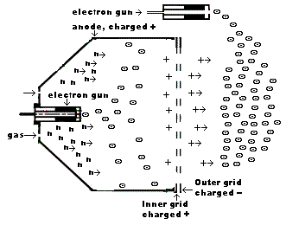
Ion Engine Diagram

Slide 15
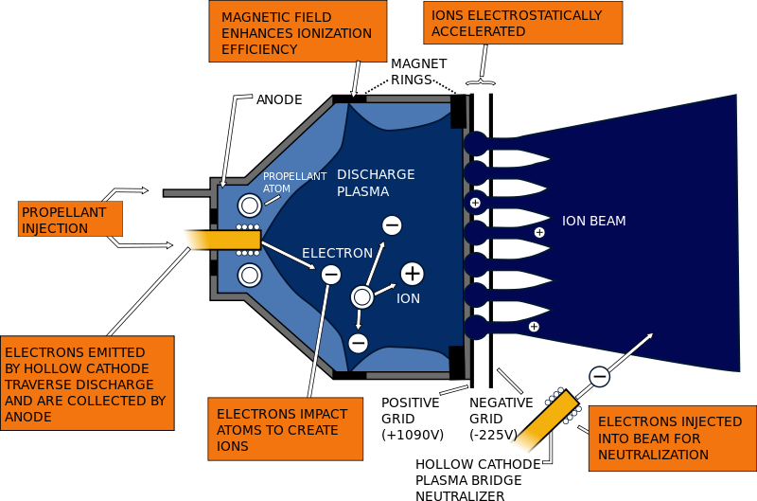
ION THRUSTER

Slide 16
ION THRUSTER
Gridded electrostatic ion thrusters commonly utilize xenon gas.
This gas has no charge and is ionized by bombarding it with energetic electrons.
These electrons can be provided from a hot cathode filament and when accelerated in the electrical field of the cathode.
The positively charged ions are extracted by an extraction system consisting of 2 or 3 multi-aperture grids.
After entering the grid system via the plasma sheath the ions are accelerated due to the potential difference between the first and second grid to the final ion energy of typically 1–2 keV, thereby generating the thrust.
Ion thrusters emit a beam of positive charged xenon ions only.
To avoid charging up the spacecraft, another cathode is placed near the engine, which emits electrons into the ion beam.
This also prevents the beam of ions from returning to the spacecraft and cancelling the thrust.

Slide 17
V=V₀
x=0
Electric field
E=dV/dx
V=0
X=L
V_{J}
Ion stream
Ion source
Accelerating grid

Slide 18
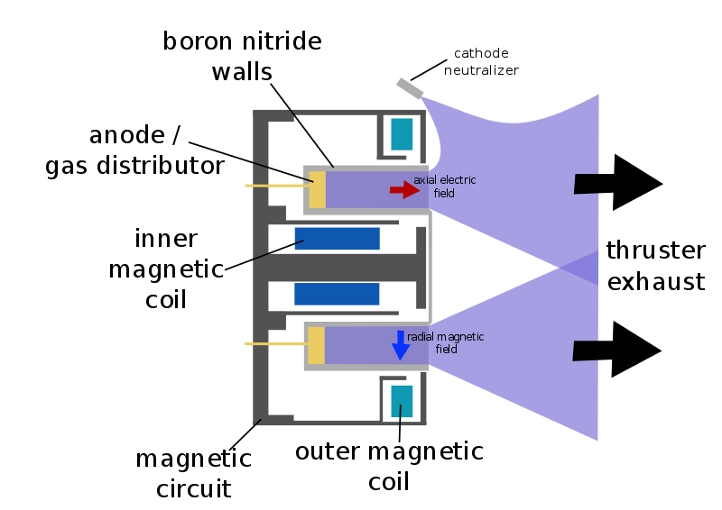
HALL EFFECT THRUSTER

Slide 19
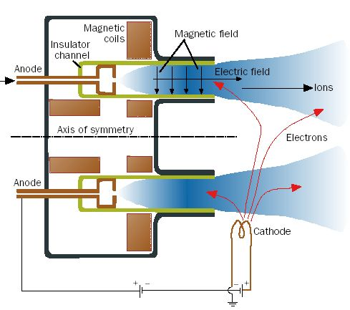
HALL THRUSTER

Slide 20
HALL THRUSTER
Electromagnets around the outside cylinder and inside core create a magnetic field pointing radially inward.
The interplay of this magnetic field and the electric field between the anode propellant injectors and the electron cloud created outside of the thruster causes a current called the Hall current, to be induced to flow azimuthally around the open annulus in the thruster.
The magnetic field pushes on the current and accelerates it out of the thruster to create thrust.

Slide 21
HALL THRUSTER
It uses an electrostatic potential to accelerate ions up to high speeds.
In a Hall thruster the negative charge is provided by an electron plasma at the open end of the thruster instead of a grid.
A radial magnetic field of about 100–300 G (0.01–0.03 T) is used to confine the electrons, where the combination of the radial magnetic field and axial electric field cause the electrons to drift in and forming the Hall current.
An electric potential between 150 and 800 volts is applied between the anode and cathode.
The central spike forms one pole of an electromagnet and is surrounded by an annular space, and around that is the other pole of the electromagnet, with a radial magnetic field in between.

Slide 22
HALL THRUSTER
The propellant is fed through the anode, which has numerous small holes in it.
Xenon propellant is used because of its high atomic weight and low ionization potential.
Gas is ionized by collisions with circulating high-energy electrons (typically 10–40 eV).
The Xenon ions are then accelerated by the electric field between the anode and the cathode.
For discharge voltages of 300 V, the ions reach speeds of around 15 km/s (9.3 mps) for a specific impulse of 1,500 seconds (15 kN·s/kg).
Upon exiting, the ions pull an equal number of electrons with them, creating a plasma plume with no net charge.
the thrust is very small, on the order of 83 mN for a typical thruster operating at 300 V, 1.5 kW

Slide 23
ELECTRO-MAGNETIC PROPULSION
Electromagnetic propulsion systems expel charged plasma particles, similar to electrostatic thrusters
The temperature and density of plasma generated and expelled by electromagnetic thrusters are, however, considerably larger and produce significantly higher exhaust velocities
The basic operating principle for all electromagnet thrusters is the production, acceleration, and expulsion of plasma through the use of powerful electromagnetic fields

Slide 24
A conductive propellant, typically a high mass gas such as xenon, is injected into the primary chamber.
Once inside, perpendicular electric and magnetic fields interact with the propellant, and electrons traversing across or trapped within said fields ionize the injected particles
The horizontally located magnetic field accelerates the positively charged ions, and collisions from trapped electrons further contribute to the acceleratory effects
Powerful magnetic fields allow for denser, higher temperature plasma to be accelerated and expelled, while maintaining high exhaust velocities and high mass efficiencies

Slide 25
ELECTROMAGNETIC: MPD
Electromagnetic devices pass a large current through a small amount of gas to ionize propellant
Once ionized, plasma is accelerated by electromagnetic body force called Lorentz force which is created by interaction of a current (j) with magnetic field (B):
F=j x B
Current provided between energized positive and negative electrodes, while magnetic field is either induced by (created from) current itself, applied externally via an electromagnet or both

Slide 26
ELECTROMAGNETIC: MPD
Strength of Lorentz force for an MPD thruster with a self-induced magnetic field is roughly proportional to ratio J² / mdot, where J is total thruster current
While gas-phase propellants like hydrogen and lithium (after vaporization) can be used, solid propellants can also be used in pulsed electromagnetic accelerators called pulsed plasma thrusters (PPTs).

Slide 27
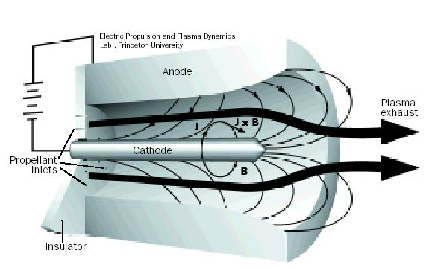
Magneto Plasma Dynamic Thruster

Slide 28
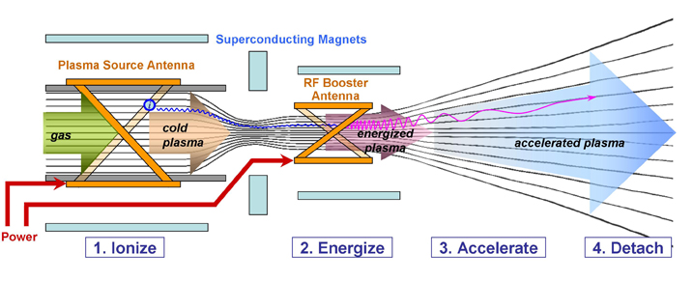
Magneto Plasma Acceleration

Slide 29
PULSED PLASMA THRUSTER(PPT)
PPTs use solid Teflon propellant to deliver specific impulses in the 900 - 1,200 s range and very low, precise impulse "bits" (10-1,000 μNs) at low average power (< 1 to 100 W)
PPTs inherently inefficient (η ~5%)
Simplicity and low impulse bits provide highly useful
Precision-flying of a spacecraft constellation
PPT consists of a coiled spring that feeds Teflon propellant bar, an igniter plug to initiate a small-trigger electrical discharge, a capacitor, and electrodes through which current flows

Slide 30
PULSED PLASMA THRUSTER(PPT)
Plasma is created by ablating Teflon from discharge of capacitor across electrodes
Plasma is then accelerated to generate thrust by Lorenz force that is established by current and its induced magnetic field
PPT flown on both American and Soviet/Russian spacecraft since the 1960s
PPT was used to maintain fine pitch attitude control for NASA New Millennium Program's Earth Observing-1 mission launched in 2000

Slide 31
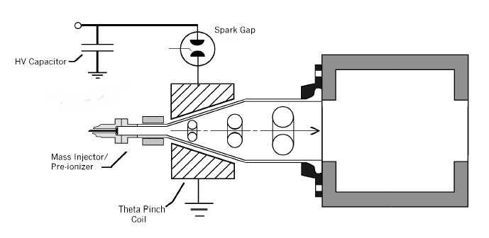
Plasmoid Thruster Experiment (PTX)

Slide 32
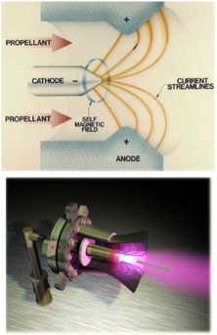
Electromagnetic Propulsion
Electromagnetic forces are used to accelerate a plasma
A gas consisting of positive ions, electrons
5000 – 9000 ºR
Neutral beam is produced
Higher thrust per unit area than electrostatic thruster
Classifications
Magnetoplasmadynamic
Pulsed plasma
Electric discharge creates plasam from solid Telfon
Hall effect
Developed in Russia
Flew on U.S. STEx mission (1998)
www.nasa.gov

Slide 33
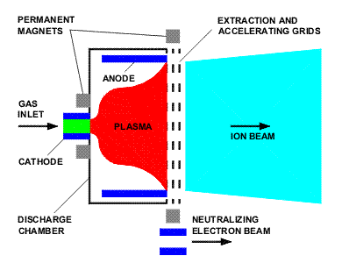
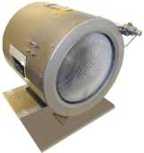
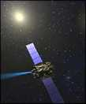
Electrostatic Propulsion
Xenon Ion Thruster
Xenon propellant
Electrostatic forces are used to accelerate charged particles to very high velocities
Xenon is ionized by electron bombardment
Thermionic cathode
Positively charged particles accelerated by grid
Electrons routed to second anode and injected into beam to neutralize
www.plasma.inpe.br
aerospace.engin.umich.edu
ESA’s SMART-1 uses a xenon ion propulsion system (XIPS)

Slide 34
NUCLEAR ROCKET PROPULSION

Slide 35
Nuclear pulse propulsion or external pulsed plasma propulsion, is a hypothetical method of spacecraft propulsion that uses nuclear explosions for thrust
The fission-fragment rocket is a rocket engine design that directly harnesses hot nuclear fission products for thrust, as opposed to using a separate fluid as working mass.
In a nuclear thermal rocket a working fluid, usually hydrogen, is heated to a high temperature in a nuclear reactor, and then expands through a rocket nozzle to create thrust.

Slide 36
Nuclear Thermal Propulsion (NTP)
System that utilizes a nuclear fission reactor
Energy released from controlled fission of material is transferred to a propellant gas
Fission
Absorption of neutrons in a fuel material
Excitation of nucleus causes fuel atoms to split
Two new nulcei on average (Fission Fragments)
High KE from release of nuclear binding energy
Usually radioactive
1 to 3 free neutrons
Necessary to keep reaction going
Critical if each fission events leads to another
Can be absorbed by reactor material or leak from reactor

Slide 37
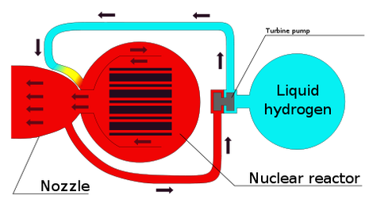

Slide 38
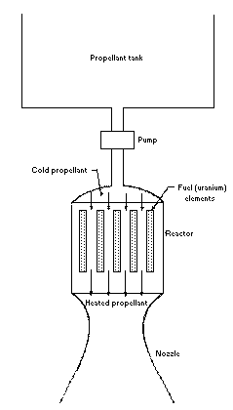

Slide 39
ADVANTAGES
High Isp (2-10x that of chemical systems)
Low Specific Mass (kg/kW)
High Power Allows High Thrust
High F/W
Use of Any Propellant
Safety
Reduced Radiation for Some Missions

Slide 40
DISADVANTAGES:
Political Issues
Social Issues
Low Technology Readiness Level (Maturity)
Radiation issues (Shielding)
High Inert Mass

Slide 41
Solar sails

Slide 42
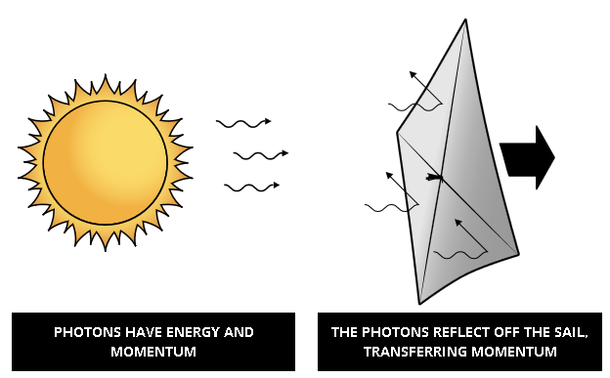
Solar sails
Solar sails use the sun’s energy as a method of propulsion—flight by light. Light is made of packets of energy called photons. While photons have no mass, a photon traveling as a packet of light has energy and momentum.

Slide 43
Solar sails
Solar sail spacecraft capture light momentum with large, lightweight mirrored surfaces—sails. As light reflects off a sail, most of its momentum is transferred, pushing on the sail. The resulting acceleration is small, but continuous. Unlike chemical rockets that provide short bursts of thrust, solar sails thrust continuously and can reach higher speeds over time.

Slide 44


