Slide 1
MANUFACTURING TECHNOLOGY
INTRODUCTION TO CASTING

Slide 2
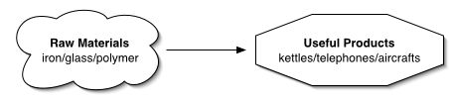
Manufacturing Technology
Manufacturing
Technology – Applied Science
  The discipline dealing with the art or science of applying
  scientific knowledge to practical problems

Slide 3
Manufacturing Technology
What is Casting?
Casting is a process in which molten metal flows by gravity or other force into a mold and solidifies in the shape of the mold cavity. The part produced is called casting.
Casting Procedure

Slide 4
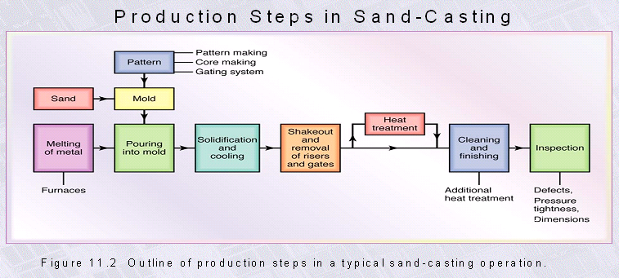
Manufacturing Technology
Casting Procedure

Slide 5
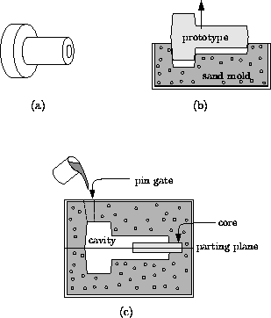
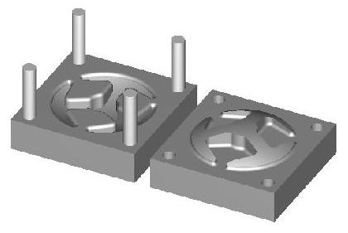
Manufacturing Technology
The Casting Process Today
Sand Casting
Die Casting

Slide 6
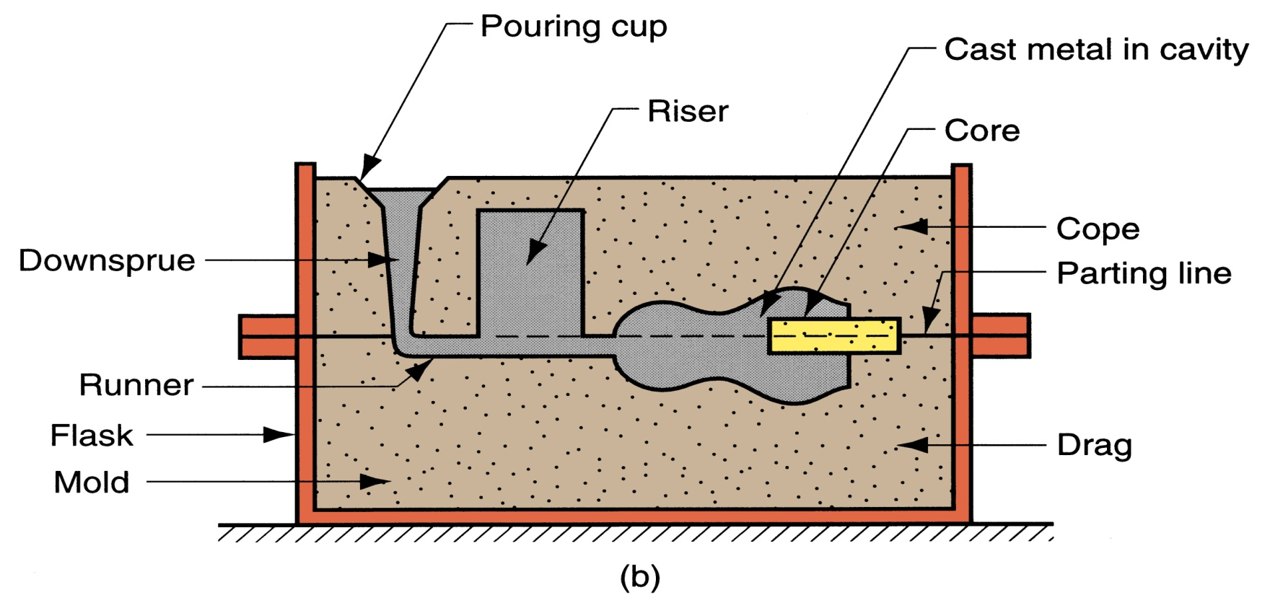
Manufacturing Technology
Casting nomenclature
The pouring cup, down sprue, runners, etc., are known as the mold gating system, which serves to deliver the molten metal to all sections of the mold cavity.

Slide 7
Manufacturing Technology
Casting Terms
Flask: A metal or wooden frame, without fixed top or bottom, in which the mold is formed. Depending upon the position of the flask in the molding structure, it is referred to by various names such as drag - lower molding flask, cope - upper molding flask, cheek - intermediate molding flask used in three piece molding.
Pattern: It is the replica of the final object to be made. The mold cavity is made with the help of pattern.

Slide 8
Manufacturing Technology
Parting line: This is the dividing line between the two molding flasks that makes up the mold.
Molding sand: Sand, which binds strongly without losing its permeability to air or gases. It is a mixture of silica sand, clay, and moisture in appropriate proportions.
Facing sand: The small amount of carbonaceous material sprinkled on the inner surface of the mold cavity to give a better surface finish to the castings.

Slide 9
Manufacturing Technology
Core: A separate part of the mold, made of sand and generally baked, which is used to create openings and various shaped cavities in the castings.
Pouring basin: A small funnel shaped cavity at the top of the mold into which the molten metal is poured.
Sprue: The passage through which the molten metal, from the pouring basin, reaches the mold cavity. In many cases it controls the flow of metal into the mold.
Gate: A channel through which the molten metal enters the mold cavity.

Slide 10
Manufacturing Technology
Runner: The channel through which the molten metal is carried from the sprue to the gate.
Chaplets: Chaplets are used to support the cores inside the mold cavity to take care of its own weight and overcome the metallostatic force.
Riser: A column of molten metal placed in the mold to feed the castings as it shrinks and solidifies. Also known as "feed head".
Vent: Small opening in the mold to facilitate escape of air and gases.

Slide 11
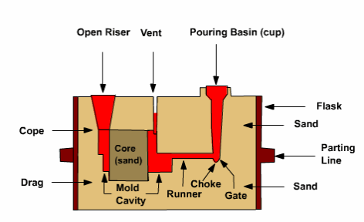
Manufacturing Technology
Mold Section showing some casting terms

Slide 12
Manufacturing Technology
Steps in Making Sand Castings
There are six basic steps in making sand castings:
  Patternmaking
  Core making
  Molding
  Melting and pouring
  Cleaning

Slide 13
Manufacturing Technology
Pattern making
The pattern is a physical model of the casting used to make the mold.
The mold is made by packing some readily formed aggregate material, such as molding sand, around the pattern. When the pattern is withdrawn, its imprint provides the mold cavity, which is ultimately filled with metal to become the casting. If the casting is to be hollow, as in the case of pipe fittings, additional patterns, referred to as cores, are used to form these cavities.

Slide 14
Manufacturing Technology
Core making
Cores are forms, usually made of sand, which are placed into a mold cavity to form the interior surfaces of castings. Thus the void space between the core and mold-cavity surface is what eventually becomes the casting.

Slide 15
Manufacturing Technology
Molding
Molding consists of all operations necessary to prepare a mold for receiving molten metal. Molding usually involves placing a molding aggregate around a pattern held with a supporting frame, withdrawing the pattern to leave the mold cavity, setting the cores in the mold cavity and finishing and closing the mold.

Slide 16
Manufacturing Technology
Melting and Pouring
The preparation of molten metal for casting is referred to simply as melting. Melting is usually done in a specifically designated area of the foundry, and the molten metal is transferred to the pouring area where the molds are filled.

Slide 17
Manufacturing Technology
Cleaning
Cleaning refers to all operations necessary to the removal of sand, scale, and excess metal from the casting. Burned-on sand and scale are removed to improved the surface appearance of the casting. Excess metal, in the form of fins, wires, parting line fins, and gates, is removed. Inspection of the casting for defects and general quality is performed

Slide 18
Manufacturing Technology
Functions of the Pattern
A pattern prepares a mold cavity for the purpose of making a casting.
A pattern may contain projections known as core prints if the casting requires a core and need to be made hollow.
Runner, gates, and risers used for feeding molten metal in the mold cavity may form a part of the pattern.
Patterns properly made and having finished and smooth surfaces reduce casting defects.
A properly constructed pattern minimizes the overall cost of the castings.

Slide 19
Manufacturing Technology
Pattern Types
  Solid or single piece pattern
  Split pattern
  Loose piece pattern
  Match plate pattern
  Sweep pattern
  Skeleton pattern
  Cope and drag pattern
  Shell pattern

Slide 20
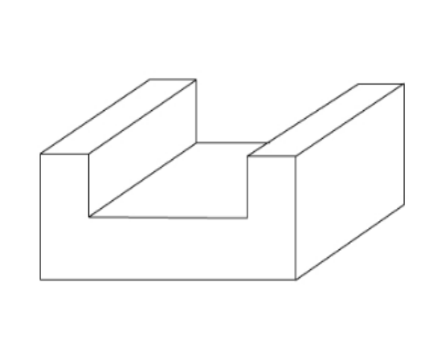
Manufacturing Technology
Solid or single piece pattern
These types of patterns are made of single solid piece without joints
It is made exactly into the desire casting shape to be produced with some allowance
Removal of pattern from the sand is easy
single piece patterns

Slide 21
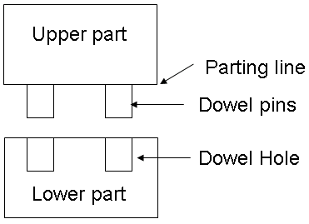
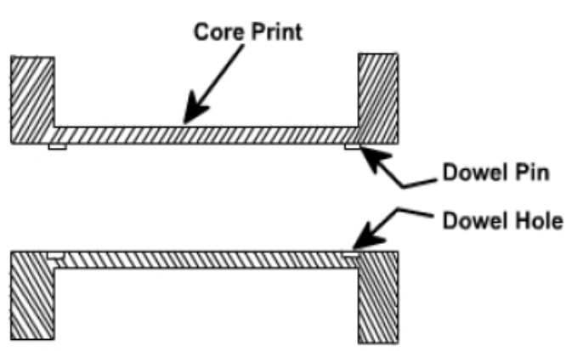
Manufacturing Technology
Split pattern
These types of patterns are made up of two parts. One part is used to produce the lower half of the mould, where us the other part is used to produce the upper half of the mould
The two parts are assembled together in correct position by pins called dowel pins. The line separating two parts is called parting line
Split or two piece pattern is most widely used type of pattern for intricate castings
Split patterns

Slide 22
Manufacturing Technology
Loose piece pattern
A pattern which has loose pieces above or below the solid pattern
Loose patterns are attached to the main body of the pattern by pins
Loose piece
Solid pattern

Slide 23
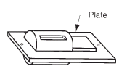
Manufacturing Technology
Match plate pattern
A pattern is made into two halves mounted on both sides of the plate called match plate (wood or Al)
Mainly used for machine components moulding

Slide 24
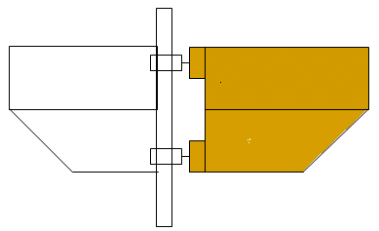
Manufacturing Technology
Sweep pattern
A sweep is a section or board made of wood or metal to the required cross section that is rotated about one edge to shape mould cavities having shapes of rotational symmetry.
Sweep patterns are mainly used to generate surface of revolution like cylinder, cone, sphere in large castings
Mould cavity
Sweep
Spindle

Slide 25
Manufacturing Technology
Skeleton pattern
A skeleton pattern in which large no of portioning is made using wooden strips.
Mainly used to generate large size castings having simple shapes
Rib
Wooden strips
End support

Slide 26
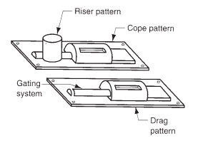
Manufacturing Technology
Cope and drag pattern
A split pattern which has cope, riser and gating arrangement.
Mainly used for producing complex shapes

Slide 27
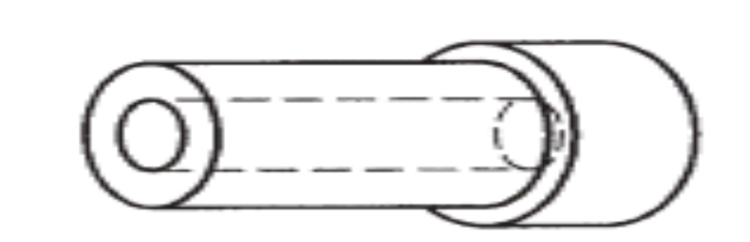
Manufacturing Technology
Shell pattern
A pattern which has Hollow hole in it. only the outer shape is used for making the mould
The core is prepared inner surface of the pattern itself
Hole

Slide 28
Manufacturing Technology
Pattern Material
Patterns may be constructed from the following materials. Each material has its own advantages, limitations, and field of application. Some materials used for making patterns are: wood, metals and alloys, plastic, plaster of Paris, plastic and rubbers, wax, and resins.

Slide 29
Manufacturing Technology
To be suitable for use, the pattern material should be:
  Easily worked, shaped and joined
  Light in weight
  Strong, hard and durable
  Resistant to wear and abrasion
  Resistant to corrosion, and to chemical reactions
  Dimensionally stable and unaffected by variations in temperature and humidity
  Available at low cost

Slide 30
Manufacturing Technology
Pattern Allowances
  Shrinkage allowance
  Machining or finishing allowance
  Draft or Taper allowance
  Distortion or Camber allowance
  Rapping or shake allowance

Slide 31
Manufacturing Technology
Shrinkage Allowance
Almost all cast metals shrink or contract volumetrically on cooling. The metal shrinkage is of two types:
Liquid Shrinkage: it refers to the reduction in volume when the metal changes from liquid state to solid state at the solidus temperature. To account for this shrinkage; riser, which feed the liquid metal to the casting, are provided in the mold.
Solid Shrinkage: it refers to the reduction in volume caused when metal loses temperature in solid state. To account for this, shrinkage allowance is provided on the patterns.

Slide 32
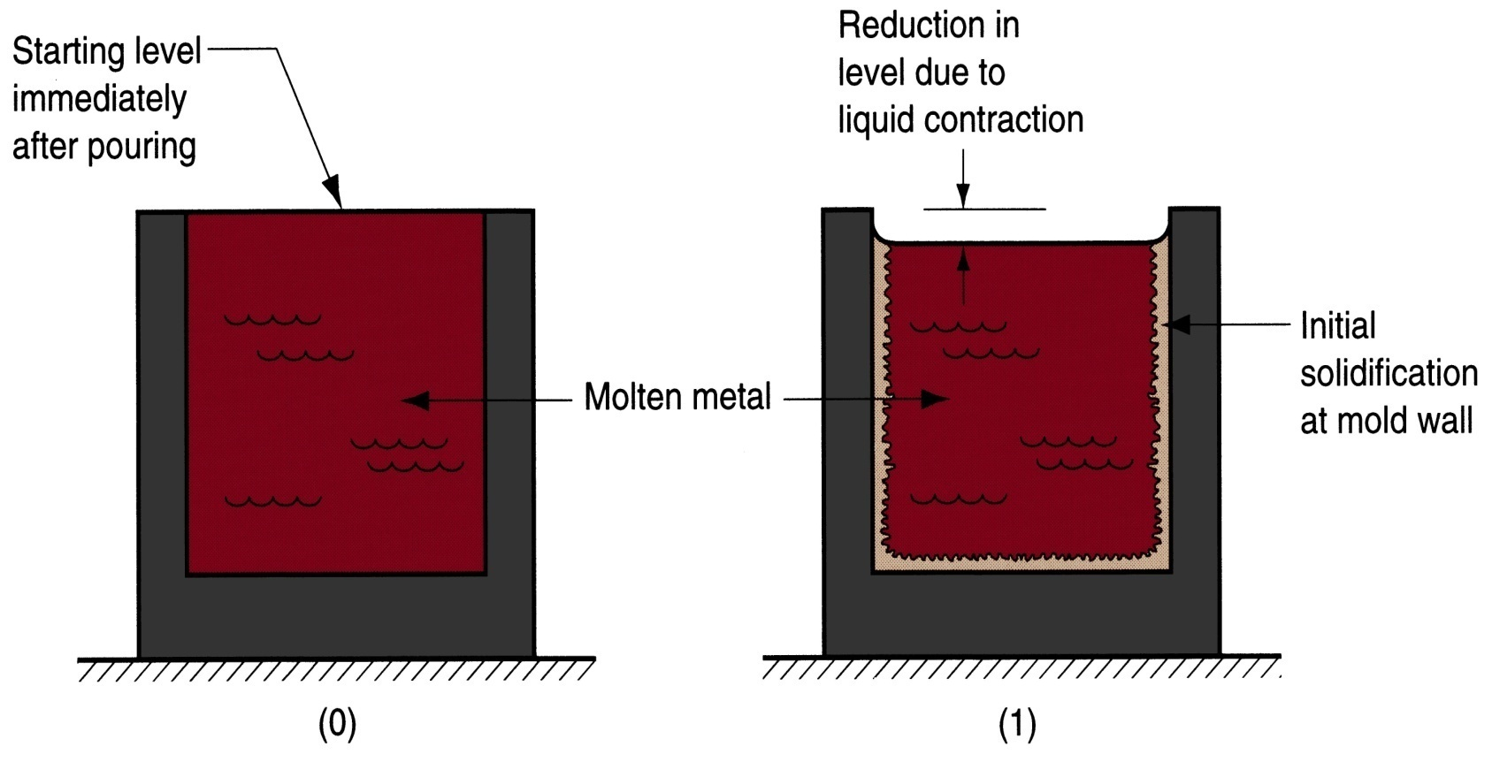
Manufacturing Technology
Shrinkage Allowance
Liquid Shrinkage:

Slide 33
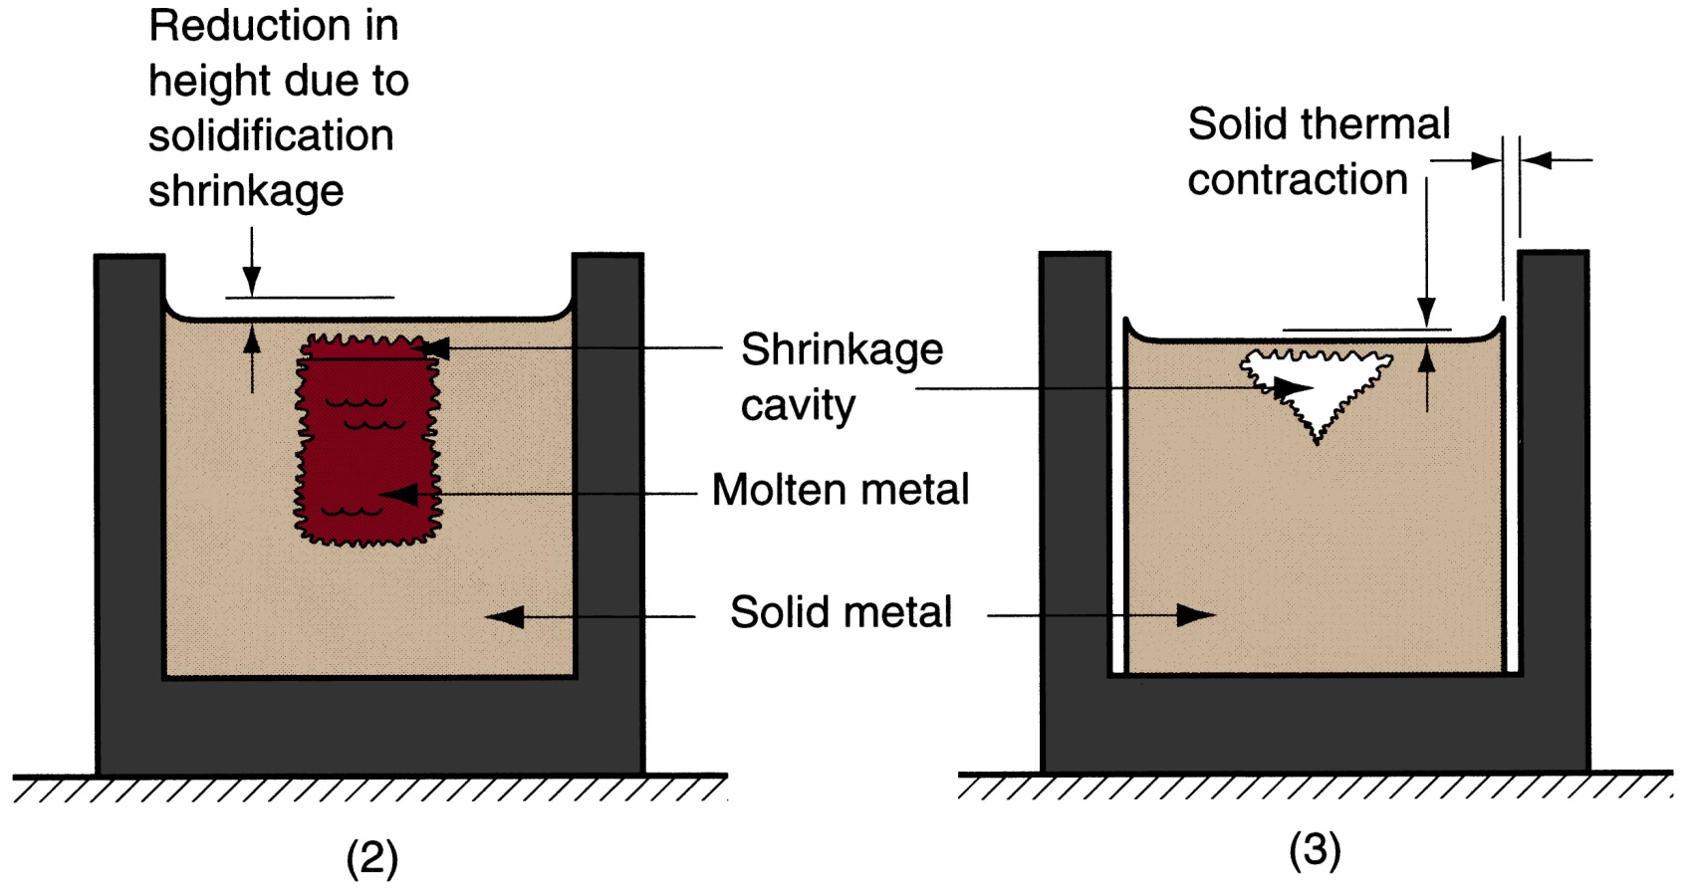
Manufacturing Technology
Shrinkage Allowance
Solid Shrinkage:

Slide 34
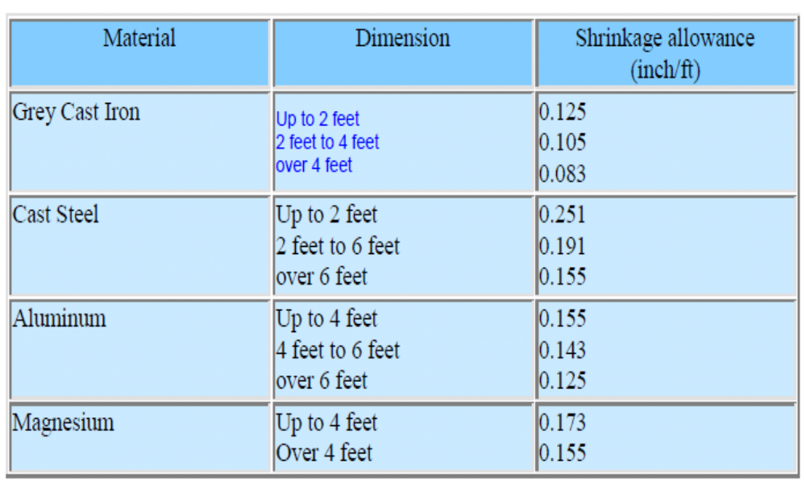
Manufacturing Technology
Shrinkage Allowance Various Metals

Slide 35
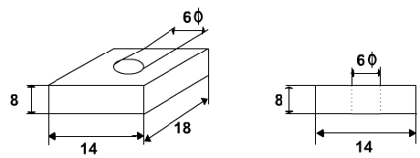
Manufacturing Technology
Exercise
The casting shown is to be made in cast iron using a wooden pattern. Assuming only shrinkage allowance, calculate the dimension of the pattern. All Dimensions are in Inches

Slide 36
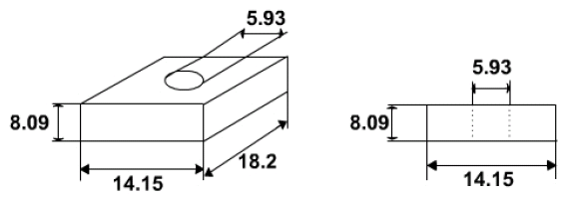
Manufacturing Technology
Solution
The shrinkage allowance for cast iron for size up to 2 feet is o.125 inch per feet ( as per Table)
For dimension 18 inch, allowance = 18 X 0.125 / 12 = 0.1875 inch » 0.2 inch
For dimension 14 inch, allowance = 14 X 0.125 / 12 = 0.146 inch » 0.15 inch
For dimension 8 inch, allowance = 8 X 0.125 / 12 = 0.0833 inch » 0. 09 inch
For dimension 6 inch, allowance = 6 X 0.125 / 12 = 0.0625 inch » 0. 07
The pattern drawing with required dimension is shown below:

Slide 37
Manufacturing Technology
Machining or Finish Allowance
The finish and accuracy achieved in sand casting are generally poor and therefore when the casting is functionally required to be of good surface finish or dimensionally accurate, it is generally achieved by subsequent machining. Machining or finish allowances are therefore added in the pattern dimension. The amount of machining allowance to be provided is affected by the method of molding and casting

Slide 38
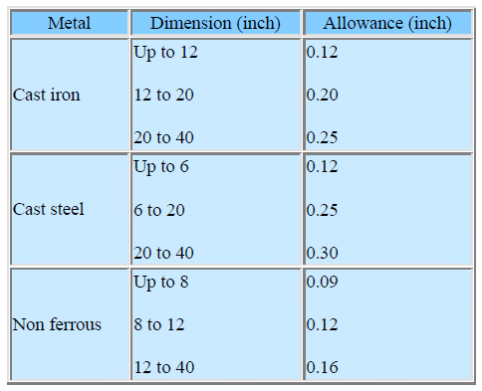
Manufacturing Technology
Machining or Finish Allowance
The amount of machining allowance is also affected by the size and shape of the casting; the casting orientation; the metal; and the degree of accuracy and finish required.
Machining Allowances of Various Metals

Slide 39
Manufacturing Technology
Draft or Taper Allowance
By draft is meant the taper provided by the pattern maker on all vertical surfaces of the pattern so that it can be removed from the sand without tearing away the sides of the sand mold and without excessive rapping by the molder

Slide 40
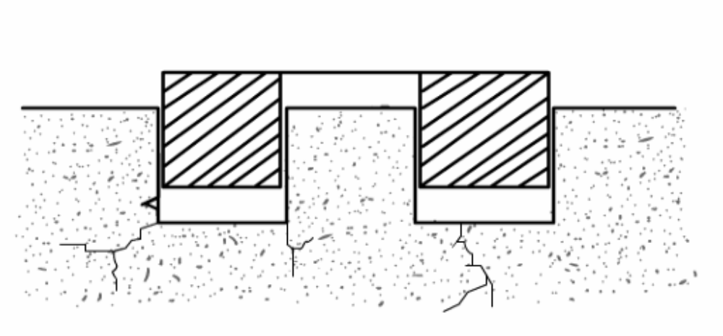
Manufacturing Technology
Figure shows a pattern having no draft allowance being removed from the pattern. In this case, till the pattern is completely lifted out, its sides will remain in contact with the walls of the mold, thus tending to break it.
Pattern Having No Draft on Vertical Edges

Slide 41
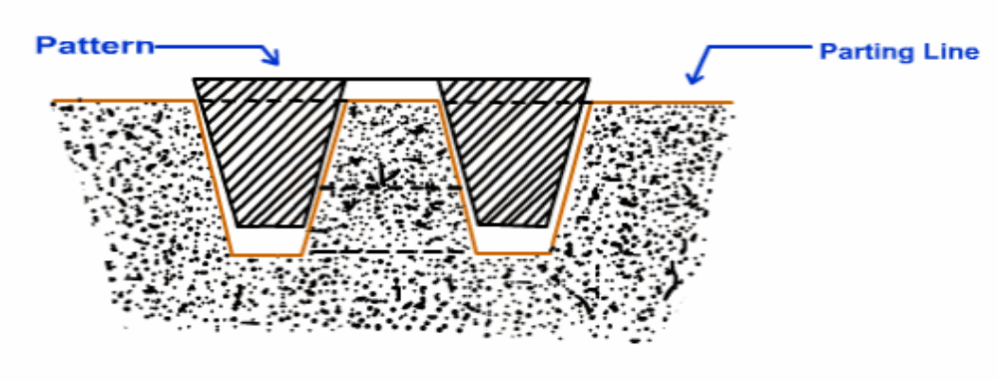
Manufacturing Technology
The given figure is an illustration of a pattern having proper draft allowance. Here, the moment the pattern lifting commences, all of its surfaces are well away from the sand surface. Thus the pattern can be removed without damaging the mold cavity.
Pattern Having Draft on Vertical Edges

Slide 42
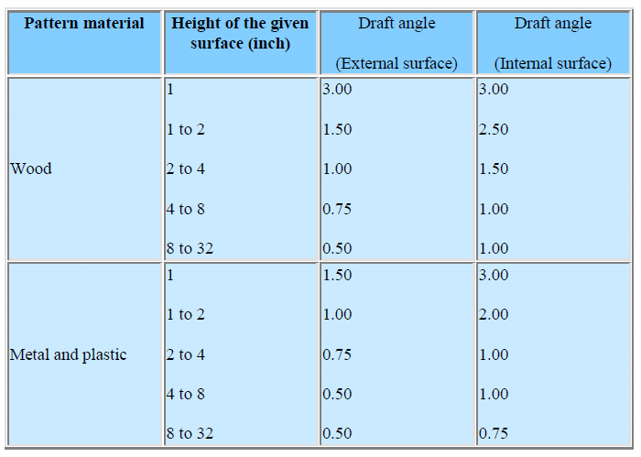
Manufacturing Technology
Draft Allowances of Various Metals

Slide 43
Manufacturing Technology
Distortion or Camber Allowance
Sometimes castings get distorted, during solidification, due to their typical shape. For example, if the casting has the form of the letter U, V, T, or L etc. it will tend to contract at the closed end causing the vertical legs to look slightly inclined.
This can be prevented by making the legs of the U, V, T, or L shaped pattern converge slightly (inward) so that the casting after distortion will have its sides vertical

Slide 44
Manufacturing Technology
The distortion in casting may occur due to internal stresses. These internal stresses are caused on account of unequal cooling of different section o f the casting and hindered contraction.
Measure taken to prevent the distortion in casting include:
Modification of casting design
Providing sufficient machining allowance to cover the distortion affect
Providing suitable allowance on the pattern, called camber or distortion allowance (inverse reflection)

Slide 45
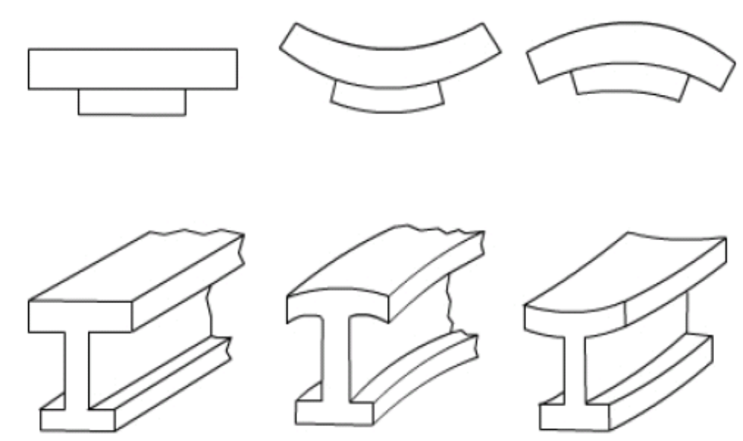
Manufacturing Technology
Distortions in Casting

Slide 46
Manufacturing Technology
Rapping or shake allowance
Before the withdrawal from the sand mold, the pattern is rapped all around the vertical faces to enlarge the mold cavity slightly, which facilitate its removal. Since it enlarges the final casting made, it is desirable that the original pattern dimension should be reduced to account for this increase.
There is no sure way of quantifying this allowance, since it is highly dependent on the foundry personnel practice involved. It is a negative allowance and is to be applied only to those dimensions that are parallel to the parting plane.

Slide 47
Manufacturing Technology
Core and Core Prints
Castings are often required to have holes, recesses, etc. of various sizes and shapes. These impressions can be obtained by using cores. So where coring is required, provision should be made to support the core inside the mold cavity. Core prints are used to serve this purpose.
The core print is an added projection on the pattern and it forms a seat in the mold on which the sand core rests during pouring of the mold.
The core print must be of adequate size and shape so that it can support the weight of the core during the casting operation.
Depending upon the requirement, a core can be placed horizontal, vertical and can be hanged inside the mold cavity.

Slide 48
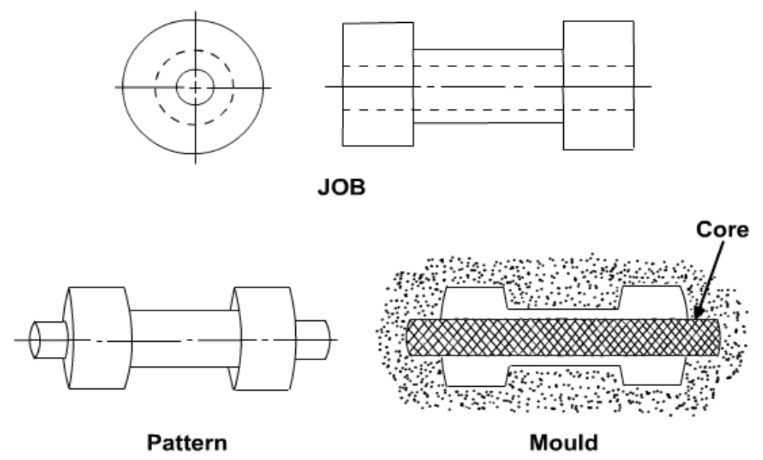
Manufacturing Technology
Core and Core Prints
A job & its pattern and the mold cavity with core and core print is shown in Figure

Slide 49
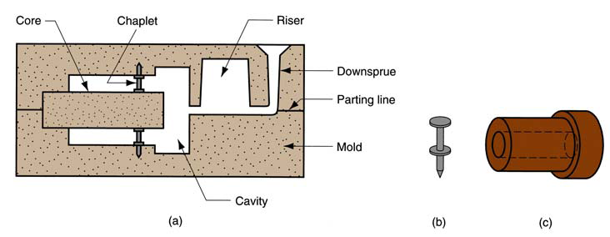
Manufacturing Technology
Core and Core Prints
A job & its pattern and the mold cavity with core and core print is shown in Figure

Slide 50
Manufacturing Technology
Moulding
Moulding is the process of making a mould cavity by packing prepared moulding sand around the pattern and removing the pattern from the mould to form the mould cavity.
Types
Green sand moulding
Dry sand moulding
Loam moulding

Slide 51
Manufacturing Technology
Moulding Sand
Special type of sand used for making mould is called moulding sand
Constituents of moulding sand
  Sand
  Binder
  Additive
Types of Moulding sand
  Green sand
  Dry sand
  Facing sand
  Loam sand
  Backing sand
  Parting sand

Slide 52
Manufacturing Technology
Green sand
8% water, 16 to 30% clay, soft, light and porous ,High damping capacity
Dry sand
Dry in nature, High strength and rigidity
Facing sand
Mixture of silica and dry sand
Normally used to cover the surface of the pattern (fine finish)
Loam sand
Fine silica, fine refractories, clay, graphite, fiber and water
It becomes very hard when it is dried
Backing sand
Old sand, can be used repeatedly
Parting sand
Mixture Silica and brick powder, used to avoid the sticking of patterns while removing (split pattern)

Slide 53
Manufacturing Technology
Binder
  Organic binder – cereal, resins, drying oils, molasses etc.
  Inorganic binder – clay (fire clay, bentonite, kaolinite)
Additives
  Sea coal, sawdust, pitch, cereals, silica flour, fuel oil
Properties of moulding sand
  Porosity or permeability
  Plasticity or flowability
  Adhesiveness
  Strength or cohesiveness
  Refractoriness
  collapsibility

Slide 54
Manufacturing Technology
Gating and Risering
GATE -A channel through which the molten metal enters the mold cavity.
The goals for the gating system are;
To minimize turbulence to avoid trapping gases and breaking up the sand mold.
To get enough metal into the mold cavity before the metal starts to solidify.
To avoid shrinkage

Slide 55
Manufacturing Technology
Gating and Risering
Riser -A column of molten metal placed in the mold to feed the castings as it shrinks and solidifies. Also known as "feed head".
The Purpose of Riser system is;
To provide that extra molten metal. Basically a riser is a vertical portion of the gating system, similar to a straight sprue, that stores the molten metal until it is needed by the casting. This means the metal in the riser must stay liquid longer than the metal in the part being cast. .
To avoid shrinkage

Slide 56
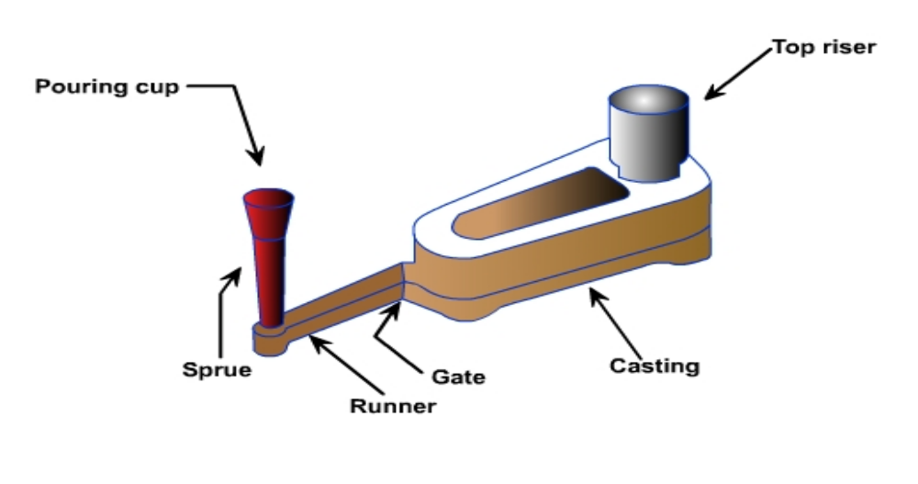
Manufacturing Technology
Gating and Risering
A typical pattern attached with gating and Risering system

Slide 57
Manufacturing Technology
Cores & Core Making
Core: A separate part of the mold, made of sand and generally baked, which is used to create openings and various shaped cavities in the castings.
Core Making: The process of making cores using core sand, binder and additives with the help of core boxes.
Types of Cores
Horizontal core – supported Horizontally in the mould
Vertical core - supported Vertically in the mould
Balancing core – supported at the ends of the mould
Hanging core – supported at the top and hung into the mould
Drop core – supported top or bottom of the parting line

Slide 58

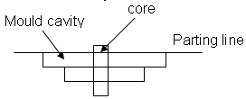
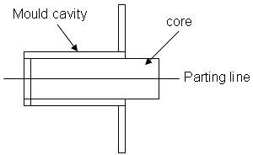
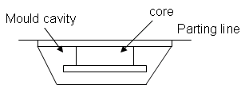
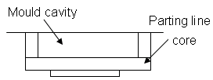
Manufacturing Technology
Horizontal core
Vertical core
Hanging core
Balancing core
Drop core

Slide 59
END

