Slide 1
MANUFACTURING TECHNOLOGY
UNIT – I
ELECTRON BEAM WELDING

Slide 2
ELECTRON BEAM WELDING
Introduction
Electron beam machining (EBW) is a fusion welding process that uses high velocity stream of electrons focused on work piece surface to weld material by melting and vaporization
In electron-beam welding (EBW), electrons are accelerated to a velocity nearly three-fourths that of light (~200,000 km/sec).

Slide 3
ELECTRON BEAM WELDING
How it Works
An electron beam machine works in much the same way as a cathode ray tube in a television.
  A cathode section generates an electron beam.
  An anode section accelerates the beam.
  The lens system converges and deflects the electron beam to the desired position.

Slide 4
ELECTRON BEAM WELDING
Operating principle
A high velocity stream of electrons is directed against a precisely limited area of the work piece; on impact, the kinetic energy of the electrons is converted into thermal energy that melts and joins the materials to be weld.
The process is performed in a vacuum chamber to reduce the scattering of electrons by gas molecules in the atmosphere.

Slide 5
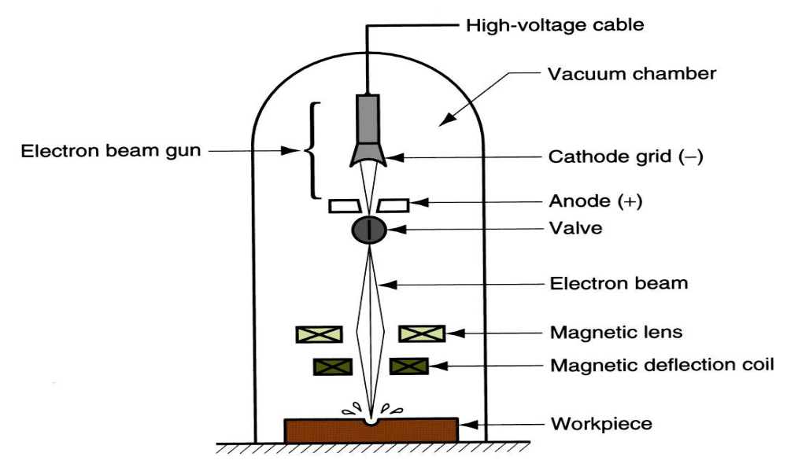
ELECTRON BEAM WELDING
Equipment
Schematic illustration of the Electron Beam Welding Process

Slide 6
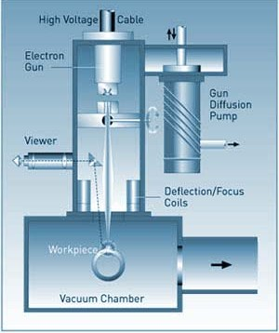
ELECTRON BEAM WELDING
Equipment
Schematic illustration of the Electron Beam Welding Process

Slide 7
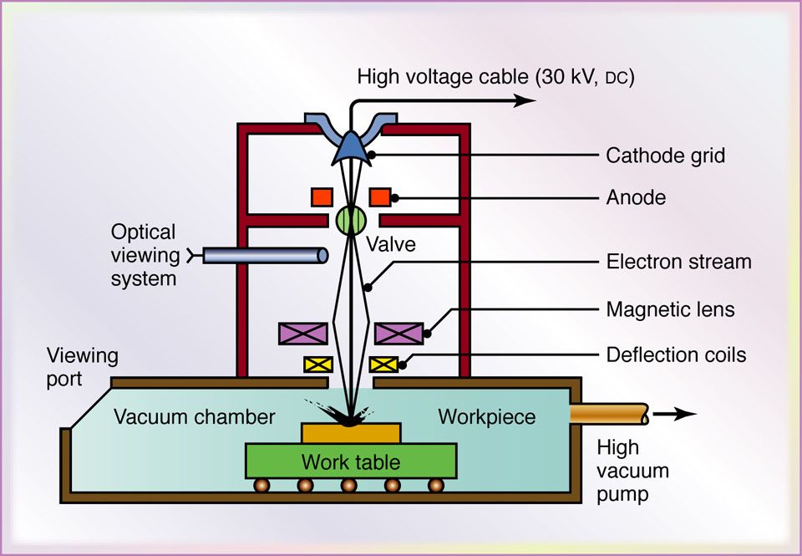
ELECTRON BEAM WELDING
Overall setup

Slide 8
ELECTRON BEAM WELDING
Sub systems of the Equipment
Electron Gun
The electron beam is formed inside of an electron gun, which has
  Cathode – Hot tungsten filament emitting electrons
  Grid Cup – Element which is negatively biased with respect to the filament
  Anode – a neutral element through which the accelerated electron pass

Slide 9
ELECTRON BEAM WELDING
Sub systems of the Equipment
Magnetic Lens
Used to focus the electron beam to any desired diameter to less than 0.00254 cm at a precise location on the work piece
Vacuum Chamber
It prevents collision of electrons with gas molecules which would scatter or diffuse the electron beam
It prevents the possibility of an arc discharge between the electrons

Slide 10
ELECTRON BEAM WELDING
Process Parameters
Processing material
Power supply
Beam current (A)
pulse duration (μs)
Lens Current
Focusing length
Beam Deflection
Safety characteristics

Slide 11
ELECTRON BEAM WELDING
Process capabilities
A range of materials such as stainless steel, nickel and cobalt alloys, copper, aluminium, titanium, ceramic, leather and plastics can be processed by this method
This is mainly used to weld metals about 0.1 to 1.4 mm in thicknesses up to 10 mm can be made
Aspect ratios as large as 15:1(Depth:width) can be achieved in most materials

Slide 12
ELECTRON BEAM WELDING
Applications
The metals about 0.5 to 1.5mm thick can be welded
It is used to weld non-metallic materials and alloys.
It is used to weld dissimilar metals
Electron beam machining is being used extensively in the electronic. aerospace and automotive industries.
Welding of cams
Suitable for large scale production

Slide 13
ELECTRON BEAM WELDING
Advantages
Single pass welding of thick joints
Hermetic seals of components retaining a vacuum
Low distortion
Low contamination in vacuum
Weld zone is narrow
Heat affected zone is narrow
Dissimilar metal welds of some metals
Uses no filler metal

Slide 14
ELECTRON BEAM WELDING
Limitations
High equipment cost
Work chamber size constraints
Time delay when welding in vacuum
High weld preparation costs
X-rays produced during welding
Rapid solidification rates can cause cracking in some materials

Slide 15
END

