Slide 1
MANUFACTURING TECHNOLOGY
UNIT – I
ELECTRO SLAG WELDING

Slide 2
ELECTRO SLAG WELDING
Introduction
Electro Slag Welding (ESW) is a highly productive, single pass fusion welding process for thick (greater than 25mm up to about 300mm) materials in a vertical or close to vertical position.
It is similar to electro gas welding but the main difference is the arc starts in a different location. An electric arc is initially struck by wire that is fed into the desired weld location and then flux is added.
Unlike other high current fusion processes, electro slag welding is not an arc process. Heat required for melting both the welding wire and the plate edges is generated through a molten slag's resistance to the passage of an electric current.

Slide 3
ELECTRO SLAG WELDING
Introduction
Additional flux is added until the molten slag, reaching the tip of the electrode, extinguishes the arc.
The wire is then continually fed through a consumable guide tube (can oscillate if desired) into the surfaces of the metal work pieces and the filler metal are then melted using the electrical resistance of the molten slag to cause coalescence.
The wire and tube then move up along the work piece while a copper retaining shoe that was put into place before starting (can be water cooled if desired) is used to keep the weld between the plates that are being welded.

Slide 4
ELECTRO SLAG WELDING
Operating Principle
Electro slag welding is a process in which the coalescence is formed by molten slag and molten metal pool remains shielded by the molten slag.
In its original form, plates are held vertically approximately 30mm apart with the edges of the plate cut normal to the surface.
A bridging run-on piece of the same thickness is attached to the bottom of the plates. Water cooled copper shoes are then placed each side of the joint, forming a rectangular cavity open at the top.

Slide 5
ELECTRO SLAG WELDING
Filler wire, which is also the current carrier, is then fed into this cavity, initially striking an arc through a small amount of flux. Additional flux is added which melts forming a flux bath which rises and extinguishes the arc.
The added wire then melts into this bath sinking to the bottom before solidifying to form the weld.
For thick sections, additional wires may be added and an even distribution of weld metal is achieved by oscillating the wires across the joint.
As welding progresses, both the wire feed mechanism and the copper shoes are moved progressively upwards until the top of the weld is reached

Slide 6
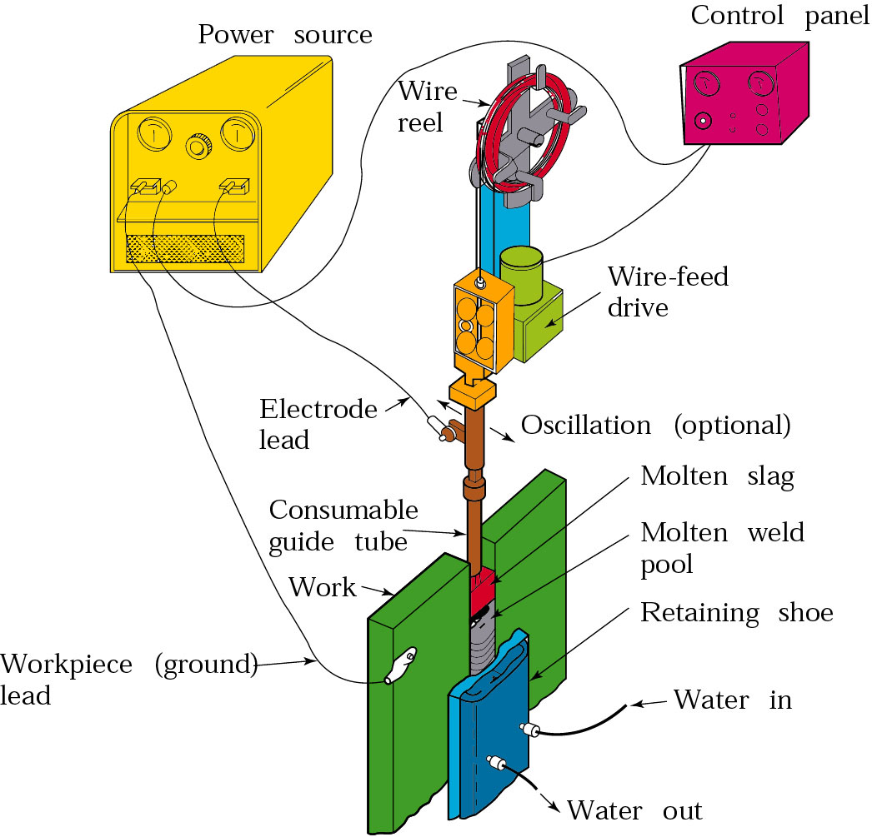
ELECTRO SLAG WELDING
Equipment
Electro Slag Welding Equipment

Slide 7
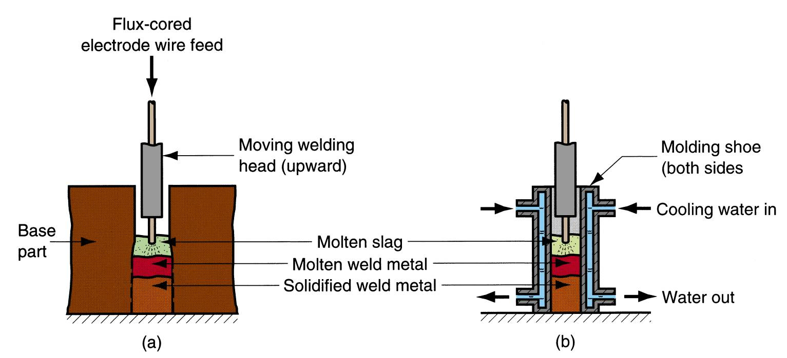
ELECTRO SLAG WELDING
Equipment
Schematic illustration of Electro Slag Welding Equipment

Slide 8
ELECTRO SLAG WELDING
Process steps in Detail
Prepare the edges to be joined and maintain the proper position
Arc is started between electrode tip and bottom part of the part to be welded
Flux added first and then melted by the heat on the arc
Molten slag reaches the tip of the electrode and the arc is extinguished
Heat is then continuously produced by electrical resistance of the molten slag
Molten slag solidifies by means of water cooled copper shoes

Slide 9
ELECTRO SLAG WELDING
Advantages
High metal deposition rates—it can lay metal at a rate between 15 and 20 kg per hour
Ability to weld thick materials. Many welding processes require more than one pass for welding thick work pieces, but often a single pass is sufficient for electro slag welding.
The process is also very efficient, since joint preparation and materials handling are minimized while filler metal utilization is high.
The process is also safe and clean, with no arc flash and low weld splatter or distortion.
Electro slag welding easily lends itself to mechanization, thus reducing the requirement for skilled manual welders.

Slide 10
ELECTRO SLAG WELDING
Limitations
Difficult to weld cylindrical objects
Hot cracking may occur
Expensive

Slide 11
ELECTRO SLAG WELDING
Applications
Construction of bridges, pressure vessels, large diameter pipes, storage tanks and ships.
welding forgings and castings

Slide 12
END

