Slide 1
MANUFACTURING TECHNOLOGY
UNIT – I
FRICTION WELDING

Slide 2
FRICTION WELDING
Introduction
Friction welding is a solid-state welding process in which coalescence is achieved by frictional heat combined with mechanical pressure.
The heat is generated by the friction between the two components surfaces, usually by rotation of one part relative to the other. Then the parts are driven toward each other with sufficient force to form a metallurgical bond.

Slide 3
FRICTION WELDING
Operating Principle
Work pieces must be axis-symmetric
Clamp one work piece in Rotatable jaw; clamp other work piece in axially movable jaw.
Rotate first work piece (attached to Rotatable jaw), then press second work piece against first work piece.
Friction between the work pieces generates heat.
localized heating causes work pieces to be softened
Axial force cause soften metal to be upset and joined together

Slide 4
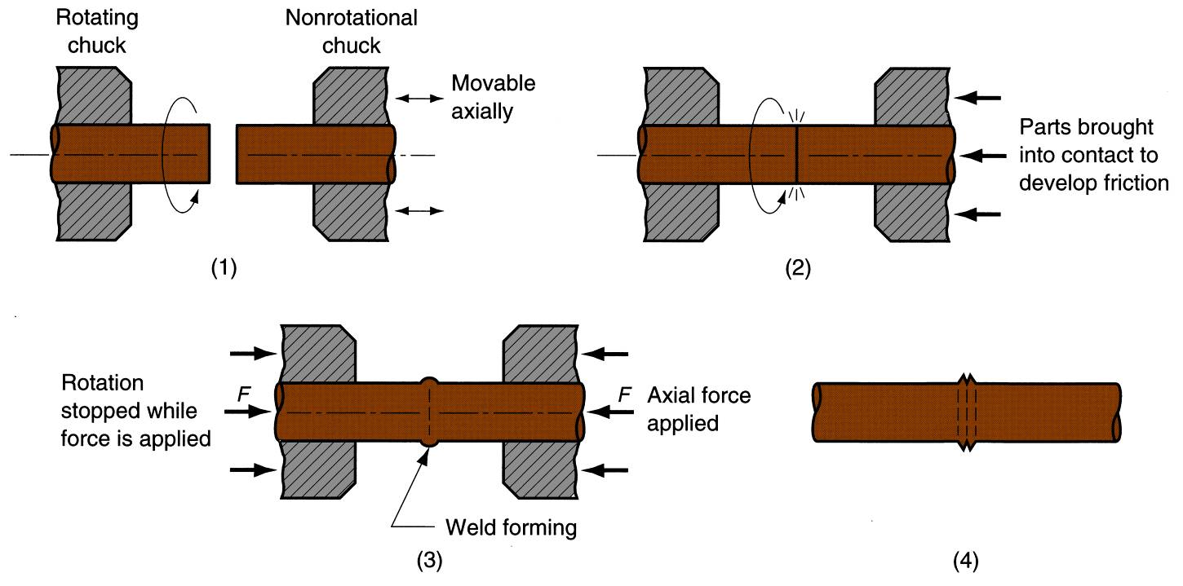
FRICTION WELDING
Equipment
Schematic illustration of Friction Welding process

Slide 5
FRICTION WELDING
Operating Principle in Detail
Rotating part, no contact
Parts brought into contact to generate friction heat
Rotation stopped and axial pressure applied
Weld created.

Slide 6
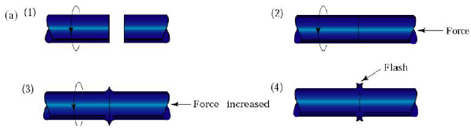
FRICTION WELDING
Equipment
Schematic illustration of Friction Welding process

Slide 7
FRICTION WELDING
Operating Principle in Detail
Left-hand component is rotated at high speed.
Right-hand component is brought into contact under an axial force
Axial force is increased; the flash begins to form
Left-hand component stops rotating, weld is completed. The flash can subsequently be removed by machining or grinding

Slide 8
FRICTION WELDING
Types of Friction Welding
Inertia Friction welding
Flywheel
Motor
Non-rotating chuck
Workpieces
Spindle
Chuck
Hydraulic cylinder

Slide 9
FRICTION WELDING
Inertia Friction Welding
Modification of Friction Welding
Energy is supplied by a fly wheel
The parts are pressed together by a normal force
As friction at the interface increases, the fly wheel slows down
The weld is completed when the flywheel stops

Slide 10
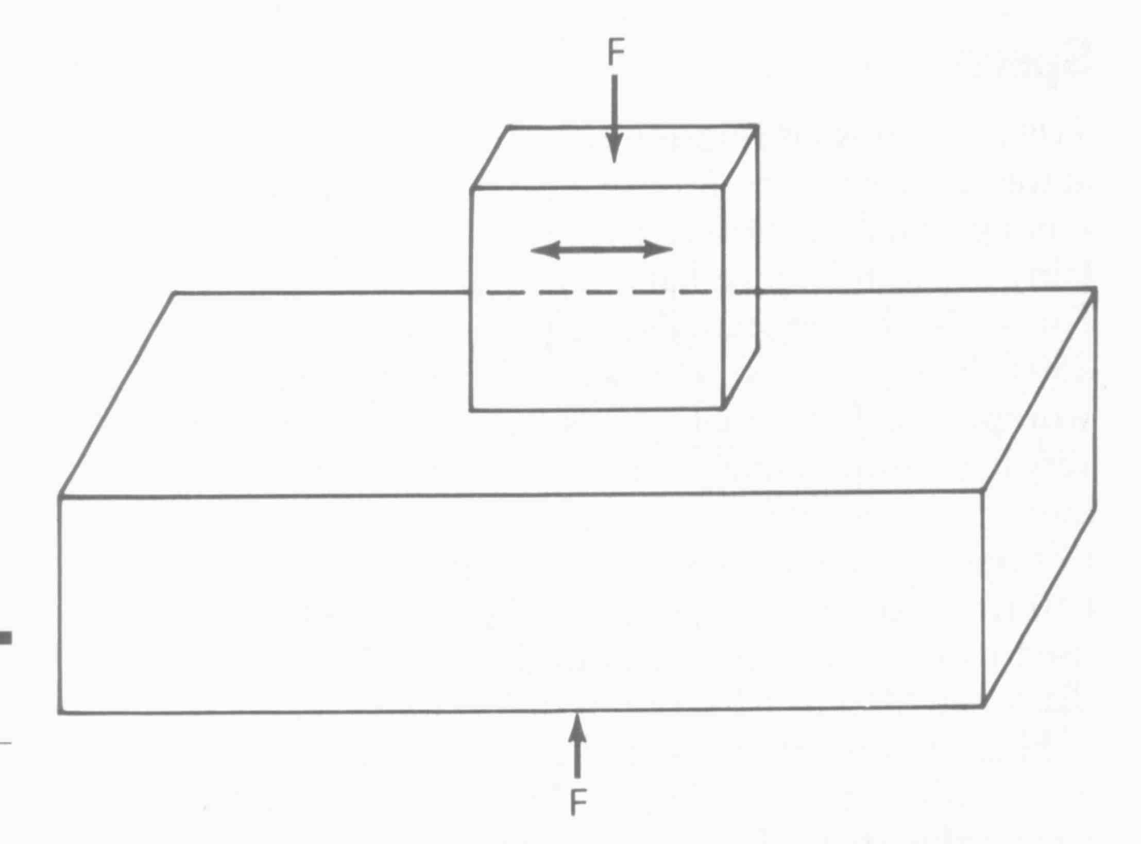
FRICTION WELDING
Linear Friction Welding
Parts are joined by a linear reciprocating motion
Parts do not have to be circular or tubular
In this application, one part is moved across the face of the other part using a balanced reciprocating mechanism

Slide 11
FRICTION WELDING
Continuous Drive Friction Welding
Workpieces
Motor
Non-rotating vise
Spindle
Hydraulic cylinder
Chuck
Brake

Slide 12
FRICTION WELDING
Continuous Drive Friction Welding
One of the work pieces is attached to a rotating motor drive, the other is fixed in an axial motion system.
One work piece is rotated at constant speed by the motor.
An axial or radial force is applied.
The work pieces are brought together under pressure for a pre-determined time, or until a preset upset is reached.
Then the drive is disengaged and a break is applied to the rotating work piece.

Slide 13
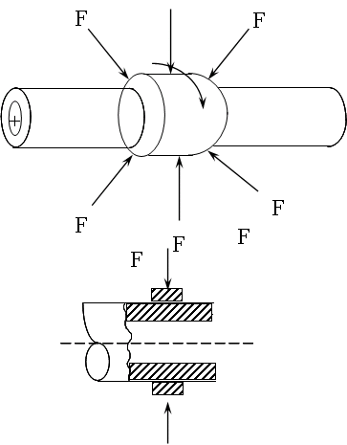
FRICTION WELDING
Radial Friction Welding

Slide 14
FRICTION WELDING
Radial Friction Welding
Used to join collars to shafts and tubes.
Two tubes are clamped in fixed position. The collar to be joined is placed between the tubes.
The collar is rotated producing frictional heat.
Radial forces are applied to compress the collar to complete welding.

Slide 15
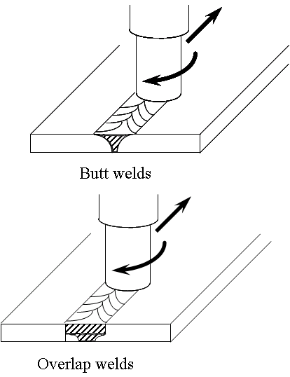
FRICTION WELDING
Friction Stir Welding

Slide 16
FRICTION WELDING
Friction Stir Welding
Parts to be joined are clamped firmly.
A rotating hardened steel tool is driven into the joint and traversed along the joint line between the parts.
The rotating tool produces friction with the parts, generating enough heat and deformation to weld the parts together.

Slide 17
FRICTION WELDING
Process Parameters
Rotational speed
Heating pressure
Forging pressure
Heating time
Braking time
Forging time

Slide 18
FRICTION WELDING
Advantages
When properly carried out, no melting occurs at faying surfaces
No filler metal, flux, or shielding gases normally used
Process yields a narrow HAZ
Can be used to join dissimilar metals
Widely used commercial process, amenable to automation and mass production

Slide 19
FRICTION WELDING
Limitations
At least one of the parts must be rotational
Flash must usually be removed
Upsetting reduces the part lengths (which must be taken into consideration in product design)

Slide 20
FRICTION WELDING
Applications
Shafts and tubular parts
Industries: automotive, aircraft, farm equipment, petroleum and natural gas

Slide 21
END

