Slide 1
MANUFACTURING TECHNOLOGY
UNIT – I
LASER BEAM WELDING

Slide 2
LASER BEAM WELDING
LASER
LASER: “Light Amplification by Stimulated Emission of Radiation”
Focused laser beam has high power density.
  Useful for welding, cutting, heat treating, ...
Materials processing lasers
  Gas (CO2)
  Solid-state lasers (Yttrium aluminum garnet-YAG)

Slide 3
LASER BEAM WELDING
Laser Concept
Add energy to make electrons “jump” to higher energy orbit
Electron “relaxes” and moves to equilibrium at ground-state energy level
Emits a photon in this process (key laser component)
Two mirrors reflect the photons back and forth and “excite” more electrons
One mirror is partially reflective to allow some light to pass through: creates narrow laser beam

Slide 4
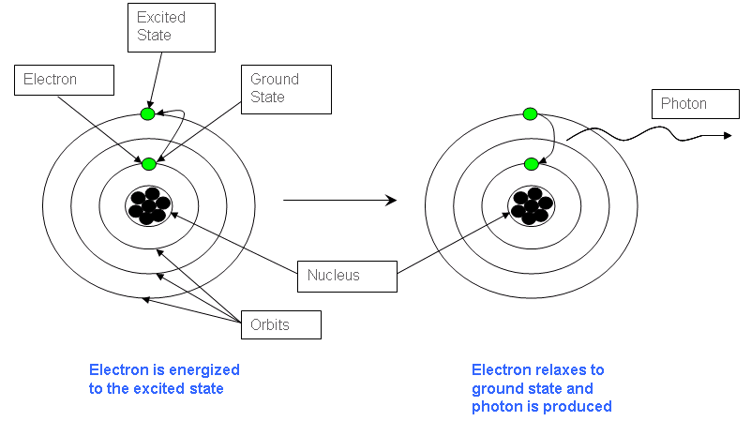
LASER BEAM WELDING
Photon Emission Model

Slide 5
LASER BEAM WELDING
Introduction
Laser-beam welding is a fusion welding process that utilizes a high-energy, coherent light beam to melt and join the particles on the surface of metallic and non-metallic work pieces. Lasers can be used to cut, drill, weld and mark
LBW is particularly suited to weld all type of materials . It can be used to perform precision welding on all microelectronic substrates such as ceramic, silicon, diamond, and graphite

Slide 6
LASER BEAM WELDING
Operating principle
Uses light energy from a laser to join materials by melting and solidification
Energy is concentrated optically and in terms of time
Light beam pulsed so that the released energy results in an impulse against the work surface, producing evaporation and melting

Slide 7
LASER BEAM WELDING
Operating principle in detail
The focal spot is targeted on the work piece surface which will be welded.
At the surface the large concentration of light energy is converted into thermal energy.
The surface of the work piece starts melting and progresses through it by surface conductance.
Finally the molten area solidifies and weld product obtained.

Slide 8
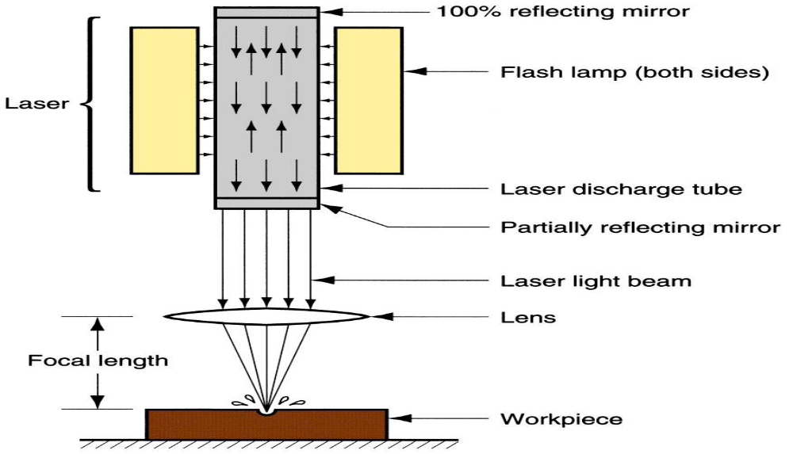
LASER BEAM WELDING
Equipment
Schematic illustration of the Laser Beam Machining Process

Slide 9
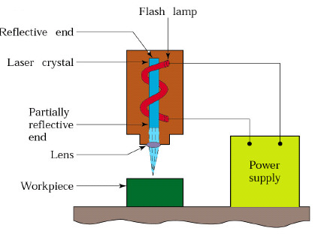
LASER BEAM WELDING
Overall setup

Slide 10
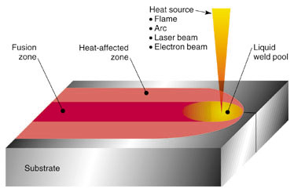
LASER BEAM WELDING
Weld Interface

Slide 11
LASER BEAM WELDING
Sub systems of the Equipment
Flash Lamp
A gas filled light emitting system emits an intense flash or white light with a power source of 250W -1000W. Life time of lamp mainly depends upon the energy input and the current pulse shape
Reflecting mirrors
Two mirrors reflect the photons back and forth and “excite” more electrons
One mirror is partially reflective to allow some light to pass through: creates narrow laser beam
Optical lenses
Used to focus laser beam in to small intense spot on the work piece

Slide 12
LASER BEAM WELDING
Process Parameters
Processing material
Power supply
pulse current (A)
pulse duration (μs)
pulse off time (μs)
Focusing length
Light density
Safety characteristics

Slide 13
LASER BEAM WELDING
Process capabilities
Laser beam drilling
In drilling, energy transferred (e.g., via a Nd:YAG laser) into the work piece melts the material at the point of contact, which subsequently changes into a plasma and leaves the region.
A gas jet (typically, oxygen) can further facilitate this phase transformation and departure of material removed.
Laser drilling should be targeted for hard materials and hole geometries that are difficult to achieve with other methods.

Slide 14
LASER BEAM WELDING
Laser beam milling
A laser spot reflected onto the surface of a workpiece travels along a prescribed trajectory and cuts into the material.
Continuous-wave mode (CO2) gas lasers are very suitable for laser cutting providing high-average power, yielding high material-removal rates, and smooth cutting surfaces.

Slide 15
LASER BEAM WELDING
Applications
The metals about 0.5 to 1.5mm thick can be welded
It is used to weld non-metallic materials and alloys.
It is used to weld dissimilar metals
Laser beam machining is being used extensively in the electronic, aerospace and automotive industries.

Slide 16
LASER BEAM WELDING
Advantages
Single pass weld penetration up to 3/4” in steel
High Travel speed
Materials need not be conductive
No filler metal required
Low heat input produces low distortion
Does not require a vacuum
Sticky materials are also be weld by this process.
High accuracy.
No cutting lubricants required
No tool wear
Narrow heat effected zone

Slide 17
LASER BEAM WELDING
Limitations
Un-Economic on high volumes compared to stamping
High capital cost
High maintenance cost
Assist or cover gas required
Part fit-up and joint tracking are critical
Not portable
Metals such as copper and aluminum have high reflectivity and are difficult to laser weld
High cooling rates may lead to materials problems

Slide 18
END

