Slide 1
MANUFACTURING TECHNOLOGY
UNIT – I
ULTRASONIC WELDING

Slide 2
ULTRASONIC WELDING
Introduction
A solid state welding process in which coalescence is produced at the faying surfaces by the application of high frequency vibratory energy while the work pieces are held together under moderately low static pressure.
This process is performed under the application of clamping force which holds the surfaces to be welded together.

Slide 3
ULTRASONIC WELDING
Operating Principle
Ultrasonic welding (USW) is a solid state welding process used for rapidly joining a wide range of similar and dissimilar combinations of metals in very short cycle time and without melting the materials being joined
It used the high frequency mechanical vibrations to join materials. This is performed by the local application of mechanical energy in a direction parallel to the weld interface

Slide 4
ULTRASONIC WELDING
A static clamping force is applied perpendicular to the interface between the work pieces.
The contacting sonotrode oscillates parallel to the interface.
Combined effect of static and oscillating force produces deformation which promotes welding.

Slide 5
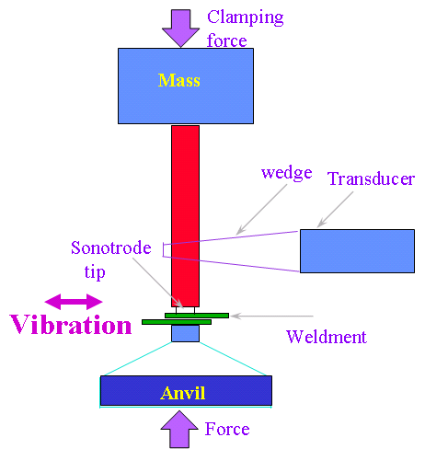
ULTRASONIC WELDING
Equipment
Schematic illustration of the ultrasonic-machining process

Slide 6
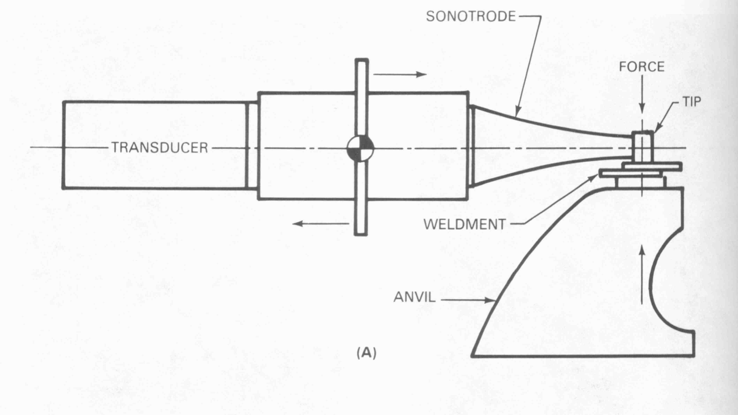
ULTRASONIC WELDING
Sub Systems of the Equipment

Slide 7
ULTRASONIC WELDING
Sub Systems of the Equipment
Power supply
Electrical power of 60 Hz is supplied to the frequency converter.
The frequency converter converts the required 60 Hz signal to the welding frequency (from 10 to 75 kHz).
Frequency is transformed to vibration energy through the transducer.

Slide 8
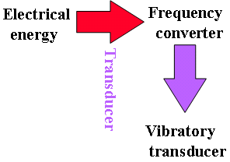
ULTRASONIC WELDING
Energy requirement established through the following empirical relationship.
  E = K (HT)^{3/2}
  E = electrical energy
  H = Vickers hardness number
  T = thickness of the sheet
Where:
E = electrical energy
k = a constant for a given welding system ( based on transducer type)
H = Vickers hardness number of the sheet
T = thickness of the sheet in contact with the sonotrode tip, in mm

Slide 9
ULTRASONIC WELDING
Transducer
Converts Electrical Energy in to Mechanical Energy in the form of high frequency vibrations
When transducer is magnetized, a change in length occurs. The connecting body attached to the transducer receives and transmits this change in length and it is further amplified by a Coupling system( usually stepped or exponential in shape)

Slide 10
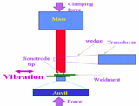
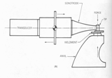
ULTRASONIC WELDING
Coupling system
It transmits high frequency vibrations from the transducer to the work piece
Types
  Wedge reed system ( Vertical vibrations)
  Lateral drive system ( Horizontal vibrations)
Wedge reed system
Lateral drive system

Slide 11
ULTRASONIC WELDING
Clamping system
It provides the static force necessary to hold the work pieces together during the weld cycle
Types
  Spring systems ( Low clamping force requirement)
  Pneumatic systems ( Medium clamping force requirement)
  Hydraulic systems ( High clamping force requirement)

Slide 12
ULTRASONIC WELDING
Sonotrode
Supplies the clamping force perpendicular to the interface between the work pieces.
Types
  Linear Sonotrode - Line Welding
  Roller Sonotrode - Continuous Seam Welding

Slide 13
ULTRASONIC WELDING
Process Parameters
Ultrasonic power
Clamping force
Welding time
Frequency
Linear Vibration Amplitude

Slide 14
ULTRASONIC WELDING
Ultrasonic power
  16000W- Spot weld, 100 to 500W – Seam weld
Clamping force
  Depends upon the contact area of the weld zone - 270 to 2720 N
Welding time
  Depends upon the thickness of the weld zone – 4.5 m/min
Frequency
  Depends upon the natural resonance frequency of the coupling system
Linear Vibration Amplitude
  Depends upon the operating frequency of transducer

Slide 15
ULTRASONIC WELDING
Applications
Assembling of electronic components such as diodes and semiconductors with substrates.
Electrical connections to current carrying devices including motors, field coils, and capacitors.
Encapsulation and packaging.
Plastic parts

Slide 16
ULTRASONIC WELDING
Advantages
No heat is applied and no melting occurs.
Permits welding of thin to thick sections.
Welding can be made through some surface coatings.
Pressures used are lower, welding times are shorter, and the thickness of deformed regions are thinner than for cold welding.
Welds high thermal conductive materials

Slide 17
ULTRASONIC WELDING
Limitations
Process is limited to lap joints.
Butt welds can not be made because there is no means of supporting the work pieces and applying clamping force.
Limited in thickness
Tip sticking may occur in some applications
Possibility of part damage because of resonance

Slide 18
END

