Slide 1
MANUFACTURING TECHNOLOGY
UNIT – I
ELECTRICAL RESISTANCE WELDING

Slide 2
ELECTRICAL RESISTANCE WELDING
Introduction
Resistance welding uses the application of electric current and mechanical pressure to create a weld between two pieces of metal.
Weld electrodes conduct the electric current to the two pieces of metal as they are forged together.
The welding cycle must first develop sufficient heat to raise a small volume of metal to the molten state.
This metal then cools while under pressure until it has adequate strength to hold the parts together.
The current density and pressure must be sufficient to produce a weld nugget, but not so high as to expel molten metal from the weld zone.

Slide 3
ELECTRICAL RESISTANCE WELDING
Operating Principle
Parts to be welded (usually sheet metal) are placed in between two opposing copper electrodes
When alternating current (A/C) is passed through the electrodes ,the electrical resistance at the metal joints becomes very high.
Heat generated by electrical resistance to current flow at junction to be welded by means of applying pressure to squeeze parts between electrodes
Pressure is applied to the contact zone until the current is turned off in order to obtain a strong weld.

Slide 4
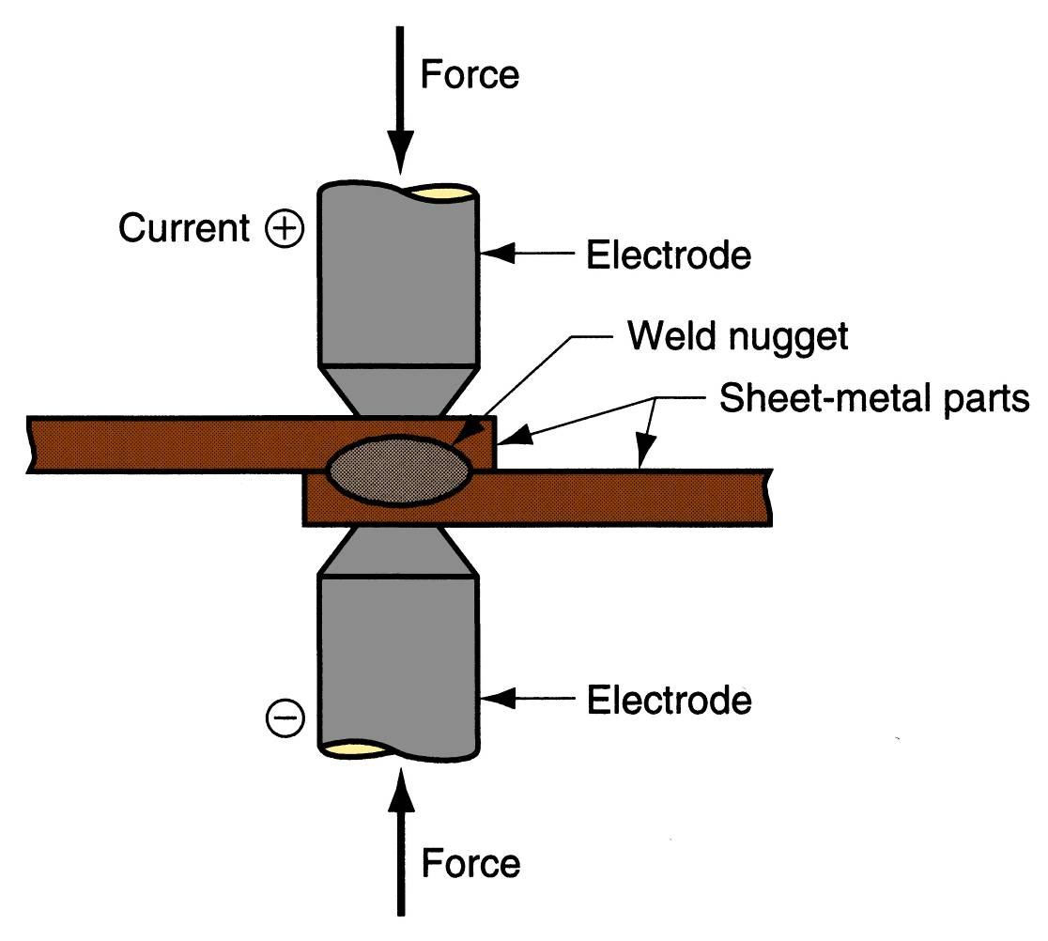
ELECTRICAL RESISTANCE WELDING
Equipment
Schematic illustration of Electrical Resistance Welding

Slide 5
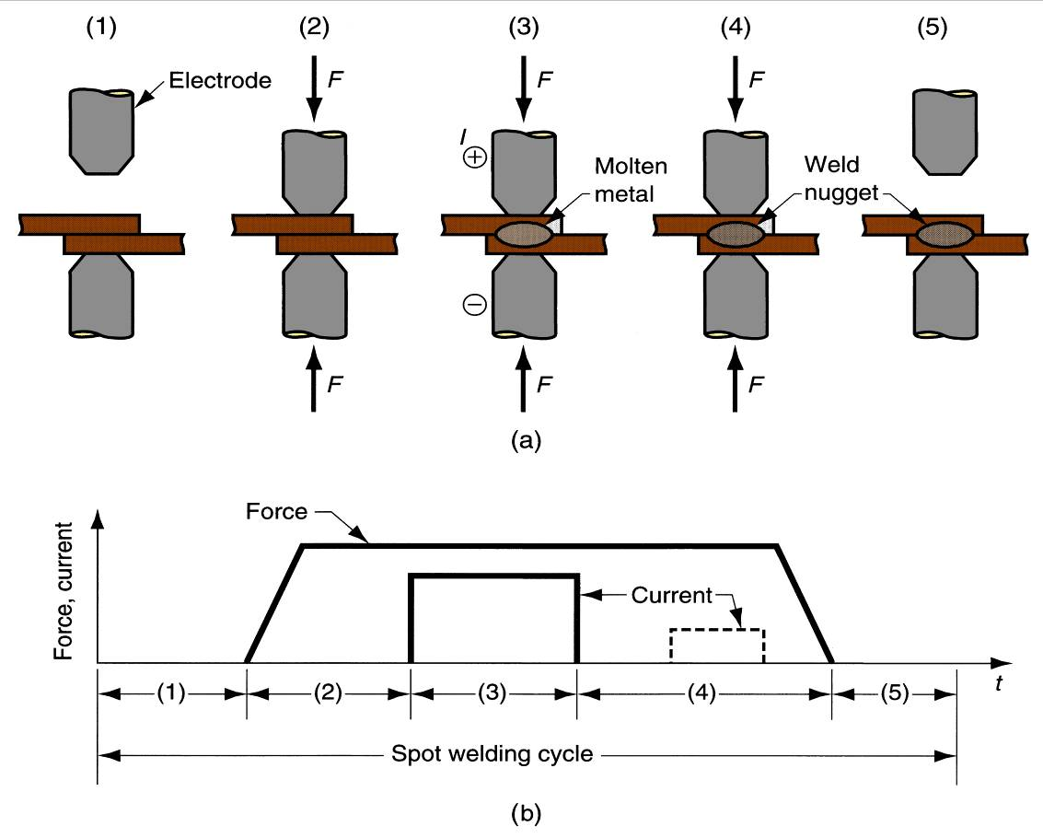
ELECTRICAL RESISTANCE WELDING
Equipment
Electrical Resistance Welding Process

Slide 6
ELECTRICAL RESISTANCE WELDING
Operating Principle in Detail
Parts inserted between electrodes
Electrodes close, force applied
Current on
Current off
Electrodes opened

Slide 7
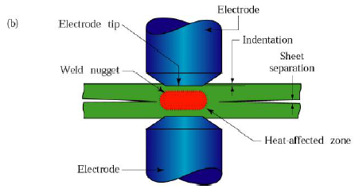
ELECTRICAL RESISTANCE WELDING
Types of Resistance Welding
Resistance Spot Welding

Slide 8
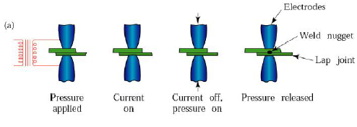
ELECTRICAL RESISTANCE WELDING
Resistance Spot Welding Process Detail

Slide 9
ELECTRICAL RESISTANCE WELDING
Operating Principle
Resistance welding process in which fusion of faying surfaces of a lap joint is achieved at one location by opposing electrodes
Used to join sheet metal parts using a series of spot welds
Widely used in mass production of automobiles, appliances, metal furniture, and other products made of sheet metal

Slide 10
ELECTRICAL RESISTANCE WELDING
Resistance Seam Welding
Resistance Seam Welding is modification of spot welding wherein the electrodes are replaced by rotating wheels or rollers
The electrically conducting rollers produce a spot weld
RSEM can produce a continuous seam & joint that is liquid and gas tight

Slide 11
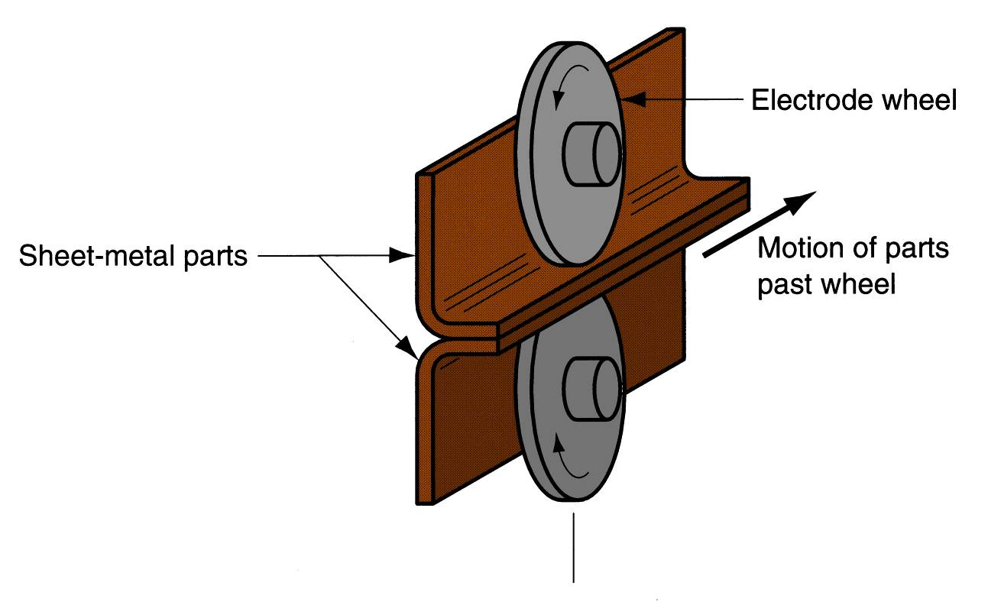
ELECTRICAL RESISTANCE WELDING
Resistance Seam Welding

Slide 12
ELECTRICAL RESISTANCE WELDING
Resistance Projection Welding
RPW is developed by introducing high electrical resistance at a joint by embossing one or more projections on the surface to be welded
The electrodes exert pressure to compress the projections
Nuts and bolts can be welded to sheet and plate by this process
Metal baskets, oven grills, and shopping carts can be made by RPW

Slide 13
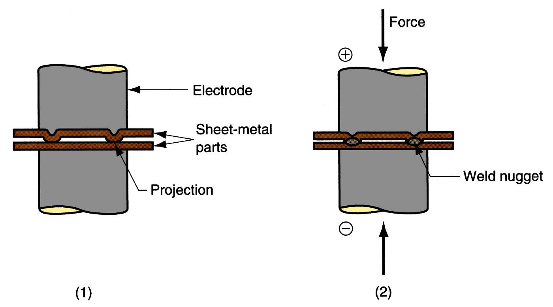
ELECTRICAL RESISTANCE WELDING
Resistance Projection Welding

Slide 14
ELECTRICAL RESISTANCE WELDING
Resistance Projection Welding Process steps
start of operation, contact between parts is at Projections
When current is applied, weld nuggets similar to spot welding are formed at the projections.

Slide 15
ELECTRICAL RESISTANCE WELDING
Heat Generated in the weld may be expressed as
Q = K R I² T
Where,
K: constant less than 1 related to heat losses.
I : Current.
R: Resistance of ionized air gap.
T : Welding time.

Slide 16
ELECTRICAL RESISTANCE WELDING
Process Parameters
The welding current
welding temperatures
Electrode materials
Electrode geometry
Electrode pressing force
Weld current and weld time.

Slide 17
ELECTRICAL RESISTANCE WELDING
Advantages
High speed welding
Easily automated
Suitable for high rate production
Economical

Slide 18
ELECTRICAL RESISTANCE WELDING
Limitations
Initial equipment costs
Lower tensile and fatigue strengths
Lap joints add weight and material

Slide 19
ELECTRICAL RESISTANCE WELDING
Applications
Industries: automotive, aircraft, farm equipment, petroleum and natural gas

Slide 20
END

