Slide 1
MANUFACTURING TECHNOLOGY
UNIT – IV
GEAR MANUFACTURING PROCESS

Slide 2
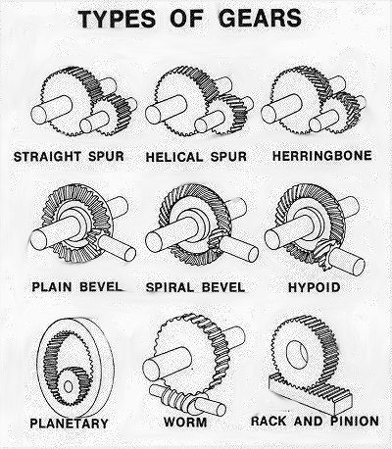
Manufacturing Technology
Introduction
Gears are used extensively for transmission of power.
Applications
Automobiles,
gear boxes,
oil engines,
machine tools,
industrial machinery,
agricultural machinery,
geared motors etc.

Slide 3
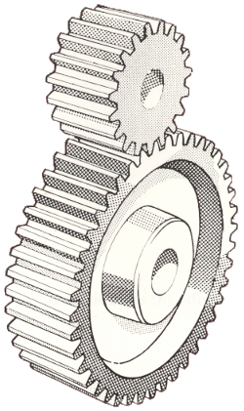
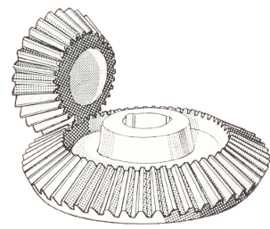
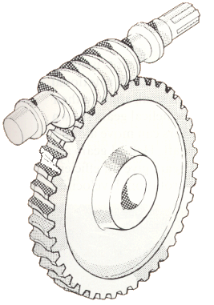
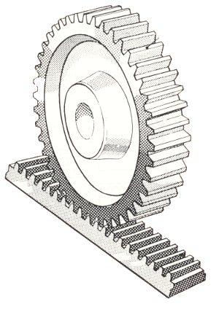
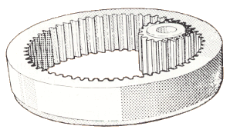
Types of gears
Spur gear→The larger gear is called a wheel, and the smaller gear is called a pinion.
Bevel gears have teeth cut on a cone instead of a cylinder blank. They are used in pairs to transmit rotary motion and torque where the bevel gear shafts are at right angles(90 degrees) to each other.
A gear which has one tooth is called a worm. The tooth is in the form of a screw thread. The worm-wheel is a helical gear with teeth inclined so that they can engage with the thread-like worm. The worm-wheel transmits torque and rotary motion through a right angle.
A rack and pinion mechanism is used to transform rotary motion into linear motion and vice versa. A round spur gear, the pinion, meshes with a spur gear which has teeth set in a straight line, the rack.
Internal gears have better load-carrying capacity than external spur gears. They are safer in use because the teeth are guarded

Slide 4
Manufacturing Technology
Materials used in Gear Manufacturing Process
Ferrous materials(Cast irons)
Non ferrous materials
Selection of Gear Materials Depends upon
Type of service
Peripheral speed
Degree of accuracy required
Method of manufacture
Required dimensions & weight of the drive
Allowable stress
Shock resistance
Wear resistance.

Slide 5
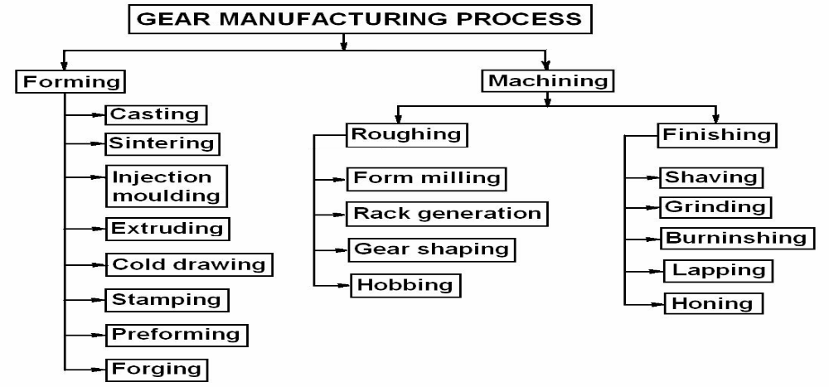
Manufacturing Technology
Gear Manufacturing can be divided into two categories,
Forming and Machining.
Forming - Casting, molding, drawing, or extrusion of tooth forms in molten, powdered, or heat softened materials.
Machining - roughing , finishing operations.

Slide 6
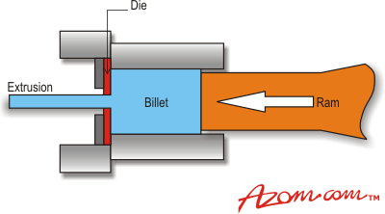
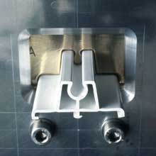
Manufacturing Technology
Gear Forming Process
Extrusion
Extrusion is a manufacturing process where material is drawn through a die, giving the material a new cross-sectional shape that is usually constant throughout the lengths of the material. Dies with multiple openings can extrude several strands simultaneously, as well as create hollow cross-sections by using a pin (mandrel) in the die.

Slide 7
Manufacturing Technology
Extrusion
Extrusion process is used to form teeth on long rods, which are then cut into usable lengths and machined for bores and keyways etc.
Nonferrous materials such as aluminum and copper alloys are commonly extruded rather than steels.
Small sized gear can also be made by extrusion process.
This method can produce any shape of tooth & it is suitable for high volume production.
Application
watches, clocks, type writers etc.

Slide 8
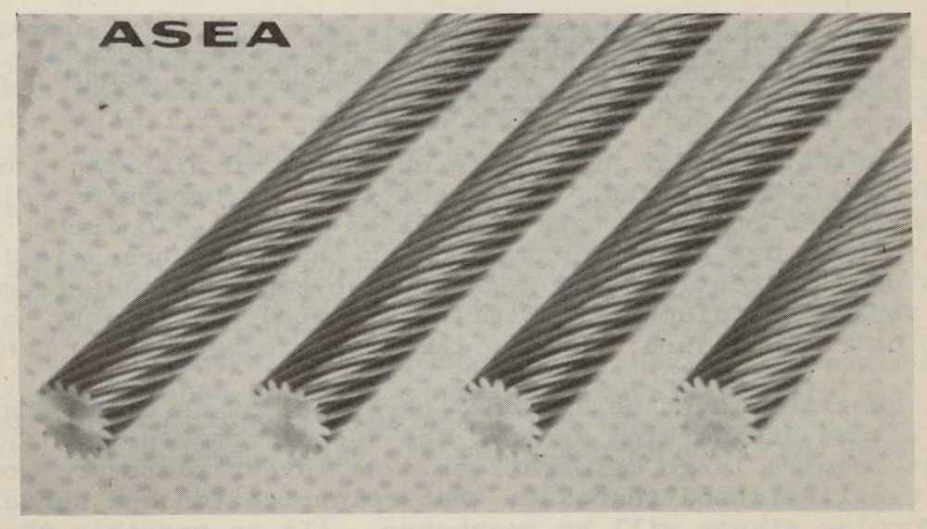
Manufacturing Technology
Extrusion
Helical Gear Made by Extrusion Process

Slide 9
Manufacturing Technology
Stamping
Stamping (also known as pressing) includes a variety of sheet-metal forming manufacturing processes, such as punching using a machine press or stamping press
Sheet metal can be stamped with tooth shapes to form low precision gears at low cost in high quantities.
Surface finish and accuracy are poor.
Application
Toy gears, hand operated machine gears, slow speed mechanism gears
Precision stamping
The dies are made of higher precision with close tolerances. The stamped gears will not have burrs.
Application
Clock gears, watch gears etc.

Slide 10
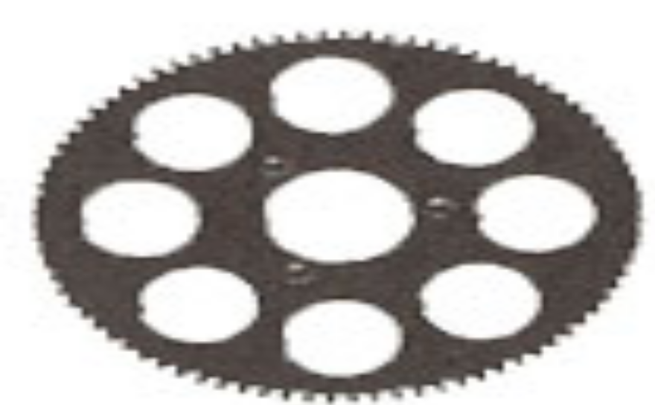
Manufacturing Technology
Stamping
After stamping, the gears are shaved; they give best finish & accuracy.
suitable for large volume production.
Materials
low, medium & high carbon steels, stainless steel.
Stamped Gear

Slide 11
Manufacturing Technology
Powder metallurgy
Sintering Process
Sintering is a method for creating objects from powders, including metal and ceramic powders. It is based on atomic diffusion. Diffusion occurs in any material above absolute zero, but it occurs much faster at higher temperatures. In most sintering processes, the powdered material is held in a mold and then heated to a temperature below the melting point.
The atoms in the powder particles diffuse across the boundaries of the particles, fusing the particles together and creating one solid piece.
The metal powder is pressed in dies to convert into tooth shape, after which the product is sintered. After sintering, the gear may be coined to increase density & surface finish. This method is usually used only for small gears.

Slide 12


Slide 13
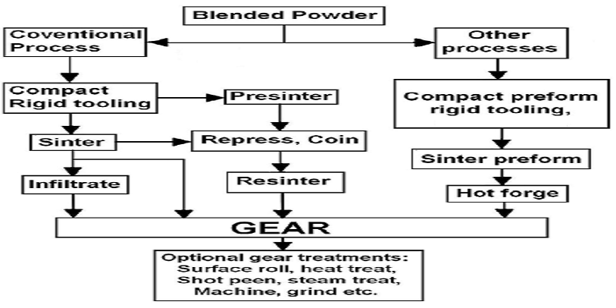
sintering

Slide 14
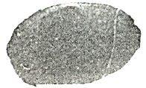
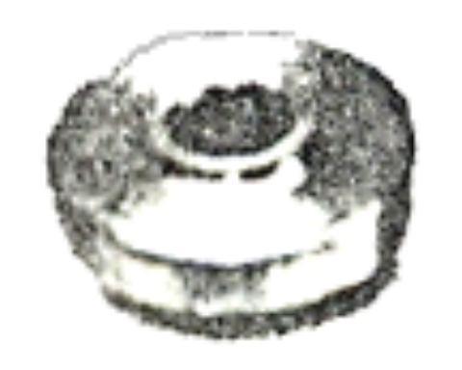
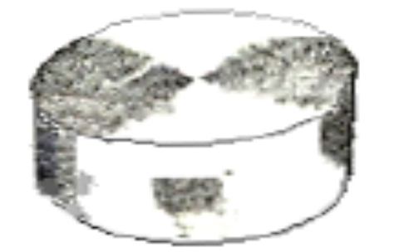
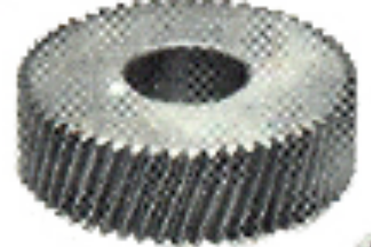
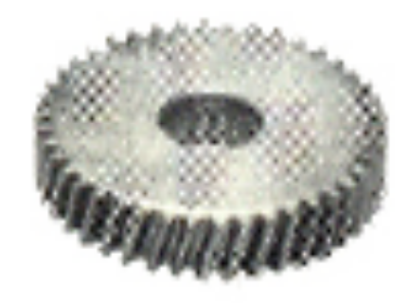
Manufacturing Technology
Sintering Process
Blended Powder
Compacted Rigid Tooling
( Powder compacted rigidly)
Pre-sinter
Repress or Coining
Re-sinter
Gear

Slide 15
Manufacturing Technology
Sintered Gear characteristics
Accuracy similar to die cast gears
Material properties can be tailor made
Typically suited for small size gears
Economical for large lot size only
Secondary machining is not required
Applications
High quality gears.
Toys, instruments, small motor drives etc.

Slide 16
Manufacturing Technology
Gear Machining or Generating Process
Roughing processes
Generating the shape with a rack cutter, shaping cutter or a hob cutter.
Roughing processes actually produce a smooth and accurate gear tooth.
For high precision and quiet running, the secondary finishing operation is justified at added cost

Slide 17
Manufacturing Technology
Gear shaping Process
Gear shaping uses a cutting tool in the shape of a gear which is reciprocated axially across the gear blank to cut the teeth while the blank rotates around the shaper tool.
Gear shaping by disc Cutter
The disc cutter shape confirms the gear tooth shape. Each gear needs separate cutter.
With 8 to 10 std. cutters, gears from 121 to 120 teeth can be cut with fair accuracy.
Tooth is cut one by one by plunging the rotating cutter in to the blank.

Slide 18
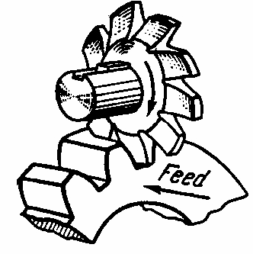
Manufacturing Technology
Gear shaping by disc Cutter

Slide 19
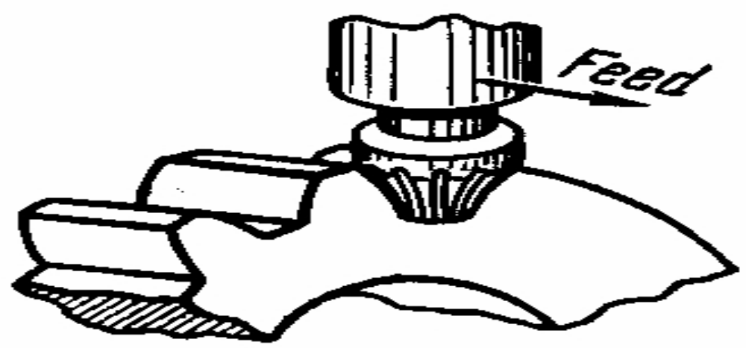
Manufacturing Technology
Gear Shaping by End Mill Cutter
The End mill cutter shape confirms the gear tooth shape.
Each tooth is cut at time and then indexed for next Tooth space for cutting. A set of 10 cutters will do for 12 to 120 teeth gears.
small volume production of low precision gears.

Slide 20
Manufacturing Technology
Gear Shaping by Rack – type cutter
The rack cutter generating process is also called gear shaping process. In this method, the generating cutter has the form of a basic rack for a gear to be generated.
The cutter reciprocates rapidly & removes metal only during the cutting stroke.
The blank is rotated slowly but uniformly about its axis and between each cutting stroke of the cutter, the cutter advances along its length at a speed Equal to the rolling speed of the matching pitch lines.
When the cutter & the blank have rolled a distance Equal to one pitch of the blank, the motion of the blank is arrested, the cutter is with drawn from the blank to give relief to the cutting Edges & the cutter is returned to its starting position. The blank is next indexed & the next cut is started following the same procedure.

Slide 21
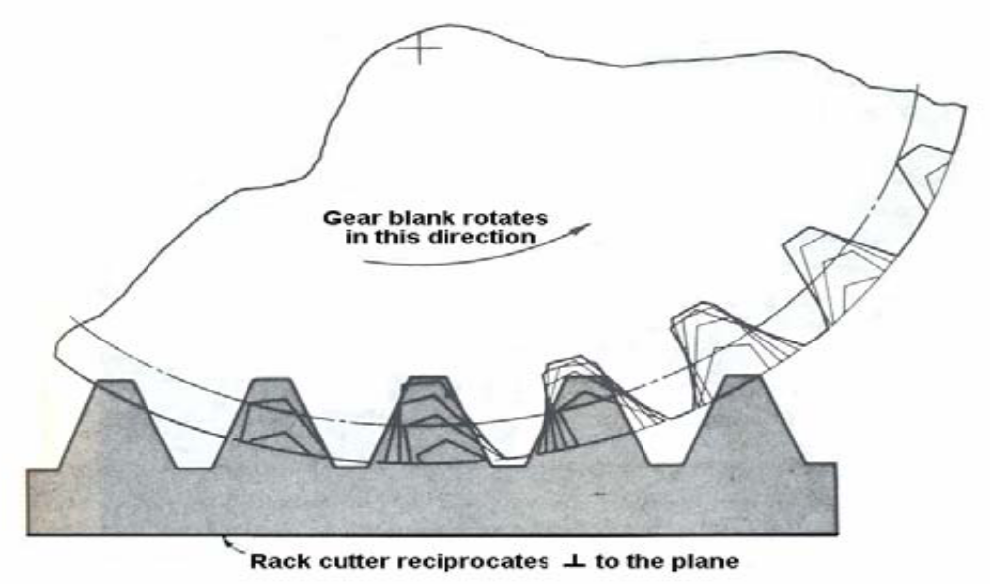
Manufacturing Technology
Gear Shaping by Rack – type cutter

Slide 22
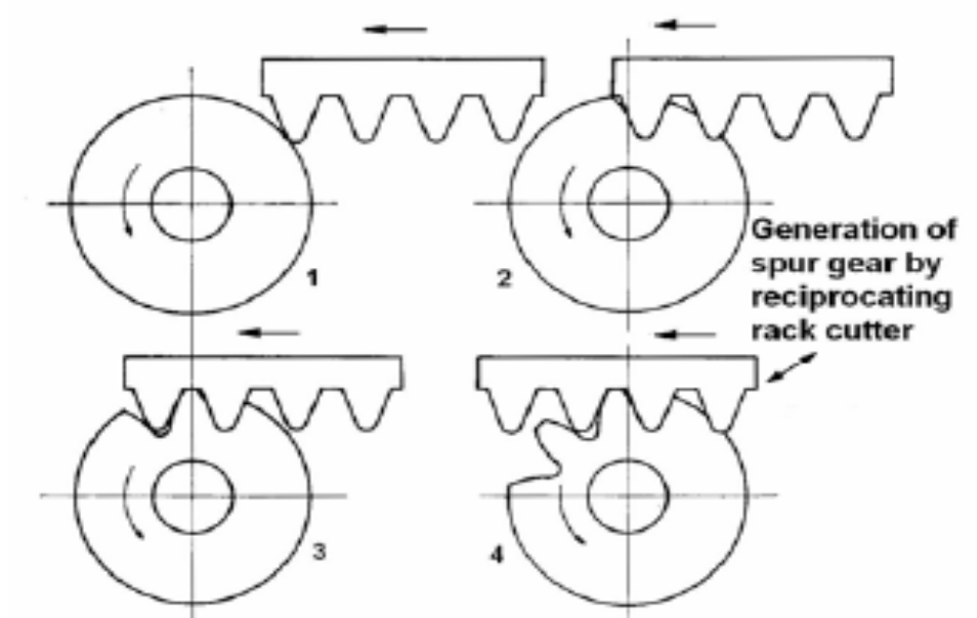
Manufacturing Technology
Spur Gear Generation by Rack – type cutter

Slide 23
Manufacturing Technology
Gear Shaping by Pinion type cutter
The pinion cutter generating process is fundamentally the same as the rack cutter generating process, and instead of using a rack cutter, it uses a pinion to generate the tooth profile.
The cutting cycle is commenced after the cutter is fed radically into the gear blank Equal to the depth of tooth required. The cutter is then given reciprocating cutting motion parallel to its axis similar to the rack cutter and the cutter & the blank are made to rotate slowly about their axis at speeds which are equal at the matching pitch surfaces.
This rolling movement blow the teeth on the blank are cut. The pinion cutter in a gear shaping machine may be reciprocated either in the vertical or in the horizontal axis.

Slide 24
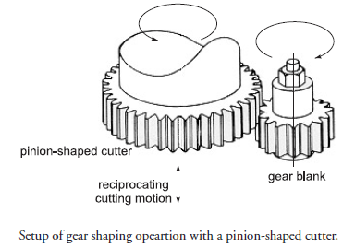
Manufacturing Technology
Gear Shaping by Pinion type cutter

Slide 25
Manufacturing Technology
Gear Hobbing
Hobbing is the process of generating gear teeth by means of a rotating cutter called a hob. It is a continues indexing process in which both the cutting tool & work piece rotate in a constant relationship while the hob is being fed into work.
The hob and the gear blank are connected by means of proper change gears. The ratio of hob & blank speed is such that during one revolution of the hob, the blank turns through as many teeth.
The teeth of hob cut into the work piece in Successive order & each in a slightly different position.
Each hob tooth cuts its own profile depending on the shape of cutter. one rotation of the work completes the cutting up to certain depth.

Slide 26
Manufacturing Technology
Gear Hobbing
Hob teeth are shaped to match the tooth shape and space and are interrupted with grooves to provide cutting surfaces. It rotates about an axis normal to that of the gear blank, cutting into the rotating blank to generate the teeth
It is the most accurate machining process since no repositioning of tool or blank is required and each tooth is cut by multiple hop teeth averaging out any tool errors. Excellent surface finish is achieved by this method and it is widely used for production of gears

Slide 27
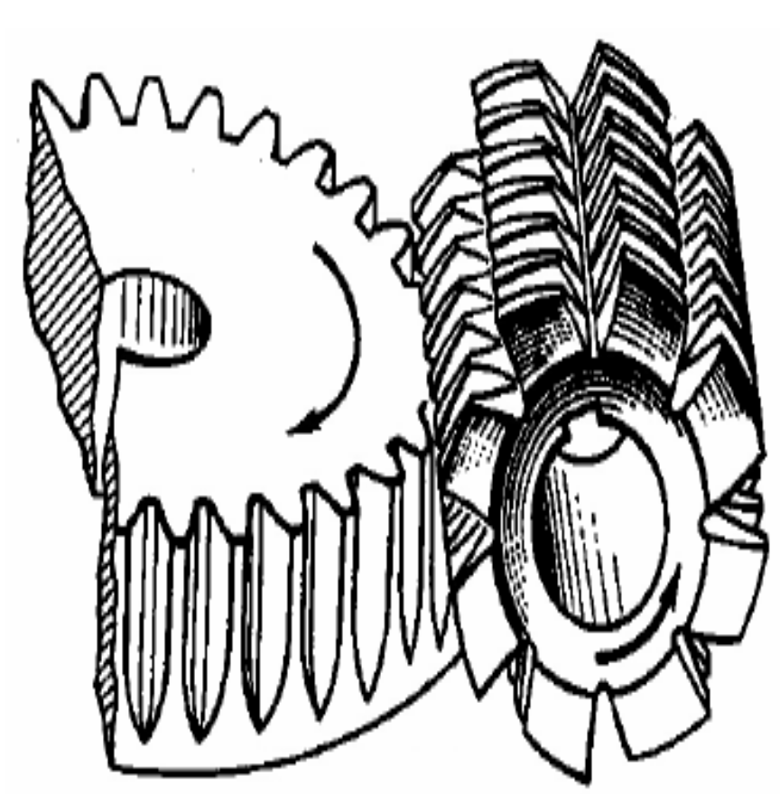
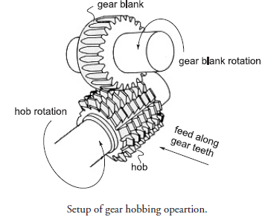
Manufacturing Technology
Gear Hobbing

Slide 28
Manufacturing Technology
Types of Gear Hobbing
Axial hobbing
This type of feeding method is mainly used for cutting spur or helical gears. In this type, firstly the gear blank is brought towards the hob to get the desired tooth depth.
The table side is then clamped after that, the hob moves along the face of the blank to complete the job.
Axial hobbing which is used to cut spur & helical gears can be obtained by ‘climb noting’ or ‘conventional hobbing!

Slide 29
Manufacturing Technology
Radial Hobbing
This method of hobbing is mainly used for cutting Bevel Gears. In this method the hob & gear blank are set normal to Each other.
The gear blank continues to rotate at a set speed about its vertical axes and the rotating hob is given a feed in a radial direction. As soon as the required depth of tooth is cut, feed motion is stopped.
Tangential hobbing
This is another common method used for cutting worm wheel or gears ( non parallel and non intersecting). In this method, the worm wheel blank is rotated in a vertical plane about a horizontal axis. The hob is also held its axis or the blank.
Before starting the cut, the hob is set at full depth of die tooth and then it is rotated.
The front portion of the hob is tapered up to a certain length & gives the feed in tangential to the blank face & hence the name ‘Tangential feeding or hobbing.

Slide 30
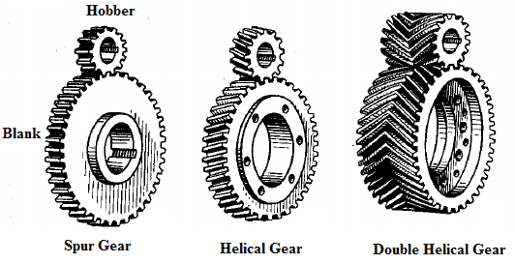
Manufacturing Technology
Axial Hobbing ( Axis of Hobber and blank are parallel)

Slide 31
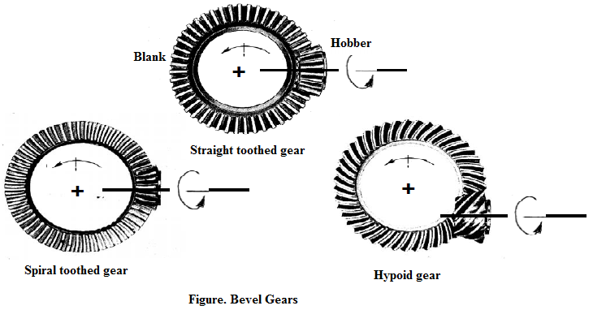
Manufacturing Technology
Radial Hobbing ( Axis of Hobber and blank are Perpendicular)

Slide 32
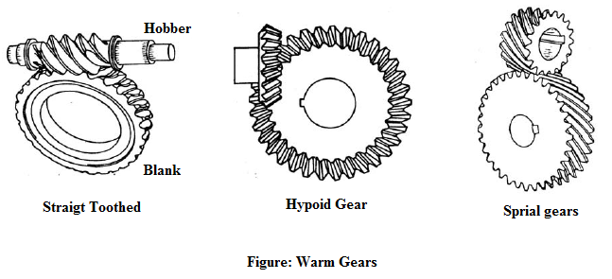
Manufacturing Technology
Tangential Hobbing ( Axis of Hobber and blank are Tangential)

Slide 33
Manufacturing Technology
Advantages
The gears produced by the method are of very high accuracy.
Both internal & external gears can be cut by this process.
Non – conventional types of gears can also be cut by this method.
Disadvantages
The production rate with gear shaper is lower than Hobbing.
There is no cutting on the return stroke in a gear shaper.
Worm & worm wheels can’t be generated on a gear shaper.

Slide 34
END

