Slide 1
MANUFACTURING TECHNOLOGY
UNIT – II
MECHANICAL WORKING OF METALS

Slide 2
MECHANICAL WORKING OF METALS
Hot and Cold Working: Rolling, Forging, Wire Drawing, Extrusion– types– Forward, backward and tube extrusion.
Sheet Metal Operations: Blanking– blank size calculation, draw ratio, drawing force, Piercing, Punching, Trimming, Stretch forming, Shearing, Bending– simple problems– Bending force calculation, Tube forming – Embossing and coining, Types of dies: Progressive, compound and combination dies.

Slide 3
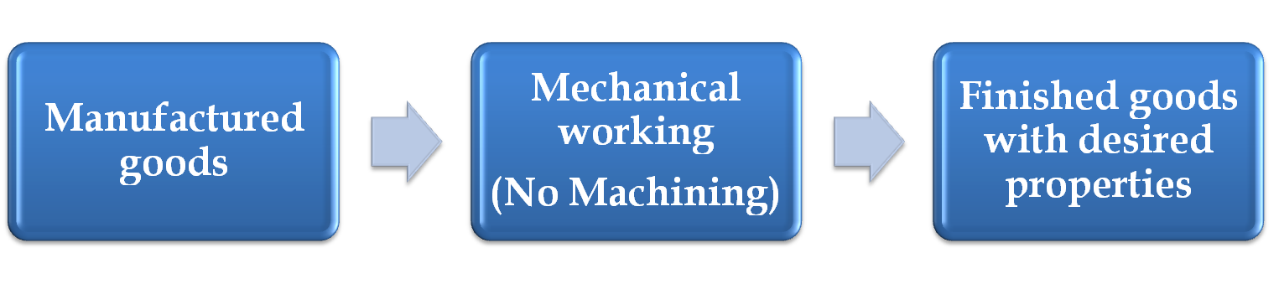
Manufacturing Technology
Mechanical Working of Metals
In this method no machining process is carried out, but it is used to achieve optimum mechanical properties in the metal.
The wastage of material in metal working process is negligible or very small. But the production is very high compared to other process.

Slide 4
Manufacturing Technology
Types of Metal Working or Processing Methods
Mechanical processing
  Hot working
  Cold working
Thermal processing
  Annealing
    Recovery, recrystallization and growth
  Heat treatments
Both of these are used to control properties of the final product

Slide 5
Manufacturing Technology
Hot Working: T>0.5T_{m}
Mechanical working of a metal above the recrystallization temperature but below the melting point is known as hot working.
The temperature at which the complete recrystallization of a metal take place with in a specified time
The recrystallization temperature of metal will be about 30 to 50% of its melting temperature.
Types
Forging
Rolling
Extrusion
Drawing

Slide 6
Manufacturing Technology
Hot Working
Advantages
  Force requirement is less
  Refined grain structure
  No stress formation
  Quick and Economical
  Suitable for all metals
Disadvantages
  Poor surface finish
  Less accuracy
  Very high tooling and handling cost
  Sheets and wires cannot be produced

Slide 7
Manufacturing Technology
Cold Working :T<0.3T_{m}
Mechanical working of a metal below the recrystallization temperature (Room Temperature) is known as cold working.
Reduces the amount of plastic deformation that a material can undergo in subsequent processing and requires more power for further working
Types
Drawing
Squeezing
Bending

Slide 8
Manufacturing Technology
Cold Working
Advantages
  Better surface finish
  High dimensional accuracy
  Sheets and wires can be produced
  Suitable for Mass production
Disadvantages
  Stress formation in metal very high
  Close tolerances cannot be achieved
  No Refined grain structure

Slide 9
Manufacturing Technology
Comparison of Hot and Cold Working
S.No | Hot Working | Cold Working
1 | Working above recrystallization temperature | Working below recrystallization temperature
2 | Formation of new crystals | No crystal formation
3 | Surface finish not good | Good surface finish
4 | No stress formation | Internal Stress formation
5 | No size limit | Limited size

Slide 10
Manufacturing Technology
Forging
Forging is a process in which the work piece is shaped by compressive forces applied through various dies and tools. It is one of the oldest metalworking operations. Most forgings require a set of dies and a press or a forging hammer.
Unlike rolling operations, which generally produce continuous plates, sheets, strip, or various structural cross-sections, forging operations produce discrete parts.
Typical forged products are bolts and rivets, connecting rods, shafts for turbines, gears, hand tools, and structural components for machinery, aircraft, railroads and a variety of other transportation equipment.

Slide 11
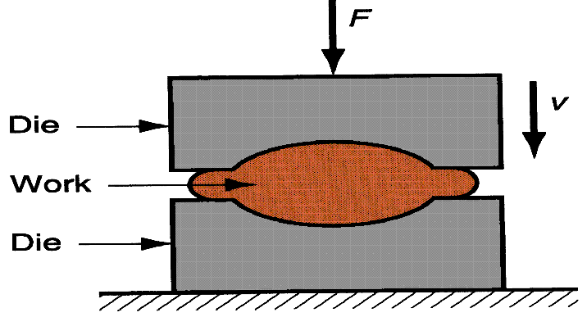
Manufacturing Technology
Forging

Slide 12
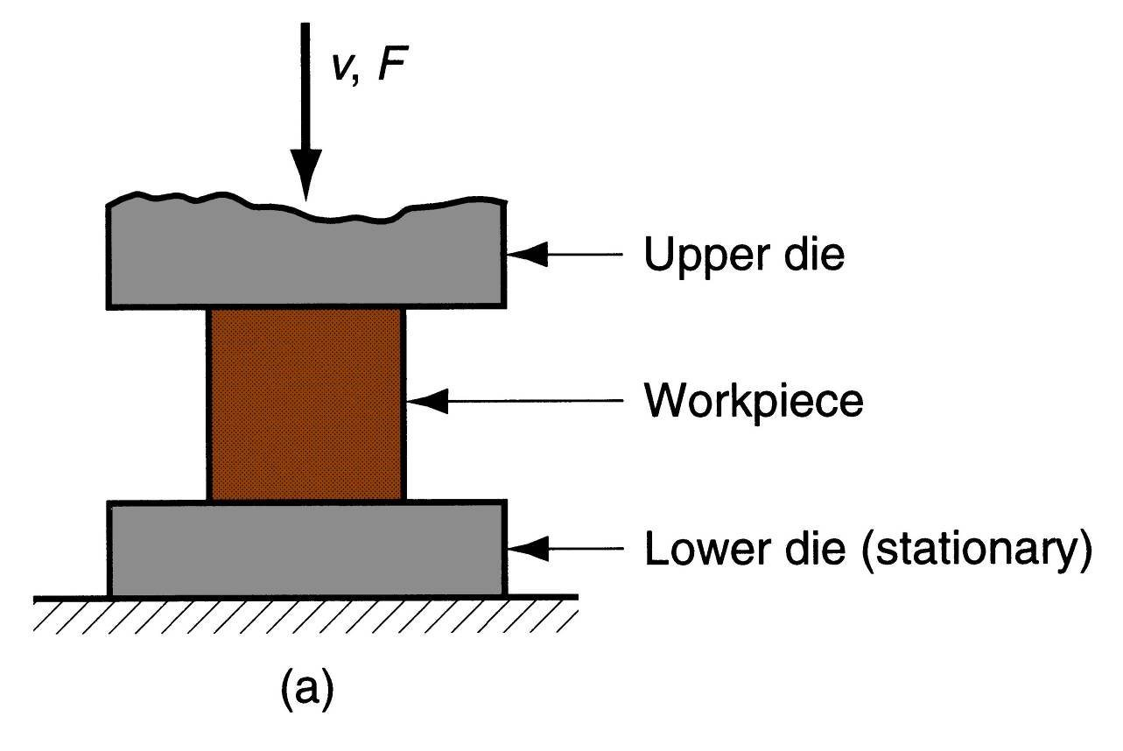
Manufacturing Technology
Forging Methods
Open‑Die Forging
Compression of work part between two flat dies
Deformation operation reduces height and increases diameter of work
Common names include upsetting or upset forging

Slide 13
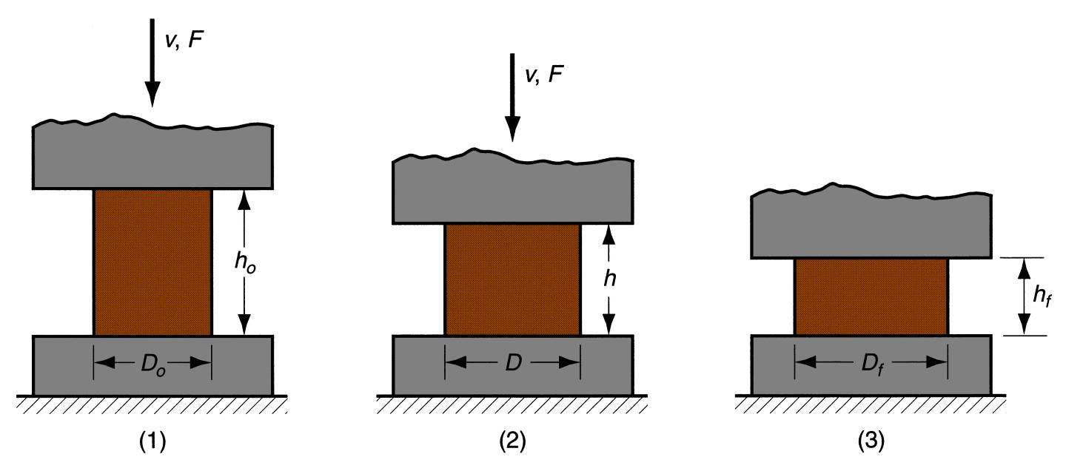
Manufacturing Technology
Open‑Die Forging with No Friction
If no friction occurs between work and die surfaces, then homogeneous deformation occurs, so that radial flow is uniform throughout work part height
Homogeneous deformation of a cylindrical work part
start of process with work piece at its original length and diameter,
partial compression, 3. final size.

Slide 14
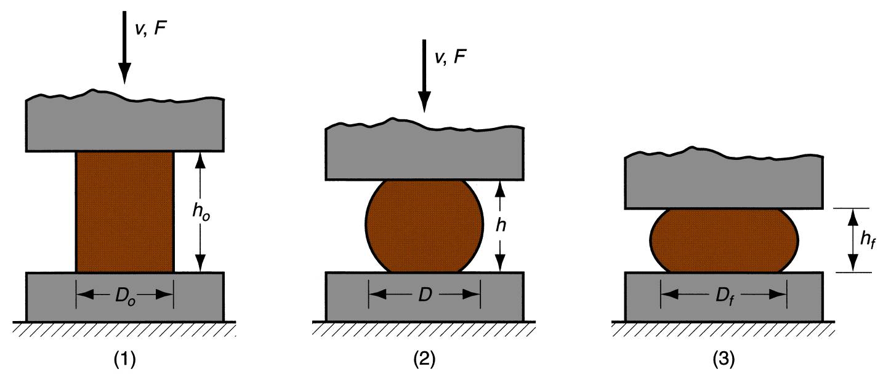
Manufacturing Technology
Open‑Die Forging with Friction
Friction between work and die surfaces constrains lateral flow of work, resulting in barreling effect
In hot open-die forging, effect is even more pronounced due to heat transfer at and near die surfaces, which cools the metal and increases its resistance to deformation
Deformation of a cylindrical work part in open‑die forging, showing pronounced barreling
(1) start of process, (2) partial deformation, (3) final shape.

Slide 15
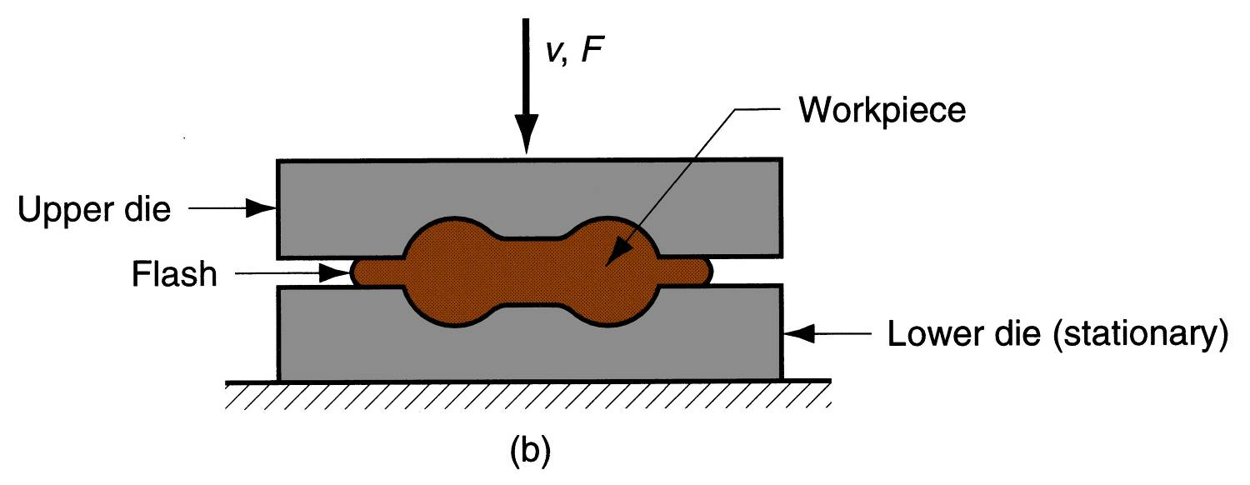
Manufacturing Technology
Impression‑Die Forging
Compression of work part by dies with inverse of desired part shape
Flash is formed by metal that flows beyond die cavity into small gap between die plates
Flash serves an important function:
  As flash forms, friction resists continued metal flow into gap, constraining material to fill die cavity
  In hot forging, metal flow is further restricted by cooling against die plates

Slide 16
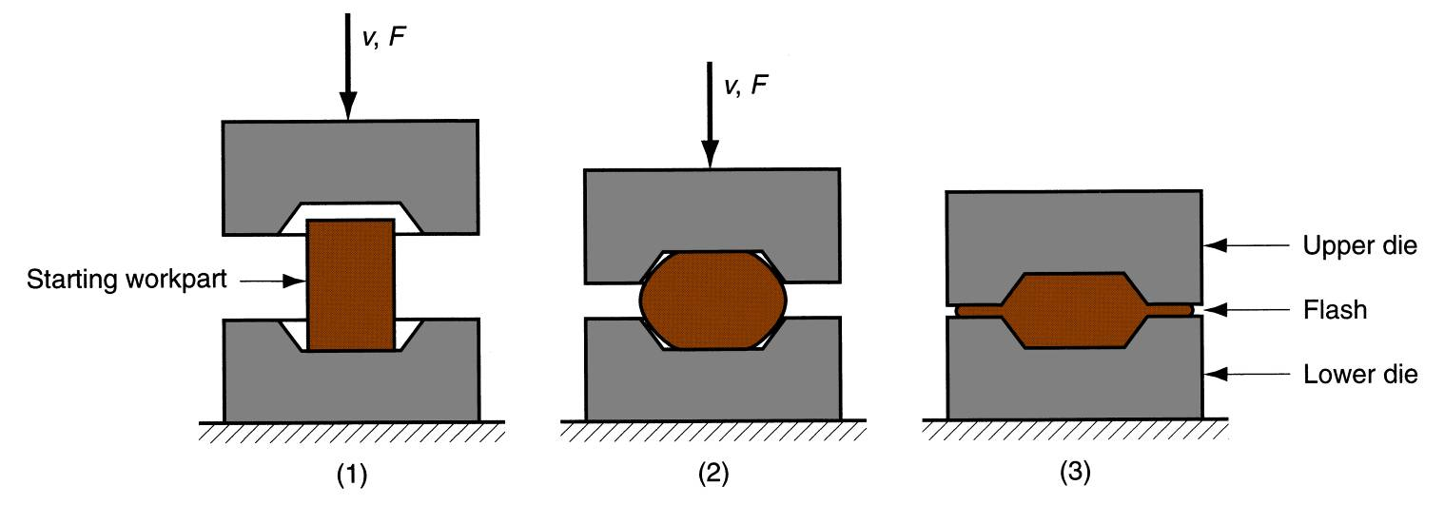
Manufacturing Technology
Impression‑Die Forging
(1) just prior to initial contact with raw work piece, (2) partial compression, and (3) final die closure, causing flash to form in gap between die plates.

Slide 17
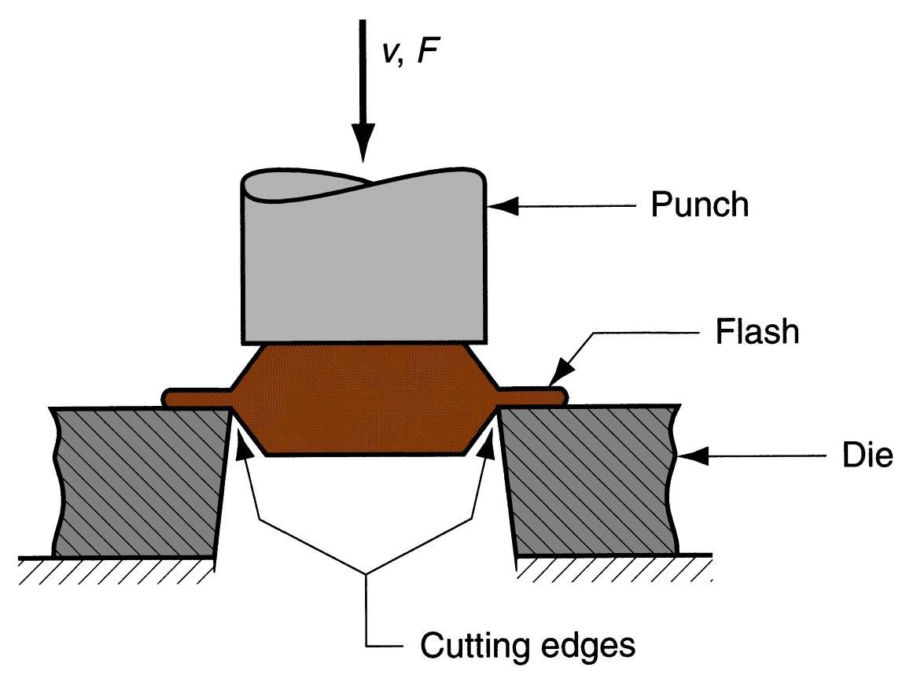
Manufacturing Technology
Trimming After Impression-Die Forging
Trimming operation (shearing process) to remove the flash after impression‑die forging.

Slide 18
Manufacturing Technology
Advantages of impression-die forging compared to machining from solid stock:
  Higher production rates
  Less waste of metal
  Greater strength
  Favorable grain orientation in the metal
Limitations:
  Not capable of close tolerances
  Machining often required to achieve accuracies and features needed

Slide 19
Manufacturing Technology
Flash less Forging
Compression of work in punch and die tooling whose cavity does not allow for flash
Starting work part volume must equal die cavity volume within very close tolerance
Process control more demanding than impression‑die forging
Best suited to part geometries that are simple and symmetrical
Often classified as a precision forging process

Slide 20
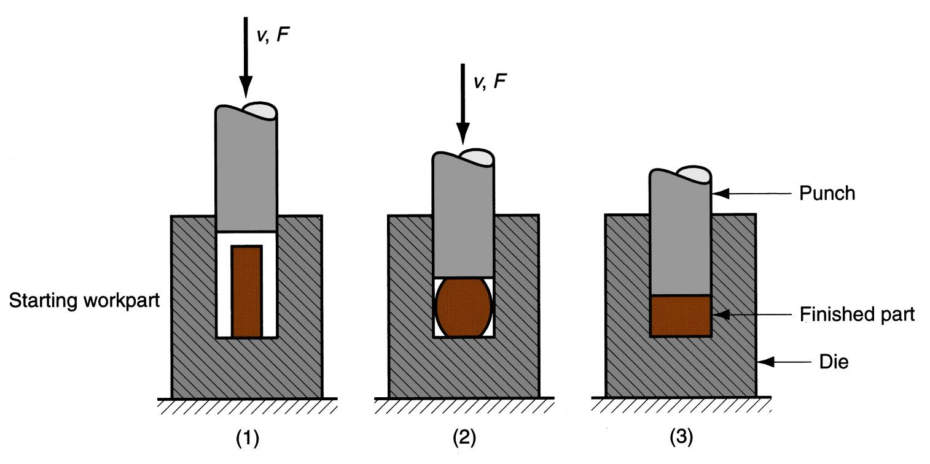
Manufacturing Technology
Flash less Forging
(1) just before initial contact with work piece, (2) partial compression, and (3) final punch and die closure.

Slide 21
Manufacturing Technology
Forging Hammers (Drop Hammers)
Apply impact load against work part
Two types
  Gravity drop hammers - impact energy from falling weight of a heavy ram
  Power drop hammers - accelerate the ram by pressurized air or steam
Disadvantage: impact energy transmitted through anvil into floor of building
Commonly used for impression-die forging

Slide 22
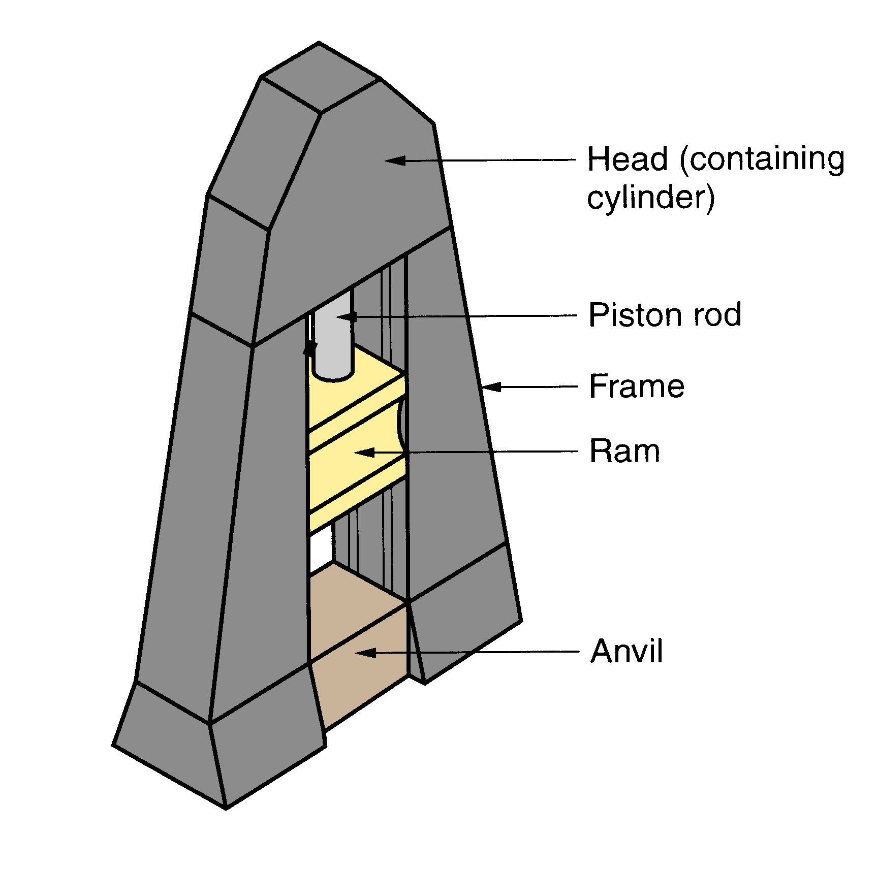
Manufacturing Technology
Drop Hammer Details
Diagram showing details of a drop hammer for impression‑die forging.

Slide 23
Manufacturing Technology
Forging Presses
Apply gradual pressure to accomplish compression operation
Types
  Mechanical press - converts rotation of drive motor into linear motion of ram
  Hydraulic press - hydraulic piston actuates ram
  Screw press - screw mechanism drives ram

Slide 24
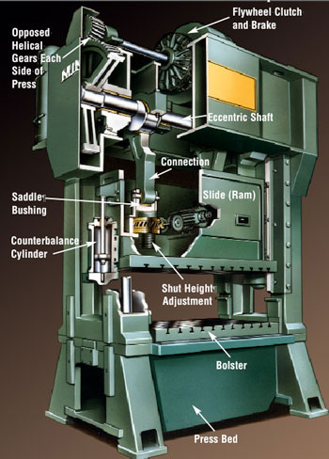
Manufacturing Technology
Mechanical press

Slide 25
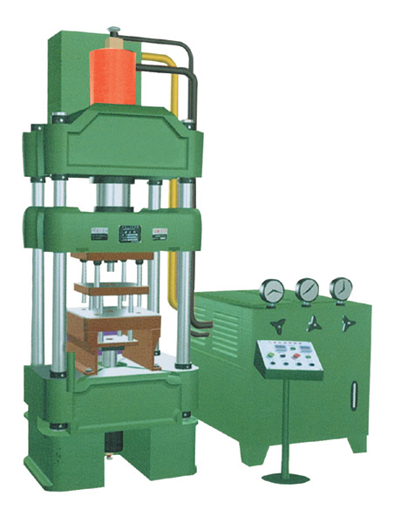
Manufacturing Technology
Hydraulic press

Slide 26
Manufacturing Technology
Upsetting and Heading
Forging process used to form heads on nails, bolts, and similar hardware products
More parts produced by upsetting than any other forging operation
Performed cold, warm, or hot on machines called headers or formers
Wire or bar stock is fed into machine, end is headed, then piece is cut to length
For bolts and screws, thread rolling is then used to form threads

Slide 27
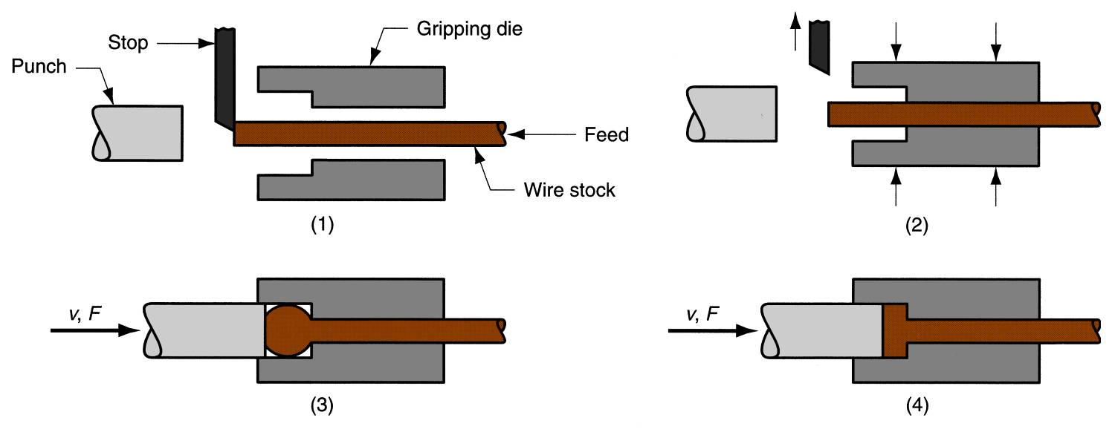
Manufacturing Technology
Upset Forging
An upset forging operation to form a head on a bolt or similar hardware item The cycle consists of: (1) wire stock is fed to the stop, (2) gripping dies close on the stock and the stop is retracted, (3) punch moves forward, (4) bottoms to form the head.

Slide 28
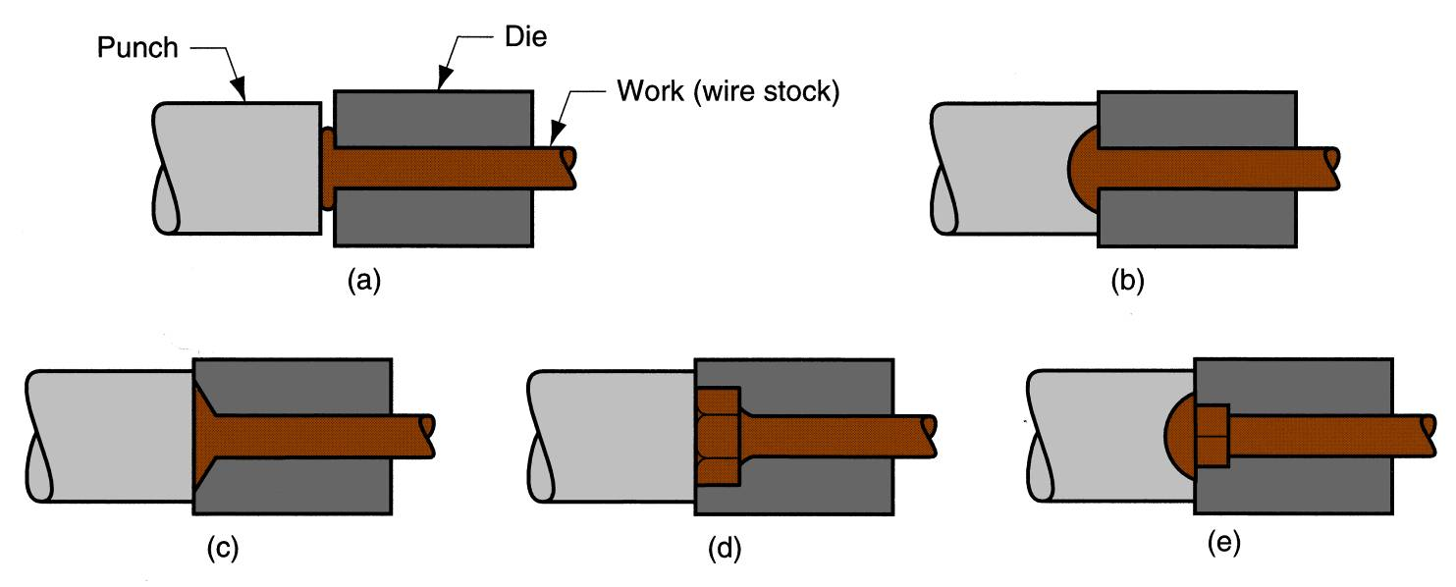
Manufacturing Technology
Heading
Examples of heading (upset forging) operations: (a) heading a nail using open dies, (b) round head formed by punch, (c) and (d) two common head styles for screws formed by die, (e) carriage bolt head formed by punch and die.

Slide 29
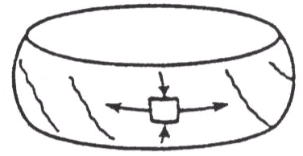
Manufacturing Technology
Forging Defects
Fracture
  Exhausted ductility
  Inter-granular fracture
Barreling - Friction
Solution
  limited deformation per step
  Process anneal between steps

Slide 30
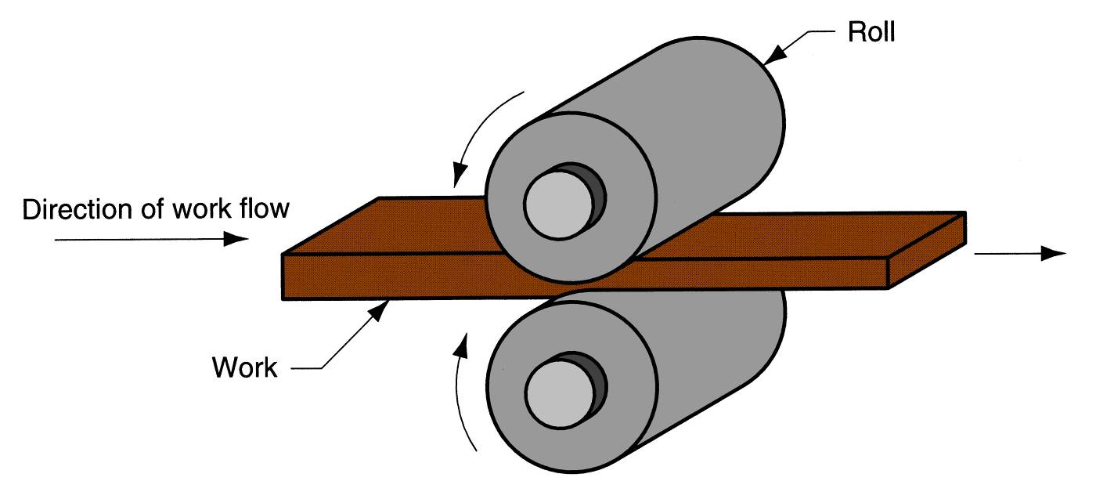
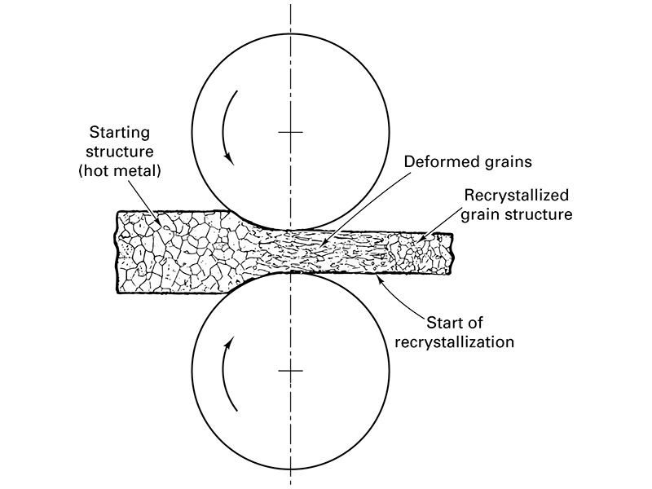
Manufacturing Technology
Rolling
Deformation process in which work thickness is reduced by compressive forces exerted by two opposing rolls
The rolling process (specifically, flat rolling)

Slide 31
Manufacturing Technology
Rolling
The initial breaking down of an ingot or of a continuously cast slab is done by hot rolling. A cast structure includes coarse and non-uniform grains. This structure is usually brittle and may contain porosities.
Hot rolling converts the cast structure to a wrought structure. This structure has finer grains and enhanced ductility, both resulting from the breaking up of brittle grain boundaries and the closing up of internal defects, especially porosity.
The product of the first hot rolling operation is called bloom or slab. A bloom usually has a square cross-section, at least 150 mm (6in) on the side; a slab is usually rectangular in cross section. Blooms are processed further, by shape rolling, into structural shapes, such as I-beams and railroad rails. Slabs are rolled into planes and sheet.
Billets are usually square, with a cross-sectional area smaller than blooms; they are later rolled into various shapes, such as round rods and bars, by the use of shaped rolls. Hot-rolled round rods are used as the starting material for rod and wire drawing. They are called wire rods.

Slide 32
Manufacturing Technology
Rolling
One of the primary first process to convert raw material into finished product.
Starting material (Ingots) are rolled into blooms, billets, or slabs by feeding material through successive pairs of rolls.
    Bloom - square or rectangular cross section with a thickness greater than 6” and a width not greater than twice the thickness
    Billets - square or circular cross section - - smaller than a bloom
    Slabs - rectangular in shape (width is greater than twice the thickness), slabs are rolled into plate, sheet, and strips.

Slide 33
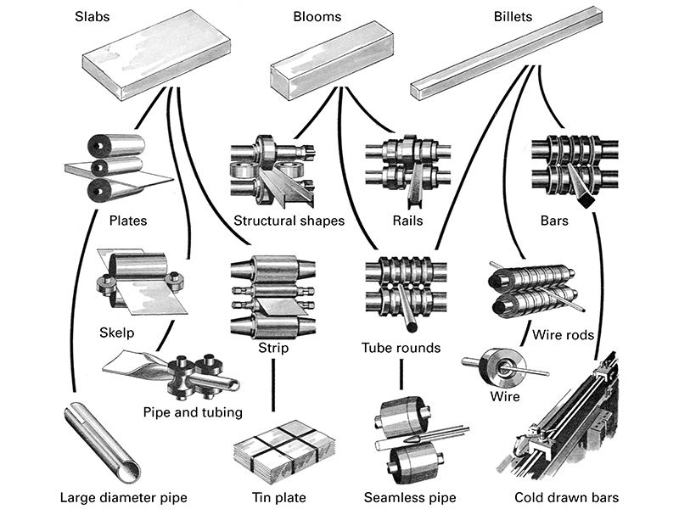
Manufacturing Technology
Rolling

Slide 34
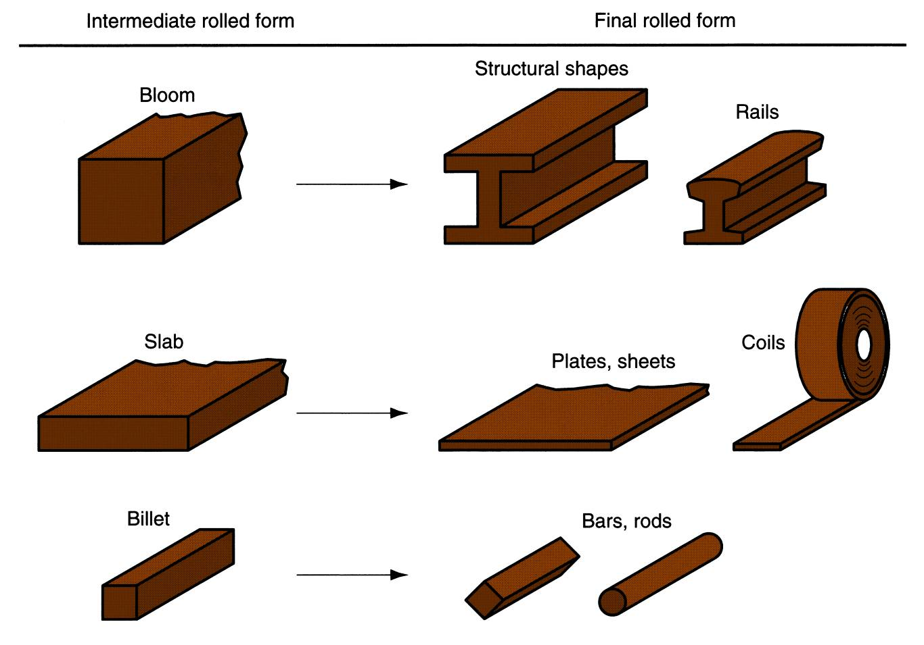
Manufacturing Technology
Rolled Products Made of Steel
Some of the steel products made in a rolling mill
.

Slide 35
Manufacturing Technology
Rotating rolls perform two main functions:
Pull the work into the gap between them by friction between work part and rolls
Simultaneously squeeze the work to reduce its cross section

Slide 36
Manufacturing Technology
Types of Rolling
Based on work piece geometry :
  Flat rolling - used to reduce thickness of a rectangular cross section
  Shape rolling - square cross section is formed into a shape such as an I‑beam
Based on work temperature :
  Hot Rolling – most common due to the large amount of deformation required
  Cold rolling – produces finished sheet and plate stock

Slide 37
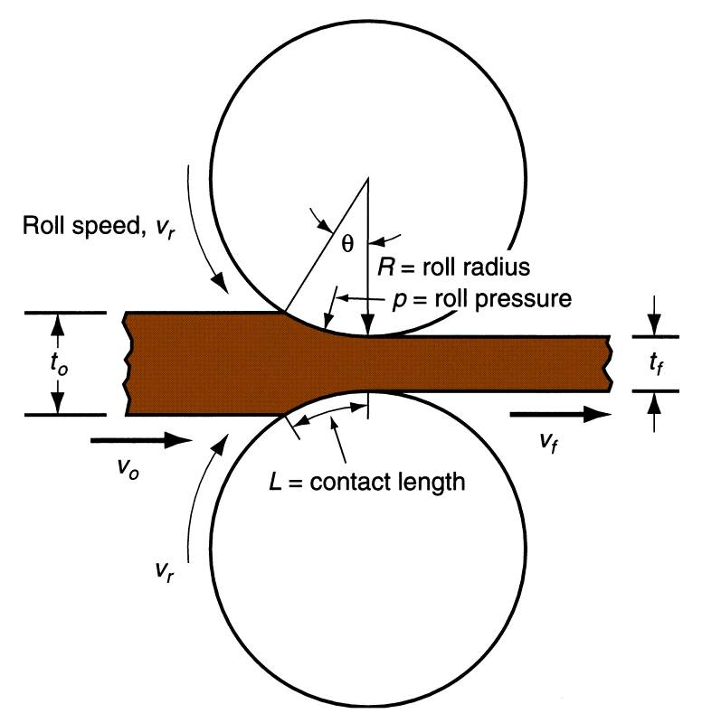
Manufacturing Technology
Flat Rolling
Heated metal is passed between rotating rolls to reduce the cross-section.
Side view of flat rolling, indicating before and after thicknesses, work
velocities, angle of contact with rolls, and other features.

Slide 38
Manufacturing Technology
Shape Rolling
Work is deformed into a contoured cross section rather than flat (rectangular)
Accomplished by passing work through rolls that have the reverse of desired shape
Products include:
  Construction shapes such as I‑beams, L‑beams, and U‑channels
  Rails for railroad tracks
  Round and square bars and rods

Slide 39
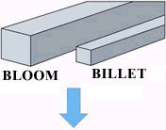
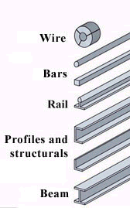
Manufacturing Technology
Shape Rolling

Slide 40
Manufacturing Technology
Thread Rolling
Bulk deformation process used to form threads on cylindrical
parts by rolling them between two dies
Important commercial process for mass producing bolts and screws
Performed by cold working in thread rolling machines
Advantages over thread cutting (machining):
  Higher production rates
  Better material utilization
  Stronger threads and better fatigue resistance due to work hardening

Slide 41
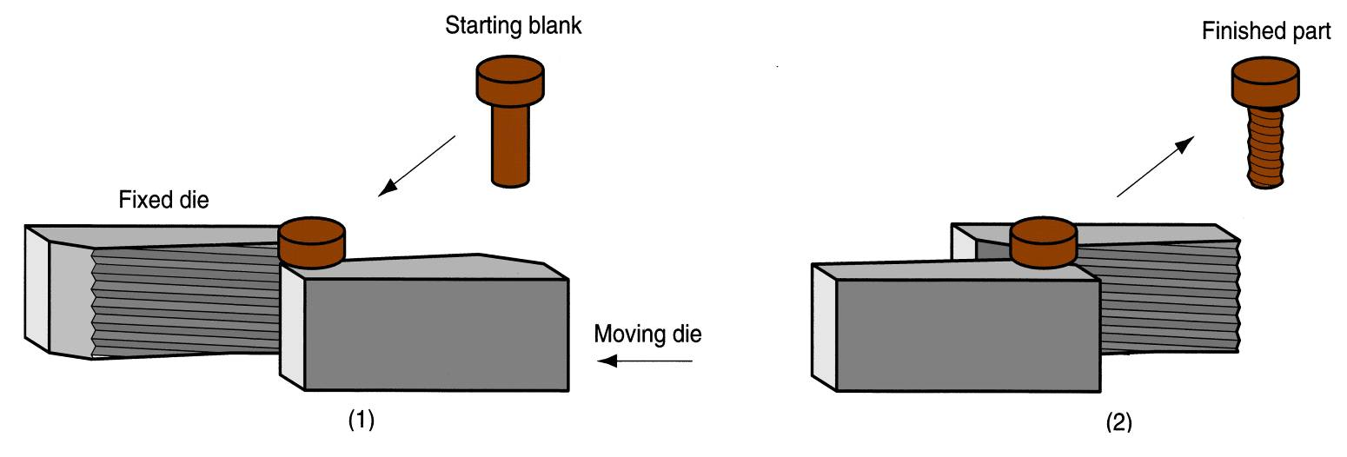
Manufacturing Technology
Thread rolling with flat dies
(1) start of cycle
(2) end of cycle

Slide 42
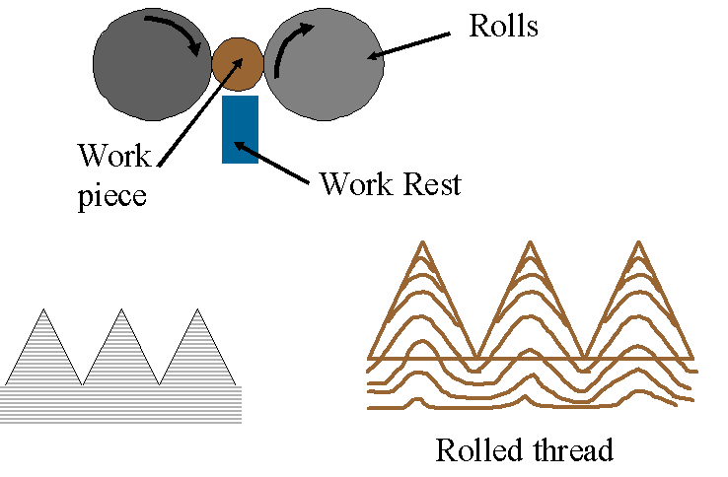
Manufacturing Technology
Thread Rolling

Slide 43
Manufacturing Technology
Rolling Mills
Equipment is massive and expensive
Rolling mill configurations:
  Two-high – two opposing rolls
  Three-high – work passes through rolls in both directions
  Four-high – backing rolls support smaller work rolls
  Cluster mill – multiple backing rolls on smaller rolls
  Tandem rolling mill – sequence of two-high mills

Slide 44
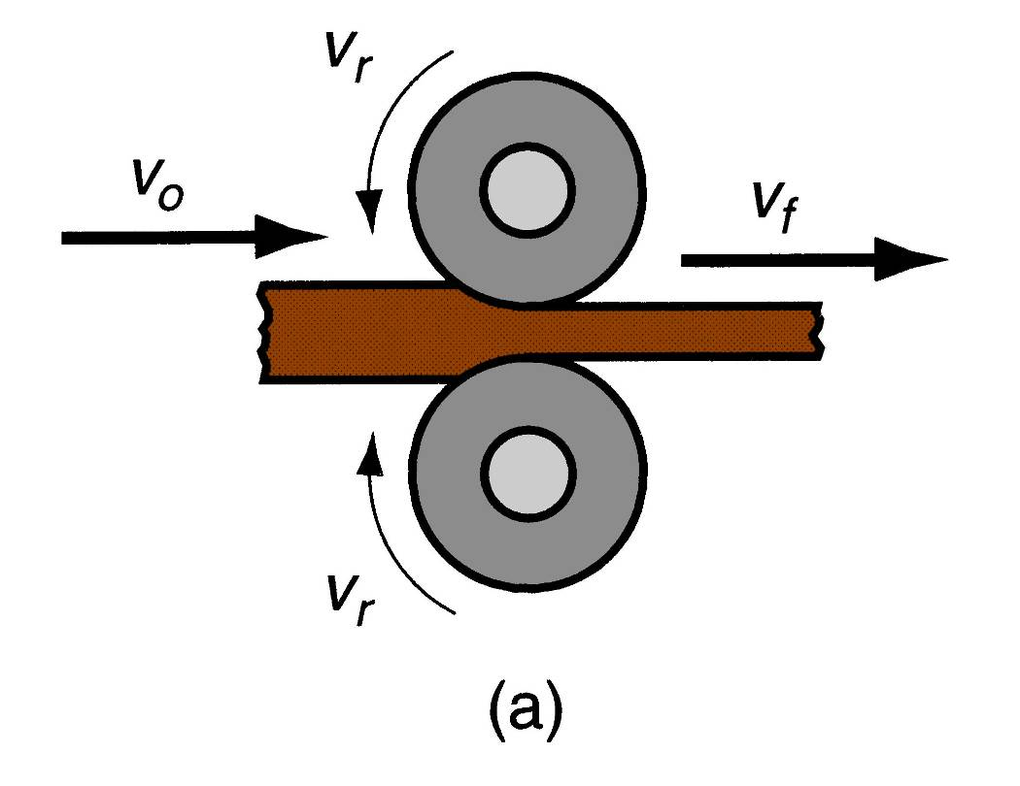
Manufacturing Technology
Two-High Rolling.
a -2‑high rolling mill.

Slide 45
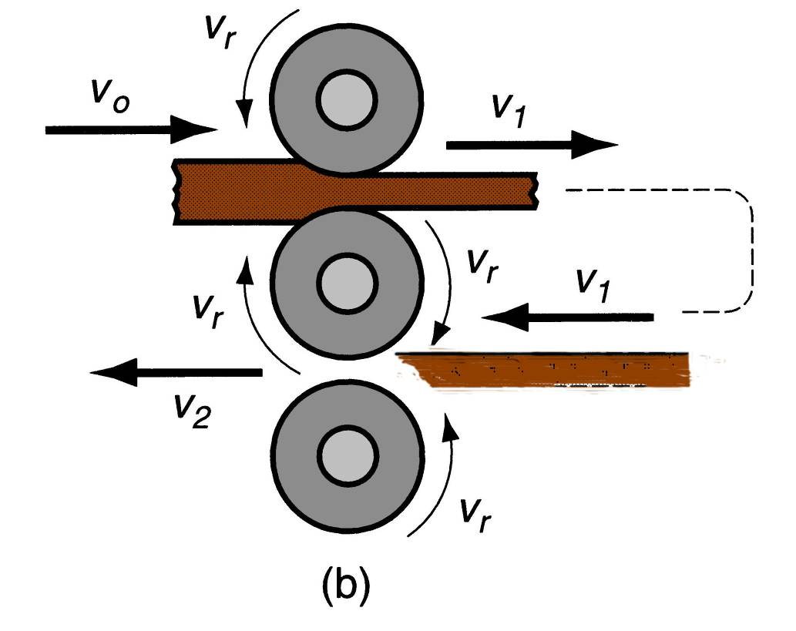
Manufacturing Technology
Three-High Rolling.
b -3‑high rolling mill.

Slide 46
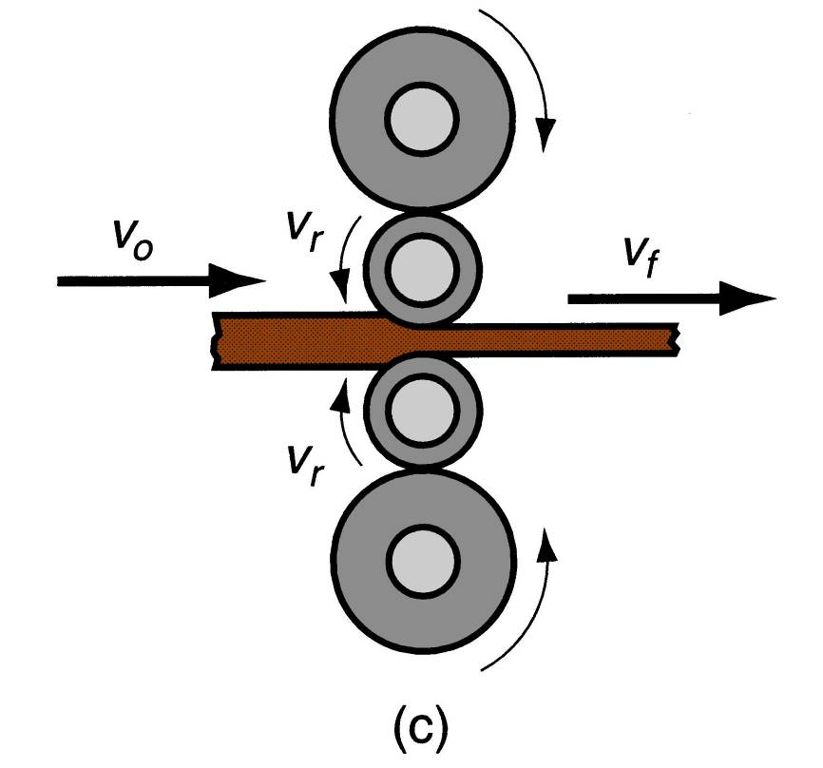
Manufacturing Technology
Four-High Rolling.
b -4‑high rolling mill.

Slide 47
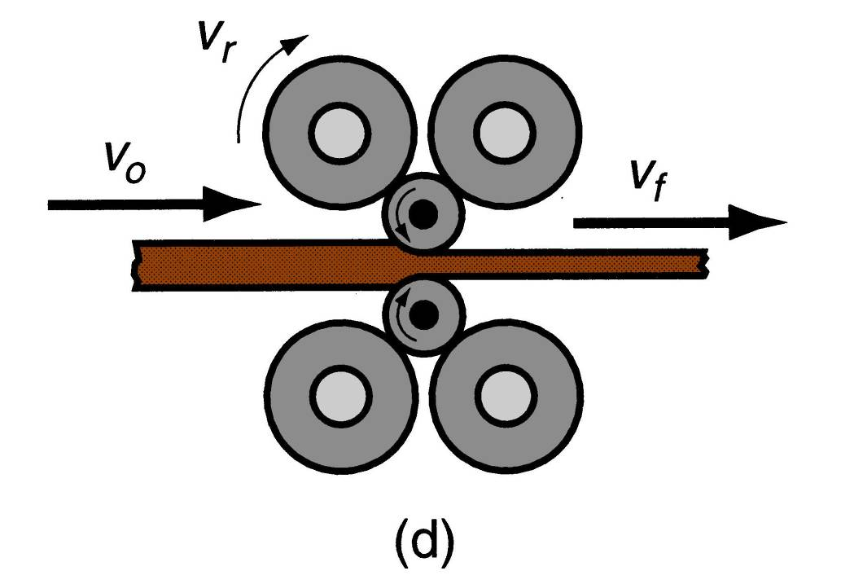
Manufacturing Technology
Cluster Mill
d -Cluster mill.

Slide 48
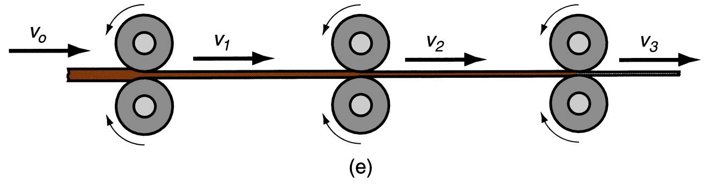
Manufacturing Technology
Tandem Rolling Mill
A series of rolling stands in sequence
e –Tandem Rolling mill.

Slide 49
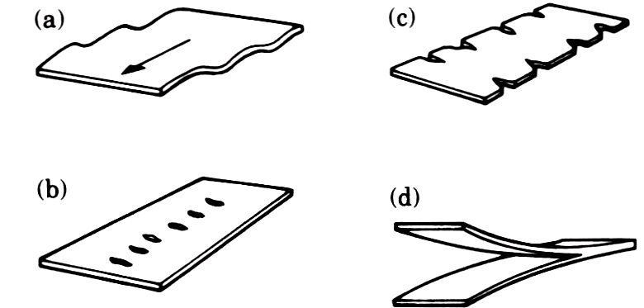
Manufacturing Technology
Rolling Defects
Waviness-a
  Improper roller speeds
Zipper cracks-b
  Too much rolling in center
Edge cracks-c
  Too much rolling on outside
Alligatoring-d
  Too much induced tensile stress in the part, or defects

Slide 50
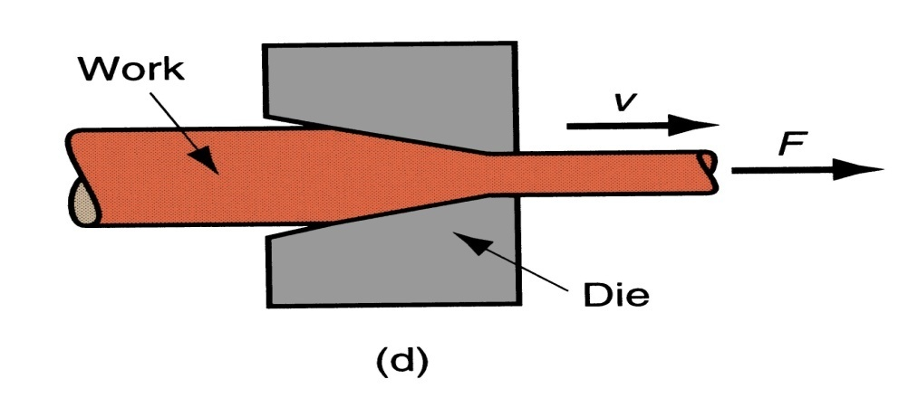
Manufacturing Technology
Drawing
Drawing is an operation in which the cross-section of solid rod, wire or tubing is reduced or changed in shape by pulling it through a die. Drawn rods are used for shafts, spindles, and small pistons and as the raw material for fasteners such as rivets, bolts, screws.
Drawing also improves strength and hardness when these properties are to be developed by cold work and not by subsequent heat treatment.

Slide 51
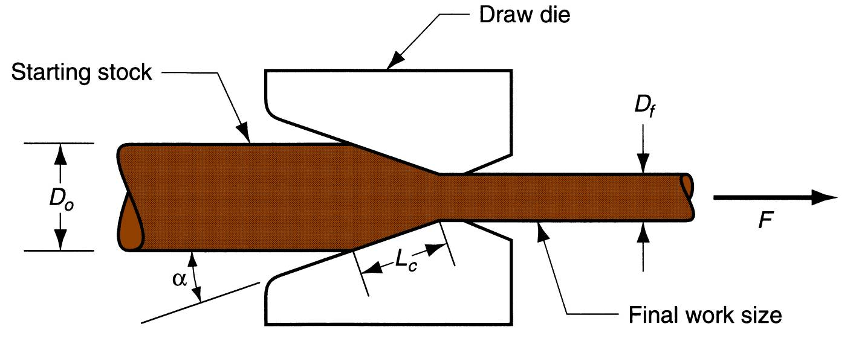
Manufacturing Technology
Drawing Types
Wire Drawing
  Cross‑section of a bar, rod, or wire is reduced by pulling it through a die opening
  Similar to extrusion except work is pulled through die in drawing (it is pushed through in extrusion)
  Although drawing applies tensile stress, compression also plays a significant role since metal is squeezed as it passes through die opening
Drawing of wire.

Slide 52
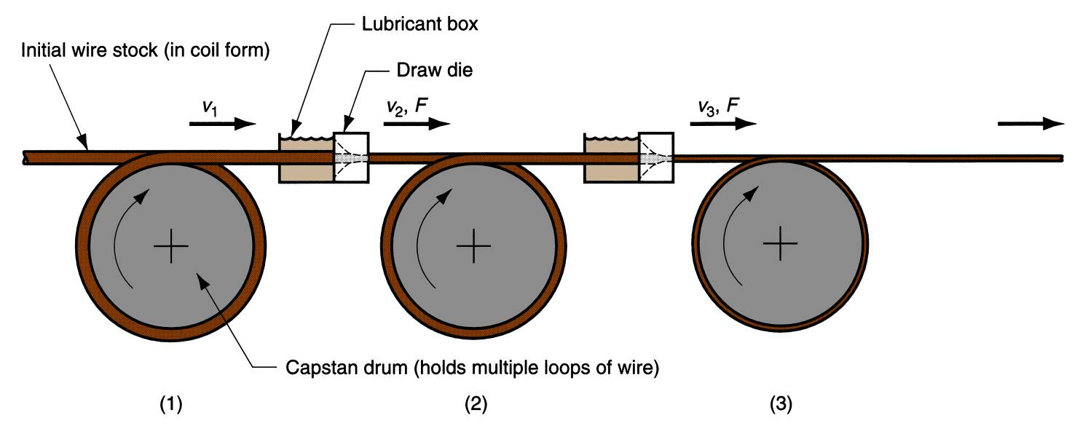
Manufacturing Technology
Wire drawing machines consisting of multiple draw dies (typically 4 to 12) separated by accumulating drums
  Each drum (capstan) provides proper force to draw wire stock through upstream die
  Each die provides a small reduction, so desired total reduction is achieved by the series
  Annealing sometimes required between dies to relieve work hardening
Continuous drawing of wire

Slide 53
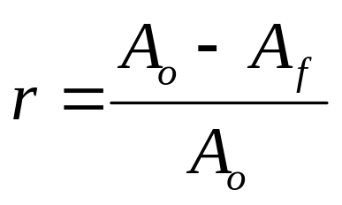
Manufacturing Technology
Area Reduction in wire Drawing
Change in size of work is usually given by area reduction
  where r = area reduction in drawing; A_{o} = original area of work; and A_{f} = final work
Die Materials
Commonly used materials are Tool Steels and Carbides
Diamond dies are used for fine wire.
For improved wear resistance, steel dies may be chromium plated, and carbide dies may be coated with titanium nitride
For Hot drawing, cast-steel dies are used

Slide 54
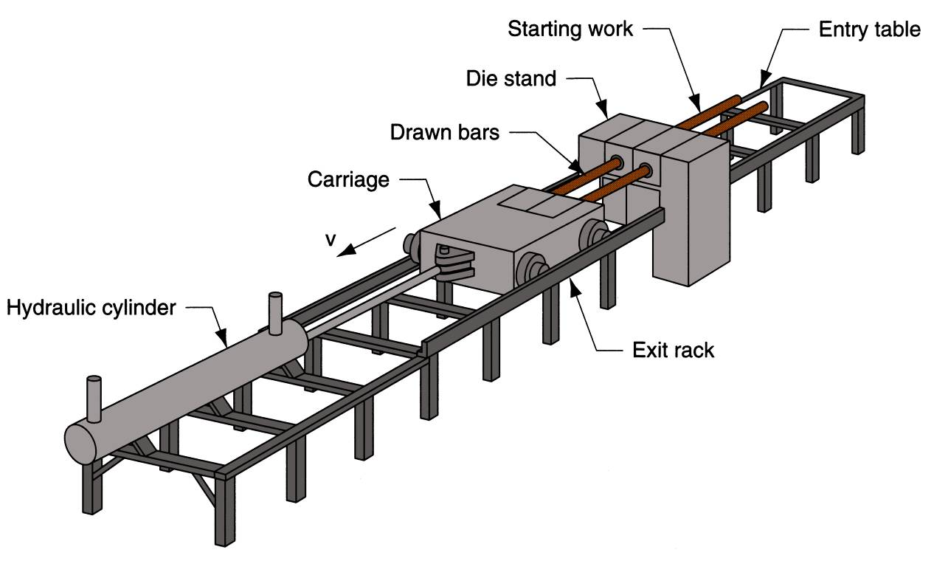
Manufacturing Technology
Bar or Rod Drawing
Accomplished as a single‑draft operation ‑ the stock is pulled through one die opening
Beginning stock has large diameter and is a straight cylinder
Requires a batch type operation
Hydraulically operated draw bench for drawing metal bars

Slide 55
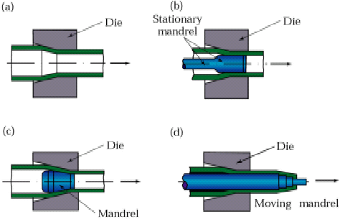
Manufacturing Technology
Tube Drawing
Accomplished by pulling the stock through the sides of the mandrel placed between dies

Slide 56
Manufacturing Technology
Wire Drawing vs. Bar Drawing
Difference between bar drawing and wire drawing is stock size
  Bar drawing - large diameter bar and rod stock
  Wire drawing - small diameter stock - wire sizes down to 0.03 mm (0.001 in.) are possible
Although the mechanics are the same, the methods, equipment, and even terminology are different

Slide 57
Manufacturing Technology
Preparation of Work for Drawing
Annealing – to increase ductility of stock
Cleaning - to prevent damage to work surface and draw die
Pointing – to reduce diameter of starting end to allow insertion through draw die

Slide 58
Manufacturing Technology
Features of a Draw Die
Entry region - funnels lubricant into the die to prevent scoring of work and die
Approach - cone‑shaped region where drawing occurs
Bearing surface - determines final stock size
Back relief - exit zone - provided with a back relief angle (half‑angle) of about 30°
Die materials: tool steels or cemented carbides

Slide 59
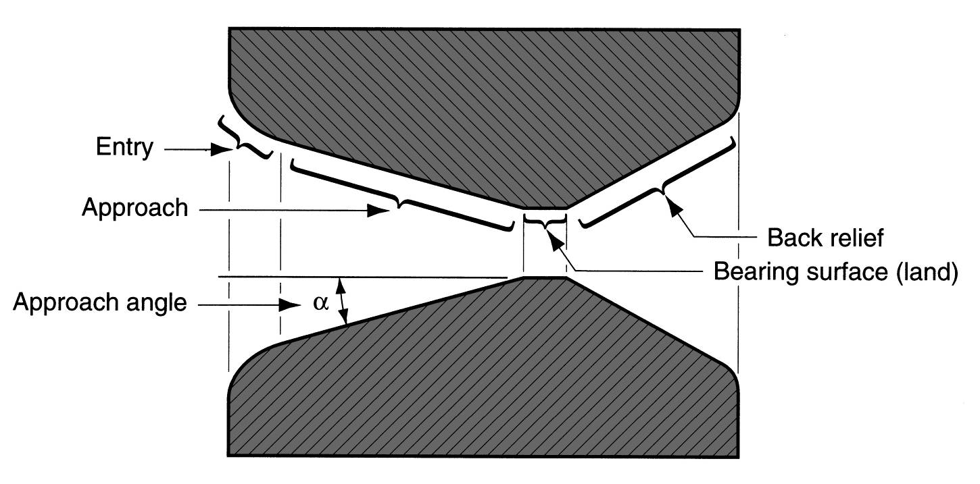
Manufacturing Technology
Draw Die Details
Draw die for drawing of round rod or wire

Slide 60
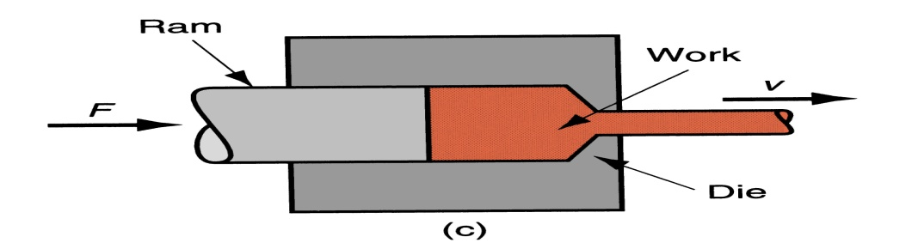
Manufacturing Technology
Extrusion
A plastic deformation process in which metal is forced under pressure to flow through a single, or series of dies until the desired shape is produced.
Process is similar to squeezing toothpaste out of a toothpaste tube
In general, extrusion is used to produce long parts of uniform cross sections
Typical products made by extrusion are railings for sliding doors, tubing having various cross-sections, structural and architectural shapes, door and windows frames.

Slide 61
Manufacturing Technology
Extrusion Ratio
  ER= A _{o} /A _{f}
  A _{o} – cross-sectional area of the billet
  A _{f} - cross-sectional area of extruded product
Extrusion Force
  F = A _{o} K Ln (A _{o}/A _{f})
  K-extrusion constant
  A _{o} , A _{f} billet and extruded product areas
Types
  Direct Extrusion (Forward Extrusion)
  Indirect Extrusion (Backward Extrusion)
  Hydrostatic Extrusion
  Impact Extrusion

Slide 62
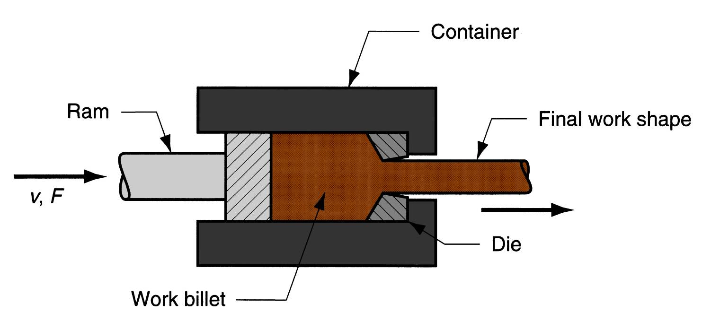
Manufacturing Technology
Direct Extrusion
Billet is placed in a chamber and forced through a die opening by a hydraulically-driven ram or pressing stem.
Dies are machined to the desired cross-section
Friction increases the extrusion force

Slide 63
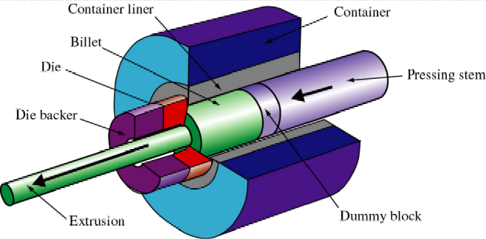
Manufacturing Technology
Direct Extrusion
Schematic illustration of direct extrusion process

Slide 64
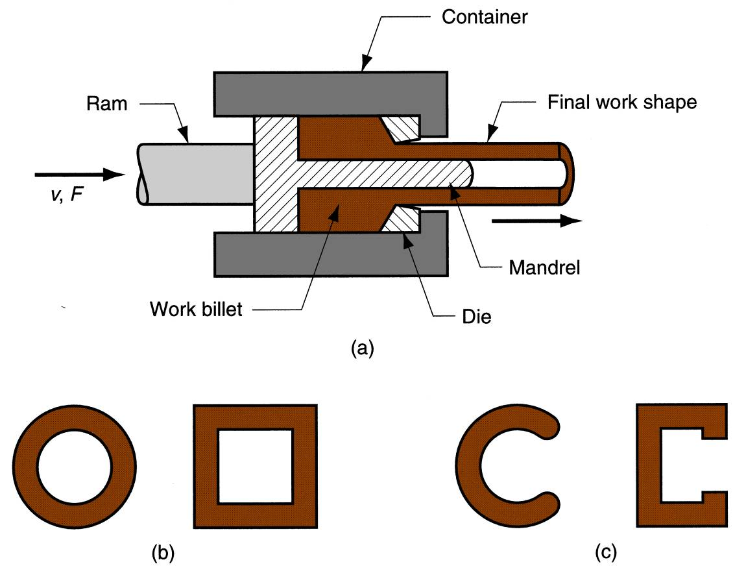
Manufacturing Technology
Direct Extrusion
Hollow and Semi Hollow section is formed using a mandrel

Slide 65
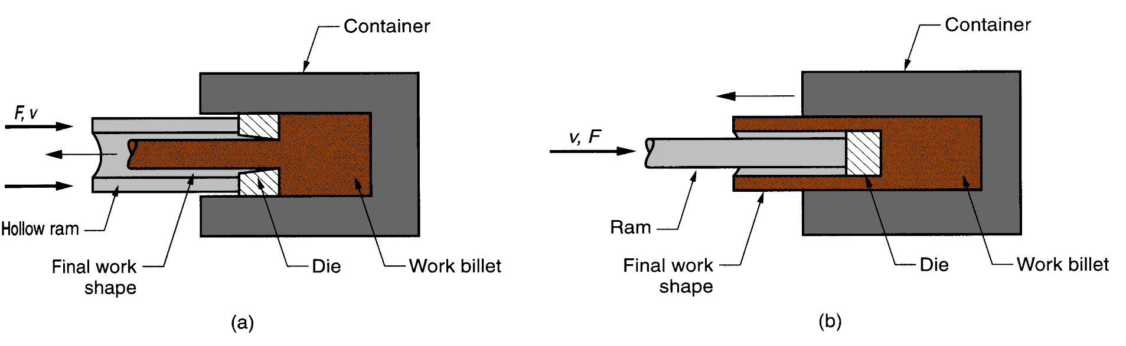
Manufacturing Technology
Indirect Extrusion
Metal is forced to flow through the die in an opposite direction to the ram’s motion.
Lower extrusion force as the work billet metal is not moving relative to the container wall.
Limitations
Lower rigidity of hollow ram
Difficulty in supporting extruded product as it exits die
Indirect extrusion to produce (a) a solid cross section and (b) a hollow cross section.

Slide 66
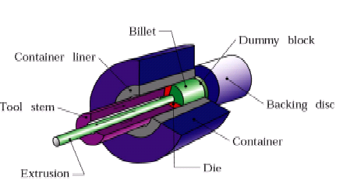
Manufacturing Technology
Indirect Extrusion
Schematic illustration of indirect extrusion process

Slide 67
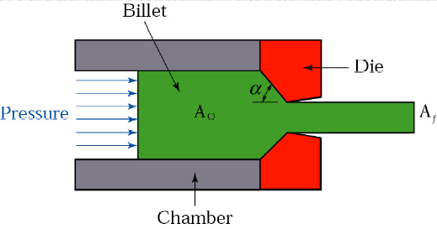
Manufacturing Technology
Process Variables in Direct & Indirect Extrusion
The die angle α
Reduction in cross-section A _{f}
Extrusion speed
Billet temperature,
Extrusion pressure.

Slide 68
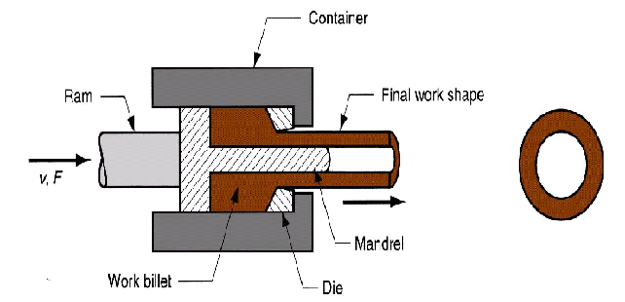
Manufacturing Technology
Tube Extrusion
Accomplished by forcing the stock through the sides of the mandrel placed between dies
Tube or Pipe

Slide 69
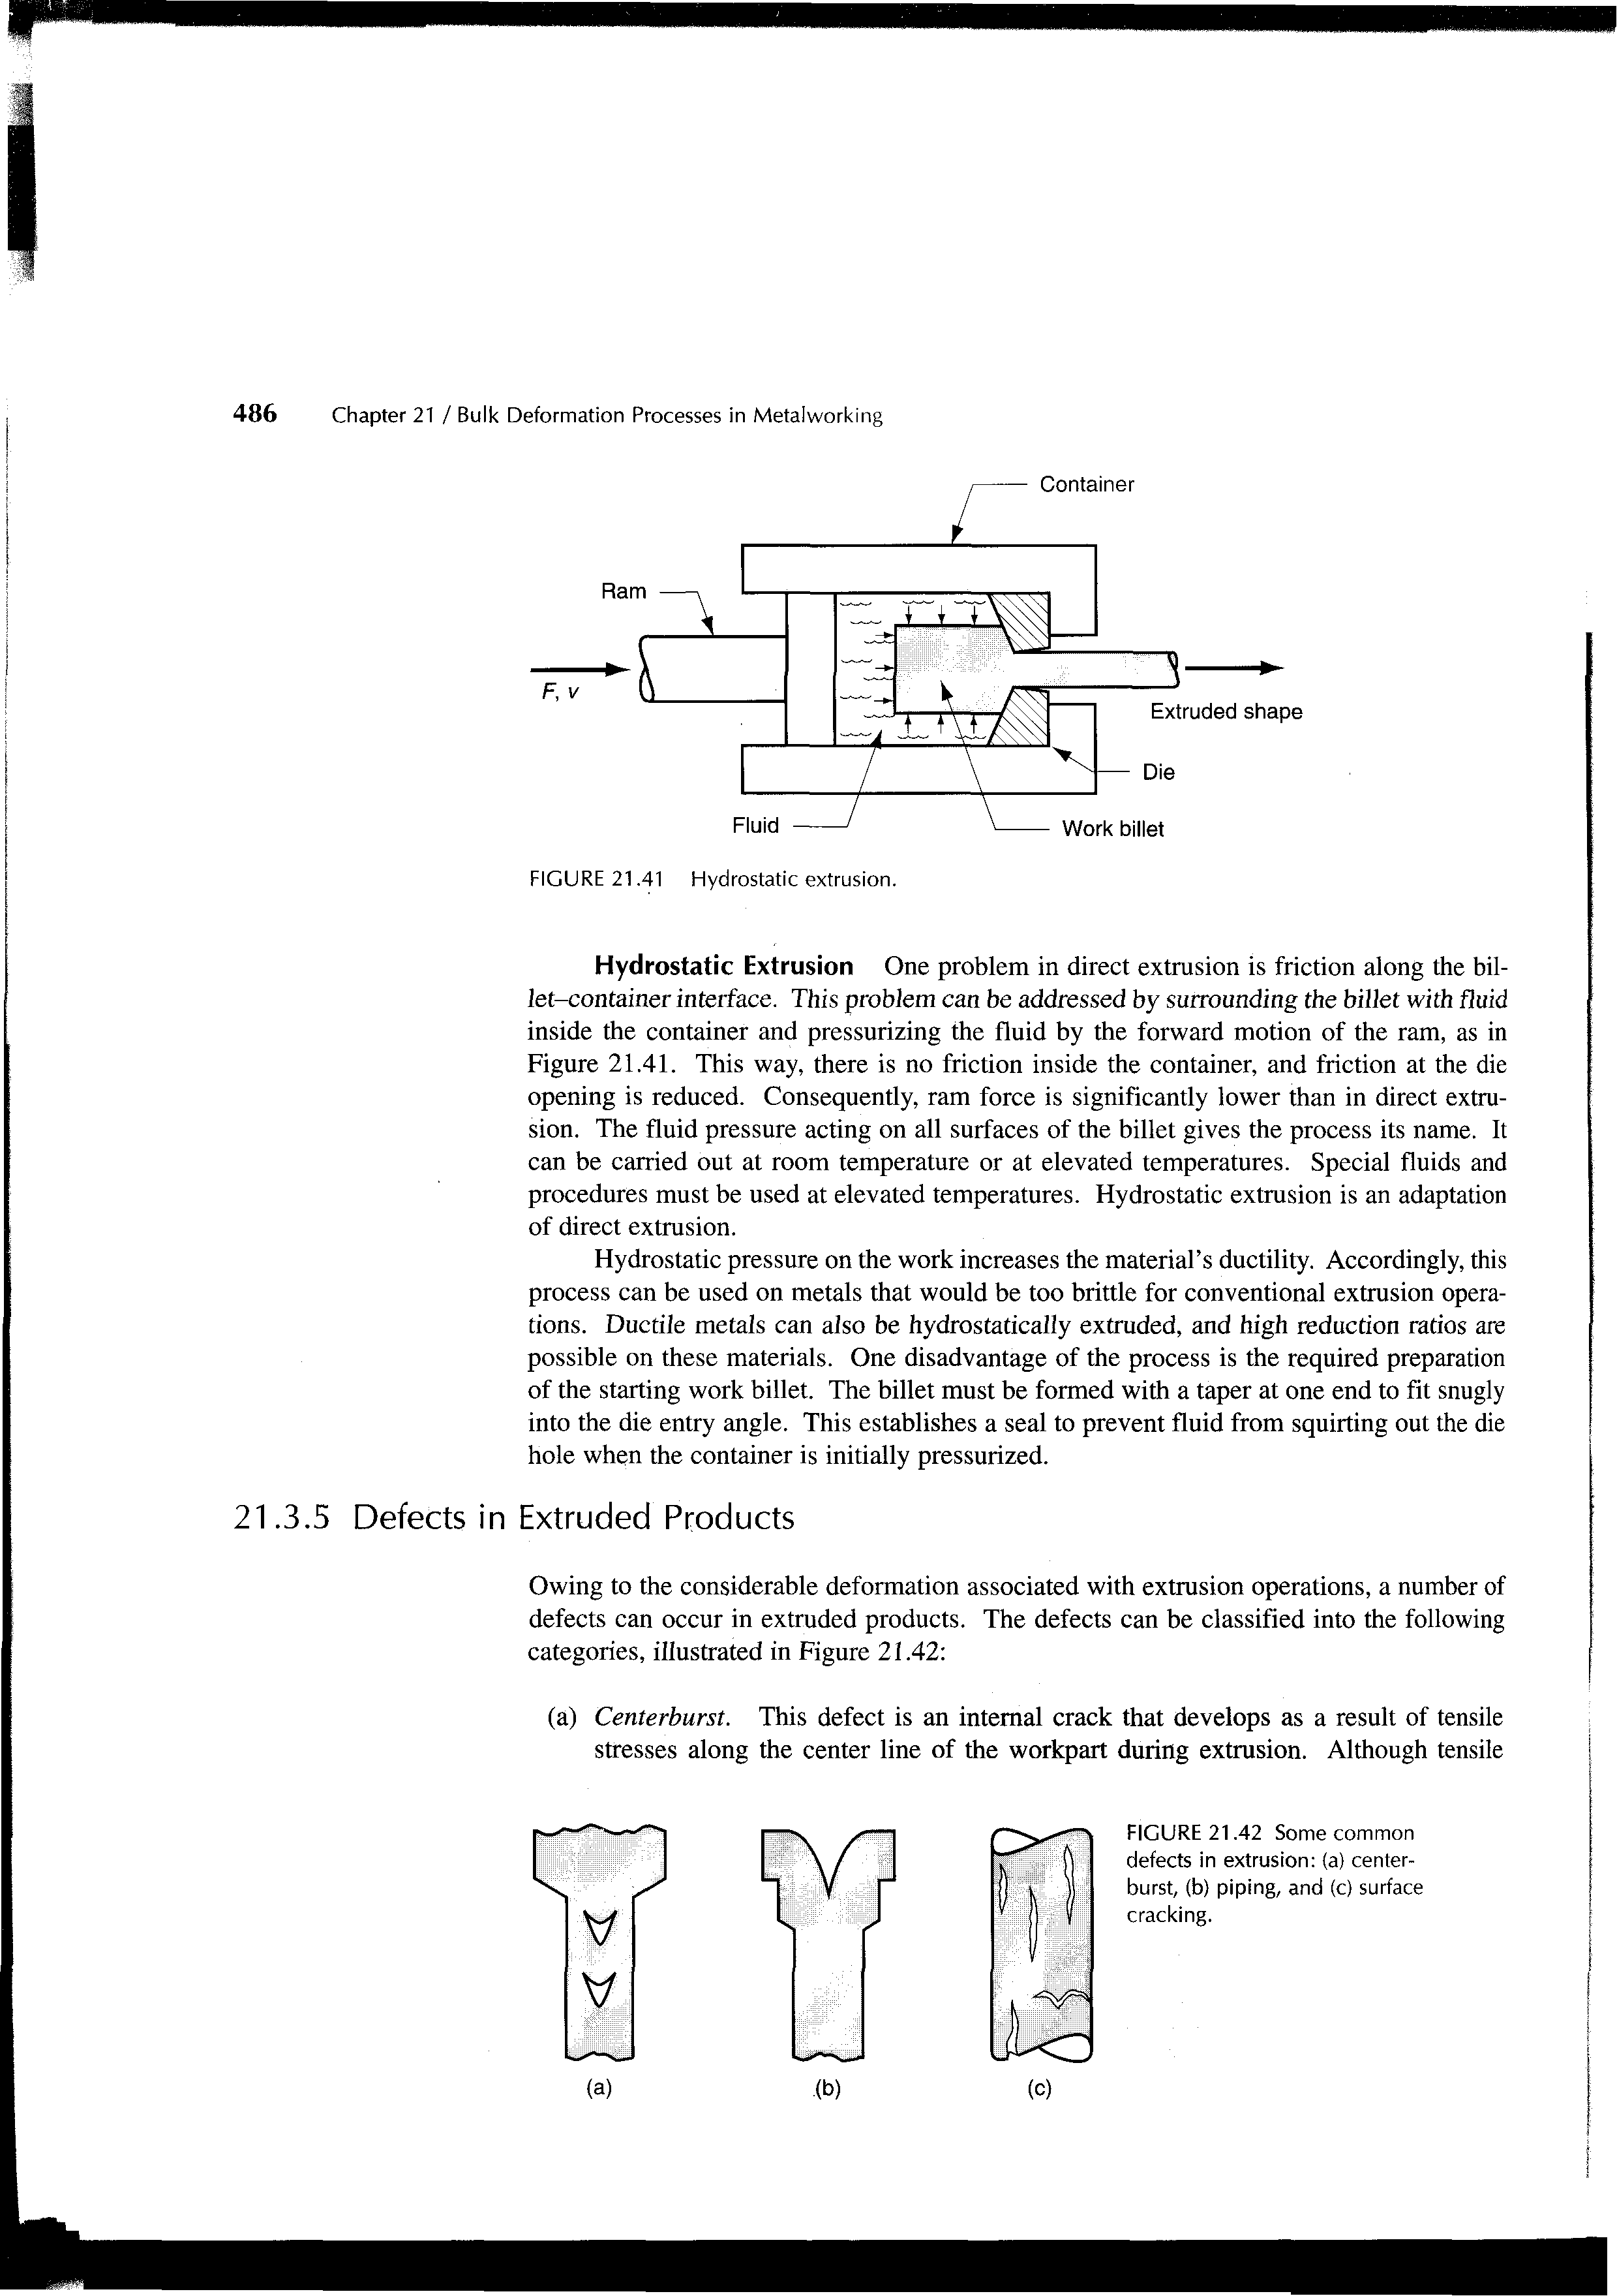
Manufacturing Technology
Hydrostatic Extrusion
The pressure required for extrusion is supplied through and incompressible fluid medium surrounding the billet
Usually carried at room temperature, typically using vegetable oils as the fluid
Brittle materials are extruded generally by this method
It increases ductility of the material
It has complex nature of the tooling

Slide 70
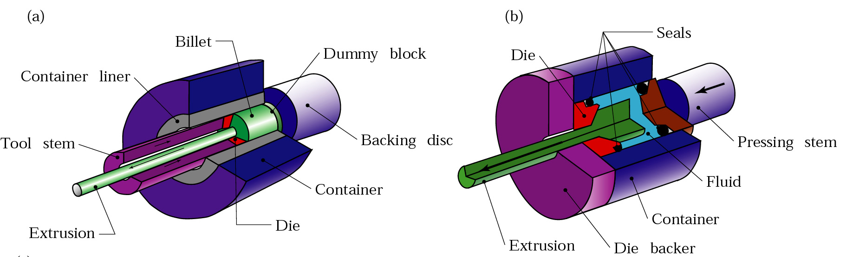
Manufacturing Technology
Hydrostatic Extrusion
Schematic illustration Hydrostatic Extrusion process

Slide 71
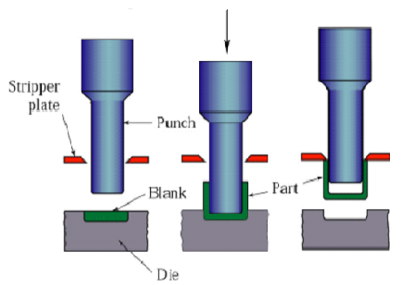
Manufacturing Technology
Impact Extrusion
Similar to indirect extrusion
Punch descends rapidly on the blank, which is extruded backward
Schematic illustration of the impact-extrusion process. The extruded parts are stripped by the use of a stripper plate, because they tend to stick to the punch

Slide 72
Manufacturing Technology
Hot extrusion
  prior heating of billet to above its recrystallization temperature
Cold extrusion
  prior heating of billet to below its recrystallization temperature
Advantages
  Wide variety of shapes
  High production rates
  Improved microstructure and physical properties
  Close tolerances are possible
  Economical
  Design flexibility
Limitation
  part cross section must be uniform throughout length

Slide 73
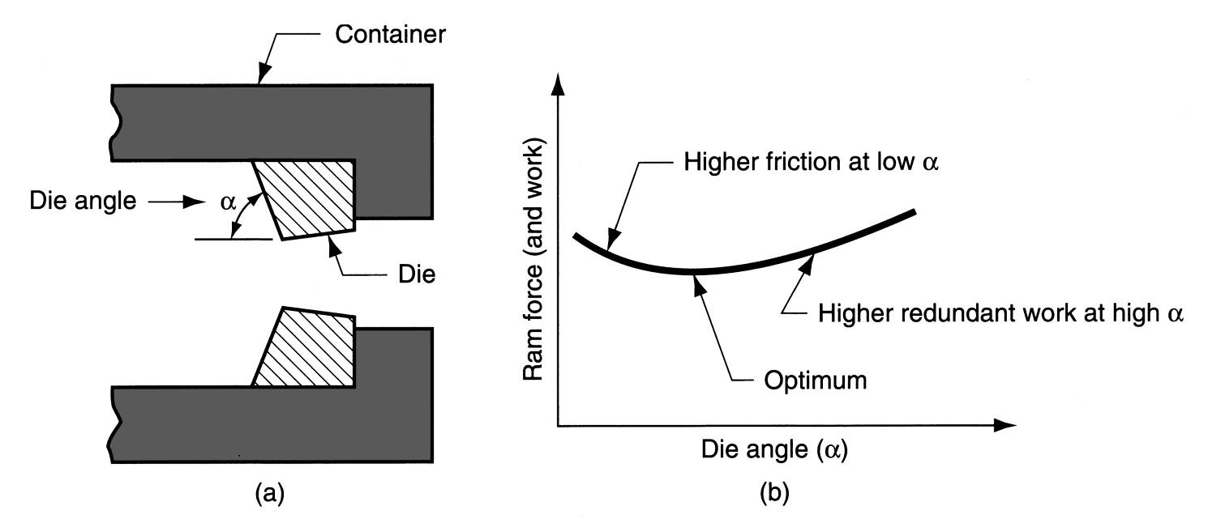
Manufacturing Technology
Extrusion Die Features
(a) Definition of die angle in direct extrusion; (b) effect of die angle on ram force.

Slide 74
Manufacturing Technology
Extrusion Defects
Centre-burst: internal crack due to excessive tensile stress at the centre possibly because of high die angle, low extrusion ratio.
Piping: sink hole at the end of billet under direct extrusion.
Surface cracking: High part temperature due to low extrusion speed and high strain rates.

Slide 75
Manufacturing Technology
Factors Influencing the Extrusion Force
Friction
Material Properties
Reduction In Area
Speed
Temperature
Geometry Of The Die

Slide 76
END

