Slide 1
MANUFACTURING TECHNOLOGY
UNIT – III
THEORY OF METAL CUTTING

Slide 2
SYLLABUS
Orthogonal and oblique cutting– Classification of cutting tools: single, multipoint – Tool signature for single point cutting tool – Mechanics of orthogonal cutting – Shear angle and its significance – Chip formation– Cutting tool materials– Tool wear and tool life – Machinability – Cutting Fluids– Simple problems.

Slide 3
Manufacturing Technology
Material Removal Processes – Metal Cutting Process
A family of shaping operations, the common feature of which is removal of material from a starting work part so the remaining part has the desired geometry
Traditional Process (Machining) – Material removal by a sharp cutting tool, e.g., turning, milling, drilling
Nontraditional processes - Various energy forms other than sharp cutting tool to remove material. e.g., Laser and Electron Beam machining
Abrasive processes – Material removal by hard, abrasive particles, e.g., grinding

Slide 4
Manufacturing Technology
Why Machining is Important
Variety of work materials can be machined
Most frequently used to cut metals
Variety of part shapes and special geometric features possible, such as:
Screw threads
Accurate round holes
Very straight edges and surfaces
Good dimensional accuracy and surface finish

Slide 5
Manufacturing Technology
Disadvantages with Machining
Wasteful of material
Chips generated in machining are wasted material, at least in the unit operation
Time consuming
A machining operation generally takes more time to shape a given part than alternative shaping processes, such as casting, powder metallurgy, or forming

Slide 6
Manufacturing Technology
Machining in Manufacturing Sequence
Generally performed after other manufacturing processes, such as casting, forging, and bar drawing
Other processes create the general shape of the starting work part
Machining provides the final shape, dimensions, finish, and special geometric details that other processes cannot create

Slide 7
Manufacturing Technology
Machining Operations
Most important machining operations
Turning
Drilling
Milling
Other machining operations
Shaping and planing
Broaching
Sawing

Slide 8
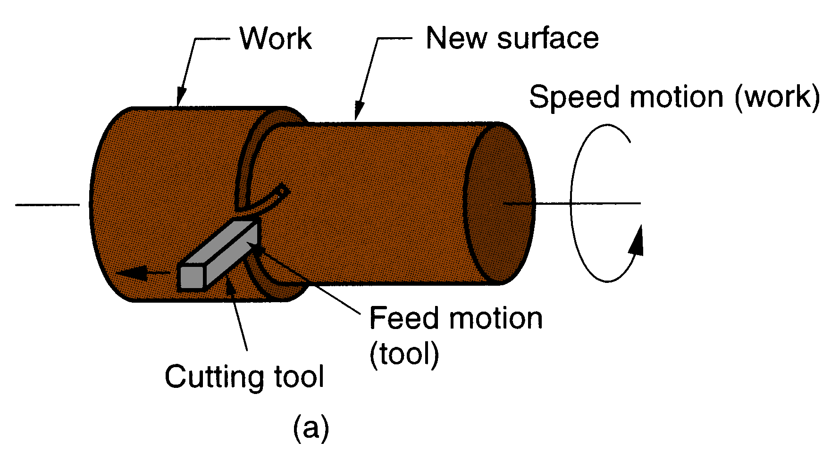
Manufacturing Technology
Turning
Single point cutting tool removes material from a rotating
work piece to form a cylindrical shape

Slide 9
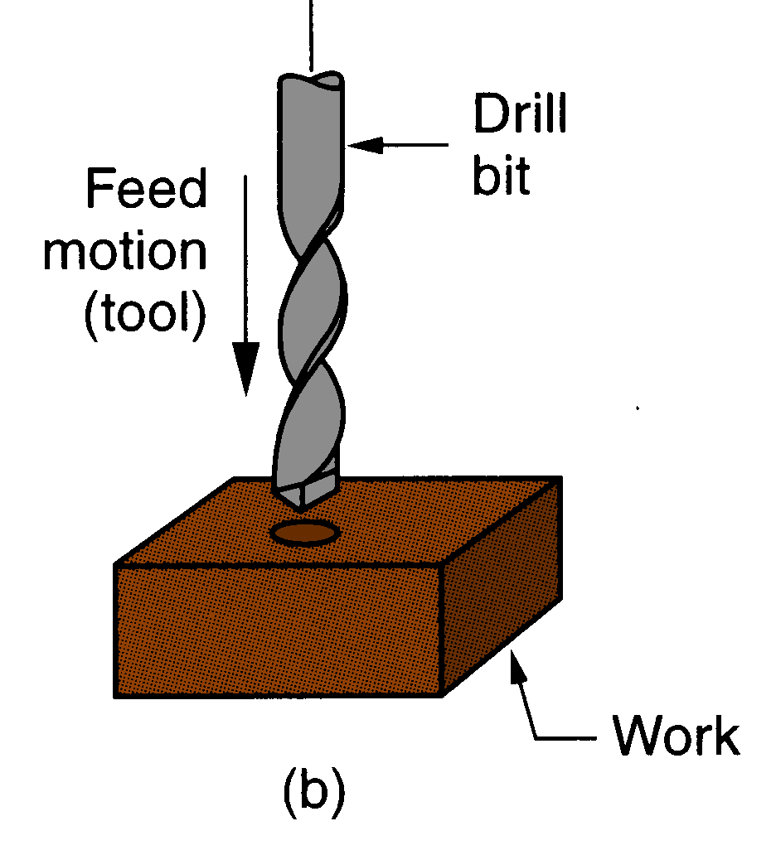
Manufacturing Technology
Drilling
Used to create a round hole, usually by means of a
rotating tool (drill bit) with two cutting edges

Slide 10
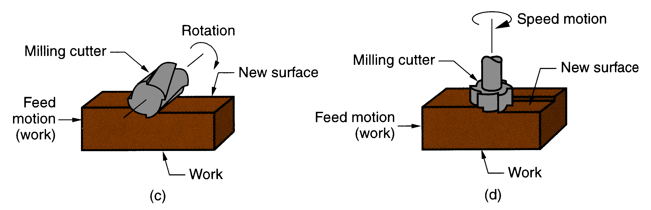
Manufacturing Technology
Milling
(c) peripheral milling (d) face milling.
Rotating multiple-cutting-edge tool is moved across
work to cut a plane or straight surface

Slide 11
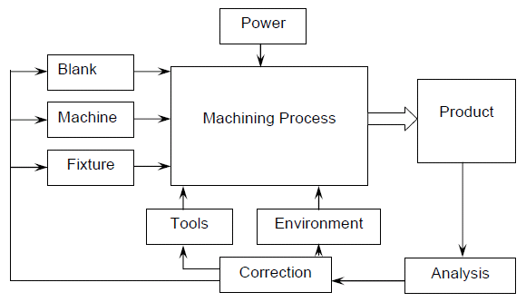
Manufacturing Technology
Machining requirements
The blank and the cutting tool are properly mounted (in fixtures) and moved in a powerful device called machine tool enabling gradual removal of layer of material from the work surface resulting in its desired dimensions and surface finish. Additionally some environment called cutting fluid is generally used to ease machining by cooling and lubrication.

Slide 12
Manufacturing Technology
Machine Tool - Definition
A machine tool is a non-portable power operated and reasonably valued device or system of devices in which energy is expended to produce jobs of desired size, shape and surface finish by removing excess material from the preformed blanks in the form of chips with the help of cutting tools moved past the work surface's.
Basic functions of Machine Tools
Machine Tools basically produce geometrical surfaces like flat, cylindrical or any contour on the preformed blanks by machining work with the help of cutting tools.

Slide 13
Manufacturing Technology
The physical functions of a Machine Tool in machining are
Firmly holding the blank and the tool
Transmit motions to the tool and the blank
Provide power to the tool-work pair for the machining action.
Control of the machining parameters, (speed, feed and depth of cut).

Slide 14
Manufacturing Technology
Classification of cutting tools
Single-Point Cutting Edge Tools
One dominant cutting edge
Point is usually rounded to form a nose radius
Turning uses single point tools
Multiple Point Cutting Edge Tools
More than one cutting edge
Motion relative to work achieved by rotating
Drilling and milling use rotating multiple cutting edge tools

Slide 15
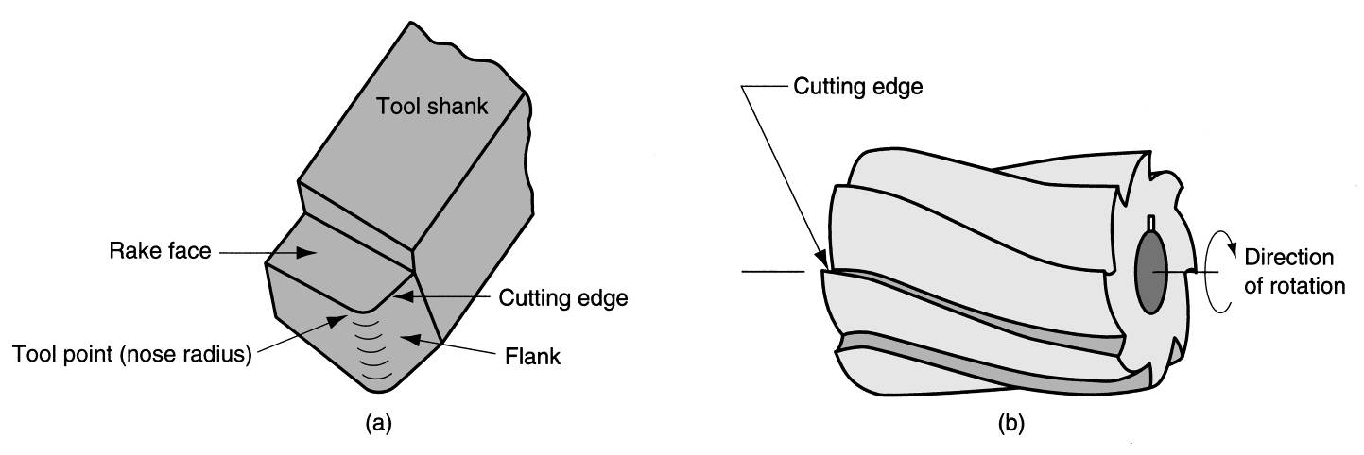
Manufacturing Technology
Cutting Tools
a. Single-Point Cutting Tool
b. Multi-Point Cutting Tool
Figure (a) A single‑point tool showing rake face, flank, and tool point; and (b) a helical milling cutter, representative of tools with multiple cutting edges.

Slide 16
Manufacturing Technology
Tool signature for single point cutting tool
Flank

Slide 17
Manufacturing Technology
Tool signature for single point cutting tool
Shank
It is the main body of the tool
Flank
The surface of the tool adjacent to the cutting edge
Face
The surface on which the chip slides
Nose
It is the point where the side cutting edge and end cutting edge intersect
Nose Radius
Strengthens finishing point of tool
Cutting Edge
It is the edge on the face of the tool which removes the material from the work piece
Side cutting edge angle
Angle between side cutting edge and the side of the tool shank

Slide 18
Manufacturing Technology
Tool signature for single point cutting tool
End cutting edge angle
Angle between end cutting edge and the line normal to the tool shank
Side Relief angle
Angle between the portion of the side flank immediately below the side cutting edge and a line perpendicular to the base of the tool, measured at right angle to the side flank
End Relief angle
Angle between the portion of the end flank immediately below the end cutting edge and a line perpendicular to the base of the tool, measured at right angle to the end flank
Side Rake angle
Angle between the tool face and a line parallel to the base of the tool and measured in a plane perpendicular to the base and the side cutting edge
Back Rake angle
Angle between the tool face and a line parallel to the base of the tool and measured in a plane perpendicular to the side cutting edge

Slide 19
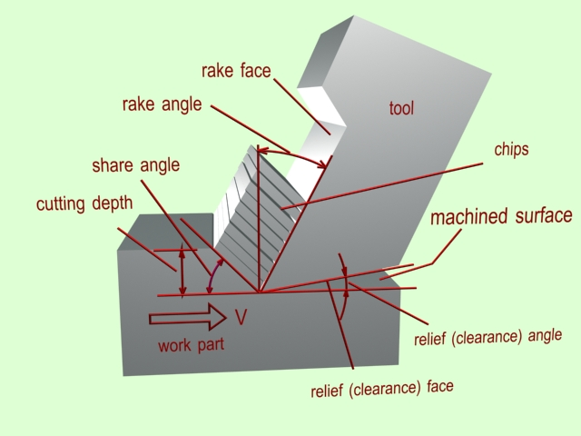
Manufacturing Technology
Single Point Cutting Tool Terminology – 3D

Slide 20
Manufacturing Technology
Cutting Tool Materials
Carbon steels, High-speed steels
Cast carbides, Cemented carbides, Coated carbides
Cermets, Ceramic Tools
Polycrystalline Cubic Boron Nitride (PCBN)
Polycrystalline Diamond (PCD)
Properties of Cutting Tool Materials
Harder than work piece.
High toughness
High thermal shock resistance
Low adhesion to work piece material
Low diffusivity to work piece material

Slide 21
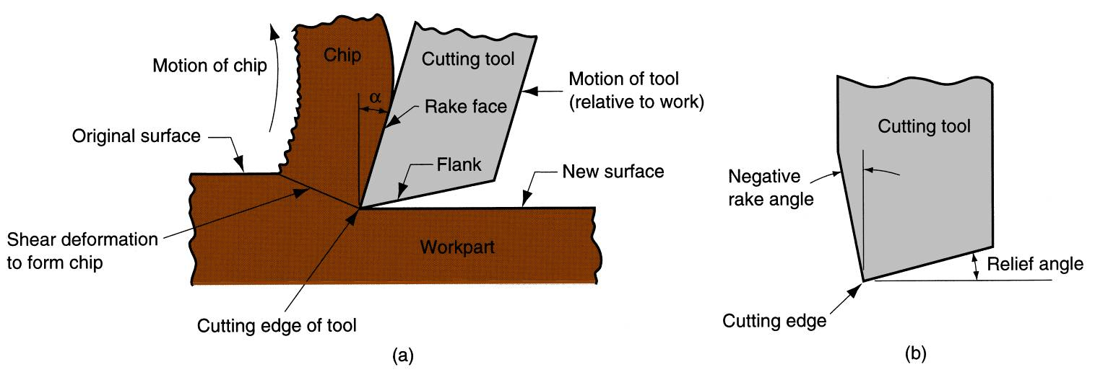
Manufacturing Technology
Theory of Metal Cutting
Metal cutting or machining is the process of producing a work piece by removing unwanted material from a block of metal, in the form of chips.
This process is most important since almost all the products get their final shape and size by metal removal, either directly or indirectly.
Figure (a) A cross‑sectional view of the machining process,
(b) tool with negative rake angle; compare with positive rake angle in (a).

Slide 22
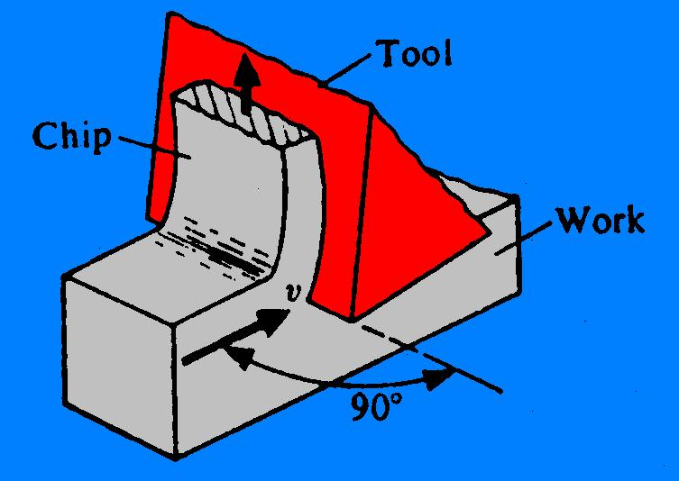
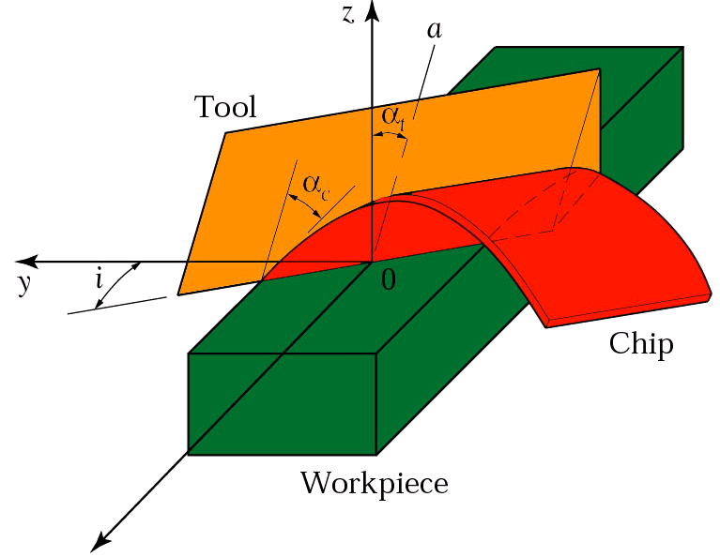
Manufacturing Technology
Orthogonal and oblique cutting
Orthogonal cutting
The cutting edge of the tool is straight and perpendicular to the direction of motion.
Oblique cutting
The cutting edge of the tool is set at an angle to the direction of motion.

Slide 23
The Mechanism of Cutting
Cutting action involves shear deformation of work material to form a chip. As chip is removed, new surface is exposed
Orthogonal Cutting - assumes that the cutting edge of the tool is set in a position that is perpendicular to the direction of relative work or tool motion. This allows us to deal with forces that act only in one plane.
(a) A cross‑sectional view of the machining process, (b) tool with negative rake angle; compare with positive rake angle in (a).

Slide 24
Mechanics of Orthogonal Cutting
Orthogonal Cutting
Ideal Orthogonal Cutting is when the cutting edge of the tool is straight and perpendicular to the direction of motion.
During machining, the material is removed in form of chips, which are generated by shear deformation along a plane called the shear plane.
The surface the chip flows across is called the face or rake face.
The surface that forms the other boundary of the wedge is called the flank.
The rake angle is the angle between the tool face and a line perpendicular to the cutting point of the work piece surface.

Slide 25
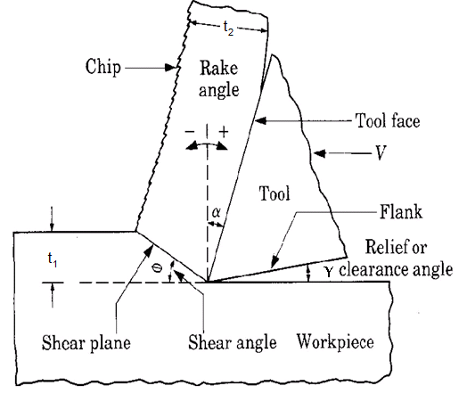
Mechanics of Orthogonal Cutting
The relief or clearance angle is the angle between the tool flank and the newly formed surface of the work piece angle.

Slide 26
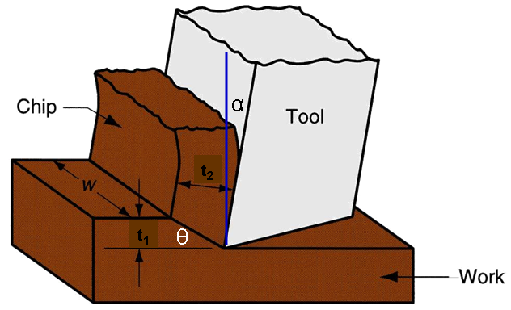
Mechanics of Orthogonal Cutting
Orthogonal cutting model:
t₁ = un deformed chip thickness
t₂ = deformed chip thickness (usually t₂ > t₁)
α = rake angle
If we are using a lathe, t₁ is the feed per revolution.

Slide 27
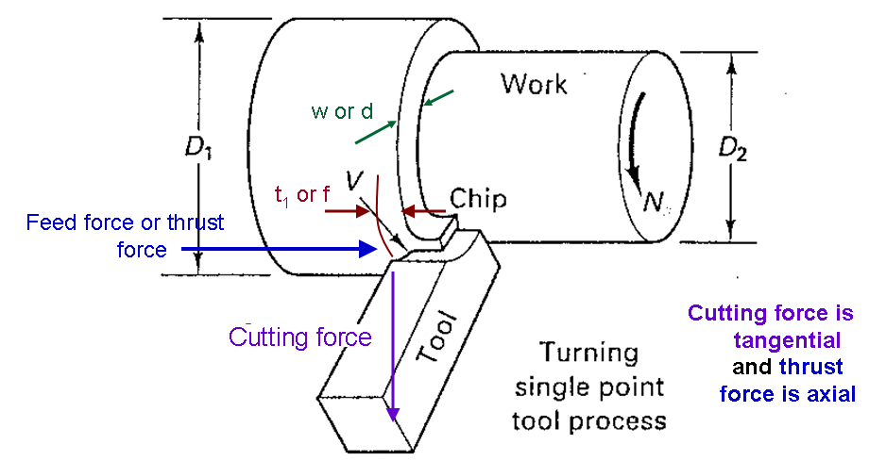
The Mechanism of Cutting
In turning, w = depth of cut and t₁= feed

Slide 28
Mechanics of Orthogonal Cutting
Chip thickness ratio (or) cutting ratio
where
r = chip thickness ratio or cutting ratio;
t₁ = thickness of the chip prior to chip formation;
t₂ = chip thickness after separation
Which one is more correct?
r ≥ 1
r ≤1
Chip thickness after cut always greater than before, so chip ratio always less than 1.0

Slide 29
Mechanics of Orthogonal Cutting
Shear Plane Angle
Based on the geometric parameters of the orthogonal model, the shear plane angle ө can be determined as:
where
r = chip thickness ratio or cutting ratio;
α = Rake angle
ө = Shear angle

Slide 30
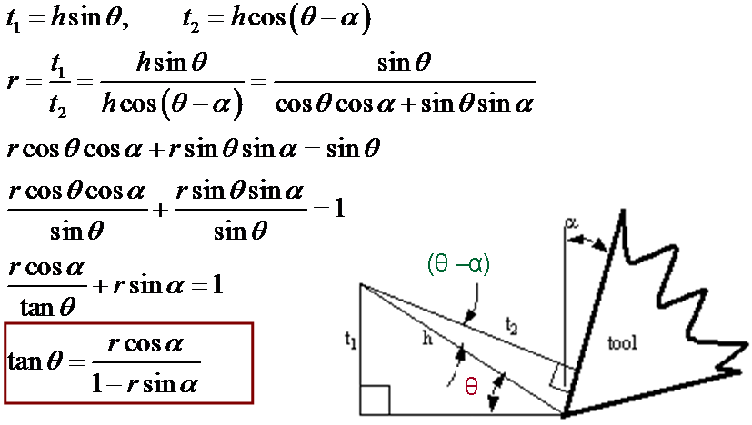
Mechanics of Orthogonal Cutting
Shear Plane Angle Proof

Slide 31
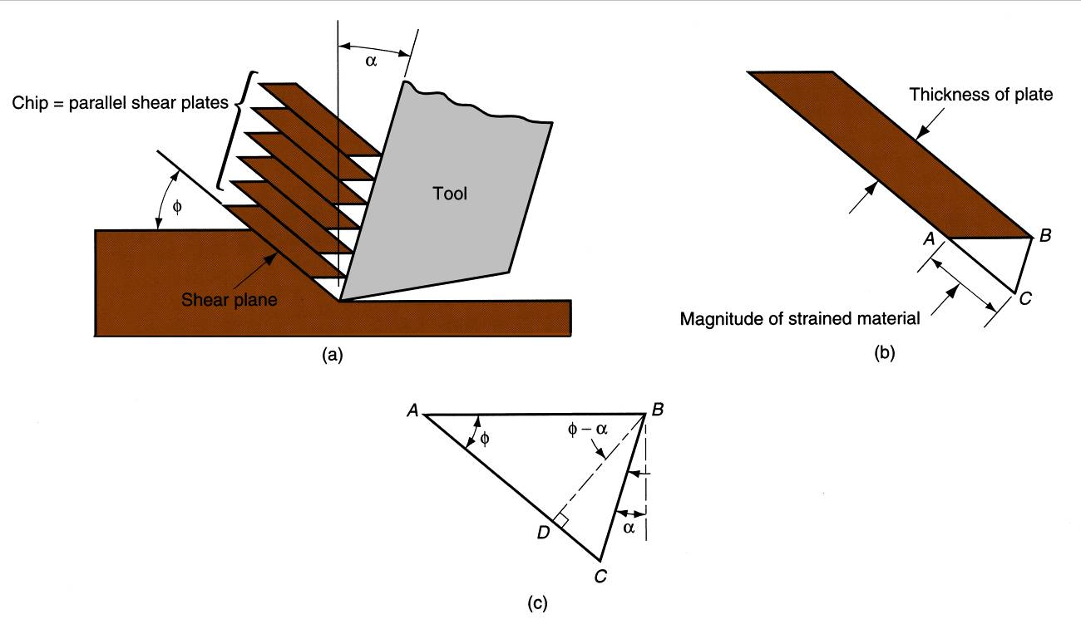
Mechanics of Orthogonal Cutting
Shear Strain in chip formation
θ
θ
θ -α
(a) chip formation depicted as a series of parallel plates sliding relative to each other, (b) one of the plates isolated to show shear strain, and (c) shear strain triangle used to derive strain equation.

Slide 32
Mechanics of Orthogonal Cutting
Shear Strain in chip formation
Shear strain in machining can be computed from the following equation, based on the preceding parallel plate model:
γ = tan(θ - α) + cot θ
where
γ = shear strain
θ = shear angle
α = rake angle of cutting tool

Slide 33
Mechanics of Orthogonal Cutting
Shear Strain Proof
From the shear strain triangle (image c –slide 35)
γ = AC/DB= (AD+DC)/DB
γ = AD/DB + DC/DB
AD/DB = Cot θ
DC/DB = tan (θ - α)
Therefore γ = Cot θ + tan (θ - α)
γ = tan(θ - α) + cot θ

Slide 34
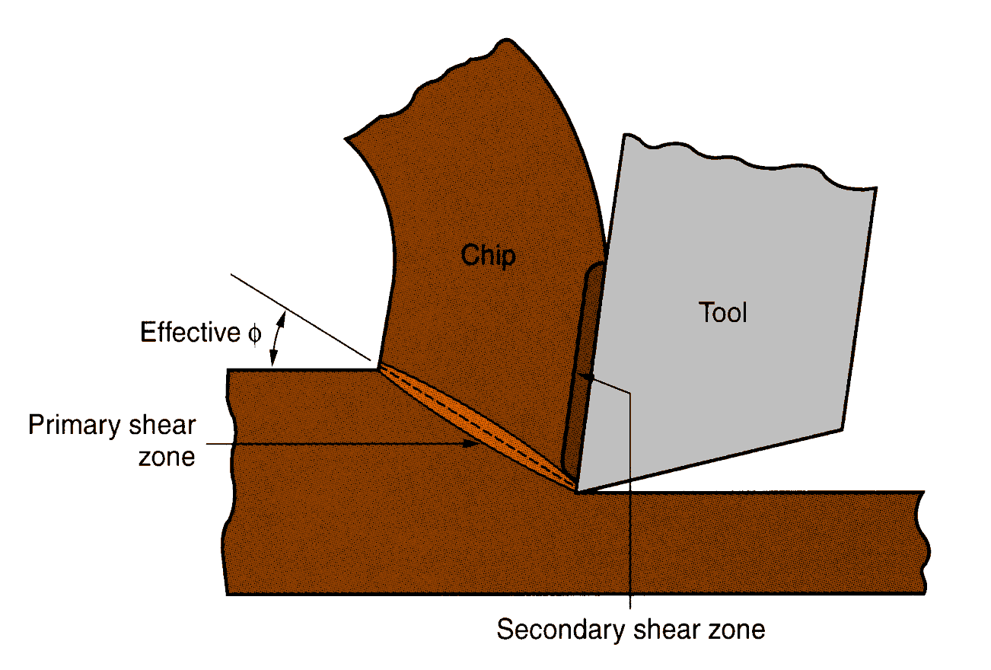
Manufacturing Technology
Chip formation
Mechanics of metal cutting is greatly depend on the shape and size of the chips formed.
More realistic view of chip formation, showing shear zone rather than shear plane. Also shown is the secondary shear zone resulting from tool‑chip friction.

Slide 35
Manufacturing Technology
Four Basic Type of Chips in Machining are
Discontinuous chip
Continuous chip
Continuous chip with Built-up Edge (BUE)
Serrated chip

Slide 36
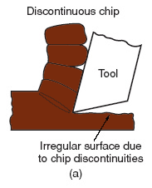
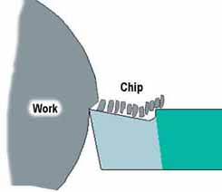
Manufacturing Technology
Discontinuous chip
When brittle materials like cast iron are cut, the deformed material gets fractured very easily and thus the Chip produced is in the form of discontinuous segments
Reasons
Brittle work materials
Low cutting speeds
Large feed and depth of cut
High tool‑chip friction

Slide 37
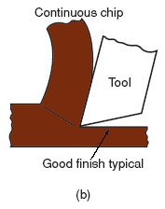
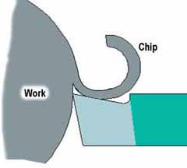
Manufacturing Technology
Continuous chip
Continuous chips are normally produced when machining steel or ductile materials at high cutting speeds. The continuous chip which is like a ribbon flows along the rake face.
Reasons
Ductile work materials
High cutting speeds
Small feeds and depths
Sharp cutting edge
Low tool‑chip friction

Slide 38
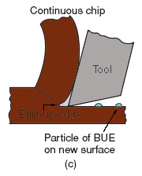
Manufacturing Technology
Continuous chip with Built-up Edge (BUE)
When the friction between tool and chip is high while machining ductile materials, some particles of chip adhere to the tool rake face near the tool tip. When such sizeable material piles upon the rake face, it acts as a cutting edge in place of the actual cutting edge is termed as built up edge (BUE). By virtue of work hardening, BUE is harder than the parent work material
Reasons
Ductile materials
Low‑to‑medium cutting speeds
Tool-chip friction causes portions of
chip to adhere to rake face
BUE forms, then breaks off, cyclically

Slide 39
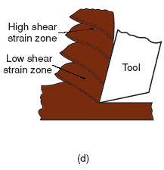
Manufacturing Technology
Serrated chip
Semi Continuous ( saw tooth appearance) chips produced when machining tool steels or Harden materials at high cutting speeds.
Reasons
Ductile materials
Low‑to‑medium cutting speeds
Tool-chip friction causes portions of
chip to adhere to rake face
BUE forms, then breaks off, cyclically

Slide 40
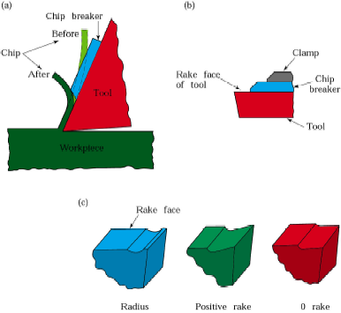
Manufacturing Technology
Chip Breakers
Long continuous chip are undesirable
Chip breaker is a piece of metal clamped to the rake surface of the tool which bends the chip and breaks it
Chips can also be broken by changing the tool geometry, thereby controlling the chip flow
Fig. (a) Schematic illustration of the action of a chip breaker .(b) Chip breaker Clamped on the rake of a cutting tool. (c) Grooves in cutting tools acting as chip breakers

Slide 41
Manufacturing Technology
Cutting Temperature
Approximately 98% of the energy in machining is converted into heat
This can cause temperatures to be very high at the tool‑chip
The remaining energy (about 2%) is retained as elastic energy in the chip
High cutting temperatures
Reduce tool life
Produce hot chips that pose safety hazards to the machine operator
Can cause inaccuracies in part dimensions due to thermal expansion of work material

Slide 42
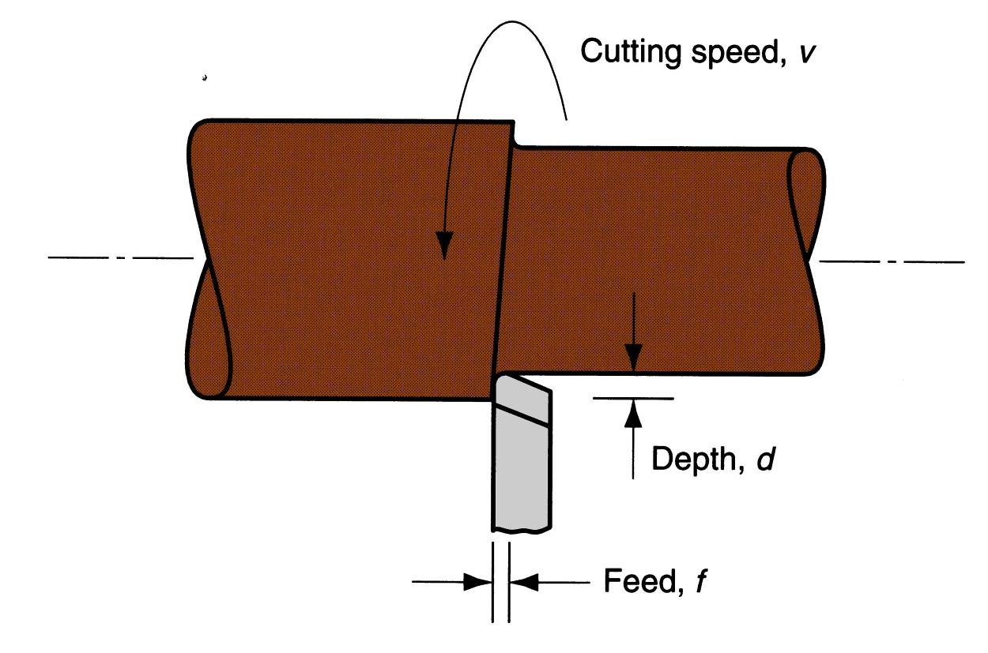
Manufacturing Technology
Process Parameters
Speed (v),→relative surface speed between tool and job
Feed (f),→relative small movement per cycle of the cutting tool , relative to the workpiece in a direction which is usually perpendicular to the cutting speed direction
Depth of Cut (d)→Thickness of the layer of metal removed in one cut or pass measured in a direction perpendicular to the machining surface
Material Removal Rate (MRR) = f x d x v

Slide 43
Manufacturing Technology
Shear angle and its significance
Shear angle(θ) is the angle made by the shear plane with the cutting speed vector.
Shear angle is very important parameter in metal cutting. Higher the shear angle, better is the cutting performance.
In metal cutting it is observed that a higher rake angles give rise to higher shear angles

Slide 44
Manufacturing Technology
Tool Wear
Tools get worn out due to long term usage
Types of Tool Wear
Flank wear (VB)
It occurs on the relief face of the tool and the side relief angle.
Crater wear (KT)
It occurs on the rake face of the tool.
Notch wear or Chipping (VN)
Breaking away of a small piece from the cutting edge of the tool

Slide 45
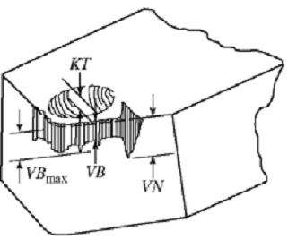
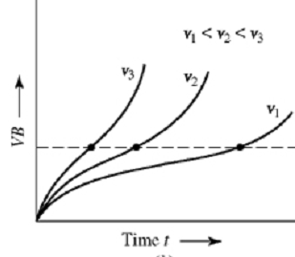
Manufacturing Technology
Tool Wear
Crater wear (KT)
Notch wear (VN)
Flank wear (VB)
Flank wear rate based on cutting speed

Slide 46
Manufacturing Technology
Tool Wear
Fig (a) Flank and crater wear in a cutting tool. tool moves to the left. (b) View of the rake of a turning tool, showing nose radius R and crater wear pattern on the rake face of the tool c) View of the flank face of a turning tool, sowing the average flank wear land VB and the depth-of-cut line (wear notch)

Slide 47
Manufacturing Technology
Tool Life
Tool life is defined as the time interval between two successive regrinds.
Tool life represents the useful life of the tool, expressed generally in time units from the start of cut to some end point defined by a failure criterion.
Tool Life Prediction
Taylor’s tool life equation predicts tool failure based on flank wear of the tool
where
V is the cutting speed, T is the tool life,
n is Taylor exponent.
n=0.125 for HSS
n=0.25 for Carbide
n=0.5 for Coated Carbide/Ceramic
C is a constant given for work piece material

Slide 48
FACTORS AFFECTING TOOL LIFE
Tool Material
Hardness of the material
Type of cutting material
Type of surface of the metal
Profile of the cutting tool
Type of machining operation being performed
Microstructure of the material
Finish Required
Cutting speed, feed and depth of cut, Cutting temperature

Slide 49
Tool life
Tool life can be given for a increase in percentage of cutting speed, feed and depth of cut
Where x and m are constants

Slide 50
problem
The Taylor tool-life equation for machining C-40 steel with a HSS
cutting tool at a feed of 0.2 mm/min and a depth of cut of 2 mm is
given by VT^{n} =C
= , where n and C are constants. The following V
and T observations have been noted :
V =15m/min →T=115min
V=55 m/min →T=15min
Calculate
(1) n and C,
(2) Hence recommend the cutting speed for a desired tool life of
80 min.

Slide 51
Manufacturing Technology
Machinability
Machinability is a system property that indicates how easy a material can be machined at low cost.
Good Machinability may mean one or more of the following: cutting with minimum energy, minimum tool wear, good surface finish, etc.
Quantitative measures of machinability
Machinability index: an average rating stated in comparison with reference materials. This measure can be misleading.
Tool life: service time in minutes or seconds to total failure by chipping or cracking of the tool at certain cutting speed, or the volume of material removed before total failure.
Surface finish produced at standardized cutting speeds and feeds.
Others based on cutting force, power, temperature, or chip formation.

Slide 52
Manufacturing Technology
Machinable Materials
Good machinable materials should have the following properties
Low ductility, low strain-hardening exponent (n), low fracture toughness.
Low shear strength (low TS), low hardness.
A strong metallurgical bond (adhesion) between tool and work piece is undesirable when it weakens the tool material.
Very hard compounds, such as some oxides, all carbides, many inter metallic compounds, and elements such as silicon, embedded in the work piece material accelerate tool wear, thus should be avoided.
Inclusions that soften at high temperatures are beneficial.
High thermal conductivity is helpful.

Slide 53
Manufacturing Technology
Machinable Materials
Ferrous materials
Carbon steels: annealed, heat-treated (spheroidized), cold worked
Free-machining steels: special inclusions
Alloy steels: hard
Stainless steels: high strength, low thermal conductivity, high strain hardening rate
Cast iron: white, gray, nodular cast iron
Non-ferrous materials
Zinc, Magnesium, Aluminum alloys, Beryllium, Copper-based alloys, Nickel-based alloys and super alloys,
Titanium, Plastics, composites.

Slide 54
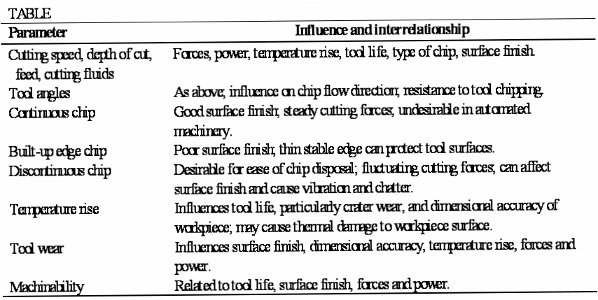
Manufacturing Technology
Factors Affecting Machining

Slide 55
Manufacturing Technology
Cutting Fluids
A fluid which is used in machining as well as abrasive machining processes to reduce friction and tool wear
Function of cutting fluids
Lubrication
Cooling
Chip removal
Types
Straight Oil (Petroleum based oils)
Soluble Oil (water based oils)

