Slide 1
MANUFACTURING TECHNOLOGY
UNIT – IV
SURFACE FINISHING PROCESS

Slide 2
Manufacturing Technology
Finishing Operation
To ensure reliable performance and prolonged service life of modern machinery, its components require to be manufactured not only with high dimensional and geometrical accuracy but also with high surface finish.
The surface finish has a vital role in influencing functional characteristics like wear resistance, fatigue strength, corrosion resistance and power loss due to friction.
The finishing operations are assigned as the last operations in the single part production cycle usually after the conventional or abrasive machining operations, but also after net shape processes such as powder metallurgy, cold flash less forging, etc.

Slide 3
Manufacturing Technology
Finishing Operations
  Lapping
  Buffing
  Honing
  Super finishing
  Wire brushing
  Polishing
  Electro polishing
  Magnetic-field-assisted polishing

Slide 4
Manufacturing Technology
Lapping
In lapping, instead of a bonded abrasive tool, oil-based fluid suspension of very small free abrasive grains (aluminum oxide and silicon carbide, with typical grit sizes between 300 and 600) called a lapping compound is applied between the work piece and the lapping tool.
The lapping tool is called a lap, which is made of soft materials like copper, lead or wood. The lap has the reverse of the desired shape of the work part. To accomplish the process, the lap is pressed against the work and moved back and forth over the surface.
Lapping is sometimes performed by hand, but lapping machines accomplish the process with greater consistency and efficiency.

Slide 5
Manufacturing Technology
Lapping
Lapping is regarded as the oldest method of obtaining a fine finish. Lapping is basically an abrasive process in which loose abrasives function as cutting points finding momentary support from the laps. Material removal in lapping usually ranges from .003 to .03 mm but many reach 0.08 to 0.1mm in certain cases.
The cutting mechanism in lapping is that the abrasives become embedded in the lap surface, and the cutting action is very similar to grinding, but a concurrent cutting action of the free abrasive particles in the fluid cannot be excluded.
Lapping is used lo produce optical lenses, metallic bearing surfaces, gages, and other parts requiring very good finishes and extreme accuracy.

Slide 6
Manufacturing Technology
Characteristics of lapping process:
Use of loose abrasive between lap and the work piece
Usually lap and work piece are not positively driven but are guided in contact with each other
Relative motion between the lap and the work should change continuously so that path of the abrasive grains of the lap is not repeated on the work piece.

Slide 7
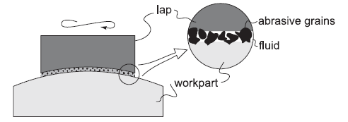
Manufacturing Technology
Lapping
Schematics of lapping process showing the lap and the cutting action of suspended abrasive particles.

Slide 8
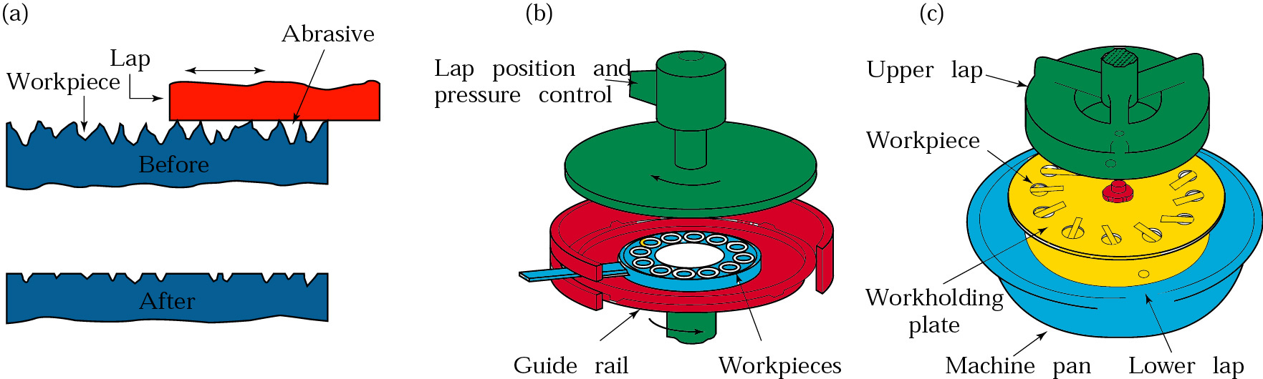
Manufacturing Technology
Lapping
Figure (a) Schematic illustration of the lapping process. (b) Production lapping on
flat surfaces.(c) Production lapping on cylindrical surfaces.

Slide 9
Manufacturing Technology
Abrasives of lapping
  Al2O3 and SiC, grain size 5~100μm
  Cr2O3, grain size 1~2 μm
  B4C3, grain size 5-60 μm
  Diamond, grain size 0.5~5 μm
Lubricating materials of lapping
  Machine oil
  Rape oil
  grease
Technical parameters affecting lapping processes are
  unit pressure
  the grain size of abrasive
  concentration of abrasive in the vehicle
  lapping speed

Slide 10
Manufacturing Technology
Polishing
Polishing is a finishing operation to improve the surface finish by means of a polishing wheel made of fabrics or leather and rotating at high speed. The abrasive grains are glued to the outside periphery of the polishing wheel. Polishing operations are often accomplished manually.
Buffing
Buffing is a finishing operation similar to polishing, in which abrasive grains are not glued to the wheel but are contained in a buffing compound that is pressed into the outside surface of the buffing wheel while it rotates. As in polishing, the abrasive particles must be periodically replenished.
As in polishing, buffing is usually done manually, although machines have been designed to perform the process automatically.
Buffing wheels are made of discs of linen, cotton, broad cloth and canvas

Slide 11
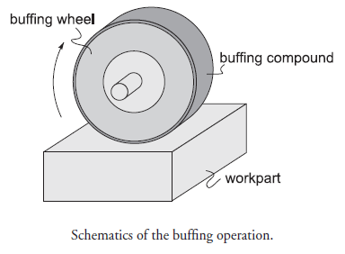
Manufacturing Technology
Buffing

Slide 12
Manufacturing Technology
Honing
Honing is a finishing process, in which a tool called hone carries out a combined rotary and reciprocating motion while the work piece does not perform any working motion. Most honing is done on internal cylindrical surface, such as automobile cylindrical walls.
The honing stones are held against the work piece with controlled light pressure. The honing head is not guided externally but, instead, floats in the hole, being guided by the work surface
It is desired that
  honing stones should not leave the work surface
  stroke length must cover the entire work length.

Slide 13
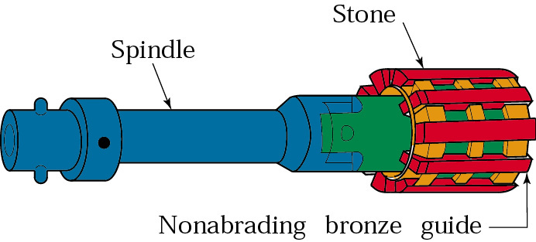
Manufacturing Technology
Honing
Honing is a finishing process performed by a honing tool, which contains a set of three to a dozen and more bonded abrasive sticks. The sticks are equally spaced about the periphery of the honing tool. They are held against the work surface with controlled light pressure, usually exercised by small springs.
The honing tool is given a complex rotational and oscillatory axial motion, which combine to produce a crosshatched lay pattern of very low surface roughness
Honing tool

Slide 14
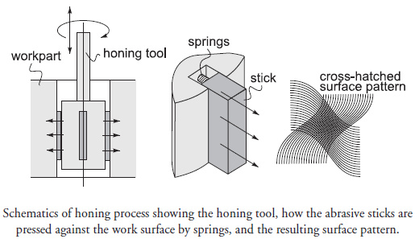
Manufacturing Technology
Honing

Slide 15
Manufacturing Technology
Stone
  Al2O3 or SiC bonded abrasives
The critical process parameters are:
  Rotation speed
  Oscillation speed
  Length and position of the stroke
  Honing stick pressure
Parameters that affect material removal rate (MRR) and surface roughness (R) are:
  Unit pressure, p
  Peripheral honing speed, Vc
  Honing time, T

Slide 16
Manufacturing Technology
Super finishing
Super finishing is a micro finishing process that produces a controlled surface condition on parts which is not obtainable by any other method. The operation which is also called ‘micro stoning’ consist of scrubbing a stone against a surface to produce a fine quality metal finish.
The process consists of removing chatter marks and fragmented or smear metal from the surface of dimensionally finished parts. As much as 0.03 to 0.05 mm of stock can be efficiently removed with some production applications, the process becomes most economical if the metal removal is limited to 0.005 mm

Slide 17
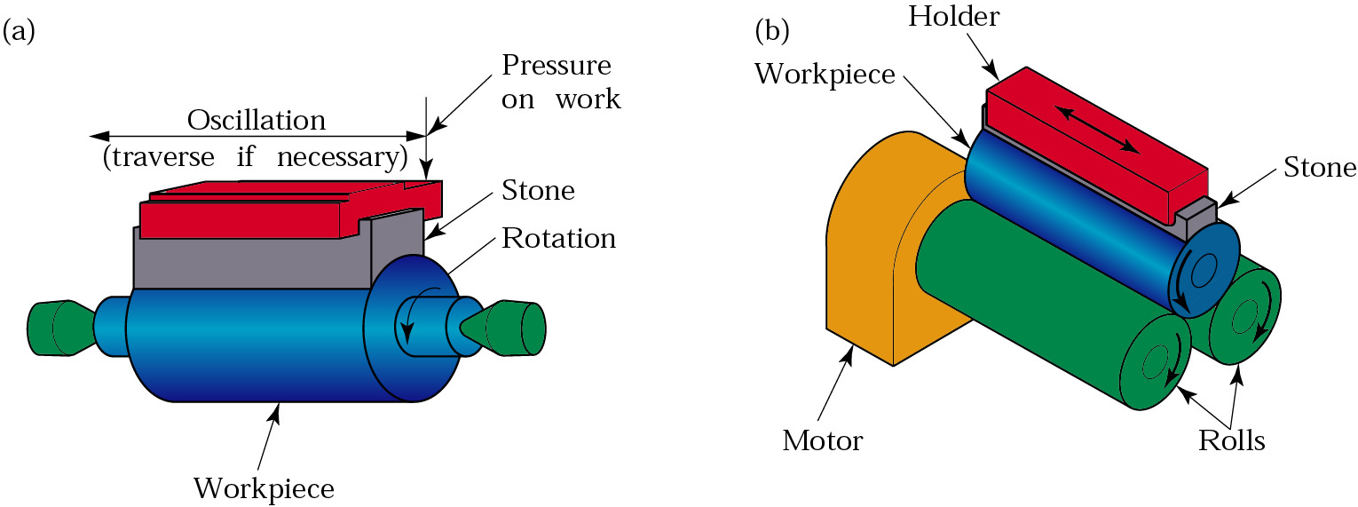
Manufacturing Technology
Super finishing
Figure Schematic illustrations of the super finishing process for a cylindrical part. (a) Cylindrical mircohoning, (b) Centerless microhoning.

Slide 18
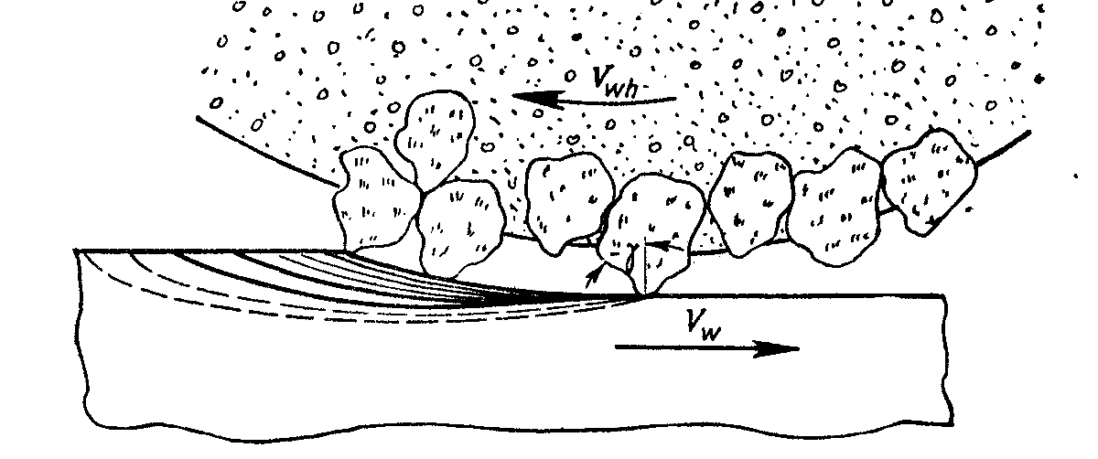
Manufacturing Technology
Grinding
Grinding is the most common form of abrasive machining. It is a material cutting process which engages an abrasive tool whose cutting elements are grains of abrasive material known as grit. These grits are characterized by sharp cutting points, high hot hardness, chemical stability and wear resistance.
The grits are held together by a suitable bonding material to give shape of an abrasive tool.
Fig. illustrates the cutting action of abrasive grits of disc type grinding wheel similar to cutting action of teeth of the cutter in slab milling.

Slide 19
Manufacturing Technology
Major advantages and applications of grinding
Advantages
  Dimensional accuracy
  Good surface finish
  Good form and locational accuracy applicable to both hardened and unhardened material
Applications
Surface finishing
Slitting and parting
De-scaling , De-burring
Stock removal (abrasive milling) finishing of flat as well as cylindrical surface
Grinding of tools and cutters and re-sharpening of the same.

Slide 20
Manufacturing Technology
Grinding Machines
Grinding Machines are also regarded as machine tools. A distinguishing feature of grinding machines is the rotating abrasive tool.
Grinding machine is employed to obtain high accuracy along with very high class of surface finish on the work piece. However, advent of new generation of grinding wheels and grinding machines, characterized by their rigidity, power and speed enables one to go for high efficiency deep grinding (often called as abrasive milling) of not only hardened material but also ductile materials.
Conventional grinding machines can be broadly classified as:
  Surface grinding machine
  Cylindrical grinding machine
  Internal grinding machine
  Tool and cutter grinding machine

Slide 21
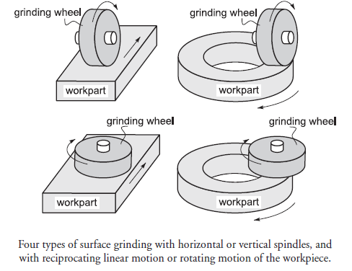
Manufacturing Technology
Surface grinding
In surface grinding, the spindle position is either horizontal or vertical, and the relative motion of the work piece is achieved either by reciprocating the work piece past the wheel or by rotating it. The possible combinations of spindle orientations and work piece motions yield four types of surface grinding processes illustrated in the figure

Slide 22
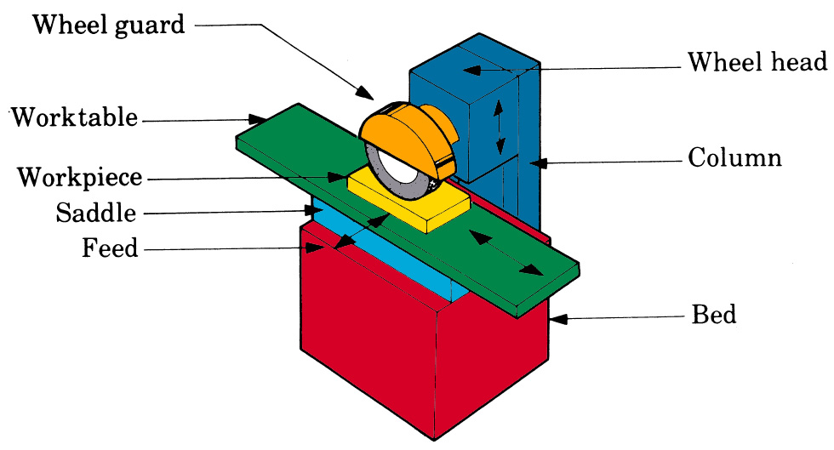
Manufacturing Technology
Surface grinding machine
Schematic illustration surface grinding Machine

Slide 23
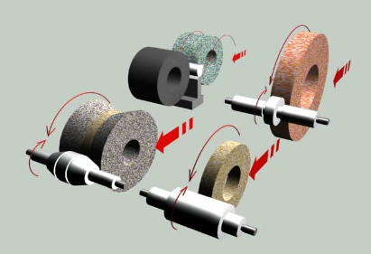
Manufacturing Technology

Slide 24
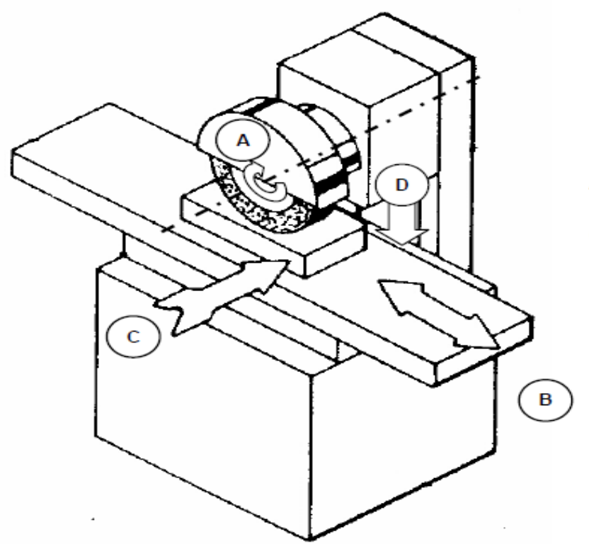
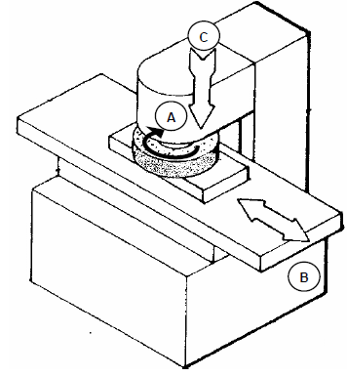
Manufacturing Technology
Surface grinding machine
This machine may be similar to a milling machine used mainly to grind flat surface. However, some types of surface grinders are also capable of producing contour surface with formed grinding wheel.
Horizontal Grinding Machine
Vertical Grinding Machine
A: rotation of grinding wheel B: reciprocation of worktable C: transverse feed D: down feed

Slide 25
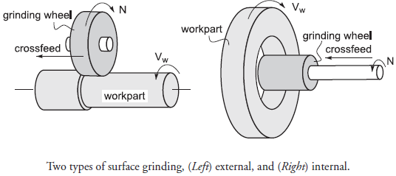
Manufacturing Technology
Cylindrical grinding
In external cylindrical grinding (also center-type grinding) the work piece rotates and reciprocates along its axis, although for large and long work parts the grinding wheel reciprocates.
In internal cylindrical grinding, a small wheel grinds the inside diameter of the part. The work piece is held in a rotating chuck in the headstock and the wheel rotates at very high rotational speed. In this operation, the work piece rotates and the grinding wheel reciprocates.

Slide 26
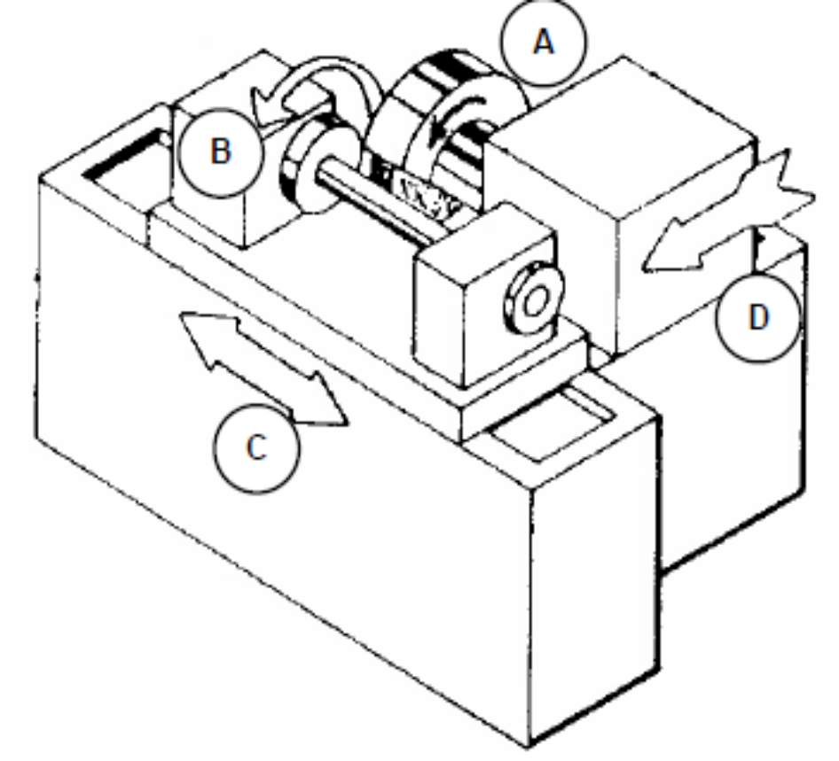
Manufacturing Technology
Cylindrical grinding machine
This machine is used to produce external cylindrical surface. The surfaces may be straight, tapered, steps or profiled.
A: rotation of grinding wheel B: work table rotation C: reciprocation of worktable D: infeed

Slide 27
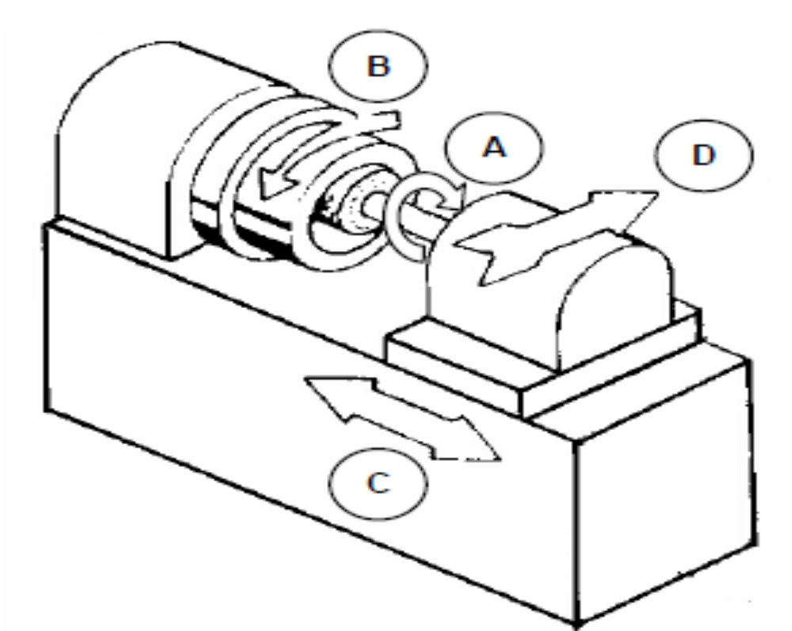
Manufacturing Technology
Internal grinding machine
This machine is used to produce internal cylindrical surface. The surface may be straight, tapered, grooved or profiled.

Slide 28
Manufacturing Technology
Center less grinding
Center less grinding is a process for continuously grinding cylindrical surfaces in which the work piece is supported not by centers or chucks but by a rest blade. The work piece is ground between two wheels. The larger grinding wheel does grinding, while the smaller regulating wheel, which is tilted at an angle i, regulates the velocity Vf of the axial movement of the work piece.
Center less grinding can also be external or internal, traverse feed or plunge grinding. The most common type of center less grinding is the external traverse feed grinding.

Slide 29
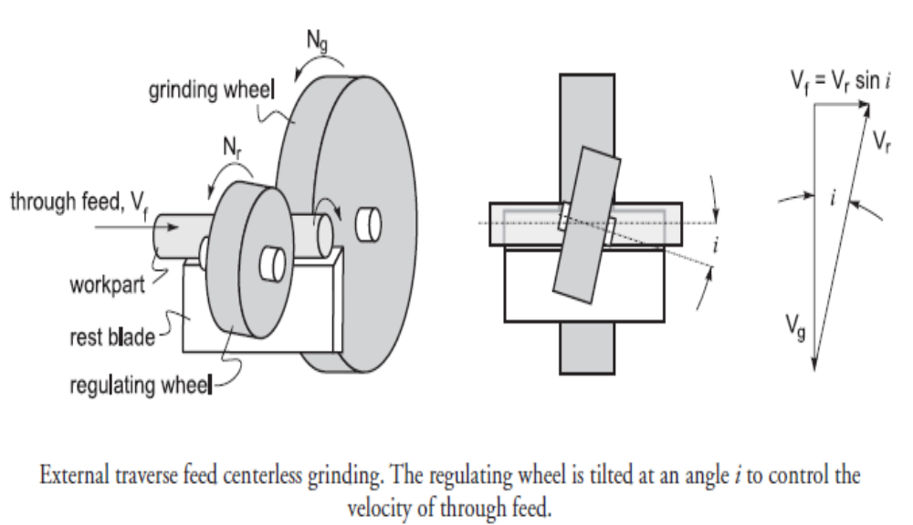
Manufacturing Technology
Center less grinding Machine

Slide 30
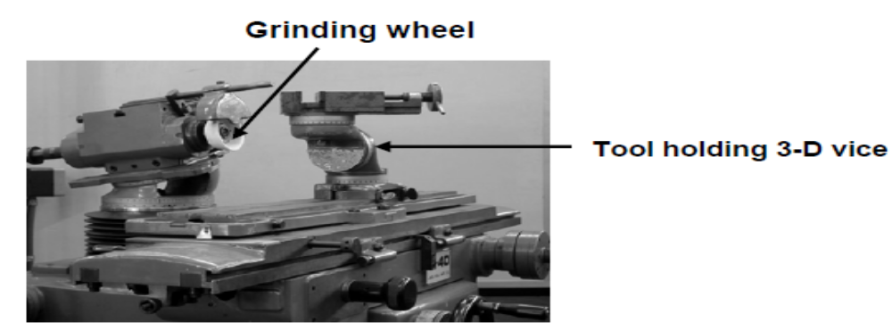
Manufacturing Technology
Tool and cutter grinder machine
Tool grinding may be divided into two subgroups: tool manufacturing and tool re sharpening. There are many types of tool and cutter grinding machine to meet these requirements. Simple single point tools are occasionally sharpened by hand on bench or pedestal grinder. However, tools and cutters with complex geometry like milling cutter, drills, reamers and hobs require sophisticated grinding machine commonly known as universal tool and cutter grinder. Present trend is to use tool and cutter grinder equipped with CNC to grind tool angles, concentricity, cutting edges and dimensional size with high precision.

Slide 31
Manufacturing Technology
Grinding wheel
Grinding wheel consists of hard abrasive grains called grits, which perform the cutting or material removal, held in the weak bonding matrix. A grinding wheel commonly identified by the type of the abrasive material used. The conventional wheels include aluminium oxide and silicon carbide wheels while diamond and CBN (cubic boron nitride) wheels fall in the category of super abrasive wheel.
Specification of grinding wheel
A grinding wheel requires two types of specification
  Geometrical specification
  Compositional specification

Slide 32
Manufacturing Technology
Geometrical specification
This is decided by the type of grinding machine and the grinding operation to be performed in the workpiece. This specification mainly includes wheel diameter, width and depth of rim and the bore diameter.
Compositional specifications
Specification of a grinding wheel ordinarily means compositional specification. Conventional abrasive grinding wheels are specified encompassing the following parameters.
  The type of grit material
  The grit size
  The bond strength of the wheel, commonly known as wheel hardness
  The structure of the wheel denoting the porosity i.e. the amount of inter grit spacing
  The type of bond material
  other than these parameters, the wheel manufacturer may add their own identification code prefixing or suffixing (or both) the standard code.

Slide 33
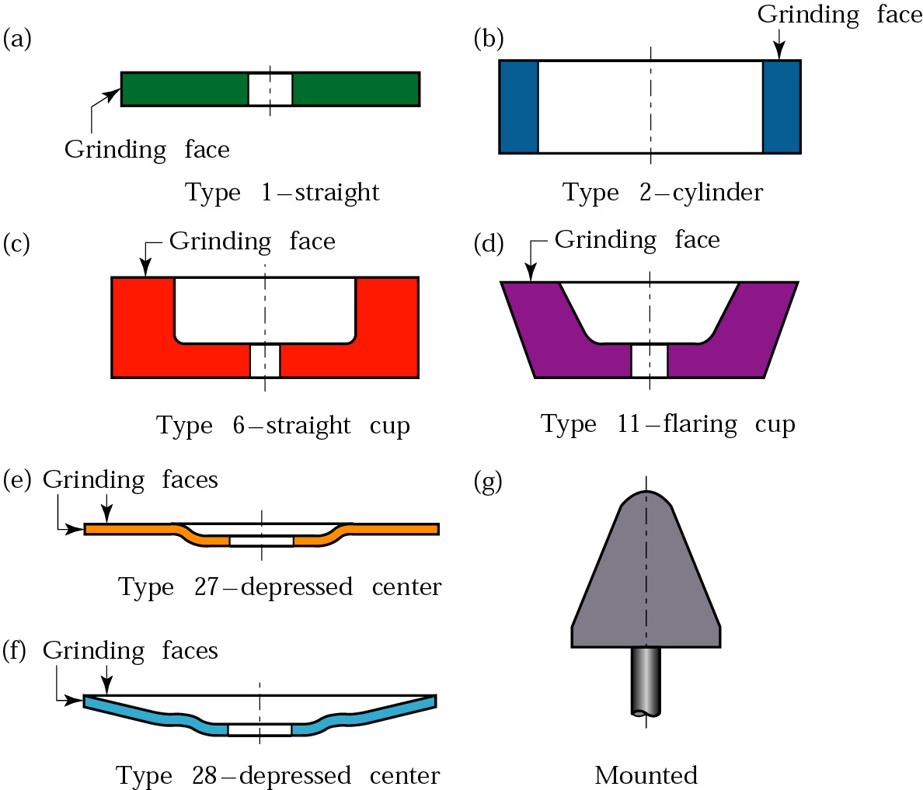
Manufacturing Technology
Types
Conventional abrasive grinding wheels

Slide 34
Manufacturing Technology
Examples of Bonded Abrasives
Conventional abrasives
  Al₂O₃
  SiC
Super abrasives
  Cubic boron nitride (CBN)
  Diamond

Slide 35
Manufacturing Technology
Selection of Cutting speed and Working speed is based on
Material and its hardness.
Amount of stock removal and finish required.
Whether the grinding is done wet or dry.
Wheel speed.
Area of grinding contact.
Severity of the grinding operation.

Slide 36
Manufacturing Technology
Truing and dressing of grinding wheel
Truing
Truing is the act of regenerating the required geometry on the grinding wheel, whether the geometry is a special form or flat profile. Therefore, truing produces the macro-geometry of the grinding wheel.
Truing is also required on a new conventional wheel to ensure concentricity with specific mounting system. In practice the effective macro-geometry of a grinding wheel is of vital importance and accuracy of the finished work piece is directly related to effective wheel geometry.

Slide 37
Manufacturing Technology
Dressing
Dressing is the conditioning of the wheel surface which ensures that grit cutting edges are exposed from the bond and thus able to penetrate into the work piece material. Also, in dressing attempts are made to splinter the abrasive grains to make them sharp and free cutting and also to remove any residue left by material being ground.
Dressing therefore produces micro-geometry. The structure of micro-geometry of grinding wheel determine its cutting ability with a wheel of given composition. Dressing can substantially influence the condition of the grinding tool.
Truing and dressing are commonly combined into one operation for conventional abrasive grinding wheels, but are usually two distinctly separate operation for super abrasive wheel.

Slide 38
END

