Slide 1
MANUFACTURING TECHNOLOGY
UNIT – V
Machine Tools

Slide 2
Manufacturing Technology
Introduction
One of the most versatile machine tools; used to bore holes in large and heavy parts as engine frames, machine housings etc which are practically impossible to hold and rotate in an engine lathe or in a drilling machine.
Also drilling, milling and facing can be preformed with equal facility.
Along with attachments screw cutting, turning, grinding or gear cutting can also be performed.

Slide 3
Manufacturing Technology
CLASSIFICATION OF BORING MACHINE
The boring machine is one of the vertalile machine tool used to enlarge already drilled hole.
Boring operation can be performed on lathe as that of turning where tool is stationary and work piece is rotating.
But in case of boring is rotating and work piece is stationary which is similar to
Drilling ,reaming , milling etc.
Boring machines can be classified based on position of boring tools, accuracy of work required etc.

Slide 4
Manufacturing Technology
Boring machines
1. Horizontal
Boring
Machine
(HBM)
2. Vertical
Boring
Machine
(VBM)
3. Precision (Jig)
Boring
Machine
(PBM)

Slide 5
Manufacturing Technology
Types
Horizontal boring machine:
The work is supported on a table which is stationary and tool revolves in a horizontal axis.
Can perform boring, reaming, turning, threading, facing, milling , grooving and many other operations with suitable tools.
Work piece which are heavier and asymmetrical can be easily held and machined.
Different types has been designed to suit the different purpose.

Slide 6
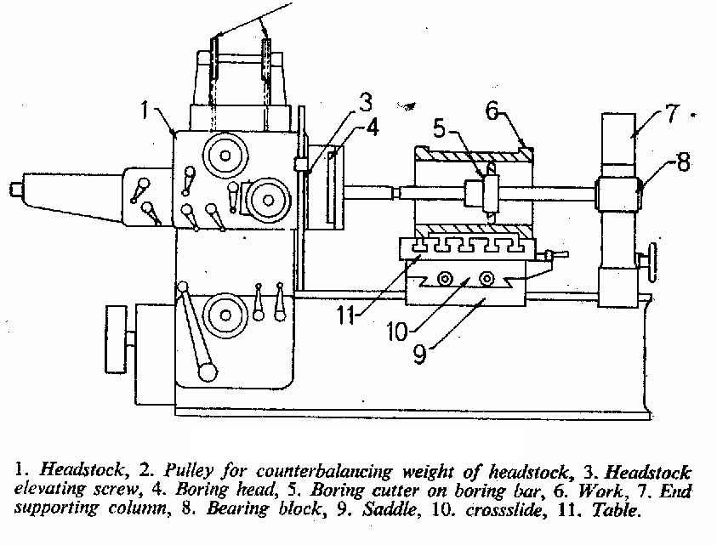
Manufacturing Technology
Horizontal boring machine

Slide 7
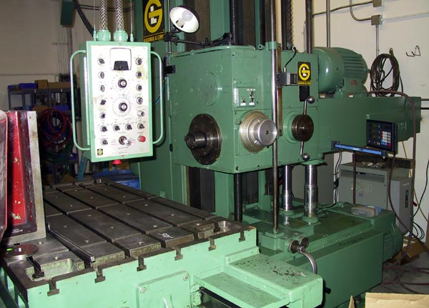
Manufacturing Technology
Horizontal boring machine

Slide 8
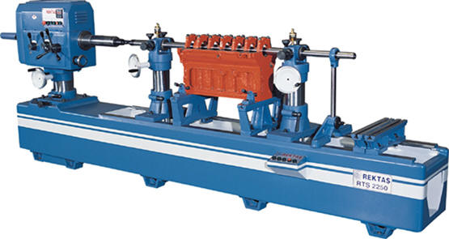
Manufacturing Technology
Horizontal Line Boring Machine

Slide 9
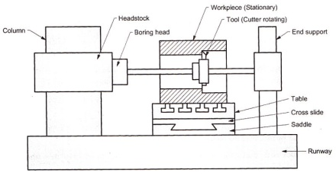
Block diagram of horizontal boring machine

Slide 10
Important parts of the horizontal boring machines are as following.
(1) Head Stock
(2) Column
(3) Runway
(4) End Support
(5) Table
(6) Saddle

Slide 11
(1) Head Stock
It is the most important part of a boring machine.
It contains spindles.
It supports, drives and feeds the boring tool.
The spindle rotation is reversible for backing out tools.
Boring tool is held in boring head which will be held in head stock.

Slide 12
(2) Column
Column supports head stock and tail stock.
It guides up and down movement by means of ways.
It is hollow and heavily constructed.
To balance head stock and make it easy to move.
Columns are keyed, dowelled and bolted to the base of the machine.

Slide 13
(3) Runways
Definition:→
When ever the column is traversing the base used is known as runway.
Main function of runways are to carry the main column, end support column and rotary table if any.

Slide 14
(4) End Support Column
Definition:→
An out-board bearing is required to support the other end of the bar is known as end END SUPPORT COLUMN.
End support column is necessary in case of long boring and heavy tools are used.
There is an opened and closed type of end support.

Slide 15
(5) Table
Main function of the table is to support for holding the workpiece rigidly during the operation.
Table is equipped with suitable ranges of feeds as well as quick reverse mechanism.
Table moves perpendicular to the axis of the spindle.

Slide 16
(6) Saddle
The main function of saddle is to provide a compound movement of the table.
This helps the table to move axially as well as transversly to the spindle.

Slide 17
Applications Of HBM
Horizontal boring machine can be used to drill, bore ream holes.
These are widely used in batch production where work piece is less.
These machine can also be used for machining type parts like gear boxes and engine blocks.

Slide 18
Manufacturing Technology
Vertical Boring Machine:
The work rotates on a horizontal table about a vertical axis and the tool is stationary except for feed.
Machine may look like a vertical lathe.
Larger diameter and heavy work pieces, can be set up more quickly than in lathe.
Multiple tooling may be adapted with its turret type tool post, increasing the rate of production.

Slide 19
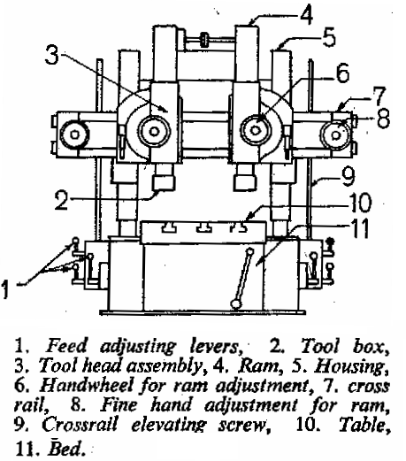
Manufacturing Technology
Vertical boring machine

Slide 20
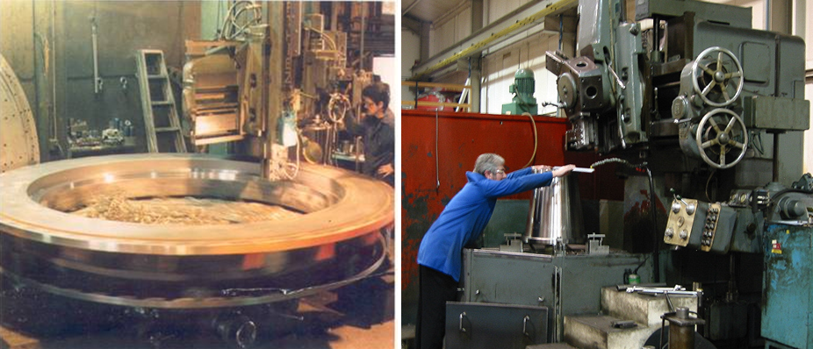
Manufacturing Technology
Vertical boring machine

Slide 21
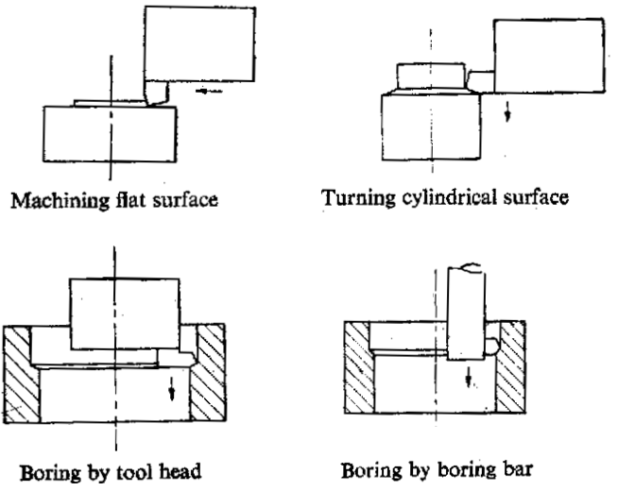
Manufacturing Technology
Vertical Boring Operations

Slide 22
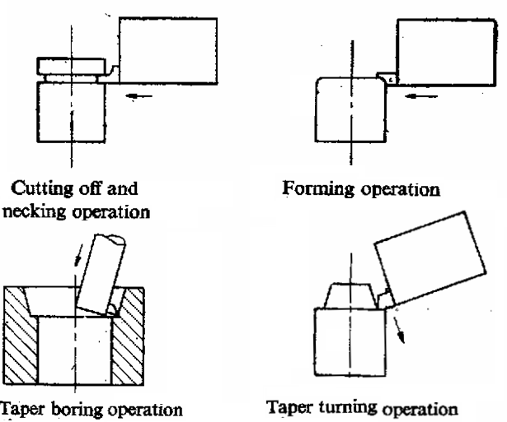
Manufacturing Technology
Vertical Boring Operations

Slide 23
Manufacturing Technology
Jig Boring Machine
It uses a single point cutting tools to machine surfaces rapidly and accurately.
Cemented carbide and diamond tipped tools are operated at a very high cutting speed to produce accurately sized holes with fine surface.
Jig boring machine is a precision boring machine, resembles to vertical milling machine in construction.
Accurate positioning of holes is achieved by Lead screw method or Mechanical / Electrical Gauging method or Optical measuring method.

Slide 24
Manufacturing Technology
Jig Boring Machine
Jig-Boring Machine a metal-cutting machine for finishing holes, planes, and slots with a highly precise location of centers or surfaces without the use of special attachments for tool alignment.
Jig-boring machines are used for boring, drilling, counter-sinking, reaming, milling, and other types of finishing in individual and small-scale production during the manufacture of cutting and measuring tools, jigs, dies, and key components of machines and instruments. Devices with stable and adjustable end gauges and indicator sensing units are used on jig-boring machines for precise measurements; also used are lead screws with dials and a vernier, which are equipped with error-elimination compensators, and graduated shafts with optical measuring instruments.

Slide 25
Manufacturing Technology
There are two types of these machine tools: double-sided (gantry) machines with a one-movement table and open-sided (single-sided, overhanging) machines with a two-movement table. In open-sided machines the spindle head moves only vertically; in the double-sided machines it moves horizon-tally along the crosspiece, which can travel in a vertical direction.
The manufactured article and the cutting tool on the jig-boring machine are moved relative to one another along orthogonal coordinates (with linear displacement accuracy to 2 microns) and polar coordinates (with angular displacement accuracy to 5 seconds of arc). Sturdy construction is a feature of jig-boring machines, which have smooth drive motions and accurate balancing of fast-rotating parts (to reduce vibration).
The machines are installed in insulated areas in which a constant temperature of 20°C is maintained. Jig-boring machines are operated by highly skilled workers.

Slide 26
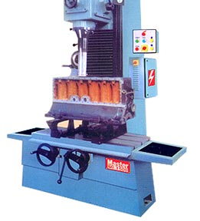
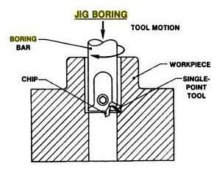
Manufacturing Technology
Jig Boring
Jig Boring Machine
Jig Boring

Slide 27
END

