Slide 1
MANUFACTURING TECHNOLOGY
UNIT – V
Machine Tools

Slide 2
Manufacturing Technology
BASIC PRINCIPLES OF BROACHING
Broaching is a machining process for removal of a layer of material of desired width and depth usually in one stroke by a slender rod or bar type cutter having a series of cutting edges with gradually increased protrusion as indicated in Fig.a. In shaping, attaining full depth requires a number of strokes to remove the material in thin layers step – by – step by gradually in-feeding the single point tool (Fig.b).. Whereas, broaching enables remove the whole material in one stroke only by the gradually rising teeth of the cutter called broach. The amount of tooth rise between the successive teeth of the broach is equivalent to the in feed given in shaping.

Slide 3
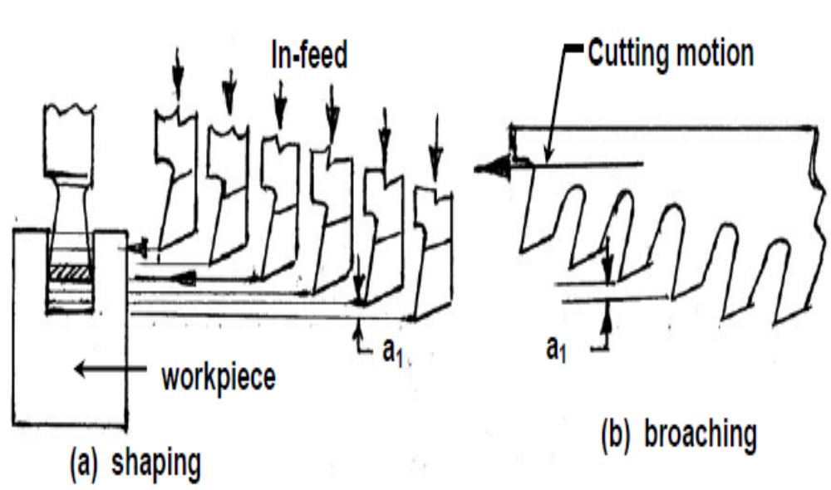
Manufacturing Technology
Basic principles of Broaching

Slide 4
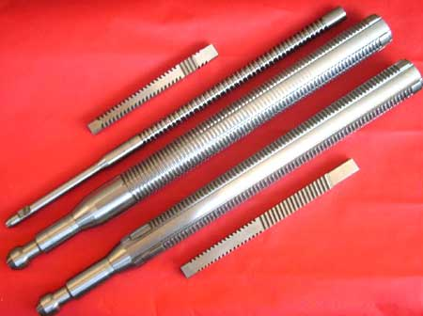

Tools used in broaching machine.

Slide 5
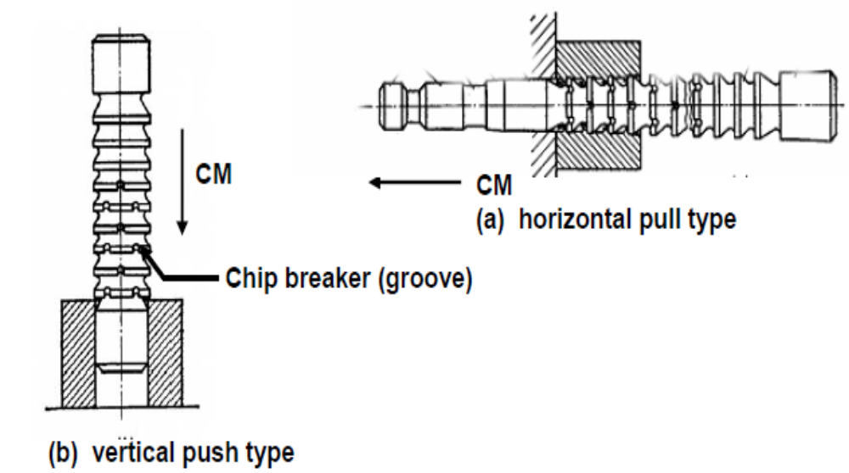
Manufacturing Technology
Basic principles of Broaching
Finishing hole by broaching

Slide 6
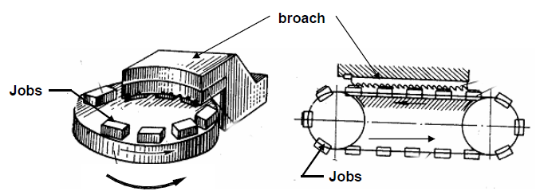
Manufacturing Technology
Basic principles of Broaching
Continuous broaching.

Slide 7
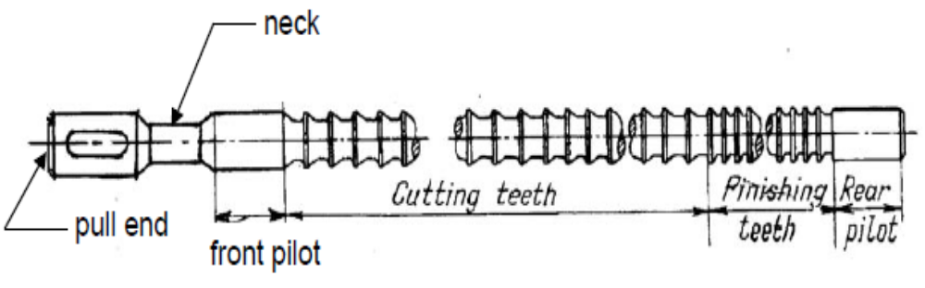
Manufacturing Technology
Nomenclature of broaching tool
Both pull and push type broaches are made in the form of slender rods or bars of varying section having along its length one or more rows of cutting teeth with increasing height (and width occasionally). Push type broaches are subjected to compressive load and hence are made shorter in length to avoid buckling.
The general configuration of pull type broaches, which are widely used for enlarging and finishing preformed holes, is schematically shown in Fig.

Slide 8
Manufacturing Technology
Nomenclature of broaching tool
Pull end for engaging the broach in the machine
Neck of shorter diameter and length, where the broach is allowed to fail, if at all, under overloading
Front pilot for initial locating the broach in the hole
Roughing and finishing teeth for metal removal
Finishing and burnishing teeth for fine finishing
Rear pilot and follower rest or retriever

Slide 9
Manufacturing Technology
There are different types of broaching machines which are broadly classified
  According to purpose of use
    Δ general purpose
    Δ single purpose
    Δ special purpose
  According to nature of work
    Δ internal broaching
    Δ external (surface) broaching
  According to configuration
    Δ horizontal
    Δ vertical
  According to number of slides or stations
    Δ single station type
    Δ multiple station type
    Δ indexing type
  According to tool / work motion
    Δ intermittent (one job at a time) type
    Δ continuous type

Slide 10
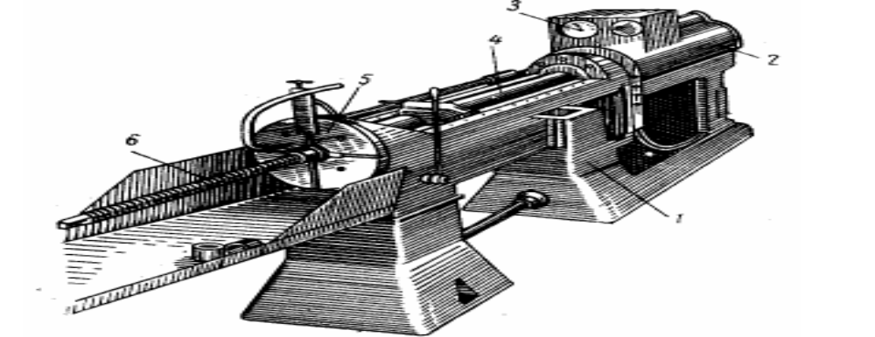
Manufacturing Technology
Horizontal broaching machine
Horizontal broaching machines, typically shown in Fig. are the most versatile in application and performance and hence are most widely employed for various types of production. These are used for internal broaching but external broaching work are also possible. The horizontal broaching machines are usually hydraulically driven and occupies large floor space.

Slide 11
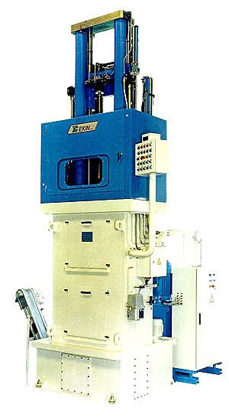
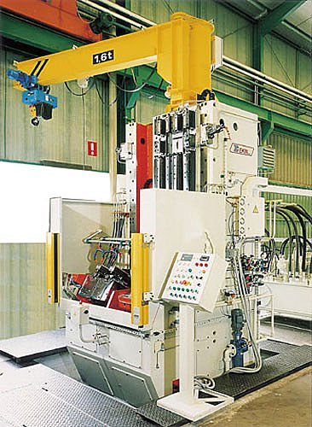

Slide 12
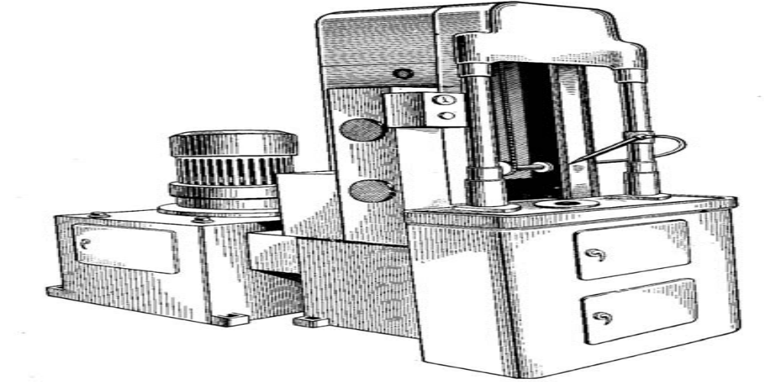
Manufacturing Technology
Vertical broaching machine
Vertical broaching machines, typically shown in Fig.
  occupies less floor space
  are more rigid as the ram is supported by base
  mostly used for external or surface broaching though internal broaching is also possible and occasionally done.

Slide 13
Manufacturing Technology
Major advantages
Very high production rate (much higher than milling, planing, boring etc.)
High dimensional and form accuracy and surface finish of the product
Roughing and finishing in single stroke of the same cutter
Needs only one motion (cutting), so design, construction, operation and control are simpler
Extremely suitable and economic for mass production

Slide 14
Manufacturing Technology
Limitations
Only through holes and surfaces can be machined
Usable only for light cuts, i.e. low chip load and unhard materials
Cutting speed cannot be high
Defects or damages in the broach (cutting edges) severely affect product quality
Design, manufacture and restoration of the broaches are difficult and expensive
Separate broach has to be procured and used whenever size, shape and geometry of the job changes
Economic only when the production volume is large.

Slide 15
Manufacturing Technology
Surface Broaching Machine:
Surface broaching machines have their broaching tools attached to a ramp forced in a straight path along guide ways past the work piece. On some machines the ram moves horizontally on others vertically. When two ramps are used the machine is called a duplex broach.

Slide 16
Manufacturing Technology
Continuous Broaching Machine:
For mass production of small parts the highly productive continuous broaching method is used on rotary or horizontally continuous broaching machine.
In Rotary broaching machines the work piece is loaded on the table which rotates continuously.
In Horizontal broaching machines the work pieces travel as they are carried by an endless chain.

Slide 17
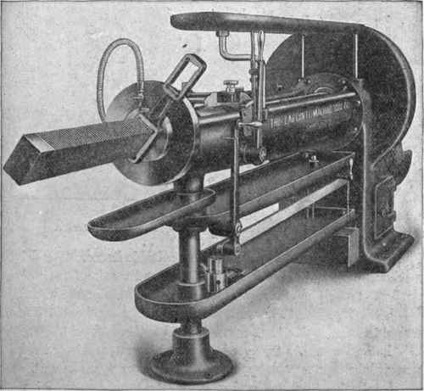
Broaching machine from the earlier time..

Slide 18
Manufacturing Technology
BROACHING METHODS
Broaching, according to the method of operation maybe classified as follows:-
PULL BROACHING
PUSH BROACHING
SURFACE BROACHING
CONTINUOUS BROACHING

Slide 19
Manufacturing Technology
PULL BROACHING
The work is held stationary and the broach is pulled through the work. Broaches are usually long and are held in a special head. This is used mostly for internal broaching but it can do some surface broaching.

Slide 20
Manufacturing Technology
PUSH BROACHING
The work is held stationary and the broach is pushed through the work. Hand and hydraulic arbor presses are popular for push broaching. This method is used usually for sizing holes or cutting keyways .

Slide 21
Manufacturing Technology
SURFACE BROACHING
This method has rapidly become an important means of surface finishing. Many irregular or intricate shapes can be broached by surface broaching. But the tools must be specially for each job.

Slide 22
Manufacturing Technology
CONTINOUS BROACHING
The work is moved continuously and the broach is held stationary. The path of movement maybe either straight, horizontal or circular. This method is very suitable for broaching a number of similar works at a time.

Slide 23
Manufacturing Technology
BROACHING OPERATIONS
Broaching is applied for machining various internal and external surfaces. For round or irregular shaped holes from 6 to 100 mm in diameter for external, flat and contour surfaces.
Most broaching operations are completed in one pass but some are arranged for repeated cuts to simplify the design of the broach.

Slide 24
Manufacturing Technology
BROACHING OPERATIONS
Broaching a key in a hole with a keyway broach.
Broaching hole with a round back.
Surface broaching with a contour broach.
Broaching a spline hole with a spline broach.

Slide 25
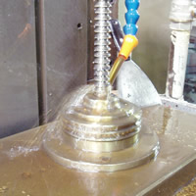
Manufacturing Technology
Broaching in being done

Slide 26
Manufacturing Technology
ADVANTAGES
Rate of production is very high.
Little skill is required to perform a broaching operation.
High accuracy and a high class of surface finish is possible.
Both roughing and finishing cuts are completed in one pass of the tool.
The process can be used for either internal or external surface finishing
Any form that can be reproduced on a broaching can be machined.
Cutting fluid maybe readily applied where it is most effective.

Slide 27
Manufacturing Technology
LIMITATION
High tool cost.
Very large work pieces cannot be broached.
The surfaces to be broached cannot have an obstruction.
Broaching cannot be used for the removal of a large amount of stock.
Parts to be broached must be capable of being rigid and must withstand the forces that set up during cutting.

Slide 28
END

