Slide 1
MANUFACTURING TECHNOLOGY
UNIT – V
Machine Tools

Slide 2
Manufacturing Technology
Milling
Introduction
Milling is the process of machining flat, curved, or irregular surfaces by feeding the work piece against a rotating cutter containing a number of cutting edges. The usual Mill consists basically of a motor driven spindle, which mounts and revolves the milling cutter, and a reciprocating adjustable worktable, which mounts and feeds the work piece.
Milling machines are basically classified as vertical or horizontal. These machines are also classified as knee-type, ram-type, manufacturing or bed type, and planer-type. Most milling machines have self-contained electric drive motors, coolant systems, variable spindle speeds, and power-operated table feeds

Slide 3
Manufacturing Technology
Milling is a process of producing flat and complex shapes with the use of multi-tooth cutting tool, which is called a milling cutter and the cutting edges are called teeth.
The axis of rotation of the cutting tool is perpendicular to the direction of feed, either parallel or perpendicular to the machined surface. The machine tool that traditionally performs this operation is called milling machine.
Milling is an interrupted cutting operation in which the teeth of the milling cutter enter and exit the work during each revolution. This interrupted cutting action subjects the teeth to a cycle of impact force and thermal shock on every rotation. The tool material and cutter geometry must be designed to withstand these conditions. Cutting fluids are essential for most milling operations.

Slide 4
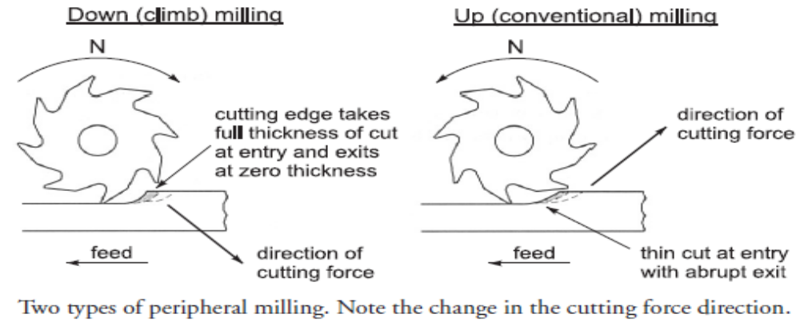
Manufacturing Technology
Types of milling
There are two basic types of milling
Down (climb) milling, when the cutter rotation is in the same direction as the motion of the work piece being fed.
up (conventional) milling, in which the work piece is moving towards the cutter, opposing the cutter direction of rotation

Slide 5
Manufacturing Technology
Comparison of Up and Down Milling
Down milling, the cutting force is directed into the work table, which allows thinner work parts to be machined. Better surface finish is obtained but the stress load on the teeth is abrupt, which may damage the cutter.
Up milling, the cutting force tends to lift the work piece. The work conditions for the cutter are more favorable. Because the cutter does not start to cut when it makes contact (cutting at zero cut is impossible), the surface has a natural waviness.

Slide 6
Manufacturing Technology
Milling Operations
Milling of Flat Surfaces
Peripheral Milling
In peripheral milling, also called plain milling, the axis of the cutter is parallel to the surface being machined, and the operation is performed by cutting edges on the outside periphery of the cutter. The primary motion is the rotation of the cutter. The feed is imparted to the work piece.
In peripheral milling the axis of the cutter rotation is parallel to the work surface to be machined.

Slide 7
Manufacturing Technology
Types of Peripheral Milling
Slab milling
  The basic form of peripheral milling in which the cutter width extends beyond the work piece on both sides
Slotting
  Slotting, also called slot milling, in which the width of the cutter, usually called slotter, is less than the work piece width.
  The slotter has teeth on the periphery and over the both end faces. When only the one-side face teeth are engaged, the operations is known as the side milling, in which the cutter machines the side of the work piece

Slide 8
Manufacturing Technology
Straddle milling
  Straddle milling, which is the same as side milling where cutting takes place on both sides of the work.
  In straddle milling, two slotters mounted on an arbor work together;
  When the slotter is very thin, the operation called slitting can be used to mill narrow slots (slits) or to cut a work part in two.
  The slitting cutter (slitter) is narrower than the slotter and has teeth only on the periphery.

Slide 9
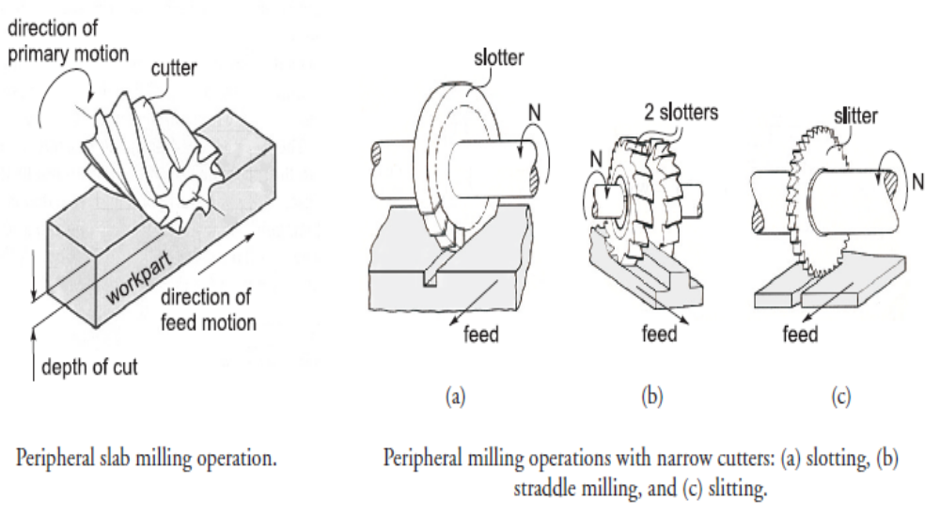
Manufacturing Technology
Peripheral Milling

Slide 10
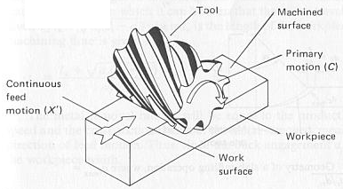
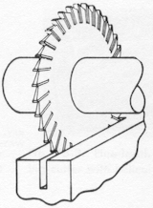
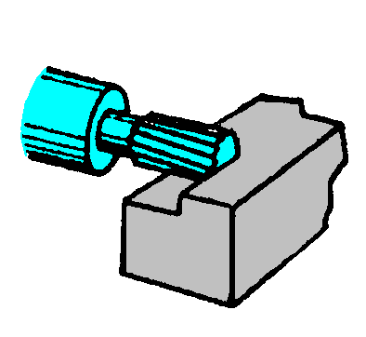
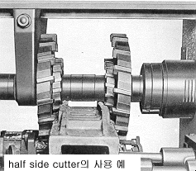
Manufacturing Technology
Peripheral Milling
A
B
C
D
A. Slab milling , B. Slot milling , C. Side milling , D. Straddle milling

Slide 11
Manufacturing Technology
Advantages of peripheral milling
More stable holding of the cutter.
There is less variation in the arbor torque
Lower power requirements.
Better surface finish.

Slide 12
Manufacturing Technology
Face milling
In face milling, cutter is perpendicular to the machined surface. The cutter axis is vertical, but in the newer CNC machines it often is horizontal. In face milling, machining is performed by teeth on both the end and periphery of the face-milling cutter.
Face milling is usually applied for rough machining of large surfaces. Surface finish is worse than in peripheral milling, and feed marks are inevitable. One advantage of the face milling is the high production rate because the cutter diameter is large and as a result the material removal rate is high. Face milling with large diameter cutters requires significant machine power.
In Face milling the axis of the cutter rotation is perpendicular to the work surface to be machined.

Slide 13
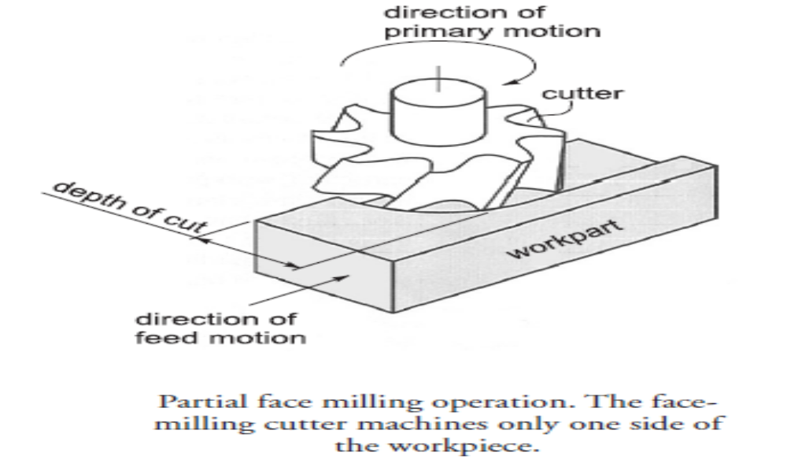
Manufacturing Technology
Face milling

Slide 14
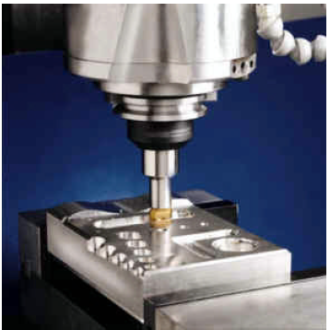
Manufacturing Technology
End milling
In end milling, the cutter, called end mill, has a diameter less than the work piece width. The end mill has helical cutting edges carried over onto the cylindrical cutter surface are used to produce pockets, closed or end key slots, etc.
End milling operation used to cut a pocket in
an aluminum work part.

Slide 15
Manufacturing Technology
Milling of Complex Surfaces
Milling is one of the few machining operations, which are capable of machining complex two- and three-dimensional surfaces, typical for dies, molds, cams, etc. Complex surfaces can be machined either by means of the cutter path (profile milling and surface contouring), or the cutter shape (form milling).
Form milling
In form milling, the cutting edges of the peripheral cutter (called form cutter) have a special profile that is imparted to the work piece. Cutters with various profiles are available to cut different two-dimensional surfaces. One important application of form milling is gear manufacturing

Slide 16
Manufacturing Technology
Types of Form Milling
Profile milling
In profile milling, the conventional end mill is used to cut the outside or inside periphery of a flat part. The end mill works with its peripheral teeth and is fed along a curvilinear path equidistant from the surface profile.
Surface contouring
The end mill, which is used in surface contouring has a hemispherical end and is called ball-end mill. The ball-end mill is fed back and forth across the work piece along a curvilinear path at close intervals to produce complex three-dimensional surfaces.
Similar to profile milling, surface contouring require relatively simple cutting tool but advanced, usually computer-controlled feed control system.

Slide 17
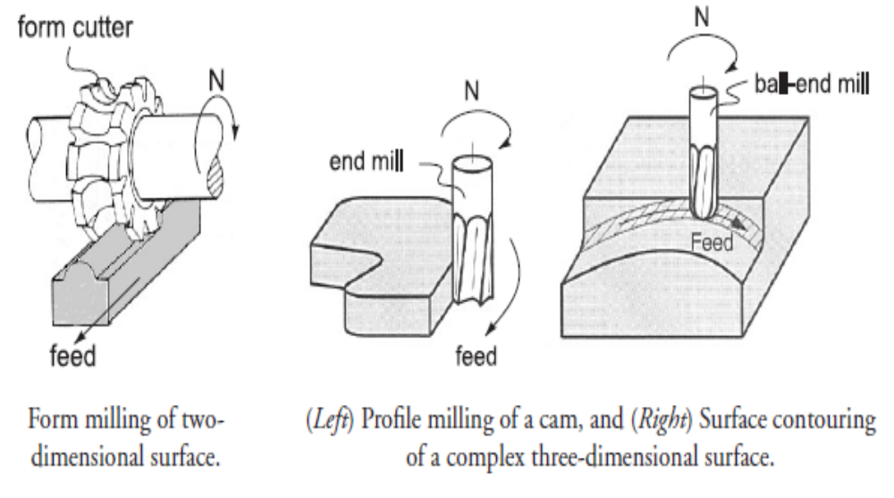
Manufacturing Technology
Form Milling

Slide 18
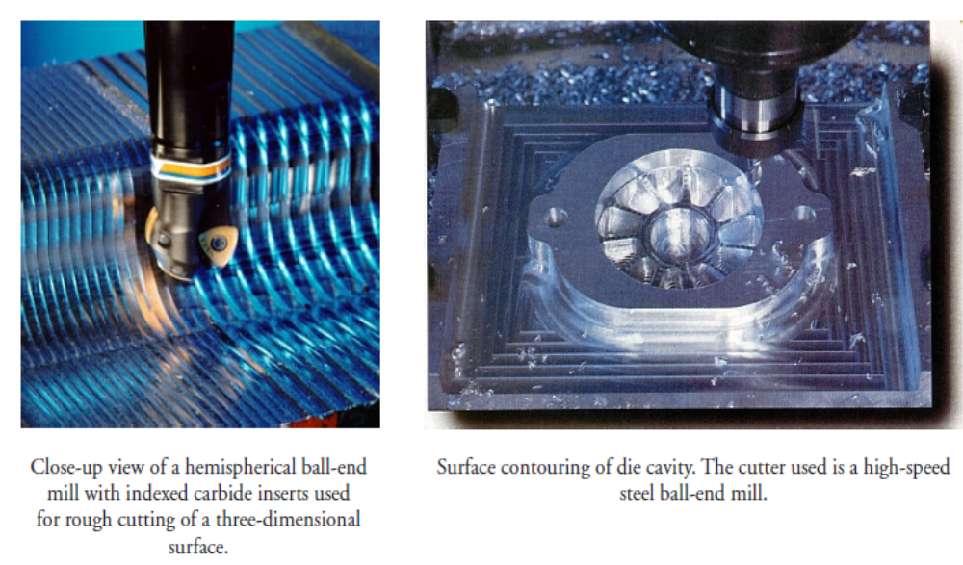
Manufacturing Technology
Surface contouring

Slide 19
Manufacturing Technology
Milling machines
The conventional milling machines provide a primary rotating motion for the cutter held in the spindle, and a linear feed motion for the work piece, which is fastened onto the worktable.
Milling machines for machining of complex shapes usually provide both a rotating primary motion and a curvilinear feed motion for the cutter in the spindle with a stationary work piece.
Milling Machine Types
Various machine designs are available for various milling operations. In this section we discuss only the most popular ones, classified into the following types
  Column-and-knee milling machines
  Bed type milling machines
  Machining centers

Slide 20
Manufacturing Technology
Other Classifications
According to nature of purposes of use
General Purpose Milling Machine
  Conventional milling machines, e.g Up and down milling machines
Single Purpose Milling Machine
  Thread, cam milling machines and slitting machine
Special Purpose Milling Machine
  Mass production machines, e.g., duplicating mills, die sinkers, thread milling etc.

Slide 21
Manufacturing Technology
According to configuration and motion of the work-holding table / bed
Knee type
small and medium duty machines the table with the job/work travels over the bed (guides) in horizontal (X) and transverse (Y) directions and the bed with the table and job on it moves vertically (Z) up and down.
Bed type
Usually of larger size and capacity; the vertical feed is given to the milling head instead of the knee type bed
According to the orientation of the spindle
Horizontal Milling Machine
  Horizontal spindle Feed
Vertical milling machine
  Vertical Spindle Feed
Universal milling machine
  Both Horizontal and Vertical spindle Feed

Slide 22
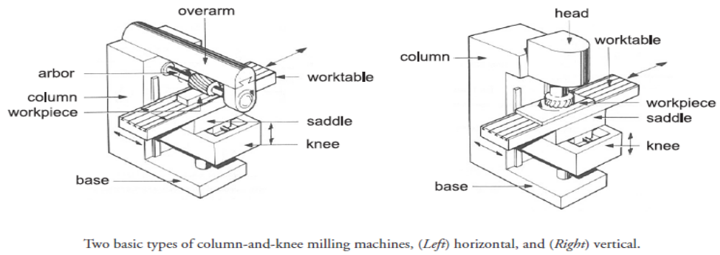
Manufacturing Technology
Column-and-knee milling machines
The column-and-knee milling machines are the basic machine tool for milling. The name comes from the fact that this machine has two principal components, a column that supports the spindle, and a knee that supports the work table.
There are two different types of column-and-knee milling machines according to position of the spindle axis
  Horizontal &Vertical.

Slide 23
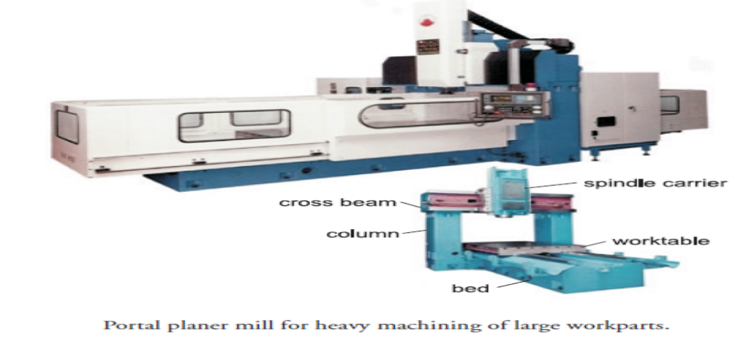
Manufacturing Technology
Bed type machines
In bed type milling machines, the worktable is mounted directly on the bed that replaces the knee. This ensures greater rigidity, thus permitting heavier cutting conditions and higher productivity. This machines are designed for mass production.
Single-spindle bed machines are called simplex mills and are available in either horizontal or vertical models. Duplex mills have two spindle heads, and triplex mills add a third spindle mounted vertically over the bed to further increase machining capability.

Slide 24
Manufacturing Technology
Machining centers
A machining center is a highly automated machine tool capable of performing multiple machining operations under CNC control.
The features that make a machining center unique include the following
Tool storage unit called tool magazine that can hold up to 120 different cutting tools.
Automatic tool changer, which is used to exchange cutting tools between the tool magazine and machining center spindle when required. The tool changer is controlled by the CNC program.
Automatic work part positioning. Many of machining centers are equipped with a rotary worktable, which precisely position the part at some angle relative to the spindle. It permits the cutter to perform machining on four sides of the part.

Slide 25
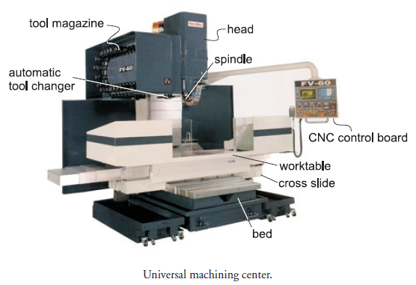
Manufacturing Technology
Machining center

Slide 26
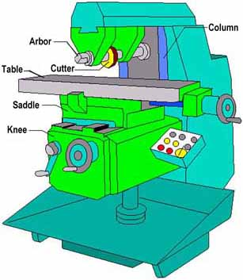
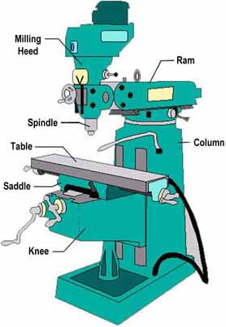
Manufacturing Technology
Milling Machine Specifications
Horizontal Milling Machine
Vertical Milling Machine

Slide 27
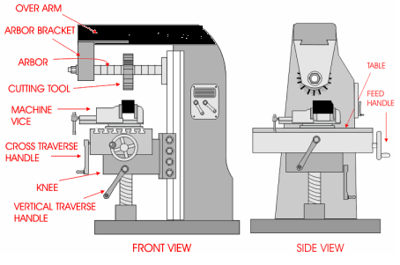
Manufacturing Technology
Milling Machine Specifications

Slide 28
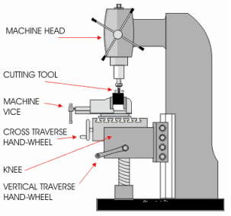
Manufacturing Technology
Milling Machine Specifications

Slide 29
Manufacturing Technology
Milling cutters
Classification of milling cutters according to their design
HSS cutters: Many cutters like end mills, slitting cutters, slab cutters, angular cutters, form cutters, etc., are made from high-speed steel (HSS).
Brazed cutters: Very limited number of cutters (mainly face mills) are made with brazed carbide inserts. This design is largely replaced by mechanically attached cutters.
Mechanically attached cutters: The vast majority of cutters are in this category. Carbide inserts are either clamped or pin locked to the body of the milling cutter.

Slide 30
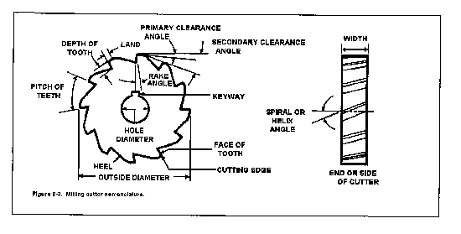
Manufacturing Technology
Milling Cutter Nomenclature

Slide 31
Manufacturing Technology
Milling Cutter Nomenclature
The pitch refers to the angular distance between like or adjacent teeth.
The pitch is determined by the number of teeth. The tooth face is the forward facing surface of the tooth that forms the cutting edge.
The cutting edge is the angle on each tooth that performs the cutting.
The land is the narrow surface behind the cutting edge on each tooth.
The rake angle is the angle formed between the face of the tooth and the centerline of the cutter. The rake angle defines the cutting edge and provides a path for chips that are cut from the workpiece.
The primary clearance angle is the angle of the land of each tooth measured from a line tangent to the centerline of the cutter at the cutting edge. This angle prevents each tooth from rubbing against the workpiece after it makes its cut.

Slide 32
Manufacturing Technology
Milling Cutter Nomenclature
This angle defines the land of each tooth and provides additional clearance for passage of cutting oil and chips.
The hole diameter determines the size of the arbor necessary to mount the milling cutter.
Plain milling cutters that are more than 3/4 inch in width are usually made with spiral or helical teeth. A plain spiral-tooth milling cutter produces a better and smoother finish and requires less power to operate. A plain helical-tooth milling cutter is especially desirable when milling an uneven surface or one with holes in it.

Slide 33
Manufacturing Technology
Classification of milling cutters associated with the various milling operations
Profile sharpened cutters
surfaces are not related with the tool shape
  Slab or plain milling cutter : straight or helical fluted
  Side milling cutters – single side or both sided type
  Slotting cutter
  Slitting or parting tools
  End milling cutters – with straight or taper shank
  Face milling cutters

Slide 34
Manufacturing Technology
Form relieved cutters
Where the job profile becomes the replica of the tool-form
  Form cutters
  Gear (teeth) milling cutters
  Spline shaft cutters
  Tool form cutters
  T-slot cutters
  Thread milling cutter

Slide 35
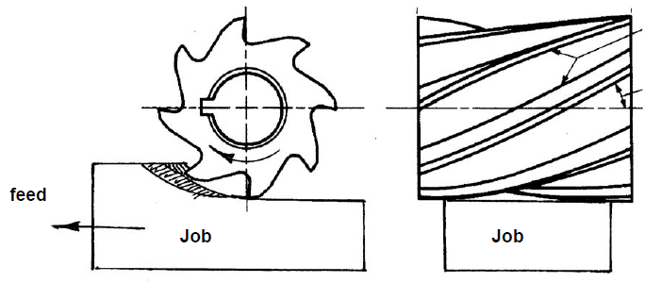
Manufacturing Technology
Profile sharpened cutters
The profile sharpened cutters are inherently used for making flat surfaces or surface bounded by a number of flat surfaces only.
Slab or Plain milling cutters
Plain milling cutters are hollow straight HSS cylinder of 40 to 80 mm outer diameter having 4 to 16 straight or helical equi-spaced flutes or cutting edges and are used in horizontal arbour to machine flat surface
Machining flat surface by slab milling Cutter

Slide 36
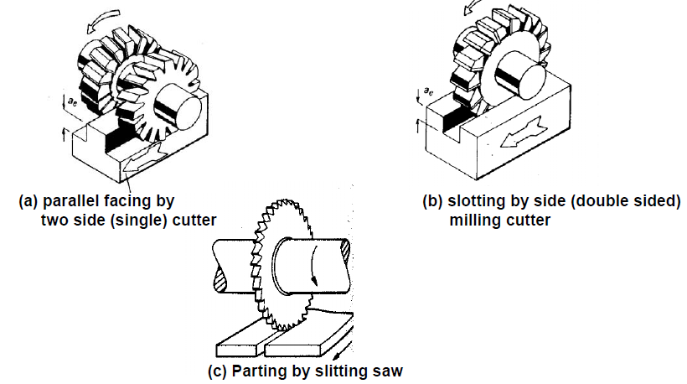
Manufacturing Technology
Side and slot milling cutters
These arbour mounted disc type cutters have a large number of cutting teeth at equal spacing on the periphery.
Side milling cutters

Slide 37
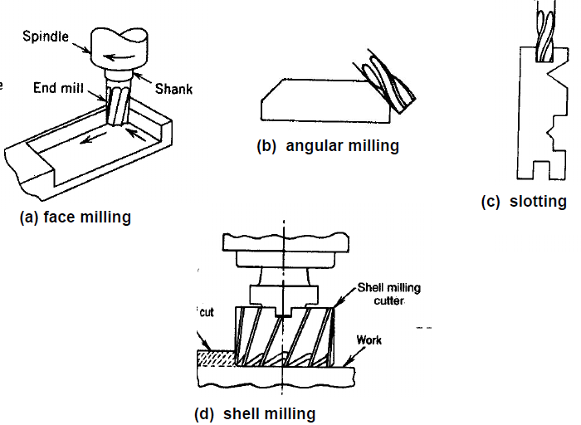
Manufacturing Technology
End milling cutters
The end milling cutter, also called an end mill, has teeth on the end as well as the periphery

Slide 38
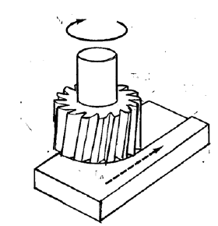
Manufacturing Technology
Face milling cutter

Slide 39
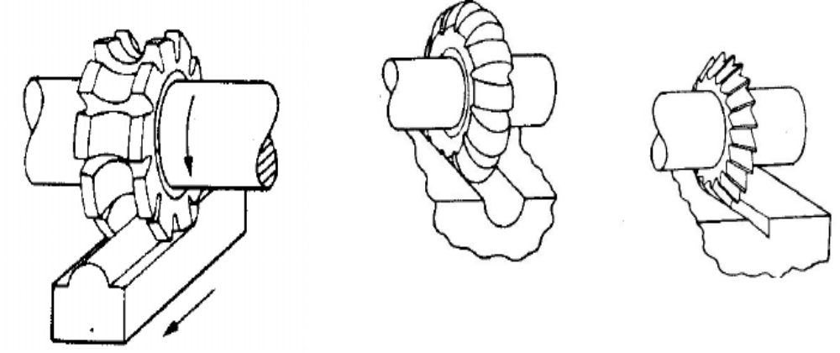
Manufacturing Technology
Form relieved cutters
Form of the tool is exactly replica of the job-profile to be made
Clearance or flank surfaces of the teeth are spiral shaped instead of flat
Used for making 2-D and 3-D contour surfaces

Slide 40
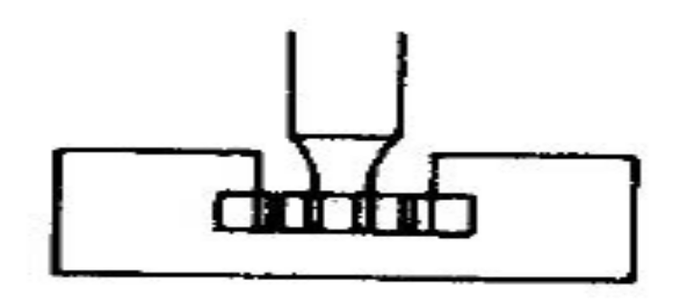
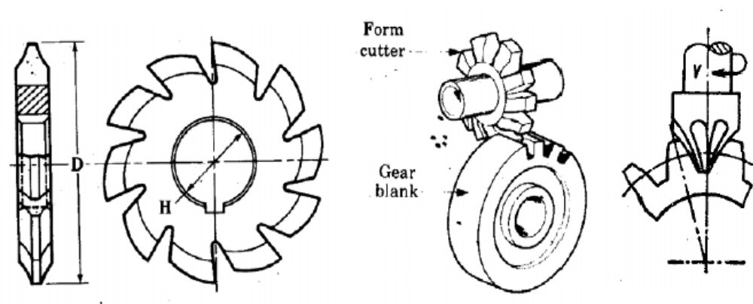
Manufacturing Technology
T-slot & Gear milling cutters

Slide 41
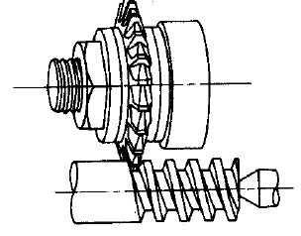
Manufacturing Technology
Thread milling cutter

Slide 42
Manufacturing Technology
Indexing
Indexing is the process of evenly dividing the circumference of a circular work piece into equally spaced divisions, such as in cutting gear teeth, cutting splines, milling grooves in reamers and taps, and spacing holes on a circle.
The index head of the indexing fixture is used for this purpose.

Slide 43
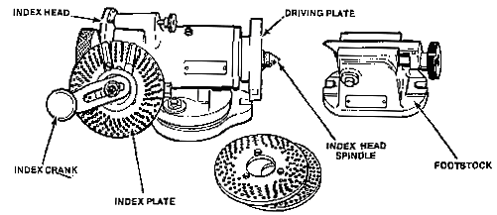
Manufacturing Technology
Index Head
The index head of the indexing fixture (Figure ) contains an indexing mechanism which is used to control the rotation of the index head spindle to space or divide a work piece accurately. A simple indexing mechanism consists of a 40-tooth worm wheel fastened to the index head spindle, a single-cut worm, a crank for turning the worm shaft, and an index plate and sector. Since there are 40 teeth in the worm wheel, one turn of the index crank causes the worm, and consequently, the index head spindle to make 1/40 of a turn; so 40 turns of the index crank revolve the spindle one full turn.

Slide 44
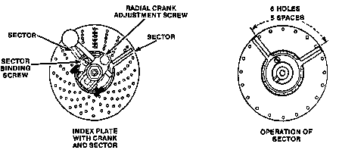
Manufacturing Technology
Index Plate
The indexing plate (Figure) is a round plate with a series of six or more circles of equally spaced holes; the index pin on the crank can be inserted in any hole in any circle. With the interchangeable plates regularly furnished with most index heads, the spacing necessary for most gears, bolt heads, milling cutters, splines, and so forth can be obtained.
Sector
The sector (Figure) indicates the next hole in which the pin is to be inserted and makes it unnecessary to count holes when moving the index crank after each cut. It consists of two radial, beveled arms which can be set at any angle to each other and then moved together around the center of the index plate.

Slide 45
Manufacturing Technology
Index Plate Types
Brown and Sharpe type consists of 3 plates of 6 circles each drilled as follows:
  Plate I - 15, 16, 17, 18, 19, 20 holes
  Plate 2 - 21, 23, 27, 29, 31, 33 holes
  Plate 3 - 37, 39, 41, 43, 47, 49 holes
Cincinnati type consists of one plate drilled on both sides with circles divided as follows:
  First side - 24, 25, 28, 30, 34, 37, 38, 39, 41, 42, 43 holes
  Second side - 46, 47, 49, 51, 53, 54, 57, 58, 59, 62, 66 holes

Slide 46
Manufacturing Technology
Indexing Methods
Simple Indexing or Plain Indexing
In simple or plain indexing, an index plate selected for the particular application, is fitted on the worm shaft and locked through a locking pin’
To index the work through any required angle, the index crank pin is withdrawn from the hole of the index plate than the work is indexed through the required angle by turning the index crank through a calculated number of whole revolutions and holes on one of the hole circles, after which the index pin is relocated in the required hole
If the number of turns that the crank must be rotated for each indexing can be found from the formula
  N = 40 / Z
  Where
  Z - No of divisions or indexings needed on the work
  40 – No of teeth on the worm wheel attached to the indexing plate, since 40 turns of the index crank will turn the spindle to one full turn

Slide 47
Manufacturing Technology
Suppose it is desired to mill a gear with eight equally spaced teeth. l/8th of 40 or 5 turns (Since 40 turns of the index crank will turn the spindle one full turn) of the crank after each cut, will space the gear for 8 teeth. If it is desired to space equally for 10 teeth, 1/10 of 40 or 4 turns would produce the correct spacing.
The same principle applies whether or not the divisions required divide equally into 40. For example, if it is desired to index for 16 divisions, 16 divided into 40 equals 2 8/16 turns. i.e for each indexing we need two complete rotations of the crank plus 8 more holes on the 16 hole circle of plate 1(Plate I - 15, 16, 17, 18, 19, 20 holes)

Slide 48
Manufacturing Technology
Direct Indexing
In direct indexing, the index plate is directly mounted on the dividing head spindle ( no worm shaft or wheel)
While indexing, the index crank pin is withdrawn from the hole of the index plate than the pin is engaged directly after the work and the indexing plate are rotated to the desire number of holes
In this method fractions of a complete turn of the spindle are limited to those available with the index plate
Direct indexing is accomplished by an additional index plate fastened to the index head spindle. A stationary plunger in the index head fits the holes in this index plate. By moving this plate by hand to index directly, the spindle and the work piece rotate an equal distance. Direct index plates usually have 24 holes and offer a quick means of milling squares, hexagons, taps, and so forth. Any number of divisions which is a factor of 24 can be indexed quickly and conveniently by the direct indexing method.

Slide 49
Manufacturing Technology
Differential Indexing
Sometimes, a number of divisions is required which cannot be obtained by simple indexing with the index plates regularly supplied. To obtain these divisions, a differential index head is used. The index crank is connected to the worm shaft by a train of gears instead of a direct coupling as with simple indexing. The selection of these gears involves calculations similar to those used in calculating change gear ratio for lathe thread cutting.
Gear Ratio I = 40/K ( K – Z)
  Where
  K – a number very nearly equal to Z
  For example if the value of Z is 53, the value of K is 50

Slide 50
Manufacturing Technology
Indexing in Degrees
Work pieces can be indexed in degrees as well as fractions of a turn with the usual index head. There are 360 degrees in a complete circle and one turn of the index crank revolves the spindle 1/40 or 9 degrees. Therefore, 1/9 turn of the crank rotates the spindle 1 degree. Work pieces can therefore be indexed in degrees by using a circle of holes divisible by 9. For example, moving the crank 2 spaces on an 18-hole circle, 3 spaces on a 27-hole circle, or 4 spaces on a 36-hole circle will rotate the spindle 1 degree.
Smaller crank movements further subdivide the circle: moving 1 space on an 18-hole circle turns the spindle 1/2 degree (30 minutes), 1 space on a 27-hole circle turns the spindle 1/3 degree (20 minutes), and so forth.

Slide 51
Manufacturing Technology
Indexing Problems
Refer P.C. Sharma –Vol-II, Page No 157 to 162

Slide 52
END

