Slide 1
MANUFACTURING TECHNOLOGY
UNIT – V
Machine Tools

Slide 2
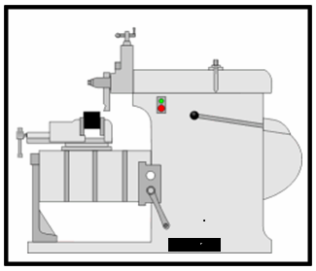
Manufacturing Technology
Shaping Machine
Introduction
A shaping machine is used to machine surfaces. It can cut curves, angles and many other shapes. It is a popular machine in a factory workshop because its movement is very simple although it can produce a variety of work. They are less common in school workshops, perhaps because of their moving parts which present a high risk.

Slide 3
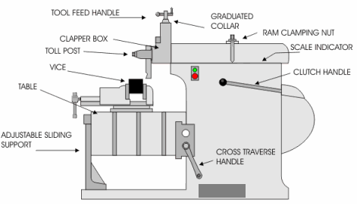
Manufacturing Technology
Shaping Machine Description

Slide 4
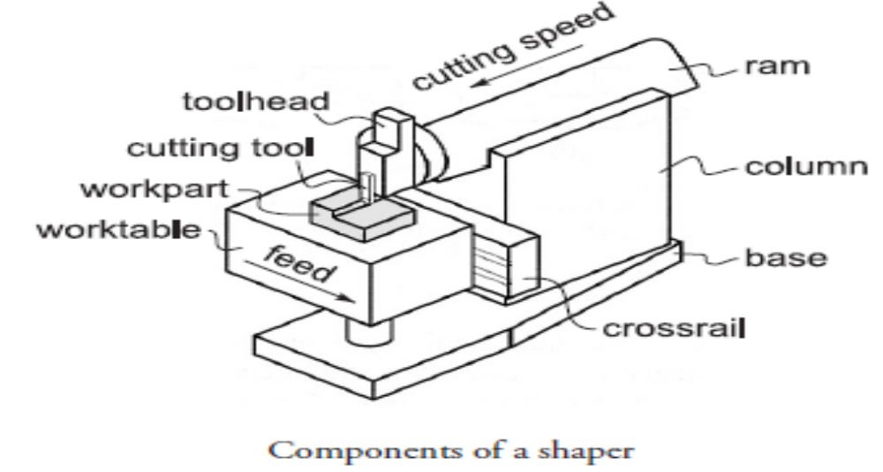
Manufacturing Technology
The major components of a shaper are the ram, which has the tool post with cutting tool mounted on its face, and a worktable, which holds the part and accomplishes the feed motion.

Slide 5
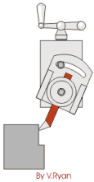
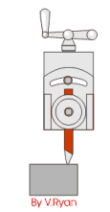
Manufacturing Technology
Shaping Machine operation
The tool feed handle can be turned to slowly feed the cutting tool into the material as the 'ram' moves forwards and backwards. The strong machine vice holds the material securely. A small vice would not be suitable as the work could quite easily be pulled out of position and be damaged. The vice rests on a steel table which can be adjusted so that it can be moved up and down and then locked in position. Pulling back on the clutch handle starts the 'ram' moving forwards and backwards.
The tool post has been turned at an angle so that side of the material can be machined
The tool post is not angled so that the tool can be used to level a surface.

Slide 6
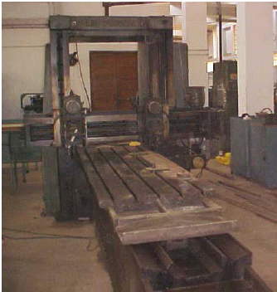
Manufacturing Technology
Planning Machine
The machine tool for planning is a planer. Cutting speed is achieved by a reciprocating worktable that moves the part past the single-point cutting tool. Construction and motion capability of a planer permit much larger parts to be machined than on a shaper.

Slide 7
Manufacturing Technology
Planers can be classified as either open side planers or double-column planers.
The open side planer, also known as a single-column planer has a single column supporting the cross rail on which a tool head is mounted. The configuration of the open side planer permits very wide work parts to be machined.
A double-column planer has two columns, one on either side of the bed and worktable. The columns support the cross rail on which one or more tool heads are mounted. The two columns provide a more rigid structure for the operation but limit the width of the work that can be handled.

Slide 8
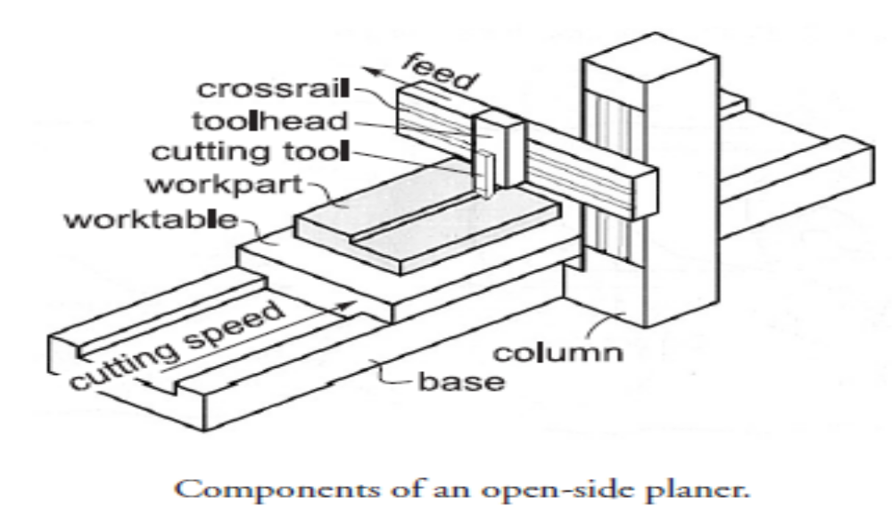
Manufacturing Technology
Planning Machine Description

Slide 9
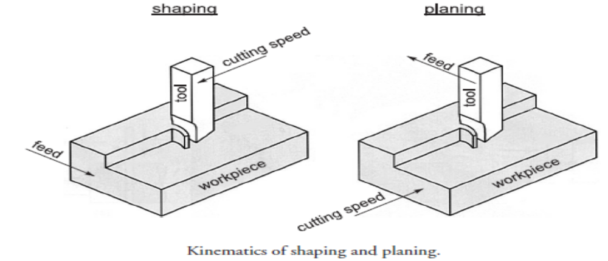
Manufacturing Technology
planning and shaping
Planning and shaping are similar operations, which differ in the kinematics of the process. Planning is a machining operation in which the primary cutting motion is performed by the work piece and feed motion is imparted to the cutting tool. In shaping, the primary motion is performed by the tool, and feed by the work piece

Slide 10
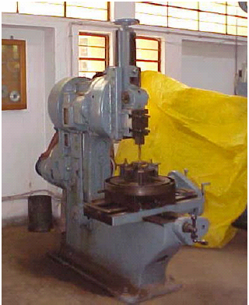
Manufacturing Technology
Slotting Machine
Slotting machines can simply be considered as vertical shaping machine. Unlike shaping and planning machines, slotting machines are generally used to machine internal surfaces (flat, formed grooves and cylindrical).

Slide 11
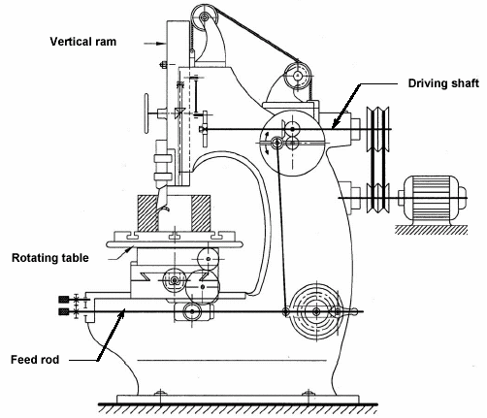
Manufacturing Technology
Slotting Machine Description

Slide 12
END

