Slide 1
MANUFACTURING TECHNOLOGY
UNIT – V
Machine Tools

Slide 2
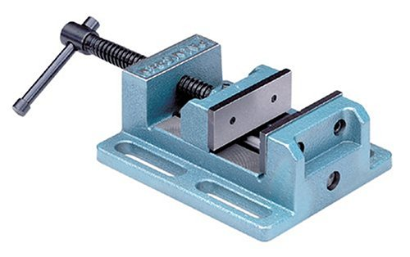
Manufacturing Technology
Work Holding Devices
Drill Press Vise
  Used to hold round, square or odd-shaped rectangular pieces
  Clamp vise to table for stability

Slide 3
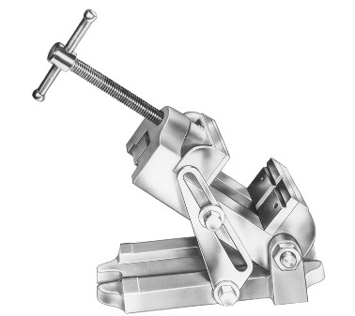
Manufacturing Technology
Angle vise
  Angular adjustment on base to allow operator to drill holes at an angle without tilting table

Slide 4
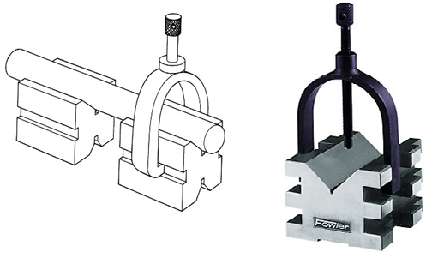
Manufacturing Technology
V-blocks
  Made of cast iron or hardened steel
  Used to support round work for drilling

Slide 5
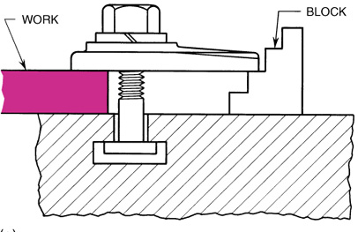
Manufacturing Technology
Step blocks
  Used to provide support for outer end of strap clamps

Slide 6
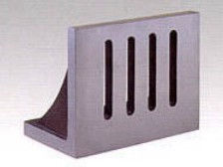
Manufacturing Technology
Angle plate
  L-shaped piece of cast iron or hardened steel machined to accurate 90º may be bolted or clamped to table

Slide 7
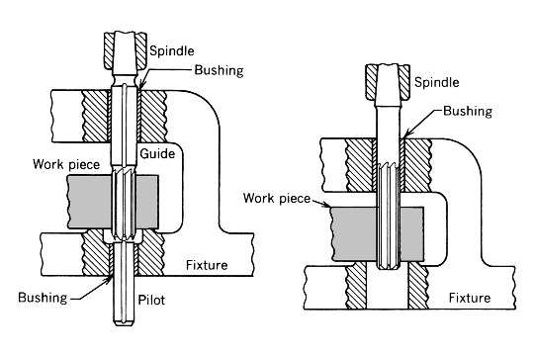
Manufacturing Technology
Drill jigs
  Used in production for drilling holes in large number of identical parts
  Eliminate need for laying out a hole location

Slide 8
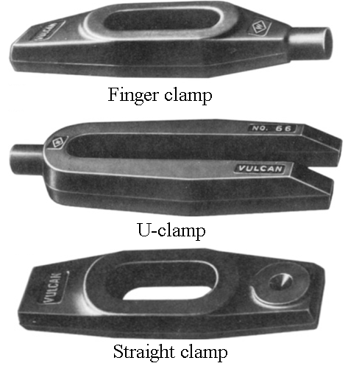
Manufacturing Technology
Clamps or straps
  Used to fasten work to table or angle plate for drilling
  Usually supported at end by step block and bolted to table by T-bolt
  that fits into table T-slot

Slide 9
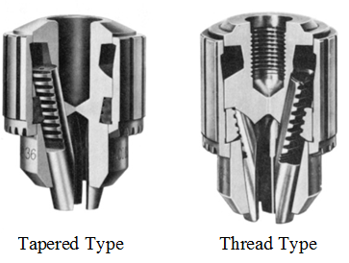
Manufacturing Technology
Tool-Holding Devices
Drill Chucks
Most common devices used for holding straight-shank cutting tools
Most contain three jaws that move simultaneously when outer sleeve turned
  Hold straight shank of cutting tool securely
Two common types
  Key
  Keyless

Slide 10
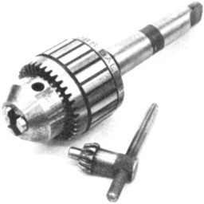
Manufacturing Technology
Key-type
  Most common
  Three jaws move simultaneously when outer sleeve turned
    Tighten with key
    Different size keys for different size chucks

Slide 11
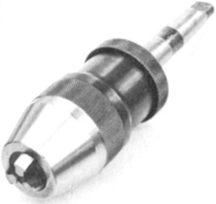
Manufacturing Technology
Keyless
  Chuck loosened or tightened by hand without key
Precision keyless
  Holds smaller drills accurately

Slide 12
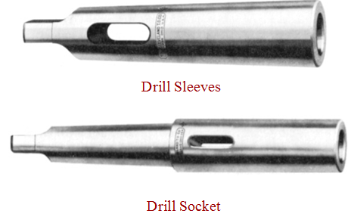
Manufacturing Technology
Drill Sleeves
  Used to adapt drill shank to machine spindle if taper on tool is smaller than taper in spindle
Drill Socket
  Used when hole in spindle of drill press too small for taper shank of drill
  Used often as extension sockets

Slide 13
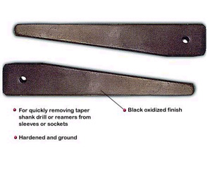
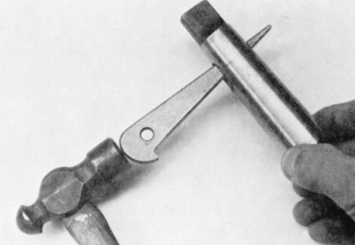
Manufacturing Technology
Drill Drift
Used to remove tapered-shank drills or accessories from drill press spindle
Always place rounded edge up so this edge will bear against round slot in spindle
Use hammer to tap drill drift and loosen tapered drill shank
Use board or piece of pressed-wood to protect table or vise

Slide 14
END

