Slide 1
CHAPTER-2
FRACTRURE BEHAVIOUR

Slide 2
GRIFFTH'S THEORY
Griffith proposed that the brittle materials contain fine cracks which leads to the stress concentration.
The sufficient magnitude of stress concentration will reach to overcome cohesive strength at localised regions at nominal stress.
This nominal stress is well below the theoretical value.

Slide 3
GRIFFTH'S THEORY
When crack propagates to a fracture the surface area of the crack increases. This leads to increase in surface energy by spending elastic strain energy to overcome cohesive force of atoms.
A crack will propagate when the decrease in elastic strain energy is atleast equal to the energy required to create the new crack surface.
This criterion can be used to determine the magnitude of the tensile stress which will just cause a crack of a certain size to propagate as a brittle fracture.

Slide 4
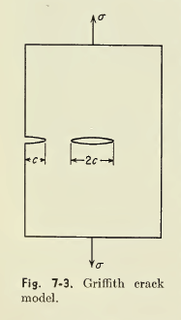
GRIFFTH’S THEORY

Slide 5

GRIFFTH’S THEORY
Thickness of the plate is negligible and so problem can be treated as plane stress.
A decrease in strain energy results from the formation of a crack.
The elastic strain energy per unit of plate thickness is given by
where, σ is the tensile stress acting normal to
the crack of length 2c.
E is the modulus of elasticity

Slide 6
GRIFFTH’S THEORY
The surface energy due to the presence of crack is
U_{S} = 4cγ_{s}
where γ_{s} is the surface energy per unit area of the crack (Jm⁻²)
The total change in potential energy resulting from the creation of crack is
ΔU = ΔU_{S} + ΔU_{E}

Slide 7
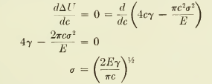
GRIFFTH’S THEORY
According to Griffth’s criterion, the crack will propagate under a constant applied stress σ if an incremental increase in crack length produces no change in the total energy of the system i.e., the increased surface energy is compensated by a decrease in elastic strain energy

Slide 8

GRIFFTH’S THEORY
The above equation gives the stress required to propagate a crack in a brittle material as a function of the size of the microcrack.
It indicates that the fracture stress is inversely proportional to the square root of the crack length.
For a plate which is thick compared with the length of the crack i.e., plain strain case, Griffth’s equation is given by

Slide 9

GRIFFTH’S THEORY
Oorwan suggested that the Griffth equation would be made more compatible with brittle fracture in metals by the inclusion of a term p.
where p is plastic work required to extend the crack wall for a crack length of 2c.
The surface energy term can be neglected since the plastic work term is about 10² to 10³ Jm⁻² compared with values of γ_{s} of about 1 to 2 Jm⁻² .

Slide 10
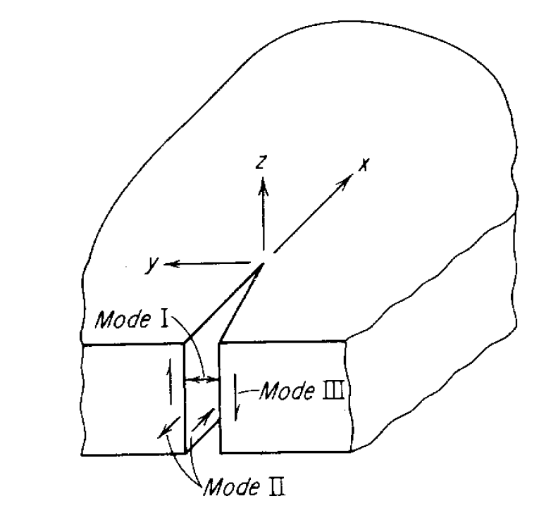
CRACK DEFORMATION MODES

Slide 11
CRACK DEFORMATION MODES
Crack opening mode: Tensile stress applied in y-direction normal to the faces of the crack.
Forward shear mode: A shear stress applied normal to the leading edge of the crack but in the plane of crack.
The parallel shear mode: Shear stresses applied parallel to the leading edge of the crack.

Slide 12
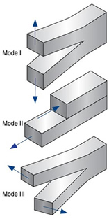
STRESS-INTENSITY FACTOR (K)
The stress-intensity factor (K) is used to determine the fracture toughness of most materials.
A Roman numeral subscript indicates the mode of fracture and the three modes of fracture are illustrated in the image to the right.
Mode I fracture is the condition where the crack plane is normal to the direction of largest tensile loading. This is the most commonly encountered mode.
The stress intensity factor is a function of loading, crack size, and structural geometry. The stress intensity factor may be represented by the following equation:
K_{I} is the fracture toughness in
σ is the applied stress in MPa or psi
a is the crack length in meters or inches
β is a crack length and component geometry factor that is different for each specimen, dimensionless.

Slide 13
CRITICAL STRESS
All brittle materials contain a population of small cracks and flaws that have a variety of sizes, geometries and orientations.
When the magnitude of a tensile stress at the tip of one of these flaws exceeds the value of this critical stress, a crack forms and then propagates, leading to failure.
Condition for crack propagation:
K ≥ K_{c}
Stress Intensity Factor:
--Depends on load & geometry.
Fracture Toughness:
--Depends on the material,
temperature, environment &
rate of loading.

Slide 14
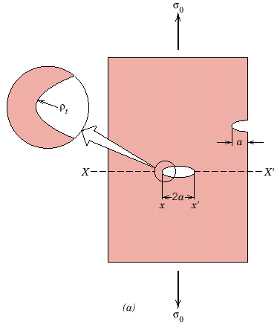
FLAWS ARE STRESS CONCENTRATORS
If the crack is similar to an elliptical hole through plate, and is oriented perpendicular to applied stress, the maximum stress σ_{m}=
where ρ_{t} = radius of curvature
σ_{o} = applied stress
σ_{m} = stress at crack tip
a = length of surface crack or ½ length of internal crack
σ_{m} / σ_{o} = Kt the stress concentration factor
ρ_{t}
Notes:
14
Stress concentrated at crack tip

Slide 15
DUCTILE TO BRITTLE TRANSITION
This phenomenon is most common in steel and other bcc metals.
This type of fracture behavior occurs with decreasing temperature.
This transition is based on the dislocation concepts.
The equation which describes the ductile to brittle transition is given by

Slide 16
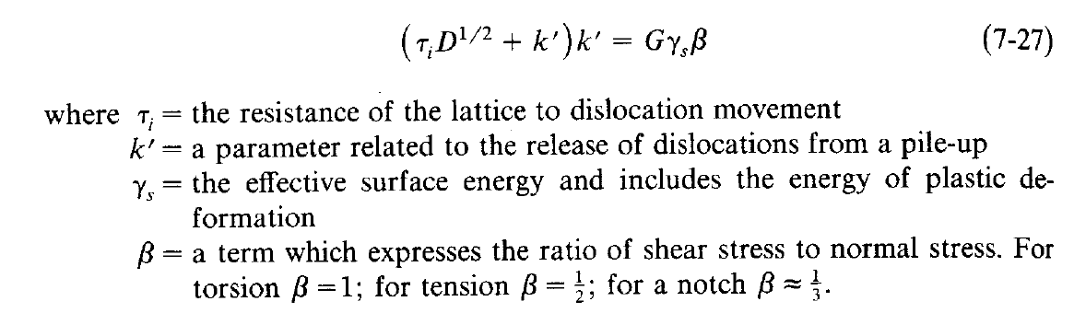
DUCTILE TO BRITTLE TRANSITION

Slide 17
DUCTILE TO BRITTLE TRANSITION
If left hand side of the equation is smaller than the right hand side, a micro crack can form but it cannot grow. This is the case of non-propagating micro cracks.
When the left hand side of the equation is greater than the right hand side, a propagating brittle fracture can be produced at a shear stress equal to yield stress.

Slide 18
DUCTILE TO BRITTLE TRANSITION
The temperature at which the fracture would change from ductile to brittle is called transition temperature.
Materials with a high value of K’ (Fe and Mo) are more prone to brittle fracture than materials with lower values (Nb and Ta).
High value of frictional resistance leads to brittle fracture, since high stresses will be reached before yielding occurs.

Slide 19
DUCTILE TO BRITTLE TRANSITION
In bcc materials the frictional resistance increases rapidly as the temperature falls below room temperature and then leads to a ductile to brittle transition.
If the effective surface energy is large at a given temperature, then brittle fracture is suppressed.
The presence of a notch greatly increases the tendency for brittle fracture.

Slide 20
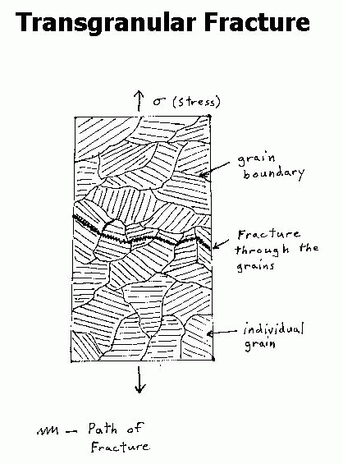
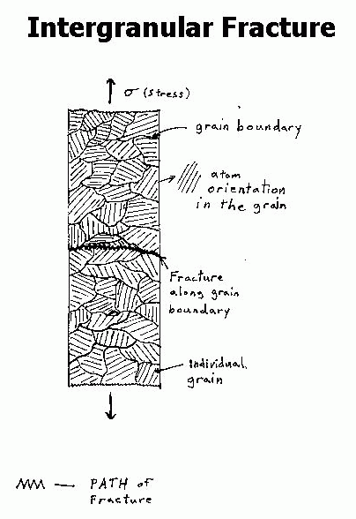
HIGH TEMPERATURE FRACTURE

Slide 21
HIGH TEMPERATURE FRACTURE
Metals undergo a transition from transgranular fracture to intergranular fracture as the temperature is increased.
When transgranular fracture occurs, the slip planes are weaker than the grain boundaries, while for intergranular fracture the grain boundary is the weaker component.
Equi-cohesive temperature (ECT) is defined as that temperature at which the grains and grain boundaries have equal strength.

Slide 22
HIGH TEMPERATURE FRACTURE
ECT is not fixed as it depends on several factors.
Decreasing the strain rate lowers the ECT and therefore increases the tendency for intergranular fracture.
Since the amount of grain-boundary area decreases with increasing grain size, a material with a large grain size will have higher strength above the ECT than a fine-grain material.

Slide 23
CREEP
The progressive deformation of a material subjected to constant stress at constant temperature to a prolonged time is called creep.
A creep curve can be drawn by measuring the strain of a specimen determined as a function of time.
The slope of this curve is called creep rate.

Slide 24
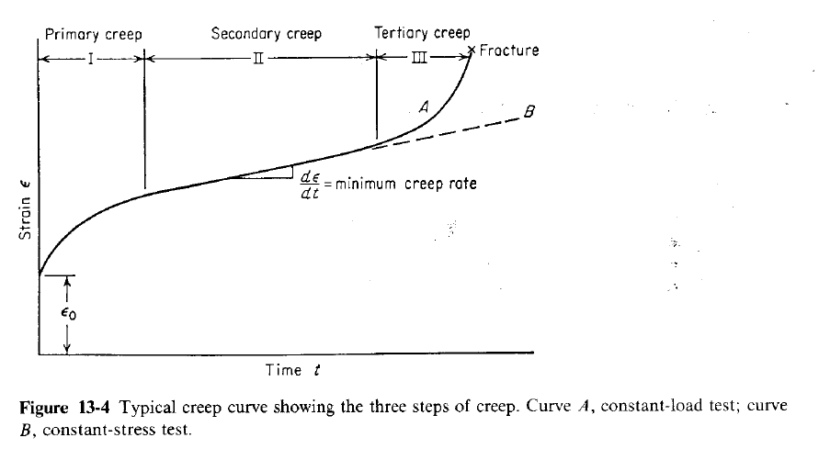
CREEP

Slide 25
CREEP
The first stage of creep, primary creep represents a region of decreasing creep rate.
Primary creep is a period of predominantly transient creep.
The second stage of creep, secondary creep is a period of nearly constant creep rate which results from equalizing strain hardening and recovery.
Secondary creep is usually referred to as a steady-state creep. The average value of the creep rate during secondary creep is called the minimum creep rate.

Slide 26
CREEP
Third-stage or tertiary creep mainly occurs in constant load creep tests at high stresses at high temperatures.
Tertiary creep occurs when there is an effective reduction in cross-sectional area either because of necking or internal void formation.
Third stage creep is often associated with metallurgical changes such as coarsening of precipitate particles and recrystallization.

Slide 27
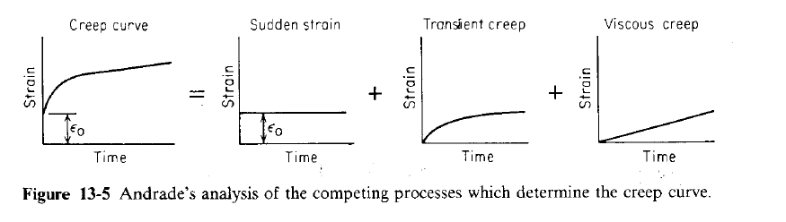
CREEP

Slide 28
CREEP
Andrade considered that the constant-stress creep represents the superposition of two separate creep processes
The first component is a transient creep with a creep decreasing with time .
The second component is a constant-rate viscous creep.

Slide 29

CREEP
He found that the creep curve could be represented by
where ε is the strain in time t
β and k are constants
ε_{o} is instantaneous strain on loading
Transient creep is represented by β and extension
per unit length at constant rate is represented by k.

Slide 30
CREEP DEFORMATION MECHANISM
The chief creep deformation mechanisms can be grouped as
Dislocation glide: Involves dislocations moving along slip planes and overcoming barriers by thermal activation. This mechanism occurs at high stress, (σ/G)>10⁻²
Dislocation creep: Involves the movement of dislocations which overcome barriers by thermally assisted mechanisms involving difussion vacancies and interstitials . According orawan and bailey the recovery rate (faster) should be balanced with strain hardening(Slower). This occurs for 10⁻⁴< (σ/G)<10⁻²

Slide 31
CREEP DEFORMATION MECHANISM
Diffusion Creep: Involves the flow of vacancies and interstitials through a crystal under the influence of applied stress. Occurs for (σ/G)<10⁻⁴ . This category includes Nabarro-Herring and Coble creep.
Coble Creep is form diffusion through grain boundaries along the stress axis.
Nabarro – Herring is form of diffusion through lattices along the stress axis.
Grain boundary sliding: involves the grains sliding pas each other.

Slide 32
DEFORMATION MECHANISM MAP
The map which indicate the dominant mechanism for particular stress-temperature combination is called deformation mechanism map.
The boundaries of these regions are obtained by equating the appropriate equations and solving for stress as a function of temperature.
The boundaries represent combinations of stress and temperature where the respective strain rates for the two deformation mechanisms are equal.

Slide 33
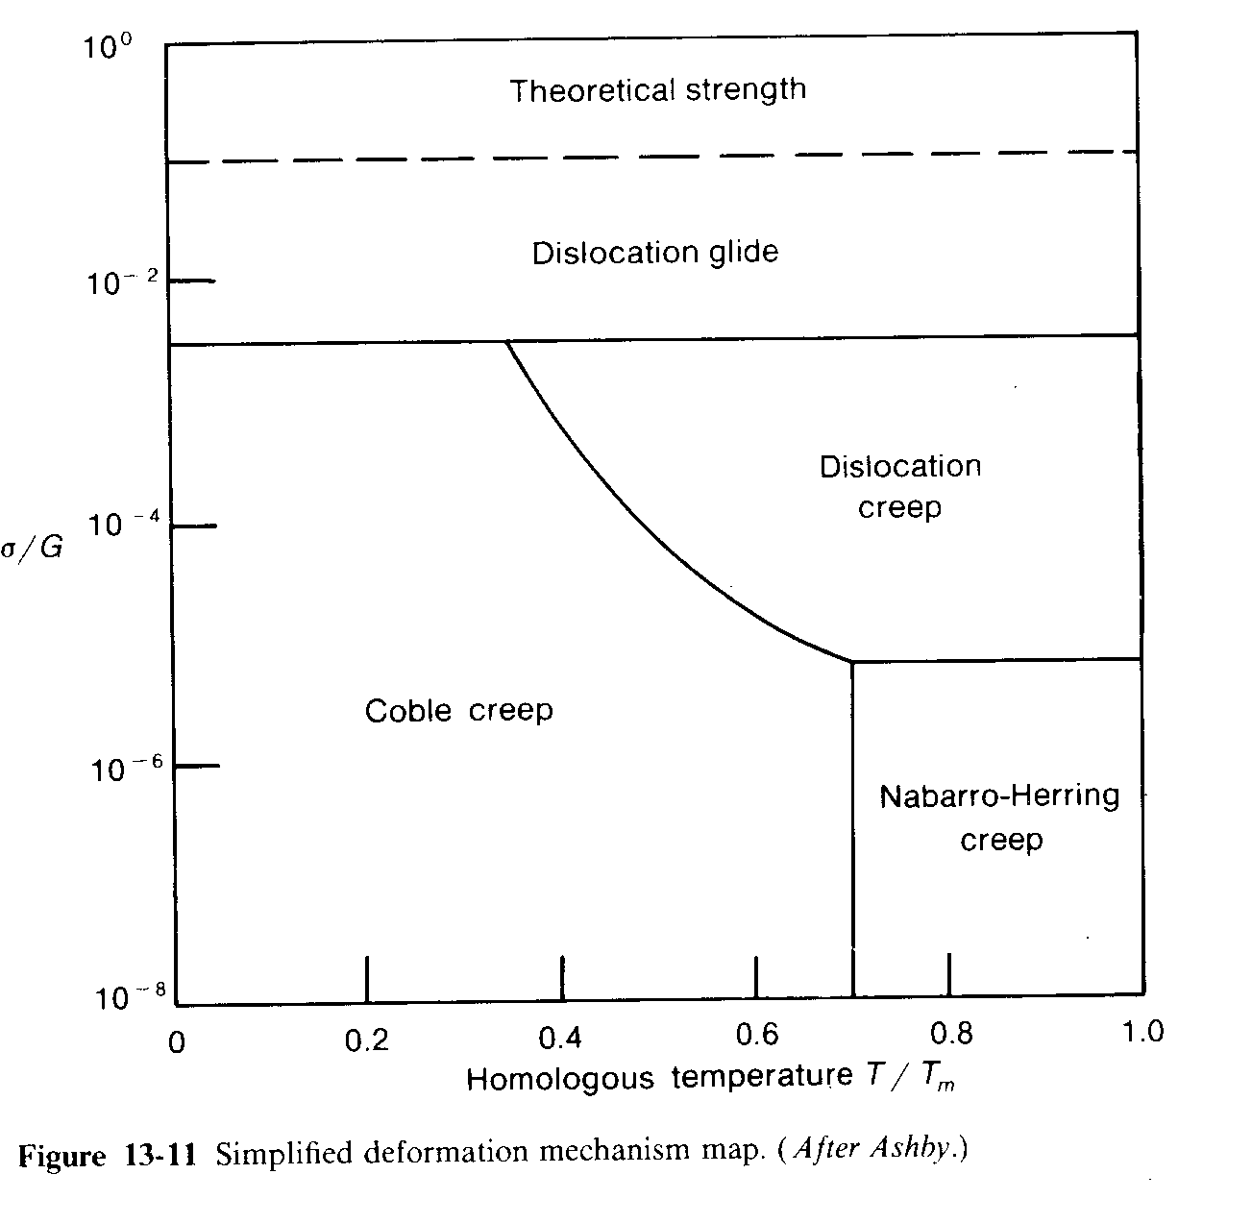
DEFORMATION MECHANISM MAP

Slide 34
FATIGUE
A metal subjected to a repetitive or fluctuating stress will fail at a stress much lower than that required to cause fracture on a single application of load. These failures are called fatigue failures.
These occur under conditions of dynamic loading. These are insidious because they occur without any obvious warning.
Fatigue results in brittle-appearing fracture with no gross deformation at the fracture.
On a Macroscopic scale, the fracture propagates normal to the principal stress

Slide 35
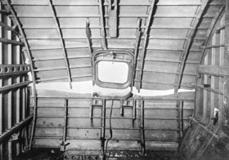
FATIGUE
Fatigue failure occurs at a point of stress concentration such as a sharp corner or notch or at a metallurgical stress concentration like an inclusion.

Slide 36
FACTORS NECESSARY FOR FATIGUE
Three basic factors that are necessary to cause fatigue failure are
A maximum tensile stress of sufficiently high value.
A large enough variation or fluctuation in the applied stress.
A sufficiently large number of cycles of the applied stress.
Other variables such as corrosion, stress concentration, temperature, overload, metallurgical structure etc. may alter the nature of fatigue.

Slide 37
TYPES OF FATIGUE
General types of fluctuating stresses which can cause fatigue-stress cycles:
Reversed stress cycle: In this maximum & Minimum stresses are equal but opposite direction. If it is tensile consider positive & for compressive as negative.
Repeated stress cycle: In this Max & min are not equal lies in the same direction. It may be positive or negative depends on the load
Irregular or Random stress cycle: It is not in sinusoidal form or doesn’t follow any pattern. The load may be compressive or tensile at any time, maximum & minimum is a stress at a point.

Slide 38
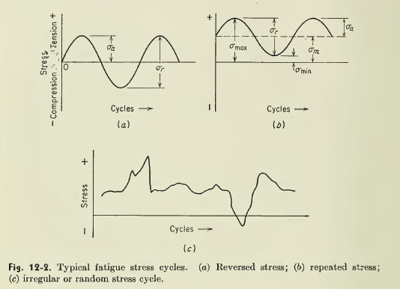
FATIGUE

Slide 39

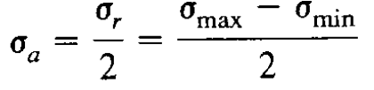
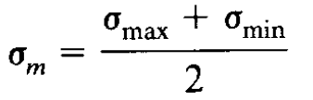
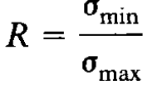
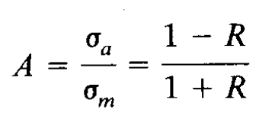
FATIGUE
Range stress
Alternate Stress
Average mean stress
Stress ratio
Amplitude ratio

Slide 40
FATIGUE
The method of presenting engineering fatigue data is by means of the S-N curve, a plot of stress S against the number of cycles to failure N.
Based on the number of cycles to failure fatigue tests are classified as
High cycle fatigue test: N>10⁵ cycles at low stresses.
Low cycle fatigue test: N less than 10⁴ cycles at high stresses.

Slide 41
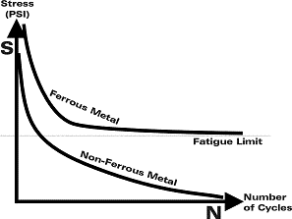
FATIGUE LIMIT
the amplitude (or range) of cyclic stress that can be applied to the material without causing fatigue failure

Slide 42
HIGH CYCLE FATIGUE
In high cycle fatigue condition, on a gross scale the deformation is elastic but it is plastic in nature in a localised way.
At higher stress the fatigue life is shortened but gross plastic deformation makes interpretation difficult in terms of stress.
A metal endure more cycle before failure for less applied stress. Fatigue test done at low stress would be carried out at 10^7 cycles & sometimes 5x10^8 cycles for non ferrous.
The S-N curve goes horizontal at a certain limiting stress for some metals such as aluminium & titanium, which is called fatigue limit. Which can endure for infinite number of cycles.

Slide 43

HIGH CYCLE FATIGUE
The high cycle region in S-N curve is given by the basquin equation
δ_{a} is stress amplitude
C and p are empirical constants.
The specimen test is carried out until failure is attained and repeated till they find out the fatigue limit of the metal.

Slide 44
LOW-CYCLE FATIGUE
Test are conducted with control elastic + plastic strain instead of controlled load or stress cycles.
This type of failure must be considered in nuclear pressure vessel, steam turbines and other types of power machinery.
The low cycle fatigue are created when repeated stress is of thermal origin.

Slide 45
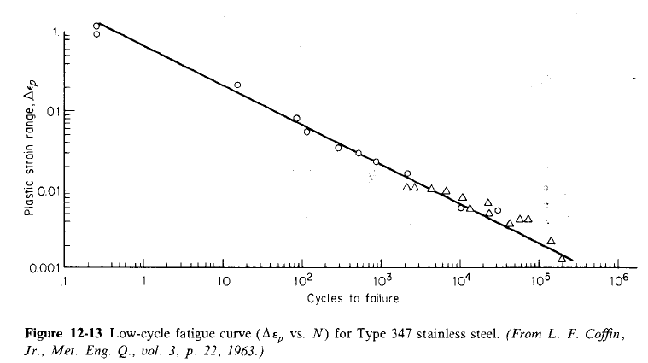
LOW-CYCLE FATIGUE

Slide 46
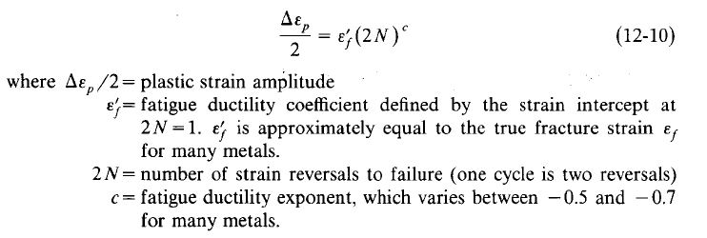
LOW-CYCLE FATIGUE
The behaviour is called coffin-manson relation

Slide 47
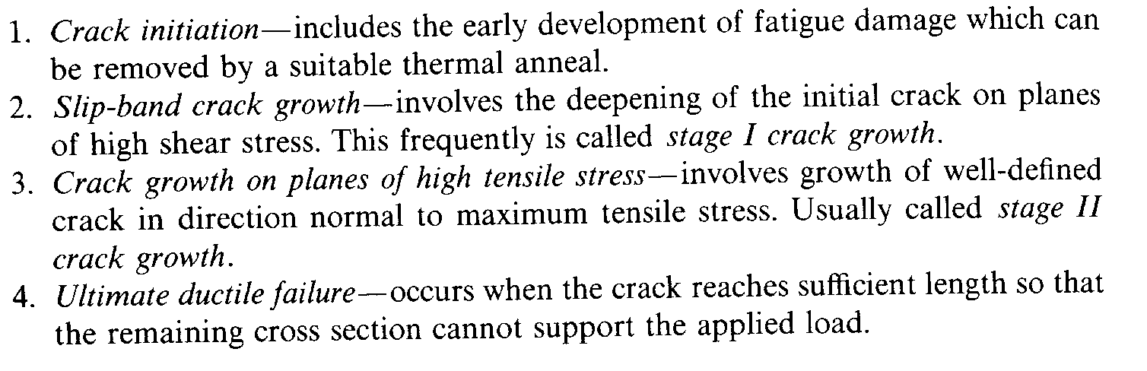
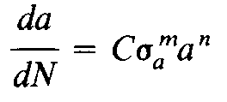
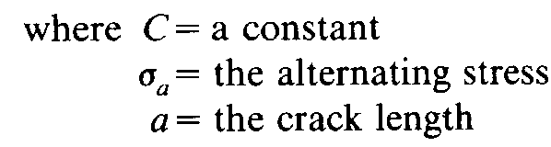
FATIGUE CRACK INITIATION

Slide 48
STAGE 1 & STAGE 2 CRACK GROWTH
Stage 1 | Stage 2
In crack propagation, it has major portion in low cycle fatigue. Minor portion in high cycle fatigue. | In crack propagation, it has minor portion in low cycle fatigue. Major portion in high cycle fatigue.
In this shear stress is acting for crack propagation | In this tensile stress is acting for crack propagation
The crack will be propagating through slip planes | The crack propagate normally to direction of stress applied.
The rate of crack propagation is very low of order 10^-9 m (nm). | The rate of crack propagation is comparatively higher in terms of micro meters.

Slide 49
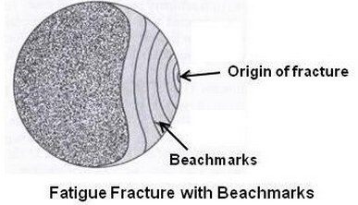
FATIGUE CRACK MECHANISIM
Crack propagation is characterized by two types of markings.
Slip bands / Beachmarks: These are of macroscopic dimensions. These markings are found for components that experienced interruptions during crack propagation.
Each beachmark band represents a period of time over which crack growth has occurred.

Slide 50
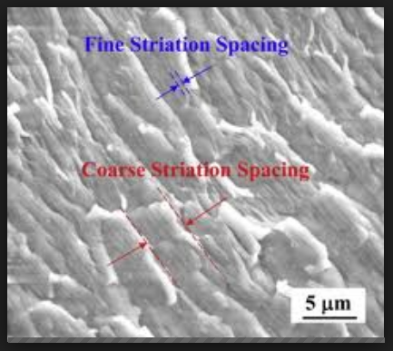
FATIGUE
2. Striations: These are microscopic in size. Each striation is thought to represent the advance distance of a crack front during a single load cycle.
Striation width depends on, and increases with, increasing stress range.

Slide 51
FAILURE
It is the gap between expectation and performance.
It represents an adverse situation wherein a component, material or system fails to fulfill its intended function satisfactorily, during its intended service-life.
Failures are inevitable in the life span of any system.

Slide 52
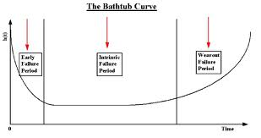
FAILURE CURVE OR BATH TUB CURVE
The first is the short initial period during which the failures are called infant or early failure caused generally due to design deficiency, manufacturing defects, assembly and installation lapses.

Slide 53
FAILURE CURVE OR BATH TUB CURVE
The failures in the second zone are termed service failures or constant rate failures. These failures are random and are fairly evenly distributed.
The curve in the third zone is due to wearing out of parts. The incidence of failures in this zone is high since most of the components would have rendered their service life.

Slide 54
FAILURE ANALYSIS
It is a technique by which facts are gathered and analyzed to determine the cause of failure.
A fault-tree technique is used for analyzing service failures.
A fault-tree is a graphical technique that provides a systematic description of the combination of possible occurrences in a system, which can result in a fault or undesired event.

Slide 55
FAILURE ANALYSIS
The fault-tree analysis has multi-faceted applications. It can be used as
A diagnostic tool
A design tool
A method of system safety analysis
A management tool
A comprehensive method of documentation and to get logical understanding of the system

Slide 56
SOURCES OF FAILURE
Improper material selection
Improper design
Improper processing and fabrication
Improper operation
Improper repair and maintenance
Exposure to hostile environments not designed for.
Corrosion
Wear

Slide 57
SOURCES OF FAILURE
Mechanical failure includes excessive deflection, thermal shock, application of sudden loads.
Manufacturing defects like presence of notches, inclusions or voids, improper welding of joints.

Slide 58
TYPES OF FAILURE
Overload failures
Distortion failures
Fatigue failures
Corrosion failures
Creep failures
Wear failures

Slide 59
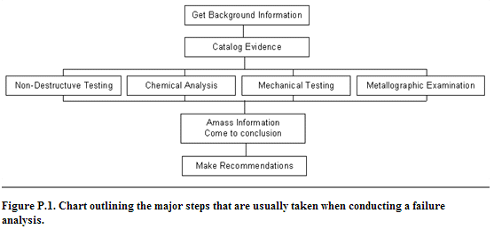
PROCEDURE OF FAILURE ANALYSIS

Slide 60
PROCEDURE OF FAILURE ANALYSIS
Background information which provides what happened prior to and at the time of failure, the manufacturing history of the part, and discussion with the eye witness.
Visual examination includes a visit to the scene of failure, making sketches and taking measurements, notes and photographs.This allows to study the fracture in detail. This serves the functions of:
Familiarising the investigators with the evidence.
Creating a permanent record that can be referred to in light of new information.

Slide 61
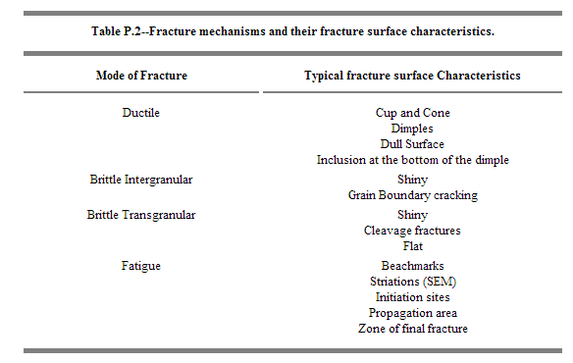
PROCEDURE OF FAILURE ANALYSIS

Slide 62
PROCEDURE OF FAILURE ANALYSIS
The third step is to decide on a course of action. Based on the visual examinations and the background information the investigator must outline a plan of action, which is the series of steps that will be needed to successfully complete the case.
Macroscopic examination is best performed when cataloguing the samples, Use of a scanning electron microscope (SEM) often reveals good quality fracture surfaces similar to those that caused failure
Non-destructive examination to obtain defect-information on the surface as well as the core of the failed product. Nondestructive tests (NDT) are a good way to examine parts without causing permanent damage
Chemical analysis is done on the bulk of the material to confirm the material composition. Depending on the investigation, chemical analysis should also be done on any overlay materials or surface residue

Slide 63
Metallographic examination involves the sectioning of samples to examine the microstructure. Samples should be mounted, ground, and polished using metallographic techniques. They should be examined before etching for porosity, inclusions, and other defects. Microstructures should be identified and their properties researched.
Mechanical testing is done to verify that the mechanical properties of the material conform to the standards. There are many types of mechanical testing that can be performed and their procedures can be found in the ASTM mechanical testing standards.
Examination of all data to arrive at a conclusion of the cause of failure and recommendations for its prevention.

