Slide 1
CHAPTER-3
PHASE DIAGRAMS

Slide 2
WHAT IS PHASE?
A phase is a form of matter that is uniform throughout in chemical composition and physical state.
A phase can be defined as a homogeneous portion of a system that has uniform physical and chemical characteristics i.e. it is a physically distinct from other phases, chemically homogeneous and mechanically separable portion of a system.

Slide 3
SYSTEM & COMPONENT
Almost all materials have more than one phase in them. A system is a substance or group of substance which is unaffected by the presence of its surroundings.
When two phases are present in a system, it is not necessary that there be a difference in both physical and chemical properties; either one or the other set of properties is sufficient.
Basic unit of a composition in a material is called component. It refers to independent chemical element. The components of a system may be elements, ions or compounds.
A component can exist in many phases.
E.g.: Water exists as ice, liquid water, and water vapour.
Carbon exists as graphite and diamond

Slide 4
SOLUTIONS & MIXTURE
A solution(liquid or solid) is phase with more than one component; a mixture is a material with more than one phase.
Solute (minor component of two in a solution) does not change the structural pattern of the solvent, and the composition of any solution can be varied.
In mixtures, there are different phases, each with its own atomic arrangement. It is possible to have a mixture of two different solutions!

Slide 5
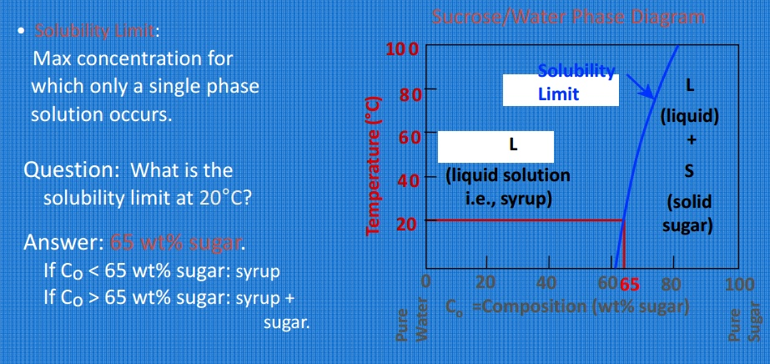
SOLUBILTY LIMIT
There is a maximum concentration of solute atoms that may dissolve in the solvent to form a solid solution, this is called solubility limit.

Slide 6
SOLID SOLUTION
It is a solution in the solid state and consists of two types of atoms combined in one type of space lattice.
The solute is the minor part of the solution, while the solvent constitutes the major portion of the solution.
The solute is generally more soluble in the liquid state than in the solid state.

Slide 7
SOLID SOLUTION
The solid solutions comprise of atoms of almost the same atomic radius , and they tend to form a single phase and the elements are soluble in both their solid and liquid states .
The key feature of a solid solution is that the metals retain their homogeneity and hence their solubility after their transformation to a solid crystalline state.

Slide 8
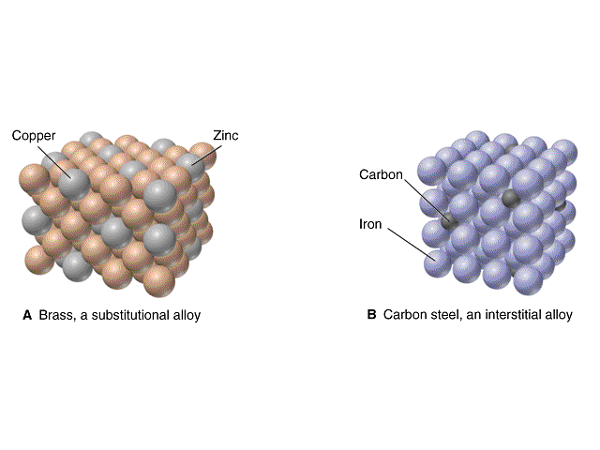
TYPES OF SOLID SOLUTIONS
Solid Solution
Substitutional solid solution
Ordered solid solution
Disordered solid solution
Interstitial solid solution

Slide 9
TYPES OF SOLID SOLUTIONS
Substitutional Solid Solutions have a direct substitution of one type of atom for another so that solute atoms (Cu) enter the crystal to take positions normally occupied by solvent atoms (eg Zn atoms).
Disordered Substitutional Solid Solutions are those type of solid solutions in which the solute atoms are randomly distributed in the solvent lattice structure , hence disordered.
Ordered Substitutional Solid Solutions are those in which the solute atoms are uniformly distributed in the solvent lattice

Slide 10
TYPES OF SOLID SOLUTIONS
Interstitial Solid Solutions are those in which the solute atoms occupy the interstitial positions in the solvent crystal lattice , without any replacement of solvent atoms , on account of a very small solute atomic size relative to that of the solvent.

Slide 11
FACTORS THAT AFFECT THE SOLUBILITY
Crystal-structure factor: Complete solid solubility of two elements is never attained unless the elements have the same type of crystal lattice structure.
Relative size factor: Difference in atomic radii less than 15 percent favors solid solution formation. Difference grater than 15 percent limits the solid solution formation.

Slide 12
SUBSTITUTIONAL SOLID SOLUTION
3. Chemical-affinity factor: The greater the chemical affinity of two metals the more restricted is their solid solubility and the grater is the tendency toward compound formation.
4. Relative-valence factor: A metal of lower valence tends to dissolve more with metal of higher valence than vice-versa. Eg if Si (4 valence electron) is replaced by Cu (Monovalent) as a solute,the solubility will be reduced.

Slide 13
FACTORS AFFECTING INTERSTITIAL SOLID SOLUTION
Atomic radii: Only atoms with atomic radii less than 1 angstrom(1 angstrom = 1x10⁻¹⁰ m) are likely to form interstitial solid solutions. Examples are hydrogen (0.46), boron(0.97), Carbon (0.77), nitrogen (0.71) and oxygen (0.60).
Interstitial solid solutions normally have very limited solubility and generally are of little importance.

Slide 14
INTERMEDIATE PHASES
An alloying element is added to given metal in such a amount the limit of solid solubility is exceeded, a second phase appears in the solid solution. This second phase is called intermediate phase.
The intermediate phase may have either narrow or wide ranges of homogeneity and may or may not include a composition having a simple chemical formula.

Slide 15
INTERMEDIATE PHASES
Intermediate phases may range between ideal solid solutions and the ideal chemical compound.
The intermediate phases are the phases that form in the intermediate regions of the equilibrium diagram.

Slide 16
INTERMEDIATE PHASES
Three most common intermediate alloy phases are
Intermetallic compounds: These are generally formed between similar in nature to chemical compounds are combined.
Intermetallic compounds have complex lattice structure and have high hardness, brittleness and melting point.
Examples are , Mg₂Pb, Mg₂Sn, Cu₂Se

Slide 17
INTERMEDIATE PHASES
Interstitial compounds: These compounds formed when interstitial element in a solid solution exceededs solubility limit.
These compounds are metallic.
Examples are TiC, TaC, CrN, and TiH

Slide 18
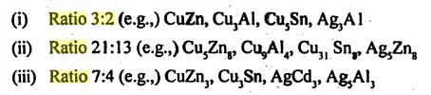
INTERMEDIATE PHASES
Electron compounds: In many alloy systems, the intermediate phase of similar crystal structure are formed having a definite ratio of valence-electron to atoms . The ratios are 3:2,21:13 & 7:4.
For ex CuZn has 3:2 ratio where Cu has mono valence electron and zinc has two valence electron. Hence two zinc atoms has three valence electron.

Slide 19
INTERMEDIATE PHASES
Chemical Compound: The chemical compound is formed between two chemically dissimilar elements having greater affinity for each other.
They are non-metallic on properties & have poor electrical conductivity.
Ex: Mg₂ Si, AlSb & CaSe etc.

Slide 20
INTERMEDIATE PHASES
Laves Phase: When the difference between the atomic radii of two elements is 20-30 % , it forms a group of compound called laves phases.
Ex: MgCu₂ (mcguinnessite), TiFe₂ (Mapiquiroite)etc.

Slide 21
GIBBS PHASE RULE
In a system under a set of conditions, number of phases (P) exist can be related to the number of components (C),degrees of freedom (F) variables like temperature & pressure (n) as non compositional variables by Gibbs phase rule.
Degrees of freedom is the number of independent variables (e.g., pressure ,temperature) that can be varied individually to effect the changes in a system.

Slide 22
GIBBS PHASE RULE
Thermodynamically derived Gibbs phase rule:
P+F=C+2
In practical conditions for metallurgical and materials systems, pressure can be treated as constant (1 atm). Thus condensed Gibbs phase rule is written as:
P+F=C+1

Slide 23
COOLING CURVE
A cooling curve is a line graph that represents the change of phase of matter.
This is basically used to determine the temperature at which phase change ( from solid to liquid ) occurs.
Cooling curve is useful in
Studying the changes that occur during solidification of alloys, and
In determining transformations subsequent to solidification .

Slide 24
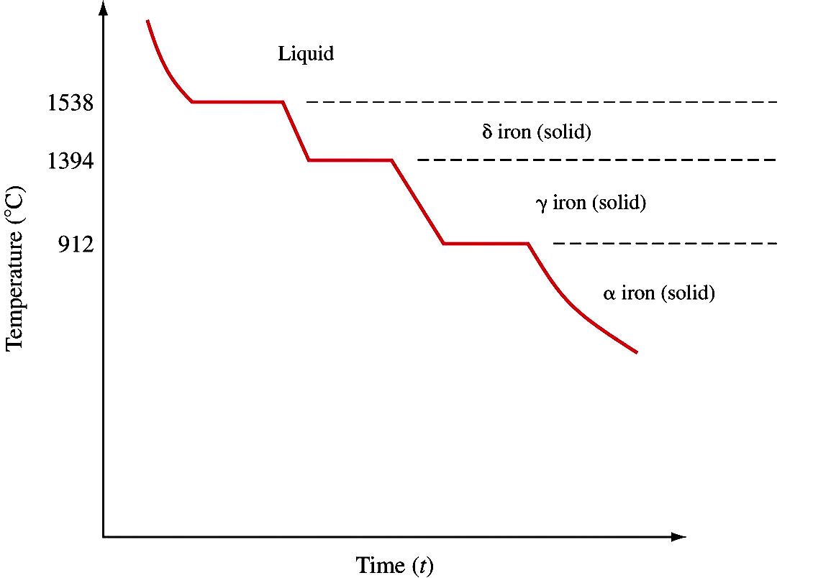
COOLING CURVE FOR PURE IRON @ 1ATM
As T ⇓: melted iron (liquid) ⇒ bcc Fe, δ (solid) ⇒ fcc Fe, γ (solid)(nonmagnetic) ⇒ bcc Fe, α (nonmagnetic)

Slide 25
PHASE DIAGRAM
A diagram that depicts existence of different phases of a system under equilibrium is termed as phase diagram.
It is actually a collection of solubility limit curves. It is also called as equilibrium or constitutional diagram.
Phase diagrams represent the relationships between temperature , compositions and the quantities of phases at equilibrium.

Slide 26
PHASE DIAGRAM
Important information, useful in materials development and selection, obtainable from a phase diagram:
It shows phases present at different compositions and temperatures under slow cooling (equilibrium) conditions.
It indicates equilibrium solid solubility of one element/compound in another.
It suggests temperature at which an alloy starts to solidify and the range of solidification.

Slide 27
PHASE DIAGRAM
It signals the temperature at which different phases start to melt.
Amount of each phase in a two-phase mixture can be obtained.
Phase diagrams are classified according to the number of components present in a particular system.

Slide 28
UNARY PHASE DIAGRAM
If a system consists of just one component (e.g.: water), equilibrium of phases exist is depicted by unary phase diagram.
The component may exist in different forms, thus variables here are –temperature and pressure.

Slide 29
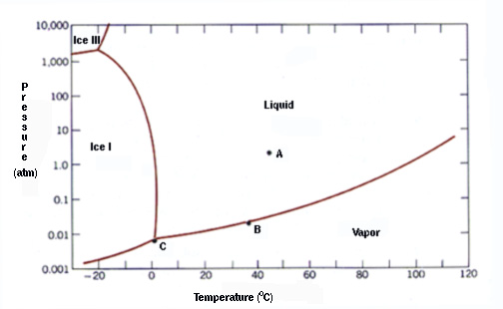
UNARY PHASE DIAGRAM

Slide 30
BINARY PHASE DIAGRAM
If a system consists of two components, equilibrium of phases exist is depicted by binary phase diagram.
Gibbs rule, P+F=C+1. Since the pressure is specified as 1 atmosphere the only independent variable is temperature
For most systems, pressure is constant, thus independently variable parameters are –temperature and composition.
Two components can be either two metals (Cu and Ni), or a metal and a compound (Fe and Fe₃C), or two compounds (Al₂O₃ and Si₂O₃), etc.

Slide 31
BINARY PHASE DIAGRAM
Two component systems are classified based on the extent of mutual solid solubility –
(a) completely soluble in both liquid and solid phases (isomorphous system) and
(b) completely soluble in liquid phase whereas solubility is limited in solid state.
Liquidus is the temperature composition curve for the liquid phase that is in equilibrium with solid (solidification starts)
Solidus is the temperature composition curve for the solid phase that is equilibrium with liquid (solidification completes)
For isomorphous system -E.g. : Cu-Ni, Ag-Au, Ge-Si, Al₂O₃-Cr₂O₃.

Slide 32
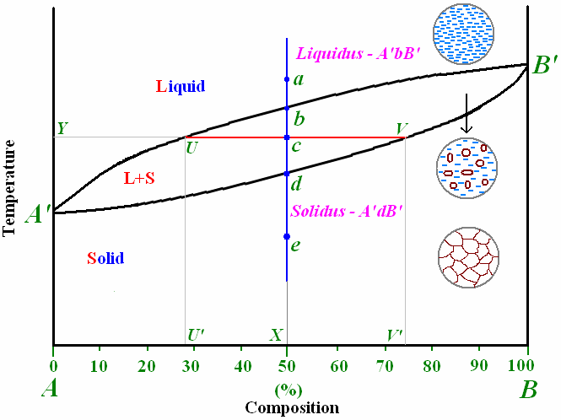
ISOMORPHOUS BINARY SYSTEM
An isomorphous system –phase diagram and corresponding microstructural changes.

Slide 33
TIE-LINE OR LEVER RULE
At a point in a phase diagram, phases present and their composition (tie-line method) along with relative fraction of phases (lever rule) can be computed.
Procedure to find equilibrium concentrations of phases (refer to the figure in previous slide):
-A tie-line or isotherm(UV) is drawn across two-phase region to intersect the boundaries of the region.

Slide 34
TIE-LINE OR LEVER RULE
-Perpendiculars are dropped from these intersections to the composition axis, represented by U’ and V’, from which each of each phase is read. U’ represents composition of liquid phase and V’ represents composition of solid phase as intersection U meets liquidus line and V meets solidus line.
Procedure to find equilibrium relative amounts of phases (lever rule):

Slide 35
TIE-LINE OR LEVER RULE
A tie-line is constructed across the two phase region at the temperature of the alloy to intersect the region boundaries.
The relative amount of a phase is computed by taking the length of tie line from overall composition to the phase boundary for the other phase, and dividing by the total tie-line length. In previous figure, relative amount of liquid and solid phases is given respectively by: C_{L} = (cV/UV), C_{S} = (Uc/UV), C_{L} + C_{S} =1

Slide 36
EUTECTIC BINARY SYSTEM
Many of the binary systems with limited solubility are of eutectic type
eutectic alloy of eutectic composition solidifies at the end of solidification at eutectic temperature.
Liquid (L) ←→ Solid (A) + Solid (B)
E.g.: Cu-Ag, Pb-Sn
It is of 2 types
Two metals are completely soluble in the liquid state but completely insoluble in solid state.
Two metals are completely soluble in the liquid state but only partly soluble in the solid state.

Slide 37
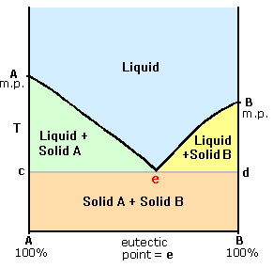
EUTECTIC BINARY PHASE DIAGRAM – TYPE I

Slide 38
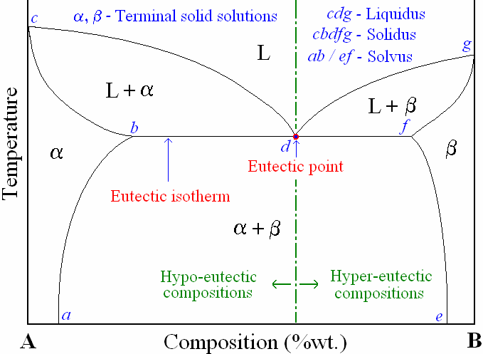
EUTECTIC BINARY SYSTEM – TYPE II

Slide 39
PERITECTIC SYSTEMS
A peritectic reaction takes place when a solid that has been produced during cooling reacts with the liquid remaining, to form another solid phase.
Liquid + Solid A ← → Solid B
Peritectic reaction takes place at constant temperature
Some example of this systems are Fe-C, Ag-Pt, Cu-Zn, Cu-Al etc

Slide 40
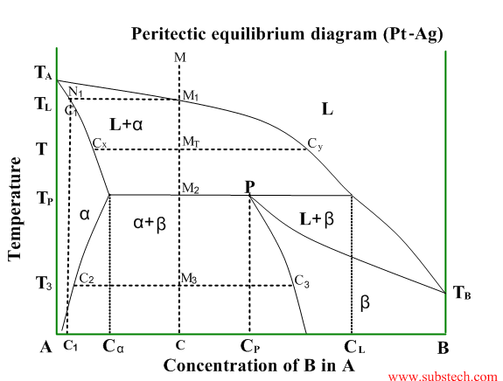
PERITECTIC SYSTEM PT-AG

Slide 41
MONOTECTIC SYSTEM
In previous systems we have seen complete solubility in the liquid phase. When for a certain range of composition two liquids are not soluble then it shows a miscibility gap. Then that system is called monotectic system.
The liquid decomposes to another liquid and solid.
Liquid A → Liquid B + Solid
Some typical systems are Cu-Pb,Cu-Cr, Al-Pb, Zn-Pb etc.

Slide 42
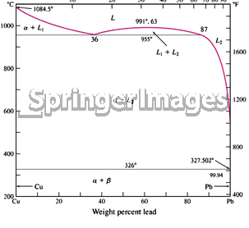
MONOTECTIC SYSTEM CU & PB

Slide 43
EUTECTOID SYSTEM
This a system in which solid to solid transformation take place. Whereas in other system it may be either solid to liquid or liquid to solid.
A solid decomposes into two different solids
Solid A → Solid B + Solid C
It take place at a constant temperature and transformation present as intimate mechanical mixture.
Some alloys following the eutectoid system are Fe-C, Cu-Zn, Al-Mn, Cu-Sn etc.

Slide 44
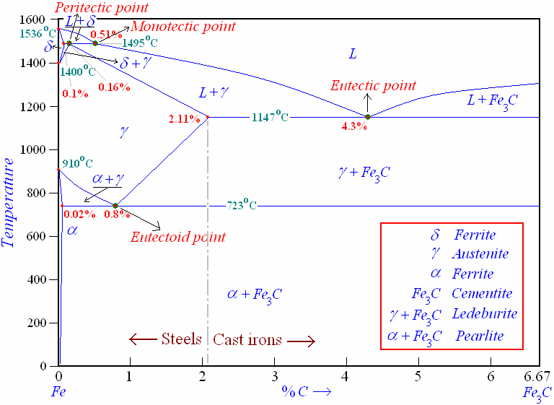
EUTECTOID SYSTEM FE-C

Slide 45
INVARIANT REACTIONS
Observed triple point in unary phase diagram for water?
How about eutectic point in binary phase diagram?
These points are specific in the sense that they occur only at that particular conditions of concentration, temperature, pressure etc.

Slide 46
INVARIANT REACTIONS
Try changing any of the variable, it does not exist i.e. phases are not equilibrium any more!
Hence they are known as invariant points, and represents invariant reactions.
In binary systems, we will come across many number of invariant reactions!

Slide 47
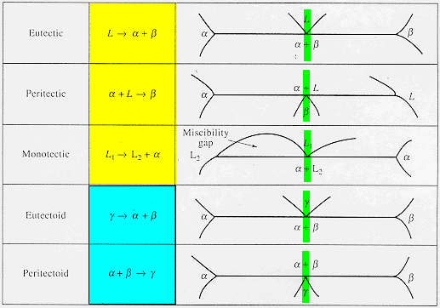
INVARIANT REACTIONS

Slide 48
CONGRUENT, INCONGRUENT TRANSFORMATIONS
Phase transformations are two kinds –congruent and incongruent.
Congruent transformation involves no compositional changes. It usually occurs at a temperature.
E.g.: Allotropic transformations, melting of pure a substance.
During incongruent transformations, at least one phase will undergo compositional change.
E.g.: All invariant reactions, melting of isomorphous alloy.

Slide 49
IRON AND IRON-CARBIDE BINARY SYSTEM

Slide 50
IRON AND IRON-CARBIDE BINARY SYSTEM
Fe-Fe₃C phase diagram is characterized by five individual phases,:
α–ferrite (BCC) Fe-C solid solution,
γ-austenite (FCC) Fe-C solid solution,
δ-ferrite (BCC) Fe-C solid solution,
Fe₃C (iron carbide) or cementite -an inter-metallic compound
liquid Fe-C solution

Slide 51
IRON AND IRON-CARBIDE BINARY SYSTEM
Four invariant reactions:
peritectic reaction at 1495⁰C and 0.16%C,
δ-ferrite + L↔γ-iron (austenite)
2. monotectic reaction at 1495⁰C and 0.51%C,
L↔L+ γ-iron (austenite)
3. eutectic reaction at 1147 ⁰Cand 4.3 %C,
L↔γ-iron + Fe₃C (cementite) [ledeburite]
4. eutectoid reaction at 723⁰Cand 0.8%C,
γ-iron ↔α–ferrite + Fe₃C (cementite) [pearlite]

Slide 52
FE-C ALLOY CLASSIFICATION
Fe-C alloys are classified according to wt.% C present in the alloy for technological convenience as follows:
Commercial pure irons % C < 0.008
Low-carbon/mild steels 0.008 -%C -0.3
Medium carbon steels 0.3-%C -0.8
High-carbon steels 0.8-%C -2.11
Cast irons 2.11 < %C

Slide 53
DEFINITION OF STRUCTURES
Cementite or iron-carbide:
Chemical formula Fe₃C
Contains 6.67 % carbon by weight
It is a brittle interstitial compound of low tensile strength but high compressive strength.
It is the hardest structure that appears on the diagram
Its crystal structure is orthorhombic.

Slide 54
DEFINITION OF STRUCTURES
2. Austenite (γ solid solution):
It is an interstitial solid solution of carbon dissolved in γ (f.c.c) iron.
Maximum solubility is 2 % carbon at 1147ºC.
Its tensile strength is 1,50,000 psi.
Elongation is 10 % in 2 inches.
Its toughness is high.

Slide 55
DEFINITION OF STRUCTURES
3. Ledeburite:
It is the eutectic mixture of austenite and cementite.
It contains 4.3 % carbon and is formed at 1147ºC.

Slide 56
DEFINITION OF STRUCTURES
4. Ferrite(α solid solution):
It is an interstitial solid solution of a small amount of carbon dissolved in α (b.c.c) iron.
The maximum solubility is 0.025 % C at 723ºC and dissolves only 0.008 % C at room temp.
It is the softest structure that appears on the diagram.
Tensile strength is 40,000 psi.
Elongation is 40 % in 2 inches.

Slide 57
DEFINITION OF STRUCTURES
5. Pearlite:
It is the eutectoid mixture containing 0.8 % C and is formed at 723ºC on very slow cooling.
It is a very fine plate like or lamellar mixture of ferrite and cementite.
Tensile strength is 1,20,000 psi.
Elongation is 20 % in 2 inches.

Slide 58
TERNARY PHASE
Diagrams that represent the equilibrium between the various phases that are formed between three components, as a function of temperature.
Normally, pressure is not a viable variable in ternary phase diagram construction, and is therefore held constant at 1 atm.

Slide 59
TERNARY PHASE
The concentration of each of the three components Can be expressed as either “wt. %” or “molar %”
Sum of the concentration of the three components must add up to 100%
The Gibbs Triangle is always used to determine the overall composition
The Gibbs Triangle: An equilateral triangle on which the pure components are represented by each corner

Slide 60
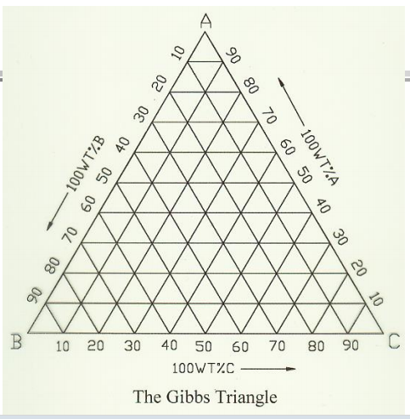
TERNARY PHASE – GIBBS TRIANGLE

Slide 61
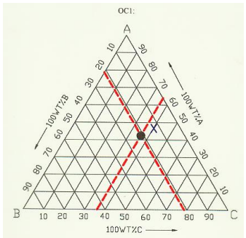
TERNARY PHASE – DETERMINING OVERALL COMPOSITION
Let the overall composition be represented by the point X
Draw lines passing through X, and parallel to each of the sides
Where the line A’C’ intersects the side AB tells us the concentration of component B in X
The concentrations of A and C, in X, can be determined in an identical manner

Slide 62
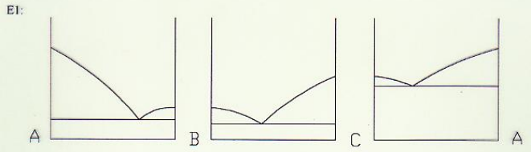
TERNARY SYSTEM – EUTECTIC REACTION
The Ternary Eutectic Reaction:
L = α + β + γ
A liquid phase solidifies into three separate solid phases Made up of three binary eutectic systems, all of which exhibit no solid solubility

Slide 63
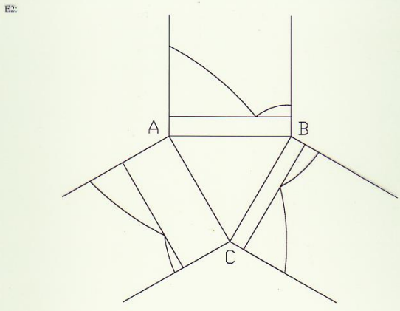
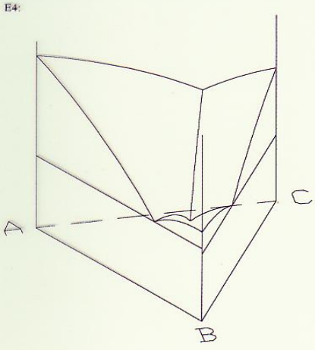
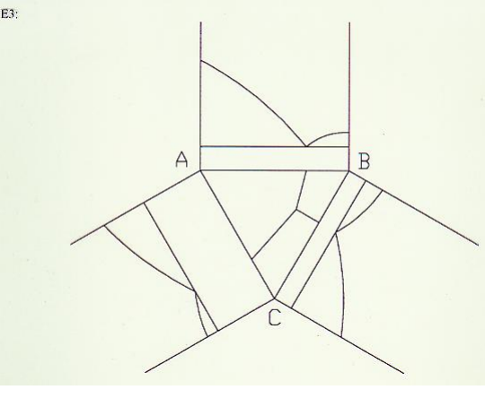
TERNARY SYSTEM – EUTECTIC REACTION

Slide 64
C = 3: TERNARY SYSTEMS: EXAMPLE 1: TERNARY EUTECTIC DI - AN - FO
Anorthite
Note three binary eutectics
No solid solution
Ternary eutectic = M
M
T
Forsterite
Diopside
Notes:
As add components, becomes increasingly difficult to dipict.
1-C: P - T diagrams easy
2-C: isobaric T-X, isothermal P-X…
3-C: ??
Still need T or P variable
Project? Hard to use as shown

Slide 65
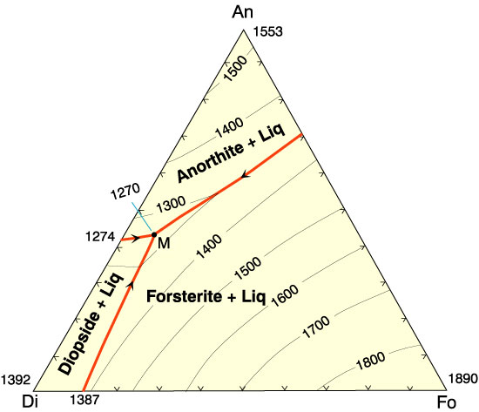
ISOBARIC DIAGRAM OF DI - AN - FO
Figure 7.2. Isobaric diagram illustrating the liquidus temperatures in the Di-An-Fo system at atmospheric pressure (0.1 MPa). After Bowen (1915), A. J. Sci., and Morse (1994), Basalts and Phase Diagrams. Krieger Publishers.
Notes:
X-X diagram with T contours (P constant)
Liquidus surface works like topographic map
Red lines are ternary cotectic troughs
Run from binary eutectics down T to ternary eutectic M
Separate fields labeled for liquidus phase in that field

