Slide 1
ELASTIC AND PLASTIC BEHAVIOUR
CHAPTER-1

Slide 2
ELASTIC AND PLASTIC BEHAVIOUR
Elastic behaviour: The recovery of the original dimensions of a deformed body when the load is removed.
Elastic limit: The limiting load beyond which the material no longer behaves elastically.
Plastic behaviour: If the elastic limit is exceeded, the body will experience a permanent set or deformation when the load is removed.

Slide 3
CLASSIFICATION ODEFORMATION F MATERIALS
DUCTILE MATERIAL: The material which exhibits the ability to undergo plastic deformation. Examples: Mild steel, Aluminiun, Copper
BRITTLE MATERIAL: The material which would fracture almost at the elastic limit i.e., which doesn't undergo plastic deformation.
Examples: Glass, Concrete, Cast iron

Slide 4
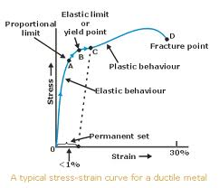
TENSILE OF DUCTILE MATERIAL

Slide 5
STRESS-STRAIN CURVES FOR GLASS AND CAST IRON

Slide 6
PLASTIC DEFORMATION
A body which is permanently deformed after the removal of the applied load is said to have undergone plastic deformation.
Two mechanisms by which metals deform plastically are
Deformation by slip
Deformation by TWINING

Slide 7
CONCEPTS OF CRYSTAL GEOMETRY
Most metals have any of the three types of crystal structure.
Body-centered cubic crystal structure.
Face-centered cubic crystal structure.
Hexagonal close-packed structure.

Slide 8
BODY-CENTERED CUBIC STRUCTURE

Slide 9
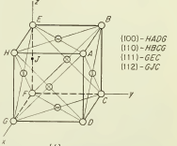
FACE-CENTERED CUBIC STRUCTURE

Slide 10
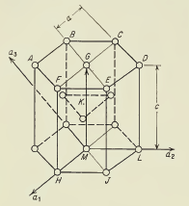
HEXAGONAL CLOSE-PACKED STRUCTURE

Slide 11
Plastic deformation is generally confined to low-index planes, which have a higher density of atoms per unit area than high-index planes

Slide 12
LATTICE DEFECTS
Defect or Imperfection: It is generally used to describe any deviation from an orderly array of lattice points.
There are two types of defects:
Point defect
Lattice defect

Slide 13
POINT DEFECT
When the deviation from the periodic arrangement of the lattice is localized to the vicinity of only a few atoms it is called o point defect.
There are three types of point defects.
Vacancy
Interstitial
Impurity atom

Slide 14
VACANCY
A vacancy or vacant lattice site exists when an atom is missing from a normal lattice position.
In pure metals ,small number of vacancies are created by thermal excitation

Slide 15
INTERSTITIAL DEFECT
An atom that is trapped inside the crystal at a point intermediate between normal lattice positions is called an interstitial atom.
The interstitial defect occurs in pure metals as a result of bombardment with high-energy nuclear particles.

Slide 16
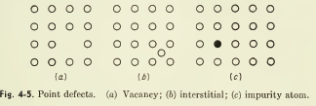
IMPURITY ATOM
The presence of an impurity atom at a lattice position or at an interstitial position results in a local disturbance of the periodicity of the lattice.

Slide 17
LATTICE DEFECT
If the defect extends through the microscopic regions of the crystal, it is called a lattice defect.
There are two types of lattice defects.
Line defects
Surface defects

Slide 18
LINE DEFECT
Line defects obtain their name because they propagate as lines or as a two-dimensional net in the crystal.
Line defect is otherwise called as dislocation.
Examples: Edge dislocation, Screw dislocation

Slide 19
DISLOCATION

Slide 20
EDGE DISLOCATION

Slide 21
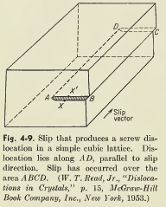
EDGE DISLOCATION
The boundary between the right-hand part slipped part of the crystal and left-hand part which has not yet slipped is the line AD, the edge dislocation.
The magnitude and direction of displacement of the dislocation are defined by vector called Burgers vector, b.
Burgers vector is always perpendicular to the dislocation line.

Slide 22
SCREW DISLOCATION
The upper part of the crystal to the right of AD has moved relative to the lower part in the direction of the slip vector. No slip has taken place to the left of AD, and therefore AD is a dislocation line
Dislocation line is parallel to its Burger vector.

Slide 23
SURFACE DEFECTS
Surface defects arise from the clustering of line defects into a plane.
Example:
Grain boundaries: The orientation difference when it is greater than 10-15 Degree. It can also be said High angle Boundaries
Low angle boundaries: The orientation difference,when it is less than 10 Degree.

Slide 24
DEFORMATION BY SLIP

Slide 25
DEFORMATION BY SLIP
Sliding of blocks of crystal over one another along definite crystallographic planes called slip planes.
In the fig. a shear stress is applied to a metal cube with a top polished surface.
Slip occurs when the shear stress exceeds a critical value.
The atoms move an integral number of atomic distances along the slip plane and a step is produced in the polished surface.

Slide 26
DEFORMATION BY SLIP
When we view the polished surface from above with an electron microscope, the step shows up as a line called slip line.
If the surface is then repolished, the step is removed and the slip line will disappear.
Slip occurs most readily in specific directions on certain crystallographic planes.

Slide 27
DEFORMATION BY SLIP
Slip plane is the plane of greatest atomic density and slip direction is the closest-packed direction within the slip plane.
The planes of greatest atomic density are also the most widely spaced planes in the crystal structure, the resistance to slip is generally less for these planes than for any other set of planes.
The slip plane together with the slip direction establishes the slip system.

Slide 28
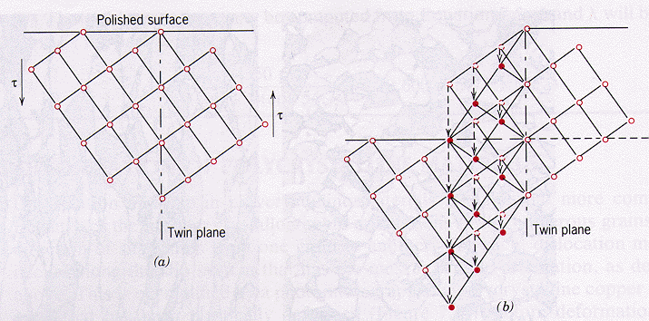
DEFORMATION BY TWINING

Slide 29
DEFORMATION BY TWINING
It results when a portion of the crystal takes up an orientation that is related to the orientation of the rest of the untwinned lattice in a definite, symmetrical way.
The twinned portion of the crystal is a mirror image of the parent crystal.
The plane of symmetry between the two portions is called the TWINING plane.
If a shear stress is applied , the crystal will twin about the TWINING plane.

Slide 30
DEFORMATION BY TWINING
The region to the right of the twining plane is not deformed. To the left of this plane, the atoms have sheared in such a way so as to form a mirror image across the twin plane. Each atom in the twinned region moves a distance proportional to its distance from the twin plane.
In fig. open circles represent atoms which have not moved.
Dashed circles indicate the original positions in the lattice of atoms which change position.
Solid circles indicate the final positions of these atoms in the twined region.

Slide 31
TYPES OF TWINS
Twins are of two types based on their formation.
Mechanical Twins: Produced by mechanical deformation.
Annealing Twins: Formed as a result of annealing.

Slide 32
DIFFERENCES BETWEEN SLIP AND TWINING
SLIP
The orientation of the crystal above and below the slip plane is same before and after deformation.
Slip is considered to occur in discrete multiples of atomic spacing.
TWINING
There will be orientation difference of the crystal across the twin plane after deformation.
The atom movements are much less than an atomic distance

Slide 33
DIFFERENCES BETWEEN SLIP AND TWINING
SLIP
It occurs on relatively widely spread planes.
It takes several milliseconds for a slip band to form.
TWINING
In the twined region of a crystal every atomic plane is involved in deformation.
Twins can form in a time as short as a few microseconds.

Slide 34
Differences between slip and twining
SLIP
Slip occurs in specific directions on certain crystallographic planes.
Deformation mechanism in metals possess many slip systems.
TWINING
Twining occurs in a definite direction on a specific crystallographic plane.
Twining is not a dominant deformation mechanism in metals

Slide 35
ROLE OF SHEAR STRENGTH OF PERFECT CRYSTAL

Slide 36
ROLE OF SHEAR STRENGTH OF PERFECT CRYSTAL
Consider two planes of atoms in which the shear stress is assumed to act in the slip plane along the slip direction.
The shearing stress is initially zero when the two planes are in coincidence and it is also zero when the two planes have moved one identity distance b.
Between these positions each atom is attracted toward the nearest atom of the other row, so that the shearing stress is a periodic function of the displacement.

Slide 37
ROLE OF SHEAR STRENGTH OF PERFECT CRYSTAL
As a first approximation, the relationship between shear stress and displacement can be expressed by a sine function
Where, b is the period

Slide 38
ROLE OF SHEAR STRENGTH OF PERFECT CRYSTAL
At small values of displacement, Hooke’s law should apply
For small values of x/b first equation can be written as

Slide 39
ROLE OF SHEAR STRENGTH OF PERFECT CRYSTAL
Combining the above two equations provides an expression for the maximum shear stress at which slip should occur.
As a rough approximation , b can taken equal to a, with the result that the theoretical shear strength of perfect crystal is approximately equal to the shear modulus divided by 2π.

Slide 40
ROLE OF SHEAR STRENGTH OF PERFECT CRYSTAL
The shear modulus for metals is in the range of 20 to 150 GPa.
Therefore the theoretical shear stress will be in the range of 3 to 30 GPa..
The actual values of the shear stress required to produce plastic deformation in metal single crystals are in the range of 0.5 to 10 MPa.

Slide 41
STRENGTHENING MECHANISM
The mechanism by which the strength of a material is increased is called strengthening mechanism.
The strength of a material is directly related to dislocation resistance.
In high purity single crystals there are a number of possible factors that can affect the strength and mechanical behavior.

Slide 42
STRENGTHENING MECHANISM
Grain Boundaries: Grain Boundaries are effective obstacles to dislocation motion. The increase in density of grain boundaries leads to strengthening. This is done by Grain refinement or Grain boundary strengthening.
Foreign Atoms: Introducing a foreign atom by alloying.
The foreign atom is dissolved random in the solid called solution strengthening .
If the atom is not soluble in host crystals, they can be aggregates of matter resulting a precipitation of alloys. This is called Precipitation strengthening.
Dislocations: Dislocation obstructs or resist each other movement. This causes strain hardening or Work hardening.

Slide 43
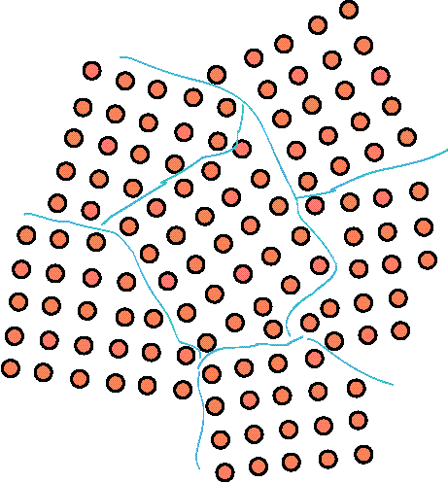
GRAIN BOUNDARY STRENGTHENING

Slide 44
GRAIN BOUNDARY STRENGTHENING
In this, the grain size of the boundary is varied, which in turn have influence on dislocation and yield strength.
The grain boundary act as a blockage of further propagation of dislocation across the grain.
The yield stress of the crystals is increased linearly with fine grained across the grain boundary than a coarse-grained boundary.
As the grain boundaries blocks the dislocations, the dislocated grains gets piled up near the boundaries. This creates backshear stress across the piled up region which act against the acting stress.

Slide 45
GRAIN BOUNDARY STRENGTHENING
This back shear stress gives resistance to the applied stress, hence more stress is needed for continuing the dislocation.
After some point the dislocation spreads to other region this causes in need of more additional stress to overcome the boundary hence, the increase in yield strength.
The grain boundary can be further strengthened by reducing the grain size. Which reduces the pile up of dislocation.
After reaching grain size of dia ~ 10nm the slip dislocation converts to grain boundary sliding where sliding occurs at grain level which is no longer blocked by the boundary. Hence, the yield strength is reduced after certain grain size.

Slide 46
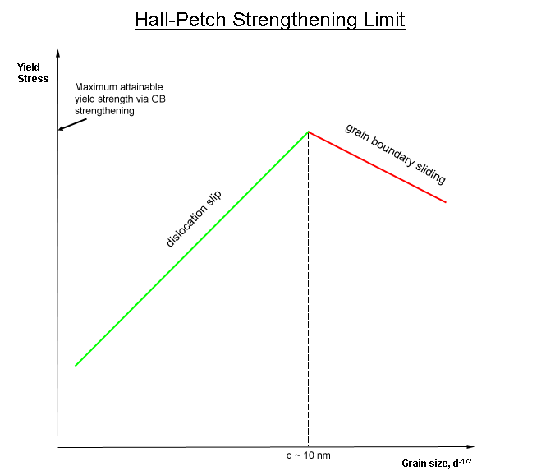
GRAIN BOUNDARY STRENGTHENING

Slide 47
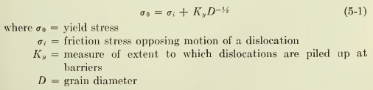
GRAIN BOUNDARY STRENGTHENING
The relation b/w yield stress and grain size is given by
This relationship is called the Hall-Petch equation.

Slide 48
SOLID-SOLUTION STRENGTHENING
In this strengthening the solute atoms are introduced into solid solution in the solvent-atom lattice invariably produces an alloy which is stronger than the pure metal.
It decreases the stress in a compression region but increase in tensile region and traps it in its vicinity.
There are two types of solid solutions.
Substitution solid solution
Interstitial solid solution

Slide 49
TYPES OF SOLUTE ATOMS
Substitution Solid Solution:
If the solute and solvent atoms are roughly similar in size, the solute atoms will occupy lattice points in the crystal lattice of the solvent atoms.
Interstitial Solid Solution:
If the solute atoms are much smaller than the solvent atoms, they occupy interstitial positions in the solvent lattice.

Slide 50
TYPES OF SOLUTE ATOMS
Interstitial atoms
Substitution atoms
Produce non-spherical distortions.
Increases relative strengthening of about three times shear modulus.
Interact with both edge and screw dislocations.
Produce spherical distortions.
Increases relative strengthening of about G/10.
3. Atoms impede the motion of edge dislocations.

Slide 51
SOLID-SOLUTION STRENGTHENING
Solute atoms can interact with dislocations by the following mechanisms.
Elastic interaction
Modulus interaction
Long-range interaction
Electrical interaction
Short-range interaction
Stacking-fault interaction

Slide 52
PARTICLE STRENGTHENING
In this, small second phase particles are distributed in a ductile matrix.
The second phase or inter metallic particles are much finer (down to submicroscopic dimensions) than the grain size of the matrix.
For particle strengthening to occur, the second phase must be soluble at an elevated temperature but must exhibit decreasing solubility with decreasing temperature.
In particle strengthened systems, there is atomic matching or coherency b/w the lattices of the precipitate and the matrix.

Slide 53
PARTICLE STRENGTHENING
The degree of strengthening depends on the distribution of particles in the ductile matrix.
The second phase particles act in two ways to retard the motion of dislocations.
Particles cut by the dislocations.
Particles resist cutting and the dislocations are forced to bypass them.

Slide 54
PARTICLE STRENGTHENING
In this strengthening slip mode formation depends on the nature of particle-dislocation interaction.
Particles which have been cut by dislocations tend to produce coarse and planar slip.
Particles which are bypassed by dislocations lead to fine wavy slip.

Slide 55
PARTICLE STRENGTHENING
The six properties of the particles which affect the ease with which they can be sheared are
Coherency strains
Stacking fault energy
Ordered structure
Modulus effect
Interfacial energy and morphology
Lattice friction stress

Slide 56
DISPERSION STRENGTHENING
In this the fine hard particles are mixed with matrix powder and consolidated and processed by powder metallurgy techniques.
The second phase in dispersion hardening systems has very little solubility in the matrix even at elevated temperatures.
In this there is no coherency between the second phase particles and the matrix.

Slide 57
DISPERSION STRENGTHENING
Advantage of this is that the dispersion hardened systems are thermally stable at very high temperatures.
Because of finely dispersed second- phase particles, these alloys are resistant to recrystallization and grain growth than single-phase alloys.
The degree of strengthening resulting from this depends on the distribution of particles.

Slide 58
DISPERSION STRENGTHENING
Dispersion strengthening can be described by
Shape of the particles
Volume fraction
Average particle diameter
Mean inter particle spacing
A simple expression for linear mean free path is λ = 4(1-f)r/(3f)
where f is volume fraction of spherical particles of radius r.

Slide 59
FIBER STRENGTHENING
In this fine fibers are incorporated in a ductile matrix.
Materials of high strength to weight ratio can be produced.
The fibers must have high strength and high elastic modulus.
The matrix must be ductile and non-reactive with fibers.

Slide 60
FIBER STRENGTHENING
Role of fibers:
Carry the total load.
Gives strength, stiffness and other mechanical properties.
Role of matrix:
Gives shape to the part.
Keeps the fiber in place.
Serves to transfer or transmit the load to the fiber.

Slide 61
FIBER STRENGTHENING
Protects the fiber from environment and surface damage.
Separates the individual fibers and blunt cracks which arise from fiber breakage.
Because the fibers and matrix have quite different elastic module a complex stress distribution will be developed when a composite body is loaded uniaxially in the direction of fibers.

Slide 62
WORK HARDENING
We have observed that stress needed for plastic deformation increases with the strain.
The increase in the stress required to cause slip because of the previous plastic deformation is known as strain hardening or work hardening.
This is done at room temperature.
Strain hardening is caused by dislocations interacting with each other resulting of vector sum of the strain field created by dislocation.
This strain field creates a barrier that impedes a motion of dislocation & it require higher stress to move.
It is commonly accomplished by rolling, forging or by hammering.

Slide 63
WORK HARDENING
Bauschinger Effect:
If a specimen is deformed plastically beyond the yield stress in one direction and then after unloading to zero stress it is reloaded in opposite direction, it is found that repeating the cycle results in less yield strength than the original yield stress.
The lowering of yield stress when deformation in one direction is followed by deformation in the opposite direction is called Bauschinger effect.

Slide 64
WORK HARDENING
Bauschinger Effect:

Slide 65
WORK HARDENING
The rate of strain hardening can be gaged from the slope of the flow curve.
Increasing temperature lowers the rate of strain hardening.
The work hardening of a material results in hard & brittle. This can be reversed by using annealing.

Slide 66
WORK HARDENING
Annealing: It happens in three successive stages:
Recovery: It removes the residual stresses stored in the crystal lattice which resulted from uneven cooling or extensive deformation.
Re-crystallization: Dislocation move & rearrange in such a way the total strain energy surrounding them is reduced.
Grain growth : The size of grain will increase at elevated temperatures. This is driven by decrease in total grain boundary energy.
The final result of annealing lowers the yield strength & increase ductility.

Slide 67
WORK HARDENING

Slide 68
EFFECT OF STRAIN RATE ON PLASTIC BEHAVIOUR
The rate at which strain is applied to a specimen is called strain rate.
It has an important influence on the flow of stress.
It is defined as έ=dε/dt.
Increasing strain rate increases flow of stress.
The strain rate dependence of strength, increases with increasing temperature.
The yield stress and flow of stress at lower plastic strains are more dependent on strain rate rather than the tensile strength

Slide 69
EFFECT OF STRAIN RATE ON PLASTIC BEHAVIOUR

Slide 70
EFFECT OF STRAIN RATE ON PLASTIC BEHAVIOUR
A relationship b/w flow stress and strain rate at constant strain and temperature is
Where, C is a generalized constant
m is known as strain-rate sensitivity

Slide 71
EFFECT OF STRAIN RATE ON PLASTIC BEHAVIOUR
Strain rate sensitivity of metals is quite low (<0.1) at room temperatures but m increases with temperature, especially at temperatures above the absolute melting point.
In hot-working conditions m values of 0.1 to 0.2 are common.
Strain rate sensitivity is a good indicator of changes in deformation behavior.

Slide 72
EFFECT OF STRAIN RATE ON PLASTIC BEHAVIOUR
Measurements of m provide a key link between dislocation concepts of plastic deformation.
For a Newtonian viscous solid the strain-rate sensitivity is 1.
High strain rate sensitivity is a characteristic of super plastic materials and alloys (hot-glass).

Slide 73
EFFECT OF TEMPERATURE ON PLASTIC BEHAVIOR
In general strength decreases and ductility increases as the test temperature is increased.
Structural changes such as precipitation, strain aging or recrystallisation may occur in certain temperature ranges to alter the general behavior.
Thermally activated processes assist deformation and reduce strength.

Slide 74
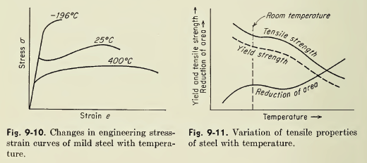
EFFECT OF TEMPERATURE ON PLASTIC BEHAVIOR

Slide 75
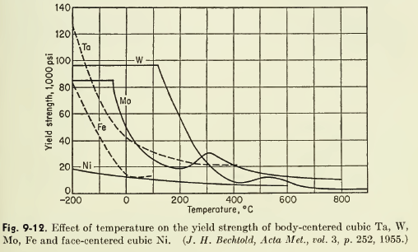
EFFECT OF TEMPERATURE ON PLASTIC BEHAVIOR

Slide 76
EFFECT OF TEMPERATURE ON PLASTIC BEHAVIOR
For bcc metals the yield stress increases rapidly with decreasing temperature, so bcc metals exhibit brittle fracture at low temperatures.
For fcc metals like Ni the yield stress is slightly temperature dependant.
Tungsten is brittle at 100º C, iron at -225ºC.

Slide 77
EFFECT OF TEMPERATURE ON PLASTIC BEHAVIOR
The relation b/w flow stress and temperature at constant strain and strain rate is
where C₂ is a constant
Q is an activation energy for plastic flow, Jmol⁻¹
R is universal gas constant, 8.314 Jmol⁻¹K⁻¹
T is temperature, K

Slide 78
SUPERPLASTICITY
It is the ability of a material to withstand very large deformations in tension without necking.
Elongations usually between 100 and 1000 percents are observed in these materials.
Testing at high temperature and low strain rate accentuate superplastic behavior.

Slide 79
SUPERPLASTICITY
Superplastic behavior occurs at T>0.5T_{m}.
High strain-rate sensitivity is a characteristic of superplastic metals and alloys.
The requirements for a material to exhibit superplasticity are a fine grain size(<10μm) and the presence of second phase which inhibits grain growth at elevated temperatures.

Slide 80
SUPERPLASTICITY
In superplastic deformation the grains remain essentially equiaxed after large deformations.
Most superplastic materials show an activation energy for superplastic flow equal to the activation energy for grain-boundary diffusion.
The predominant mechanism for superplastic deformation is grain-boundary sliding accommodated by slip.

Slide 81
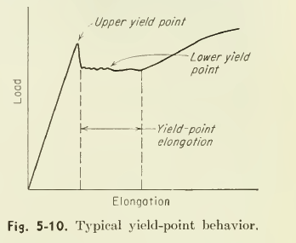
YIELD POINT PHENOMENON

Slide 82
YIELD POINT PHENOMENON
In many metals, particularly low-carbon steel the load increases steadily with elastic strain, drops suddenly, fluctuates about some approximately constant value of load, and then rises with further strain.
The load at which sudden drop occurs is called the upper yield point.
The constant load is called lower yield point.

Slide 83
YIELD POINT PHENOMENON
The elongation which occurs at the constant load is called yield-point elongation.
The deformation occurring throughout the yield-point elongation is heterogeneous.
Several slip bands are formed during the yield point elongation called the Luders bands or Hartmann lines or stretcher strains.

Slide 84
PLASTIC DEFORMATION OF NON- CRYSTALLINE MATERIALS
The non-crystalline arrangement is thermodynamically stable above Tm of the material.
The crystalline is just opposite (below the Tm is more stable).
The macroscopic deformation is similar in both crystalline and non-crystalline.
Glass transition temperature is an important factor to the deformation in non-crystalline material.
Glass transition temperature is a f(cooling rate) where the amorphous structure transition from hard and brittle to rubber like state.

Slide 85
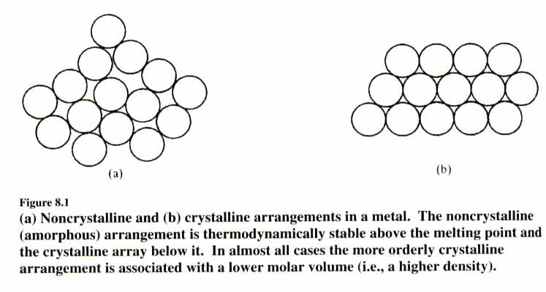
PLASTIC DEFORMATION OF NON- CRYSTALLINE MATERIALS

Slide 86
PLASTIC DEFORMATION OF NON- CRYSTALLINE MATERIALS
The ratio Tg/Tm can determine the ease of glass formation (ratio >0.67 is favourable)
Tg relates to a reduction in atomic mobility
Heating an amorphous material below its Tm can enhance the crystallization process.
Three distinct regions of strain regions: elastic, viscoelastic and viscous regions.
Heterogeneous deformation at high stress and low temperature.
Homogeneous deformation at low stress and low temperature.

Slide 87
PLASTIC DEFORMATION OF NON- CRYSTALLINE MATERIALS
Shear band : A narrow zone of intense shearing strain, usually of plastic nature, developing during severe deformation of ductile materials.
At high stresses and low temperatures, permanent deformation is associated with shear bands.
Shear band is another deformation mechanism in non-crystalline material .
Glassy polymers are deformed by forming shear bands in the compression area
Deformation in the tension side will develop necking phenomenon

Slide 88
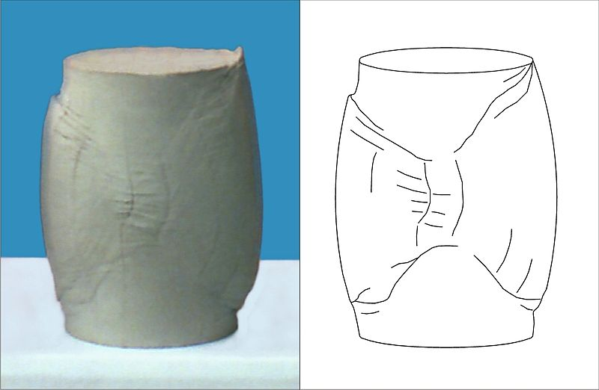
PLASTIC DEFORMATION OF NON- CRYSTALLINE MATERIALS
SHEAR BAND

Slide 89
PLASTIC DEFORMATION OF NON- CRYSTALLINE MATERIALS
Crazing is a phenomenon that frequently precedes fracture in some glassy polymers.
Crazing occurs in regions of very localized yielding, which leads to the formation of interpenetrating micro voids and small fibrils. If an applied tensile load is sufficient, these bridges elongate and break, causing the micro voids to grow and coalesce; as micro voids coalesce, cracks begin to form.
Crazing occurs in polymers, because the material is held together by a combination of weaker Vander Waals forces and stronger covalent bonds. Sufficient local stress overcomes the Vander Waals force, allowing a narrow gap.

Slide 90
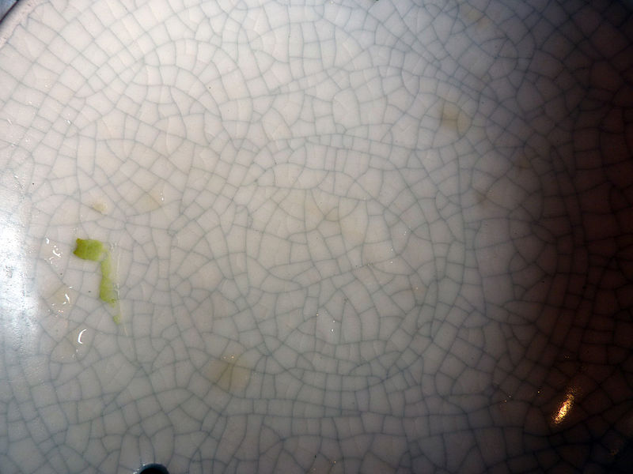
PLASTIC DEFORMATION OF NON- CRYSTALLINE MATERIALS
CRAZING

