Slide 1
CHAPTER 4
MODERN METALLIC MATERIALS

Slide 2
TOPICS TO BE COVERED
Dual phase alloys & Micro alloyed steels - High Strength Low alloy (HSLA) steel
Transformation induced plasticity ( TRIP) steel,
Maraging steel
Intermettalics - Ni and Ti aluminides
Smart materials
Shape memory alloys
Metallic glasses
Quasi crystals and nano crystalline materials.

Slide 3
DUAL PHASE ALLOYS
Dual phase alloy is a high-strength steel that has a ferrite and martensite microstructure.
Ferrite is BCC iron phase with very limited solubility for carbon. The maximum solubility is 0.025% carbon till 910º C and it dissolves only 0.008% carbon at room temp.
Martensite is a Fe-C phase with a BC tetragonal structure and possesses an acicular or needle-like structure.

Slide 4
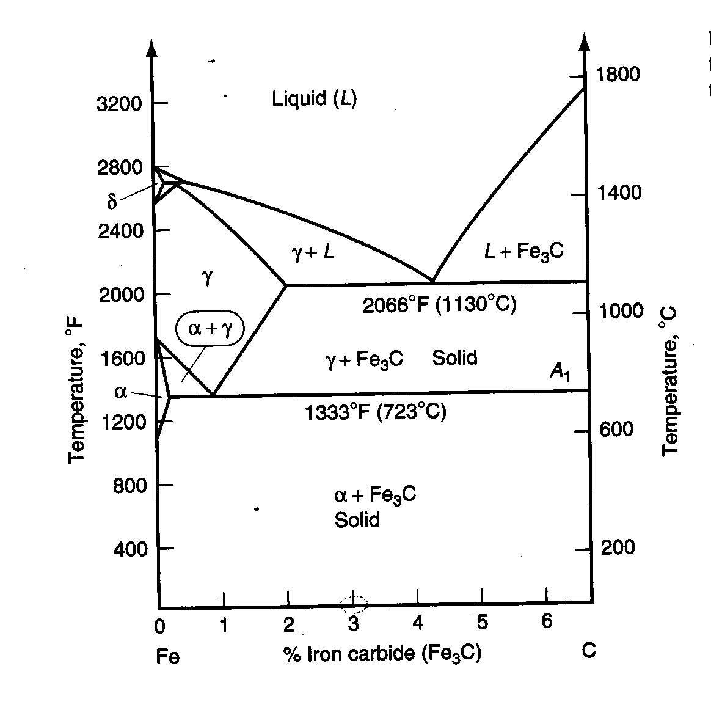
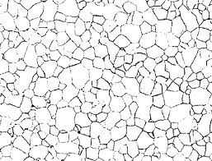
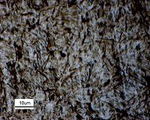
DUAL PHASE ALLOYS
Ferrite
Martensite

Slide 5
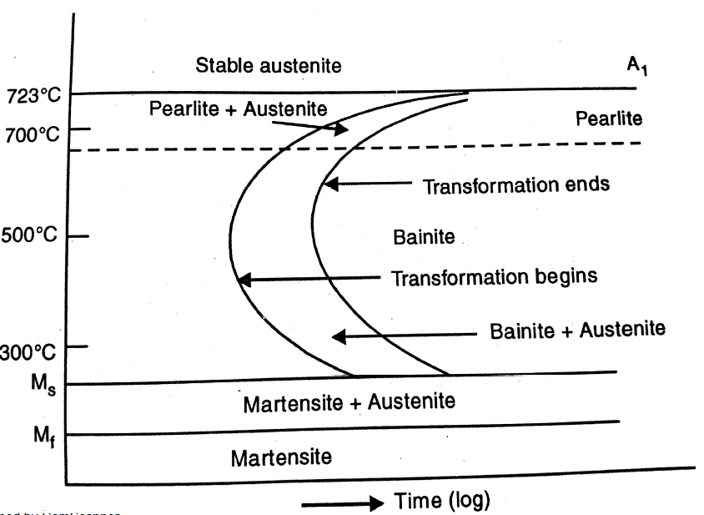
DUAL PHASE ALLOYS
The transformation to desired product is based on cooling rate in actual practice.
It can be depicted by use of two diagrams
Continuous cooling Transformation curve(CCT)
Time Temperature Transformation curve (TTT)

Slide 6
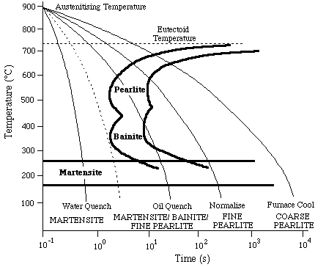
DUAL PHASE ALLOYS
Continuous Cooling Transformation:
An increase in carbon content shifts the CCT curves to the right (this corresponds to an increase in hardenability as it increases the ease of forming martensite - i.e. the cooling rate required to attain martensite is less severe).
An increase in carbon content decreases the martensite start temperature.
An increase in Mo content shifts the CCT curves to the right and also separates the ferrite + pearlite region from the bainite region making the attainment of a bainitic structure more controllable.

Slide 7
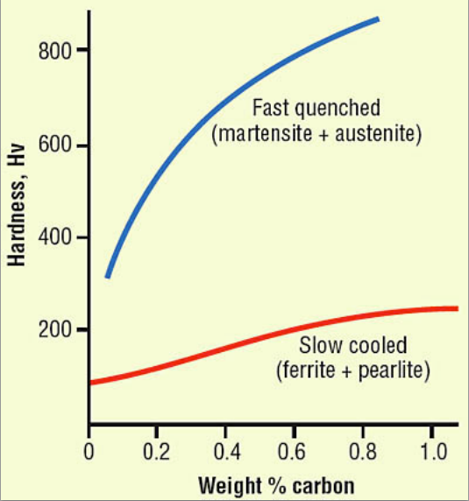
DUAL PHASE ALLOYS

Slide 8
DUAL PHASE ALLOYS
Advantages:
Low yield to tensile strength ratio (yield strength / tensile strength = 0.5)
High initial strain hardening rates
Good uniform elongation
A high strain rate sensitivity (the faster it is crushed the more energy it absorbs)
Good fatigue resistance
Due to these properties DPS(dual phase steel) is often used for automotive body panels, wheels, and bumpers

Slide 9
MICRO ALLOYED STEEL
It is a type of alloy steel that contains small amounts of alloying elements(0.05 to 0.15%).
Standard alloying elements include: niobium, vanadium, titanium, molybdenum, zirconium, boron, and rare-earth metals.
They are used to refine the grain microstructure and/or facilitate precipitation hardening.

Slide 10
MICRO ALLOYED STEEL
Advantages:
The alloy additions improve atmospheric corrosion resistance.
The primary purpose of these steels is weight reduction through increased strength.
The yield strength is usually in the range of 289 to 482MPa.
Weldability is good and can even be improved by reducing the carbon content while maintaining strength.

Slide 11
MICRO ALLOYED STEEL
Fatigue life and wear resistance are superior to similar heat treated steels.
micro alloyed steels are not quenched and tempered they are not susceptible to quench cracking, nor do they need to be straightened or stress relieved.
They are through hardened and do not have a softer and tougher core like quench and tempered steels
Disadvantages:
Ductility and toughness are not as good as normal carbon steel.

Slide 12
HIGH STRENGTH LOW- ALLOY STEELS
High-strength low-alloy (HSLA) steels, are designed to provide better mechanical properties than conventional carbon steels.
It is designed to meet specific mechanical properties rather than a chemical composition.
The chemical composition of a specific HSLA steel may vary for different product thickness to meet mechanical property requirements.
The HSLA steels have low carbon contents (less than 0.2% C) in order to produce adequate formability and weldability, and they have manganese contents up to 2.0 weight percent to produce solid solution strengthening of the ferrite.
They have a microstructure that consists of ferrite and pearlite.

Slide 13
HIGH STRENGTH LOW- ALLOY STEELS
Small quantities of chromium, nickel, molybdenum, copper, nitrogen, vanadium, niobium, titanium, and zirconium are used in various combinations for additional strengthening and other effects. This is called microalloying.
HSLA steels are not hardened by heat treatments. They are supplied and used in hot-finished conditions.

Slide 14
CLASSIICATIONS OF HIGH STRENGTH LOW- ALLOY STEELS
Weathering steels: steels which have better corrosion resistance.
Control-rolled steels: hot rolled steels which have a highly deformed austenite structure that will transform to a very fine equiaxed ferrite structure upon cooling.
Pearlite-reduced steels: low carbon content steels which lead to little or no pearlite, but rather a very fine grain ferrite matrix. It is strengthened by precipitation hardening.
Acicular ferrite steels: These steels are characterized by a very fine high strength acicular ferrite structure, a very low carbon content, and good hardenability.

Slide 15
CLASSIFICATIONS OF HIGH STRENGTH LOW- ALLOY STEELS (CONT…)
Dual-phase steels: These steels have a ferrite microstructure that contain small, uniformly distributed sections of martensite. This microstructure gives the steels a low yield strength, high rate of work hardening, and good formability.
Micro alloyed steels: steels which contain very small additions of niobium, vanadium, and/or titanium to obtain a refined grain size and/or precipitation hardening.

Slide 16
HIGH STRENGTH LOW- ALLOY STEELS
Advantages:
Higher strengths (upto 690MPa) are attainable by combinations of microalloying.
Good corrosion resistance.
Good formability
Acceptable weldability.
They provide significant weight reductions.

Slide 17
HIGH STRENGTH LOW- ALLOY STEELS
Applications:
Due to less carbon and alloy content these steels are primarily intended for structural-type applications in which weldability is a prime selection requirement.
Different alloying elements used in these steels will have a different effect in properties
Copper:
In small concentrations(<0.5%) it produces solid solution strengthening of ferrite and the atmospheric corrosion resistance of the steel can be improved.

Slide 18
HIGH STRENGTH LOW- ALLOY STEELS
They achieve improved corrosion resistance by the formation of tenacious oxide film.
Cr, Ni and P are usually used in these alloys to assist in the formation of the protective oxide film.
This film takes on the appearance of copper, but it really rust that does not crack and flake off like conventional rust.
Copper bearing HSLA steels are called weathering steels.

Slide 19
HIGH STRENGTH LOW- ALLOY STEELS
2. Niobium, Titanium, Vanadium & Nitrogen:
These are used as microalloying additions in a significant number of HSLA steels.
Their role is to form precipitates that restrict grain growth during hot rolling.
Concentrations of these elements are usually less than about 0.2%.Thus the use of these elements for strengthening does not significantly increase manufacturing costs.

Slide 20
HIGH STRENGTH LOW- ALLOY STEELS
3. Rare earth elements (Cerium, Lanthanum and Praseodymium):
These are used in HSLA steels to obtain shape control of sulfide and oxide inclusions.
These elements tend to combine with sulfides and oxides and essentially reduce their plasticity so that they do not elongate to form stringers during hot rolling.

Slide 21
HIGH STRENGTH LOW- ALLOY STEELS
4. Aluminium, Silicon & manganese:
These are used in HSLA steels for de-oxidation.
Silicon are used to dissolve iron and reduce chemical segregation in order to strengthen it.
Silicon also contributes to solid solution strengthening of ferrite.
Manganese is useful deoxidizer & desulphuriser as sulphides and oxygen are harmless and ductile.
Aluminium can control austenite growth in reheated steels to control grain size.

Slide 22
TRANSFORMATION INDUCED PLASTICITY STEEL
TRIP steel is a high strength steel typically used in the automotive industry.
TRIP steel has a triple phase microstructure consisting of ferrite, bainite and retained austenite.
During plastic deformation and straining, the metastable austenite phase is transformed into martensite. This transformation allows for enhanced strength and ductility.
the retained austenite is very finely dispersed in the ferrite phase. This fine dispersion allows TRIP steels to retain their strength. The transformation of austenite into martensite is almost instantaneous and completely diffusionless.
The strain level at which retained austenite begins to transform to martensite is controlled by adjusting the carbon content. At lower carbon levels, the retained austenite begins to transform almost immediately upon deformation, increasing the work hardening rate and formability during the stamping process. At higher carbon contents, the retained austenite is more stable and begins to transform only at strain levels beyond those produced during forming. At these carbon levels, the retained austenite persists into the final part. It transforms to martensite during subsequent deformation, such as a crash event.
Silicon and Aluminium are the two most common elements used to stabilize the austenite phase at room temperature.

Slide 23
TRANSFORMATION INDUCED PLASTICITY STEEL
In order to produce a strong and ductile TRIP steel, an intercritical annealing process is used to obtain the correct phase distribution.
the steel is brought to a temperature above the eutectoid, where the material is composed of a solid austenite phase and a solid ferrite phase.
The austenite phase is a high temperature solid phase which only exists in equilibrium at temperatures above 727 degrees Celsius.
The material is then isothermally cooled at a temperature of approximately 400 degrees Celsius, in order to allow the austenite to form a bainite ferrite phase.
In a typical steel alloy, the excess carbon would form a high carbon cementite phase. However, the silicon and aluminium prevent the formation of cementite. In consequence, the excess carbon diffuses to the remaining austenite phase.
The result of the intercritical annealing process is a material composed primarily of ferrite, and bainite formed from the austenite phase during intercritical annealing, as well as dispersed retained austenite, and martensite phases.

Slide 24
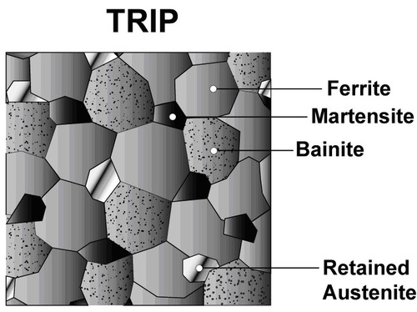
TRANSFORMATION INDUCED PLASTICITY STEEL

Slide 25
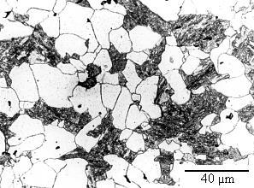
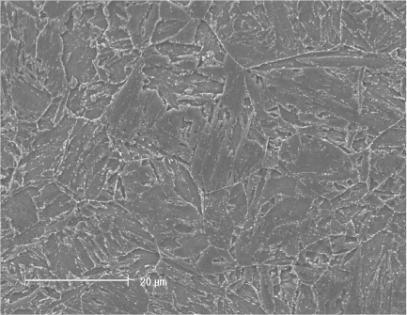
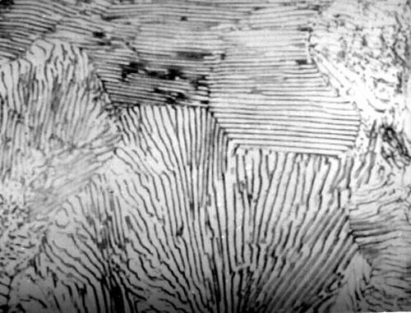
TRANSFORMATION INDUCED PLASTICITY STEEL
Bianite: Martensite:
Pearlite:

Slide 26
MARAGING STEEL
Maraging steels are low carbon, high-Nickel alloy steels capable of attaining yield strength in excess of 185 MPa in combination with good fracture toughness.
These alloys contain carbon about 0.02%, Nickel 18% , Cobalt 8% and molybdenum 5 % along with small amounts of titanium and aluminum as hardening agents.
Typical composition :
0.03% C, 18.5% Ni, 7.5% Co, 0.1% Al, 0.003% B, 0.1% Si, 4.8% Mo, 0.4%Ti, 0.01% Zr, 0.1% Mn, 0.01%S and 0.01%P
Super high strength alloy.
Good weldability.

Slide 27
MARAGING STEEL
This alloy is martensic in the annealed condition and acquires ultra high strength by an aging treatment.
The steel is first annealed at approximately 820 °C for 15 minutes to 30 minutes for thin sections and for 1 hour per 25 mm thickness for heavy sections, to ensure formation of a fully austenitized structure.
This is followed by air cooling to room temperature to form a soft, heavily dislocated iron-nickel lath (untwinned) martensite.
Subsequent aging (precipitation hardening) of the more common alloys for approximately 3 hours in the 480 °C to 500 °C range produces a fine dispersion of Ni3(X,Y) intermetallic phases along dislocations left by martensitic transformation, where X and Y are solute elements added for such precipitation.

Slide 28
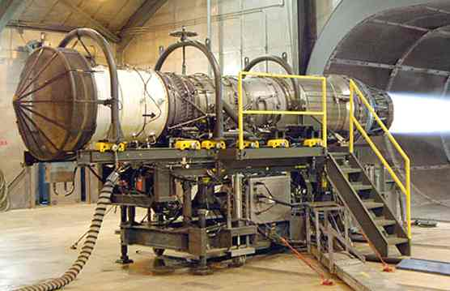
MARAGING STEEL
Overaging leads to a reduction in stability of the primary, metastable, coherent precipitates, leading to their dissolution and replacement with semi-coherent Laves phases such as Fe2Ni/Fe2Mo. Further excessive heat treatment brings about the decomposition of the martensite and reversion to austenite.

Slide 29
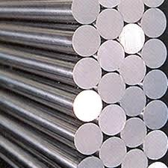
MARAGING STEEL
Maraging steels applications are aluminum die casting dies, inserts, cores, extrusion dies, forging dies, punches, cold heading dies, die holders etc.
Maraging steel's strength and malleability in the pre aged stage allows it to be formed into thinner rocket and missile skins, allowing more weight for payload while still possessing sufficient strength for the application. Maraging steels have very stable properties, and even after overaging, due to excessive temperature, only soften slightly. These alloys retain their properties at mildly elevated operating temperatures and have maximum service temperatures of over 400 °C (752 °F).

Slide 30
MARAGING STEEL
Properties:
Due to the low carbon content maraging steels have good machinability.
Maraging steels offer good weldability, but must be aged afterward to restore the properties of heat affected zone.
Non-stainless varieties of maraging steel are moderately corrosion-resistant, and resist stress corrosion.
Corrosion-resistance can be increased by cadmium plating or phosphating.

Slide 31
MARAGING STEEL
Applications:
Maraging steel's strength and malleability in the pre-aged stage allows it to be formed into thinner rocket and missile skins than other steels, reducing weight for a given strength.
They are suitable for engine components, such as crankshafts and gears, and the firing pins of automatic weapons that cycle from hot to cool repeatedly while under substantial load.
Stainless maraging steel is used in bicycle frames and golf club heads.

Slide 32
INTERMETALLICS
Intermetallic compounds are compounds that are formed by the combination of two metals.
They are not alloys.
Two metals chemically combine to form a chemical compound with a definite ratio of one element to the other.
FYI: A compound that forms in most steels is Fe₃C (Interstitial Metallic Compound).

Slide 33
INTERMETALLICS
Properties:
Sometimes they have metallic properties and sometimes they have properties that are like those of ceramic materials.
They are generally brittle and have high melting point.
They have desirable magnetic, superconducting and chemical properties.
EX:
Magnetic materials e.g. alnico; sendust; Permendur; FeCo; Terfenol-D
High-temperature structural materials e.g. nickel aluminide, Ni₃Al
Shape memory alloys e.g. Cu-Al-Ni (alloys of Cu₃Al and nickel); Nitinol (NiTi)
Hydrogen storage e.g. AB₅ compounds (nickel metal hydride batteries)

Slide 34
NICKEL ALUMINIDE (NI₃AL)
Nickel Aluminide alloys, in the form of Ni3Al, are a new class of intermetallics that offer improved high-temperature performance over traditional stainless steels and many nickel-based super alloys
Composition is 76% Ni and 24% Al.
This intermetallic has a face-center cubic structure like Ni and the aluminum atoms take up sites on the cube corners.
Having specific sites for an alloy additive produced what is called an ordered structure.
The unique feature of this is that its yield strength doubles(900MPa) as the temperature is raised to about 800ºC.
Unlike Most alloys does not get weaker as the temperature is raised. It does not have to be heat treated to develop high strength.
It is used for tough corrosion problems and for superalloy applications such as rotor vanes in jet engines.
It is used in sophisticated magnetic and electrical devices.
make it ideal for special applications like coating blades in gas turbines and jet engines.

Slide 35
TITANIUM ALUMINIDE
TiAl alloy is a new alloy based on intermetallic compounds and is characterized by the properties of light weight and high strength.
The two intermetallics of Ti are TiAl (60% Ti and 40% Al) and Ti₃Al (84%Ti and 16% Al). The alloys contain major titanium, 38 to 46 atom % aluminum, 5 to 10 atom % niobium, with small amounts of Cr, Si and Ni added according to required properties
They have attractive properties, such as the low density, excellent high-temperature strength, and good oxidation resistance(They have good corrosion resistance).
They have high specific strength.
They have good fatigue resistance.
They are used in high temperature applications (turbines and automotive applications).

Slide 36
SMART MATERIALS
Smart materials are materials that have more properties that can be significantly changed by external stimuli such as stress, light, temperature, moisture, pH, electric or magnetic fields.
Smart materials are those that change in response to changing conditions in their surroundings or by the application of other direct influences e.g. passing an electric charge through the material, or changing the pH of a surrounding aqueous solution.

Slide 37
SMART MATERIALS
The induced change might be electrical, mechanical-structural, optical, magnetic etc. to change the way the material functions in response to the stimulus.
In a 'nutshell' smart materials can change their state, and therefore their properties, in response to an external stimulus.
Smart materials are highly responsive and have a great capacity to sense and respond to any environmental change. Hence these materials are also known as “responsive materials”.

Slide 38
SMART MATERIALS
There is a huge variety of smart materials with different special properties that make a particular material well suited to a particular use.
Piezoelectric materials: Materials that produce a voltage when stress is applied. Since this effect also applies in the reverse manner, a voltage across the sample will produce stress within the sample. Suitably designed structures made from these materials can therefore be made that bend, expand or contract when a voltage is applied.

Slide 39
SMART MATERIALS
Shape memory alloys: Materials in which large deformation can be induced and recovered through temperature changes ,stress changes (pseudoelasticity) or change in magnetic field. The large deformation results due to martensitic phase change.
Magnetostrictive materials exhibit change in shape under the influence of magnetic field and also exhibit change in their magnetization under the influence of mechanical stress.

Slide 40
SMART MATERIALS
Temperature responsive polymers are materials which undergo changes upon temperature.
Halochromic materials are commonly used materials that change their color as a result of changing acidity.
Chromogenic systems change color in response to electrical, optical or thermal changes. These include electrochromic, thermochromic and photochromic materials.
Ferrofluid is a liquid which becomes strongly magnetized in the presence of magnetic field.

Slide 41
SMART MATERIALS
Photomechanical materials change shape under exposure to light.
Self-healing materials have the intrinsic ability to repair damage due to normal usage, thus expanding the material's lifetime.
Dielectric elastomers (DEs) are smart material systems which produce large strains (up to 300%) under the influence of an external electric field.
Thermoelectric materials are used to build devices that convert temperature differences into electricity and vice-versa.

Slide 42

SMART MATERIALS

Slide 43
SMART MATERIALS

Slide 44
SMART MATERIALS
Applications:
Automotive industry.
Structural engineering
Aerospace industry
Marine
Biomedical engineering
Dentistry
Computer and other electronic devices

Slide 45
SHAPE MEMORY ALLOYS
Shape Memory Alloys (SMAs) are metallic alloys that undergo a solid-to-solid phase transformation which can exhibit large recoverable strains. Example: Nitinol, Cu-Al-Ni alloy
Austenite
High temperature phase
Cubic Crystal Structure
Martensite
Low temperature phase
Monoclinic Crystal Structure

Slide 46
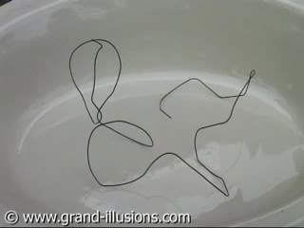
SHAPE MEMORY ALLOYS

Slide 47
SMART MATERIALS

Slide 48
SHAPE MEMORY ALLOYS
The transition from martensite phase to austenite phase is only dependant on temperature and stress, not time.
It is the reversible diffusion less transition between these two phases that results in special properties.
Shape memory alloys have different shape memory effects. Two common effects are one way effect and two way shape memory effect.

Slide 49
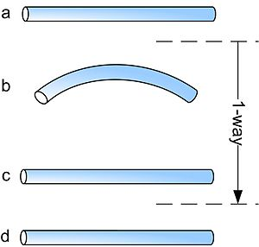
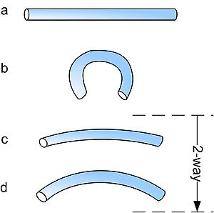
SHAPE MEMORY ALLOYS
The procedures are very similar: starting from martensite(a), adding a reversible deformation for the one-way effect or severe deformation with an irreversible amount for the two-way (b), heating the sample (c) and cooling it again (d). For one way it retains the staight shape but twoway starts to deform again to its second shape

Slide 50
SMA-ONE WAY MEMORY EFFECT
When a shape-memory alloy is in its cold state (below A_{s}), the metal can be bent or stretched and will hold those shapes until heated above the transition temperature.
Upon heating, the shape changes to its original. When the metal cools again it will remain in the hot shape, until deformed again.
A deformation is necessary to create the low-temperature shape.

Slide 51
SMA-TWO WAY MEMORY EFFECT
The two-way shape-memory effect is the effect that the material remembers two different shapes: one at low temperatures, and one at the high-temperature shape.
A material that shows a shape-memory effect during both heating and cooling is called two-way shape memory.
This can also be obtained without the application of an external force

Slide 52
SMA-TWO WAY MEMORY EFFECT
Under normal circumstances, a shape-memory alloy "remembers" its high-temperature shape, but upon heating to recover the high-temperature shape, immediately "forgets" the low-temperature shape.
It can be "trained" to "remember" to leave some reminders of the deformed low-temperature condition in the high-temperature phases.
A shaped, trained object heated beyond a certain point will lose the two-way memory effect, this is known as "amnesia“.

Slide 53
SHAPE MEMORY ALLOYS
The special property that allows shape-memory alloys to revert to their original shape after heating is that their crystal transformation is fully reversible.
A reversible transformation does not involve this diffusion of atoms, instead all the atoms shift at the same time to form a new structure.

Slide 54
SHAPE MEMORY ALLOYS
Shape-memory alloys are typically made by casting, using vacuum arc melting or induction melting.
There are specialist techniques used to keep impurities in the alloy to a minimum and ensure the metals are well mixed.
The way in which the alloys are "trained" depends on the properties wanted.

Slide 55
SHAPE MEMORY ALLOYS
Properties:
The yield strength of shape-memory alloys is lower than that of conventional steel, but some compositions have a higher yield strength than plastic or aluminum.
The yield stress for Ni Ti can reach 500 MPa.
High level of recoverable plastic strain that can be induced. The maximum recoverable strain these materials can hold without permanent damage is up to 8% for some alloys. This compares with a maximum strain 0.5% for conventional steels.

Slide 56
SHAPE MEMORY ALLOYS
Applications:
Aircraft industry(Variable geometry chevron that reduces aircraft’s engine noise)
Automotive industry (Shape memory coupling for piping)
Telecommunication(Autofocus actuator for a smart phone)
Robotics
Medicine(Optometry, Orthopedic surgery, Dentistry)

Slide 57
METALLIC GLASSES
Metallic glasses are amorphous metallic solids have high strength, magnetic properties, better corrosion resistance and will possess both the properties of metals and glasses.
Metals are made into glassy state by increasing the rate of cooling to very high level 2×10^{6 o}C/sec. Due to this the atoms are unable to arrange in a proper manner and form a new amorphous state.
The materials formed by the rapid cooling technique are called metallic glasses.

Slide 58
METALLIC GLASSES
The temperature at which the metals in the molten form transforms into glasses is called glass transition temperature.
It is a pseudo second order phase transition.

Slide 59
METALLIC GLASSES
1.Structural properties:
It does not have any crystal defects.
2. Mechanical properties:
They are strong in nature.
They have high corrosion resistance.
They have very good malleability and ductility.

Slide 60
METALLIC GLASSES
3. Magnetic properties:
They can be easily magnetized and demagnetized.
They have narrow hysteresis loop.
4. Electrical properties:
High electrical resistance and it will not vary with temperature.
Low eddy current losses.

Slide 61
METALLIC GLASSES
Applications:
Since they are malleable and ductile they are used in filament winding.
As they are strong they are used to manufacture different kinds of springs.
They have corrosion resistance they can be used in surgical clips and marine vessels.
They behave as superconductors hence they are used in production of high magnetic field.
They are not affected by magnetic radiation they are used in nuclear reactors.

Slide 62
QUASICRYSTAL
Quasicrystals are structural forms that are ordered but not periodic.
They form patterns that fill all the space but lack translational symmetry.
Classical theory of crystals allows only 2, 3, 4,and 6-fold rotational symmetries, but quasicrystals display symmetry of other orders (folds).
Just like crystals, quasicrystals produce Bragg diffraction, but where crystals have a simple repeating structure, quasicrystals are more complex.

Slide 63
QUASICRYSTAL
 | ORDERED | PERIODIC
CRYSTAL | ✓ | ✓
QUASICRYSTAL | ✓ | ×
AMORPHOUS | × | ×

Slide 64
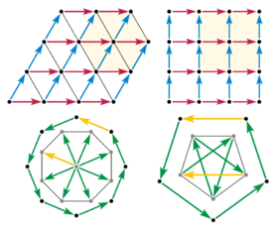
QUASICRYSTAL

Slide 65
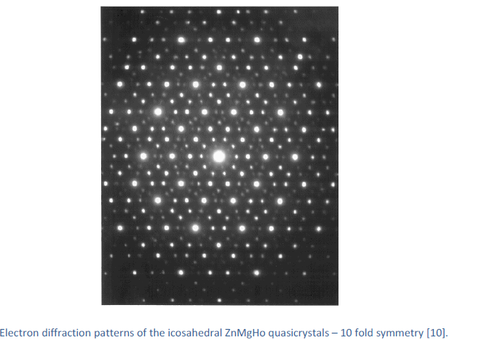

QUASICRYSTAL

Slide 66

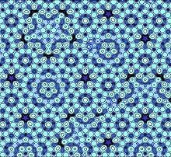
QUASICRYSTAL
Atomic model of an aluminium-palladium-manganese (Al-Pd-Mn) quasicrystal surface.
The pattern is called a quasicrystal because it has an ordered structure, but the structure never repeats exactly. The waves produced by dropping four or more stones into a pond always form a quasicrystal.

Slide 67
QUASICRYSTAL
Classification of quasicrystals:
Based on structure:
Quasiperiodic in two dimensions (polygonal or dihedral quasicrystals) - There is one periodic direction perpendicular to the quasiperiodic layers.
Octagonal quasicrystals with local 8-fold symmetry [primitive & body-centered lattices]
Decagonal quasicrystals with local 10-fold symmetry [primitive lattice]
Dodecagonal quasicrystals with local 12-fold symmetry [primitive lattice]

Slide 68
QUASICRYSTAL
quasiperiodic in three dimensions - no periodic direction
icosahedral quasicrystals with 5-fold symmetry [primitive, body-centered & face-centered lattices]
icosahedral quasicrystal with broken symmetry.

Slide 69
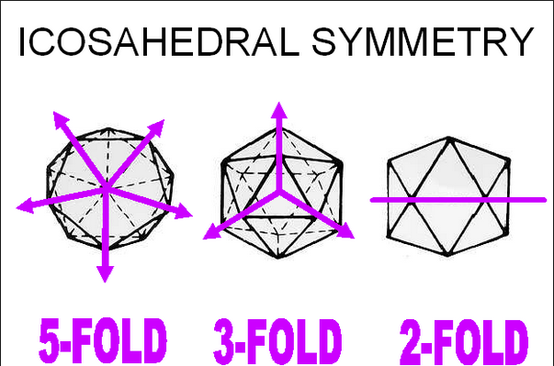

Slide 70
QUASICRYSTAL
Based on thermal stability:
stable quasicrystals grown by slow cooling or casting with subsequent annealing,
metastable quasicrystals prepared by melt-spinning, and
metastable quasicrystals formed by the crystallization of the amorphous phase.

Slide 71
QUASICRYSTAL
Examples of quasicrystals:
Icosahedral quasicrystals (5-fold symmetry: Al-Pd-Mn, Al-Cu-Fe, Ag-In-Yb),
Decagonal quasicrystals (10-fold symmetry: Al-Co-Ni, Al₅Ir),
Octagonal quasicrystals (8-fold symmetry: Mn₄Si, Cr₅Ni₃Si₂).
Dodecagonal quasicrystals (12-fold symmetry: V₃Ni₂, Cr_{70.6}Ni_{29.4}).

Slide 72
PROPERTIES OF QUASICRYSTALS
High electrical and thermal resistivity.
The coating of QC on bulk metallic parts act as an efficient thermal barrier layer for engines.
The electrical behavior of QC leads to class of related properties involving the Hall effect, thermo electric power, magnetic susceptibility, and optical conductivity.
Thermoelectric power coefficients for QC are quite large.

Slide 73
PROPERTIES OF QUASICRYSTALS
Regarding corrosion resistance, QC can be compared quite well with stainless steel: their performance is ranked between austenitic and ferritic steels
Low thermal conductivity and corrosion resistance become especially useful at high temperatures when quasicrystalline coatings are superplastic. Rocket motors and aero-engine turbine would benefit from this technology.

Slide 74
APPLICATIONS OF QUASICRYSTALS
WEAR RESISTANT COATING (Al-Cu-Fe-(Cr))
NON-STICK COATING (Al-Cu-Fe)
THERMAL BARRIER COATING (Al-Co-Fe-Cr)
HIGH THERMOPOWER (Al-Pd-Mn)
IN POLYMER MATRIX COMPOSITES (Al-Cu-Fe)
SELECTIVE SOLAR ABSORBERS (Al-Cu-Fe-(Cr))
HYDROGEN STORAGE (Ti-Zr-Ni)

Slide 75
QUASICRYSTAL
The Fibonacci sequence has a curious connection with quasicrystals* via the GOLDEN MEAN (τ)
Fibonacci→1 1 2 3 5 8 13 21 34... ∞
Ratio→1/1 2/1 3/2 5/3 8/5 13/8 21/13 34/21... τ = ( 1+√5)/2

Slide 76
NANO CRYSTAL
Nano-crystalline material are poly crystalline materials with grain size of up to about 100nm.
A nano-structure is an object of intermediate size between molecular and microscopic(micrometer-sized) structures.
In describing nano-crystalline structures it is necessary to differentiate between the numbers of dimensions on the nanoscale.

Slide 77
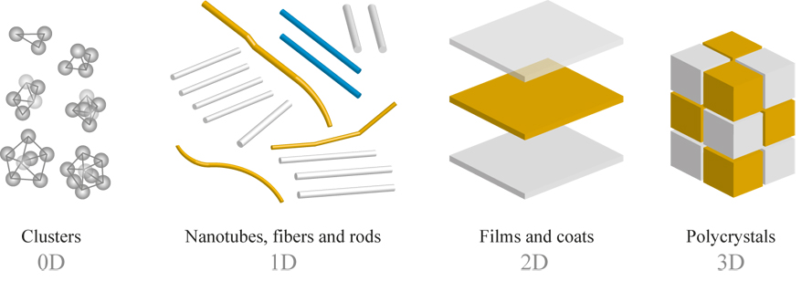
TYPES OF NANO CRYSTALS

Slide 78
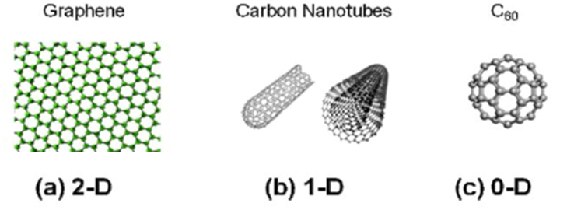
TYPES OF NANO CRYSTALS

Slide 79
TYPES OF NANO CRYSTALS
zero-dimensional (0D), one-dimensional (1D), two-dimensional (2D) and three-dimensional (3D) nanomaterials.
Zero-dimensional nanomaterials include nanocluster materials and nanodispersions, i.e. materials in which nanoparticle are isolated from each other.
One-dimensional nanomaterials are nanofibre (nanorod) and nanotubular materials with fibre (rod, tube) length from 100 nm to tens of microns
Two-dimensional nanomaterials are films (coatings) with nanometer thickness.
Three-dimensional nanomaterials include powders, fibrous, multilayer and polycrystalline materials in which the 0D, 1D and 2D structural elements are in close contact with each other and form interfaces.

Slide 80
PROPERTIES OF NANOCRYSTALLINE MATERIALS
Increased strength/hardness
Enhanced diffusivity
Improved ductility/toughness
Reduced density
Reduced modulus
Higher electrical resistance
Increased specific heat
Higher thermal expansion coefficient
Lower thermal conductivity
Superior soft magnetic properties
Improved magnetic properties

Slide 81
APPLICATIONS OF NANOCRYSTALS
Cutting tools, wear resistant
Pigments paints
Biosensors detectors
Functional fluids
Pharmaceuticals and drugs
Nanobiomaterials, magnetics
Nanoparticles, films In electronic

Slide 82
APPLICATIONS OF NANOCRYSTALS
Jewelry, optical semiconductors
Drug delivery, wound healing
Flame retardants additives
Propellants nozzles additives
Nanopower ,Nanoelectrical
Fast switches sensors
Current applications in nanotechnology and a timeline of events for future direction – High-resolution displays

