Slide 1
CHAPTER 5
NON METALLIC MATERIALS

Slide 2
POLYMERIC MATERIALS
The “Polymer” can be broken down to “poly” as in “many units” and “monomer” which stands for a single unit and hence a polymeric material is one in which many units are joined together by chemical reactions to form the polymeric material.
Characteristics of polymeric materials :-
Low density
Good corrosion resistance
Low coefficient of friction
Good mouldability
Excellent surface finish
Highly economical
Can be produced with close dimensional tolerance

Slide 3
FORMATION OF POLYMERIC STRUCTURE
“Polymerization” may be defined as the process of forming large molecules from small ones.
Polymerization links monomers together.
There are 3 mechanisms of polymerization
Addition Polymerization
Copolymerization
Condensation polymerization

Slide 4
ADDITION POLYMERIZATION
The polymer is produced by adding a second monomer to the first, and then a third monomer to the dimer, a fourth to a trimer and so on until a long polymeric chain is obtained.
The mechanism is as follows :
Initiation : This step involves the dissociation of an initiator or catalyst into two free radicals (R*),
Dissociation : I -> 2R*
And addition to the monomer molecule M to form an active radical.
Initiation : R* + M -> R-M*
Chain Propagation : This step involves the growth of the polymeric chain resulting in successive addition of other monomers to the active group.
Propagation: R-M* + M -> R-M-M* -> R-……M*
Termination :This step may take place because of the collision between the active ends of two growing chains resulting in their combination.
Termination: R….M*+ *M…..R->R….M-M…..R

Slide 5
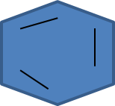
COPOLYMERIZATION REACTION
Copolymerization is another kind of addition polymerization.
Many monomers will not polymerize with themselves , but will polymerize with other compounds.
Copolymerization is the addition polymerization of two or more different monomers.
Consider the following example to understand the above :
CH₂=CH-CH=CH₂+CH=CH₂ -> … -CH₂-CH=CH-CH₂-CH-CH₂- …

Slide 6
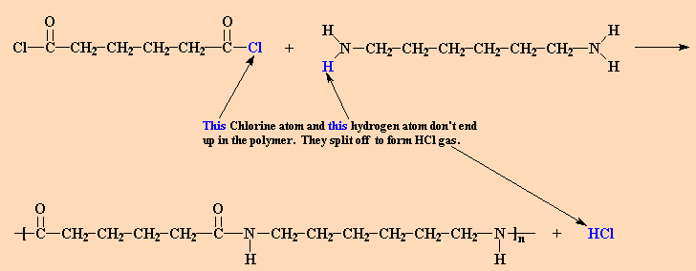
CONDENSATION POLYMERIZATION
Condensation polymerization occurs in the combination of a compound with itself or other compounds, accompanied by the elimination of some simple compound molecules such as H₂0, or HCl etc. , thus resulting in the formation of the required polymer.
Example could be the nylon 6,6 is made from adipoyl chloride and hexamethylene diamine, the chlorine atoms from the adipoyl chloride, each along with one of the amine hydrogen atoms, are expelled in the form of HCl gas.

Slide 7
PRODUCTION TECHNIQUES OF FIBERS, COATING, FOAM, ADHESIVES
Fibers :They are those that can be drawn into thin and long filaments at least at 100 :1 length to diameter ratio. They are mainly used in the textile industries .
They have high tensile strength ,high abrasion resistance and modulus of elasticity
They can also be subjected to various mechanical deformations such as the following :-
Stretching
Twisting
Shearing
Abrasion

Slide 8
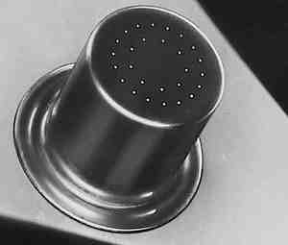
FORMING TECHNIQUES OF FIBERS
The process by which fibers are formed from bulk polymer material is called as spinning.
Most often the fibers are spin from the molten state in a process called melt spinning.
The material to be spin is initially heated until it forms a relatively viscous liquid.
Next it is pumped through a plate called as the spinneret , which contains many small and round holes.

Slide 9
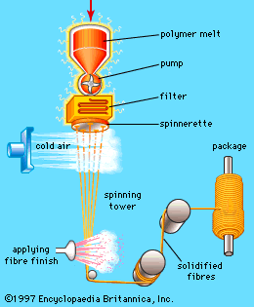
As the molten liquid passes through each hole the fiber is formed which solidifies immediately upon passing into the air. The strength of the fiber is usually increased by a post forming process called as drawing.
Drawing is simply the mechanical elongation of the fiber in the direction of its axis.
During this process the molecular chains become oriented in the direction of drawing such that the tensile strength, modulus of elasticity, and toughness are improved.

Slide 10
COATINGS
It is a layer of an inert substance relatively, on the surface of the component , and it usually minimizes the chemical or electrochemical attack ( on the component material ) by the service environment.
Some of the functions of Coatings are listed down as follows :
To protect the item from the environment that may produce corrosive or deteriorative reactions.
To improve the item’s appearance
To provide electrical Insulation
Coatings can be applied on the component depending on its type:
Metallic coating
Inorganic coating etc

Slide 11
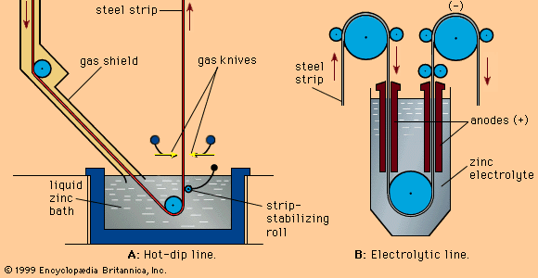
METALLIC COATINGS
Hot dipping : Involves immersing the product in the molten bath of the coating metal
Electroplating : It means electrodepositing the protective metal on the surface to be protected.

Slide 12
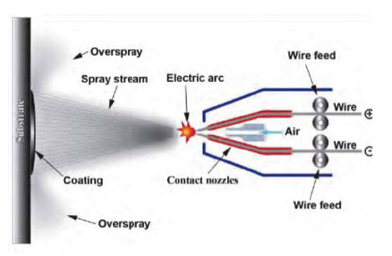
METALLIC COATINGS
Metal Spraying :The surface to be coated is exposed to a fine spray of coating metal from a filler wire ( or powder ) volatized in a high temperature flame or with the help of a spray gun.

Slide 13
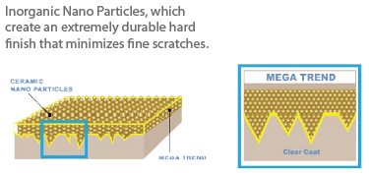
INORGANIC COATINGS
Chemical or electrochemical conversion coating .They are inorganic barriers produced by chemical or electrochemical reactions with the surface of the metal to be protected.
Other types of coatings that are applied are vitreous coating, organic coatings, etc.

Slide 14
ADHESIVES
An adhesive could be defined as any substance capable of holding materials together by surface attachment.
They are basically used to join two solid materials , as a thin uniform layer.
They have the advantage over the other joining methods in that they can be applied for any surface of material.
Some of the various types of adhesives are as follows :
Contact adhesives: Contact adhesives are used in strong bonds with high shear-resistance like laminates, such as bonding Formica to a wooden counter, and in footwear, as in attaching outsoles to uppers. Contact adhesives must be applied to both surfaces and allowed some time to dry before the two surfaces are pushed together. Some contact adhesives require as long as 24 hours to dry before the surfaces are to be held together.

Slide 15
Hot adhesives: Hot adhesives, also known as hot melt adhesives, are thermoplastics applied in molten form (in the 65-180 °C range) which solidify on cooling to form strong bonds between a wide range of materials.
Multi-part adhesives: Multi-partadhesives harden by mixing two or more components which chemically react. This reaction causes polymers to cross-link into acrylics, urethanes, and epoxies.
There are several commercial combinations of multi-component adhesives in use in industry. Some of these combinations are:
Polyester resin – polyurethane resin
Polyols – polyurethane resin
Acrylic polymers – polyurethane resins

Slide 16
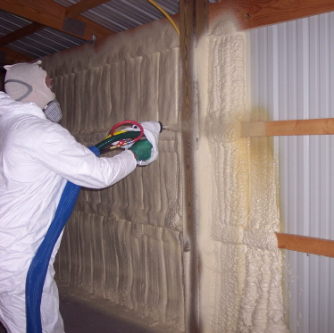
FOAMS
Very porous materials are produced in a process called foaming.
Both thermoplastic and thermosetting materials may be foamed by including in the batchin a lowing agent that upon heating, decomposes with the liberation of a gas.
Gas bubbles are generated throughout the non-fluid mass, which remain as pores upon cooling and give rise to a sponge-like structure.
The same effect is produced by bubbling an inert gas through a material while it is in a molten state.
Some of the commonly foamed polymers are polyurethane, rubber, polystyrene, and PVC (Poly-vinyl Chloride)
Foams are used as cushions in automobiles and furniture as well as in packaging and thermal insulation .
Wood being foamed

Slide 17
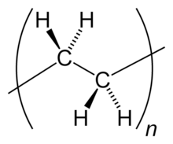
VARIOUS POLYMERS
Polythene :Polyethylene (abbreviated PE) or polythene (IUPAC name polyethene or poly(methylene)) is the most common plastic. Many kinds of polyethylene are known, but they almost always have the chemical formula (C₂H₄)nH_{2.}
Properties :
Polyethylene is a thermoplastic polymer consisting of long hydrocarbon chains.
Have excellent chemical resistance.
It is also resistant to gentle oxidants and reducing agents.
The melting point for average, commercial, low-density polyethylene is typically 105 to 115 °C (221 to 239 °F).
Repeating unit in PE

Slide 18
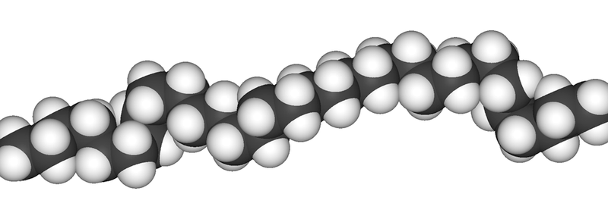
Applications :
In its foam form, polyethylene is used in packaging, vibration damping and insulation, as a barrier or buoyancy component, or as material for cushioning.
Many types of polyethylene foam are approved for use in the food industry. Found in all types of packaging, polyethylene foam is used to wrap furniture, computer components, electronics, sporting goods, plants, frozen foods, clothing, bowling balls, signs, metal products, and more.
Space filled model of PE

Slide 19
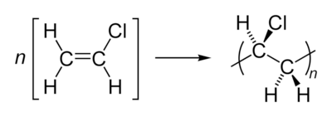
Poly vinyl Chloride (PVC) :Polyvinyl chloride, commonly abbreviated PVC, is the third-most widely produced plastic, after polyethylene and polypropylene.
Properties :
PVC is a thermoplastic polymer.
PVC is a useful material because of its inertness and this inertness is the basis of its low toxicity
PVC is a material resistant to ignition due to its chlorine content.
PVC products can last up to 100 years and even more.
Applications :
It is used for sewerage pipes
PVC is commonly used as the insulation on electrical cables
PVC has become widely used in clothing, to either create a leather-like material or at times simply for the effect of PVC.
Polymerization reaction for PVC from vinyl chloride

Slide 20
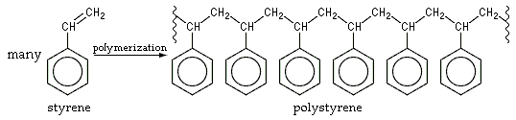
Polystyrene :
Polystyrene (PS) also known as Thermocole, abbreviated following ISO Standard PS, is an aromatic polymer made from the monomer styrene.
Properties :
Polystyrene is hard and brittle
Polystyrene is chemically nonreactive
Polystyrene is flexible and can be made into moldable solid or thick viscous solids
It is highly flammable and burns with an orange yellow flame, giving off soot
Applications :
Used to make containers for other chemicals, solvents and even food items
Is used in casting and moulding

Slide 21
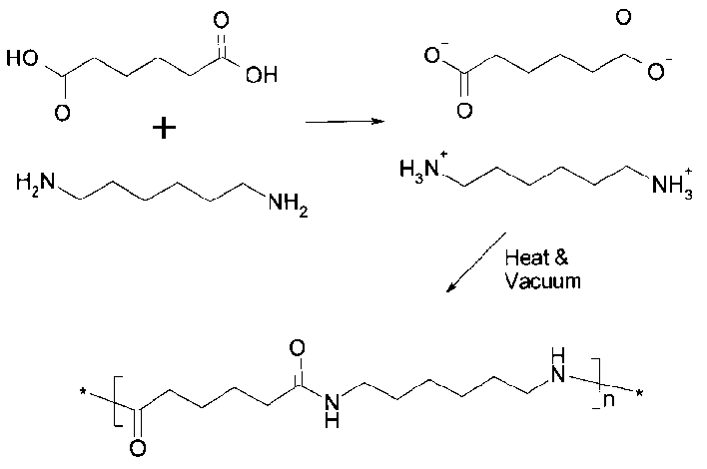
Nylon 6,6 :
Nylon 6,6 is made of hexamethylenediamine and adipic acid, which give nylon 6,6 a total of 12 carbon atoms in each repeating unit, and its name.
Properties :
Nylon 6,6 has a melting point of 265°C, high for a synthetic fiber, though not a match for polyesters or aramids such as Kevlar. This fact makes it resistant to heat and friction.
Its long molecular chain results in more sites for hydrogen bonds, creating chemical “springs”, making it very resilient.
Applications :
It is used for manufacturing the following products :
Carpet fiber
Airbags
Tires
Ropes

Slide 22
Teflon : Polytetrafluoroethylene (PTFE) is a synthetic fluoropolymer of tetrafluoroethylene that finds numerous applications.
Properties :
PTFE is a thermoplastic polymer
It has a low coefficient of friction
PTFE has excellent dielectric properties
It has a high melting point .
Applications :
Used in those components where sliding or action occurs such as plain bearings, gears, slide plates
They are used in solid rocket fuel propellants
PTFE membrane filters are among the most efficient used in industrial air filtration applications

Slide 23

Dacron / Terylene :Polyethylene terephthalate commonly abbreviated PET, PETE, or the obsolete PETP or PET-P, is a thermoplastic polymer resin of the polyester family.
Properties :
It is strong and impact-resistant.
It is light weight .
Applications :
It is used as a fiber.
It is used in bottle making
Structure of Dacron/PET

Slide 24
ADVANCED STRUCTURE CERAMICS
Ceramics comes from the Greek word Keramos which refers to burnt stuff.
Ceramics are basically defined as inorganic, non-metallic materials that are processed and/or at high temperatures.
They have been subject to a heat treatment.
They are generally brittle materials that withstand compression very well but do not hold well under tension when compared to metals.
The nature of the chemical bonds in ceramics are ionic in character , and the anions help in determining the properties of the ceramic material .
Ceramics are broadly classified as follows :
White ware , which includes china and porcelain
Structural clay products
Glass
Refractory Materials which are capable of withstanding very high temperatures.

Slide 25
TUNGSTEN CARBIDE
Tungsten carbide (WC) is an inorganic chemical compound (specifically, a carbide) containing equal parts of tungsten and carbon atoms
In its most basic form, tungsten carbide is a fine gray powder, but it can be pressed and formed into shapes for use in industrial machinery, cutting tools, abrasives, other tools and instruments, and jewelry.
Properties:
Tungsten carbide is high melting
It is extremely hard
It has two structures, the alpha (hexagonal) and the beta structures ( cubic high-temperature form - Rock salt structure).
Applications :
Hard carbides, especially tungsten carbide, are used by athletes, generally on poles which strike hard surfaces.
It is also used for making surgical instruments meant for open surgery
Tungsten carbide, also called cemented carbide, has become a popular material in the bridal jewelry
Tungsten carbide is sometimes used to make the rotating ball in the tips of ballpoint pens

Slide 26
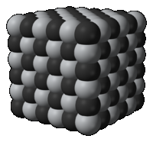
TITANIUM CARBIDE
Titanium carbide, TiC, is an extremely hard (Mohs 9-9.5) refractory ceramic material, similar to tungsten carbide.
Properties :
resistance to wear, corrosion
Applications:
It is used to make tool bits
It is used in cermet preparation.
It is used in scratch proof watches.
It is used as a heat shield in space crafts
Structure of TiC

Slide 27
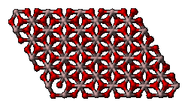
ALUMINIUM OXIDE
Aluminium oxide is an amphoteric oxide with the chemical formula Al₂O₃. It is commonly referred to as alumina (α-alumina), aloxide, or corundum in its crystalline form.
Properties:
Aluminium oxide is an electrical insulator .
It can react with both acids and bases
Applications :
Being fairly chemically inert and white, alumina is a favored filler for plastics
Alumina catalyses a variety of reactions that are useful industrially.
Alumina is widely used to remove water from gas streams.
Used as an abrasive
Structure of Aluminium Oxide

Slide 28
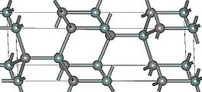
SILICON CARBIDE (SIC)
Silicon carbide (SiC), also known as carborundum, is a compound of silicon and carbon with chemical formula SiC.
It occurs in nature as the extremely rare mineral moissanite.
Properties:
Pure SiC is colorless
It is also highly inert chemically. There is currently much interest in its use as a semiconductor material in electronics, where its high thermal conductivity, high electric field breakdown strength
Has a low coefficient of thermal expansion
Applications:
Used in Abrasive and cutting tools
Used to manufacture automobile parts
Used in lightning arresters

Slide 29
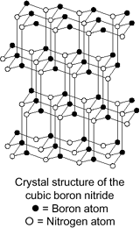
CUBIC BORON NITRIDE
Cubic Boron Nitride (cBN) is second in hardness only to diamond.
Properties:
Its usefulness arises from its insolubility in iron, nickel, and related alloys at high temperatures, whereas diamond is soluble in these metals to give carbides.
Has the highest thermal conductivity
Has the highest electrical conductivity
Applications :
It is used an abrasive
It is used for machining steel specifically
Are used to form the tool bit for cutting tools

Slide 30
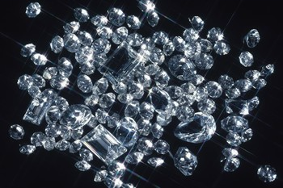
DIAMOND
In mineralogy, diamond is an allotrope of carbon, where the carbon atoms are arranged in a variation of the face-centered cubic crystal structure called a diamond lattice
Diamond is less stable than graphite, but the conversion rate from diamond to graphite is negligible at ambient conditions
Most natural diamonds are formed at high temperature and pressure at depths of 140 to 190 kilometers (87 to 120 mi) in the Earth mantle
Properties:
Has extremely high hardness
Has a high thermal conductivity
Has good optical characteristics
Diamond is chemical non-reactive
They form excellent insulators
Applications :
It is mainly used in jewelry.
Can be used in making Diamond blades.

Slide 31
COMPOSITE MATERIALS
Composite materials, often shortened to composites or called composition materials, are engineered or naturally occurring materials made from two or more constituent materials with significantly different physical or chemical properties which remain separate and distinct within the finished structure.
Metals, ceramics, glasses, polymers and cement can be combined in composite materials to produce unique characteristics such as toughness and high temperature strength and so on .
A very common example of a composite material would be the fiber-glass-reinforced plastic which is commonly used for the household goods and in many industrial applications.
Many composite materials are composed of just two phases; one is termed as the matrix and the other is termed as the dispersed phase.

Slide 32
CLASSIFICATION OF COMPOSITE MATERIALS
COMPOSITES
Particle reinforced
Fiber-reinforced
Structural
Large particle
Dispersion-strengthened
Continuous
Discontinuous
Laminates
Sandwich panels
Aligned
Randomly oriented

Slide 33
COMPOSITES
A composite material consists of two phases:
• Primary
– Forms the matrix within which the secondary phase is imbedded
– Any of three basic material types: polymers, metals, or ceramics
• Secondary
– Referred to as the imbedded phase or called the reinforcing
– Serves to strengthen the composite (fibers, particles, etc.)
– Can be one of the three basic materials or an element such as carbon or boron

Slide 34
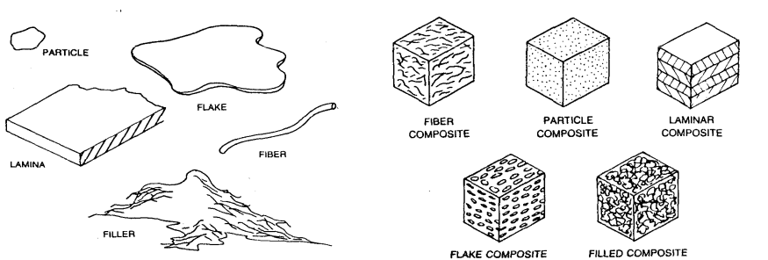
TYPES OF COMPOSITE MATERIALS
There are five basic types of composite materials: Fiber, particle, flake, laminar or layered and filled composites.

Slide 35
CLASSIFICATION OF COMPOSITE MATERIAL
• Metal Matrix Composites (MMCs)
– Mixtures of ceramics and metals, such as cemented carbides and
other cermets
– Aluminum or magnesium reinforced by strong, high stiffness fibers
• Ceramic Matrix Composites (CMCs)
– Least common composite matrix
– Aluminum oxide and silicon carbide are materials that can be
imbedded with fibers for improved properties, especially in high
temperature applications
• Polymer Matrix Composites (PMCs)
– Thermosetting resins are the most widely used polymers in PMCs.
– Epoxy and polyester are commonly mixed with fiber reinforcement

Slide 36
FUNCTION OF MATRIX
Matrix material serves several functions in the
composite
– Provides the bulk form of the part or product
– Holds the imbedded phase in place
– Shares the load with the secondary phase

Slide 37
THE REINFORCING PHASE
• The imbedded phase is most commonly one of the following shapes:
– Fibers, particles, flakes
• Orientation of fibers:
– One dimensional: maximum strength and stiffness are obtained in the direction of the fiber
– Planar: in the form of two-dimensional woven fabric
– Random or three-dimensional: the composite material tends to posses isotropic properties
Some reinforcing example
Carbon/Graphite –Graphite has a tensile strength three to five times stronger than steel and has a density that is one-fourth that of steel.
Boron – Very high elastic modulus, but its high cost limits its application to aerospace components
Ceramics – Silicon carbide (SiC) and aluminum oxide (Al2O3) are the main fiber materials among ceramics. Both have high elastic moduli and can be used to strengthen low-density, low- modulus
metals such as aluminum and magnesium
Metal – Steel filaments, used as reinforcing fibre in plastics

Slide 38
PRODUCTION TECHNIQUES
In general, the reinforcing and matrix materials are combined, compacted and processed to undergo a melding event.
Some of the moulding methods are as follows
Vacuum bag moulding
Pressure bag moulding
Resin transfer moulding (RTM)

Slide 39
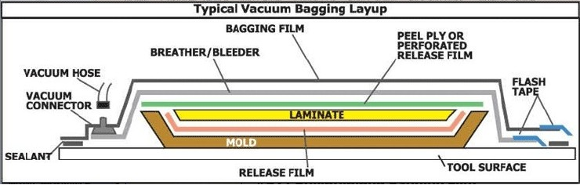
VACUUM BAG MOULDING
A process using a two-sided mould set that shapes both surfaces of the panel.
On the lower side is a rigid mould and on the upper side is a flexible membrane or vacuum bag.
The flexible membrane can be a reusable silicone material or an extruded polymer film. Then, vacuum is applied to the mould cavity.
A vacuum bag is a bag made of strong rubber-coated fabric or a polymer film used to or laminate materials.
The open end is sealed and the air is drawn out of the bag through a nipple using a vacuum pump.
As a result, uniform pressure approaching one atmosphere is applied to the surfaces of the object inside the bag, holding parts together while the adhesive cures
Layers from bottom include: mold, mold release, composite, peel-ply, breather cloth, vacuum bag, also need vacuum valve, sealing tape.
Vacuum bagging is widely used in the composites industry as well. Carbon fiber fabric and fiberglass, along with resins and epoxies are common materials laminated together with a vacuum bag operation.

Slide 40
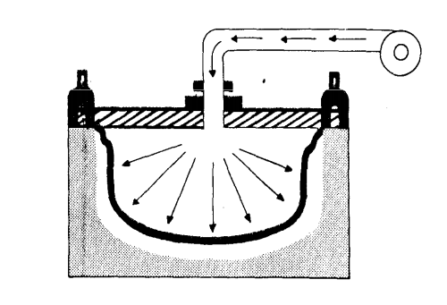
PRESSURE BAG MOULDING
Pressure–bag process is virtually a mirror image of vacuum–bag molding. A solid female mould is used along with a flexible male mould.
The reinforcement is placed inside the female mould with just enough resin to allow the fabric to stick in place (wet lay up).
A measured amount of resin is then liberally brushed indiscriminately into the mould and the mould is then clamped to a machine that contains the male flexible mould.
The flexible male membrane is then inflated with heated compressed air or possibly steam.
The female mould can also be heated. Excess resin is forced out along with trapped air. This process is extensively used in the production of composite helmets due to the lower cost of unskilled labor.
Cycle times for a helmet bag moulding machine vary from 20 to 45 minutes, but the finished shells require no further curing if the moulds are heated.
Applications are sonar domes,antenna housings, aircraft fairings, etc.

Slide 41
RESIN TRANSFER MOULDING
The two sides fit together to produce a mould cavity.
In a tool, consisting of an upper (1) and a lower mold (2), is a cavity in the shape of the final product saved.
In the cavities, a release agent and a gel coat is applied. In the gelcoat pigments and fillers that determine the color and appearance of the final product. Sit The release agent ensures that the final product does not stick to the mold.
After inserting the weave mat (5) is closed and locked with the tool clamps (3). . The resins A and B are out of the containers (7) and (8), under pressure, to the mixing head (4) pumped.
After the resins are mixed in the mixing head that are injected into the tool. The liquid flows (6) (Moldflow) in the cavities of the tool. At the same time begins the polymerization.
During the polymerization heat that may or may not forcibly removed. Through cooling channelsAfter polymerization is complete, the tool is opened and the molded part is removed RTM.
Resin transfer moulding includes numerous varieties which differ in the mechanics of how the resin is introduced to the reinforcement in the mould cavity.
These variations include everything from vacuum infusion (for resin infusion see also boat building) to vacuum assisted resin transfer moulding (VARTM). This process can be performed at either ambient or elevated temperature.

Slide 42
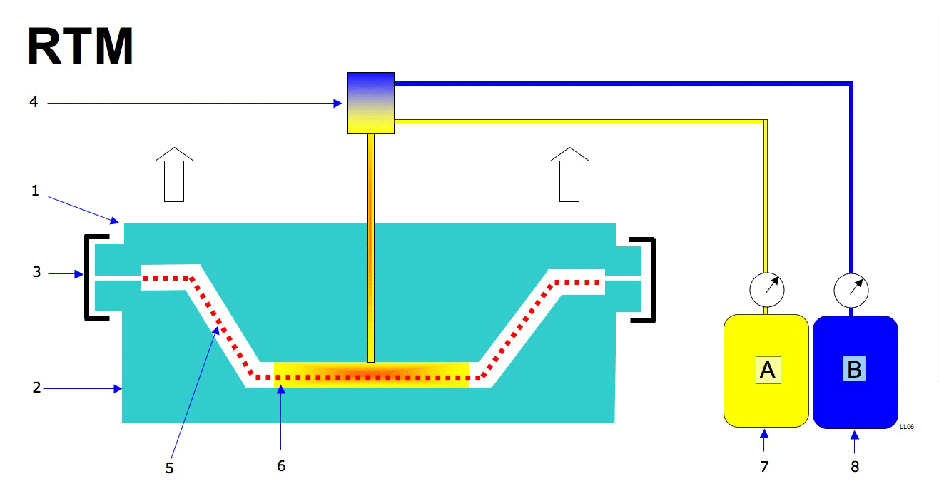

Slide 43
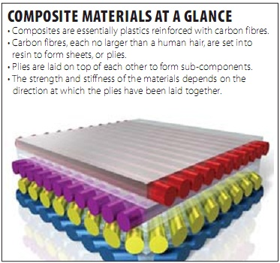
STRUCTURE AND PROPERTIES AND APPLICATIONS
Properties:
Improves the following properties
Ultimate tensile strength
Temperature resistance
Flexural modulus
Offer generally a high performance
Applications:
Carbon fibers are used in the sole of sport shoes.
Used in aircraft manufacturing
Are used for reinforcing structures in the field of civil engineering

