Slide 1
Play with Sensor

Slide 2
Outline
Definition
Types
Working Principle
Pin Description
Circuit Diagram
Application

Slide 3
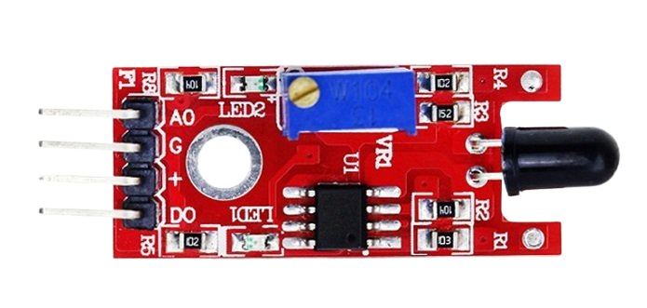
Flame Sensor
Figure : Flame Sensor
A sensor which is most sensitive to a normal light is known as a flame sensor.
This sensor detects flame otherwise wavelength within the range of 760 nm – 1100 nm from the light source.
This sensor can be easily damaged to high temperature.
The output of this sensor is an analog signal or digital signal.
These sensors are used in fire fighting robots like as a flame alarm.

Slide 4
Different Types
Flame-sensors are classified into four types:
IR single frequency
IR multi-spectrum
UV flame detectors
UV / IR flame detectors

Slide 5
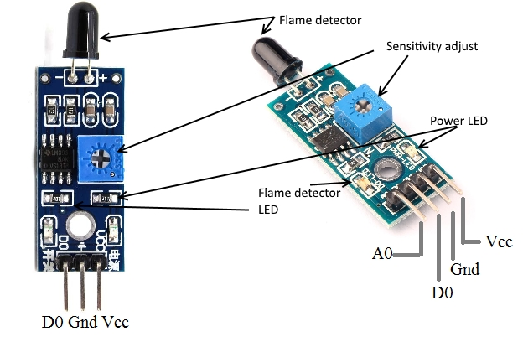
Pin Description

Slide 6
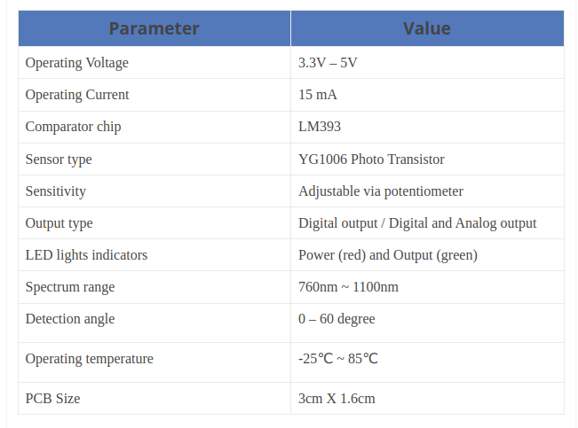
Features & Specifications
The features of this sensor include the following.

Slide 7
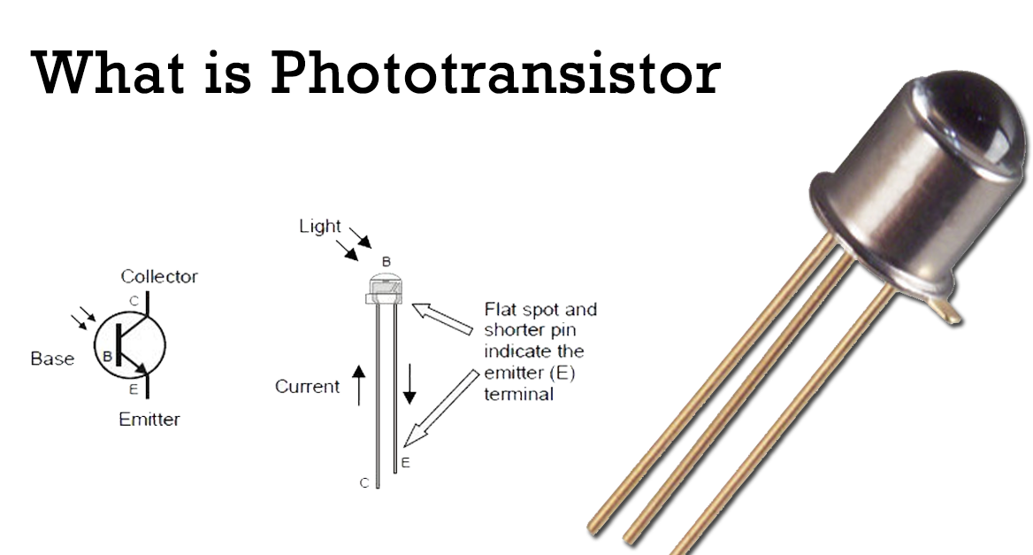
1.YG1006 Phototransistor
YG1006 Phototransistor is a 5mm NPN Transistor.
The Phototransistor is coated by black epoxy, which makes it sensitive to infrared radiation.
But, it looks like a two-terminal block LED from the outside.
It is used to sense flame or light in a range of 760 nm – 1100 nm wavelength.
This sensor is consists of two terminals, where the long terminal is the Emitter and the shorter terminal is the collector.
It has no base terminal like other transistors, when it detects light then the current starts to flow between emitter and collector.

Slide 8
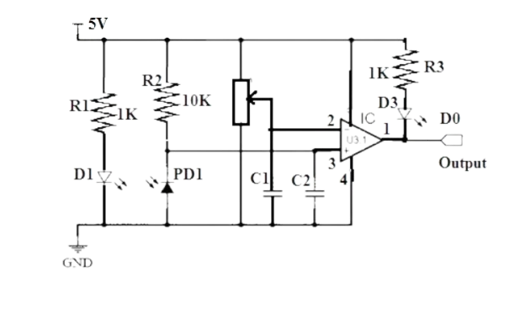
Working principle

Slide 9
Application
These sensors are used in several dangerous situations which include the following.
Hydrogen stations
Industrial heating
Fire detection
Fire alarm
Fire fighting robot
Drying systems
Industrial gas turbines
Domestic heating systems
Gas-powered cooking devices

Slide 10
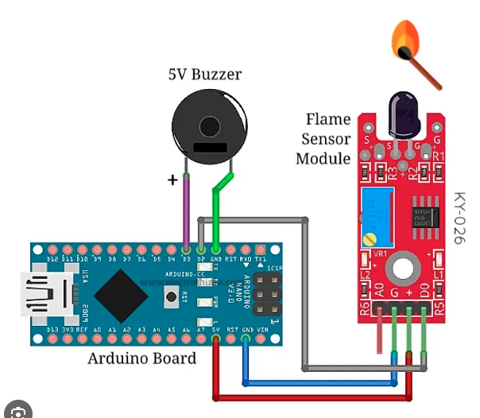
Fire alarm using flame sensor and Arduino Nano

Slide 11
Demo project video

Slide 12
Reference
https://www.elprocus.com/flame-sensor-working-and-its-applications/
https://www.electroduino.com/ir-infrared-flame-sensor-module/
https://www.electronics-notes.com/articles/electronic_components/transistor/what-is-a-phototransistor-tutorial.php
https://arduinomodules.info/ky-026-flame-sensor-module/

Slide 13
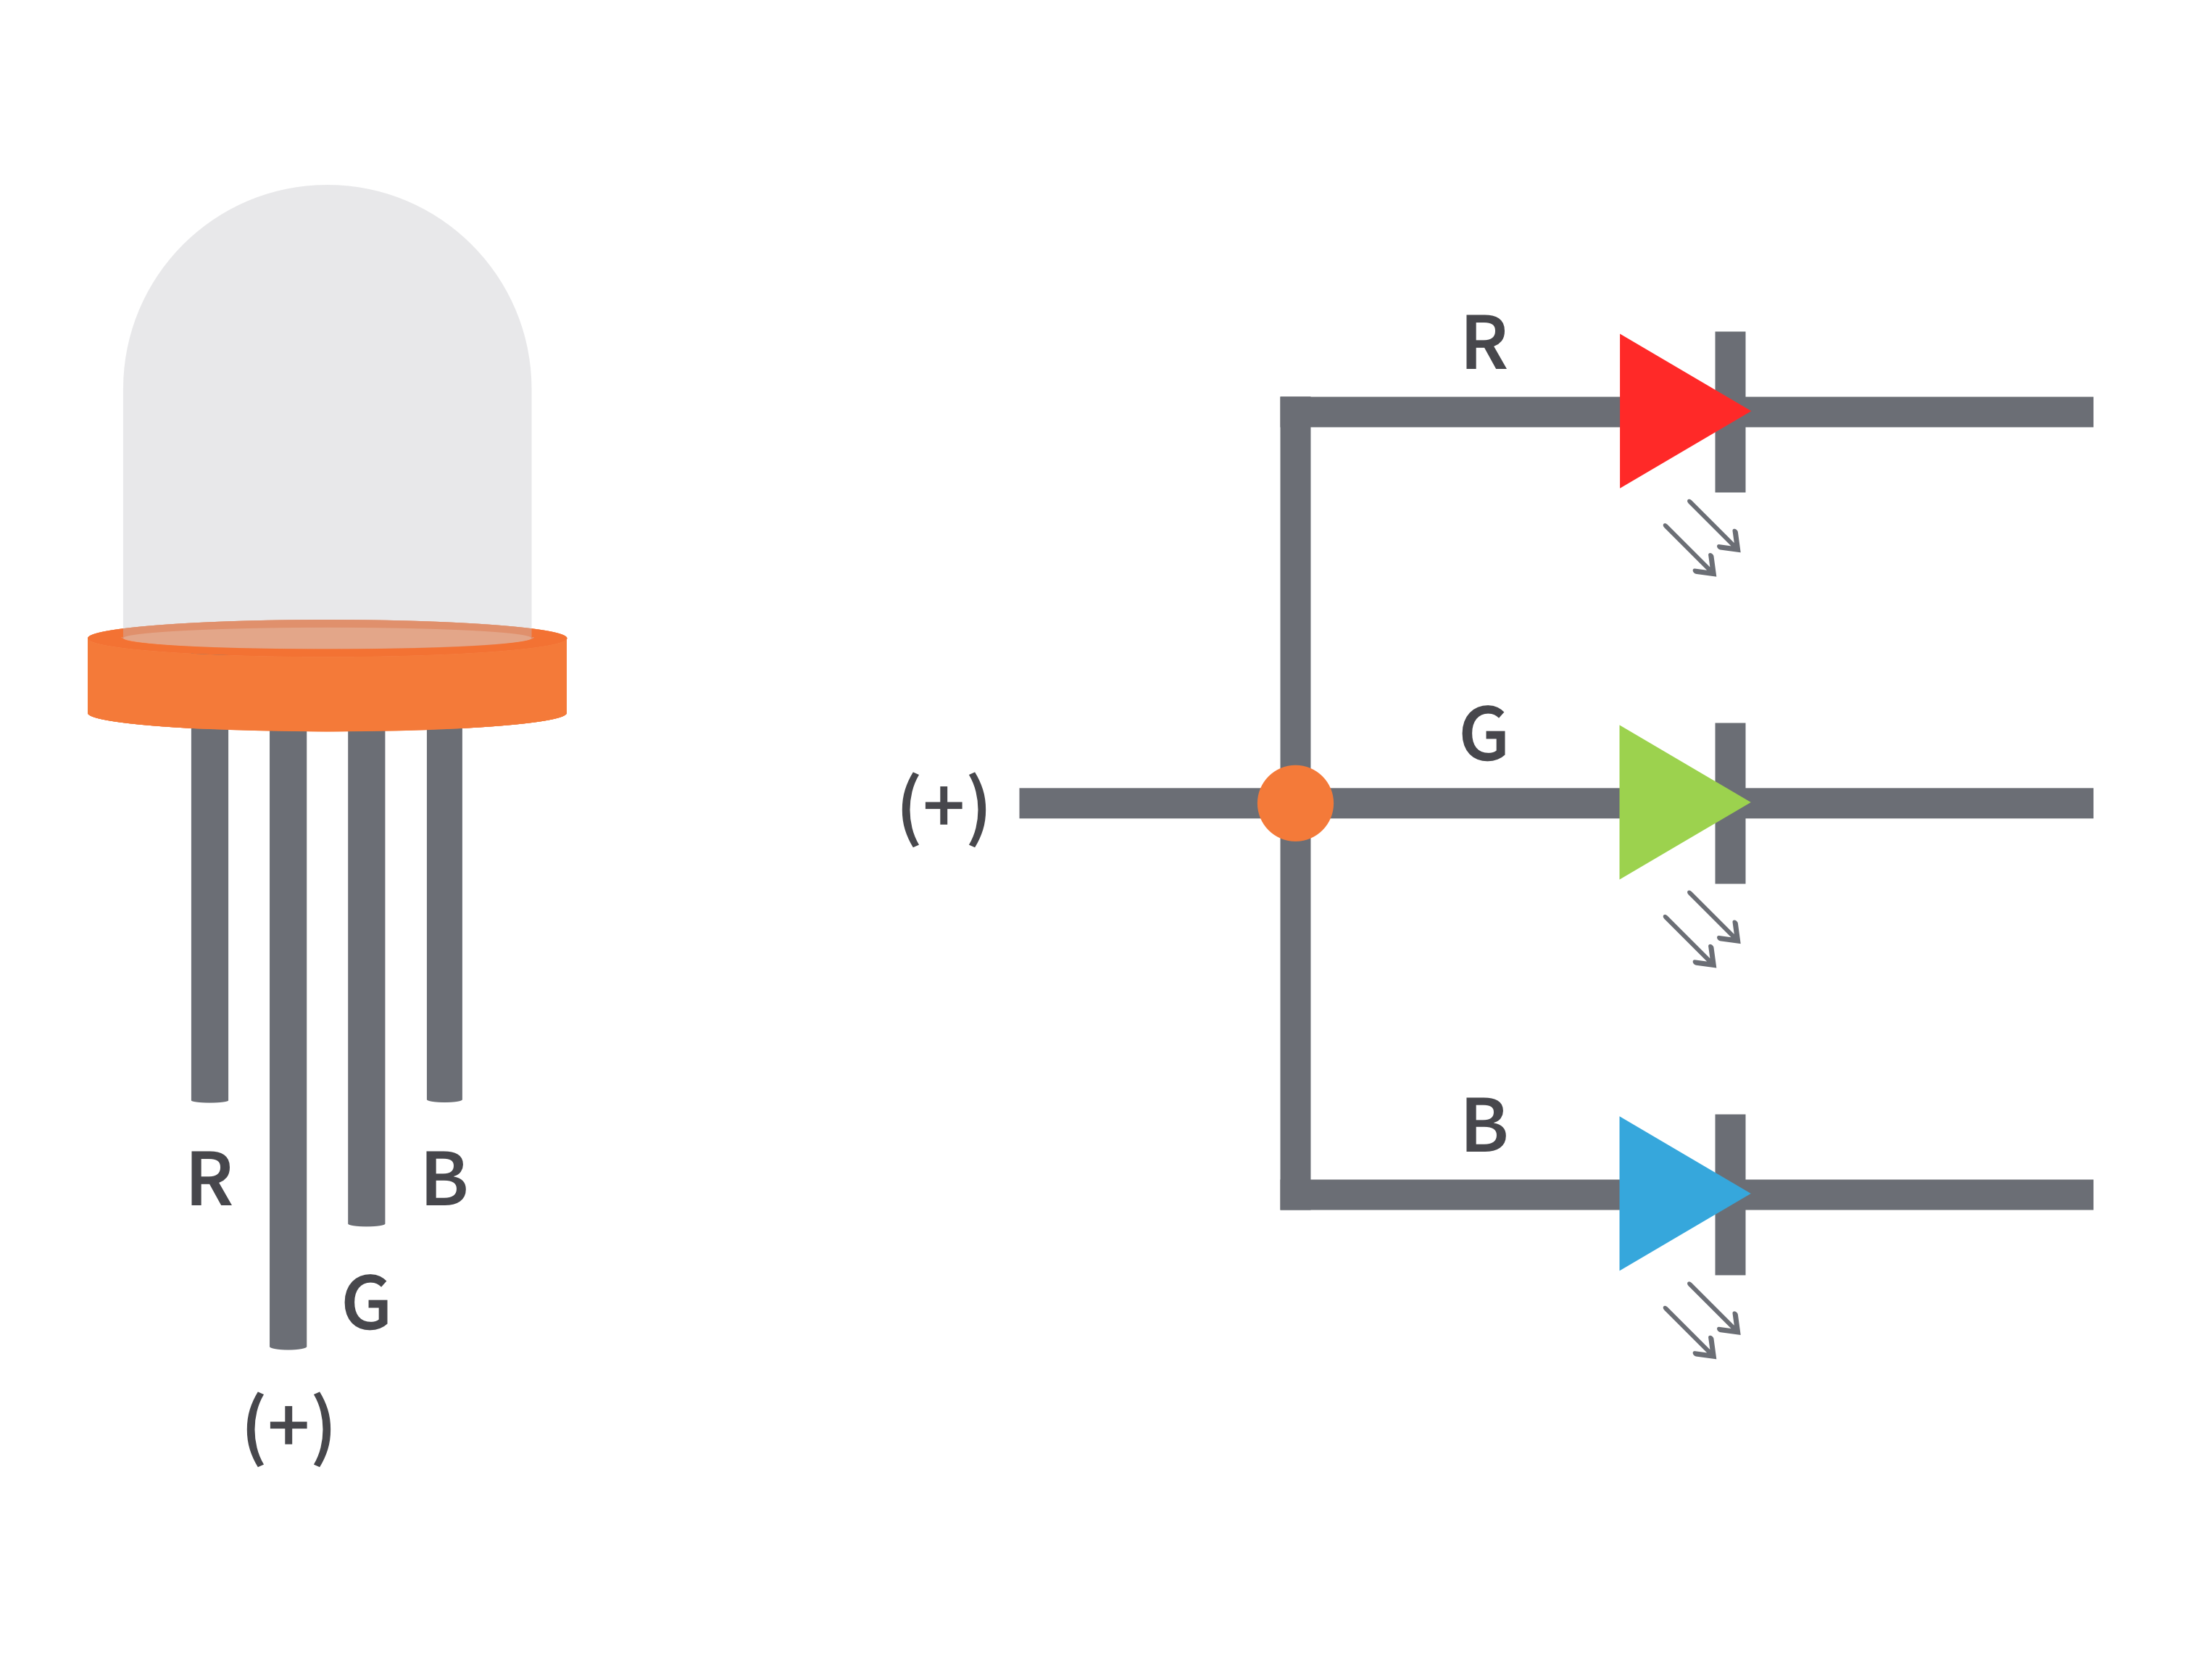
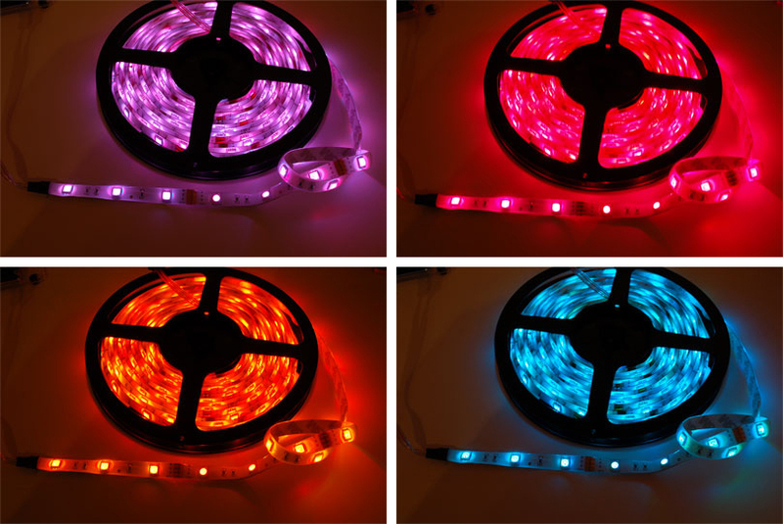
RGB LED
An RGB LED is a type of light-emitting diode that can produce a wide range of colors by combining the emission of red (R), green (G), and blue (B) light in various intensities.
The main purpose of this RGB model is for sensing, representation, and displaying images in the electronic system.

Slide 14
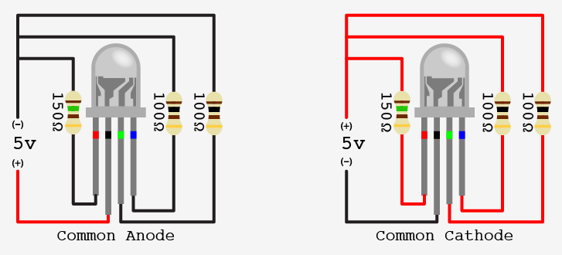
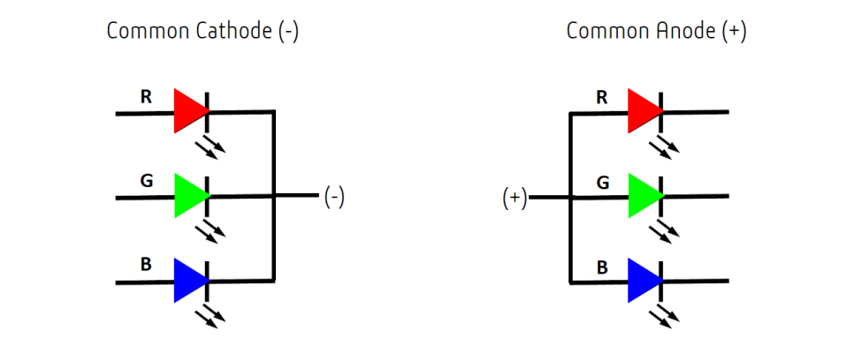
Types
There are two kinds of RGB LEDs:
Common anode LED
Common cathode LED
The figure below illustrates a common anode and a common cathode LED.

Slide 15
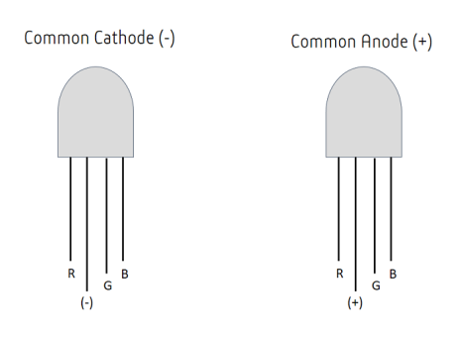
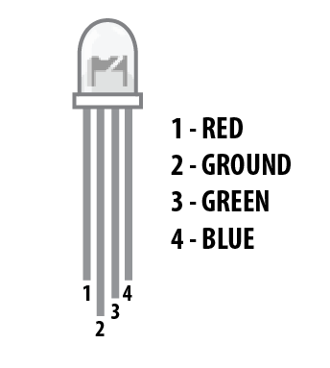
Pin configure

Slide 16
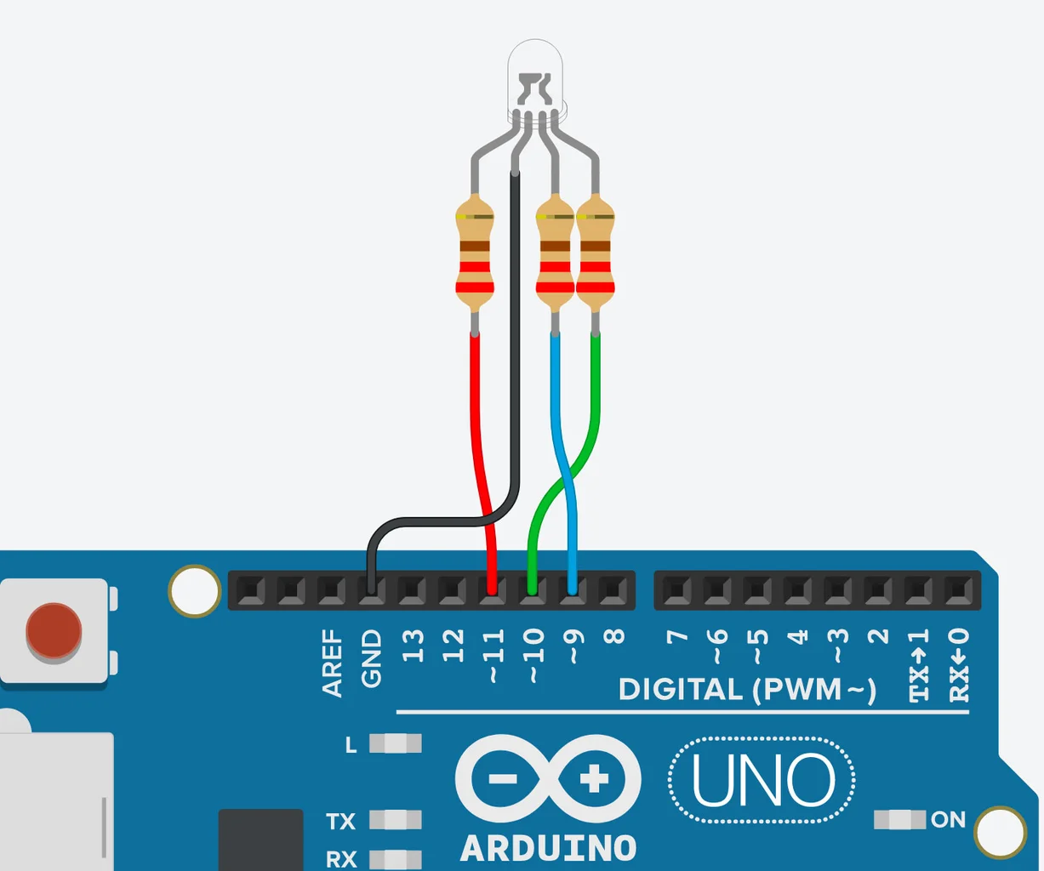
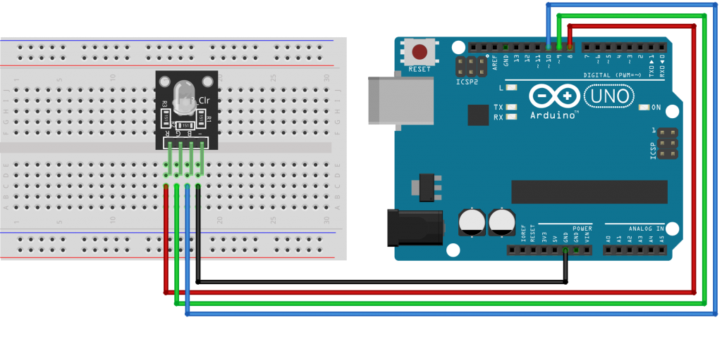
RGB led with Arduino

Slide 17
Application
Decorative Lighting: RGB LEDs are commonly used in decorative lighting, such as LED strips, bulbs, and lamps, to create dynamic and colorful lighting effects in homes, restaurants, and commercial spaces.
Indicators: They are used in electronic devices and appliances as status indicators. Different colors can represent different system states or modes.
Signage and Displays: RGB LEDs are employed in displays, screens, and signage for vibrant and eye-catching visuals.
Entertainment and Stage Lighting: RGB LEDs are essential in stage lighting and entertainment systems, allowing for dynamic and synchronized color changes during performances.
Gaming Peripherals: RGB LEDs are often integrated into gaming keyboards, mice, and other peripherals to provide customizable backlighting options for gamers.

Slide 18
Reference
https://arduinogetstarted.com/tutorials/arduino-rgb-led

Slide 19
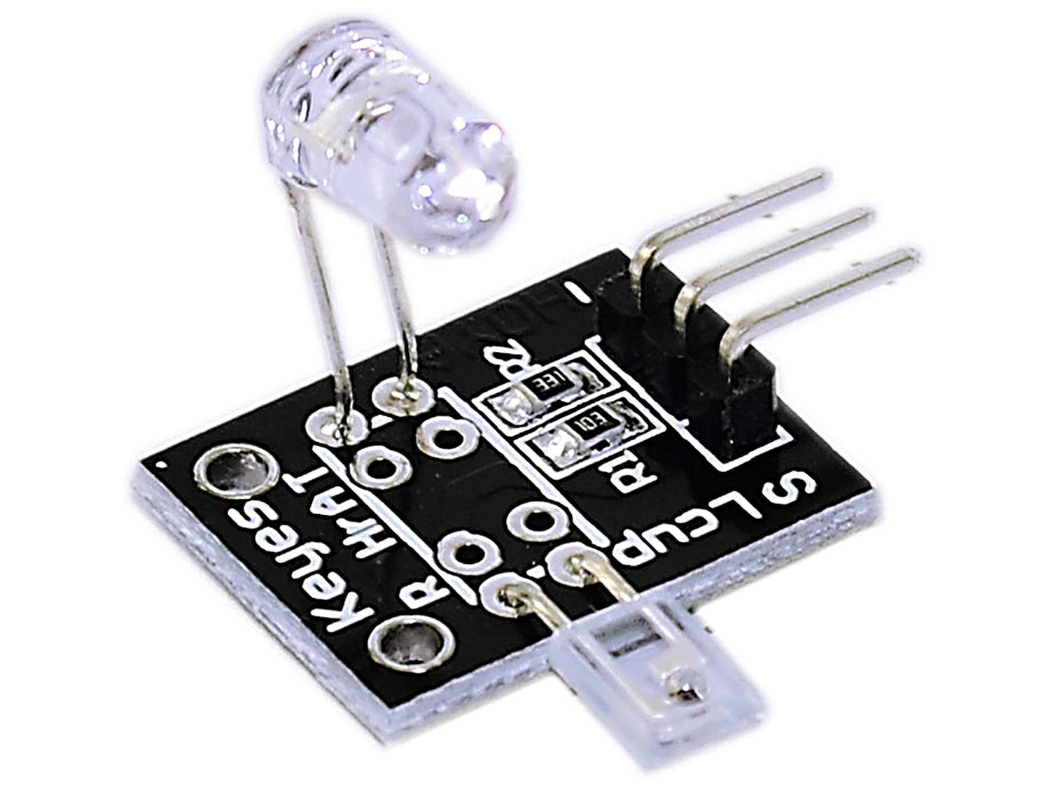
Heartbeat sensor
A pulse sensor, like any other optical heart-rate sensor, works by shining a green light (~ 550nm) on the finger and measuring the amount of reflected light with a photosensor.
This optical pulse detection technique is known as a Photoplethysmogram

Slide 20
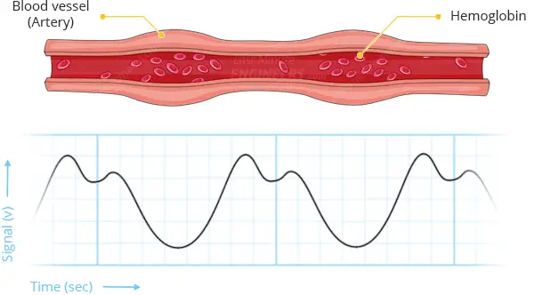
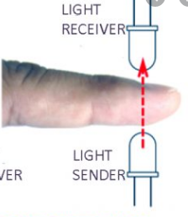
Working principle
The theory behind optical heart-rate sensors is very simple. If you’ve ever shined a flashlight through your fingers and observed your heartbeat pulsing, the concept of optical heart-rate pulse sensors can be easily grasped.

Slide 21
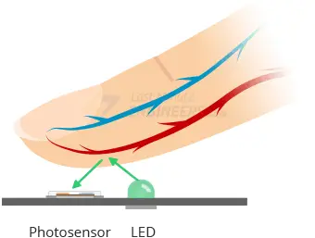

Slide 22
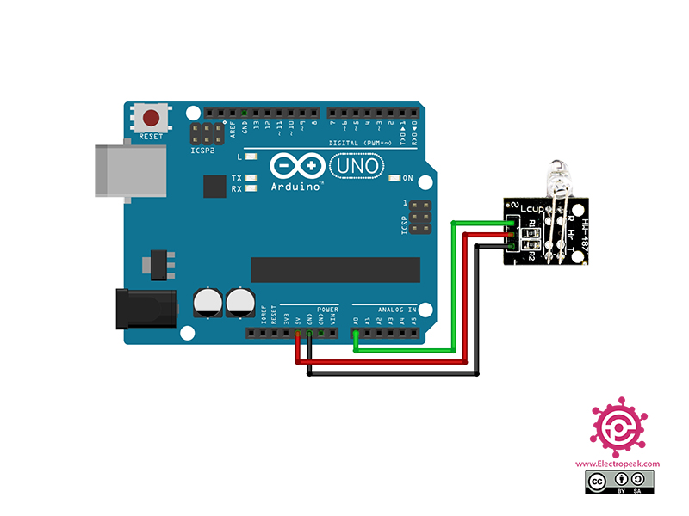
IR heartbeat sensor with Arduino

Slide 23
Reference
https://www.youtube.com/watch?v=lEodwqtlZF8

Slide 24
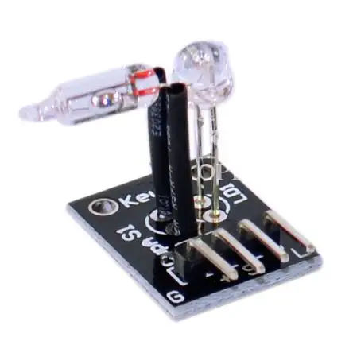
Tilt sensors
Tilt sensors are devices that produce an electrical signal that varies with an angular movement.
These sensors are used to measure slope and tilt within a limited range of motion.
Sometimes, the tilt sensors are referred to as inclinometers because the sensors just generate a signal but inclinometers generate both readout and a signal.

Slide 25
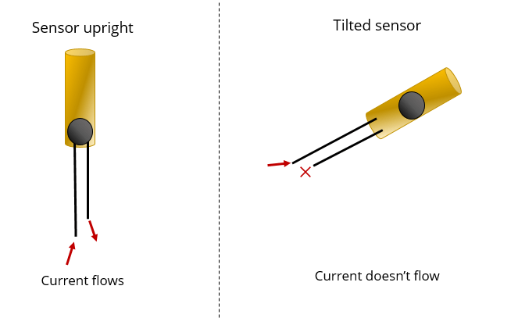
Tilt Sensor Working Principle
These sensors consist of a rolling ball with a conductive plate beneath them.
When the sensor gets power, the rolling ball falls to the bottom of the sensor to form an electrical connection.
When the sensor is tilted, the rolling ball doesn’t fall to the bottom so that the current cannot flow the two end terminals of the sensor.

Slide 26
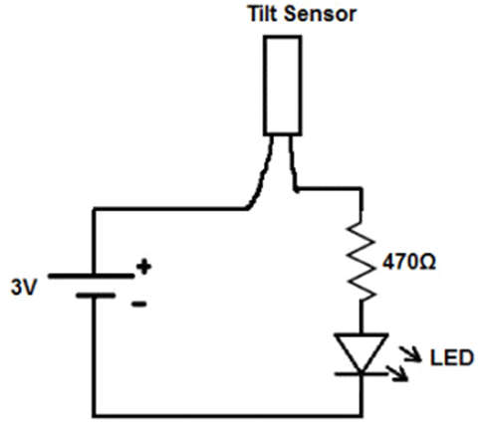
Tilt Sensor Circuit
The rolling ball settles at the bottom of the sensor when the device is powered up and in the upright position, creating an electrical connection between the sensor’s two end terminals.
The circuit then experiences a short circuit, allowing the LED to get enough current.
The circuit becomes open if it is angled so that the rolling ball doesn’t land on the sensor’s bottom along the direction of electrical conduction.
This has to do with how the circuit works.
Required components for the tilt sensor circuit.
Tilt Sensor
470 Ohms Resistor.
Led or Load
DC Voltage Source
A basic circuit that uses a tilt sensor is shown below.

Slide 27
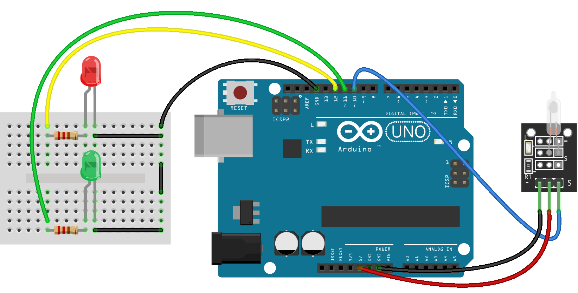
Tilt sensor with Arduino

Slide 28

Arduino code

Slide 29
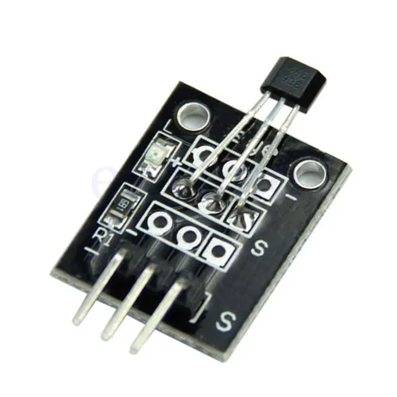
Hall Magnetic Sensor
A Hall effect sensor is a transducer that generates a voltage in response to a magnetic field.
It takes advantage of the Hall effect, which is the production of a voltage difference across an electrical conductor, transverse to an electric current in the conductor and to an applied magnetic field perpendicular to the current.
This phenomenon is used to create sensors that can detect the presence and strength of a magnetic field.

Slide 30
Types of Hall Effect Sensors:
Hall Effect Switches: These sensors are digital and produce a high or low output based on the presence or absence of a magnetic field.
Hall Effect Latches: Similar to switches, but they latch their output state. Once triggered by a magnetic field, they stay in that state until a reset condition occurs.
Analog Hall Effect Sensors: These sensors provide a continuous output voltage that varies with the strength of the magnetic field.
Linear Hall Effect Sensors: These sensors provide a linear output proportional to the strength of the magnetic field.

Slide 31
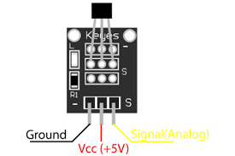
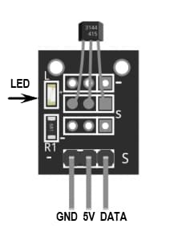
Pin description
Vcc (Power): This is the supply voltage for the sensor.
GND (Ground): Connect this pin to the ground of your circuit.
OUT (Output): This is the pin where the sensor outputs a voltage signal based on the detected magnetic field.

Slide 32
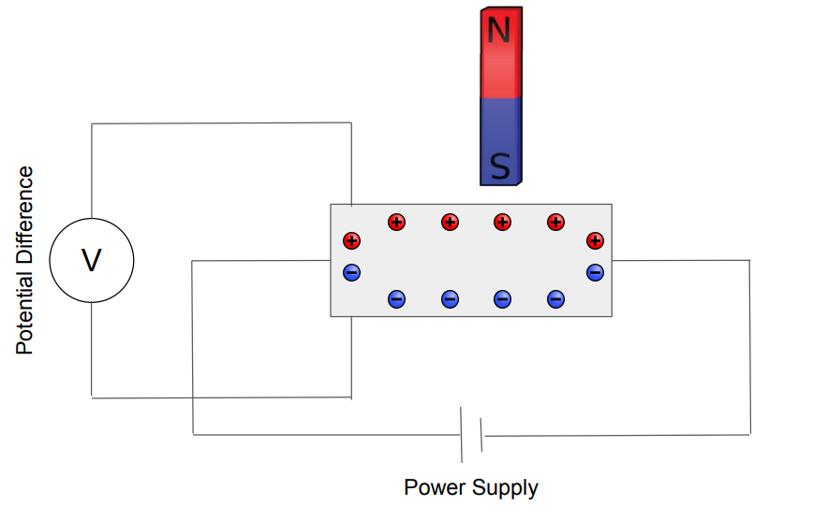
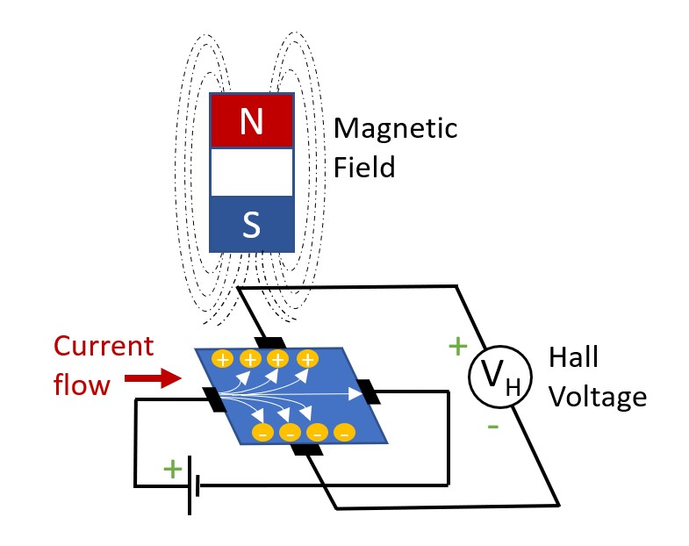
Working principle

Slide 33
Application
Proximity Switches: Hall effect sensors can be used to detect the presence of a magnet, enabling applications such as proximity switches.
Speed Sensing: Hall effect sensors are used in applications where the speed of a rotating object needs to be measured, such as in automotive applications for sensing the speed of a vehicle.
Current Sensing: They can be used for measuring current in a conductor by detecting the magnetic field generated by the current.
Magnetic Encoders: Hall effect sensors are used in rotary encoders to measure the position of a rotating object.
Magnetic Field Measurement: Hall effect sensors are also used for measuring the strength and direction of a magnetic field in scientific and industrial applications

Slide 34
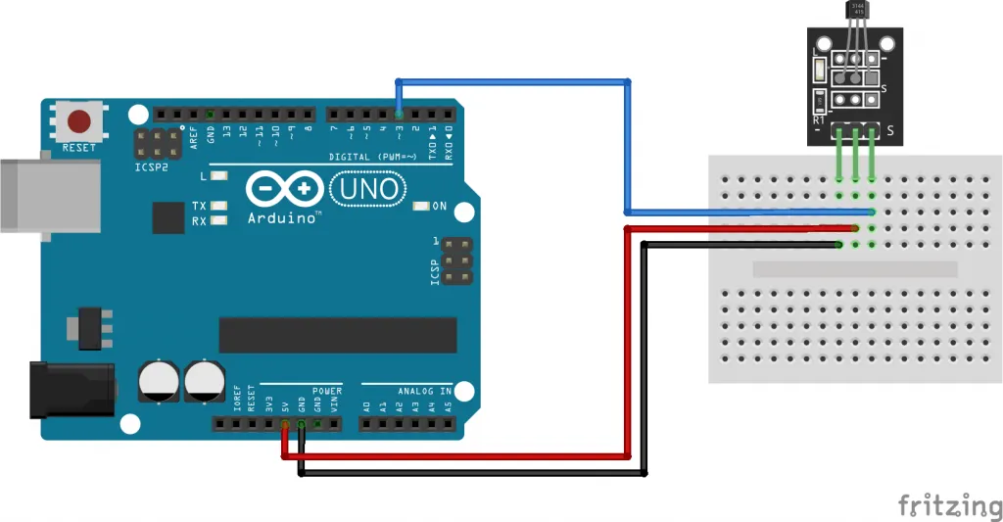
Projects: Arduino with hall magnetic sensor
Components Needed:
Arduino board (e.g., Arduino Uno)
Hall effect sensor
Magnet
LED
Resistor (220 ohms)
Breadboard and jumper wires

Slide 35
Circuit:
Connect the Vcc pin of the Hall effect sensor to the 5V pin on the Arduino.
Connect the GND pin of the Hall effect sensor to the GND pin on the Arduino.
Connect the OUT pin of the Hall effect sensor to digital pin 2 on the Arduino.
Connect the anode (longer leg) of the LED to digital pin 13 on the Arduino through the resistor.
Connect the cathode (shorter leg) of the LED to the GND pin on the Arduino.

Slide 36
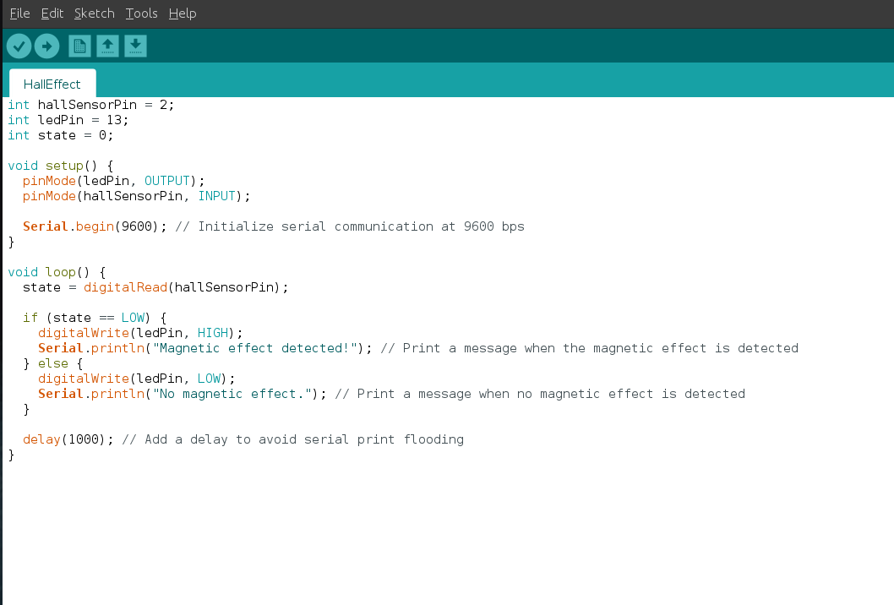
Arduino code

Slide 37
Reference
https://www.melexis.com/en/tech-talks/hall-effect
https://www.youtube.com/watch?v=wn1UCt9Z6NQ
https://littlebirdelectronics.com.au/guides/67/hall-effect-sensor-with-arduino

Slide 38
Laser emit sensor

