Slide 1
Project On A Low Cost Artificial Humanoid Robotic Hand Using sEMG Sensor.
Presented by
Name : H.M. Mehedi Hasan (Badhon)

Slide 2


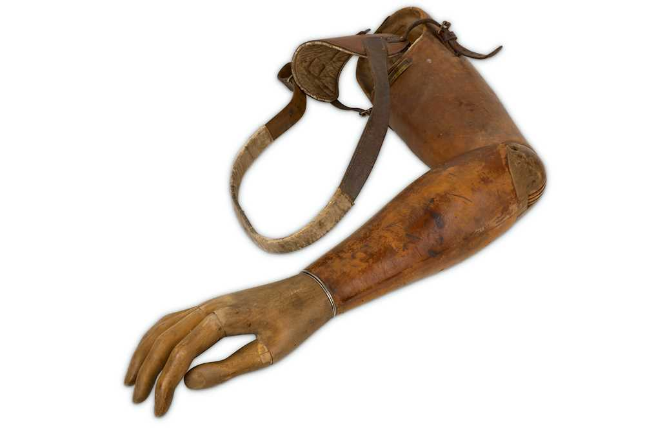
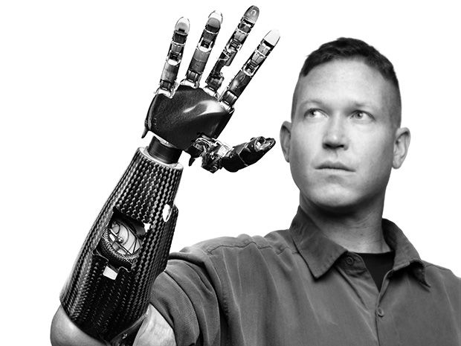
Problem Statement
Accident or Paralytic Disorder
Not Having Hand by Birth
Used Non Functional Wooden Hand
Offered By Medical Field Very High Cost.
1

Slide 3
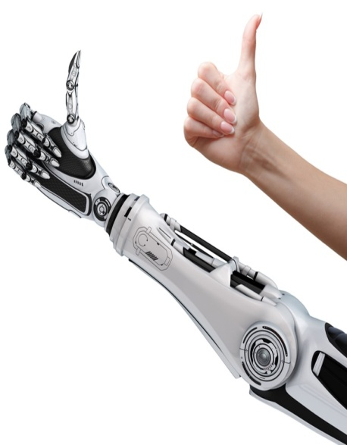
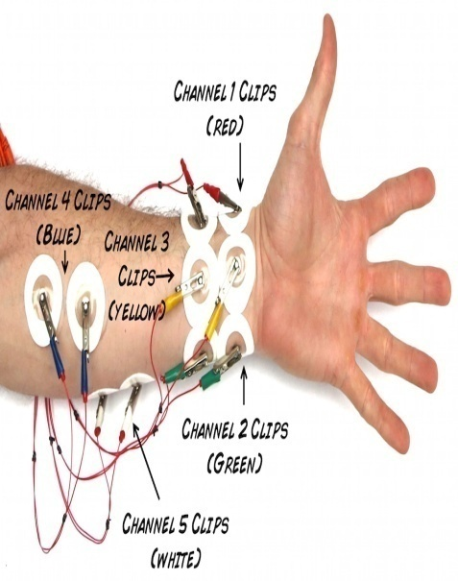
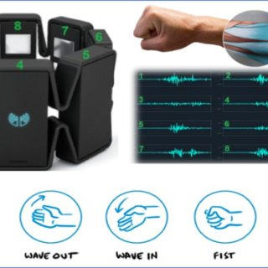
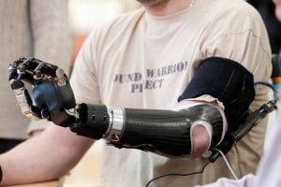
Project Objective
To design a 3d hand model (Fusion 360 software)
To connect the electrodes carefully
To ensure electrical muscle pulse on the sEMG sensor
To connect sEMG sensor and servo motor with micro controller
2

Slide 4

Necessary Equipment :
Hardware requirements
Software requirements
Electromyography Sensor
Electrodes
3-D Printed Hand Parts
Arduino Nano or Uno Board
Servo Motor (MG996R)
Rechargeable Battery
Elastic Wire
Nylon wire
Bread Board
Soft Silicone Gloves
Connecting wire (Jumper)
Arduino IDE
Fusion 360 software or any d model design
3

Slide 5
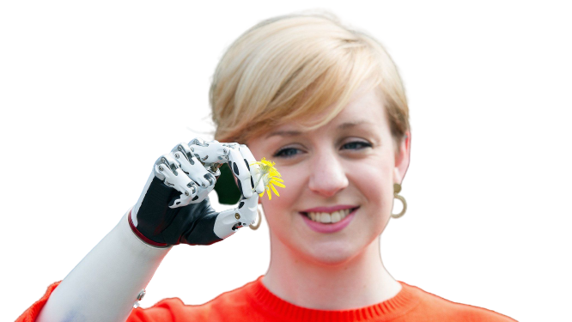
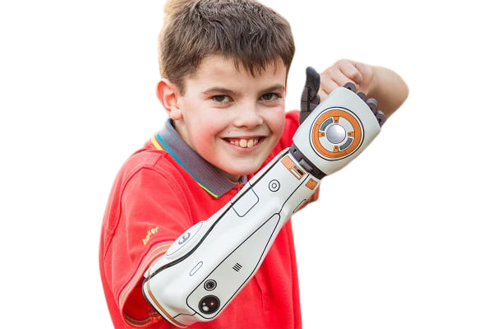


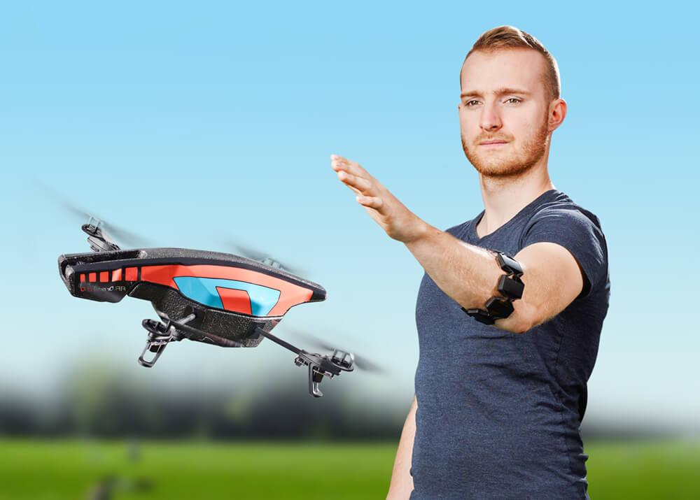
Features
Budgets friendly
Battery Backup (Analysis)
Light Weight 3D Printed Modules/parts
Different Moving Mode (Fixed Fingers)
Controlled Other Devices Through Wi-Fi
4
Notes:
5

Slide 6
Design and Implementation
1 Software implementation
1.1 : 3D Robotic Hand Model Design Using
Fusion360 Programming (3d model) Software
1.2 : Arduino Programming
2 Hardware implementation
5

Slide 7
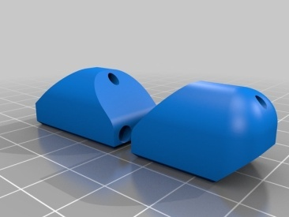
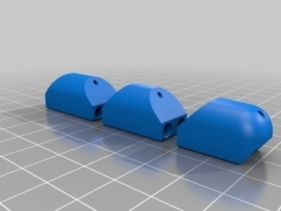
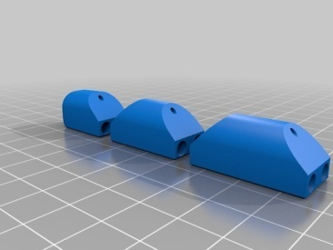
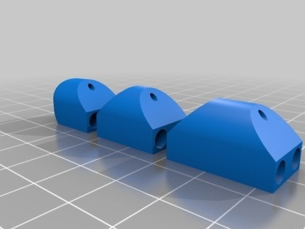
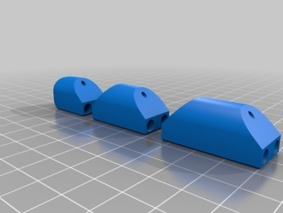
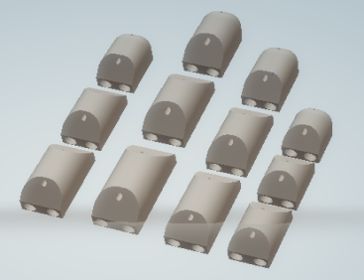
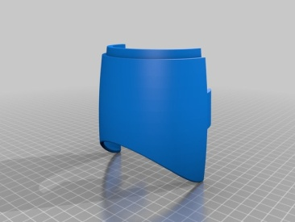
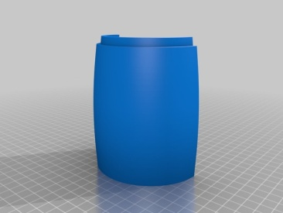
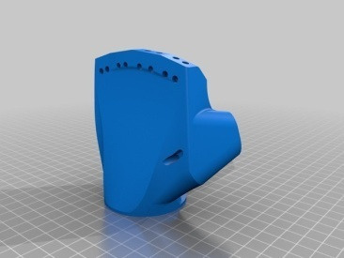
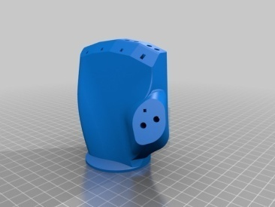
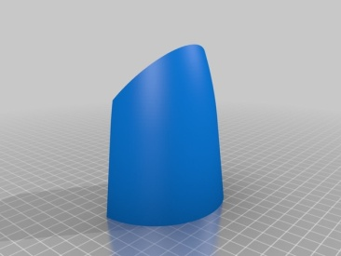
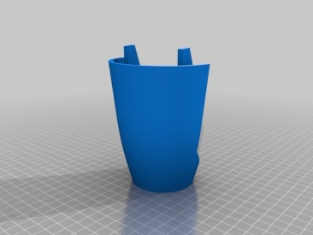
1.1 3D Model Design
6

Slide 8
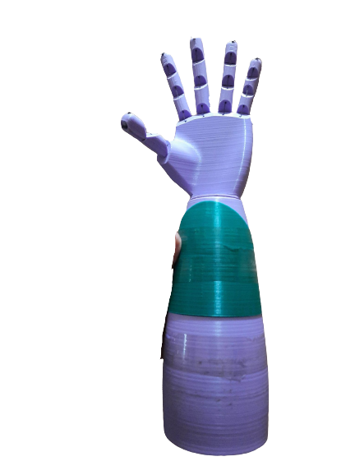
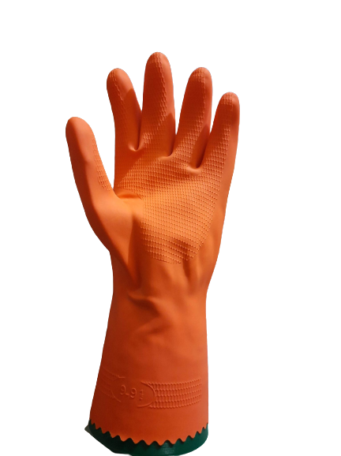
1.2 3D Model Design Robotic Full Hand
With Rubber Hand Glove
7

Slide 9
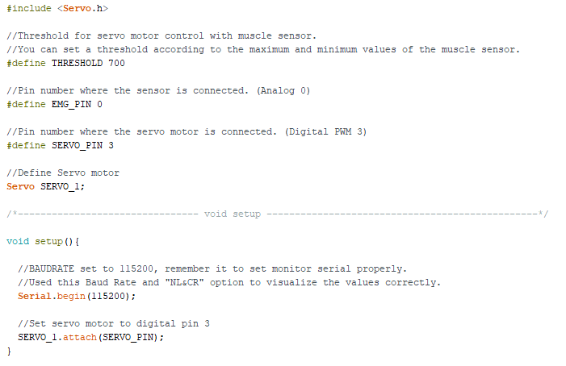
Arduino Program Part 1
8

Slide 10
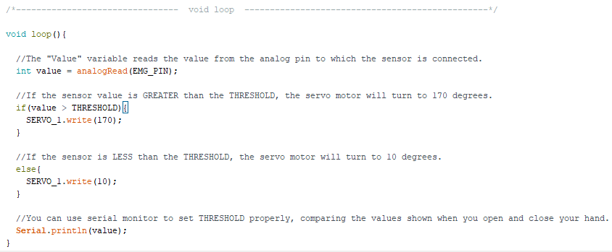
Part 2
9

Slide 11
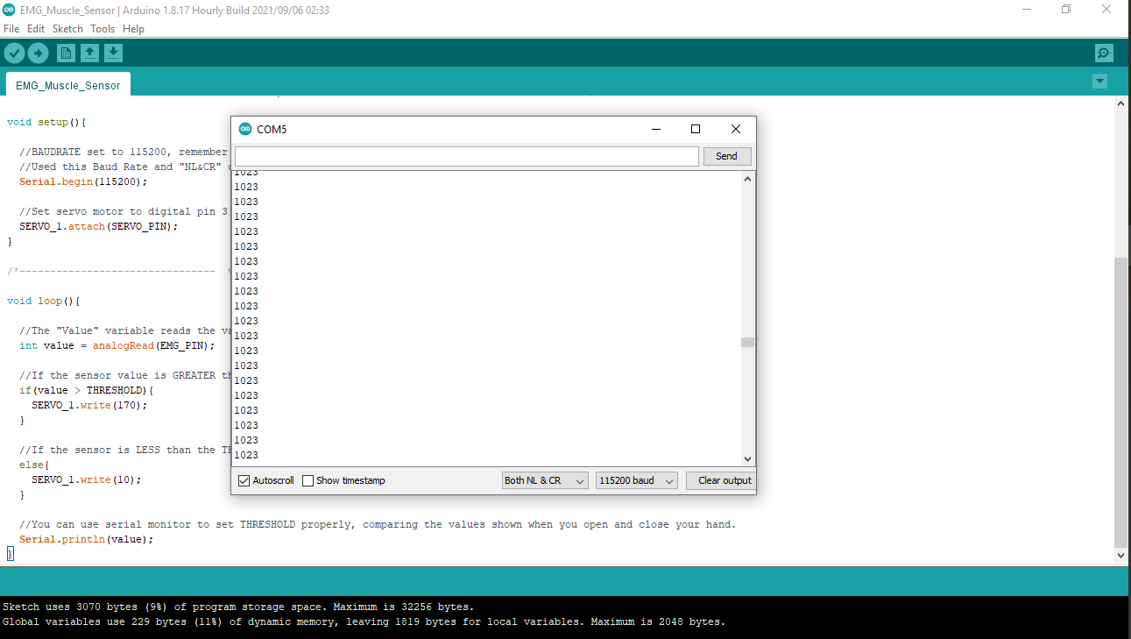
Output Response

Slide 12
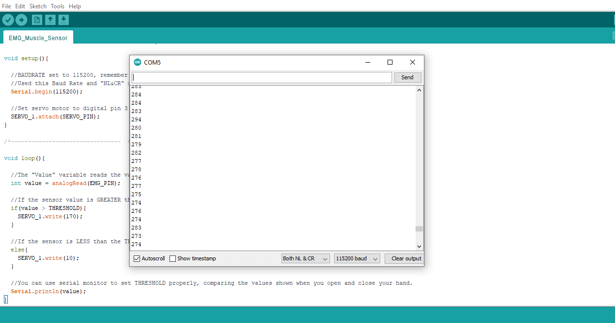

Slide 13


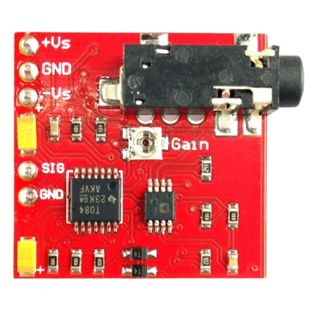
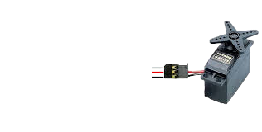
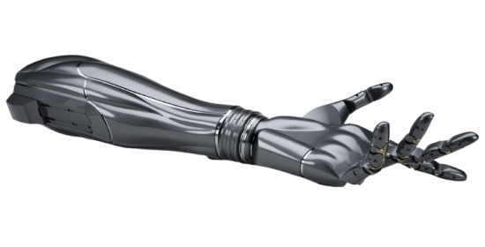
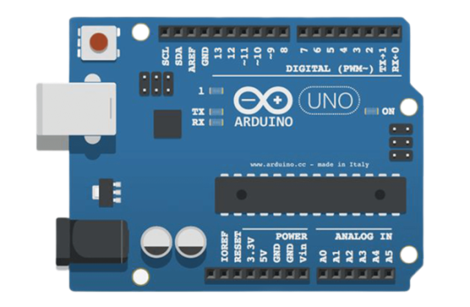
Hardware Implementation
1
5
2
6
4
3

Slide 14
Working Process
Human
Remaining Hand
EMG sensor
Battery
(+-18V)
Robotic Arm
Arduino Uno
or Nano
Servo Motor

Slide 15
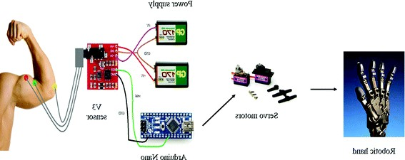
Methodology
Power supply
sEMG
Servo
Electrodes
Switching
Mode
Robotic Arm
Arduino Uno
3

Slide 16
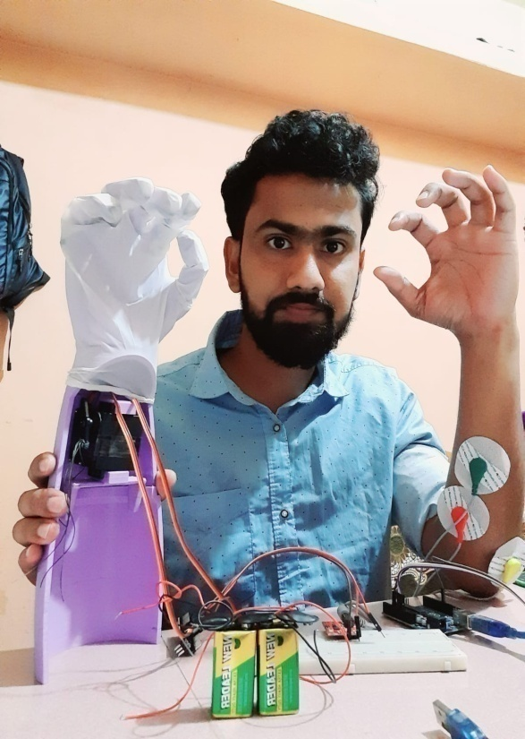
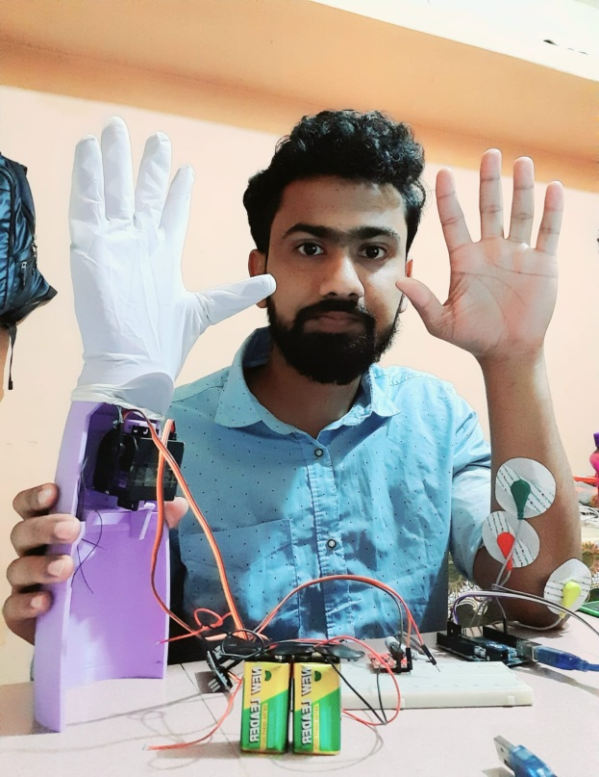
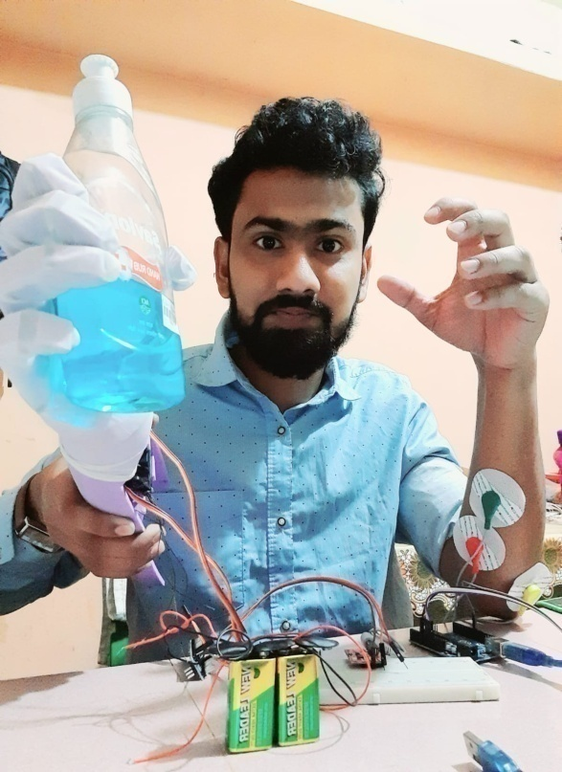
Demonstration
A
B
C
7

Slide 17
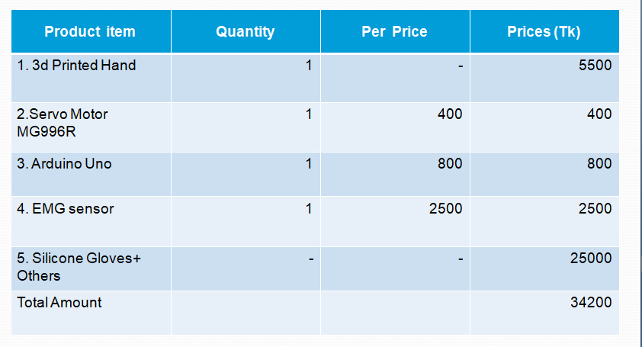
Total Cost
* I did not wear the silicon gloves in the demo video.

Slide 18
Thank You For Watching and Listening.
You can find me at: h.m.badhoneee@gmail.com

