Slide 1
Data Platform Operational Metadata Reporting Tool System Design
ENL
Rev 0.7, 2024 July 2nd
All content of this document based on the information ENL and HSBC have on 18th June 2024, we will change the design later on if any condition changed.

Slide 2
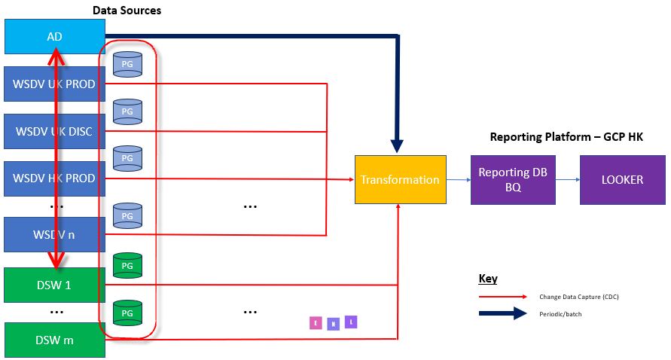
Current High Level Pain Points and Asks
There are multiple instances of same application (WSDV, DSW etc)
It consumes repeatable effort to consolidate performance data from multiple instance to a central datalake for analytical like performance, daily operational report
Current operational queries running on production instance directly, we plan to offload them to a read-only data lake.

Slide 3
High-level requirements
Consumption Analysis
How much is a particular user using the platform?
How much is a particular role using the platform?
Comparisons between different roles using the platform – ability to apportion costs based on consumption
Most queried assets
Least queried assets (should they go on a demise path?)
Identification of Problematic Queries
Long-running queries
Failing queries
Queries getting blocked
Costly queries, e.g. expensive queries on Google Cloud Platform (GCP)
Compliance/Audit
What users can access a particular asset?
What users are accessing a particular asset?
What are all the assets a given user has access to?
What are all the assets a given role has access to?
Reconciliation breaks
Active Directory (AD) versus Data Science Workbench (DSW)
DSW versus Wholesale Data Virtualisation (WSDV) Built-in Access Control (BIAC)
Needed Metadata
Staff ID, user name, user location, user email address
Staff ID to AD group mappings
AD group to Starburst role mappings
Day One Data Sources
WSDV UK Production
WSDV UK Discovery
WSDV HK Production
AD
DSW UK On-premises (Tesseract)
About 40 tables in each existing PG DB.*
Timeliness
Real-time where at all possible, e.g. WSDV and DSW
preferable <5s; less than 5min at max if cost/other limitation applies; *
Periodic polling, e.g. AD
For all roles in WSDV UK Prod/HK Prod/UK Discovery get a list of AD groups and users
For all AD groups get the current list of users in the group
Get a distinct list of all users on the platform
Download all the needed metadata for each user in the list
Design
Separate reporting database to the operational Starburst database to avoid performance conflicts
House the reporting database on GCP
Choose the reporting database technology – BQ, PG, etc.
Cost considerations
Ability to get timely data from all Starburst clusters
Possible staging schema for raw data from each Starburst cluster
JSON format transforming*
historical data should be kept long for archive propose in reporting DB, while purging happens in source PG DB.*
Transformation into new data model to facilitate reporting both at the cluster level and combined across multiple clusters
Enrich existing table for reporting across multiple clusters(e.g. adding cluster_id column with multiple tables)*
Deconstruct the JSON structures with multiple values into a relational schema? Easier to report?
Ingest raw JSON into staging zone; transform into flat relational schema*
Ease of extensibility
Additional WSDV clusters in future via configuration only
Additional DSW instances in future via configuration only
Subsequent phases – additional data platform components, e.g. Alteryx, MSML etc.
Design should be expandable, adaptive, to accommodate additional Postgres SQL server to include new clusters and DSWs.*
Potential connectivity consideration that might affect the real-time requirement: for 2 clusters of UK, a firewall for HSZ should be considered; HK PROD has no firewall between BQ;*
Deliverable deployment & codes should utilize CI/CD capable patten to be integrated into HSBC CI/CD platform.**
* Items clarified & added on 3rd May’24
** item clarified & added on 13rd May’24

Slide 4
High-level architecture requirement from HSBC
Data Sources
AD
PG
WSDV UK PROD
PG
WSDV UK DISC
Reporting Platform – GCP HK
PG
Transformation
Reporting DB
BQ
LOOKER
WSDV HK PROD
…
…
PG
WSDV n
PG
DSW 1
Key
…
…
Change Data Capture (CDC)
PG
Periodic/batch
DSW m

Slide 5


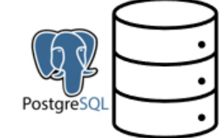
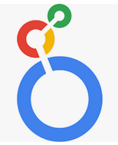
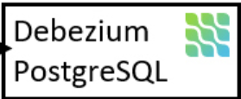
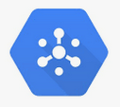

Architecture - Cloud Services View
Ingest
Tables
(transform)
views
BI Analytics
Batch
Batch REST Call
Complex table
BQ API call
https
Cloud Function
OMR restAPI
Cloud Function
Schedule Job
DataFlow
Python UDF
Transform
enrich
Stream
Stream
Ad hoc query
WSDV DB1
BQ Raw Table
Before transform
（CDC JSON Row）
Streaming
SQL
SQL
Stream
Simple table
Streaming
k8s
GCP Pubsub
GCP Looker
dashboard
tables
view
WSDV DB2
IKP
GCP

Slide 6
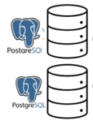

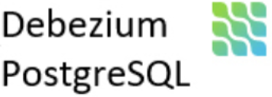
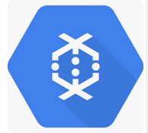
Streaming System Module and Message Flow, Target latency < 5 Secs
GCP Dataflow
PG-Data Sources
Debezium-Stream Producer
message Topic
Dataflow-Stream Sink
Big Query Raw Table
Dataflow-Transform
Big Query Validated/Model Table
GCP Pubsub
✓
regular
GCP PUBSUB
GCP Pubsub
Complex
transform
GCP Dataflow

Slide 7
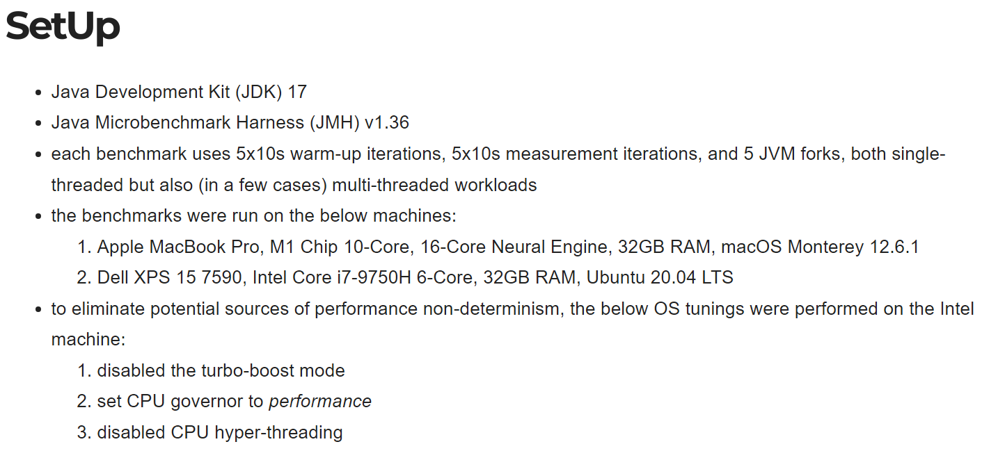
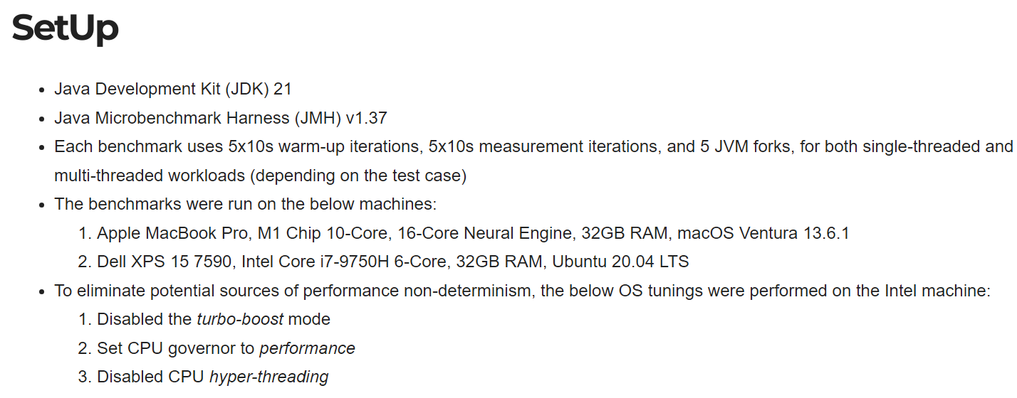
Debezium hardware requirement
Debezium is a distributed platform that can run on multiple hardware and operating systems. However, the performance and resource requirements of Debezium depend on specific usage scenarios, such as the rate of data change, the number and type of monitored database tables, etc.
The official Debezium documentation does not provide specific hardware requirements for Debezium deployment. However, we can refer to Debezium‘s minimum and recommended hardware requirements for JVMs to infer Debezium’s hardware requirements, as with each Pod or VM:
6-Core, 32G RAM, Ubuntu 20.04LTS
https://openbenchmarking.org/
Notes:
If Debezium, consider physical implementation of machines required to host Debezium

Slide 8
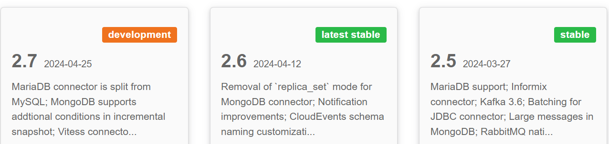
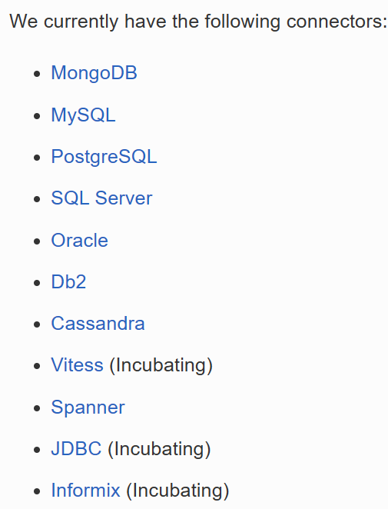
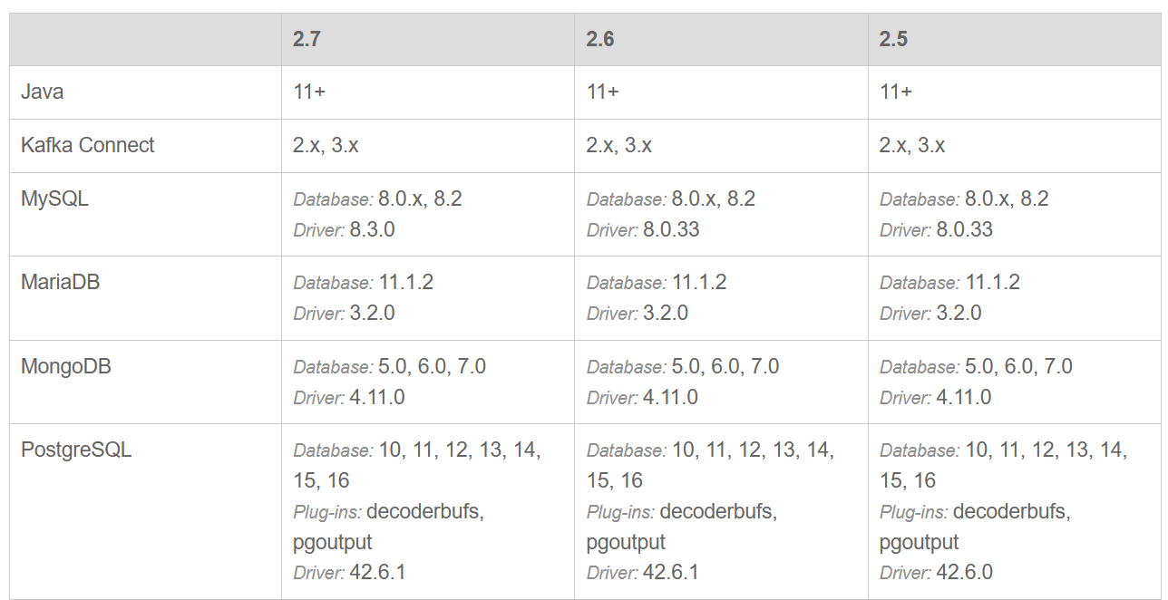
Module Design – Debezium data sources support

Slide 9
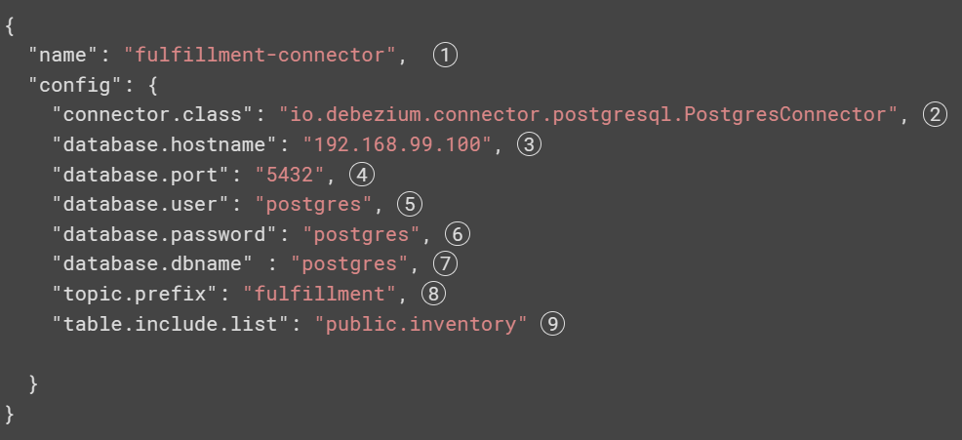
Module Design – Stream Producer - Debezium
Debezium’s goal is to build up a library of connectors that capture changes from a variety of database management systems and produce events with very similar structures, making it far easier for your applications to consume and respond to the events regardless of where the changes originated.
Arguments
The name of the connector when registered with a Connect service.
The name of this PostgreSQL connector class.
The address of the PostgreSQL server.
The port number of the PostgreSQL server.
The name of the PostgreSQL user that has the required privileges.
The password for the PostgreSQL user that has the required privileges.
The name of the PostgreSQL database to connect to
The topic prefix for the PostgreSQL server/cluster, which forms a namespace and is used in all the names of the Kafka topics to which the connector writes, the Kafka Connect schema names, and the namespaces of the corresponding Avro schema when the Avro converter is used.
A list of all tables hosted by this server that this connector will monitor. This is optional, and there are other properties for listing the schemas and tables to include or exclude from monitoring.
Debezium supports full snapshot & ad-hoc snapshot. For big DB or day-1 initial sync, use ad-hoc snapshot specifying tables to throttle down the volume with schedule.

Slide 10
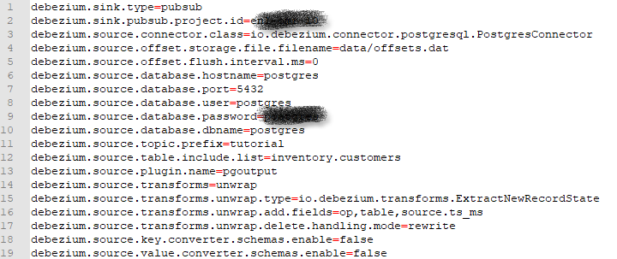
Module Design – Debezium Docker deployment
Debezium is designed to talk to a number of external systems, such as various databases and services, and our integration tests verify Debezium does this correctly. But rather than expect you have all of these software systems installed locally, Debezium's build system uses Docker to automatically download or create the necessary images and start containers for each of the systems. The integration tests can then use these services and verify Debezium behaves as expected, and when the integration tests finish, Debezium's build will automatically stop any containers that it started.
Docker Compose is a tool for defining and running multi-container applications. It is the key to unlocking a streamlined and efficient development and deployment experience.
Compose simplifies the control of your entire application stack, making it easy to manage services, networks, and volumes in a single, comprehensible YAML configuration file. Then, with a single command, you create and start all the services from your configuration file.
https://github.com/debezium/debezium-examples/tree/main/debezium-server/debezium-server-sink-pubsub

Slide 11
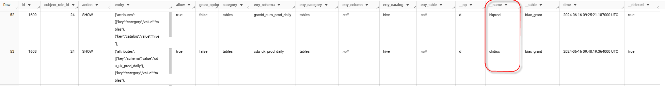
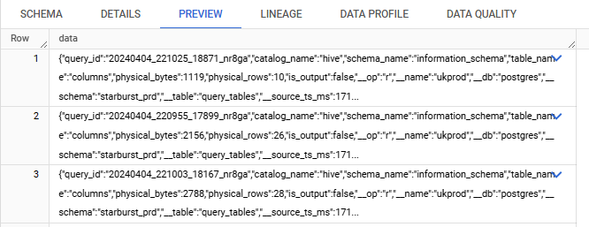
Module Design – Pubsub Topic Design
Pub/Sub is an asynchronous and scalable messaging service that decouples services producing messages from services processing those messages. Pub/Sub allows services to communicate asynchronously, with latencies on the order of 100 milliseconds.
The default behavior is that a Debezium connector sends each change event record to a topic whose name is formed from the name of the database and the name of the table in which the change was made. In other words, a topic receives records for one physical table. When you want a topic to receive records for more than one physical table, you must configure the Debezium connector to re-route the records to that topic.
We use one topic mapping to a same physical table on different PG servers; adding cluster_id column to identify source.
Table: completed_queries
Table: query_plan
Table: usage_metrics
….
UKprod.completed_queries
UKprod. query_plan
UKprod.usage_metrics
….
topic.completed_queries
topic. query_plan
topic usage_metrics
….
Table: completed_queries.raw
Table: query_plan.raw
Table: usage_metrics.raw
….
UKdisc.completed_queries
UKdisc. query_plan
UKdisc.usage_metrics
….
HKprod.completed_queries
HKprod. query_plan
HKprod.usage_metrics
….
PUBSUB

Slide 12
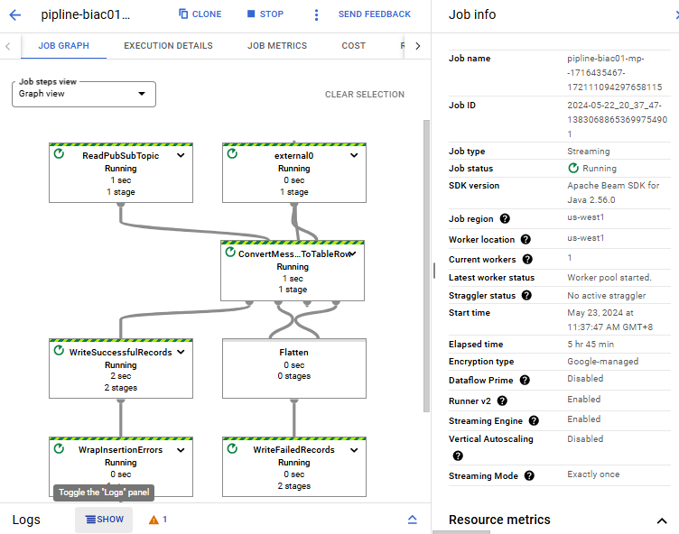
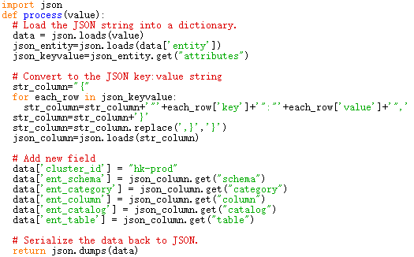
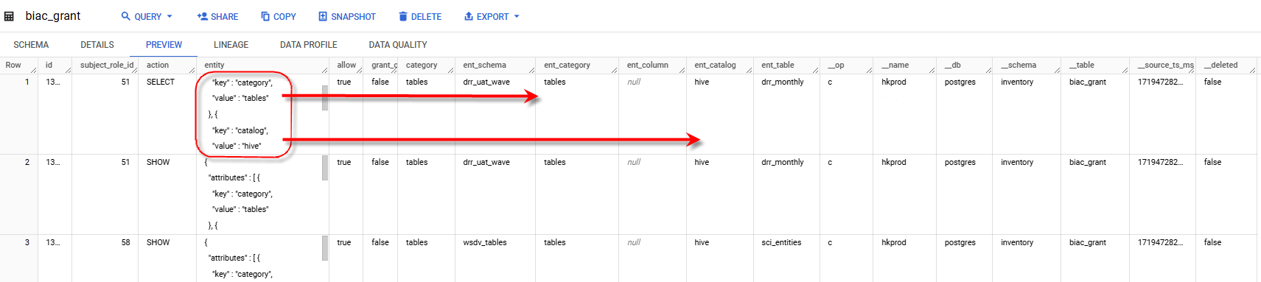
Module Design – Dataflow for complex data transformation
Dataflow is a managed service for executing a wide variety of data processing patterns.
Dataflow is used only with tables that require transformation before landing in BQ, for example, BIAC_grant
Confirmed on 22nd/May
Use UDF(user defined functions) to implement transformation
Python is preferred for UDF.

Slide 13
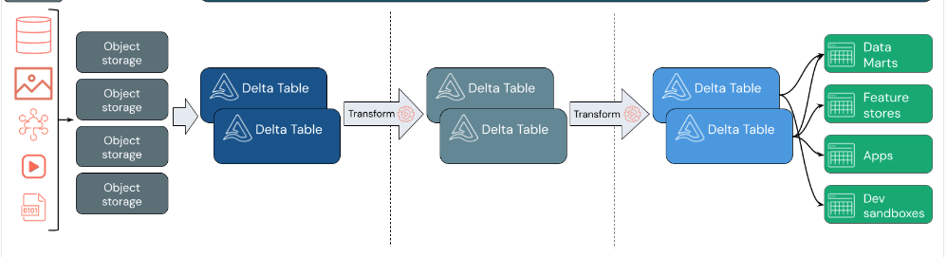
Module Design – Big Query Table Design
The medallion architecture describes a series of data layers that denote the quality of data stored in the lakehouse. We recommends taking a multi-layered approach to building a single source of truth for enterprise data products. This architecture guarantees atomicity, consistency, isolation, and durability as data passes through multiple layers of validations and transformations before being stored in a layout optimized for efficient analytics. The terms bronze (raw), silver (validated), and gold (enriched) describe the quality of the data in each of these layers.
Ingest raw data to the bronze layer
Validate and deduplicate data in the silver layer
Power analytics with the gold layer

Slide 14
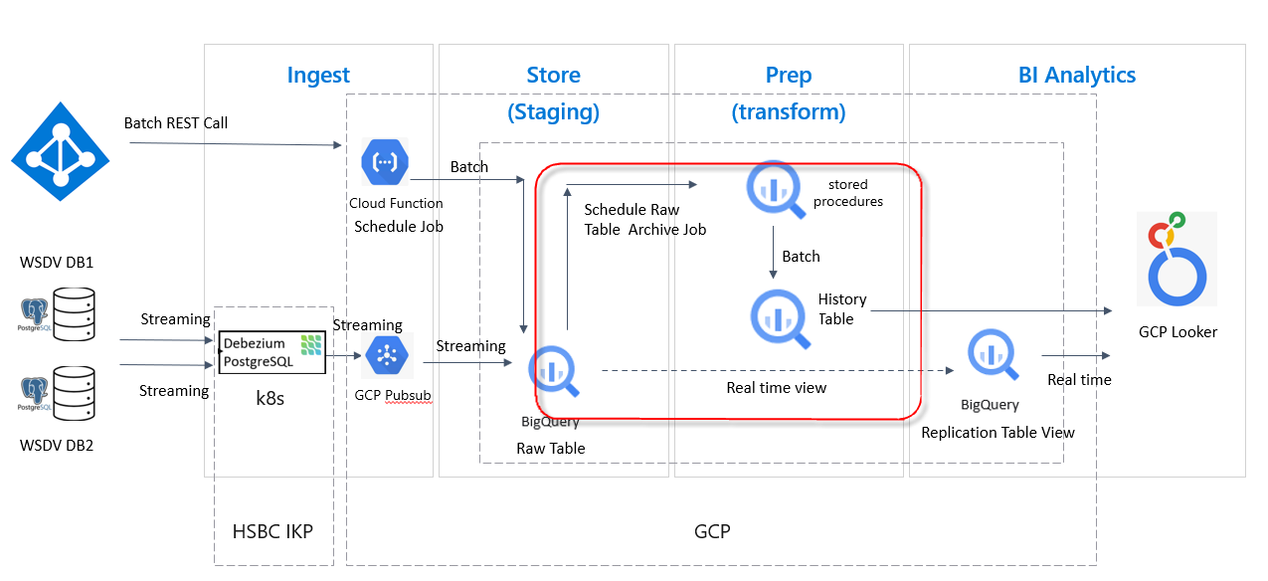
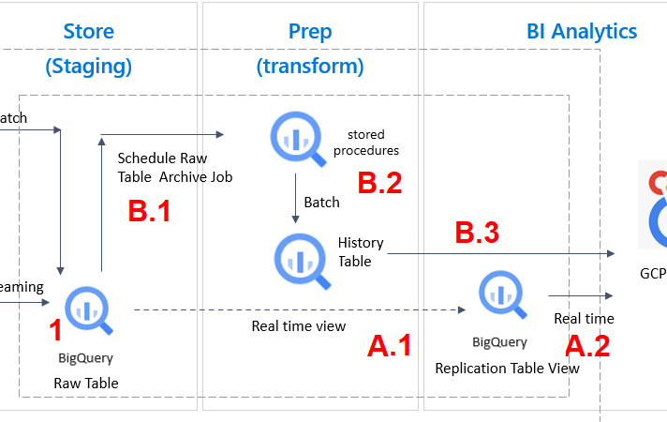
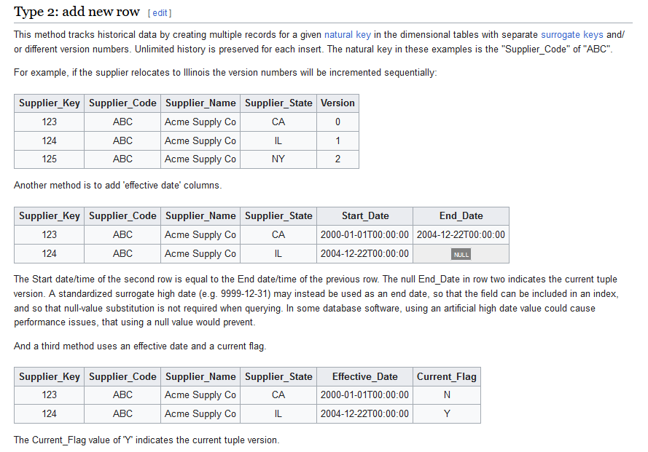
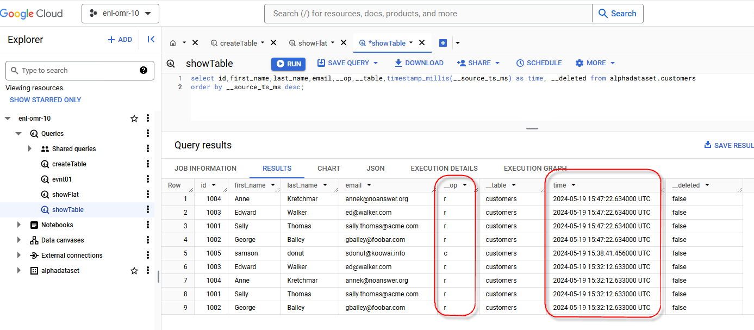
Module Design – History table
PG source tables are basically time-series like appending table
1.Raw layer(bronze) captures every create, update, delete with timestamp
Real time view
A.1 view or BQ query transformation is applied to stream the consolidated table to reporting DB
A.2 users consumes latest updated reporting DB data
B.1 scheduled archive job is run to retrieve raw data
B.2 BQ stored procedure transforms raw to desired history table, adding version/effective date to achieve SCD type2 capability
B.3 users consumes historical data with extra granularity and detail according to their needs.

Slide 15
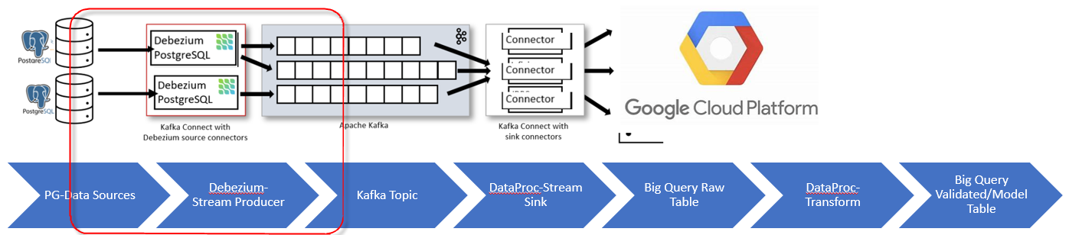
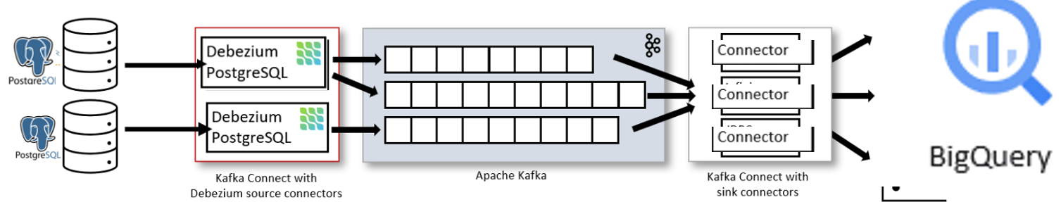

Deployment pattern & DR implementations
PG-Data Sources
Debezium-Stream Producer
Kafka Topic
1.Debezium deploy options:
Kubernetes
Redhat Openshift
2. Docker & Kubernetes deployment recommended
For fast startup & expansion
Less maintenance effort
3. Can leverage HSBC K8S or private cloud infra
K8S: 3+1+1 Debezium containers
Private cloud VM: 3+1+1 containers on 2x VM
1
2
3
HSZ firewall
4. DR implementations
(1)Debezium can resume on DBs restart via snapshot mechanism
(2)&(3) duplicate events can exist;
<offset setting>;
Logic defined in consumer anticipating duplicate events
Debezium deploy on K8S
https://debezium.io/documentation/reference/stable/operations/kubernetes.html
What if consumer or Debezium or PG crashes?
https://debezium.io/documentation/faq/#what_happens_when_an_application_stops_or_crashes
https://debezium.io/documentation/reference/stable/connectors/postgresql.html#postgresql-becomes-unavailable
https://debezium.io/documentation/reference/stable/connectors/postgresql.html#postgresql-kafka-connect-process-crashes

Slide 16


Deployment pattern – component view
HSBC IKP
Alerts
Log analysis
HSBC JMX monitor
GCP Cloud monitoring
No
transform
UK PROD
Pod
UK01
PV
Persist volume
40+18 topics
GCP Looker
Pod
UK02
tables
views
UK DISC
IKP cluster UK
transform
GCP Pubsub
GCP Looker
HK PROD
Pod
HK01
GCP region EURO-2(London)
Dataflow
PV
GCP inter-region
backbone
IKP requirements (HSBC DEV env)
Cluster in UK & HK dev; 2 pods in each
Namespace OMR
Available storage classes – pd.csi.storage
Helm chart will be provided for deploy
Outbound 'googleapis.l.google.com' or CNAME 'pubsub.googleapis.com'
DSW01
Pod
DSW01
IKP cluster HK
GCP Looker

Slide 17
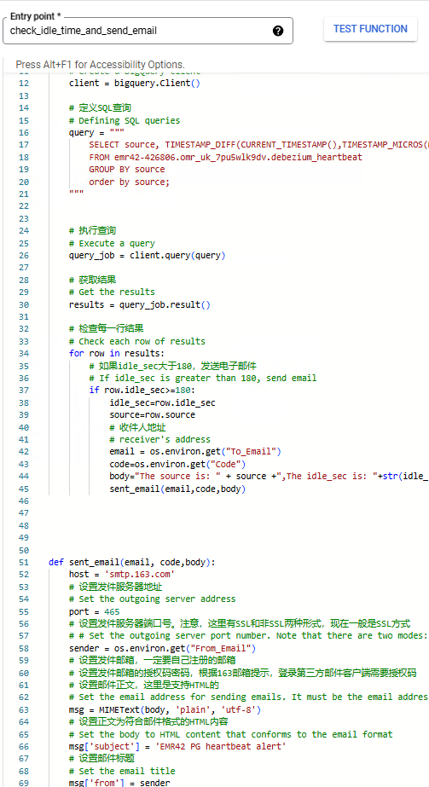
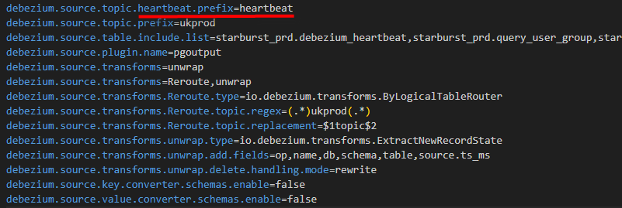
PG->BQ heartbeat detect
Debezium heartbeat is implemented though PG->BQ->email alert if heart beat not detected for 180 second continuous
GCP Cloud function
Email alert

Slide 18
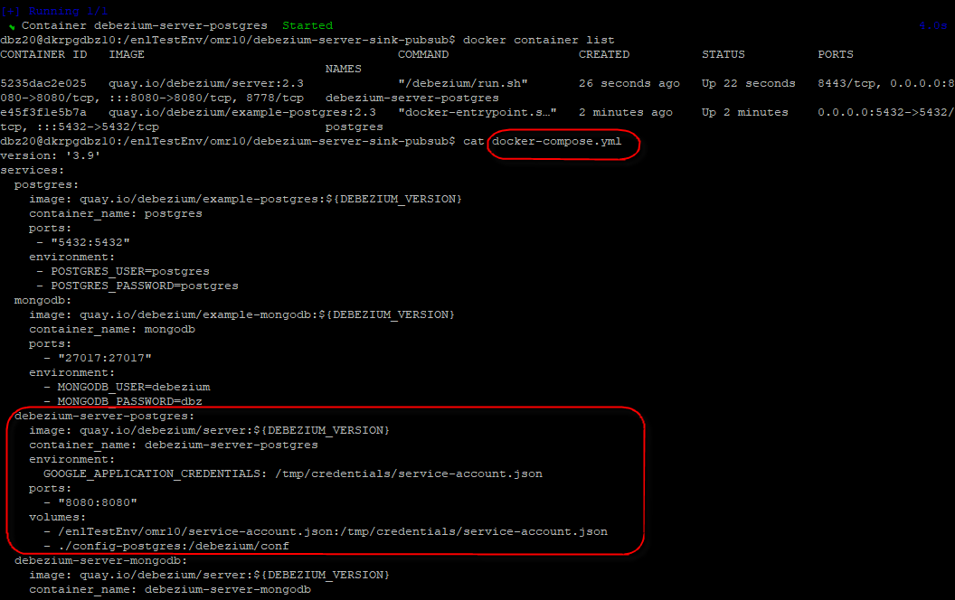
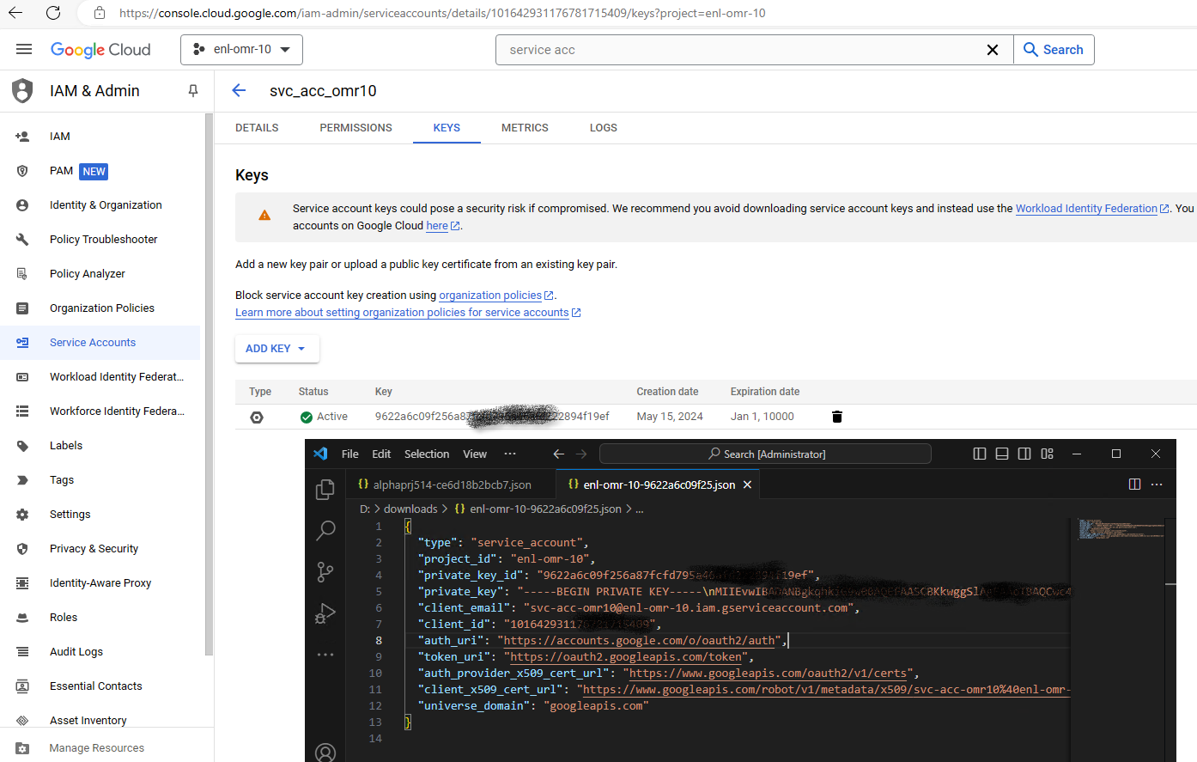
Deploy pattern design – CI/CD for deploy
Code pattern in configurable & modular .yml, .json, de-coupled modules design (using key, tag) to enable CI/CD
Direct call-log-sprint-test circle in dev & test stage
To integrate with Jenkins / GCP Cloudbuild Cloudrun; IKP / GCP docker registry, in deploy stage

Slide 19
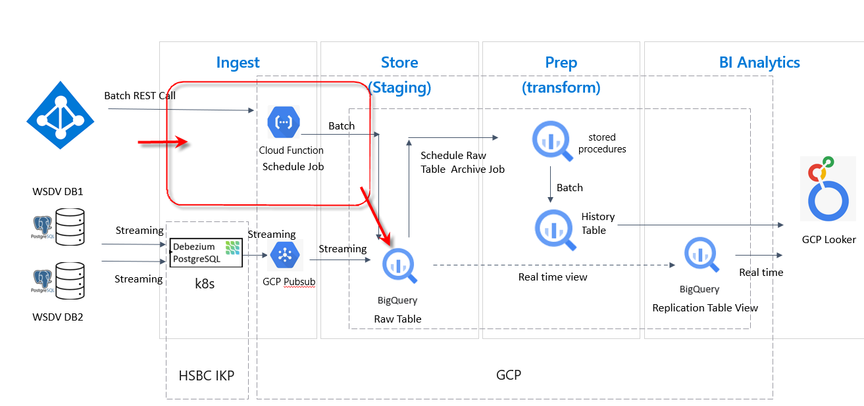
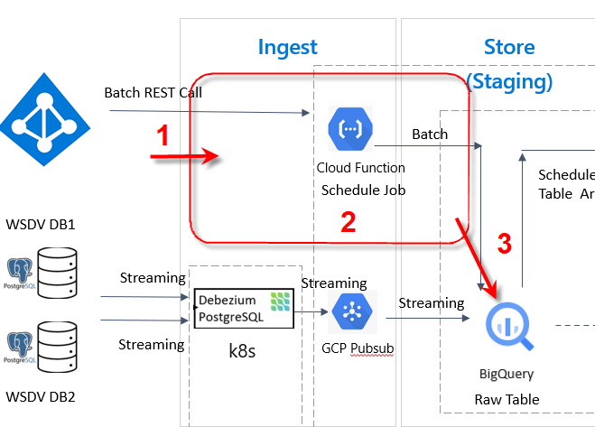
Module design – AD app
Functions of the app
Periodically polls the AD RESTapi to get the AD data
Perform basic clear up
Write output to BQ/pubsub
1. Polls the AD API
Consult the API document to determine 1)what data are available, and compare to the requirements; 2)what restriction exist with polling (min interval, max message length per polling, etc); 3)authentication to the API;
implement the API call, cache the return message in the app for step 2
Suggest 1-hour interval to avoid triggering security concern
2. Basic clean up
Add timestamp(if not provided by the API) of message arrives the app
Clean up extra noisy JSON structs
flatten the data structure
3. Write output
Authenticate to BQ with project ID and service account provided
Append to configured dataset.table in JSON format with two column <“user_name”>, <“data”> string column. Example format:
[{"user_name":"edwalker","data": {"id":1003,"first_name":"Edward","last_name":"Walker","email":"ed@walker.com", "__deleted":"false","__op":"r","__source_ts_ms":1716132732633}},
{"user_name":"salthomas","data": {"id":1001,"first_name":"Sally","last_name":"Thomas", "email":"sally.thomas@acme.com","__deleted":"false","__op":"r","__source_ts_ms":1716132732633}}]
omradapp.config parameters
(AD) API_URI; ad_auth_token_path; polling_internal(if <60, enforce = 60min)
(BQ) project_ID; service_account; bq_auth_key_path; dataset_name; table_name;
Other non-functional requirements
Honor API security restrictions
Poll for info needed only; purge cache after appending, do not keep data in app
Code pattern in configurable & modular .yml, .json, de-coupled modules design (using key, tag) to enable CI/CD
AD data is ingested into staging rather than target DB, because the transformation for PG data from raw to gold can incorporate the updated AD data.

Slide 20
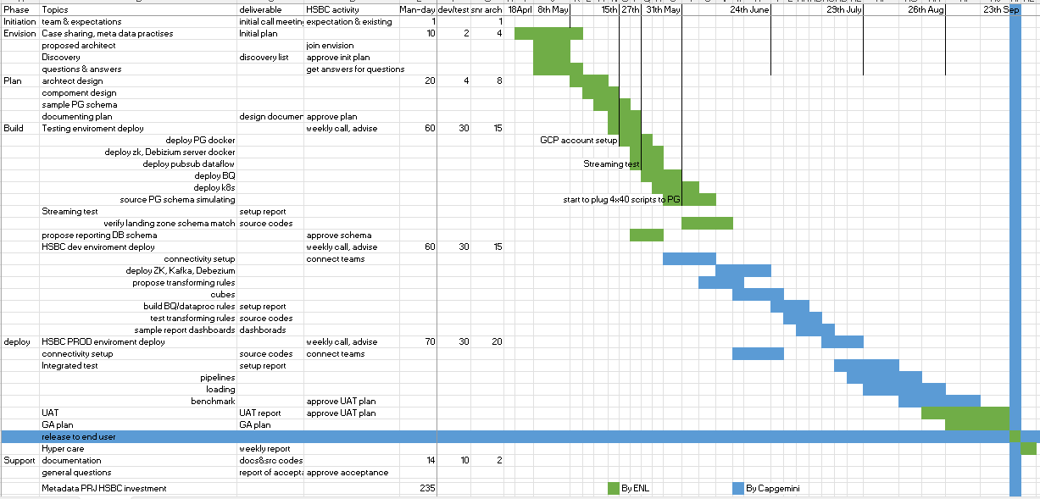
Timeline, Efforts
We are here

Slide 21


Slide 22
APPENDIX

Slide 23
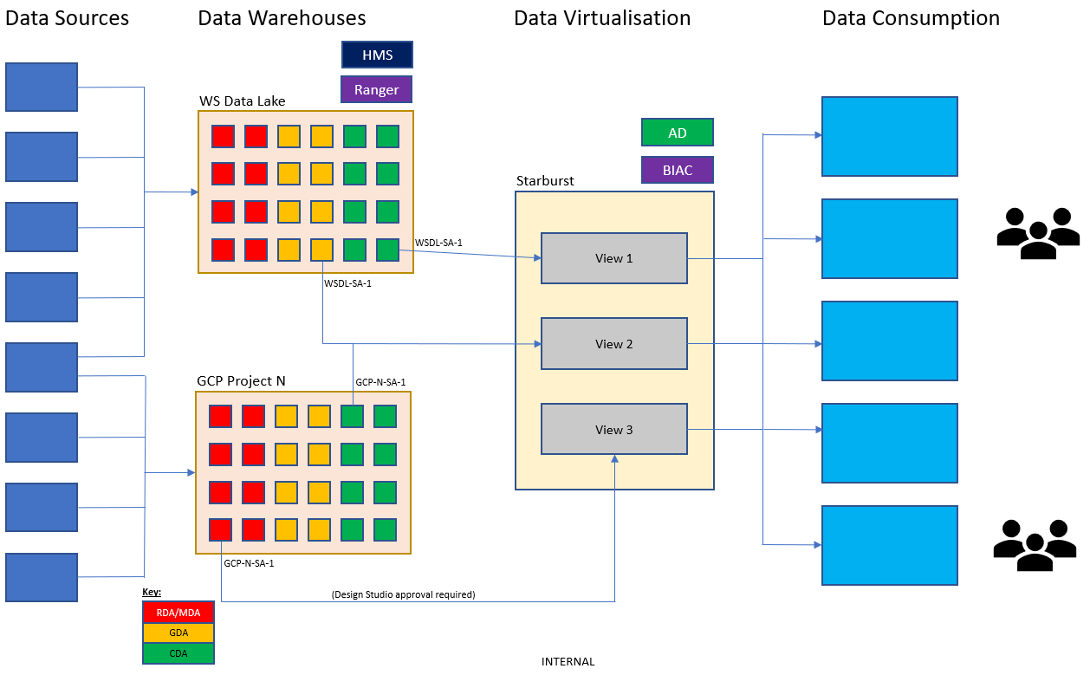
Wholesale Data Virtualisation (WSDV) – high-level architecture

Slide 24

Wholesale Data Virtualisation (WSDV) environments
DNS
DNS
DNS
{
*
Discovery
*
Gateways
UAT/PRE
Prod
PG
PG
PG
{
Coordinators
UK UAT/PRE
HK Prod
Stargate
UK Prod
UK Discovery
{
Workers
…
**
{
*
Databases
PG
PG
*
PG
*
PG
HDP46
HDP12
Ali Cloud
HK GCP
HDP45
HDP12
HDP46
HDP12
Key
HIC
Notes
The local DNS resolves the general domain name alias (e.g. wsdv-prod, wsdv-disc, wsdv-pre) to a local gateway.
The non-HIC databases are on shared DAIS PostgreSQL instances (including the ESG PostgreSQL database and the gateway databases).
The 4 new ESG machines are added as workers to the existing UK Prod cluster.
Starburst resource groups are utilised to allocate resources for ESG and non-ESG consumers.
If a DR scenario occurs, a decision would need to be made on whether ESG users would be allowed to access the Starburst DR environment.
New workers could be added up to about a 30-worker cluster size before the coordinator might start to become a bottleneck. At that point, a new cluster would be needed with the gateway using a round-robin approach to send requests to the different coordinators.
WGDC
SYGDC
*High availability
**Other workers, e.g for WCL
Data

