Slide 1
Views of your Model

Slide 2
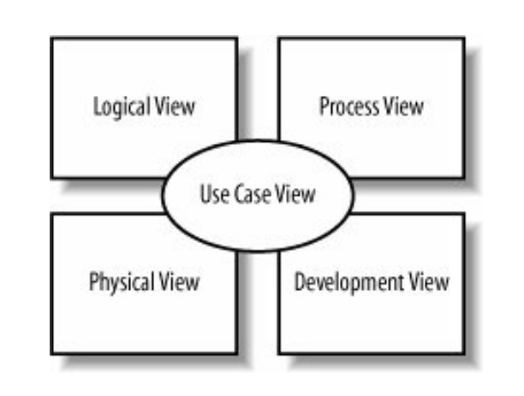
Philippe Kruchten's 4+1 view model

Slide 3
Logical View
Describes the abstract descriptions of a system's parts. Used to model what a system is made up of and how the parts interact with each other. The types of UML diagrams that typically make up this view include class, object, state machine, and interaction diagrams.

Slide 4
Use Cases
A use case is a case (or situation) where your system is used to fulfill one or more of your user's requirements; a use case captures a piece of functionality that the system provides.
Use cases specify only what your system is supposed to do, i.e., the system's functional requirements. They do not specify what the system shall not do, i.e., the system's nonfunctional requirements. Nonfunctional requirements often include performance targets and programming languages.

Slide 5
Use Cases
use cases can be assigned to teams or individuals to be implemented and, since a use case represents tangible user value, you can track the progress of the project by use cases delivered.
If and when a project gets into schedule trouble, use cases can be jettisoned or delayed to deliver the highest value soonest.

Slide 6
Use Cases
use cases also help construct tests for your system. Use cases provide an excellent starting point for building your test cases and procedures because they precisely capture a user's requirements and success criteria.

Slide 7
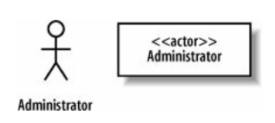
Example: Content Management System
Requirement A.1:
CMS contains an Administrator actor that interacts with the system to create a blog account
An actor is drawn in UML notation using either a "stick man" or a stereotyped box
Stereotypes signify a special use or intent and can be applied to almost any element of UML notation

Slide 8
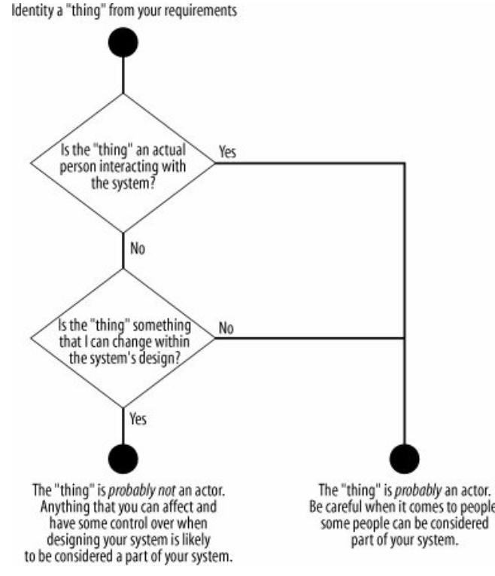
What is an actor?

Slide 9
Refining Actors
Actors may be related to each other
An administrator is a special kind of user with more functionality
Both administrator and user are actors in this case

Slide 10
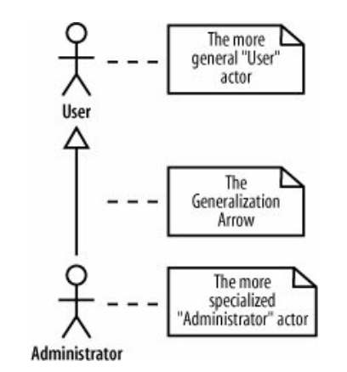
Refining Actors

Slide 11
Use Cases
A use case defines a use of the system. It can either be simple or complex as long as the system is being used
A use case is something that provides some measurable result to the user or an external system. Any piece of system behavior that meets this simple test is likely to be a good candidate for a use case.
A use case in UML is drawn as an oval with a name that describes the interaction that it represents
Create a new Blog Account

Slide 12
Communication Lines
A communication line connects an actor and a use case to show the actor participating in the use case.
A communication line joins the Administrator actor to the "Create a new Blog Account" use case; the Administrator is involved in the interaction that the use case represents
Create a new Blog Account
Administrator

Slide 13
Communication Lines
There is potential to have any number of actors involved in a use case. There is no theoretical limit to the number of actors that can participate in a use case.
Login
Administrator
Author Credential Database
User

Slide 14
System Boundaries
Although there is an implicit separation between actors (external to your system) and use cases (internal to your system) that marks your system's boundary, UML does provide another small piece of notation if you want to make things crystal clear.
To show your system's boundary on a use case diagram, draw a box around all of the use cases but keep the actors outside of the box. It's also good practice to name your box after the system you are developing
Content Management
System
Create a new Blog Account
Administrator

Slide 15
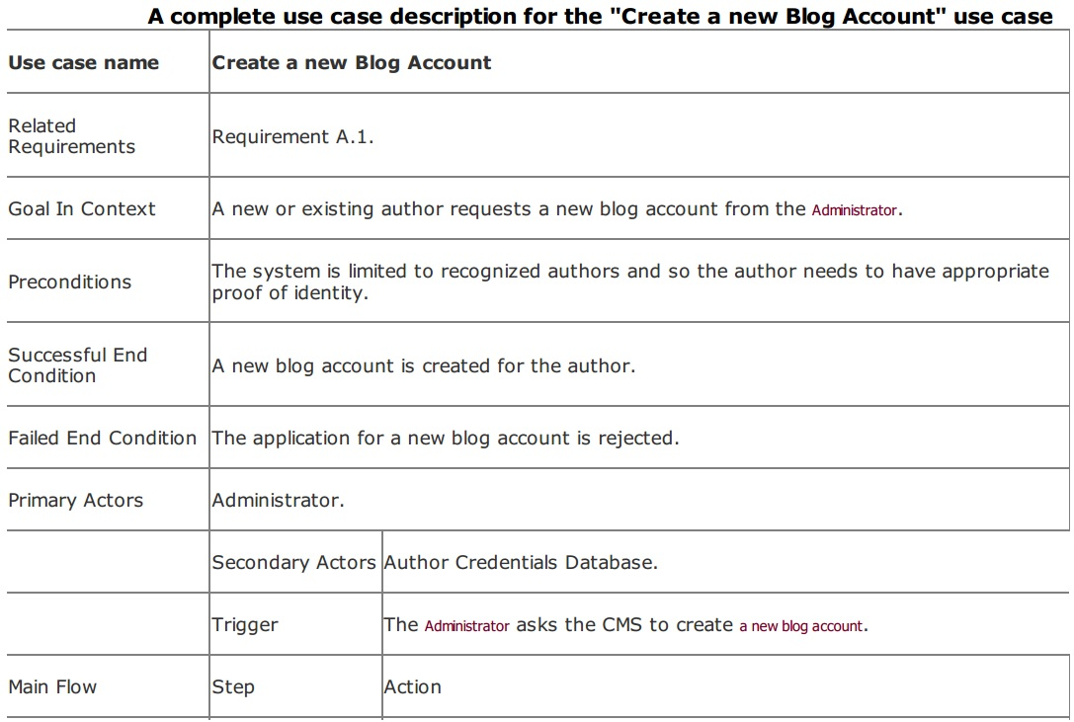

Slide 16
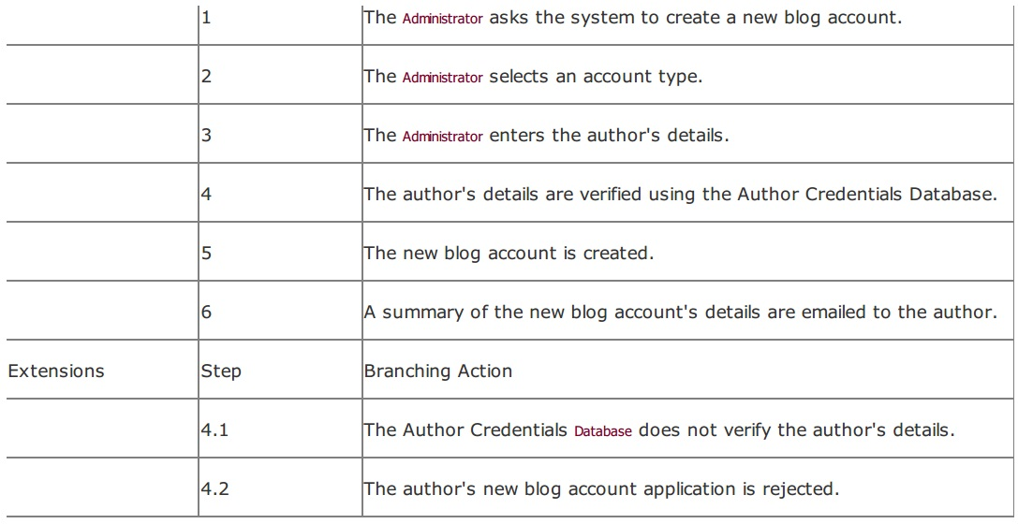

Slide 17
Fixing the use case diagram
Content Management
System
Create a new Blog Account
Administrator
Author Credential
Database

Slide 18
The <<include>> Relationship
Relationships between use cases are more about breaking your system's behavior into manageable chunks than adding anything new to your system.
The purpose of use case relationships is to provide your system's designers with some architectural guidance so they can efficiently break down the system's concerns into manageable pieces within the detailed system design.

Slide 19
The <<include>> Relationship
Suppose we add another requirement
Requirement A.2:
The content management system shall allow an administrator to create a new personal Wiki, provided the personal details of the applying author are verified using the Author CredentialsDatabase.
Content Management
System
Create a new Blog Account
Administrator
Create a new Wiki
Author Credential
Database

Slide 20
The <<include>> Relationship
There is redundancy because both the use cases will require the Author Credential Database to verify the user.
This repetitive behavior shared between two use cases is best separated and captured within a totally new use case. This new use case can then be reused by the Create a new Blog Account and Create a new Personal Wiki use cases using the <<include>> relationship.

Slide 21
The <<include>> Relationship
Content Management
System
Create a new Blog Account
<<include>>
Check identity
Administrator
Create a new Wiki
<<include>>
Author Credential
Database

Slide 22
Special cases
Content Management
System
Create a new Wiki
<<include>>
Check identity
Administrator
Create a new Blog Account
<<include>>
Author Credential
Database
Create a Regular Blog Account
Create an Editorial Blog Account

Slide 23
The <<extend>> Relationship
a use case might completely reuse another use case's behavior, similar to the <<include>> relationship, but that this reuse was optional and dependent either on a runtime or system implementation decision
From the CMS example, the Create a new Blog Account use case might want to record that a new author applied for an account and was rejected, adding this information to the author's application history

Slide 24
Content Management
System
Create a new Wiki
<<include>>
<<extend>>
Record Application Failure
Check identity
Administrator
<<extend>>
Create a new Blog Account
<<include>>
Author Credential
Database
Create a Regular Blog Account
Create an Editorial Blog Account

Slide 25
Define Use Cases for your Projects
Define actors
Stereotypes
Use Cases
Include Relationships
Extend Relationships

