Slide 1
Activity Diagram

Slide 2
Activity diagrams allow you to specify how your system will accomplish its goals.
Activity diagrams show high level actions chained together to represent a process occurring in your system.
Activity diagrams are the only UML diagram in the process view of your system's model.

Slide 3
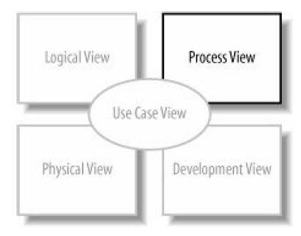

Slide 4
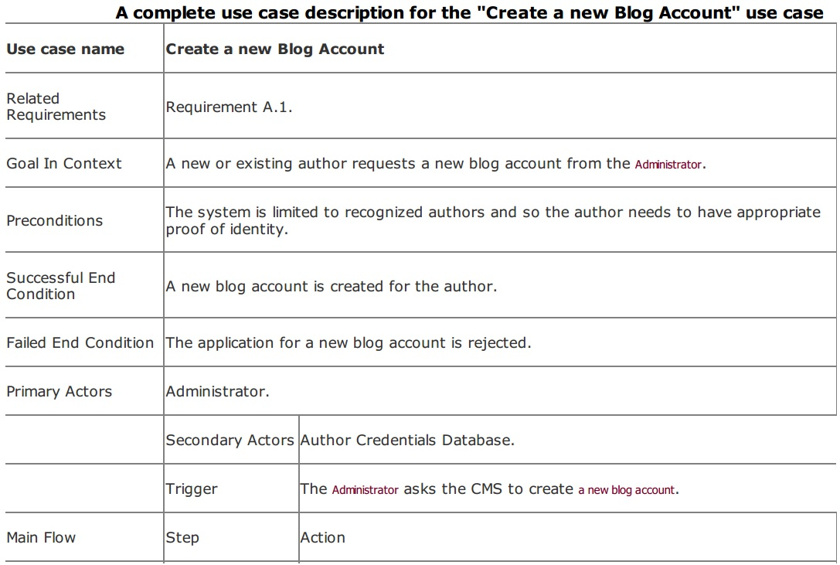

Slide 5
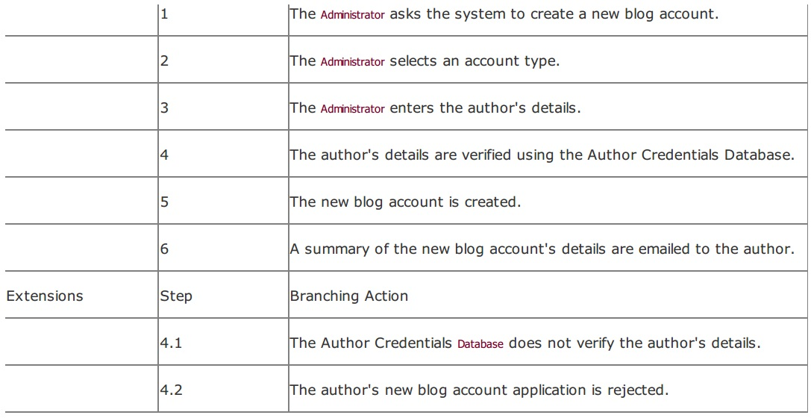

Slide 6
Starting an Activity Diagram
An activity diagram is useful here because it helps you to better visualize a use case's steps.
The activity is launched by the initial node , which is drawn as a filled circle. The initial node simply marks the start of the activity. At the other end of the diagram, the activity final node, drawn as two concentric circles with a filled inner circle, marks the end of the activity

Slide 7
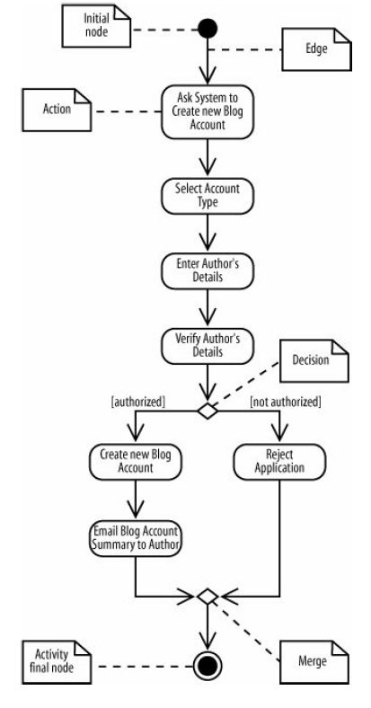

Slide 8
Actions
In between the initial node and the activity final node are actions , which are drawn as rounded rectangles.
Actions are the important steps that take place in the overall activity, e.g., Select Account Type, Enter Author's Details, and so on.
An action could be a behavior performed, a computation, or any key step in the process.

Slide 9
Flow of Activity
The flow of the activity is shown using arrowed lines called edges or paths.
The arrowhead on an activity edge shows the direction of flow from one action to the next.
A line going into a node is called an incoming edge, and a line exiting a node is called an outgoing edge.
Edges string the actions together to determine the overall activity flow.

Slide 10
Decision
The first diamond-shaped node is called a decision, analogous to an if-else statement in code. Notice that there are two outgoing edges from the decision in the above figure, each labeled with Boolean conditions.
Only one edge is followed out of the decision node depending on whether the author is authorized.
The second diamond-shaped node is called a merge. A merge node combines the edges starting from a decision node, marking the end of the conditional behavior.

Slide 11
Activities and Actions
The word "activity" is often mistakenly used instead of "action" to describe a step in an activity diagram, but they are not the same.
An activity is the process being modeled, such as washing a car.
An action is a step in the overall activity, such as Lather, Rinse, and Dry.

Slide 12
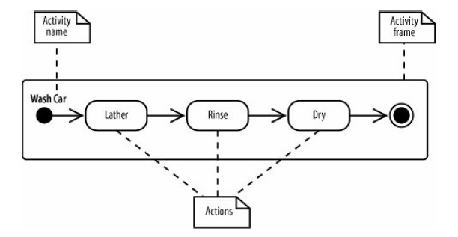

Slide 13
Activity Frame
In the above figure, the entire activity is enclosed within the rounded rectangle called an activity frame .
The activity frame is used to contain an activity's actions and is useful when you want to show more than one activity on the same diagram. Write the name of the activity in the upper left corner.
An activity frame is not necessary and can be omitted

Slide 14
Decisions and Merges
Decisions are used when you want to execute a different sequence of actions depending on a condition.
Decisions are drawn as diamond-shaped nodes with one incoming edge and multiple outgoing edges
Each branched edge contains a guard condition written in brackets. Guard conditions determine which edge is taken after a decision node.
They are statements that evaluate to true or false

Slide 15
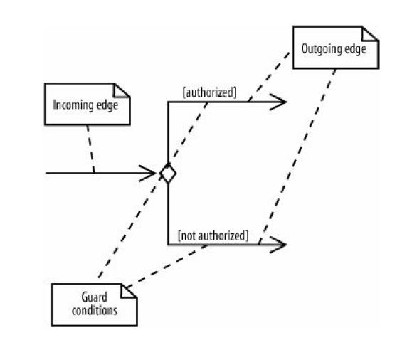

Slide 16
Examples
[authorized]
If the authorized variable evaluates to true, then follow this outgoing edge.
[wordCount >= 100]
If the wordCount variable is greater than or equal to 1,000, then follow this outgoing edge.

Slide 17
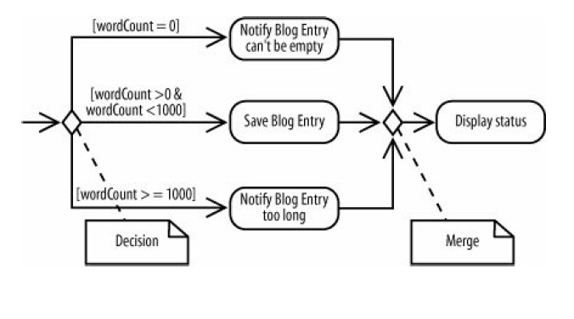
Merges
The branched flows join together at a merge node, which marks the end of the conditional behavior started at the decision node.
Merges are also shown with diamond-shaped nodes, but they have multiple incoming edges and one outgoing edge

Slide 18
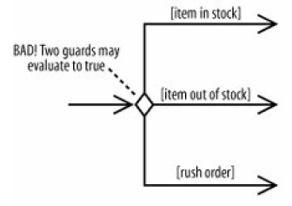
Activity diagrams are clearest if the guards at decision nodes are complete and mutually exclusive. The figure below shows a situation in which the paths are not mutually exclusive.

Slide 19
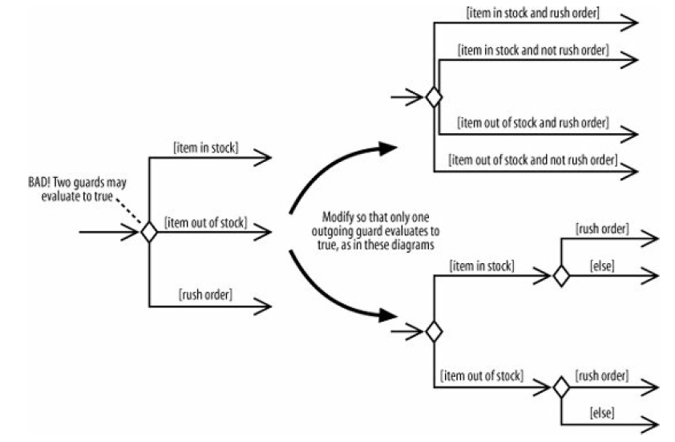

Slide 20
Doing Multiple Tasks at same Time
Consider a computer assembly workflow that involves the following steps:
1. Prepare the case.
2. Prepare the motherboard.
3. Install the motherboard.
4. Install the drives.
5. Install the video card, sound card, and modem.

Slide 21
We can model this workflow sequentially
But we can do the same actions in parallel to speed by the entire activity.
Steps that occur at the same time are said to occur concurrently or in parallel
You represent parallel actions in activity diagrams by using forks and joins, as shown in the activity diagram fragment below

Slide 22
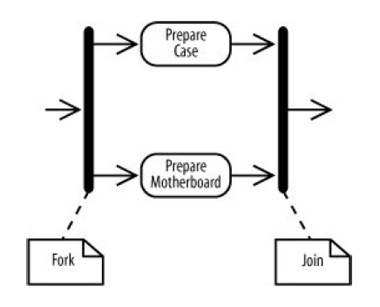
After a fork, the flow is broken up into two or more simultaneous flows, and the actions along all forked flows execute. In the figure below, Prepare Case and Prepare Motherboard begin executing at the same time.
The join means that all incoming actions must finish before the flow can proceed past the join.

Slide 23
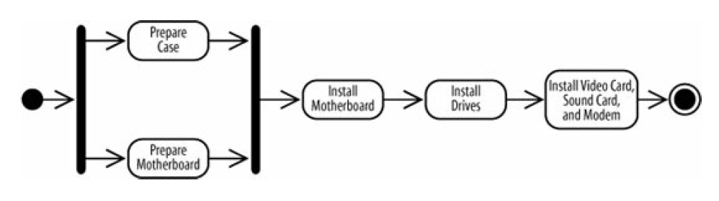
When actions occur in parallel, it doesn't necessarily mean they will finish at the same time. In fact, one task will most likely finish before the other. However, the join prevents the flow from continuing past the join until all incoming flows are complete.

Slide 24
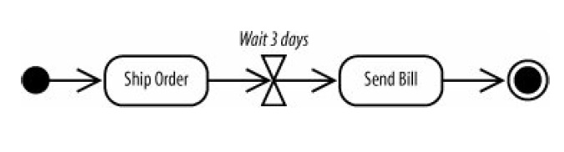
Time Events
Sometimes time is a factor in your activity. You may want to model a wait period, such as waiting three days after shipping an order to send a bill.
You may also need to model processes that kick off at a regular time interval, such as a system backup that happens every week.

Slide 25
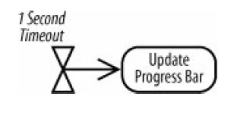
A time event with no incoming flows is a recurring time event, meaning it's activated with the frequency in the text next to the hourglass.
a time event is an alternate way to start an activity. Use this notation to model an activity that is launched periodically.

Slide 26
Calling Other Activities
As detail is added to your activity diagram, the diagram may become too big, or the same sequence of actions may occur more than once.
When this happens, you can improve readability by providing details of an action in a separate diagram, allowing the higher level diagram to remain less cluttered
In the figure below the Prepare Motherboard action now has an upside-down pitchfork symbol indicating that it is a call activity node.
A call activity node calls the activity corresponding to its node name. This is similar to calling a software procedure/function.

Slide 27
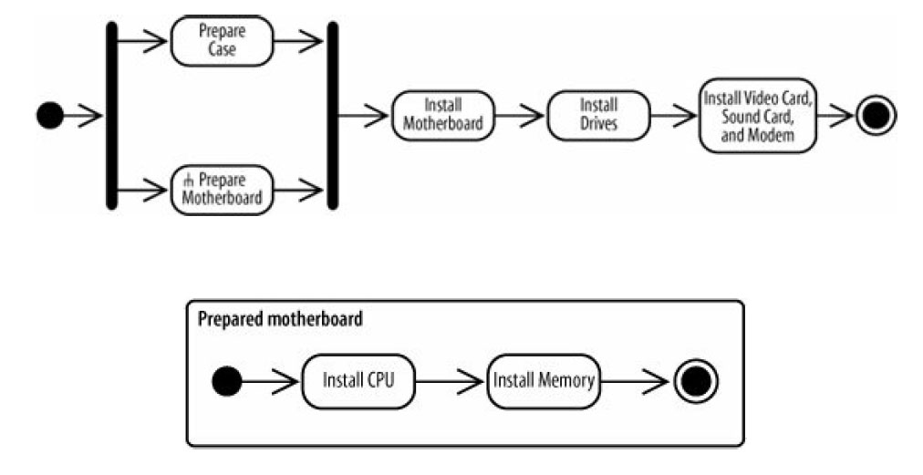

Slide 28
Objects

