Slide 1
Object Oriented Programming
Lecture 11
Polymorphism, and Virtual Functions

Slide 2
Polymorphism
The term polymorphism means the ability to take many forms.
2 types
Compile time polymorphism
Uses static or early binding
Example: Function and operator overloading
Run time polymorphism
Uses dynamic or early binding
Example: Virtual functions

Slide 3
Redefining Base Class Functions
Not the same as overloading – with overloading, parameter lists must be different
Objects of base class use base class version of function; objects of derived class use derived class version of function

Slide 4
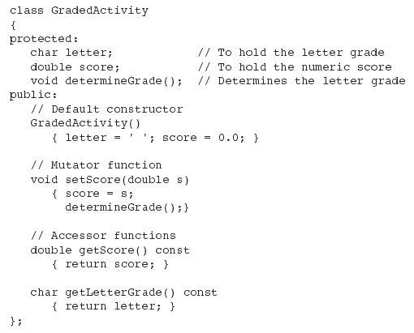
Base Class

Slide 5
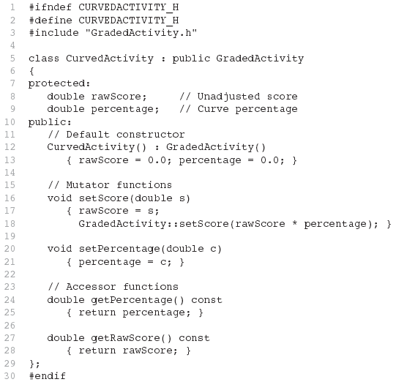
Derived Class
Redefined setScore function

Slide 6
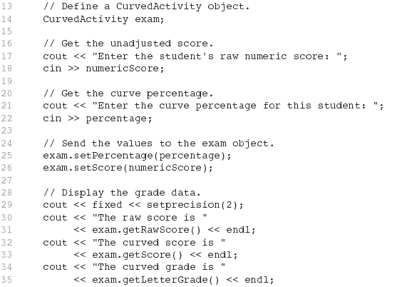
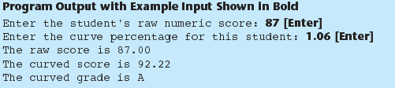
Driver Program

Slide 7
Problem with Redefining
Consider this situation:
Class BaseClass defines functions x() and y(). x() calls y().
Class DerivedClass inherits from BaseClass and redefines function y().
An object D of class DerivedClass is created and function x() is called.
When x() is called, which y() is used, the one defined in BaseClass or the the redefined one in DerivedClass?

Slide 8
Problem with Redefining
BaseClass
void X();
void Y();
Object D invokes function X()
In BaseClass. Function X()
invokes function Y() in BaseClass, not function Y() in DerivedClass,
because function calls are bound at compile time. This is static binding.
DerivedClass
void Y();
DerivedClass D;
D.X();

Slide 9
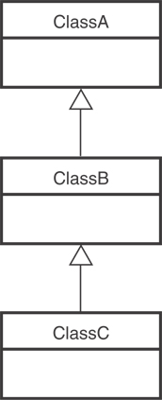
Class Hierarchies
A base class can be derived from another base class.

Slide 10
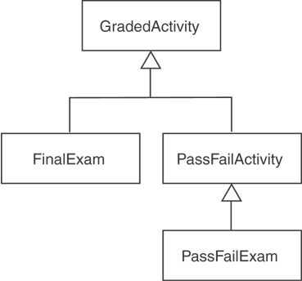
Class Hierarchies
Consider the GradedActivity, FinalExam, PassFailActivity, PassFailExam hierarchy

Slide 11
Pointers to Derived Classes
C++ allows base class pointers to point to derived class objects.
Let we have –
class base { … };
class derived : public base { … };
Then we can write –
base *p1; derived d_obj; p1 = &d_obj;
base *p2 = new derived;

Slide 12
Pointers to Derived Classes (contd.)
Using a base class pointer (pointing to a derived class object) we can access only those members of the derived object that were inherited from the base.
It is different from the behavior that Java shows.
We can get Java-like behavior using virtual functions.
This is because the base pointer has knowledge only of the base class.
It knows nothing about the members added by the derived class.

Slide 13
Pointers to Derived Classes (contd.)
class base {
public:
void show() {
cout << “base\n”;
}
};
class derived : public base {
public:
void show() {
cout << “derived\n”;
}
};
void main() {
base b1;
b1.show(); // base
derived d1;
d1.show(); // derived
base *pb = &b1;
pb->show(); // base
pb = &d1;
pb->show(); // base
}
All the function calls here are statically bound

Slide 14
Pointers to Derived Classes (contd.)
While it is permissible for a base class pointer to point to a derived object, the reverse is not true.
base b1;
derived *pd = &b1; // compiler error
We can perform a downcast with the help of type-casting, but should use it with caution (see next slide).

Slide 15
Pointers to Derived Classes (contd.)
Let we have –
class base { … };
class derived : public base { … };
class xyz { … }; // having no relation with “base” or “derived”
Then if we write –
base b_obj; base *pb; derived d_obj; pb = &d_obj; // ok
derived *pd = pb; // compiler error
derived *pd = (derived *)pb; // ok, valid downcasting
xyz obj; // ok
pd = (derived *)&obj; // invalid casting, no compiler error, but may cause run-time error
pd = (derived *)&b_obj; // invalid casting, no compiler error, but may cause run-time error

Slide 16
Pointers to Derived Classes (contd.)
In fact using type-casting, we can use pointer of any class to point to an object of any other class.
The compiler will not complain.
During run-time, the address assignment will also succeed.
But if we use the pointer to access any member, then it may cause run-time error.

Slide 17
Pointers to Derived Classes (contd.)
Pointer arithmetic is relative to the data type the pointer is declared as pointing to.
If we point a base pointer to a derived object and then increment the pointer, it will not be pointing to the next derived object.
It will be pointing to (what it thinks is) the next base object !!!
Be careful about this.

Slide 18
Important Point on Inheritance
In C++, only public inheritance supports the perfect IS-A relationship.
In case of private and protected inheritance, we cannot treat a derived class object in the same way as a base class object
Public members of the base class becomes private or protected in the derived class and hence cannot be accessed directly by others using derived class objects
If we use private or protected inheritance, we cannot assign the address of a derived class object to a base class pointer directly.
We can use type-casting, but it makes the program logic and structure complicated.

Slide 19
Introduction to Virtual Functions
A virtual function is a member function that is declared within a base class and redefined (called overriding) by a derived class.
The keyword virtual is used to designate a member function as virtual.
Supports run-time polymorphism with the help of base class pointers.

Slide 20
Introduction to Virtual Functions (contd.)
While redefining a virtual function in a derived class, the function signature must match the original function present in the base class.
So, we call it overriding, not overloading.
When a virtual function is redefined by a derived class, the keyword virtual is not needed (but can be specified if the programmer wants).
A class that contains a virtual function is referred to as a polymorphic class.

Slide 21
Introduction to Virtual Functions (contd.)
class base {
public:
virtual void show() {
cout << “base\n”;
}
};
class derived : public base {
public:
void show() {
cout << “derived\n”;
}
};
void main() {
base b1;
b1.show(); // base - (s.b.)
derived d1;
d1.show(); // derived – (s.b.)
base *pb = &b1;
pb->show(); // base - (d.b.)
pb = &d1;
pb->show(); // derived (d.b.)
}
Here,
s.b. = static binding
d.b. = dynamic binding

Slide 22
Polymorphism and Virtual Member Functions
Virtual member function: function in base class that expects to be redefined in derived class
Function defined with key word virtual:
virtual void Y() {...}
Supports dynamic binding: functions bound at run time to function that they call
Without virtual member functions, C++ uses static (compile time) binding

Slide 23
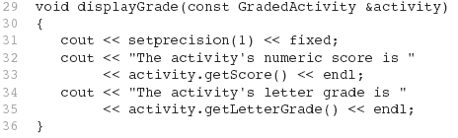
Polymorphism and Virtual Member Functions
Because the parameter in the displayGrade function is a GradedActivity reference variable, it can reference any object that is derived from GradedActivity. That means we can pass a GradedActivity object, a FinalExam object, a PassFailExam object, or any other object that is derived from GradedActivity.
A problem occurs in Program 15-10 however...

Slide 24
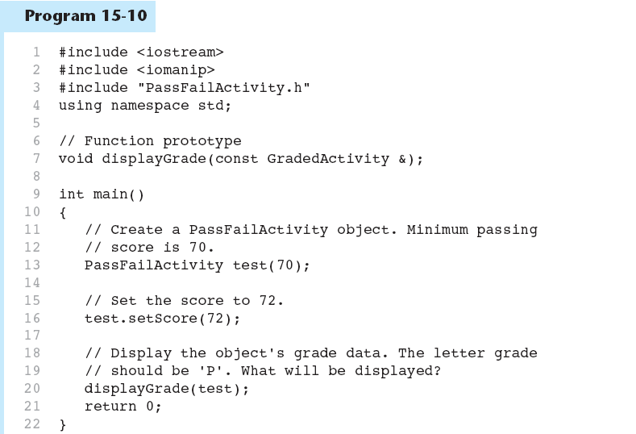

Slide 25
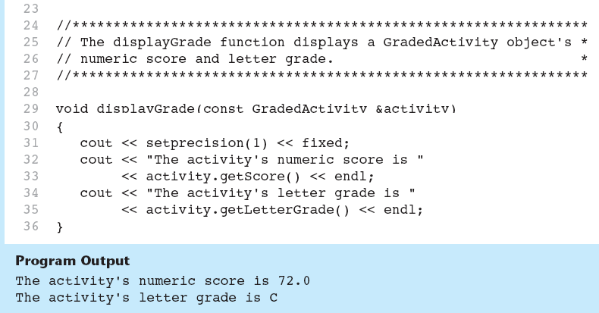
As you can see from the example output, the getLetterGrade member function returned ‘C’ instead of ‘P’. This is because the GradedActivity class’s getLetterGrade function was executed instead of the PassFailActivity class’s version of the function.

Slide 26
Static Binding
Program 15-10 displays 'C' instead of 'P' because the call to the getLetterGrade function is statically bound (at compile time) with the GradedActivity class's version of the function.
We can remedy this by making the function virtual.

Slide 27
Virtual Functions
A virtual function is dynamically bound to calls at runtime. At runtime, C++ determines the type of object making the call, and binds the function to the appropriate version of the function.

Slide 28
Virtual Functions
To make a function virtual, place the virtual key word before the return type in the base class's declaration:
virtual char getLetterGrade() const;
The compiler will not bind the function to calls. Instead, the program will bind them at runtime.

Slide 29
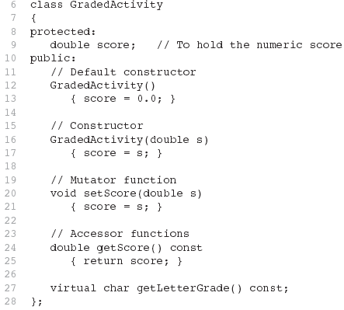
Updated Version of GradedActivity
The function is now virtual.
The function also becomes virtual in all derived classes automatically!

Slide 30

Polymorphism
If we recompile our program with the updated versions of the classes, we will get the right output, shown here:
This type of behavior is known as polymorphism. The term polymorphism means the ability to take many forms.
Program 15-12 demonstrates polymorphism by passing
objects of the GradedActivity and PassFailExam classes to the displayGrade function.

Slide 31
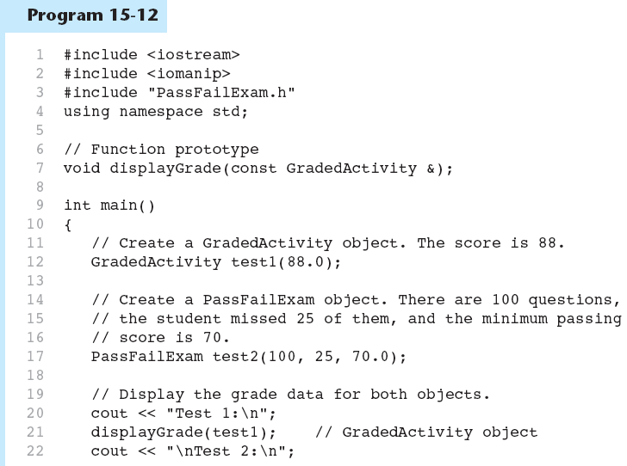

Slide 32
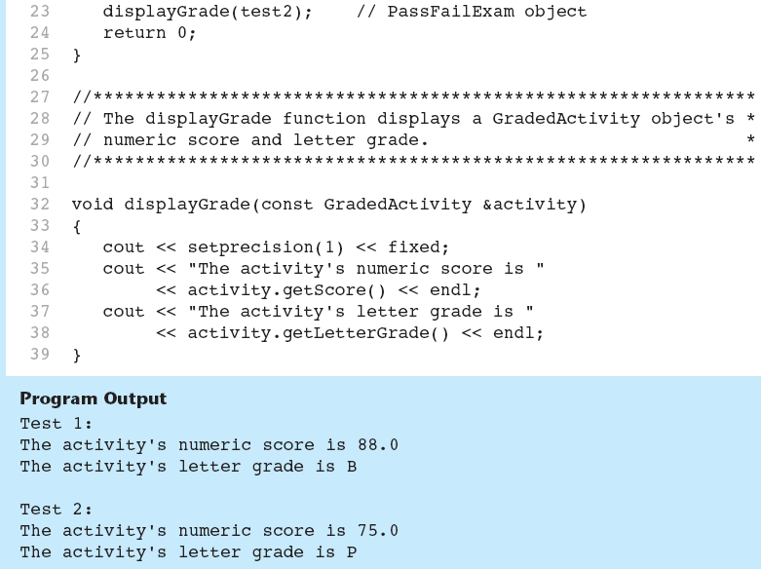

Slide 33
Polymorphism Requires References or Pointers
Polymorphic behavior is only possible when an object is referenced by a reference variable or a pointer, as demonstrated in the displayGrade function.

Slide 34

Base Class Pointers
Can define a pointer to a base class object
Can assign it the address of a derived class object

Slide 35
Base Class Pointers
Base class pointers and references only know about members of the base class
So, you can’t use a base class pointer to call a derived class function
Redefined functions in derived class will be ignored unless base class declares the function virtual

Slide 36
Redefining vs. Overriding
In C++, redefined functions are statically bound and overridden functions are dynamically bound. So, a virtual function is overridden, and a non-virtual function is redefined.

Slide 37
Virtual Destructors
It's a good idea to make destructors virtual if the class could ever become a base class.
Otherwise, the compiler will perform static binding on the destructor if the class ever is derived from.

