Slide 1
Class Relationships
*taken from http://www.classdraw.com/help.htm

Slide 2
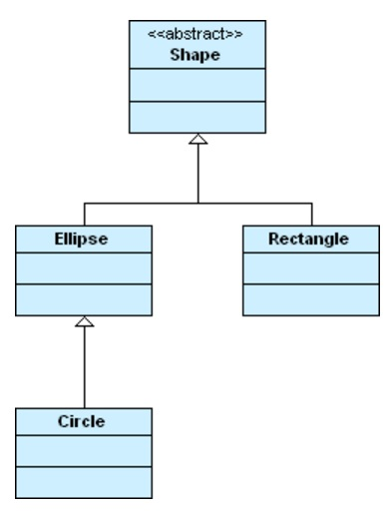
Generalization
The inheritance relationship, also known as the generalization relationship, is used to indicate that one class is a specialization of another.

Slide 3
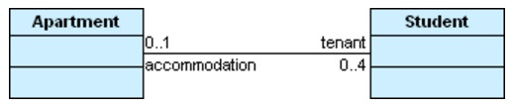
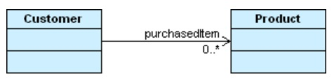
Association
An association is a relationship between two classes represented by a solid line. Associations are bi-directional by default, so both classes know about each other and about the relationship between them. Their life cycles are independent
Associations can also be unidirectional, where one class knows about the other class and the relationship but the other class does not. Such associations require an open arrowhead to point to the class that is known and only the known class can have a role name and multiplicity.

Slide 4
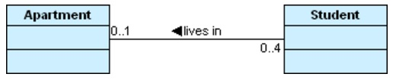
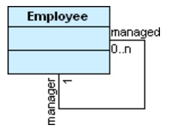
Association
An alternative to using role names is to provide a single name for an association centered between the two classes. A direction indicator can also be used to show the direction of the name
An association can also link a class to itself. Such an association is reflexive

Slide 5
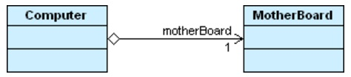
Aggregation
Aggregation is a relationship where one class is part of another class. In basic aggregation, the class that forms part of the whole class can exist independently, so the life of an instance of the part class is not determined by the whole class.

Slide 6
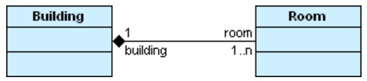
Composition
Composition is a strong type of aggregation where the whole class contains the instance of the part class. The lifetime of the part class depends on the existence of the whole class.

Slide 7
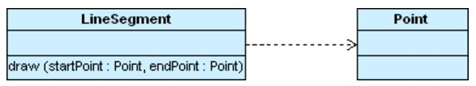
Dependencies
A dependency is a weak relationship between two classes and is represented by a dotted line. What this means is that one class might use another class, but not have it as a data type inside the class

Slide 8
How to define the relationships in your last assignment?
For C++ implementation and more details, kindly this link: http://www.learncpp.com/cpp-tutorial/10-1-object-relationships/

