Slide 1
UML Class Diagrams Explained
Reference: https://cppcodetips.wordpress.com/2013/12/23/uml-class-diagram-explained-with-c-samples/

Slide 2
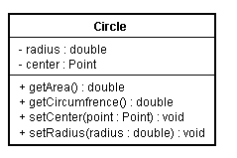
How to translate into C++ code? Please Write!

Slide 3
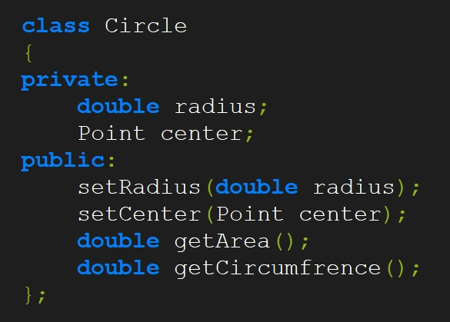

Slide 4
Different type of members in a class
1) Static members are represented as underlined.
2) Pure virtual functions are represented as italics.

Slide 5
Class relationships
Association (knows a)
Dependency (uses a)
Composition (has a)
Aggregation (has a)
Inheritance (is a)

Slide 6
Different Multiplicity in a relation
“0..1” No instances, or one instance (optional, may) “1” Exactly one instance “0..* or *” Zero or more instances “1..*” One or more instances (at least one)
“1..n” One or more instances to a maximum of n (at least one)

Slide 7

Association
One object is aware of another; it contains a pointer or reference to another object.

Slide 8
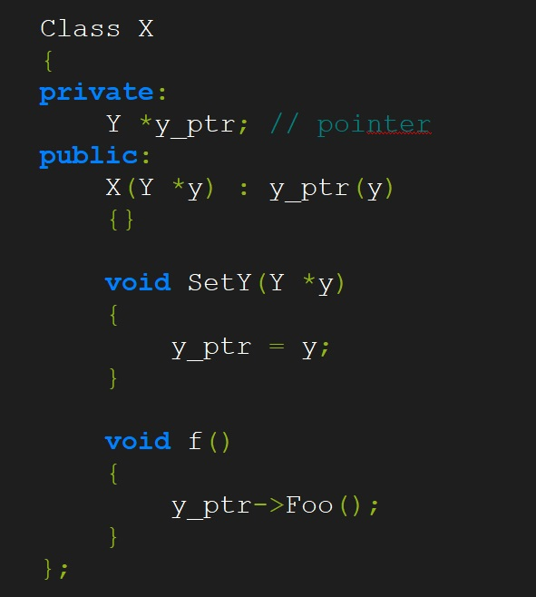

Slide 9

Dependency
One class depends on another if the independent class is a parameter variable or local variable of
a method of the dependent class

Slide 10
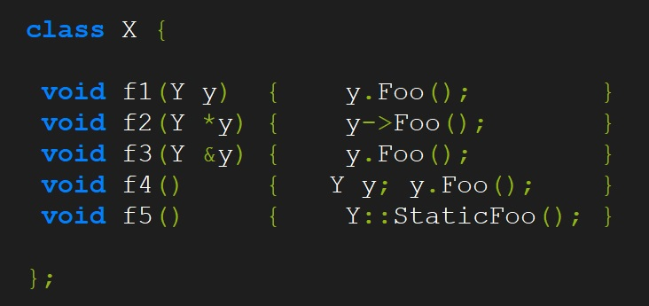

Slide 11

Aggregation
Aggregation can occur when a class is a collection or container of other classes, but where the contained classes do not have a strong life cycle dependency on the container—essentially, if the container is destroyed, its contents are not. You may have confusion between aggregation and association .Association differs from aggregation only in that it does not imply any containment.

Slide 12
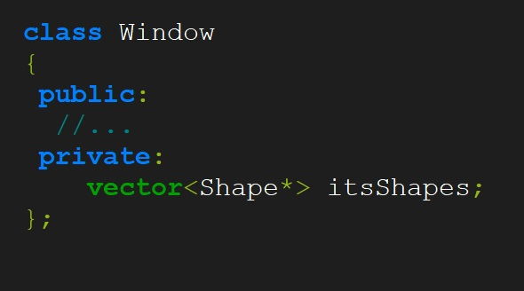
Think assignment # 3; Shapes were aggregated into a linked list

Slide 13

Composition
Composition is the stronger form of aggregation. Composition can occur when a class is a collection or container of other classes, but where the contained classes have a strong life cycle dependency on the container—essentially, if the container is destroyed, its contents are also destroyed

Slide 14
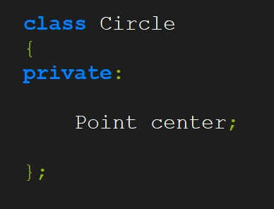
Composition
Think about your Button lab, where the Word was part of Button and Character was part of Word

Slide 15
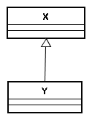
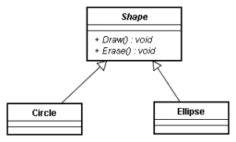
Inheritance
In Inheritance relationship a class is derived from another class. It is a “is a” relationship between two
Abstract Class as it is in italics
Pure Virtual functions in italics

Slide 16
FTL Design Exercise
https://www.youtube.com/watch?v=VTiXakTBtU4

Slide 17
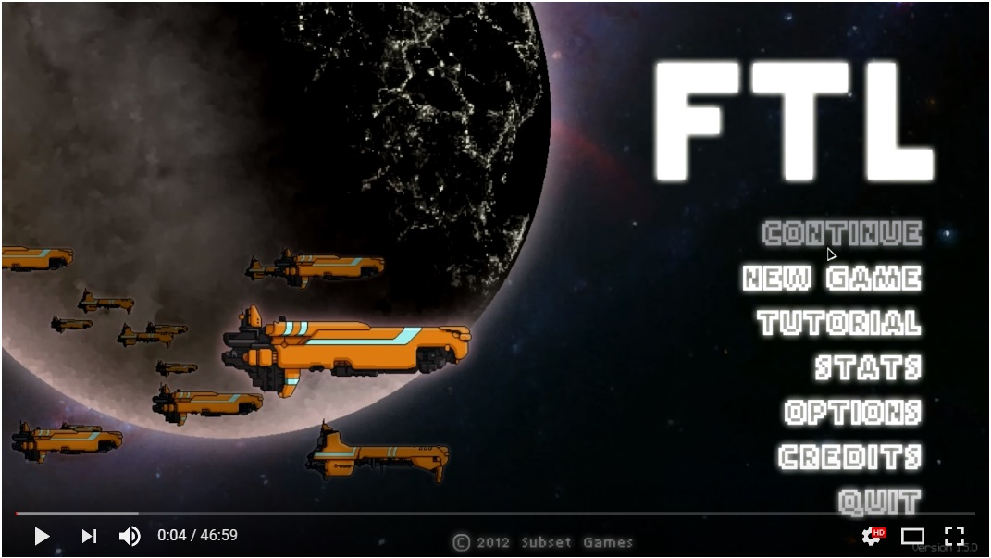

Slide 18
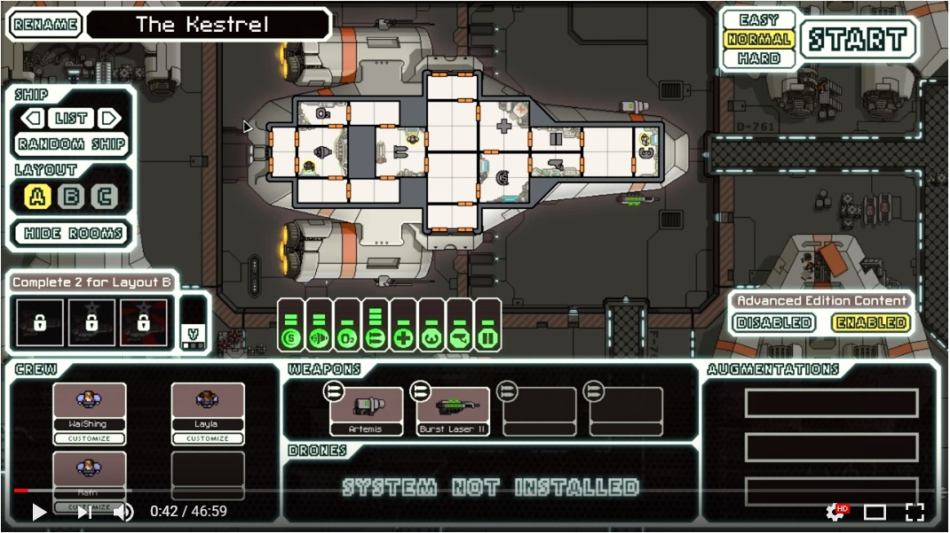

Slide 19
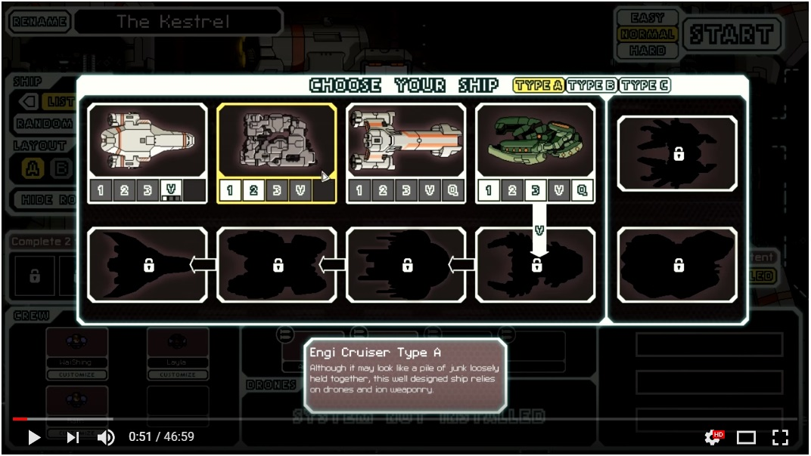

Slide 20
