Slide 1
PizzaPie M.L Project
A implementation of deep networks to determine the possibility of an image being pizza

Slide 2
What It Does
Classifies what the picture in question could possibly be
Outputs the probability of the image being pizza
If the initial guess is not pizza, the algorithm also outputs its second guess (which could also not be pizza)

Slide 3
Hurdles and Problems
Trouble with creating own network
Resizing of images
Renaming of images
Getting the network to output what I want
Classification Problems

Slide 4
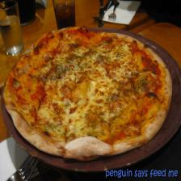
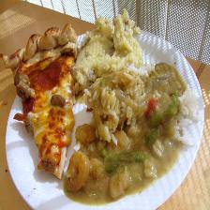
Examples and False Classification

Slide 5


Just to Make Sure…

Slide 6
Moving Forward
I would like to further my own deep network to try to get it to work correctly
In the interest of time, had to use something else

