Slide 1

KALINGA INSTITUTE OF INDUSTRIAL TECHNOLOGY
Cloud Computing
3 Credit
School of Computer Engineering

Slide 2

Unit-III
2
Virtualization

Slide 3
Virtualisation: Concept
3
Virtualization is a technique, which allows to share a single physical instance of a resource or an application among multiple customers and organizations.
It does by assigning a logical name to a physical storage and providing a pointer to that physical resource when demanded.
Virtualization in cloud computing allows you to run multiple applications and OS on the same server, thereby providing for efficient resource utilization and reducing costs.

Slide 4
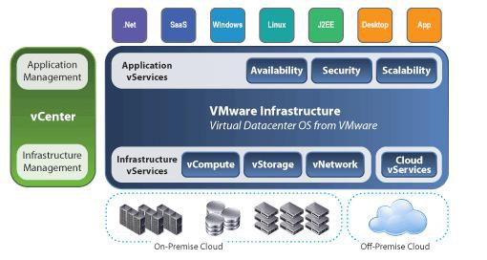
Virtualization Architecture
4

Slide 5
With the help of Virtualization multiple operating systems and applications can run on same Machine and its same hardware at the same time increasing the utilization and flexibility of hardware.
The machine on which the virtual machine is going to be build is known as Host Machine and that virtual machine is referred as a Guest Machine.

Slide 6
Hypervisor
5
The hypervisor is a firmware or low-level program that acts as a Virtual Machine Manager.
Hypervisor is a form of virtualization software used in Cloud hosting to divide and allocate the resources on various pieces of hardware.The program which provide partitioning, isolation or abstraction is called virtualization hypervisor.
Hypervisor is a hardware virtualization technique that allows multiple guest operating systems (OS) to run on a single host system at the same time. A hypervisor is sometimes also called a virtual machine manager(VMM).
There are two types of hypervisor:
Type 1 and Type 2

Slide 7
Types of Hypervisors
6
Type 1 hypervisors run directly on the system hardware. They are often referred to as a "native" or "bare metal" or "embedded" hypervisors in vendor literature. It dose not require any base server operating system.It has direct access to hardware resources
Type 2 hypervisors run on a host operating system that provides virtualization services, such as I/O device and memory management. Basically a software installed on an operatingThey are often referred to as a “Hosted Architecture" hypervisors in vendor literature.

Slide 8
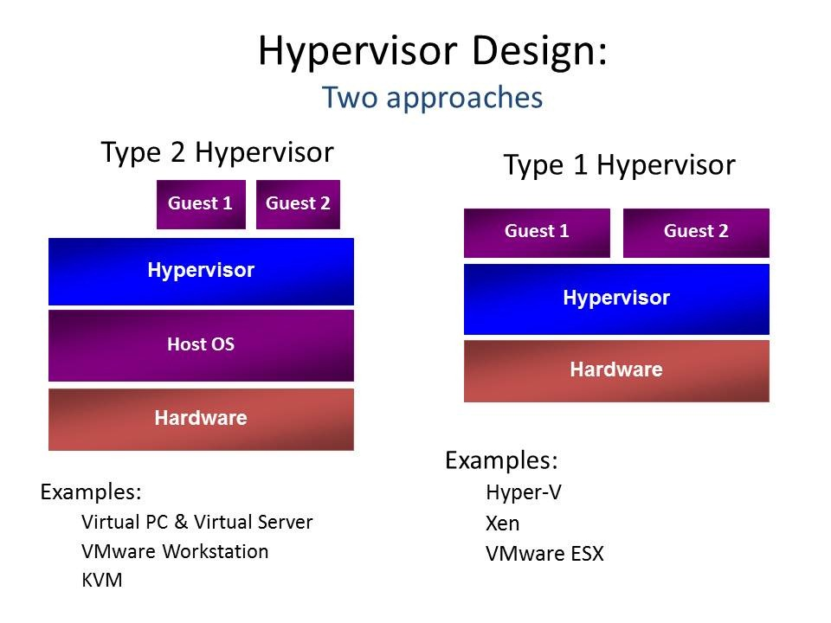
Type-1 Hypervisor
7

Slide 9
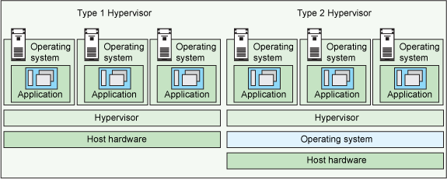
Hypervisors

Slide 10
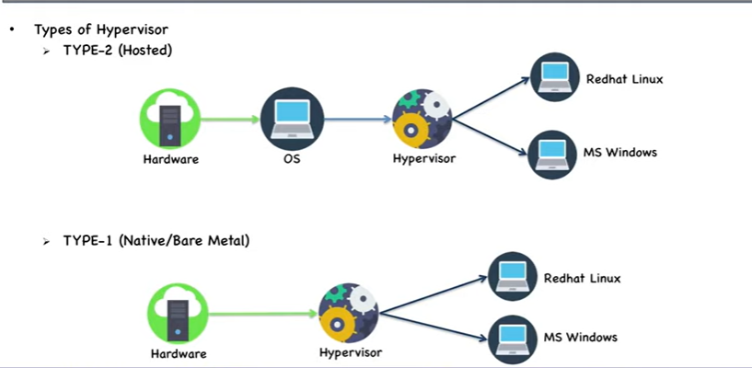
Type 1 and Type 2

Slide 11
Features of Type-1 and 2 Hypervisor
9
Type-1 Hypervisor:
provides better performance
provides greater flexibility
Servers that run Type 1 hypervisors are often single-purpose servers that offer no other function.
Type 1 hypervisors are production hypervisors or hypervisors that run VMs offering services to users.
support hardware virtualization.
Type-2 Hypervisor:
Less efficient
Less flexible
offer a series of different services.
rarely used in production.
perform software virtualization.

Slide 12
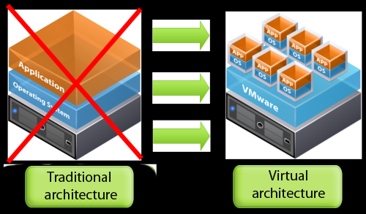
Virtualization

Slide 13
Types of Virtualization
11
Hardware Virtualization
Software Virtualization
Memory Virtualization
Storage Virtualization
Data Virtualization
Network Virtualization
Desktop Virtualization

Slide 14
Hardware Virtualization
12
Hardware virtualization also known as server virtualization runs on the concept that an individual independent segment of hardware or a physical server, may be made up of multiple smaller segments of hardware or servers, essentially consolidating multiple physical servers into virtual servers that run on a single primary physical server.

Slide 15
Hardware Virtualization:
Subtypes
13
Full Virtualization –
The underlying hardware is fully simulated.
Guest software does not require any modifications.
Para-virtualization –
The hardware is not simulated instead the guest software run their own isolated domains.
Emulation Virtualization –
The virtual machine simulates the hardware and becomes independent of it.
Guest software does not require any modifications.

Slide 16
Full virtualization is a common and cost-effective type of virtualization, which is basically a method by which computer service requests are separated from the physical hardware that facilitates them.
With full virtualization, operating systems and their hosted software are run on top of virtual hardware.
It differs from other forms of virtualization (like paravirtualization and hardware-assisted virtualization) in its total isolation of guest operating systems from their hosts.

Slide 17
Full virtualization
Full virtualization is fulfilled by the use of both binary translation and direct execution.
In full virtualization, the guest OS is completely isolated by the virtual machine from the virtualization layer and hardware.
Microsoft and Parallels systems are examples of full virtualization..

Slide 18
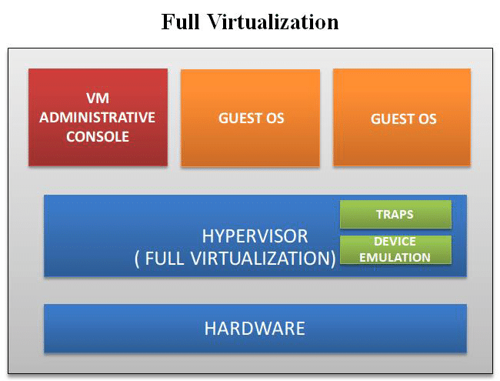
Fig.

Slide 19
Para-virtualization
Paravirtualization is the category of CPU virtualization which uses hypercalls for operations to handle instructions at compile time.
In paravirtualization, guest OS is not completely isolated but it is partially isolated by the virtual machine from the virtualization layer and hardware.
VMware and Xen are some examples of paravirtualization..

Slide 20
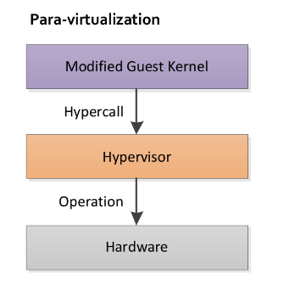
Fig.

Slide 21
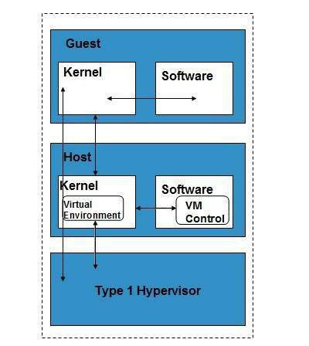
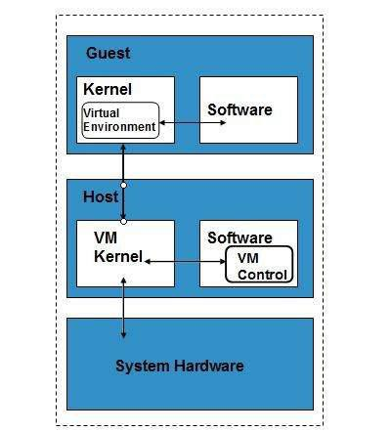
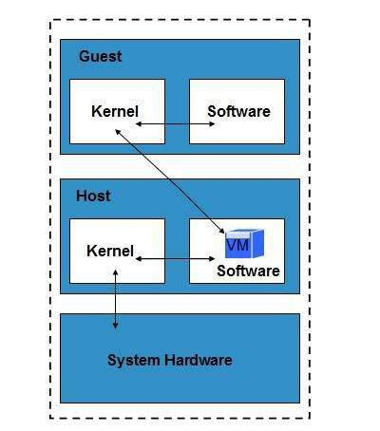
Hardware Virtualization:
Subtypes
14
Full Virtualization
Para Virtualization
Emulation

Slide 22
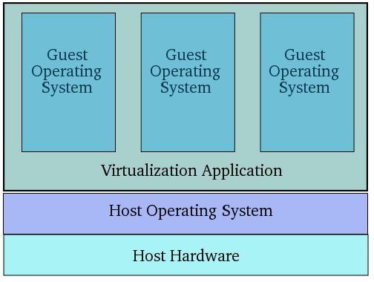
Software Virtualization
15
Software Virtualization involves the creation and operation of multiple virtual environments on the host machine.
It is used to enable a complete computer system in order to allow the guest operating system to run.
For instance, letting LINUX OS to run as a guest that is natively using a Microsoft Windows OS.

Slide 23
Software Virtualization :Subtypes
16
Operating System Virtualization –
hosting multiple OS on the native OS
Application Virtualization –
hosting individual applications in a virtual environment separate from the native OS
Service Virtualization –
hosting specific services related to a particular application.

Slide 24
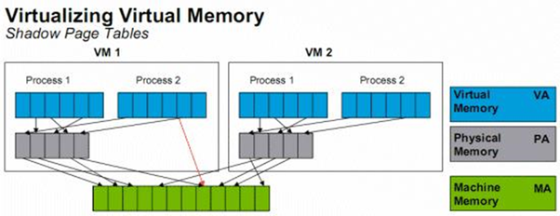
Memory Virtualization
17
Physical memory across different ser vers i s aggregated into a single virtualized memory pool.
It provides the benefit of an enlarged contiguous working memory.
For instance, as some OS such as Microsoft Windows OS allows a portion of your storage disk to serve as an extension of your RAM.

Slide 25
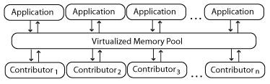
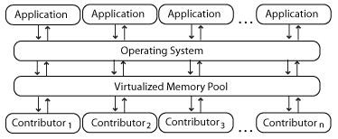
Memory Virtualization: Subtypes
18
Application-level control – Applications access the memory pool directly.
Operating system level control – Access to the memory pool is provided through an operating system.

Slide 26
Storage Virtualization
19
Multiple physical storage devices are grouped together, which then appear as a single storage device.
This provides various advantages such as homogenization of storage across storage devices of multiple capacity and speeds, reduced downtime, load balancing and better optimization of performance and speed.
Partitioning your hard drive into multiple partitions is an example of this virtualization.

Slide 27
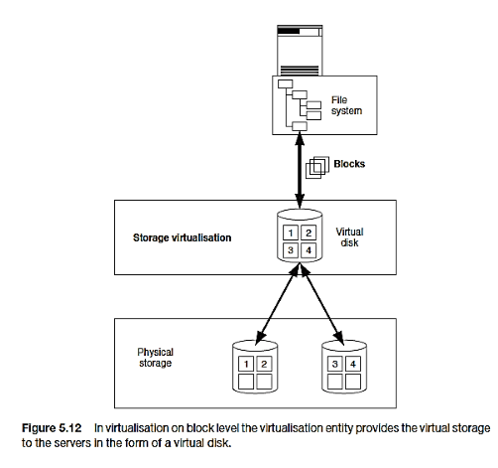
Storage Virtualization: Subtypes
20
1. Block Virtualization – Virtualisation on block level means that storage capacity is made available to the operating system or the applications in the form of virtual disks.

Slide 28
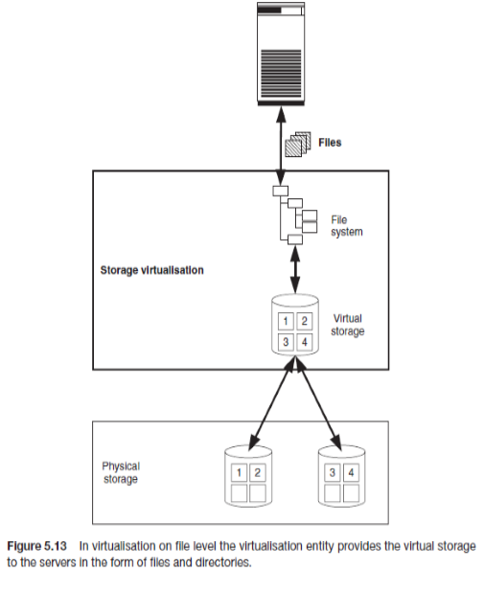
Storage Virtualization: Subtypes
2. File Virtualization
Virtualisation on file level means that the virtualisation entity provides virtual storage to the operating systems or applications in the form of files and directories

Slide 29
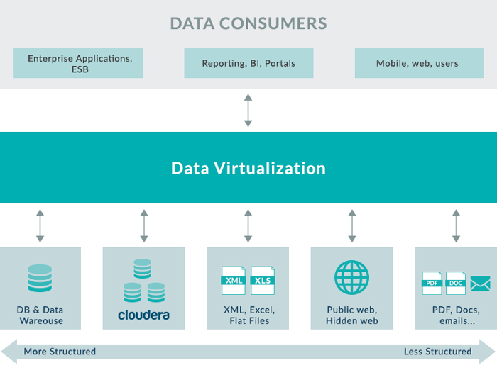
Data Virtualization
21
It lets us to easily manipulate data, as the data is presented as an abstract layer completely independent of data structure and database systems.
Decreases data input and formatting errors.

Slide 30
Network Virtualization
22
In network virtualization, multiple sub-networks can be created on the same physical network, which may or may not is authorized to communicate with each other.
This enables restriction of file movement across networks and enhances security, and
allows better monitoring and identification of data usage.
It also increases reliability as a disruption in one network doesn’t affect other networks, and the diagnosis is easier.

Slide 31
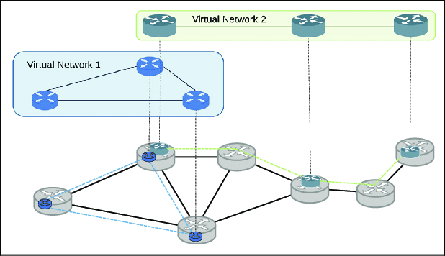
Network Virtualization :Subtypes
23
Internal network:
Enables a single system to function like a network
External network:
Consolidation of multiple networks into a single one, or segregation of a single network into multiple ones

Slide 32
Desktop Virtualization
24
This is perh a p s t h e m o s t c o m m o n fo r m o f virtualization for any regular IT employee.
The user’s desktop is stored on a remote server, allowing the user to access his desktop from any device or location.
Employees can work conveniently from the comfort of their home. Since the data transfer takes place over secure protocols, any risk of data theft is minimized.

Slide 33
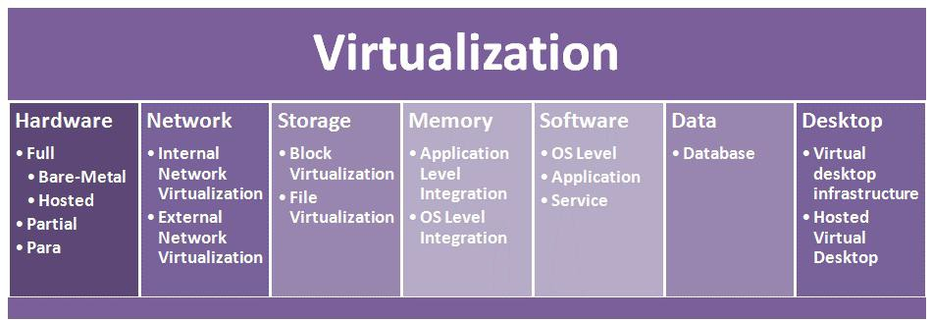
Types of Virtualization: At a
Glance
25

Slide 34
Benefits of Virtualization
26
Easily outsource your hardware and eliminate any energy costs associated with its operation.
the efficiency, security and cost advantages.
Run operating systems where the physical hardware is unavailable.
Easier to create new machines, backup machines, etc.
Software testing using “clean” installs of operating systems and software
Emulate more machines than are physically available.
Timeshare lightly loaded systems on one host.
Easy migration of virtual machines (shutdown needed or not).

Slide 35
Recap Video

