Slide 1
PEOPLE CAPABILITY MATURITY MODEL (PCMM)

Slide 2
INTRODUCTION
The People Capability Maturity Model (PCMM) is a maturity framework, patterned after the structure of the CMM that focuses on continuously improving the management and development of the human assets of an organization

Slide 3
AIM
Provides guidance on how to improve the ability of organizations to attract, develop, motivate, organize and retain the talent needed to steadily improve their productivity.

Slide 4
STRATEGIC OBJECTIVES
The primary objective of the PCMM is to improve the capability of the entire workforce. This can be defined as the level of knowledge, skills, and process abilities available for performing an organization's current and future business activities.

Slide 5
PREMISE OF MODEL
A practice cannot be improved if it cannot be repeated.
In an organization's least mature state systematic and repeated performance of practices is sporadic.

Slide 6
HELP TO BUSINESS ORGANIZATION
a) Characterize the maturity of their work force practices;
b) guide a program of continuous workforce development;
c) set priorities for immediate actions;
d) integrate work force development with process improvement;
e) establish a culture of business excellence.

Slide 7
PRACTICES IN PCMM
work environment,
communication,
staffing,
managing performance,
training,
compensation,
competency development,
career development,
team building, and
culture development

Slide 8
FIVE STAGES OF MATURITY
Level 1: Initial
Level 2: Repeatable
Level 3: Defined
Level 4: Managed
Level 5: Optimizing

Slide 9
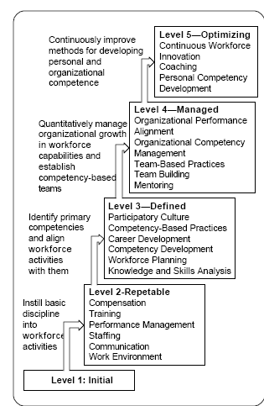

Slide 10
INITIAL LEVEL
the performance of workforce activities is inconsistent
The organization typically provide forms for activities
  but offers little guidance or training in conducting the activities supported by these forms.

Slide 11
CHARACTERISTIC OF LEVEL I
Inconsistency in performing practices
Displacement of responsibility
Ritualistic practices
An emotionally detached workforce

Slide 12
REPEATABLE LEVEL
to eliminate problems that keep people from being able to perform their work responsibilities effectively
to establish a foundation of workforce practices that can be continuously improved in developing the workforce.

Slide 13
DEFINED
to gain a strategic competitive advantage from its core competencies.
the organization begins to adapt its workforce practices to the specific nature of its business..

Slide 14
MANAGED
sets quantitative objectives for growth in core competencies
for the alignment of performance across the individual, team, unit, and organizational levels.
foundation for evaluating trends in the capability of the organization's workforce.

Slide 15
OPTIMIZING
continuous focus on improving individual competencies and
finding innovative ways to improve workforce motivation and capability.

Slide 16
KPA- KEY PROCESS AREAS
the particular tasks and activities,
which must be completed in order for an organization
to gain maturity and progress towards optimizing their training initiatives.

Slide 17
KPA AT REPEATABLE LEVEL
Work environment
Communication
Staffing
Training
Compensation
Performance management

Slide 18
KPA AT DEFINED LEVEL
Knowledge & Skills Analysis
Workforce planning
Competency Development
Career Development
Competency-based Practices
Participatory Culture.

Slide 19
KPA AT MANAGED LEVEL
Mentoring
Team-building
Team- based practices
Organizational performance
Organizational competency management

Slide 20
KPA AT OPTIMIZING LEVEL
Personal Competency Development
Coaching.
Continuous Workforce Innovation

Slide 21
FOUR THEMES OF PCMM
Developing Capabilities
Building Teams and Culture
Motivating and Managing Performance
Shaping the workforce

Slide 22
 | PROCESS CATEGORIES
MATURITY LEVELS | DEVELOPING CAPABILITES | BUILDING TEAMS & CULTURE | MOTIVATING & MANAGING PERFORMANCE | SHAPING THE WORKFORCE
5 Optimizing | Coaching Personal Competency Development
4 Managed | Mentoring | Team Building | Organizational Performance Alignment Team-Based Practices | Organizations Competency Management
3 Defined | Competency Development Knowledge & Skills Analysis | Participatory Culture | Competency-Based Practices Career Development | Workforce Planning
2 Repeatable | Training Communication | Communication | Compensation Performance Management Work Environment | Staffing
1 Initial

Slide 23
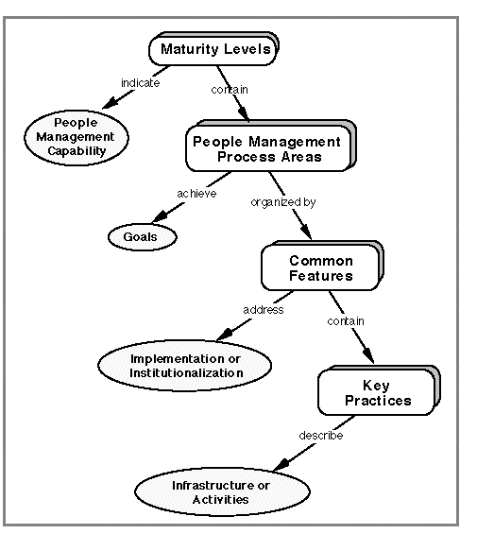
PCMM STRUCTURE

Slide 24
APPLIED BY AN ORGANIZATION IN TWO PRIMARY WAYS:
As a standard for assessing workforce practices
As a guide in planning and implementing improvement activities

