Slide 1

Software Configuration Management
Notes:
http://en.wikipedia.org/wiki/Software_configuration_management
http://en.wikipedia.org/wiki/Distributed_revision_control

Slide 2
Topics
Definitions
Working Scenarios
Revision Control Functions
  Git and GitHub

Slide 3
Why Software Config Mgmt?
Software configuration management (SCM) is the process of controlling the evolution of a software system
Simplifies sharing code and other documents
The ability to revert to an older version (“undo”)
Coherently integrate contributions from team members (“merge”)
Notify interested parties about new modifications (“reporting”)
Track software issues (e.g., bugs)
Create an auditing trail (“archiving”)
SCM system allows us to answer questions:
  When was this software module last changed?
  Who made changes in this line of code?
  What is the difference between the current version and last week’s?
  How many lines of code did we change in this release?
  Which files are changed most frequently?

Slide 4
Why Software Config Mgmt?
SCM simplifies collaboration and increases productivity
But it all can be done with
old-fashioned email, file system, etc.
  Naming convention?
  How to reconcile your version #1 with my version #1?

Slide 5
Definitions
A software configuration is a collection of work products (“artifacts”) created during a project lifetime
Software configuration item (SCI) is any piece of knowledge (a.k.a. “work product” or “artifact”) created by a person (developer or customer)
A snapshot of a software configuration or a configuration item represents the version of that item at a specific time
A commit (or “check-in”) refers to submitting a software configuration to the project database (“repository”)
A build is a version of a program code (part of a software configuration), and a process by which program code is converted into a stand-alone form that can be run on a computer (“executable code”)

Slide 6
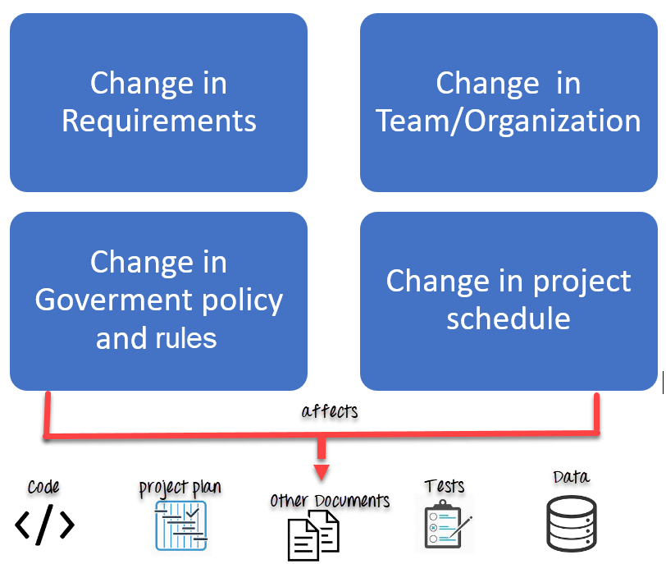

Slide 7
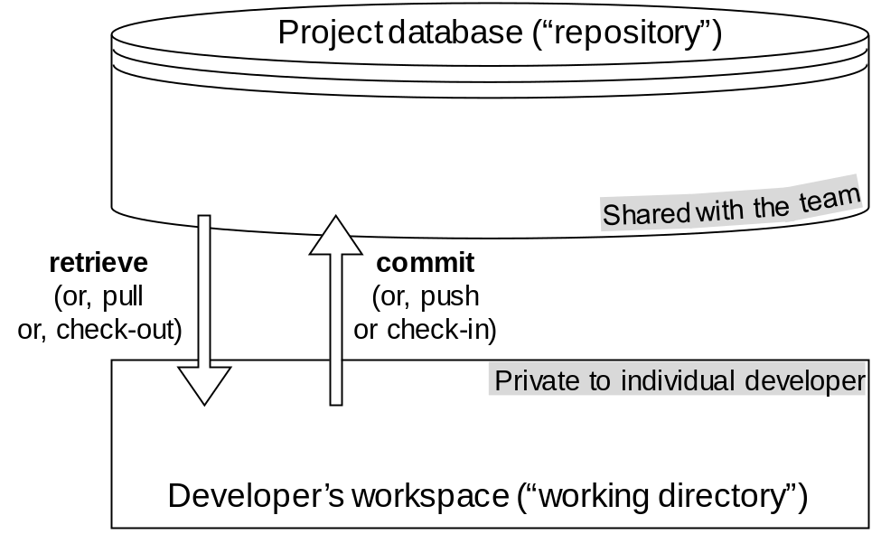
Repository vs. Workspace
Committed configurations
(at discrete times during project life)
Working copies
(piecewise continuous development)
Project database is usually on a remote server,
or “mirrored” on several servers
  This is the “team memory,” unlike individual workspaces that are private
SCM provides a set of tools to interact with project database

Slide 8
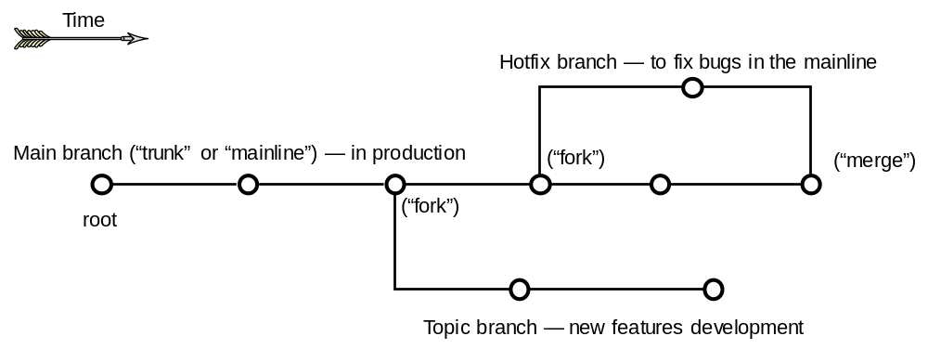
Version Graph and Branching
Each graph node (a “commit”) represents a “version” of the software configuration shared with the team
  The private workspace of one team member was publicized in the shared repository and becomes a part of “team memory”
Think of branches as separate folders, each with its own content and history
The project snapshot at the tip of a branch represents the latest version

Slide 9
Example Working Scenarios
Undoing mistakes in new work
Supporting multi-pronged product evolution
  Parallel versions coexist at times, but will eventually merge (single trunk—“Main”)
Developing product lines
  Coexisting parallel versions (same product for different markets) that will never merge (multiple trunks)
    but they still need synchronization so that versions for different markets are at the same “level”
Working with a small team of peers
  All developers can write to the project database
Working with a managed team
  Only configuration manager can write to the project database
Notes:
Also see: https://en.wikipedia.org/wiki/Fork_(software_development)
a project fork happens when developers take a copy of source code from one software package and start independent development on it, creating a distinct and separate piece of software
Compare to: https://en.wikipedia.org/wiki/Branching_(version_control)

Slide 10
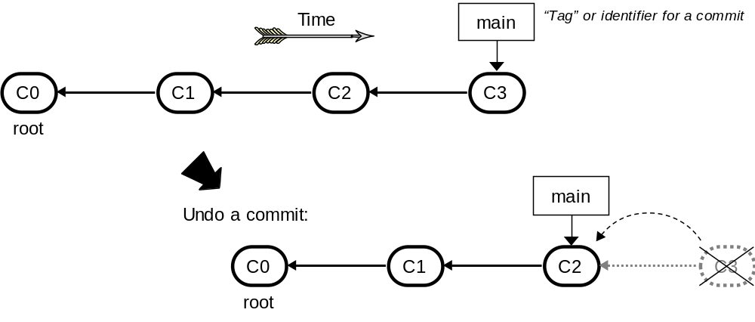
Undoing Commits
We can undo a commit; undo a merge; or undo a checkout
(See later how undo can be done without deleting the history)

Slide 11
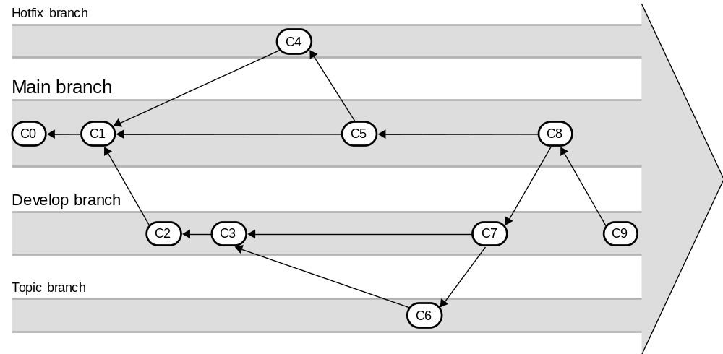
Multi-pronged Product Evolution
Parallel versions coexist at times, but will eventually merge
(to a single trunk—Main branch)
Notes:
Chacon & Straub: “Pro Git”, page 101

Slide 12
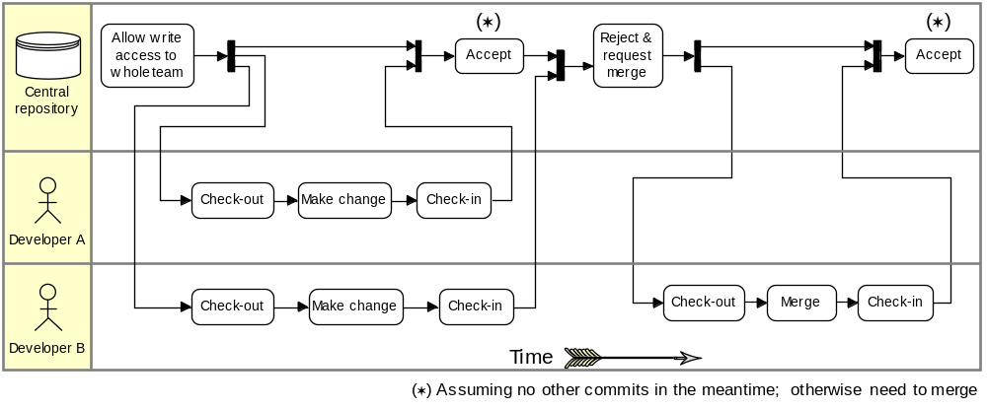
Working with Peers:
Centralized Workflow
Example scenario: Two developers clone from the hub and both make changes
The first developer to push his changes back up can do so with no problems
The second developer must merge in the first one’s work before pushing changes up, so as not to overwrite the first developer’s changes
Notes:
Chacon & Straub: “Pro Git”, page 152

Slide 13
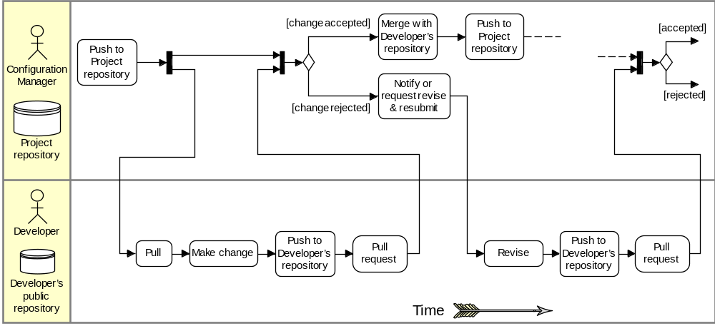
Working with a Managed Team
Example scenario:
1. The configuration manager pushes the current version to the central project repository
2. A contributor clones that repository and makes changes
3. The contributor pushes the changed version to his own public repository
4. The contributor notifies the configuration manager requesting to pull changes
5. The configuration manager adds the contributor’s repository as a remote and merges locally
6. The configuration manager pushes merged changes to the central project repository
Notes:
Chacon & Straub: “Pro Git”, page 152

Slide 14
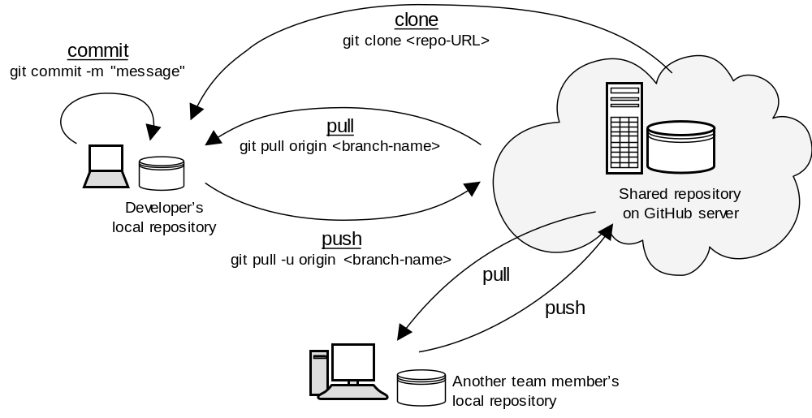
Git Commands Summary

