Slide 1
Object-Orientation Concepts, UML, and OOAD

Slide 2
Organization of This Lecture
Object-oriented concepts
Object modelling using Unified Modelling Language (UML)‏
Object-oriented software development and patterns
CASE tools
Summary

Slide 3
Object-Oriention Concepts
Object-oriented (OO) design techniques are extremely popular:
  Inception in early 1980’s and nearing maturity.
  Widespread acceptance in industry and academics.
  Unified Modelling Language (UML) already an ISO standard (ISO/IEC 19501).

Slide 4
Objects
A system is designed as a set of interacting objects:
  Often, real-world entities:
    Examples: an employee, a book etc.
  Can be conceptual objects also:
    Controller, manager, etc.
Consists of data (attributes) and functions (methods) that operate on data.
  Hides organization of internal information (Data abstraction).

Slide 5
Model of an Object
m8
m7
mi are methods
of the object
m1
Data
m6
m2
m5
Object
m3
m4

Slide 6
Class
Instances are objects
Template for object creation
Considered as abstract data type (ADT)‏
Examples: Employees, Books, etc.
Sometimes not intended to produce instances:
  Abstract classes

Slide 7
Example Class Diagram
LibraryMember
LibraryMember
LibraryMember
Member Name
Membership Number
Address
Phone Number
E-Mail Address
Membership Admission Date
Membership Expiry Date
Books Issued
issueBook( );
findPendingBooks( );
findOverdueBooks( );
returnBook( );
findMembershipDetails( );
issueBook( );
findPendingBooks( );
findOverdueBooks( );
returnBook( );
findMembershipDetails( );
Different representations of the LibraryMember class

Slide 8
Methods and Messages
Operations supported by an object:
  Means for manipulating the data of other objects.
  Invoked by sending a message (method call).
  Examples: calculate_salary, issue-book, member_details, etc.

Slide 9
What are the Different Types of Relationships Among Classes?
Four types of relationships:
    Inheritance
    Association
    Aggregation/Composition
    Dependency

Slide 10
Inheritance
Allows to define a new class (derived class) by extending or modifying existing class (base class).
  Represents generalization-specialization relationship.
  Allows redefinition of the existing methods (method overriding).

Slide 11
Inheritance
Lets a subclass inherit attributes and methods from more than one base class.
LibraryMember
Base Class
Faculty
Students
Staff
Derived
Classes
UnderGrad
PostGrad
Research

Slide 12
Inheritance Example
Library
Book
issuable
reference
Issuable
Single Volume
Book
Issuable
BookSet
Reference
Single Volume
Book
Reference
BookSet
Representation of the inheritance relationship

Slide 13
Multiple Inheritance cont…
LibraryMember
Base Class
LibraryMember
Base Class
Faculty
Students
Staff
Derived
Classes
Faculty
Students
Staff
Multiple
Inheritance
UnderGrad
PostGrad
Research
UnderGrad
PostGrad
Research

Slide 14
Association Relationship
Enables objects to communicate with each other:
  Thus, one object must “know” the address of the corresponding object in the association.
Usually binary:
  But in general, can be n-ary.

Slide 15
Association Relationship
A class can be associated with itself (recursive association).
  Give an example?
An arrowhead used along with name, indicates direction of association.
Multiplicity indicates # of instances taking part in the association.

Slide 16
Association Relationship
Library Member
Book
*
1
borrowed by

Slide 17
3-ary Association
Person
*
*
Skill
Competency
level

Slide 18
Association and Link
A link:
  An instance of an association
  Exists between two or more objects
  Dynamically created and destroyed as the run of a system proceeds
For example:
  An employee joins an organization,
  Leaves that organization and joins a new organization etc.

Slide 19
Aggregation Relationship
Represents whole-part relationship
Represented by a diamond symbol at the composite end
Cannot be reflexive(i.e. recursive)‏
Not symmetric
It can be transitive

Slide 20
Aggregation Relationship
1
*
*
1
Document
Paragraph
Line

Slide 21
Composition Relationship
Life of item is same as the order
Order
1
*
Item

Slide 22
Aggregation cont…
A aggregate object contains other objects.
Aggregation limited to tree hierarchy:
  No circular inclusion relation.

Slide 23
Aggregation vs. Inheritance
Cont…
Inheritance:
  Different object types with similar features.
  Necessary semantics for similarity of behavior is in place.
Aggregation:
  Containment allows construction of complex objects.

Slide 24
Aggregation vs. Composition
Composition:
  Composite and components have the same life.
Aggregation:
  Lifelines are different.
Consider an order object:
  Aggregation: If order items can be changed or deleted after placing the order.
  Composition: Otherwise.

Slide 25
Composition versus Aggregation
1
*
Order
Item
Composition
1
*
Order
Item
Aggregation

Slide 26
Class Dependency
Dependent Class
Independent Class
Representation of dependence between classes

Slide 27
Abstraction
Consider aspects relevant for certain purpose
  Suppress non-relevant aspects
Types of abstraction:
  Data abstraction
  Behaviour abstraction

Slide 28
Abstraction cont…
Advantages of abstraction:
  Reduces complexity of design
  Enhances understandability
  Increases productivity
It has been observed that:
  Productivity is inversely proportional to complexity.

Slide 29
Encapsulation
Objects communicate with outside world through messages:
  Data of objects encapsulated within its methods.
  Data accessible only through methods.

Slide 30
Encapsulation cont…
Methods
m4
m3
Data
m5
m2
m6
m1
Concept of encapsulation

Slide 31
Polymorphism
Denotes poly (many) morphism (forms).
Under different situations:
  Same message to the same object can result in different actions:
    Static binding
    Dynamic binding

Slide 32
An Example of Static Binding
  Class Circle{
    private float x, y, radius;
    private int fillType;
    public create ();
    public create (float x, float y, float centre);
    public create (float x, float y, float centre, int fillType);
    }

Slide 33
An Example of Static Binding cont…
A class named Circle has three definitions for create operation
  Without any parameter, default
  Centre and radius as parameter
  Centre, radius and fill Type as parameter
  Depending upon parameters, method will be invoked
  Method create is said to be overloaded

Slide 34
Dynamic Binding
A method call to an object of an ancestor class:
  Would result in the invocation of the method of an appropriate object of the derived class.
Following principles are involved:
  Inheritance hierarchy
  Method overriding
  Assignment to compatible types

Slide 35
Dynamic Binding
Principle of substitutability (Liskov’s substitutability principle):
  An object can be assigned to an object of its ancestor class, but not vice versa.
A
A a; B b;
a=b; (OK)‏
b=a; (not OK)‏
B

Slide 36
Dynamic Binding
Cont …
Exact method to be bound on a method call:
  Not possible to determine at compile time.
  Dynamically decided at runtime.

Slide 37
An Example of Dynamic Binding
Consider a class hierarchy of different geometric objects:
  Display method is declared in the shape class and overridden in each derived class.
  A single call to the display method for each object would take care of displaying the appropriate element.

Slide 38
An Example of Dynamic Binding cont…
Shape
Circle
Rectangle
Line
Ellipse
Square
Cube
Class hierarchy of geometric objects

Slide 39
An Example cont…
Traditional code
Shape s[1000];
For(i=0;i<1000;i++){
If (s[i] == Circle) then
draw_circle();
else if (s[i]== Rectangle) then
draw_rectangle();
-
}
Object-oriented code
Shape s[1000];
For(i=0;i<1000;i++)‏
Shape.draw();
-
-
-
-
Traditional code and OO code using dynamic binding

Slide 40
Genericity
Ability to parameterize class definitions.
Example: class stack of different types of elements:
  Integer stack
  Character stack
  Floating point stack
Define generic class stack:
  Later instantiate as required

Slide 41
Genericity
T
Set
insert(T)‏
remove(T)‏
Refinement
EmployeeSet

Slide 42
Advantages of Object-Oriented Development
Code and design reuse
Increased productivity
Ease of testing (?) and maintenance
Better understandability
Elegant design:
  Loosely coupled, highly cohesive objects:
  Essential for solving large problems.

Slide 43
Advantages of Object-Oriented
Development cont…
Initially incurs higher costs
  After completion of some projects reduction in cost become possible
Using well-established OO methodology and environment:
  Projects can be managed with 20% -- 50% of traditional cost of development.

Slide 44
Object Modelling Using UML
UML is a modelling language
  Not a system design or development methodology
Used to document object-oriented analysis and design results.
Independent of any specific design methodology.

Slide 45
UML Origin
OOD in late 1980s and early 1990s:
  Different software development houses were using different notations.
  Methodologies were tied to notations.
UML developed in early 1990s to:
  Standardize the large number of object-oriented modelling notations

Slide 46
UML Lineology
Based Principally on:
  OMT [Rumbaugh 1991]
  Booch’s methodology[Booch 1991]
  OOSE [Jacobson 1992]
  Odell’s methodology[Odell 1992]
  Shlaer and Mellor [Shlaer 1992]

Slide 47
Different Object Modeling Techniques in UML
OMT
UML
Booch’s
Methodology
OOSE

Slide 48
UML as A Standard
Adopted by Object Management Group (OMG) in 1997
OMG is an association of industries
Promotes consensus notations and techniques
Used outside software development
  Example car manufacturing

Slide 49
Developments to UML
UML continues to develop:
  Refinements
  Making it applicable to new contexts
UML 1.0
UML 1.X
Application to embedded systems
UML 2.0

Slide 50
Why are UML Models Required?
A model is an abstraction mechanism:
  Capture only important aspects and ignores the rest.
  Different models result when different aspects are ignored.
  An effective mechanism to handle complexity.
UML is a graphical modelling tool
Easy to understand and construct

Slide 51
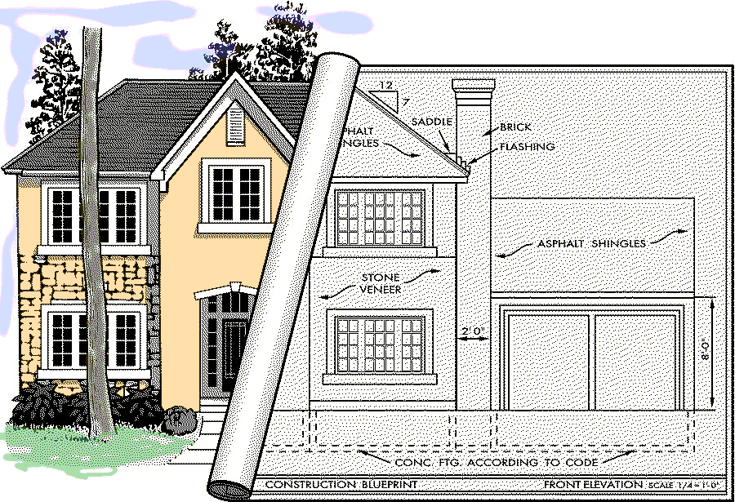
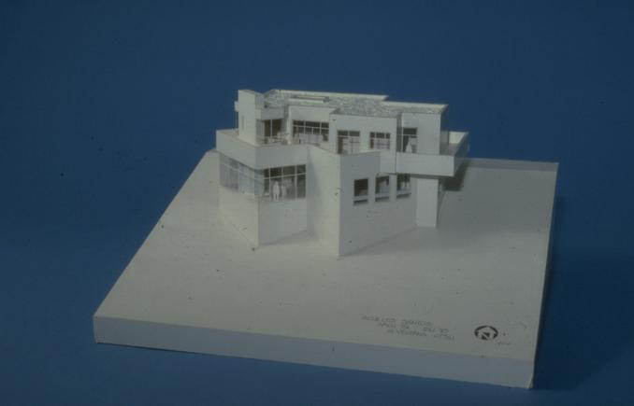
Modeling a House

Slide 52
UML Diagrams
Nine diagrams are used to capture different views of a system.
Views:
  Provide different perspectives of a software system.
Diagrams can be refined to get the actual implementation of a system.

Slide 53
UML Model Views
Views of a system:
  User’s view
  Structural view
  Behavioral view
  Implementation view
  Environmental view

Slide 54
UML Diagrams
Behavioural View
Sequence Diagram
Collaboration Diagram
- State-chart Diagram
- Activity Diagram
Structural View
Class Diagram
Object Diagram
User’s View
Use Case
Diagram
Implementation View
Component Diagram
Environmental View
Deployment Diagram
Diagrams and views in UML

Slide 55
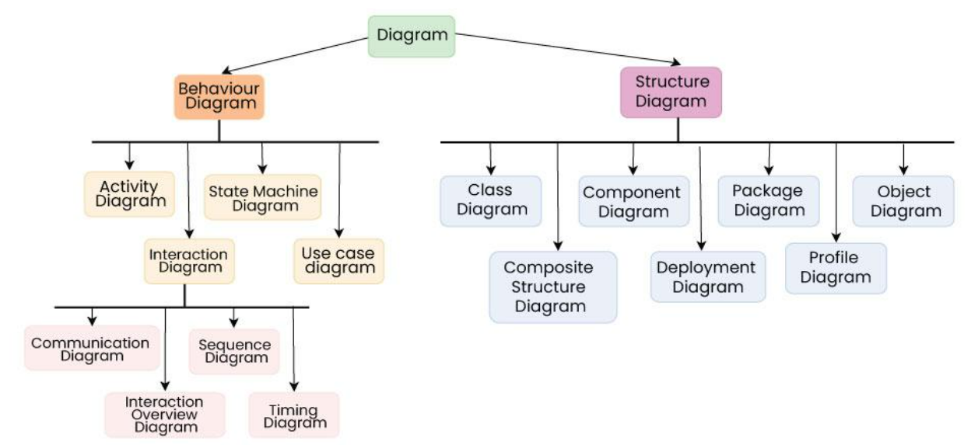
Types of UML diagrams

Slide 56
Are All Views Required for Developing A Typical System?
NO
Use case diagram, class diagram and one of the interaction diagram for a simple system
State chart diagram required to be developed when a class state changes
However, when states are only one or two, state chart model becomes trivial
Deployment diagram in case of large number of hardware components used to develop the system

Slide 57
Use Case Model
Consists of set of “use cases”
An important analysis and design artifact
The central model:
  Other models must confirm to this model
  Not really an object-oriented model
  Represents a functional or process model

Slide 58
Use Cases
Different ways in which a system can be used by the users
Corresponds to the high-level requirements
Represents transaction between the user and the system
Defines external behaviour without revealing internal structure of system
Set of related scenarios tied together by a common goal.

Slide 59
Use Cases
Cont…
Normally, use cases are independent of each other
Implicit dependencies may exist
Example: In Library Automation System, renew-book & reserve-book are independent use cases.
  But in actual implementation of renew-book: a check is made to see if any book has been reserved using reserve-book.

Slide 60
Example Use Cases
  For library information system
    issue-book
    query-book
    return-book
    create-member
    add-book, etc.

Slide 61
Representation of
Use Cases
  Represented by use case diagram
  A use case is represented by an ellipse
  System boundary is represented by a rectangle
  Users are represented by stick person icons (actor)‏
  Communication relationship between actor and use case by a line
  External system by a stereotype

Slide 62
An Example Use Case Diagram
Tic-tac-toe game
Play Move
Player
Use case model

Slide 63
Why Develop A
Use Case Diagram?
Serves as requirements specification
How are actor identification useful in software development:
  User identification helps in implementing appropriate interfaces for different categories of users
  Another use in preparing appropriate documents (e.g. user’s manual).

Slide 64
Factoring Use Cases
Two main reasons for factoring:
  Complex use cases need to be factored into simpler use cases
  To represent common behaviour across different use cases
Three ways of factoring:
  Generalization
  Includes
  Extends

Slide 65
Factoring Use Cases Using
Generalization
Pay membership fee
Pay through credit card
Pay through library pay card

Slide 66
Factoring Use Cases Using
Includes
Base use case
<<include>>
Common
use case
Base use case
Base use case
<<include>>
<<include>>
<<include>>
<<include>>
Base use case
Base use case
Base use case

Slide 67
Factoring Use Cases Using
Extends
Base
use case
<<extends>>
Common
use case

Slide 68
Hierarchical Organization of Use Cases
use case 1
use case 3
External users
use case 2
use case 3.1
use case 3.3
Subsystems
use case 3. 2
use case 1
use case 3
Method
use case 2

Slide 69
Use Case Packaging
Accounts
Query balance
Print
Balance sheet
Receive
grant
Make
payments

Slide 70
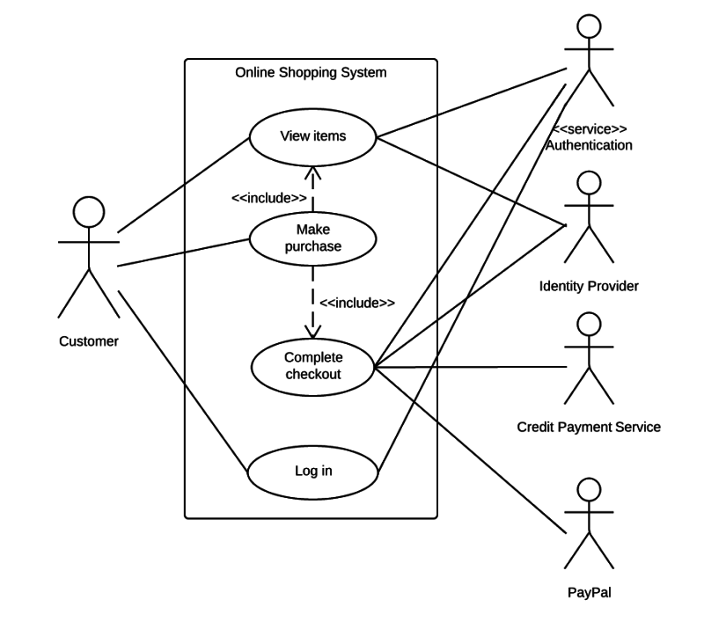
Sample

Slide 71
Class Diagram
Describes static structure of a system
Main constituents are classes and their relationships:
  Generalization
  Aggregation
  Association
  Various kinds of dependencies

Slide 72
Class Diagram
Entities with common features, i.e. attributes and operations
Classes are represented as solid outline rectangle with compartments
Compartments for name, attributes, and operations.
Attribute and operation compartments are optional depending on the purpose of a diagram.

Slide 73
Object Diagram
LibraryMember
Hitesh
B10028
C-108, Laksmikant Hall
1119
Mrituj@cse
25-02-04
25-03-06
NIL
IssueBook( );
findPendingBooks( );
findOverdueBooks( );
returnBook( );
findMembershipDetails( );
LibraryMember
Hitesh
B10028
C-108, Laksmikant Hall
1119
Mrituj@cse
25-02-04
25-03-06
NIL
LibraryMember
Different representations of the LibraryMember object

Slide 74
Interaction Diagram
Models how groups of objects collaborate to realize some behaviour
Typically, each interaction diagram realizes behaviour of a single use case

Slide 75
Interaction Diagram
Two kinds: Sequence and Collaboration diagrams.
Two diagrams are equivalent
  Portray different perspectives
These diagrams play a very important role in the design process.

Slide 76
Sequence Diagram
Shows interaction among objects as a two-dimensional chart
Objects are shown as boxes at top
If object created during execution, then shown at appropriate place
Objects existence are shown as dashed lines (lifeline)‏
Objects activeness, shown as a rectangle on lifeline

Slide 77
Sequence Diagram Cont…
Messages are shown as arrows
Each message labelled with corresponding message name
Each message can be labelled with some control information
Two types of control information
  condition ([])‏
  iteration (*)‏

Slide 78
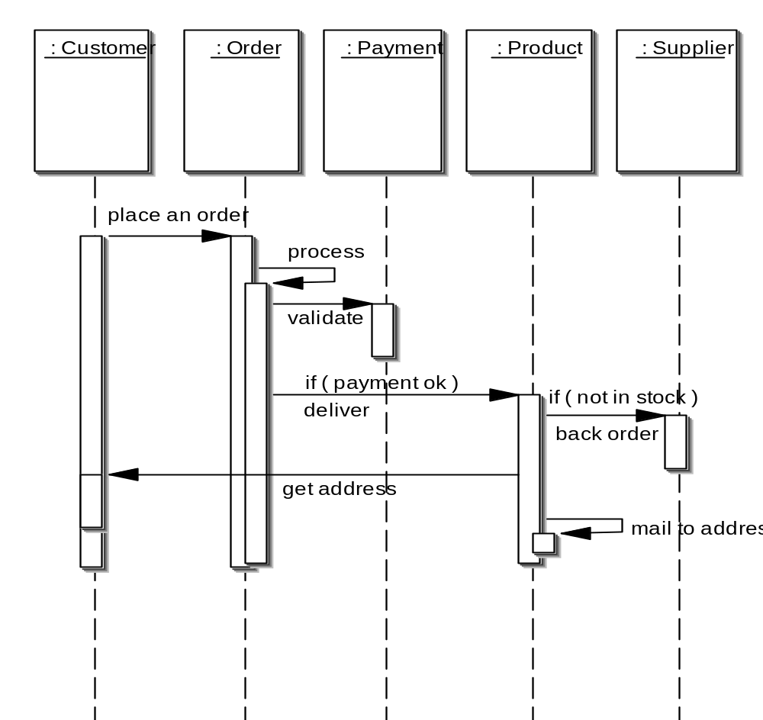
Elements of a Sequence Diagram
object
control
lifetime
message

Slide 79
Example
Cont…
Sequence of message sending

Slide 80
An Example of
A Sequence Diagram
:Library
Boundary
:Library
Book
Renewal
Controller
:Library
Book
Register
:Book
:Library
Member
renewBook
find MemberBorrowing
displayBorrowing
selectBooks
bookSelected
* find
[reserved]
[reserved]
apology
update
apology
confirm
confirm
updateMemberBorrowing
Sequence Diagram for the renew book use case

Slide 81
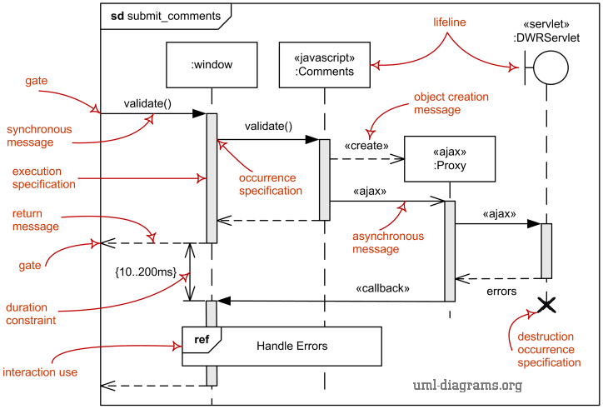
In software designing

Slide 82
Collaboration Diagram
Shows both structural and behavioural aspects
Objects are collaborator, shown as boxes
Messages between objects shown as a solid line
A message is shown as a labelled arrow placed near the link
Messages are prefixed with sequence numbers to show relative sequencing

Slide 83
An Example of
A Collaboration Diagram
:Library
Book
Register
6: * find
:Book
[reserved]
9: update
8: apology
5: book
Selected
10: confirm
:Library
Boundary
1: renewBook
:Library
Book
Renewal
Controller
[reserved]
7: apology
3: display
Borrowing
4: selectBooks
2: findMemberBorrowing
12: confirm
:Library
Member
11. updateMemberBorrowing
Collaboration Diagram for the renew book use case

Slide 84
Activity Diagram
Not present in earlier modelling techniques:
  Possibly based on event diagram of Odell [1992]
Represents processing activity, may not correspond to methods
Activity is a state with an internal action and one/many outgoing transitions
Somewhat related to flowcharts

Slide 85
Activity Diagram vs Flow Chart
Can represent parallel activity and synchronization aspects
Swim lanes can be used to group activities based on who is performing them
Example: academic department vs. hostel

Slide 86
Activity Diagram
Normally employed in business process modelling.
Carried out during requirements analysis and specification stage.
Can be used to develop interaction diagrams.

Slide 87
An Example of
An Activity Diagram
Academic Section
Accounts Section
Hostel Office
Hospital
Department
check
student
records
receive
fees
allot
hostel
create
hospital
record
receive
fees
register
in
course
conduct
medical
examination
allot
room
issue
identity card
Activity diagram for student admission procedure at KIIT

Slide 88
Activity Diagram: Example 2
Finance
Order
Processing
Stock
Manager
Receive
Order
Receive
Supply
*[for each line
item on order]
Choose
Outstanding
Order Items
Authorize
Payment
Check
Line Item
[failed]
[in stock]
* [for each chosen
order item]
Cancel
Order
Assign to
Order
Assign
Goods to
Order
[succeeded]
[need to reorder]
Reorder
Item
[stock assigned to all
line items and payment
authorized]
[all outstanding
order items filled]
Dispatch
Order

Slide 89
State Chart Diagram
Based on the work of David Harel [1990]
Model how the state of an object changes in its lifetime
Based on finite state machine (FSM) formalism

Slide 90
State Chart Diagram
Cont…
State chart avoids the problem of state explosion of FSM.
Hierarchical model of a system:
  Represents composite nested states

Slide 91
State Chart Diagram
Cont…
  Elements of state chart diagram
  Initial State: A filled circle
  Final State: A filled circle inside a larger circle
  State: Rectangle with rounded corners
  Transitions: Arrow between states, also boolean logic condition (guard)‏

Slide 92
An Example of A State Chart Diagram
order received
Unprocessed
Order
[reject] checked
[accept] checked
Rejected
Order
Accepted
Order
[some items available]
processed / deliver
[some items not
available] processed
Pending
Order
[all items
available]
newsupply
Fulfilled
Order
Example: State chart diagram for an order object

Slide 93
Package Diagrams
A package is a grouping of several classes:
  Java packages are a good example
Package diagrams show module dependencies.
Useful for large projects with multiple binary files
Order Capture
UI
AWT
Mailing List
UI
Order Capture
Application
Mailing List
Application
Dependency
Common
{global}
Oracle
Interface
Quantity
Money
DateRange
Domain
Orders
Customers
Sybase
Interface
Database
Interface
{abstract}

Slide 94
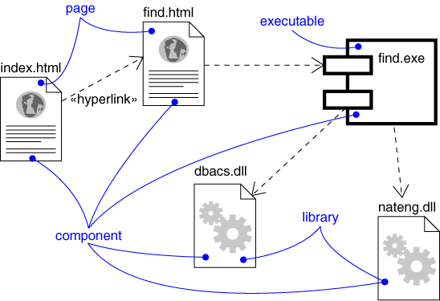
Component Diagram
Captures the physical structure of the implementation (code components)‏
dependency
Components:
Executables
Library
Table
File
Document

Slide 95
Component Diagram
Captures the physical structure of the implementation
Built as part of architectural specification
Purpose
  Organize source code
  Construct an executable release
  Specify a physical database
Developed by architects and programmers

Slide 96
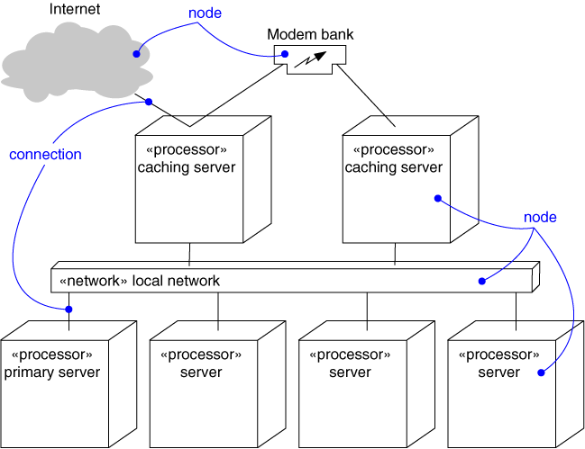
Deployment Diagram
Captures the topology of a system’s hardware
A piece of hardware

Slide 97
A Design Process
  Developed from various methodologies.
    However, UML has been designed to be usable with any design methodology.
  From requirements specification, initial model is developed (OOA)‏
    Analysis model is iteratively refined into a design model
  Design model is implemented using OO concepts

Slide 98
OOAD
Iterative and Incremental
OOA OOD/OOP
Definition of
the problem
Domain Model
Use case model
Construction of
the solution
Specification
Program

Slide 99
Unified Development Process Cont…
OOA
OOD
User interface
Issues or GUI
prototype
Use case
diagram
Interaction
diagram
Start
SRS document
Domain model
Class diagram
Code
Glossary

Slide 100
Domain Modelling
  Represents concepts or objects appearing in the problem domain.
  Also captures relationships among objects.
  Three types of objects are identified
    Boundary objects
    Entity objects
    Controller objects

Slide 101
Class Stereotypes
Three different stereotypes on classes are used: <<boundary>>, <<control>>, <<entity>>.
Boundary
Cashier Interface
Control
Withdrawal
Entity
Account

Slide 102
Boundary Objects
  Interact with actors:
    User interface objects
  Include screens, menus, forms, dialogs etc.
  Do not perform processing but validates, formats etc.

Slide 103
Entity Objects
  Hold information:
    Such as data tables & files, e.g. Book, BookRegister
  Normally are dumb servers
  Responsible for storing data, fetching data etc.
  Elementary operations on data such as searching, sorting, etc.
  Entity Objects are identified by examining nouns in problem description

Slide 104
Controller Objects
  Coordinate the activities of a set of entity objects
  Interface with the boundary objects
  Realizes use case behavior
  Embody most of the logic involved with the use case realization
  There can be more than one controller to realize a single use case

Slide 105
Use Case Realization
Boundary 1
Controller
Boundary 2
Entity 1
Entity 2
Entity 3
Realization of use case through the collaboration of
Boundary, controller and entity objects

Slide 106
Class-Responsibility-Collaborator(CRC) Cards
  Pioneered by Ward Cunningham and Kent Beck
  Index cards prepared one each per class
  Class responsibility is written on these cards
  Collaborating object is also written

Slide 107
CRC Cards Cont…
  Required for developing interaction diagram of complex use cases
  Team members participate to determine:
    The responsibility of classes involved in the use case realization

Slide 108
An Example of A CRC Card
Class name
BookRegister
FindBook
Book
CreateBook
Book
Reserve
Book
Responsibility
Collaborator
CRC card for the BookRegister class

Slide 109
Patterns
Patterns can be viewed as “building blocks” for software design.
  Help designers to make certain important design decisions.
If you master a few important patterns:
  You can easily spot them in application development and use the pattern solutions.

Slide 110
Types of Patterns
Architectural patterns
Design patterns
Code patterns (Idioms)‏

Slide 111
Architectural Patterns
Architectural designs concern the overall structure of software systems.
  Architectural designs cannot directly be translated to code.
  Form a basis for more detailed design.
While working out the high-level solutions to very large problems:
  Architectural patterns are relevant.

Slide 112
Design Patterns
A design pattern:
  Suggests a scheme for structuring the classes in a design solution.
  Also, defines the interactions required among those classes.
Design pattern solutions are described in terms of:
  Classes, their instances, their roles and collaborations.

Slide 113
Idioms
Idioms are a low-level patterns:
  Programming language-specific.
  Describes how to implement a solution to a particular problem using a given programming language.

Slide 114
Idioms
In English:
  A group of words that has meaning different from a simple juxtaposition of the meanings of the individual words.
  “Raining cats and dogs”
A C idiom:
  for(i=0;i<1000;i++){
  }

Slide 115
Patterns versus Idioms
A pattern:
  Describes a recurring problem
  Describes the core of a solution
  Is capable of generating many distinct designs
An Idiom is more restricted
  Still describes a recurring problem
  Provides a more specific solution, with fewer variations
  Applies only to a narrow context
    e.g., the C++ language

Slide 116
Antipattern
If a pattern represents a best practice:
  Antipattern represents lessons learned from a bad design.
Antipatterns help to recognise deceptive solutions:
  That appear attractive at first, but turn out to be a liability later.

Slide 117
Patterns versus Algorithms
Are patterns and algorithms identical concepts?
  After all, both target to provide reusable solutions to problems!
Algorithms primarily focus on solving problems with reduced space and/or time requirements:
  Patterns focus on understandability and maintainability of design and easier development.

Slide 118
Pros of Design Patterms
Help capture and disseminate expert knowledge.
Provide a common vocabulary:
  Help improve communication among the developers.
Reduce the number of design iterations:
  Help improve the designer productivity.

Slide 119
Cons of Design Patterms
Design patterns do not directly lead to code reuse.
To help select the right design pattern at the right point during a design exercise.
  At present no methodology exists

Slide 120
Design Patterns
Standard solutions to commonly recurring problems
Provide good solution based on common sense
Pattern has four important parts
  The problem
  The context
  The solution
  The context in which it works or does not work

Slide 121
Example Pattern: Expert
Problem: Which class should be responsible for doing certain things?
Solution:
  Assign responsibility to the class that has all/most information necessary to fulfil the required responsibility

Slide 122
Example Pattern: Expert Cont…
SaleTransaction
SaleItem
ItemSpecification
Class Diagram
1:total
:SaleTransaction
2: subTotal
3: price
:ItemSpecification
:SaleItem
Collaboration Diagram

Slide 123
Example Pattern: Creator
  Problem: Which class should be responsible for creating a new instance of some class?
  Solution: Assign a class C1 the responsibility to create class C2 if
    C1 is an aggregation of objects of type C2
    C1 contains object of type C2

Slide 124
Example Pattern: Controller
  Problem: Who should be responsible for handling the actor requests?
  Solution: Separate controller object for each use case.

Slide 125
Example Pattern: Facade
  Problem: How should the services be requested from a service package?
  Context (problem): A package (cohesive set of classes), example: RDBMS interface package
  Solution: A class (DBfacade) can be created which provides a common interface to the services of the package

Slide 126
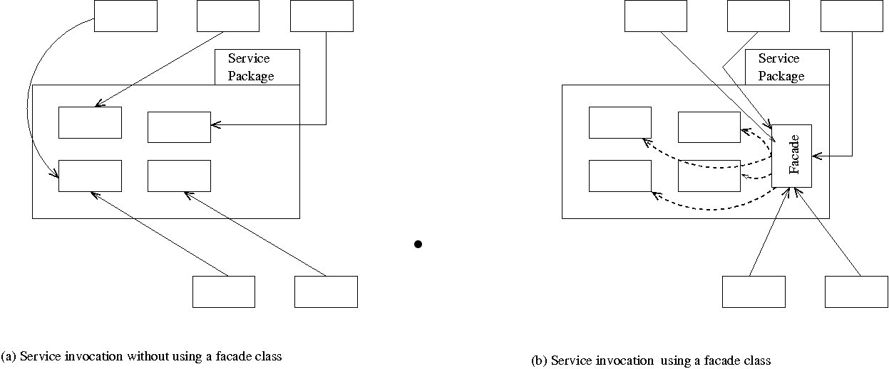
Example Pattern: Facade

Slide 127
Model View Separation Patterns
How should the non-GUI classes communicate with the GUI classes and vice versa?
Model object should be loosely coupled to the view objects.
  This would help to make reuse easier.
  Each change to a view object should not require changes to be made to the model objects.

Slide 128
  Solution 1: Pull from Above
Most obvious solution:
  Boundary object invokes other objects.
Does not work when data needs to be asynchronously displayed:
  Examples: simulation experiment, stock market alert, network monitor, etc.

Slide 129
Observer Pattern
Problem:
  When a model object is accessed by several view objects, how should the interactions between the model and the view objects be structured?

Slide 130
Observer Pattern: Solution
Observers should register themselves with the model object.
The model object would maintain a list of the registered observers.
When a change occurs to the model object:
  Model would notify all the registered observers.
  Each observer can then query the model object to get any specific information about the changes.

Slide 131
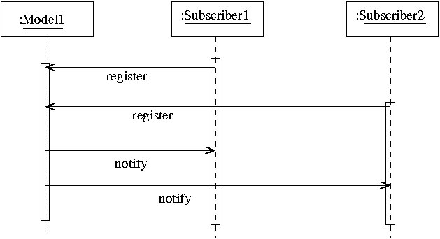
Observer Pattern

Slide 132
Limitations of Observer Pattern
Model objects incur substantial overhead:
  To support registration of the observers,
  To respond to queries from observers.
Performance concerns:
  Especially when the number of observers is large.

Slide 133
Model-View-Controller (MVC) Pattern
A controller object collects input data and passes those to model object:
  The state of the model object may change.
When the state of the model changes:
  It sends an update message to all dependent view and controller objects.
The controller object needs to be notified:
  New model object state may need dimming certain menu options, or closing certain control objects.

Slide 134
Publish-Subscribe Pattern
General form of the observer pattern:
  Overcomes many of the shortcomings of the observer pattern.
An event notification system is implemented:
  An event manager class is defined to keep track of the subscribers and the events they are interested in.
  Event is published by sending a message to event manager object.
  Event manager notifies all registered subscribers via a callback.

Slide 135
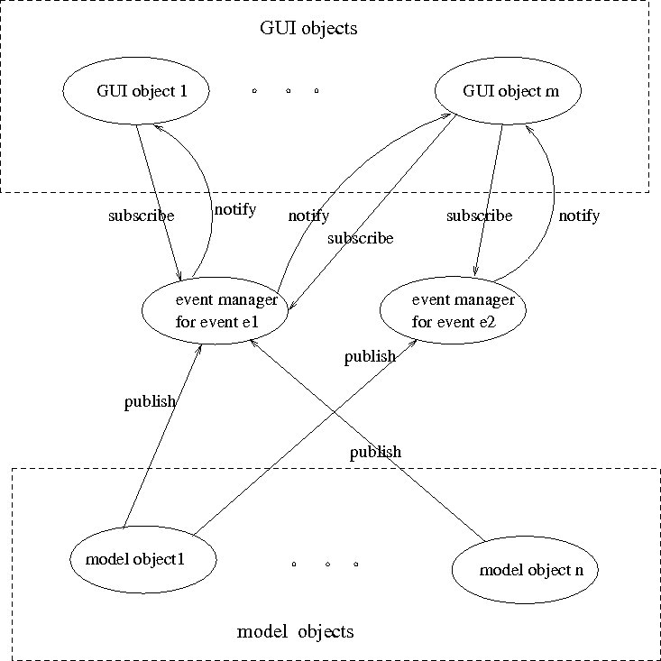
Publish-Subscribe Pattern

Slide 136
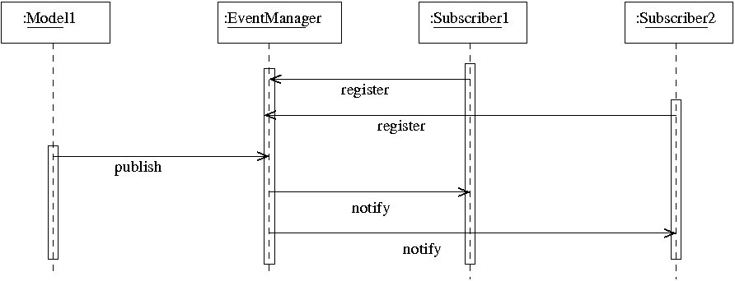
Publish-Subscribe Pattern

Slide 137
Proxy Pattern
Problem: How should a client object invoke the services of a server object?
Solution: A proxy object should be created at the client side.
Explanation:
  The proxy hides the details of network transmissions.
  Determines server address,
  Communicates with the server, obtains server response and seamlessly passes that to the client.

Slide 138
Example 1: Tic-Tac-Toe Computer Game
A human player and the computer make alternate moves on a 3 3 square.
A move consists of marking a previously unmarked square.
The user inputs a number between 1 and 9 to mark a square
Whoever is first to place three consecutive marks along a straight line (i.e., along a row, column, or diagonal) on the square wins.

Slide 139
Example 1: Tic-Tac-Toe Computer Game
As soon as either of the human player or the computer wins,
  A message announcing the winner should be displayed.
If neither player manages to get three consecutive marks along a straight line,
  And all the squares on the board are filled up,
  Then the game is drawn.
The computer always tries to win a game.

Slide 140
Example 1: Use Case Model
Tic-tac-toe game
Play Move
Player

Slide 141
Example 1: Initial and Refined Domain Model
Board
Initial domain model
PlayMoveBoundary
PlayMoveController
Board
Refined domain model

Slide 142
Example 1: Sequence Diagram
:playMove
Boundary
:playMove
Controller
:board
acceptMove
checkMoveValidity
move
[invalidMove]
[invalidMove]
announceInvalidMove
announceInvalidMove
checkWinner
[game over]
[game over]
announceResult
announceResult
playMove
checkWinner
[game over]
[game over]
announceResult
announceResult
displayBoardPositions
getBoardPositions
[game not over]
promptNextMove
Sequence Diagram for the play move use case

Slide 143
Example 1: Class Diagram
Board
PlayMoveBoundary
int position[9]
checkMove Validity
checkResult
playMove
announceInvalidMove
announceResult
displayBoard
Controller
announceInvalidMove
announceResult

Slide 144
Example 2: Supermarket Prize Scheme
Supermarket needs to develop software to encourage regular customers.
Customer needs to supply his:
  Residence address, telephone number, and the driving licence number.
Each customer who registers is:
  Assigned a unique customer number (CN) by the computer.

Slide 145
Example 2: Supermarket Prize Scheme
A customer can present his CN to the staff when he makes any purchase.
The value of his purchase is credited against his CN.
At the end of each year:
  The supermarket awards surprise gifts to ten customers who make highest purchase.

Slide 146
Example 2: Supermarket Prize Scheme
Also, it awards a 22 carat gold coin to every customer:
  Whose purchases exceed Rs. 10,000.
The entries against the CN are reset:
  On the last day of every year after the prize winner’s lists are generated.

Slide 147
Example 2: Use Case Model
Supermarket
Prize scheme
register
customer
Customer
Clerk
register
sales
Sales Clerk
select
winners
Manager

Slide 148
Example 2: Initial Domain Model
SalesHistory
CustomerRegister
1
1
*
*
SalesRecords
CustomerRecord
Initial domain model

Slide 149
Example 2: Refined Domain Model
SalesHistory
CustomerRegister
1
1
*
*
SalesRecords
CustomerRecord
RegisterCustomerBoundary
RegisterCustomerController
RegisterSalesBoundary
RegisterSalesController
SelectWinnersBoundary
SelectWinnersControllers
Refined domain model

Slide 150
Example 2: Sequence Diagram for the Select Winners Use Case
:SelectWinner
Boundary
:SelectWinner
Controller
:Sales
History
:Sales
Record
:Customer
Register
:Customer
Record
Select
Winners
SelectWinners
SelectWinners
*computeSales
*browse
[for each winner]
announces
find WinnerDetails
[for each winner]
browse
Sequence Diagram for the select winners use case

Slide 151
Example 2: Sequence Diagram for the Register Customer Use Case
:RegisterCustomer
Boundary
:RegisterCustomer
Controller
:Customer
Register
:Customer
Record
register
register
checkDuplicate
*match
[duplicate]
showError
generateCIN
create
:Customer
Record
register
displayCIN
Sequence Diagram for the register customer use case

Slide 152
Example 2: Sequence Diagram for the Register Sales Use Case
:Register
Sales
Boundary
:Register
Sales
Controller
:Sales
History
RegisterSales
registerSales
registerSales
:Sales
Record
create
confirm
confirm
Sequence Diagram for the register sales use case

Slide 153
Example 2: Sequence Diagram for the Register Sales Use Case
:Register
Sales
Boundary
:Sales
History
registerSales
RegisterSales
:Sales
Record
create
confirm
Refined Sequence Diagram for the register sales use case

Slide 154
Example 2: Class Diagram
SalesHistory
CustomerRegister
selectWinners
registerSales
findWinnerDetails
register
1
1
*
*
SalesRecords
CustomerRecord
salesDetails
name
address
computerSales
browse
create
browse
checkDuplicate
create

Slide 155
Summary
We discussed object-oriented concepts
  Basic mechanisms: Such as objects, class, methods, inheritance etc.
  Key concepts: Such as abstraction, encapsulation, polymorphism, composite objects etc.

Slide 156
Summary
We discussed an important OO language UML:
  Its origin, as a standard, as a model
  Use case representation, its factorisation such as generalization, includes and extends
  Different diagrams for UML representation
  In class diagram we discussed some relationships association, aggregation, composition and inheritance

Slide 157
Summary cont…
Other UML diagrams:
  Interaction diagrams (sequence and collaboration),
  Activity diagrams,
  State chart diagrams.
We discussed OO software development process:
  Use of patterns lead to increased productivity and good solutions.

