Slide 1
Scrum

Slide 2
SCRUM
INTRODUCTION
Scrum is an Iterative and Incremental Development (IID) method that emphasizes a set of project management values and practices, rather than those in requirements, implementation, and so on. As such, it is easily combined with or complementary to other methods.
A key Scrum theme is its emphasis on empirical rather than defined process. Scrum appears simple, yet has practices that deeply influence the work experience and that capture key adaptive and agile qualities.

Slide 3
Some key practices include
self-directed and self-organizing team
no external addition of work to an iteration, once chosen
daily stand-up meeting with special questions
usually 30-calendar day iterations
demo to external stakeholders at end of each iteration
each iteration, client-driven adaptive planning

Slide 4
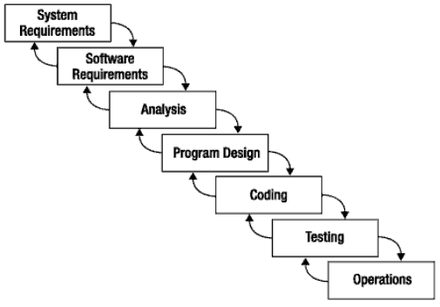
What is Scrum?
Scrum:
  Is an agile, lightweight process
  Can manage and control software and product development
  Uses iterative, incremental practices
  Has a simple implementation
  Increases productivity
  Reduces time
  Embraces the opposite of the waterfall approach…
It’s about common sense

Slide 5
Scrum at a Glance
24 hours
Daily Scrum
Meeting
Backlog tasks
expanded
by team
30 days
Sprint Backlog
Potentially Shippable
Product Increment
Product Backlog
As prioritized by Product Owner
Source: Adapted from Agile Software Development with Scrum by Ken Schwaber and Mike Beedle.

Slide 6


Sequential vs. Overlap
Requirements
Design
Code
Test
Rather than doing all of one thing at a time...
...Scrum teams do a little of everything all the time

Slide 7
Scrum Framework
Roles
Product owner
Scrum Master
Team
Ceremonies
Sprint planning
Sprint review
Sprint retrospective
Daily scrum meeting
Artifacts
Product backlog
Sprint backlog
Burndown charts

Slide 8







Scrum Roles
  Product Owner
    Possibly a Product Manager or Project Sponsor
    Decides features, release date, prioritization, $$$
  Scrum Master
    Typically a Project Manager or Team Leader
    Responsible for enacting Scrum values and practices
    Remove impediments / politics, keeps everyone productive
  Project Team
    5-10 members; Teams are self-organizing
    Cross-functional: QA, Programmers, UI Designers, etc.
    Membership should change only between sprints

Slide 9


Sprint Planning Mtg.
Team capacity
Sprint planning meeting
Sprint prioritization
Sprint
goal
Product backlog
Analyze/evaluate product backlog
Select sprint goal
Business conditions
Sprint planning
Decide how to achieve sprint goal (design)
Create sprint backlog (tasks) from product backlog items (user stories / features)
Estimate sprint backlog in hours
Current product
Sprint
backlog
Technology

Slide 10
Daily Scrum Meeting
Parameters
  Daily, ~15 minutes, Stand-up
  Anyone late pays a $1 fee
Not for problem solving
  Whole world is invited
  Only team members, Scrum Master, product owner, can talk
  Helps avoid other unnecessary meetings
Three questions answered by each team member:
  What did you do yesterday?
  What will you do today?
  What obstacles are in your way?
Notes:
10

Slide 11
Scrum's Artifacts
Scrum has remarkably few artifacts
  Product Backlog
  Sprint Backlog
  Burndown Charts
Can be managed using just an Excel spreadsheet
  More advanced / complicated tools exist:
    Expensive
    Web-based – no good for Scrum Master/project manager who travels
    Still under development

Slide 12

Product Backlog
The requirements
A list of all desired work on project
Ideally expressed as a list of user stories along with "story points", such that each item has value to users or customers of the product
Prioritized by the product owner
Reprioritized at start of each sprint
This is the
product backlog

Slide 13
User Stories
Instead of Use Cases, Agile project owners do "user stories"
  Who (user role) – Is this a customer, employee, admin, etc.?
  What (goal) – What functionality must be achieved/developed?
  Why (reason) – Why does user want to accomplish this goal?
As a [user role], I want to [goal], so I can [reason].

Slide 14
Example:
  "As a user, I want to log in, so I can access subscriber content."
story points: Rating of effort needed to implement this story
  common scales: 1-10, shirt sizes (XS, S, M, L, XL), etc.

Slide 15
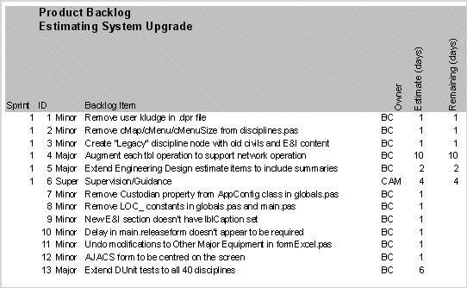
Sample Product Backlog 2

Slide 16
Sprint Backlog
Individuals sign up for work of their own choosing
  Work is never assigned
Estimated work remaining is updated daily
Any team member can add, delete change sprint backlog
Work for the sprint emerges
If work is unclear, define a sprint backlog item with a larger amount of time and break it down later
Update work remaining as more becomes known

Slide 17
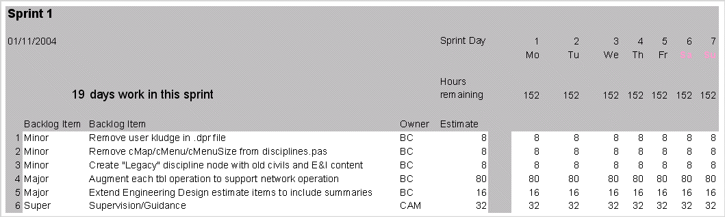
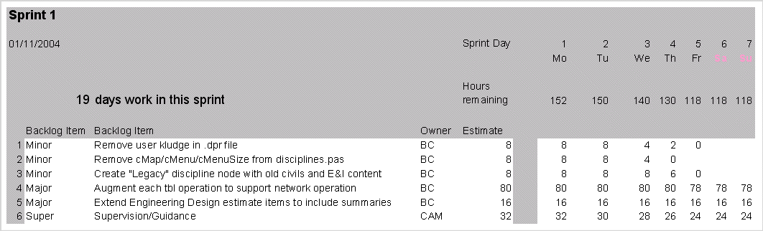
Sample Sprint Backlog

Slide 18
The Scrum Meeting: Details
The Scrum Meeting—or scrum—is the heartbeat of Scrum and the project. Each workday at the same time and place, hold a meeting with the team members standing in a circle, at which time the same special questions are answered by each member:
1. What have you done since the last Scrum?
2. What will you do between now and the next Scrum?
3. What is getting in the way (blocks) of meeting the iteration goals?
4. Any tasks to add to the Sprint Backlog
5. The last question provides an efficient forum for a continuously improving and learning group

Slide 19
Work products
In addition to the work products illustrated , Scrum allows any other work products of value to the project.
Product Backlog
Sprint Backlog
Sprint Backlog Graph
Other Practices and Values
Workers daily update the Sprint Backlog
No PERT charts allowed
Scrum Master reinforces vision
Replace ineffective Scrum Master
VALUES: Commitment, Focus, Openness, Respect, Courage

Slide 20
Questions
Define SCRUM.
2. Explain Method Overview of scrum.
Sketch and explain Lifecycle of scrum.
Explain Workproducts, Roles, and Practices.
Advantages of Scrum Meeting.
List out the values of scrum.

