Slide 1

Database Management Systems
Introduction
Suresh Jamadagni
Dept of Computer Science and Engineering

Slide 2

Database Management Systems
Text book and Slides Credit for all PPTs of this course
Text Book
Fundamentals of Database Systems, Ramez Elamsri, Shamkant B Navathe, Pearson, 7th Edition, 2017.
Slides Credit for all PPTs of this course
The slides/diagrams in this course are an adaptation, combination, and enhancement of material from the text book

Slide 3
Database Management Systems
Course Logistics: Evaluation policy
Course Name: | Database Management Systems |  | Code: |  | UE20CS301
Credits: | 5 |  | Contact Hours: |  | 105
Session Break-up |  |  | Assessment Scheme
Lectures |  | 56 | ESA |  | 50
Lab hours |  | 22 | ISA |  | 30
Lab quiz |  | 2 | Lab work |  | 4
Unit Review/Assignment |  | 5 | Lab Quiz |  | 4
CBT |  | 5 | Mini Project |  | 7
Mini Project |  | 15 | Unit Review |  | 5
Total |  | 105 | Total |  | 100
 |  |  |  | Hands-on sessions

Slide 4
Definitions
Database Management Systems
Data
Known facts that can be recorded and that have implicit meaning
When data is processed, organized, structured or presented in a given context, so as to make it useful, it is called Information.
Data is a collection of facts, while information puts those facts into context.
While data is raw and unorganized, information is organized.
Information is utilized by humans in some significant way (such as to make decisions, forecasts etc).
Data doesn’t depend on information. Information depends on data

Slide 5
Definitions
Database Management Systems
Database:
- A collection of related data
represents some aspect of the real world, sometimes called the miniworld or the universe of discourse (UoD)
logically coherent collection (not a random collection) with some inherent meaning.
designed, built and populated for a specific purpose
can be of any size and complexity

Slide 6
Definitions
Database Management Systems
Database Management System:
General-purpose software system that facilitates the processes of defining, constructing, manipulating, and sharing databases among various users and applications
Defining a database involves specifying the data types, structures, and constraints of the data to be stored in the database.
Constructing the database is the process of storing the data on some storage medium that is controlled by the DBMS.
Manipulating a database includes functions such as querying the database to retrieve specific data, updating the database to reflect changes in the miniworld, and generating reports from the data.
Sharing a database allows multiple users and programs to access the database simultaneously

Slide 7
Database Management Systems
Why study databases?
Databases help us
Store it (file structures, disk management)
Understand it (data models)
Keep it secure (security, recovery)
Find it and use it (query languages, concurrency control and data analysis tools)
DBMSs are a key part of most applications
banking, making reservations, purchasing, borrowing, schedules, browsing online catalogues, video on demand, interactive maps and images, employee information, web servers

Slide 8
Database Management Systems
Applications
Traditional Applications:
Numeric and Textual Databases
More Recent Applications:
Multimedia Databases
Geographic Information Systems (GIS)
Data Warehouses
Mobile databases
Real-time and Active databases
In-memory databases

Slide 9
Database Management Systems
Recent Developments (1)
Social Media started capturing a lot of information about people and about communications among people - posts, tweets, photos, videos in systems such as:
- Facebook
- Twitter
- Linked-In
All of the above constitutes data
Search Engines- Google, Bing, Yahoo : collect their own repository of web pages for searching

Slide 10
Database Management Systems
Recent Developments (2)
New Technologies are emerging from the so-called non-database software vendors to manage vast amounts of data generated on the web.
Big Data storage systems involving large clusters of distributed computers
NoSQL (Not Only SQL) systems
A large amount of data now resides on the “cloud” which means it is in huge data centers using thousands of machines.

Slide 11
Database Management Systems
Impact of Databases and Database Technology
Businesses:
Banking, Insurance, Retail, Transportation, Manufacturing
Service Industries:
Financial, Real-estate, Legal, Electronic Commerce, Healthcare,
Social Networks, Environmental and Scientific Applications, Medicine and Genetics
More recently:
Education : Resources for content and Delivery
Personalized Applications:
Based on smart mobile devices

Slide 12
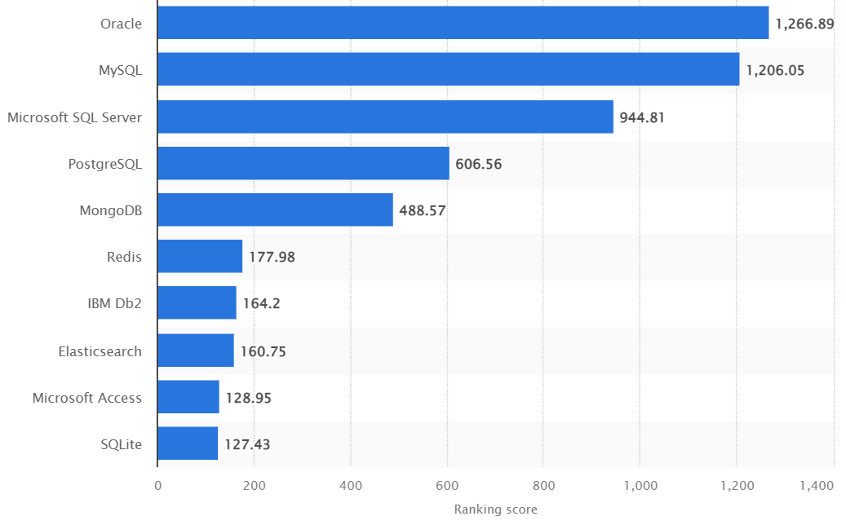
Database Management Systems
Popular DBMSs

Slide 13
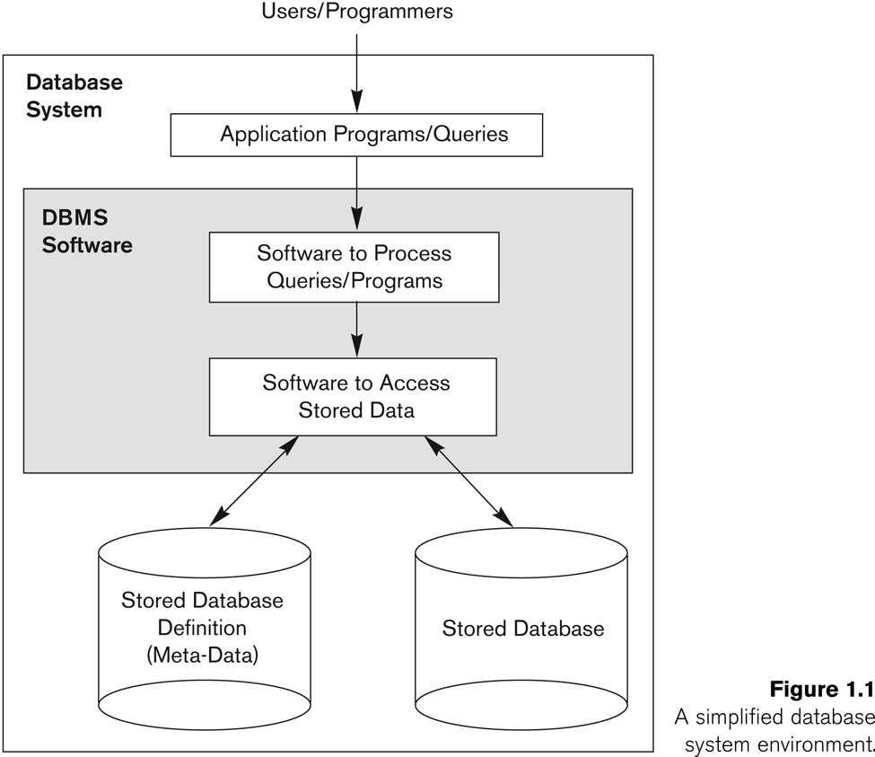
Database Management Systems
Database system environment

Slide 14
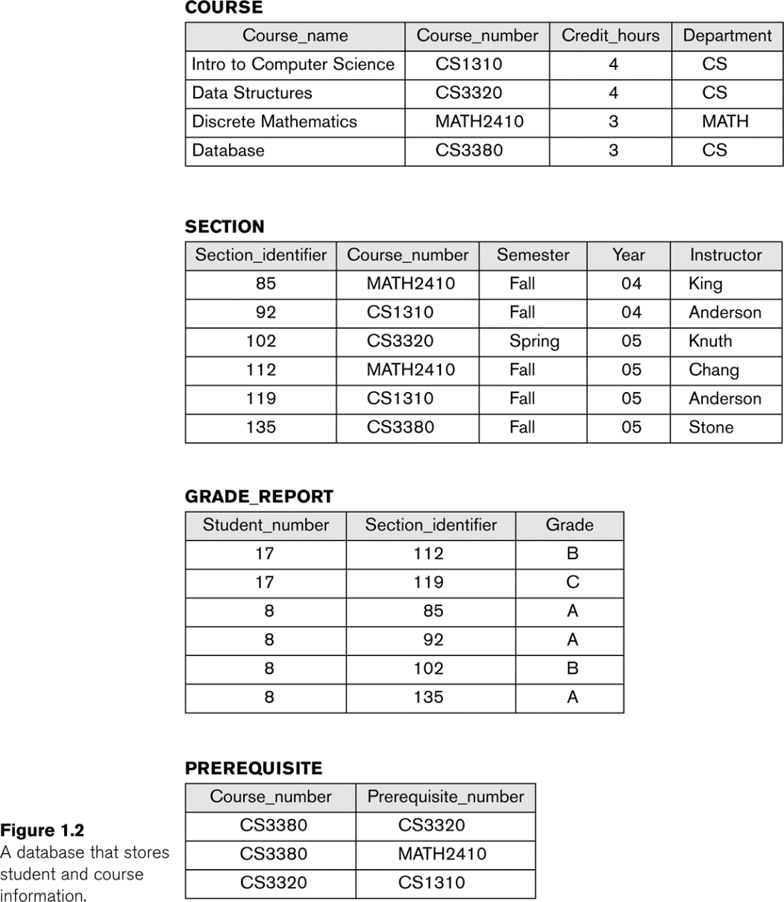
Database Management Systems
Example of a simple database

Slide 15
Database Management Systems
Characteristics of the Database Approach
Self-describing nature of a database system
The database system contains not only the database itself but also a complete definition or description of the database structure and constraints (Metadata).
Insulation between programs and data, and data abstraction
The structure of data files is stored in the DBMS catalog separately from the access programs (program-data independence)
Support of multiple views of the data
DBMSs support different types of users, each of whom may require a different perspective or view of the database. A view may be a subset of the database or it may contain virtual data that is derived from the database files but is not explicitly stored.
Sharing of data and multiuser transaction processing
A multiuser DBMS, allows multiple users to access the database at the same time. It ensures that data changes are effected in a controlled manner so that the result of the changes are correct

Slide 16
Database Management Systems
Advantages of using a Database system
Controlling redundancy in data storage.
Sharing of data among multiple users.
Restricting unauthorized access to data
Providing persistent storage for program Objects
E.g., Object-oriented DBMSs make program objects persistent
Providing Storage Structures and search techniques for efficient Query Processing
Providing backup and recovery
Providing multiple interfaces to different classes of users.

Slide 17
Database Management Systems
Advantages of using a Database system
Representing complex relationships among data.
Enforcing integrity constraints on the database.
Drawing inferences and actions from the stored data using deductive and active rules and triggers
Potential for enforcing standards
Reduced application development time
Flexibility to change data structures
Availability of current information
Economies of scale

Slide 18
Database Management Systems
Brief history of Data management
Hierarchical and Network models
Relational model
Object-oriented model
Data on the Web and E-commerce Applications
Special functionality added to DBMSs in the following areas:
Scientific Applications – Physics, Chemistry, Biology - Genetics
Earth and Atmospheric Sciences and Astronomy
XML (eXtensible Markup Language)
Image Storage and Management
Audio and Video Data Management
Data Warehousing and Data Mining
Spatial Data Management and Location Based Services
Time Series and Historical Data Management

Slide 19
THANK YOU
Suresh Jamadagni
Department of Computer Science and Engineering
sureshjamadagni@pes.edu

