Slide 1
1

Slide 2

APPLIED CRYPTOGRAPHY
Lecture 40
2

Slide 3
MD5 and One way hash function
Cryptographic hash function for authentication
3

Slide 4
Potential attacks against integrity
Accidental errors
Simple manipulation
Active attacks
Repudiation attack

Slide 5
Hash functions
A hash function is any function that can be used to map data of arbitrary size to fixed-size values.
The values returned by a hash function are called hash values, hash codes, digests, or simply hashes.
A hash function is a mathematical function (a process) for converting a numerical input value into a numerical output value

Slide 6
Hash function uses
As strong one way functions
To provide a weak notion of data integrity
As components to build other cryptographic primitives
As a means of binding data
As sources of pseudo randomness

Slide 7
Practical properties of hash function
Compress Arbitrary long inputs into fixed length output
Easy to compute

Slide 8
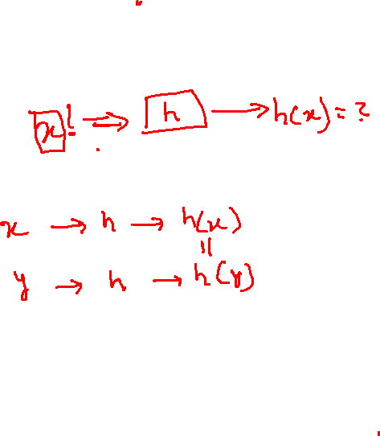
Security property of hash
Preimage resistance
Second preimage resistance
Collision resistance

Slide 9
Applications of hash functions
Applications requiring preimage resistance
Applications requiring second preimage resistance
Application requiring collution resistance

Slide 10
Modern hash functions
MD family
Sha-1 family
Sha-2 family
RiPEMD family
whirlpool

Slide 11
MD5
The MD5 message-digest algorithm is a widely used hash function producing a 128-bit hash value.
Has many vulnerabilities.
It can still be used as a checksum to verify data integrity, but only against unintentional corruption.
One basic requirement of any cryptographic hash function is that it should be computationally infeasible to find two distinct messages that hash to the same value. MD5 fails this requirement

Slide 12
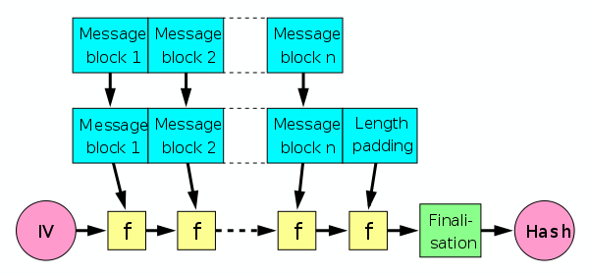

MD5 uses the Merkle–Damgård construction

Slide 13
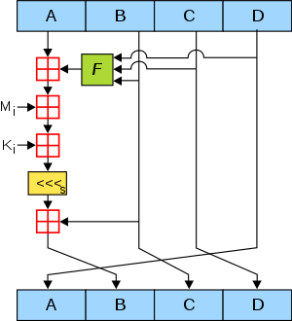

MD5 operation

Slide 14
Steps
The main MD5 algorithm operates on a 128-bit state, divided into four 32-bit words, denoted A, B, C, and D.
Four similar stages
Each stage has 16 similar operations based on a non-linear function F, modular addition, and left rotation.

Slide 15
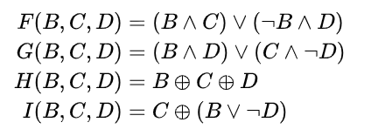
There are four possible functions; a different one is used in each round:
Below is a list of cryptography libraries that support MD5:
Botan
Bouncy Castle
cryptlib
Crypto++
Libgcrypt
Nettle
OpenSSL
wolfSSL

Slide 16
Thank You!
Next Class
Mandatory reading for the next class
https://tools.ietf.org/html/rfc1321
16

Slide 17


Rajashree S
Computer Science and Engineering
PES University, Bengaluru
10 June 2020
17

