Slide 1
Deep Learning & AI
Assignment 1
team # 4
Kears- Conv2D
Notes:
First half part of this presentation is based on this paper.
The latter part is my understanding about this topic.

Slide 2
1. Conv-2D parameters
1.1 Main parameters
•Filters: Integer: the dimensionality of the output space (i.e. the number of output filters in the convolution.
• Kernel_size: An integer or tuple/list of 2 integers, specifying the height and width of the 2D convolution window. Can be a single integer to specify the same value for all spatial dimensions.
• Strides: An integer or tuple/list of 2 integers, specifying the strides of the convolution along the height and width. Can be a single integer to specify the same value for all spatial dimensions.
• Padding: one of "valid" or "same" (case-insensitive). Note that "same" is slightly inconsistent across backends with strides != 1, as described here
• Activation: Activation function to use (see activations). If you don't specify anything, no activation is applied (ie. "linear" activation: a(x) = x).
https://keras.io/layers/convolutional/#conv2d

Slide 3
1. Conv-2D parameters
1.2 Secondary parameters
• Dilation_rate: an integer or tuple/list of 2 integers, specifying the dilation rate to use for dilated convolution.
• Use_bias: Boolean, whether the layer uses a bias vector.
Initializer
• Kernel_initializer: Initializer for the kernel weights matrix (see initializers).
• Bias_initializer: Initializer for the bias vector (see initializers).
Regularizer
• kernel_regularizer: Regularizer function applied to the kernel weights matrix (see regularizer).
• Bias_regularizer: Regularizer function applied to the bias vector (see regularizer).
• Activity_regularizer: Regularizer function applied to the output of the layer (its "activation"). (see regularizer).
• Kernel_constraint, Bias_constraint
https://keras.io/layers/convolutional/#conv2d

Slide 4
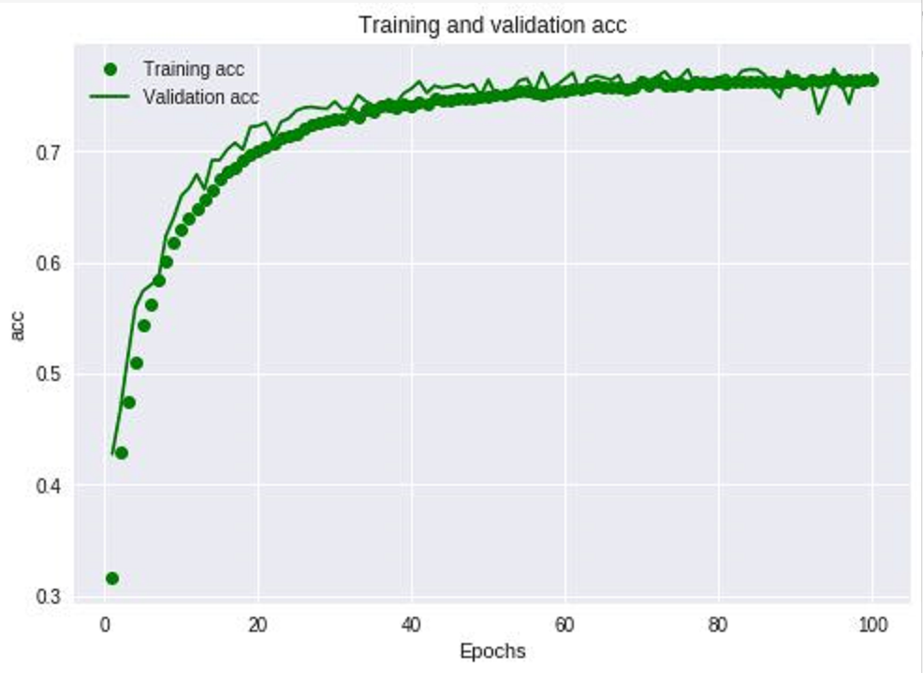
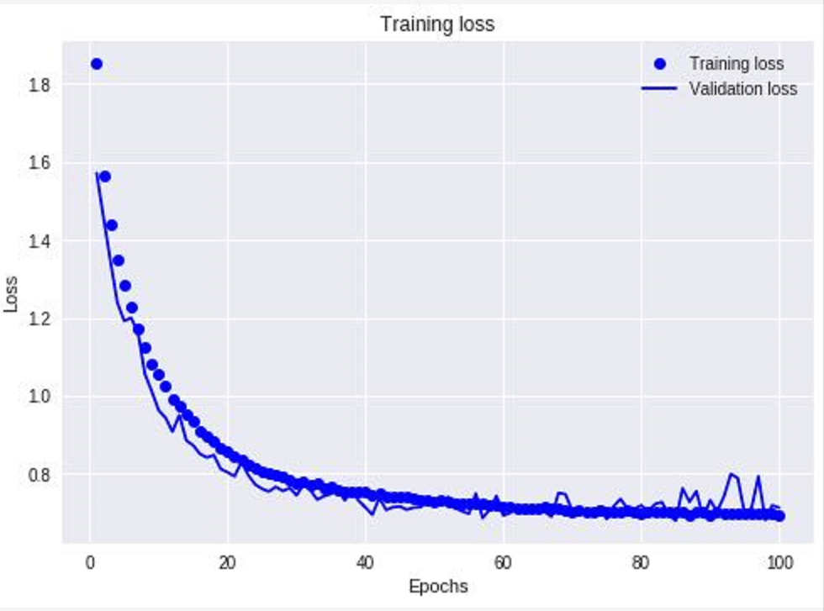
2. Main Parameters
Filters: Integer: • Kernel_size: • Strides: • Padding• Activation
2.1
Set batch_size=512,
Run base model with epochs=100
Use epochs=30, 50 to the following trials.
Notes:
There are three main roles in this article: entrant firms, exit firms and switchers.
This is the definition of them.

Slide 5
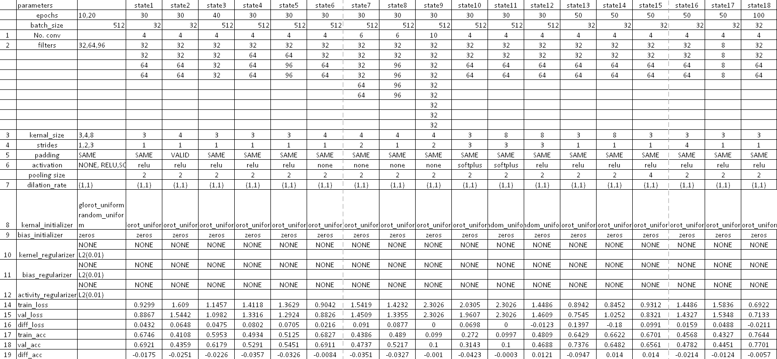
2. Main Parameters
• Set 18 models with modifying parameters
• Alter single parameter or multiple parameters
Notes:
The paper has 5 missions. First:
external shocks: such as policy or laws change and trade liberalization.
Throughout the analysis, particular focus is given to the role of trade liberalization and deregulation

Slide 6
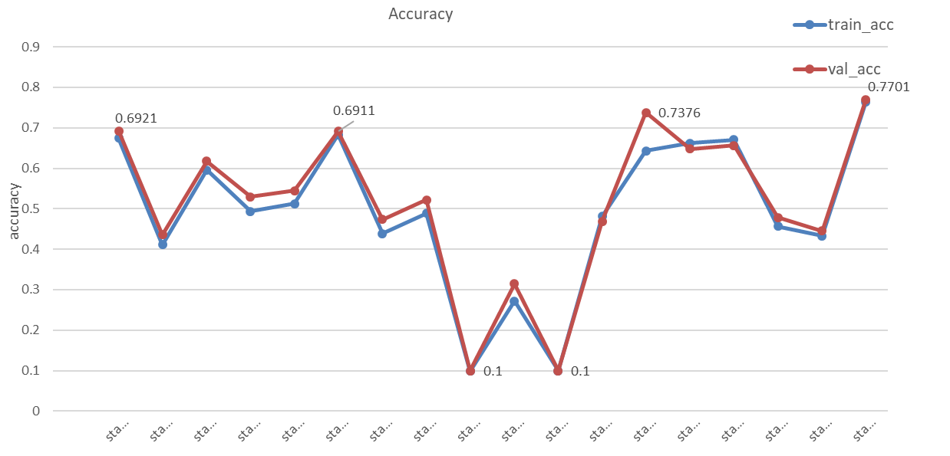
2. Main Parameters
• Set 18 models with modifying parameters
• Alter single parameter or multiple parameters
Notes:
The paper has 5 missions. First:
external shocks: such as policy or laws change and trade liberalization.
Throughout the analysis, particular focus is given to the role of trade liberalization and deregulation

Slide 7
2. Main Parameters
• Padding:
‘SAME’ to ‘VALID’
Accuracy droped to 0.4359 from 0.6921
• Pooling size：
from‘2*2’ to ‘4*4’
Accuracy droped to 0.6561 from 0.6921
further adjusting pooling size need adjust more parameters
make trade-off
Notes:
This is the article model. The target variable is probability of switching out.
The variables refer to productivity, the number of employees, ownership structure, the concentration of the objective sector and some dummies.
Due to the limited time, let’s skip the details.

Slide 8
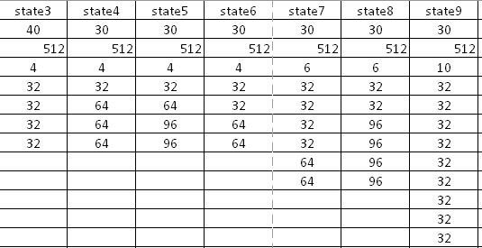
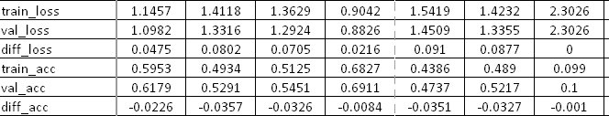
2. Main Parameters
• Filters:
• base model accuracy 0.6921
• lower than base model
• filters with convolutional layers
• make trade-off
Notes:
This is the article model. The target variable is probability of switching out.
The variables refer to productivity, the number of employees, ownership structure, the concentration of the objective sector and some dummies.
Due to the limited time, let’s skip the details.

Slide 9
2. Main Parameters
• kernel size:
• lower than base model
• make trade-off， (4*4) is better
Notes:
This is the article model. The target variable is probability of switching out.
The variables refer to productivity, the number of employees, ownership structure, the concentration of the objective sector and some dummies.
Due to the limited time, let’s skip the details.

Slide 10
2. Main Parameters
• epochs:
• not conv2D parameters
• more computing time and more accuracy than epochs=30
• Highest Accuracy:0.7701
Notes:
This is the article model. The target variable is probability of switching out.
The variables refer to productivity, the number of employees, ownership structure, the concentration of the objective sector and some dummies.
Due to the limited time, let’s skip the details.

Slide 11
3. Secondary Parameters
• kernel_regularizer• Bias_regularizer• Activity_regularizer:
Avoid overfitting
Did not design out an obvious overfitting model
Notes:
There are three main roles in this article: entrant firms, exit firms and switchers.
This is the definition of them.

Slide 12
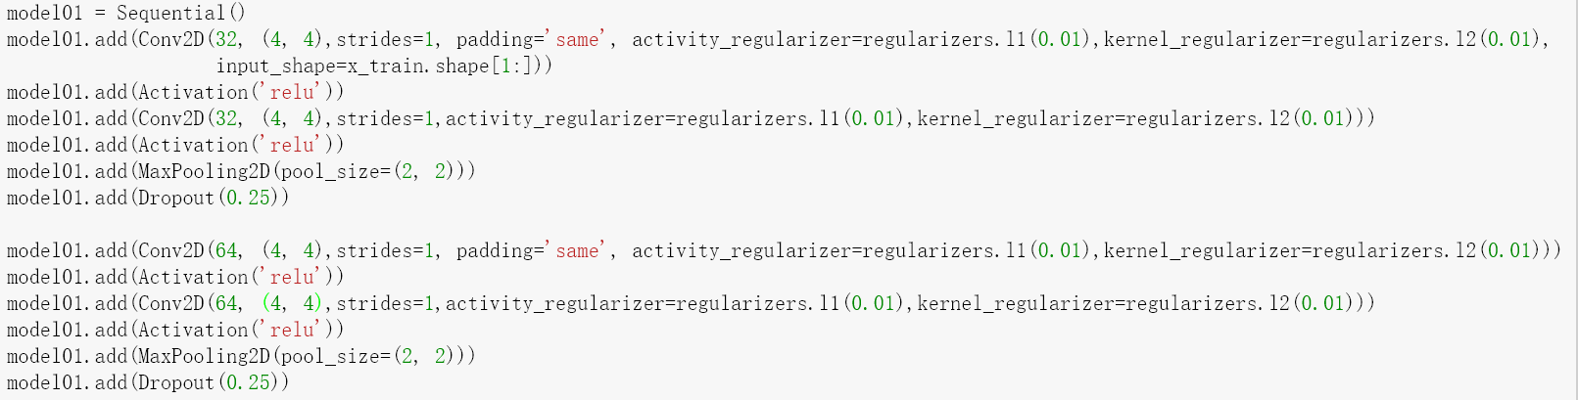
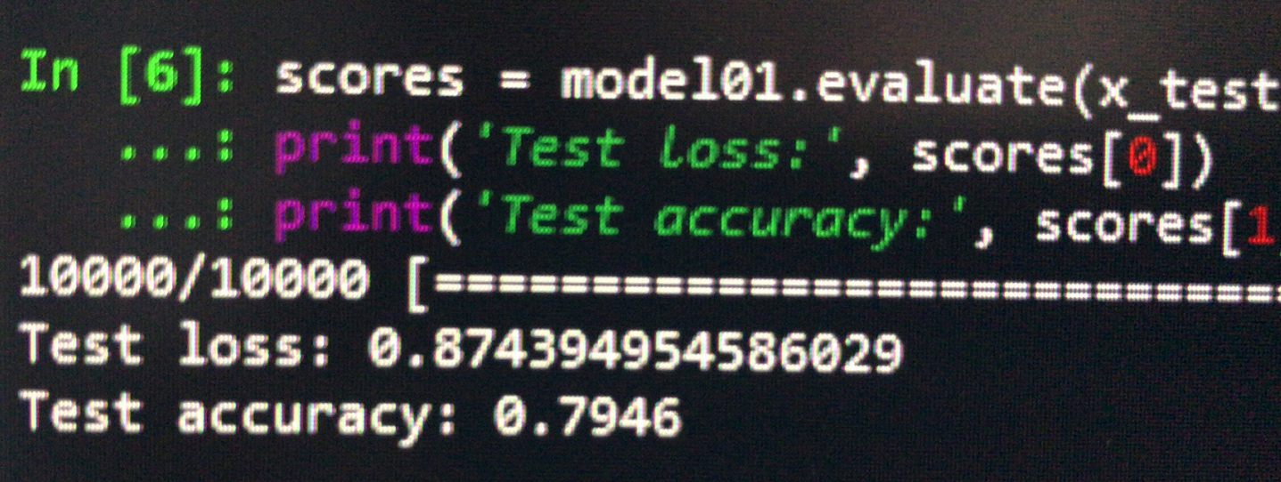
4. Optimal model
Notes:
There are three main roles in this article: entrant firms, exit firms and switchers.
This is the definition of them.

