Slide 1
Big-Data Sys Engineering Using Scala
KKBox's Churn Prediction
Group Members : Difu Chen
Haimin Zhang
Tianrun Gao

Slide 2
What is Customer Churn?
Concept
Customer churn is the loss of client or customers (also known as customer attrition or customer defection).
For businesses, accurately predicting customer churn is critical to long-term success.

Slide 3
What are we doing?
KKbox is a music streaming platform in Asia
Building a model to predict whether a user will churn when their subscription to KKBox expires
Motivation
Why are we doing this?
Important for marketing strategy
To explore complicated models that improves prediction accuracy

Slide 4
Data Source
Brief Introduction
the datasets consist of subscriber data from three distinct sources
a variety of information about subscriber activity by day
User log data
covered all payment and subscription information including renewals and cancellations
datasets
Transaction data
Member data
contained demographic information about each subscriber such as birthdate and gender

Slide 5
Data Feature
Training Set
msno | user id
is_churn | Churn is defined as whether the user did not continue the subscription within 30 days of expiration. is_churn = 1 means churn,is_churn = 0 means renewal.
Transactions
msno | user id
payment_method_id | payment method
payment_plan_days | length of membership plan in days
plan_list_price | in New Taiwan Dollar (NTD)
actual_amount_paid | in New Taiwan Dollar (NTD)
transaction_date: format | format%Y%m%d
membership_expire_date | format %Y%m%d
is_cancel | whether or not the user canceled the membership in this transaction

Slide 6
Data Feature 2
User_logs
msno | user id
date | format%Y%m%d
num_25 | songs played less than 25% of the song length
num_50 | songs played less than 50% of the song length
nubm_75 | songs played less than 75% of the song length
num_985 | songs played between 75% and 98.5% of the song length
num_100 | songs played over 98.5% of the song length
num_unq | unique songs played
total_secs | total seconds played

Slide 7
Data Feature 3
Members
msno | user id
city | city
bd | age
gender | gender
registered_visa | registration method
registration _init_time | format %Y%m%d
expiration_date | format %Y%m%d
Test Set
msno | user id
is_churn | prediction

Slide 8
Methodology
Features Engineering
Machine Learning algorithms
Evaluation Results

Slide 9
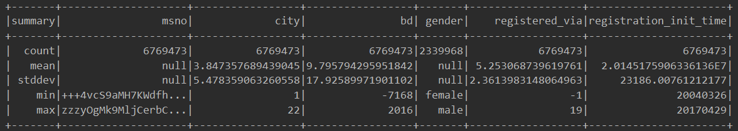
Feature Engineering
Members Part
bd means birthday. Through the Max value and min value, we can find that there are a lot of outliers. These outliers must be processed for the better prediction

Slide 10
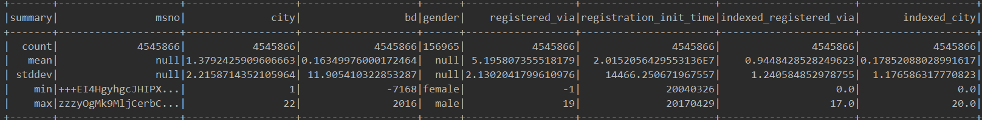
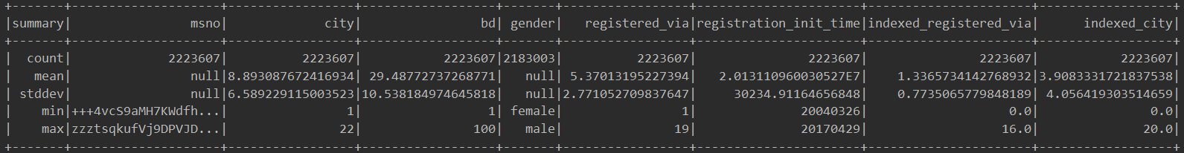
Feature Engineering
Members Part
Outliers
dsfd
sdf
sdfdsfsdf
Normal
Tables above shows that the total number of outliers is 454866 and the total number of Normal data is 223607. We can not simply remove these outliers. So we decided to use decision tree algorithm to predict the birthday of outliers

Slide 11
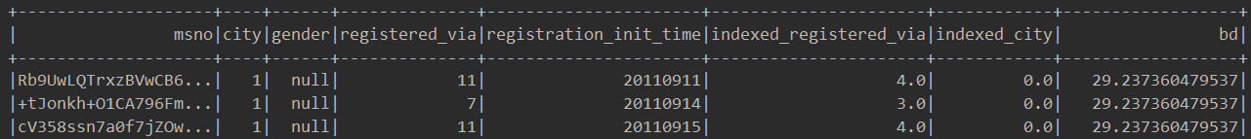
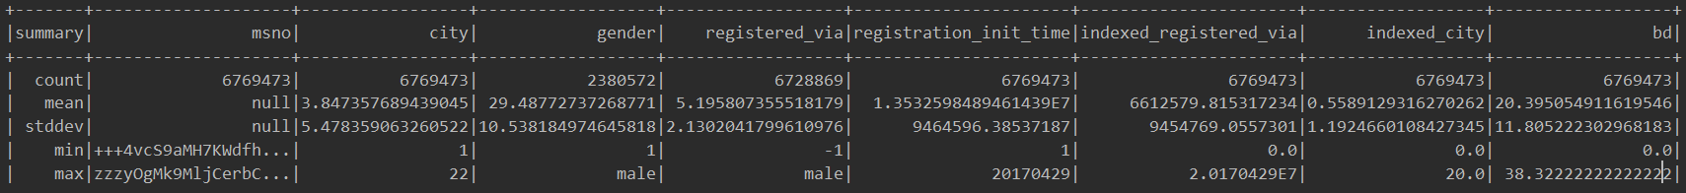
Feature Engineering
Members Part
Decision Tree
Decision Trees (DTs) are a non-parametric supervised learning method used for classification and regression. The goal is to create a model that predicts the value of a target variable by learning simple decision rules inferred from the data features.
Notes:
The target value is birthday feature.

Slide 12
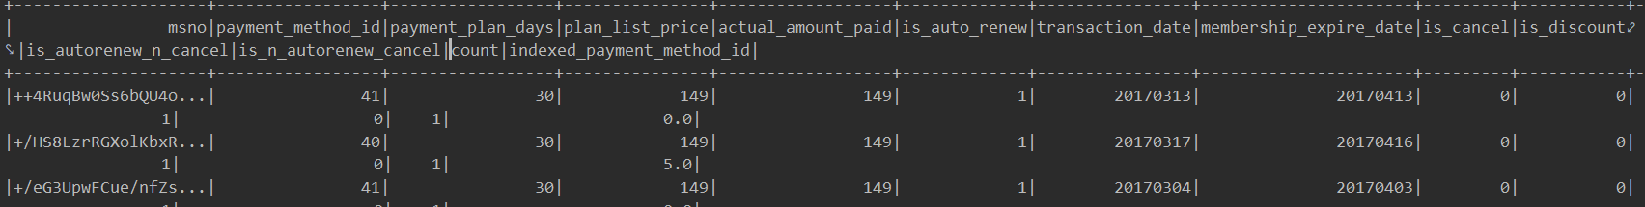
Feature Engineering
Transactions Part
Based on the basic features, we are able create some new variables that extract hidden information in the data. Below is a complete break down of all the new variables that contains predictive power
plan_list_price & actual_pay feature -------> is_discount
auto renew & not_cancel feature----->a user is using auto-renew and is not a canceled user
not Auto renew & Cancel feature-----> If a user is not using auto-renew and is a canceled user
trans_count: Number of transaction that a user has on record

Slide 13
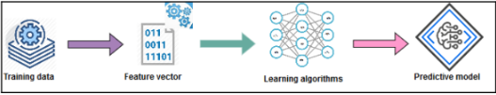

Machine Learning Algorithm
Learning Stage:
Training data and preparing feature vectors
Preparing the learning algorithm and training the algorithm to prepare the predictive model
Inference Stage:
Testing model against new data
Evaluating the performance of the model itself

Slide 14

Machine Learning Algorithm
Random Forest Classifier
A random forest is a meta estimator that fits a number of decision tree classifiers on various sub-samples of the dataset and uses averaging to improve the predictive accuracy and control over-fitting.

Slide 15
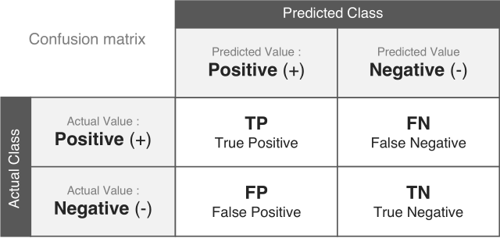
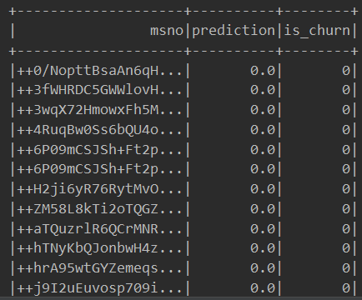
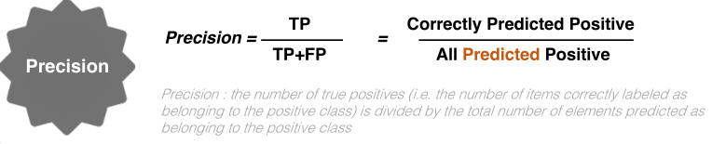
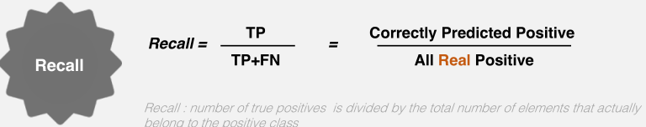
Evaluate Results
Precision:0.9070628309125287
Recall:0.8986020617028558

Slide 16
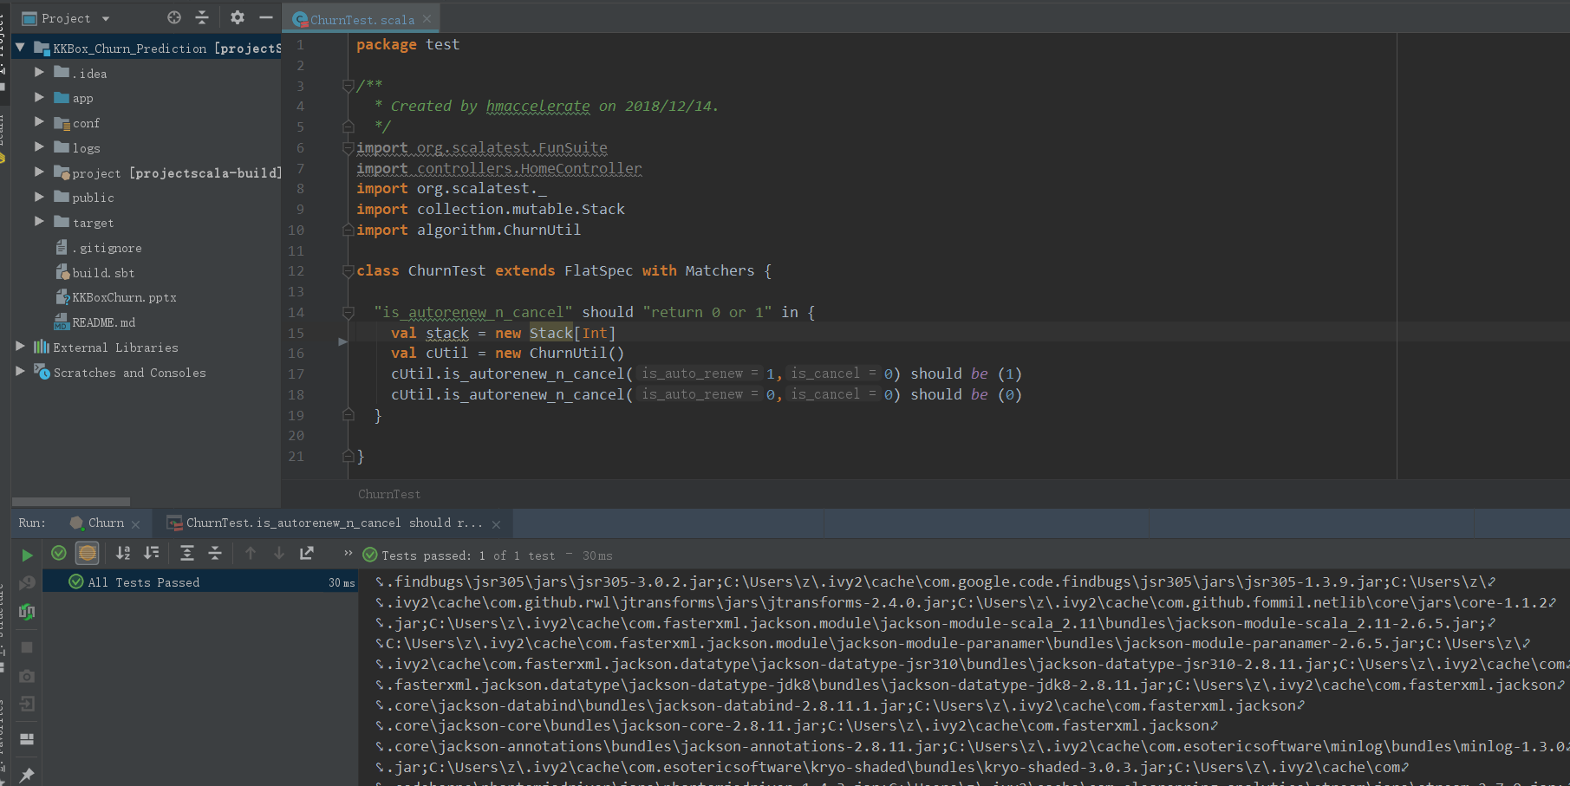
Unit Test

Slide 17
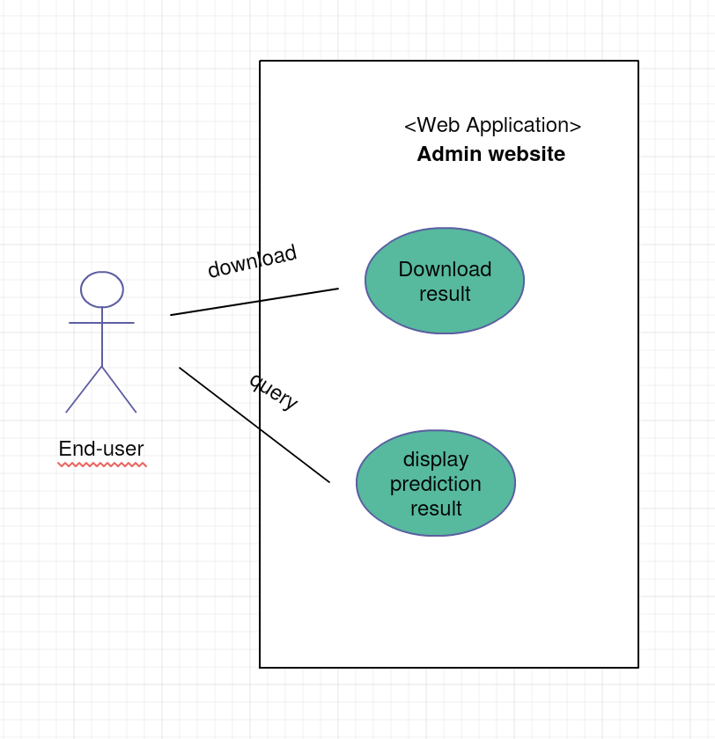
Use Case

Slide 18
User Interface
Play 2.6
Play is a high-productivity Java and Scala web application framework that integrates the components and APIs you need for modern web application development.
Play is based on a lightweight, stateless, web-friendly architecture and features predictable and minimal resource consumption (CPU, memory, threads) for highly-scalable applications thanks to its reactive model, based on Akka Streams.

Slide 19
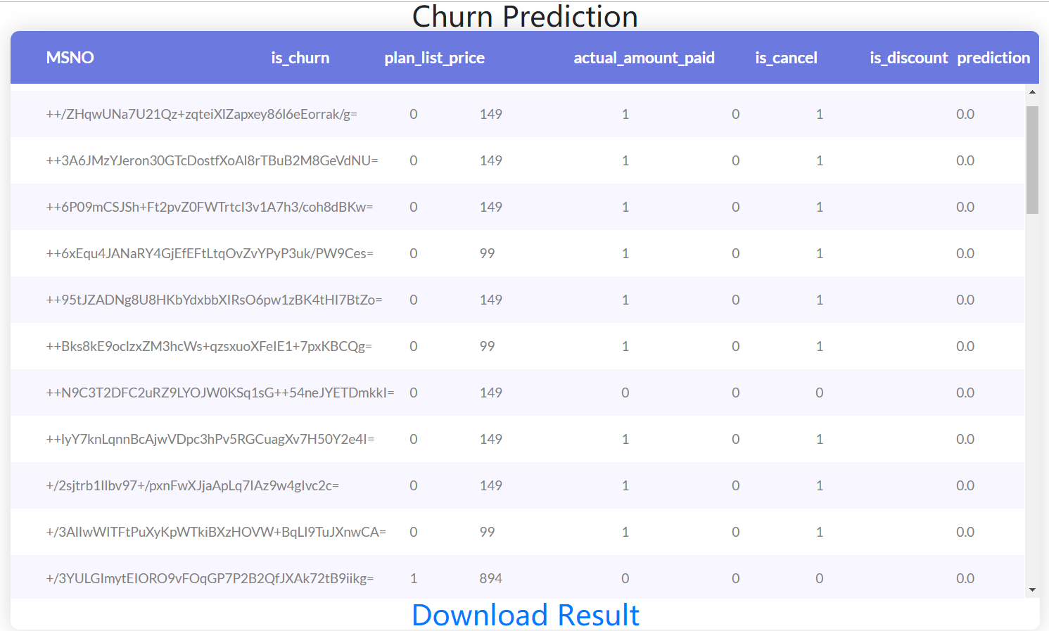
User Interface

Slide 20
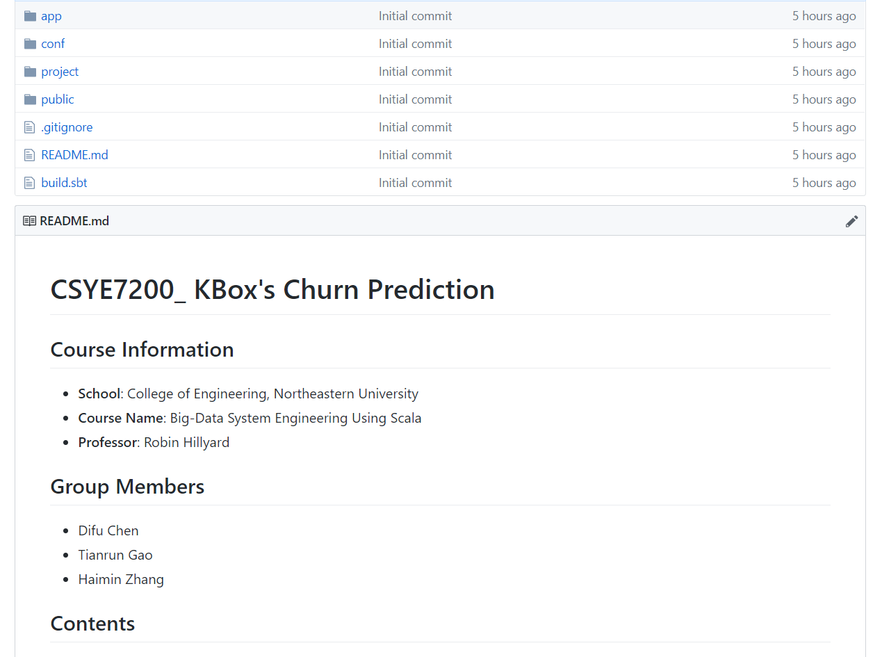
Code repository
https://github.com/hmaccelerate/KKBox_Churn_Prediction

Slide 21
Conclusion
The original estimated precision for churn prediction was 85%, but the actual precision has been up to 90%.
Framework has been used to design a good interface for user to experience.
The program is able to process the large scale of data, and the total data set of the project is almost 2GB.
The system can deal with errors and erroneous input.

