Slide 1



Employment & Wage Trends Analysis

Slide 2
Business Questions
Data Overview
Data Cleaning
Time Series Analysis
Logistic Regression Model
K-Means Clustering Analysis
Key Insights & Conclusions
Business Applications
Exploratory Data Analysis
Understand U.S. industry employment and wage trends across NAICS sectors
Identify patterns in employment levels and wage variations
Discover industry clustering based on employment and wage metrics
Determine key predictors for high-wage industries

Slide 3
Business Questions
Data Overview
Data Cleaning
Time Series Analysis
Logistic Regression Model
K-Means Clustering Analysis
Key Insights & Conclusions
Business Applications
Exploratory Data Analysis
Source
Bureau of Labor Statistics (BLS)
Quarterly data from 2022-2024
Key industries
Insurance carriers
Food manufacturing
Computing infrastructure
Telecommunications,
Oil & gas extraction
Variables
Industry codes/titles
Year
Quarter
Area titles
Establishment counts
Employment levels
Wage data
Tax contributions

Slide 4
Business Questions
Data Overview
Data Cleaning
Exploratory Data Analysis
Time Series Analysis
Logistic Regression Model
K-Means Clustering Analysis
Key Insights & Conclusions
Business Applications
Dropped rows with missing values
Handled problematic values
Replaced infinite values with NaN
Dropped rows with missing values in key calculated fields
Removed extreme outliers using IQR method
Used 3× IQR threshold (more lenient than standard 1.5×)
Calculated bounds: Q1 - 3×IQR and Q3 + 3×IQR
Removed values outside these bounds
Simplified industry names
Created shortened industry names for better visualization
Created efficiency metrics

Slide 5
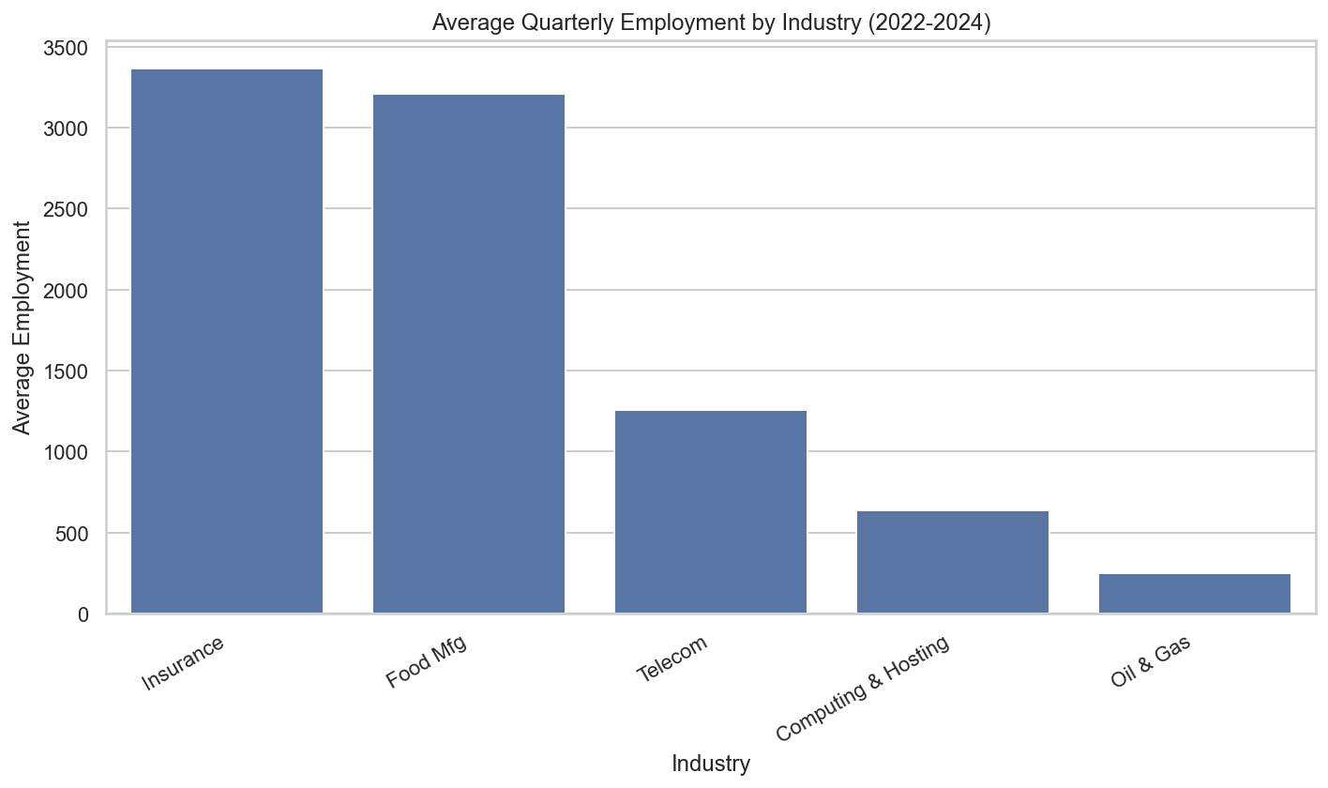
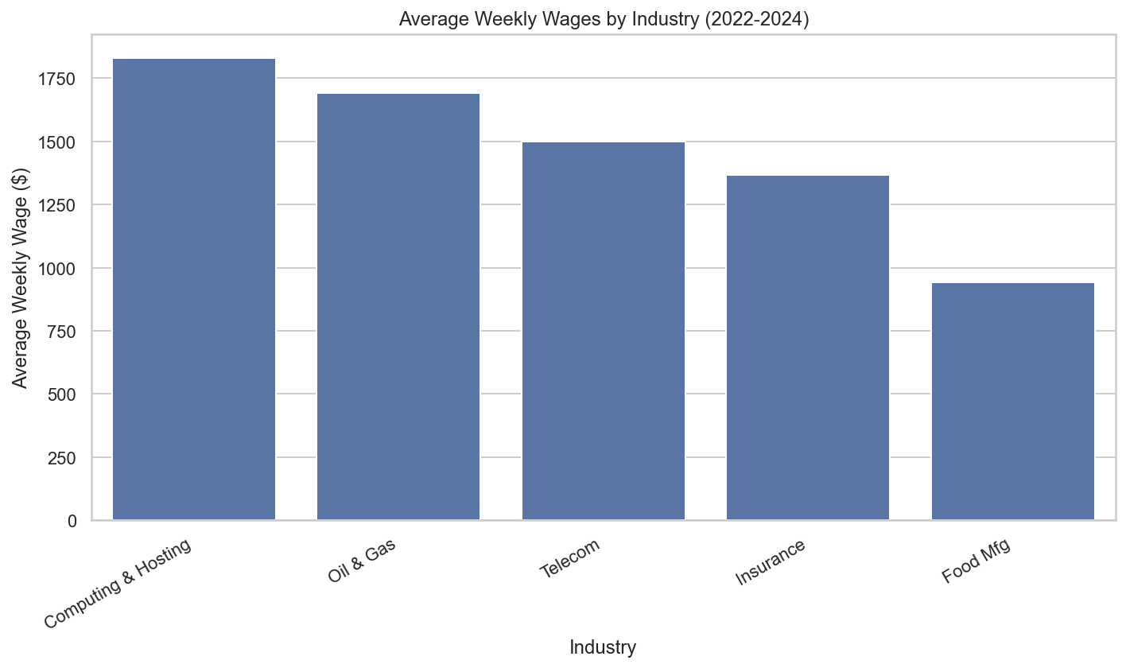
Business Questions
Data Overview
Exploratory Data Analysis
Time Series Analysis
Logistic Regression Model
K-Means Clustering Analysis
Key Insights & Conclusions
Business Applications
Data Cleaning

Slide 6
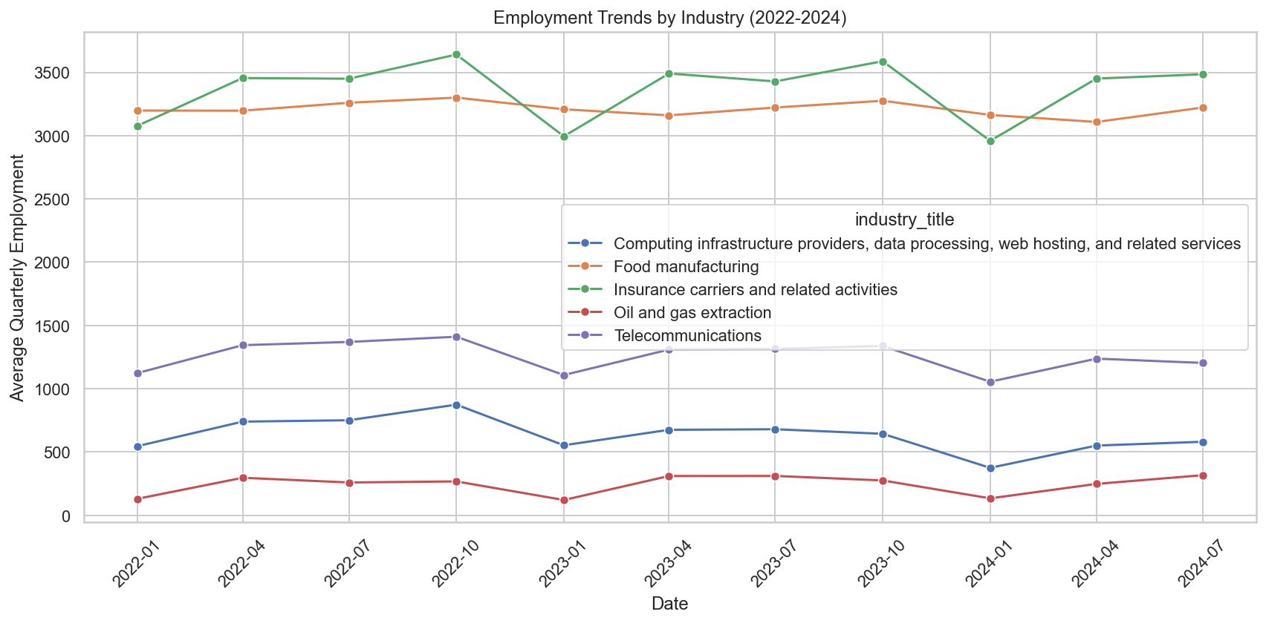
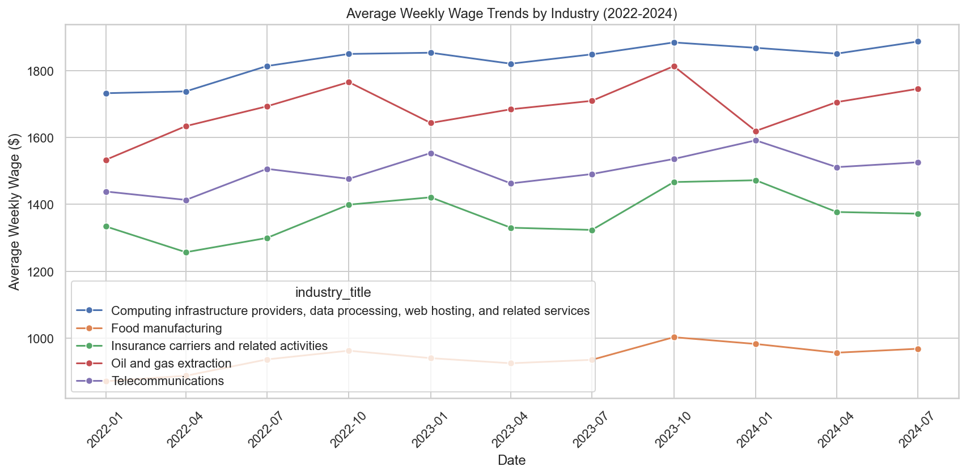
Business Questions
Data Overview
Data Cleaning
Time Series Analysis
Logistic Regression Model
K-Means Clustering Analysis
Key Insights & Conclusions
Business Applications
Exploratory Data Analysis
Different growth patterns across industries
Seasonal variations in employment levels
Wage trend differences among sectors

Slide 7
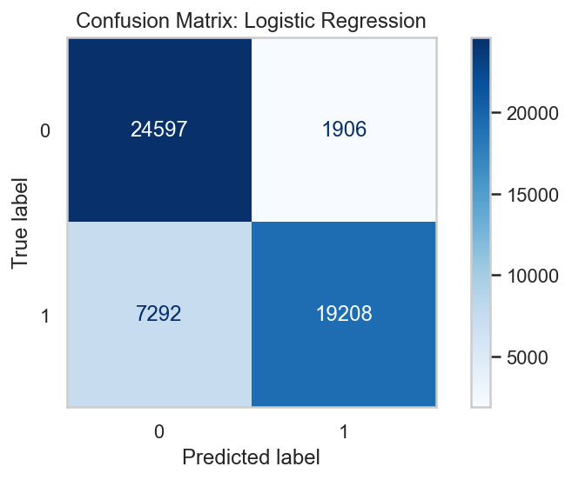
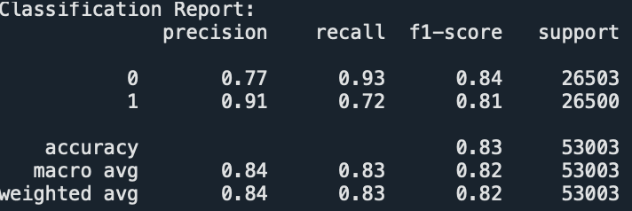
Business Questions
Data Overview
Data Cleaning
Time Series Analysis
Logistic Regression Model
K-Means Clustering Analysis
Key Insights & Conclusions
Business Applications
Exploratory Data Analysis
Goal
Classify high-wage vs. low-wage industries & identify predictors
Implementation
Converted to dummy variables
Binary target high_wage' (above/below median wages)
Standardized numeric features
80/20 train/test split
Feature Importance
Employment volatility (66.68)
Quarterly establishment count (51.56)
Monthly employment levels (~51.0)
Taxable quarterly wages (42.76)
Quarterly contributions (37.84)
Model Performance
83% overall accuracy
Low-wage Classification: 77% precision, 93% recall, 0.84 F1-score
High-wage Classification: 91% precision, 72% recall, 0.81 F1-score

Slide 8
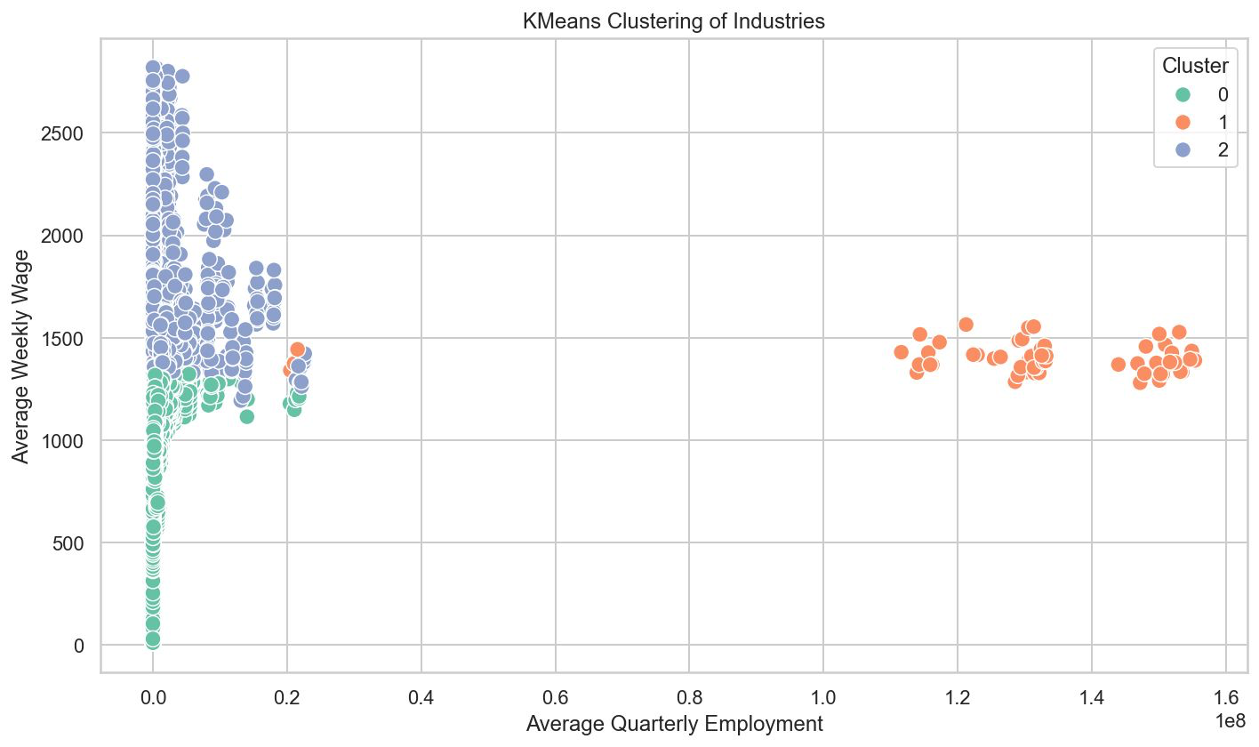
Business Questions
Data Overview
Data Cleaning
Time Series Analysis
Logistic Regression Model
K-Means Clustering Analysis
Key Insights & Conclusions
Business Applications
Exploratory Data Analysis
Goal
Group similar industries by employment and wage patterns
Implementation
Selected 6 key variables
Standardized features
Determined optimal k=3 clusters
Visualized using scatterplot
Cluster 0
Industries with lower average weekly wages (mostly between $300-$1,300,) and lower employment levels
Cluster 1
Industries with medium-range weekly wages (around $1,300-$1,600) but extremely large employment levels
Cluster 2
Industries with higher average weekly wages (mostly between $1,400-$2,800) and relatively small employment levels

Slide 9
Business Questions
Data Overview
Data Cleaning
Time Series Analysis
Logistic Regression Model
K-Means Clustering Analysis
Key Insights & Conclusions
Business Applications
Exploratory Data Analysis
Wage-Employment
Practical Applications
Industry Patterns & Characteristics
Model Performance & Validation
Business Structure Insights

Slide 10
Business Questions
Data Overview
Data Cleaning
Time Series Analysis
Logistic Regression Model
K-Means Clustering Analysis
Key Insights & Conclusions
Business Applications
Exploratory Data Analysis
Policy planning
Economic forecasting
Compensation benchmarking
Business strategy development
Workforce development

