Slide 1

jake riley
https://rstudio.cloud/project/1788351
https://github.com/rjake/workshop-flexdashboard-shinyobjects

Slide 2



About Me
Jake Riley
Clinical Data Analyst at CHOP
Avid package developer
#dogdad
@yake_84

Slide 3
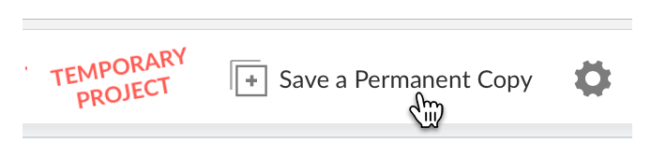
Following Along
RStudio Cloud
need an account
can sync up with GitHub
can copy my project https://rstudio.cloud/project/1788351
GitHub
https://github.com/rjake/workshop-flexdashboard-shinyobjects

Slide 4
Before we get started
Agenda
RMarkdown → RMarkdown + Shiny → Flexdashboard
shinyobjects workflow
Time to try out → put pictures on Google Drive
Reconvene & answer questions
Out of scope
Tidyverse
All data manipulation is from the tidyverse
Will not be covered in detail
shiny proper

Slide 5
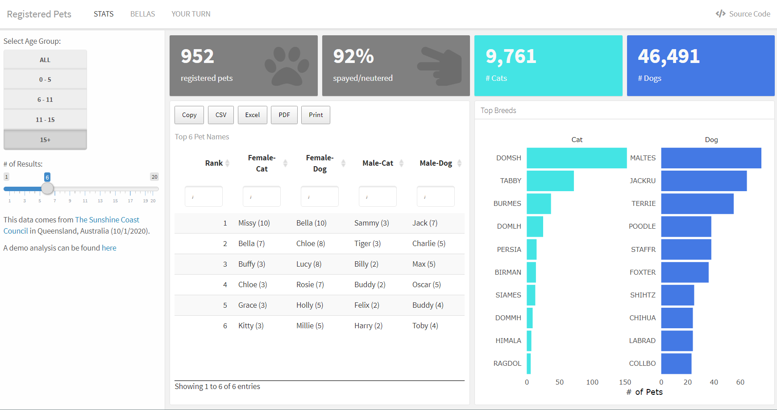

Slide 6
filtered_data()
input$age
input$n

Slide 7
What is reactivity?
radioGroupButtons(
inputId = "age_group",
choices = c("All", age_groups),
selected = "All“
)
static data: call as is
user inputs: input$x object
This is made by shiny
handled by UI components
sliderInput()
textInput()
radioGroupButtons()
dynamic data/plots/titles: reactive
text = renderText()
plot = renderPlot()
table = renderTable()
plotly = renderPlotly()
filtered_data <- reactive({
if (input$age_group != "All") {
filter(animals, age_group %in% input$age_group)
} else {
animals
}
})
plotly::renderPlotly({
p <-
filtered_data() %>%
mutate(breed = fct_lump(breed, input$n)) %>%
ggplot(aes(y = breed, fill = type)) +
geom_bar() +
labs(title = input$age_group))
plotly::ggplotly(p)
})

Slide 8
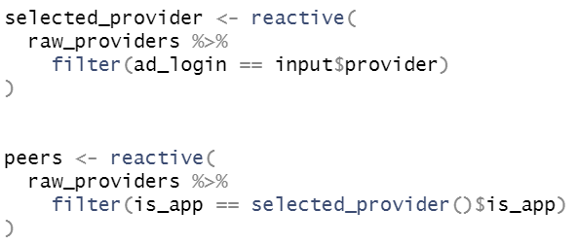
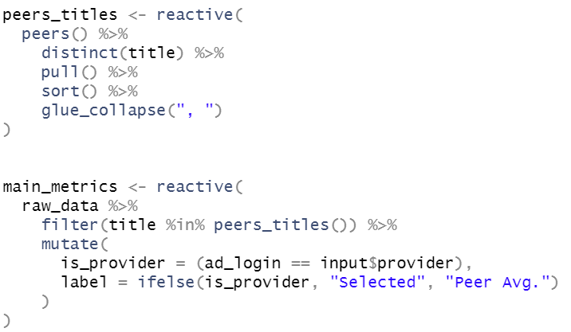
It can get really complicated

Slide 9
Good to know
plotly::renderPlotly({ # has {}
p <-
filtered_data() %>%
ggplot(aes(y = breed, fill = type)) +
geom_bar()
plotly::ggplotly(p)
})
multistep logic should go in {…}
If nothing is selected, input$x will return NULL
### when Row will put them next to each other
### when Column will stack them
plotly::renderPlotly( # no {}
plotly::ggplotly(
filtered_data() %>%
ggplot(aes(y = breed, fill = type)) +
geom_bar()
)
)

Slide 10
shinyobjects workflow
create a dummy input object
load_reactive_objects()
Changes reactive objects to static objects in your global environment
Entirely under the hood
convert_selection()
converts just the code highlighted in source pane
view_ui()
see what UI components will look like
https://rjake.github.io/shinyobjects/

