Slide 1
LAB 4 REPORT:
Dynamic Testing Tool

Slide 2

JMeter
Unleash the Power of Performance Testing

Slide 3
Table of content
Tool Introduction.
Installation guide (Windows & Ubuntu)
Usage guide
Demo
Load test
Volume test
Stress test
Test report summary
Conclusion

Slide 4
01
Introduction to JMeter
x
y

Slide 5
— Wikipedia
“...a load testing tool for analyzing and measuring the performance of a variety of services, with a focus on web applications”
Notes:
Apache JMeter là một công cụ mã nguồn mở mạnh mẽ được phát triển bởi dự án Apache, được sử dụng phổ biến để thực hiện kiểm thử tải và đo hiệu suất cho các ứng dụng web và dịch vụ. Với khả năng đa nền tảng và linh hoạt, JMeter cho phép người dùng tạo các kịch bản kiểm thử phức tạp để mô phỏng đồng thời hàng trăm, thậm chí hàng ngàn người dùng truy cập cùng một lúc. Nó cung cấp các công cụ mạnh mẽ để kiểm tra khả năng chịu tải, hiệu suất, và ổn định của ứng dụng, giúp phát hiện và giải quyết các vấn đề tiềm ẩn trước khi triển khai thực tế. Bằng cách sử dụng JMeter, các nhà phát triển và quản trị viên hệ thống có thể đảm bảo rằng ứng dụng của họ hoạt động một cách hiệu quả và đáng tin cậy dưới áp lực tải cao.

Slide 6
01
Performance testing tool
02
Open-Source Nature
03
Integration with CI/CD
04
Various Protocol Support
Simulates different types of load & stress scenarios to assess the system's capabilities.
JMeter is freely available, and the source code can be modified and extended as needed.
HTTP, HTTPS, FTP, JDBC, SOAP, etc.
Automate performance testing as part of the development process.
Notes:
JMeter là một công cụ kiểm thử hiệu năng được sử dụng để phân tích và đo hiệu suất của các ứng dụng web và dịch vụ khác nhau. Nó giúp mô phỏng các tình huống tải và áp lực khác nhau để đánh giá khả năng của hệ thống.
JMeter là một dự án mã nguồn mở do Tổ chức Apache Software Foundation phát triển. Vì là mã nguồn mở, nó hoàn toàn miễn phí và nguồn mã có thể được sửa đổi và mở rộng theo nhu cầu.
JMeter hỗ trợ nhiều giao thức, bao gồm HTTP, HTTPS, FTP, JDBC, SOAP và các giao thức khác, giúp nó phù hợp cho việc kiểm thử nhiều ứng dụng và dịch vụ khác nhau.
JMeter có thể tích hợp vào quy trình CI/CD (Continuous Integration/Continuous Deployment) để tự động kiểm thử hiệu năng trong quá trình phát triển.
Tiêu thụ bộ nhớ: JMeter có thể mô phỏng tải nặng và trực quan hóa báo cáo thử nghiệm. Điều này có thể tiêu tốn rất nhiều bộ nhớ và có thể dẫn ra khỏi bộ nhớ dưới tải nặng.
Chỉ áp dụng cho ứng dụng web: JMeter là công cụ tốt để thử nghiệm ứng dụng web nhưng nó không phải là công cụ phù hợp để thử nghiệm ứng dụng máy tính để bàn.
Thiếu hỗ trợ cho JavaScript: JMeter không phải là một trình duyệt, vì vậy nó không thể chạy JavaScript trong ứng dụng web. Nó có hỗ trợ hạn chế để xử lý JavaScript hoặc Ajax, điều này có thể ảnh hưởng đến độ chính xác của mô phỏng.

Slide 7
02
Installation guide
x
y

Slide 8

Installation guide
1. Java 8 or later
https://www.oracle.com/java/technologies/downloads/

Slide 9

Installation guide
1. Java 8 or later
2. JMeter
https://www.oracle.com/java/technologies/downloads/
https://jmeter.apache.org/download_jmeter.cgi
Notes:
Step 6: Extract the downloaded file using the following command:
tar -xf apache-jmeter-5.4.1.tgz
Step 7: Navigate to the extracted JMeter directory:
cd apache-jmeter-5.4.1/
Step 8: Start JMeter by running the following command:
./bin/jmeter.sh

Slide 10
03
Usage guide
x
y

Slide 11
Basic testing with JMeter
Open & Create
Config element
Launching the first test plan
Configuration settings for a thread group/ entire test plan
Controllers
Timer
Determine the order in which requests are executed
Introduce delays between requests in a thread group
Assertions
Test Fragment
Validate responses during test execution
Create reusable components

Slide 12



04 - On Project Demo
Load Test
Stress Test
Volume Test
application performance under heavy user loads
Assess application under extreme loads and stressing its performance
Application scalability under high volumes of user traffic

Slide 13
Load Test
Evaluate application performance under heavy user loads and ensure its ability to handle peak traffic efficiently.

Slide 14
Stress Test
Stress your application with extreme loads to ensure stability and identify areas for optimization.

Slide 15

Volume Test
Simulate high user traffic to assess application scalability, measure response, and identify bottlenecks.

Slide 16
05 - Test Report Summary

Slide 17
06
Conclusion

Slide 18
Done and Donen't
Accomplishment
Limitation
Applying JMeter on web project to assess website’s performance.
Team members are not fully proficient => only test on api.
Test script recorder has not been utilized

Slide 19
References & resources
Documents
Official document (jmeter.apache.org)
Installation guide
JMeter Tutorials
Basic JMeter
JMeter for Beginners

Slide 20
Thanks!

Slide 21
Q & A
Do you have any questions?

Slide 22
01
Computer graphics
x
y
You can enter a subtitle here if you need it

Slide 23
—Someone Famous
“This is a quote, words full of wisdom that someone important said and can make the reader
get inspired.”

Slide 24
The slide title goes here!
Do you know what helps you make your point clear? Lists like this one:
They’re simple
You can organize your ideas clearly
You’ll never forget to buy milk!
And the most important thing: the audience won’t miss the point of your presentation

Slide 25
Explore computer science
Theory
Design
Mercury is the closest planet to the Sun and the smallest in the Solar System
Despite being red, Mars is actually a cold place. It’s full of iron oxide dust

Slide 26

A picture is worth a thousand words

Slide 27
02
Bay h co muc nao nhieu
Before ….
Runing ….
after
404 NOT FOUND
You can enter a subtitle here if you need it

Slide 28
02
Computer software and media applications
404 NOT FOUND
You can enter a subtitle here if you need it

Slide 29
Job title examples
App developer
Systems engineer
Software engineer
Computer programmer
Mercury is the closest planet to the Sun and the smallest
Venus has a beautiful name, but also high temperatures
Earth is the third planet from the Sun and has life
Despite being red, Mars is actually a cold place

Slide 30
Professional areas
 | Freelancer | Employee
Professional, scientific and tech.
Publishing industries
Electronic product manufacturing
Insurance and related activities
Management of companies

Slide 31
What courses to take?
Computational
Computer app
Mercury is the smallest planet
Jupiter is the biggest planet
Development
Programming
Despite being red, Mars is a cold place
Venus has a beautiful name
Mathematics
Statistics
Neptune is far away from Earth
Earth is a planet that has life

Slide 32
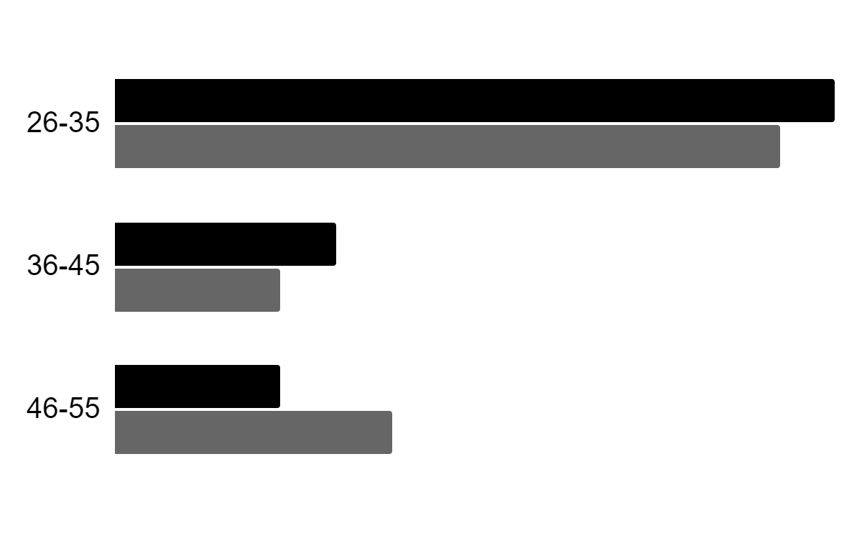
Labor insertion
Gender
Age
60%
40%
Interests
Women
Men
Follow the link in the graph to modify its data and then paste the new one here. For more info, click here

Slide 33
Where are professionals needed?
Venus
Jupiter
Venus has a beautiful name
Jupiter is the biggest planet
65%
85%
50%
75%
Mars
Saturn
Mars is a very cold place
Saturn is the ringed planet

Slide 34
What are other related majors?
Option A
Option B
Saturn is a gas giant and has several rings
Neptune is the farthest planet from the Sun
The Sun is the star at the center of the Solar System
Venus is the second planet from the Sun
Despite being red, Mars is a cold place
Jupiter is the biggest planet in the Solar System

Slide 35
03
Data modeling / warehousing database administration
You can enter a subtitle here if you need it

Slide 36
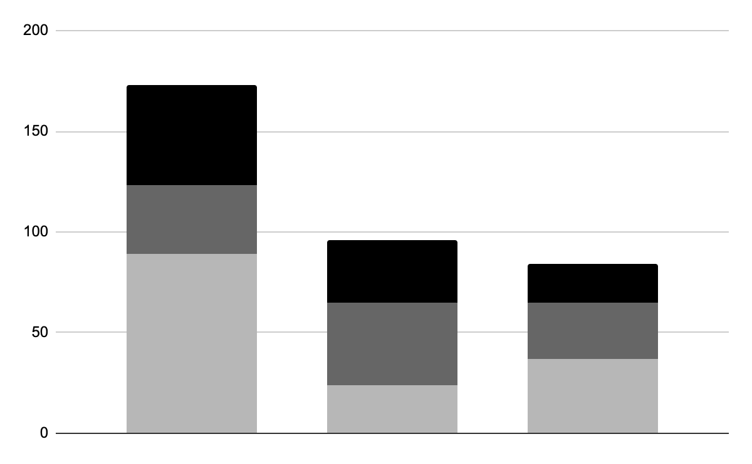
Graph about database admin.
Mercury
It’s the closest planet to the Sun
Mars
Mars is actually a very cold place
Neptune
2020
2021
2022
Neptune is far away from Earth
Follow the link in the graph to modify its data and then paste the new one here. For more info, click here

Slide 37
150,000
Big numbers catch your audience’s attention

Slide 38
9h 55m 23s
333,000
386,000 km
Jupiter's rotation period
The Sun’s mass compared to Earth’s
Distance between Earth and the Moon

Slide 39
What courses to take?
Accounting
Networks
Programming
Logic
Semantics
Architecture
Mercury is a very small planet
Venus has a beautiful name
Mars is actually a very cold place
Jupiter is the biggest planet
Saturn is the ringed planet
Neptune is far away from Earth

Slide 40
04
Modeling, virtual environments and simulation
You can enter a subtitle here if you need it

Slide 41
Our major program
Despite being red, Mars is cold
It’s the closest planet to the Sun
Mars
Mercury
2022
2023
2024
2025
Jupiter
Saturn
It’s the biggest planet of them all
It’s composed of hydrogen and helium

Slide 42
Best modeling courses
Venus
Jupiter
Venus is the second planet from the Sun
It’s the biggest planet in the Solar System
Saturn
Mercury
Saturn is a gas giant and has several rings
Mercury is the closest planet to the Sun

Slide 43
Employments in this sector
25%
50%
25%
Modeling
Virtual
Simulation
Mars is actually a very cold place
Neptune is far away from Earth
Mercury is quite a small planet

Slide 44
Study schedule
Days | 01 | 02 | 03 | 04 | 05 | 06 | 07 | 08 | 09 | 10 | 11 | 12 | 13 | 14 | 15
Task 1
Task 2
Days | 16 | 17 | 18 | 19 | 20 | 21 | 22 | 23 | 24 | 25 | 26 | 27 | 28 | 29 | 30
Task 1
Task 2
Available
No available

Slide 45

A picture always reinforces the concept
Images reveal large amounts of data, so remember: use an image instead of a long text. Your audience will appreciate it

Slide 46



Our department
Timmy Jimmy
Susan Bones
John Doe
You can replace the image on the screen with your own
You can replace the image on the screen with your own
You can replace the image on the screen with your own

Slide 47
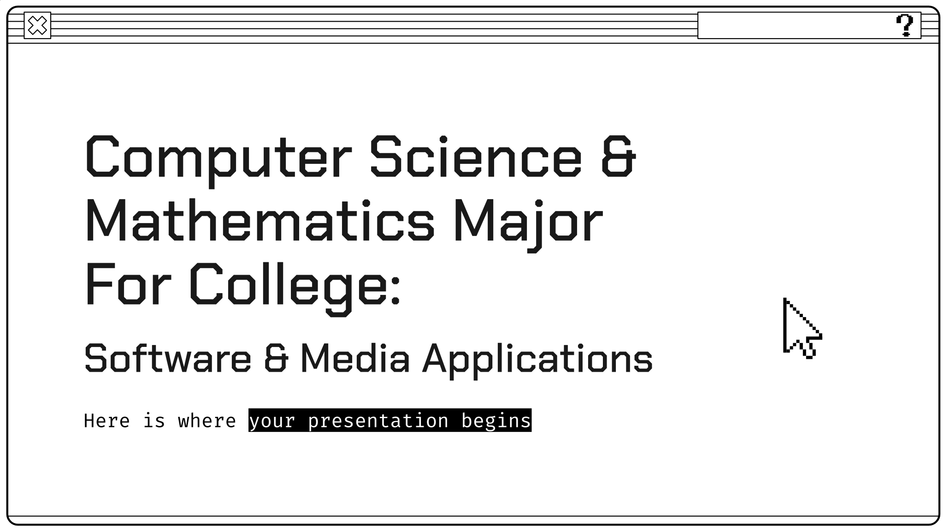
Enrollment platform
You can replace the image on the screen with your own work. Just right-click on it and select “Replace image”

Slide 48
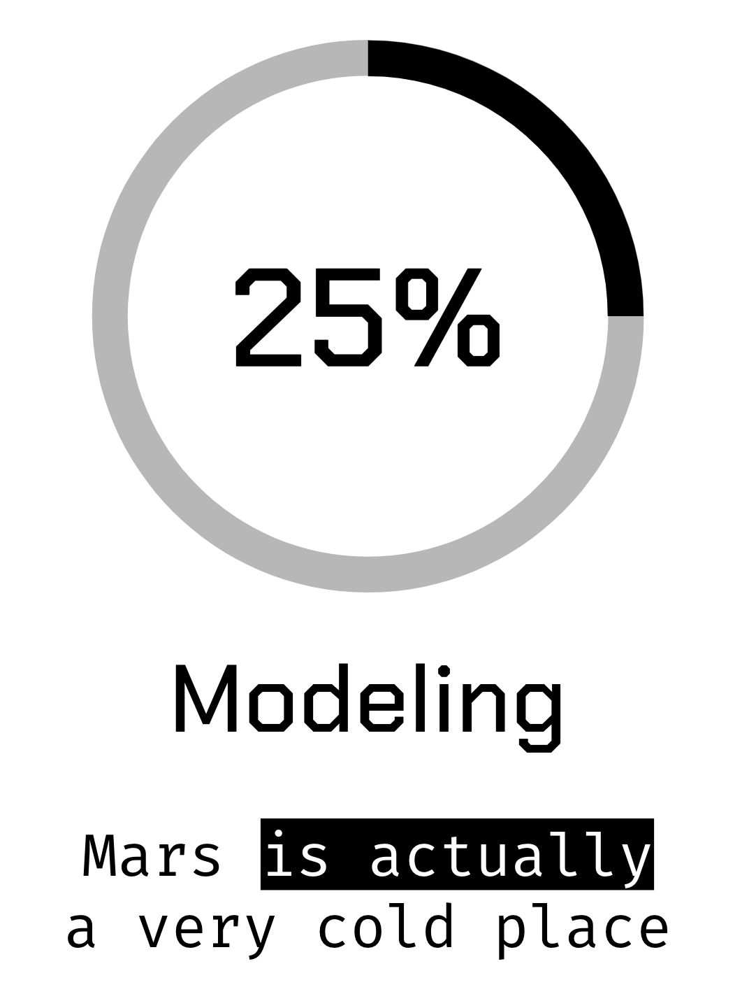
Studying app
You can replace the image on the screen with your own work. Just right-click on it and select “Replace image”

Slide 49
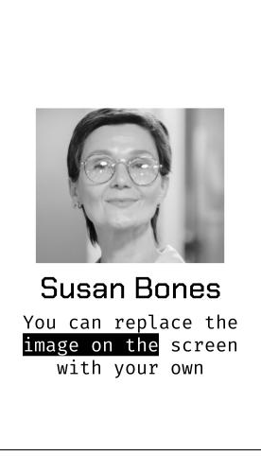
Messaging app
You can replace the image on the screen with your own work. Just right-click on it and select “Replace image”

Slide 50
Alternative resources

Slide 51
Alternative resources
Did you like the resources on this template? Get them for free at our other websites:
Photos
Young woman browsing laptop on road trip
High angle of woman drawing at desk with laptop
Flat lay desk with laptop and glasses
Vectors
Black friday background with black and white elements
Modern cursor set
Multimedia icons
Set of white speech bubbles in pixel art style

Slide 52
Resources
Did you like the resources we used in this template? Get them for free at our other websites:
Photos
Laptop Free
White keyboard of modern laptop
Medium shot colleagues back to office
Vectors
Set of white speech bubbles in pixel art style
Pixel gaming youtube channel art
Pixel mouse cursors pointer, arrow and wait
Vector pixel mouse cursors over white
Vector pixel mouse cursors over white

