Slide 1



VITE
BUSINESS ANALYSIS
AND
INFORMATION ENGINEERING
Project Manager: Hemshree Mangrolla
Members: Ashwanth Ramji
Chandrika Bolla
Malick Fairoz
Prasanna Kumar Hari
Siddyesh Wardhekar

Slide 2
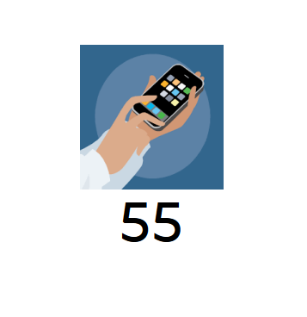
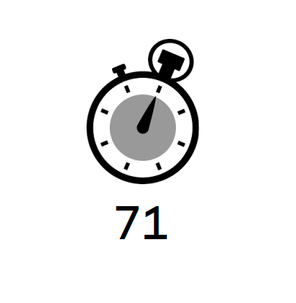
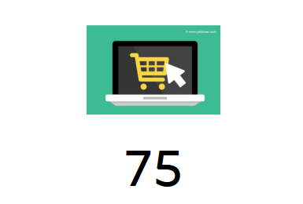
INTRODUCTION & STATISTICS
75 % buy products online
71 % users spend time searching for products and best deals online
55 % people use phones to search for the product

Slide 3




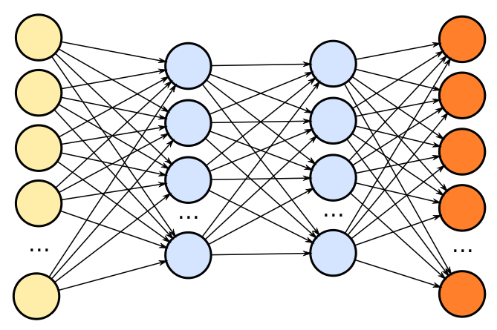
TECH TALK

Slide 4
REQUIREMENTS
Business
Functional
Non-Functional
User

Slide 5



USE CASE
Title
1. User Registration Perspective
2. User Login Perspective
3. User Search Perspective
Description
Primary Actor
Preconditions
Postconditions
Main Success Scenario

Slide 6
DIAGRAMS
Use Case Diagram: https://www.draw.io/?state=%7B%22ids%22:%5B%2212wsEinKZGXe7RFK2zwMgNK59nO05Lt3E%22%5D,%22action%22:%22open%22,%22userId%22:%22116772182161621248487%22%7D#G12wsEinKZGXe7RFK2zwMgNK59nO05Lt3E
Activity Diagram: https://www.draw.io/?state=%7B%22ids%22:%5B%220Bz-Jm3G51shRR0pweUZwWXZSeFdoX2NYVmZzOEhKYjVJWDZF%22%5D,%22action%22:%22open%22,%22userId%22:%22116772182161621248487%22%7D#G0Bz-Jm3G51shRR0pweUZwWXZSeFdoX2NYVmZzOEhKYjVJWDZF
BPMN Diagram: https://www.draw.io/?state=%7B%22ids%22:%5B%221zwAYtaH89VViAY2FT_m9um0Lt4agINET%22%5D,%22action%22:%22open%22,%22userId%22:%22116772182161621248487%22%7D#G1zwAYtaH89VViAY2FT_m9um0Lt4agINET

Slide 7
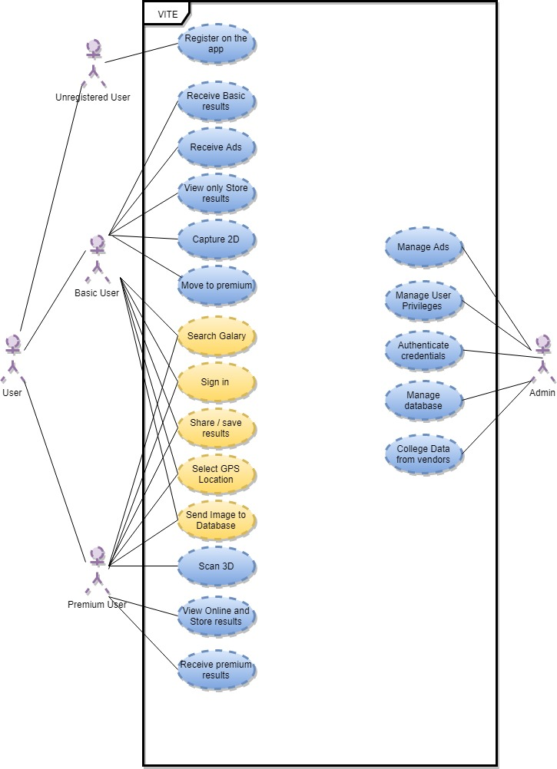
USE CASE DIAGRAM

Slide 8
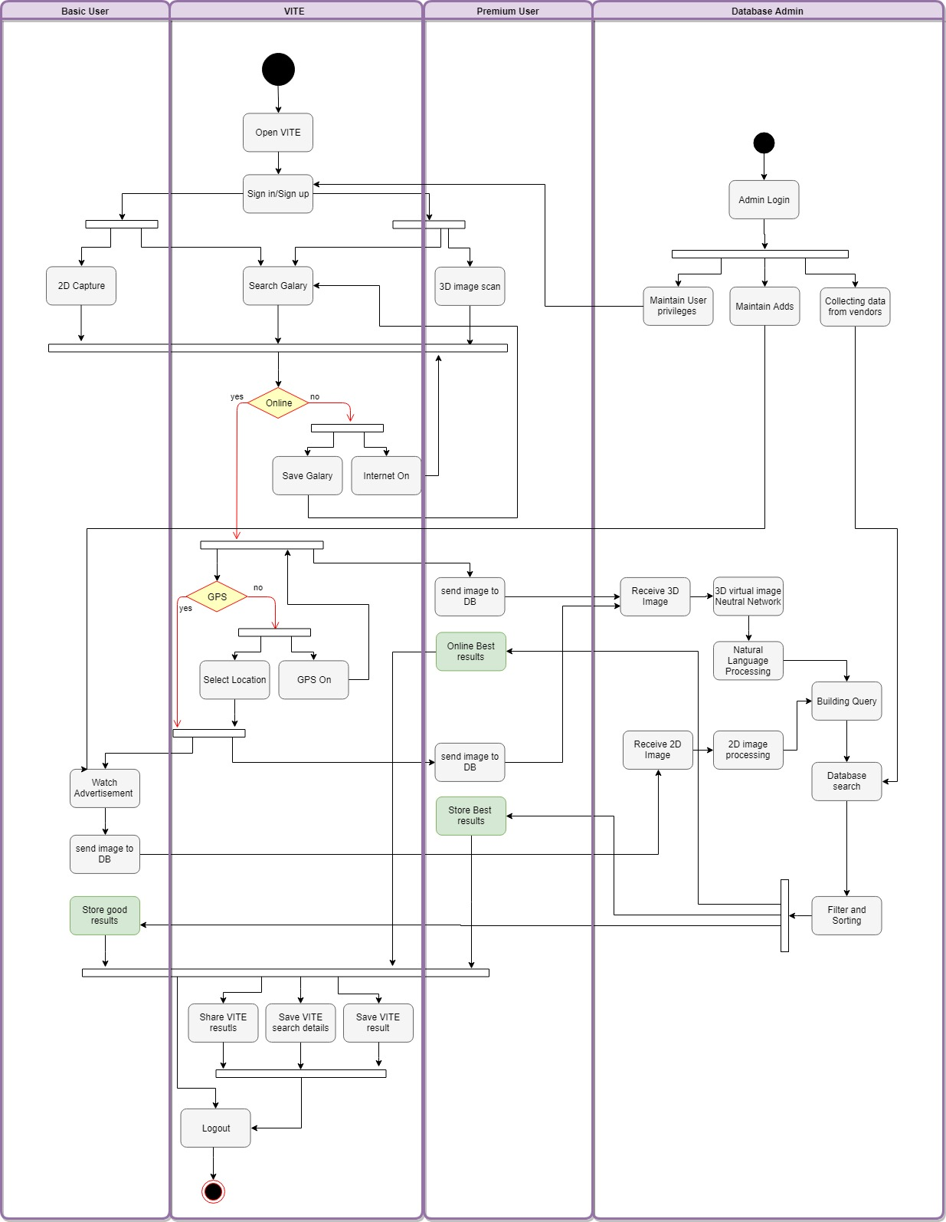
ACTIVITY DIAGRAM

Slide 9
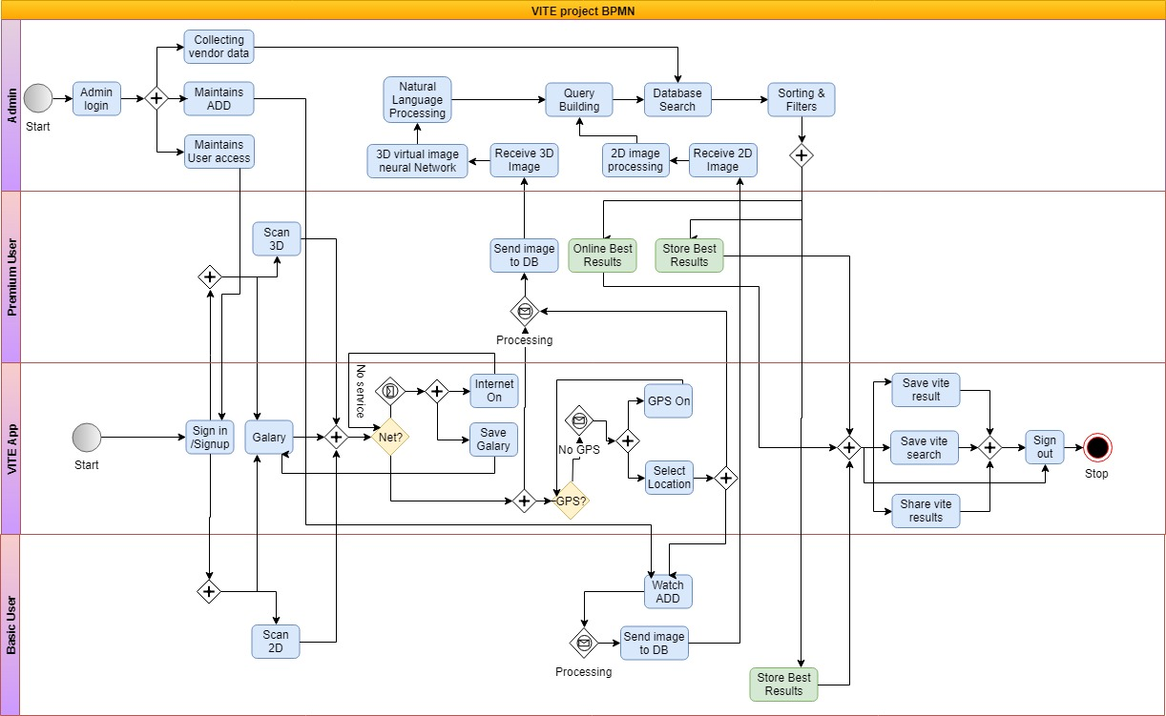
BPMN DIAGRAM

Slide 10
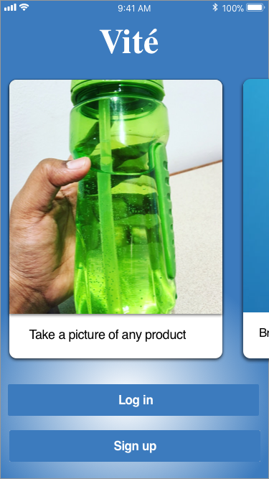
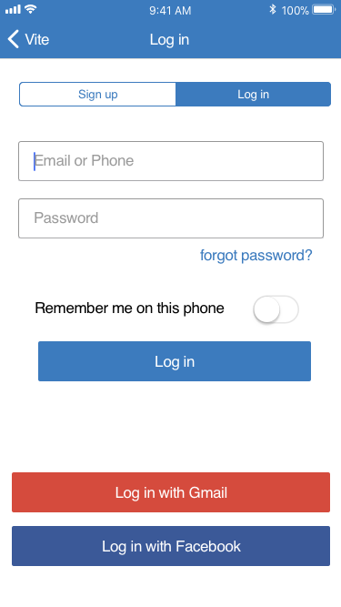
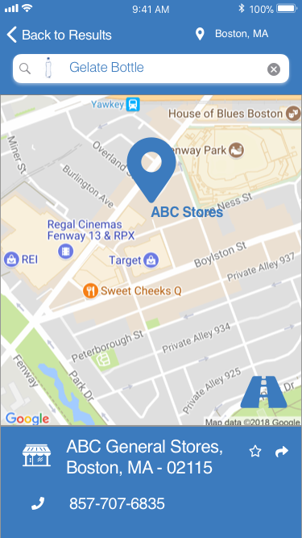
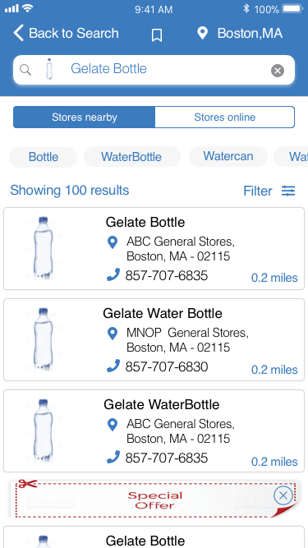
SCREENSHOTS

Slide 11

ANY QUESTIONS ?

